Slide 1



PCI of Native Coronary Artery versus Saphenous Vein Graft in Patients with Prior CABG (PROCTOR)
a Multicenter, Open-label, Randomized Trial
Ruben W. de Winter*, Roel Hoek*, Simon J. Walsh, Colm G. Hanratty, Ralf W. Sprengers, Jos W.R. Twisk, Iris Vegting, Stefan P. Schumacher, Michiel J. Bom, Niels J. Verouden, José P. Henriques, Adriaan Wilgenhof, Michele M. Viscusi, Koen Teeuwen, Maksymilian P. Opolski, Rafał Wolny, Pierfrancesco Agostoni, Jan-Peter van Kuijk, Bas E. Schölzel, Adriaan O. Kraaijeveld, Robert-Jan M. van Geuns, Maurits T. Dirksen, Antonius A.C.M. Heestermans, Jo Dens, Johan Bennett, Steven E.F. Haine, Ronak Delewi, Alexander Nap, James C. Spratt, Paul Knaapen; On behalf of the PROCTOR Trial Investigators†
Ruben W. de Winter MD, PhD Research Fellow
Dept. of Cardiology, Amsterdam University Medical Centers, The Netherlands
TRANSCATHETER CARDIOVASCULAR THERAPEUTICS®

Slide 2
Disclosure of relevant financial relationships
Within the prior 24 months, I have had a financial relationship with a company producing, marketing, selling, re-selling, or distributing healthcare products used by or on patients
Nature of financial relationship
Grant/research support
Ineligible company
Abbott Vascular International BVBA
All relevant financial relationships have been mitigated.
Faculty disclosure information can be found on the app.

Slide 3

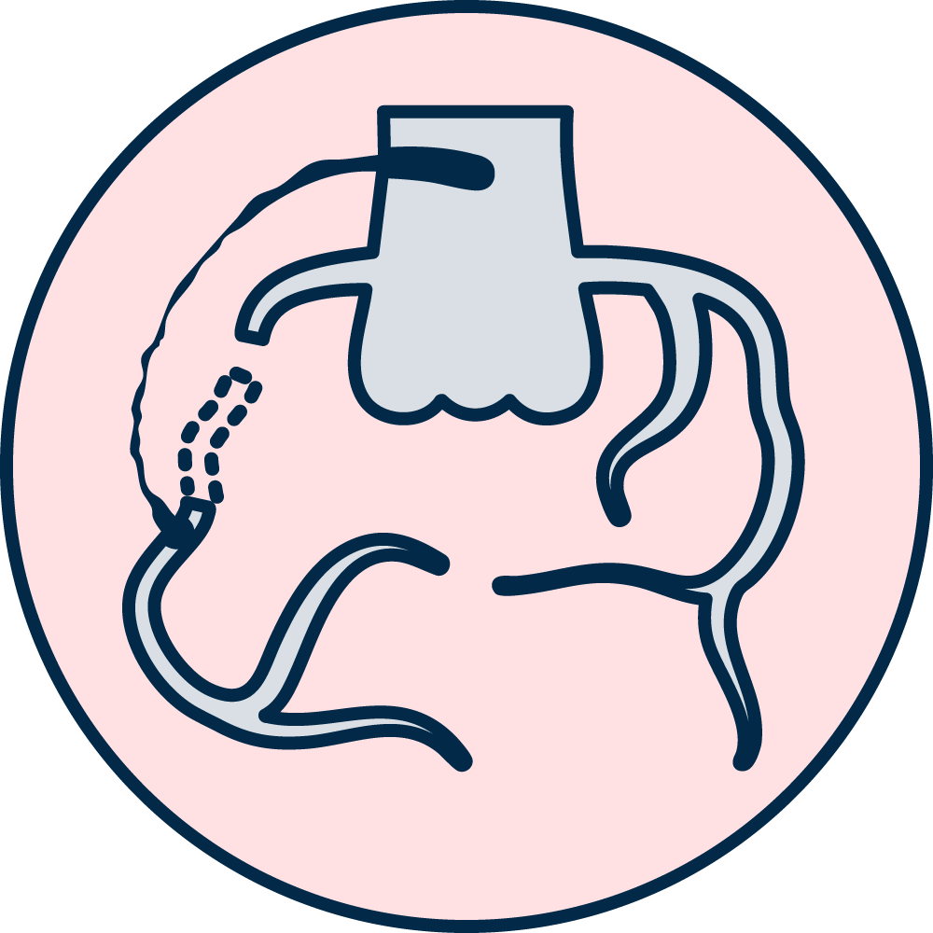


Re
What are the challenges for post-CABG patients?
CABG long-term efficacy limited by graft failure and native coronary disease progression^{1,2}
Substantial number of patients experience recurrent angina symptoms and ischemia
±20% at 5 years, 40-50% after 10 years and up to 60% at 15 years after surgery³⁻⁵
Many prior CABG patients require repeat coronary angiography and subsequent revascularisation therapy^{6,7}
1. Morrison et al. JACC 2002 | 2. Sabik J et al. Thorac Cardiovasc Surg 2006 | 3. Rogers et al. Circulation 1990 | 4. Sergeant et al. JTCVS 1998 | 5. Hattler et al. Circ: Cardiovascular Quality and Outcomes 2021 | 6. Brilakis et al. JACC Cardiovasc Interv 2016 | 7. Joshi et al. CCI 2017

Slide 4
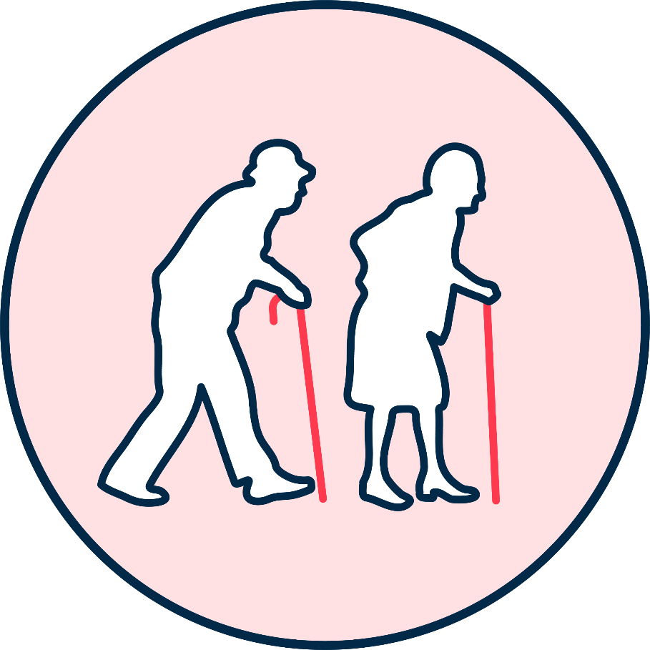
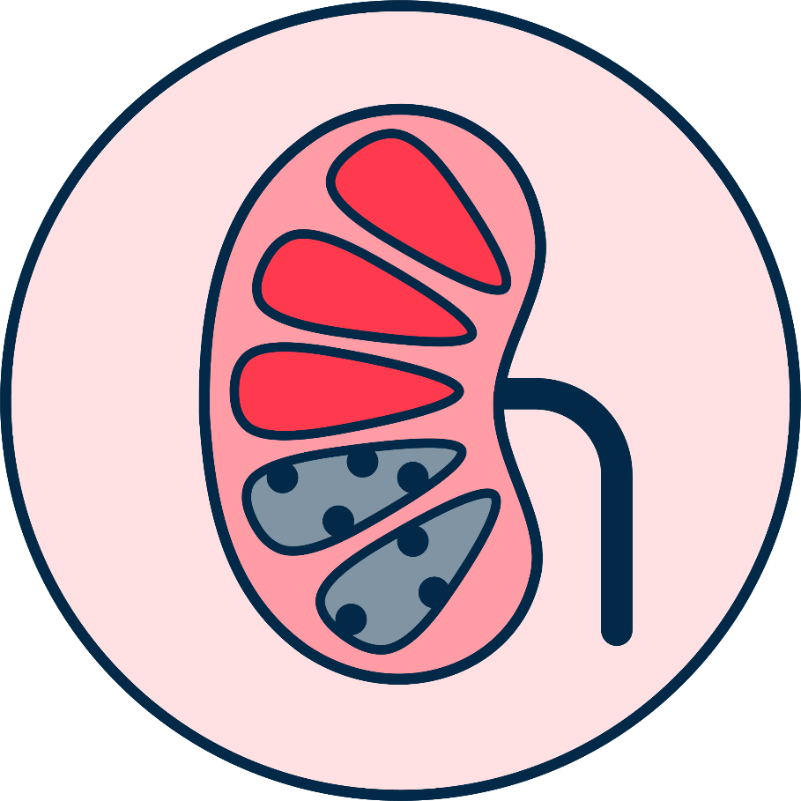

Re
A high-risk and complex patient population
Patients are older / frail^{8,9}
High prevalence of CV risk factors and comorbidities
(DM, COPD, renal failure)⁸⁻¹¹
Complex atherosclerotic lesion morphology¹⁰⁻¹³
8. Budassi et al. CCI 2020 | 9. Shoaib et al. Cathether ardiovasc Interv 2021 | 10. De Winter et al. Curr Cardiol Reports 2022 | 11. Beerkens et al. Nature Rev Cardiol 2021 | 12. Fefer et al. JACC 2012 | 13. Pereg et al. JACC Cardiovasc Interv 2014

Slide 5
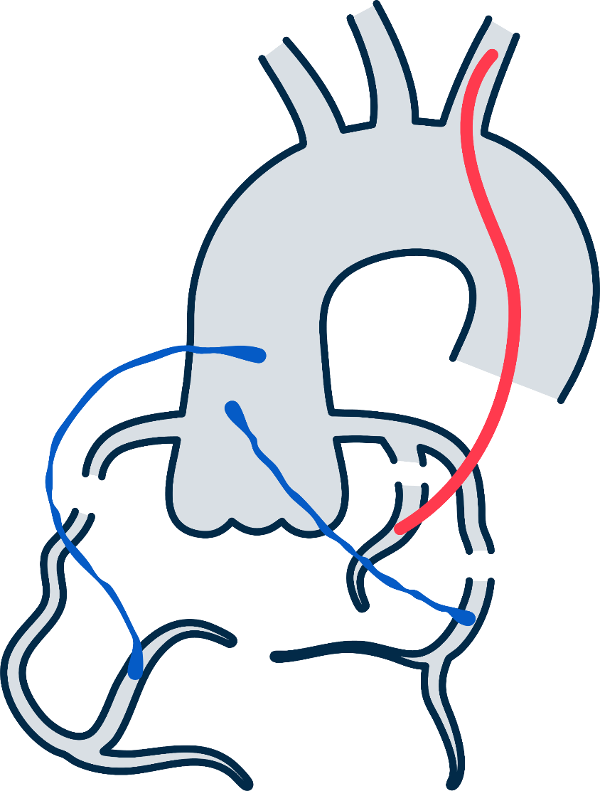


Re
Anatomical and procedural complexity
Diseased bypass grafts with friable atheromatous plaques
Predominantly degenerated saphenous vein grafts (SVGs)⁸⁻¹¹
Extensive and accelerated native coronary atherosclerotic disease
Resulting in long, calcified lesions¹⁰⁻¹³
High prevalence of chronic total coronary occlusions (CTOs)
Reported in >50%¹²⁻¹³
8. Budassi et al. CCI 2020 | 9. Shoaib et al. Cathether ardiovasc Interv 2021 | 10. De Winter et al. Curr Cardiol Reports 2022 | 11. Beerkens et al. Nature Rev Cardiol 2021 | 12. Fefer et al. JACC 2012 | 13. Pereg et al. JACC Cardiovasc Interv 2014

Slide 6
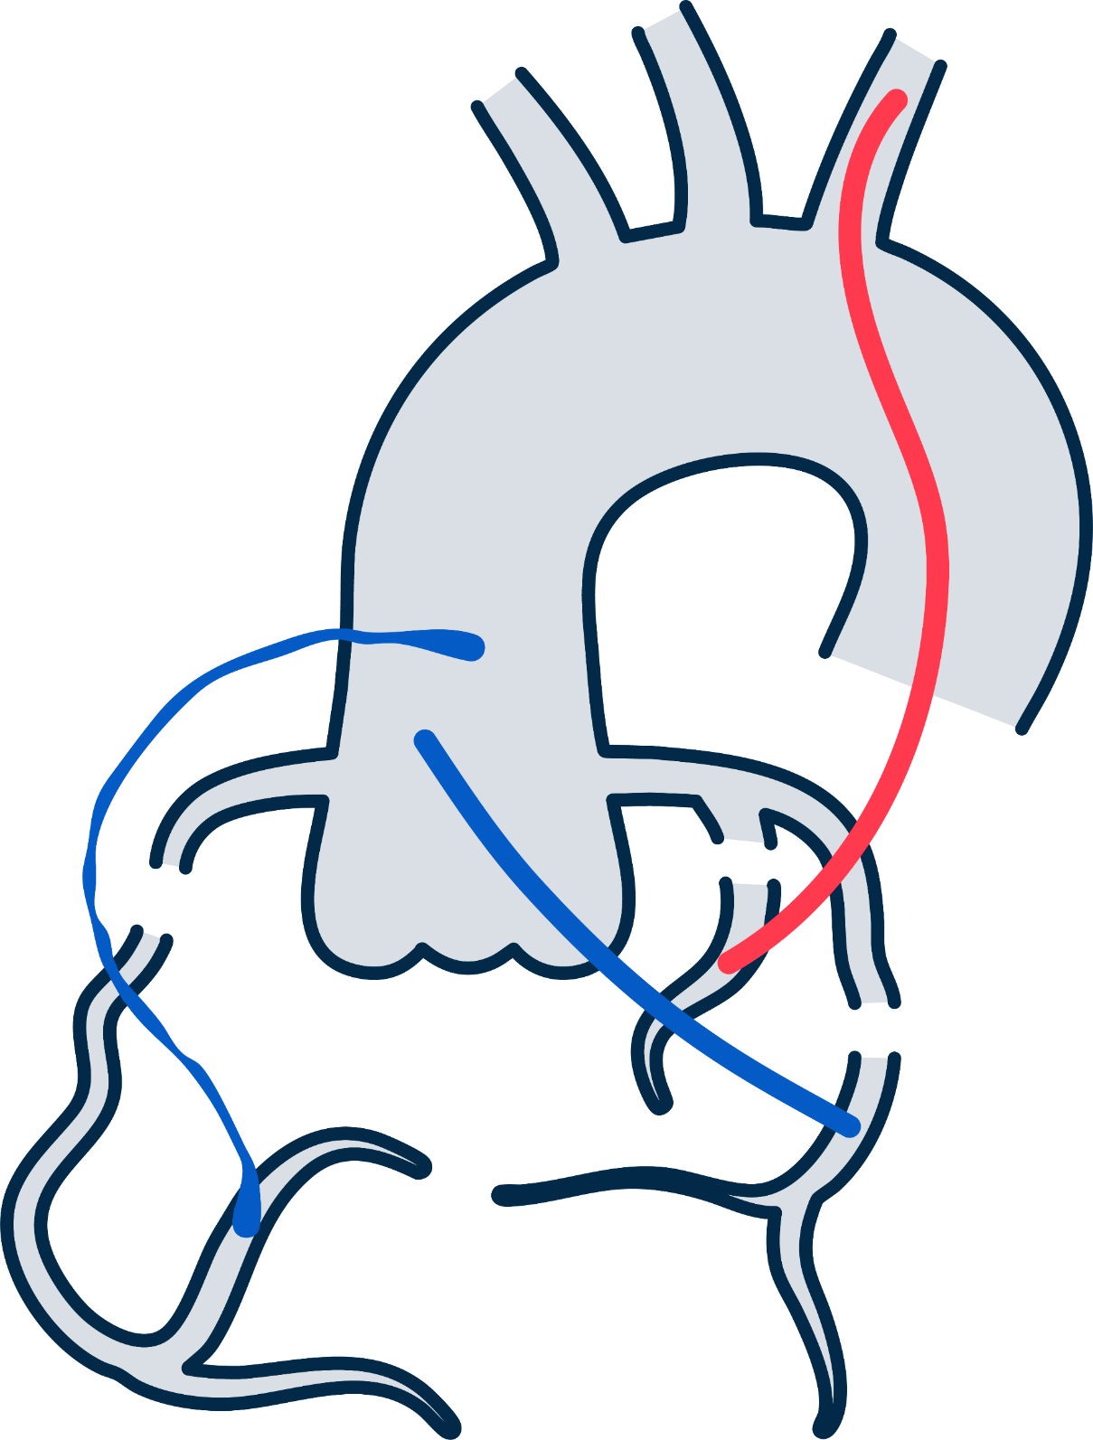





Re
Where do we go: graft or native vessel?
2a
B-NR
Native vessel PCI
In patients with previous CABG, if PCI of a diseased native coronary artery is feasible, then it is reasonable to choose PCI of the native coronary artery over PCI of the severely diseased SVG (4-6).
SVG PCI
6
14. Lawon et al. JACC 2021 | 15. Vrints et al. EHJ 2024

Slide 7


Re
PROCTOR trial: Rationale and Purpose
PROCTOR Trial Rationale
Randomized trials comparing native vessel PCI with bypass graft PCI are lacking
PROCTOR Trial Purpose
The first randomized study to compare clinical outcomes between a strategy of native vessel PCI with SVG PCI
16. De Winter et al. AHJ 2023

Slide 8
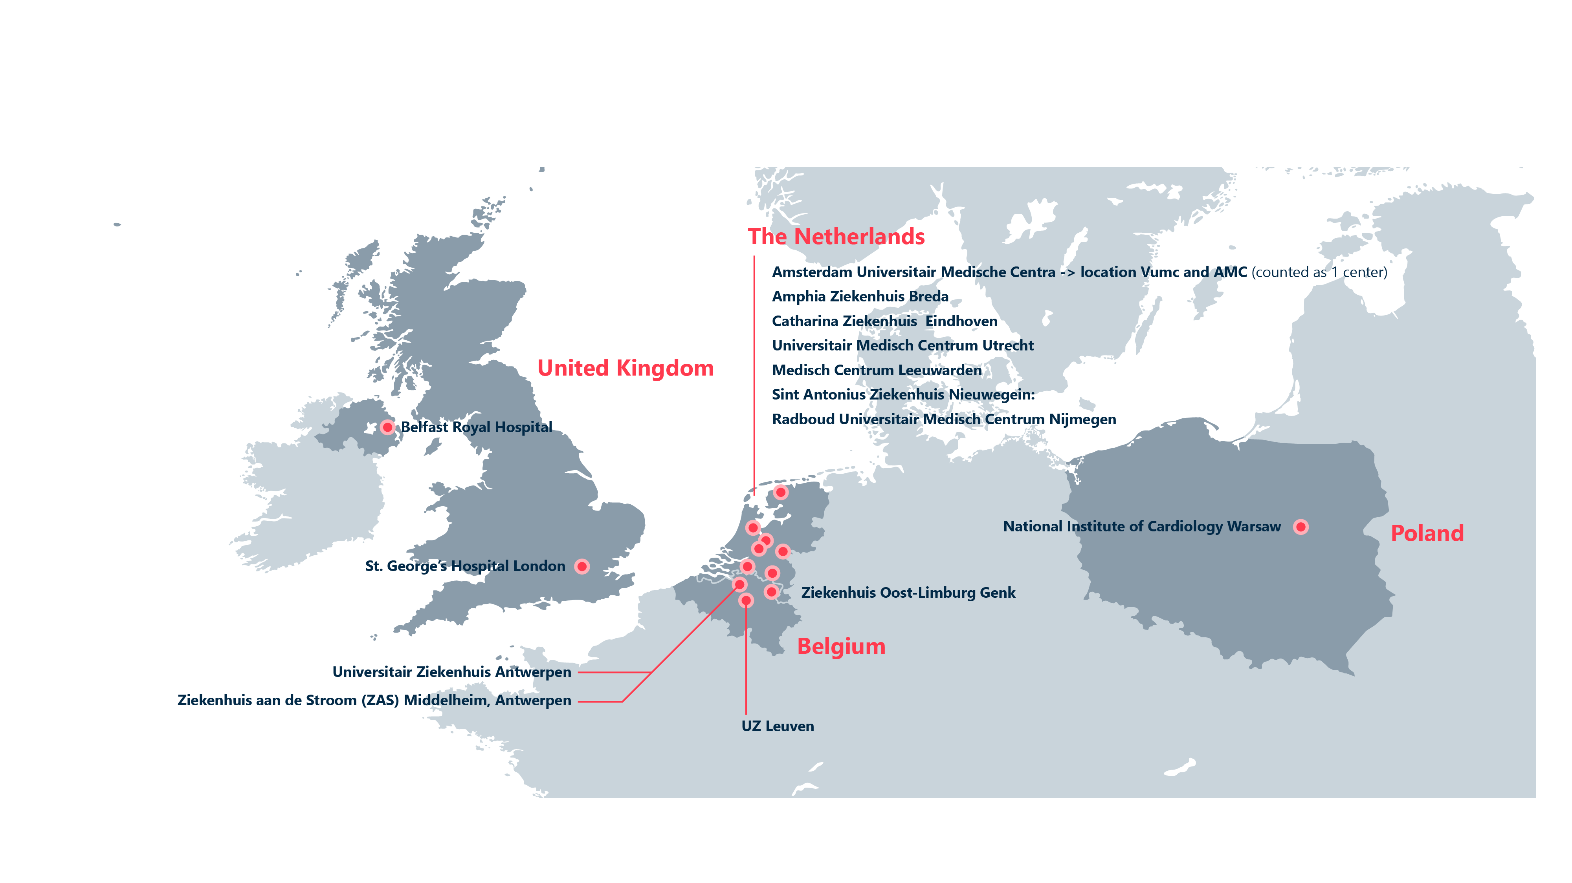


Investigator-initiated, open-label, randomized trial
Trial design and population
14 centers across Europe
Patients
with prior CABG and significant SVG stenosis
Randomized 1:1
to SVG PCI or native vessel PCI
1
year
1 year follow-up
Clinicaltrials.gov Identifier: (NCT03805048)

Slide 9
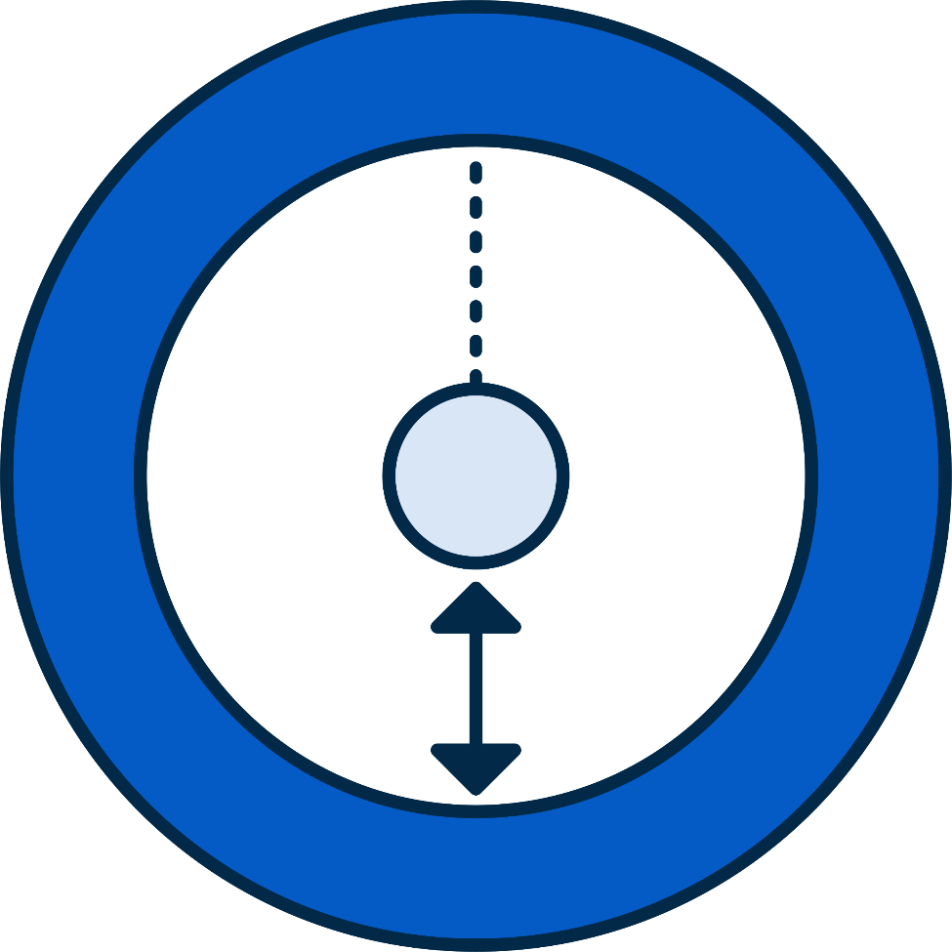

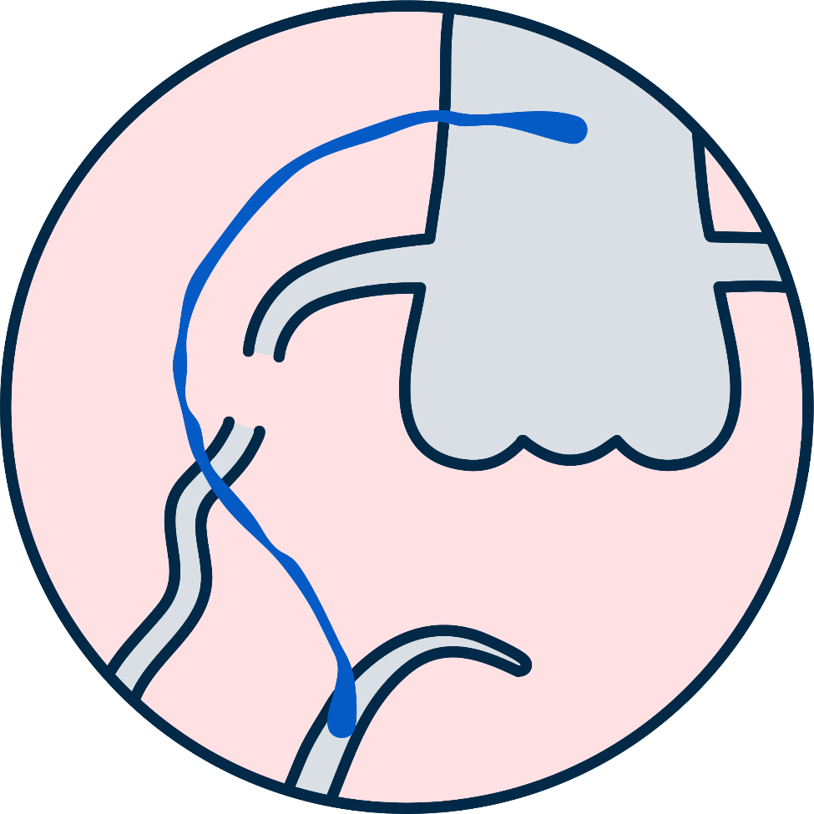


Re
Inclusion criteria
A significant diameter stenosis in a saphenous vein graft
>50% on coronary angiography
Clinical indication for percutaneous revascularization
As determined by the local Heart Team
Both native coronary artery and SVG lesion(s) deemed technically feasible for PCI by the Heart Team

Slide 10





Key exclusion criteria
<2.5mm
Target vessel
CABG performed <1 year prior to inclusion
STEMI or NSTEMI with
ongoing ischemia*
>5.5mm
Aneurysm or heavy thrombus formation in the bypass graft
Graft diameter
*characterized by ≥1 of the following components: recurrent or ongoing chest pain refractory to medical treatment, recurrent dynamic ECG changes suggestive of ischaemia on 12-lead ECG, heart failure, and hemodynamic or electrical instability.

Slide 11



Study flow
341 patients assessed for eligibility
121 ineligible
26 did not meet inclusion criteria
95 met exclusion criteria
220 patients randomized
108 randomly assigned to PCI of the native vessel
112 randomly assigned to PCI of the SVG
Primary endpoint of this analysis
12 crossover to SVG PCI
MACE at 1 year
3 crossover to native vessel PCI
0 lost to follow-up
0 withdrew consent
0 lost to follow-up
0 withdrew consent
All-cause mortality
Non-fatal target territory MI*
Clinically driven target territory revascularisation
*PCI-related MI occurring during the index procedure was included as part of the composite endpoint and adjudicated according to the SCAI criteria | MI occurring >48 hours after the index procedure was adjudicated according to the 4th Universal Definition
11

Slide 12
Baseline characteristics
 | Native vessel PCI (N = 108) | SVG PCI (N = 112)
Demographics
Age (years) | 73 ± 7 | 73 ± 7
Male sex | 88 (81) | 97 (87)
Comorbidities
Hypertension | 78 (73) | 96 (86)
Hypercholesterolemia | 86 (80) | 92 (83)
Diabetes mellitus | 46 (43) | 53 (47)
Family history of CAD | 66 (64) | 67 (62)
Chronic kidney disease (eGFR <60 mL/min/1.73m²) | 35 (32) | 39 (35)
Cardiac history
Prior PCI | 68 (63) | 67 (60)
Prior target SVG PCI | 24 (22) | 22 (20)
Prior MI | 51 (47) | 65 (58)
Years since CABG to PCI (years) | 18 ± 9 | 17 ± 8
Data are presented as mean ± SD or frequencies (%)

Slide 13
Angiographic and procedural characteristics
 | Native vessel PCI (N = 108) | SVG PCI (N = 112)
Target native vessel angiographic characteristics
Right coronary artery | 57 (53)
Left main/left anterior descending coronary artery | 14 (13)
Left circumflex coronary artery | 37 (34)
Lesion characteristics
Lesion length, mm | 34 ± 21
Chronic total coronary occlusion | 90 (83)
Target SVG angiographic characteristics
Single graft |  | 52 (46)
Jump graft |  | 60 (54)
Coronary angiography
Lesion length, mm |  | 17 ± 16
In-stent lesion |  | 10 (9)
Procedural characteristics |  |  | P-value
Overall technical success* | 99 (92) | 104 (93) | 0.741
Number of stents implanted | 2.7 ± 1.3 | 1.3 ± 0.8 | <0.001
Total stent length | 84 [52 - 111] | 23 [18 - 38] | <0.001
Fluoroscopy time (min) | 55 [35 - 81] | 11 [6 - 16] | <0.001
Contrast use (ml) | 220 [150 - 300] | 100 [73 - 150] | <0.001
Data are presented as mean ± SD or frequencies (%). *Defined as successful revascularization achieved through the initial or crossover strategy, including repeated attempts, with final TIMI flow grade 3 and residual stenosis <30%

Slide 14
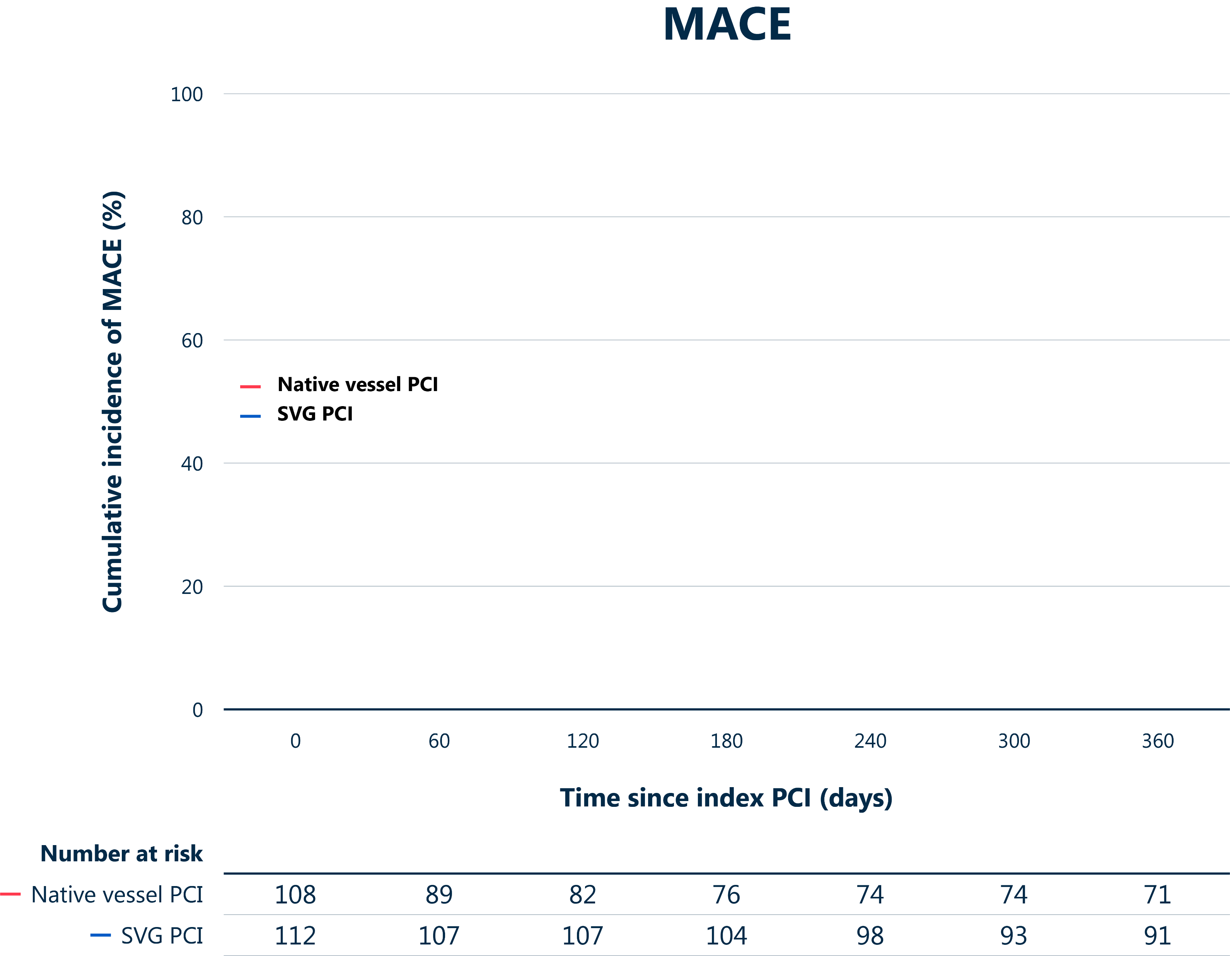
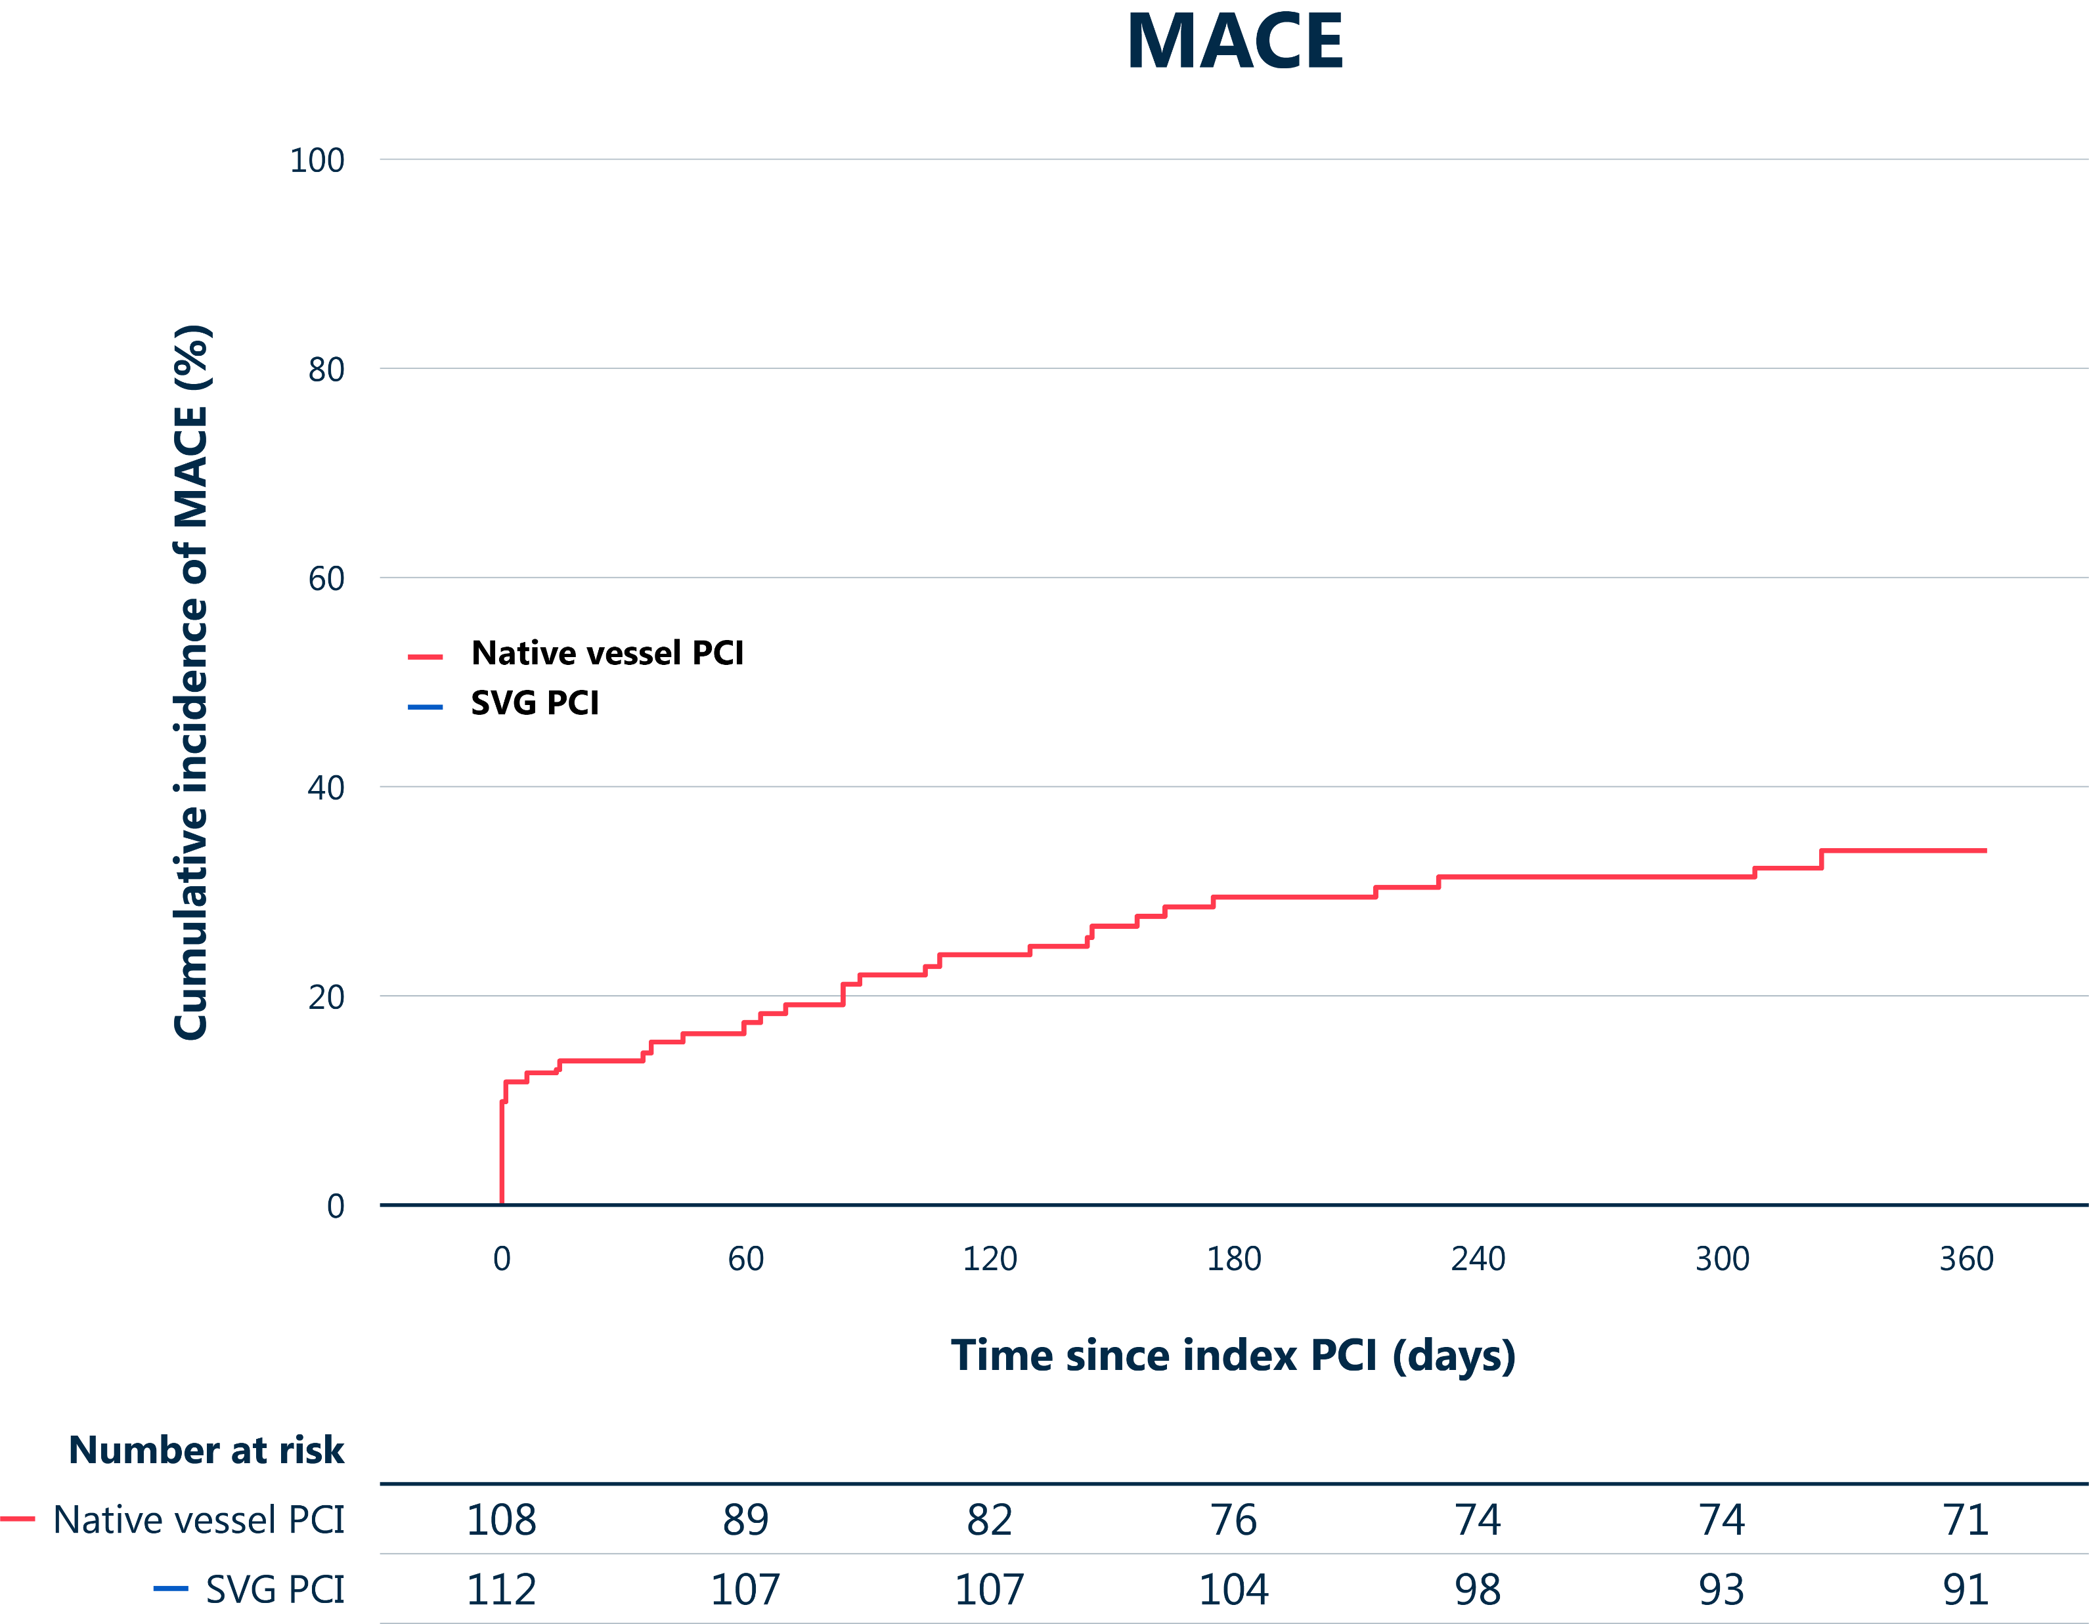
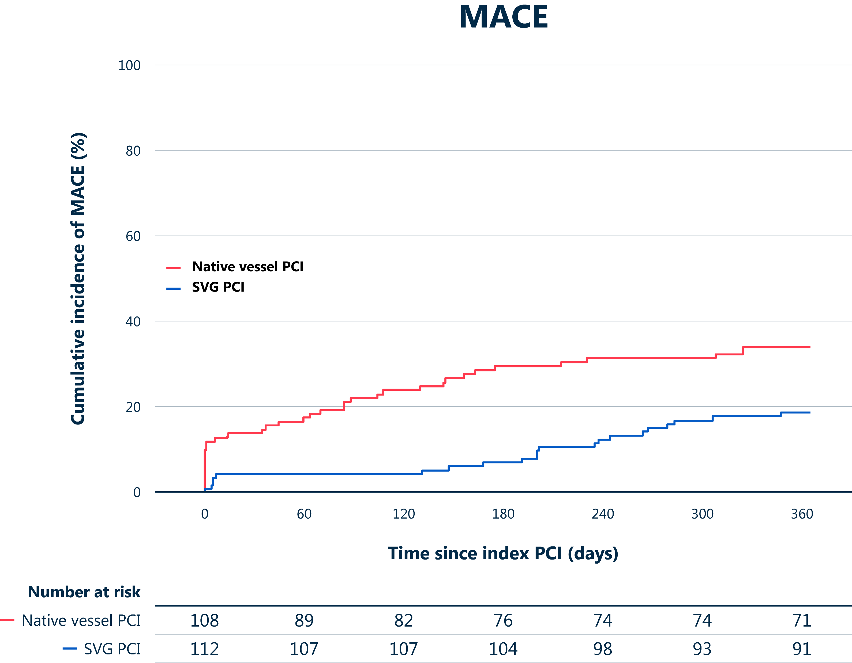
Primary endpoint of this analysis: 1-year MACE
MACE
Hazard ratio 2.14 (95% CI 1.25 - 3.65)
Log-rank p = 0.004
Cumulative incidence of MACE (%)
Native vessel PCI
SVG PCI
34.3%
18.7%
Time since index PCI (days)
MACE: all-cause mortality, non-fatal target territory MI, clinically driven target territory revascularization
Event rates are Kaplan Meier estimates | Comparison by unadjusted Cox regression and log-rank test

Slide 15
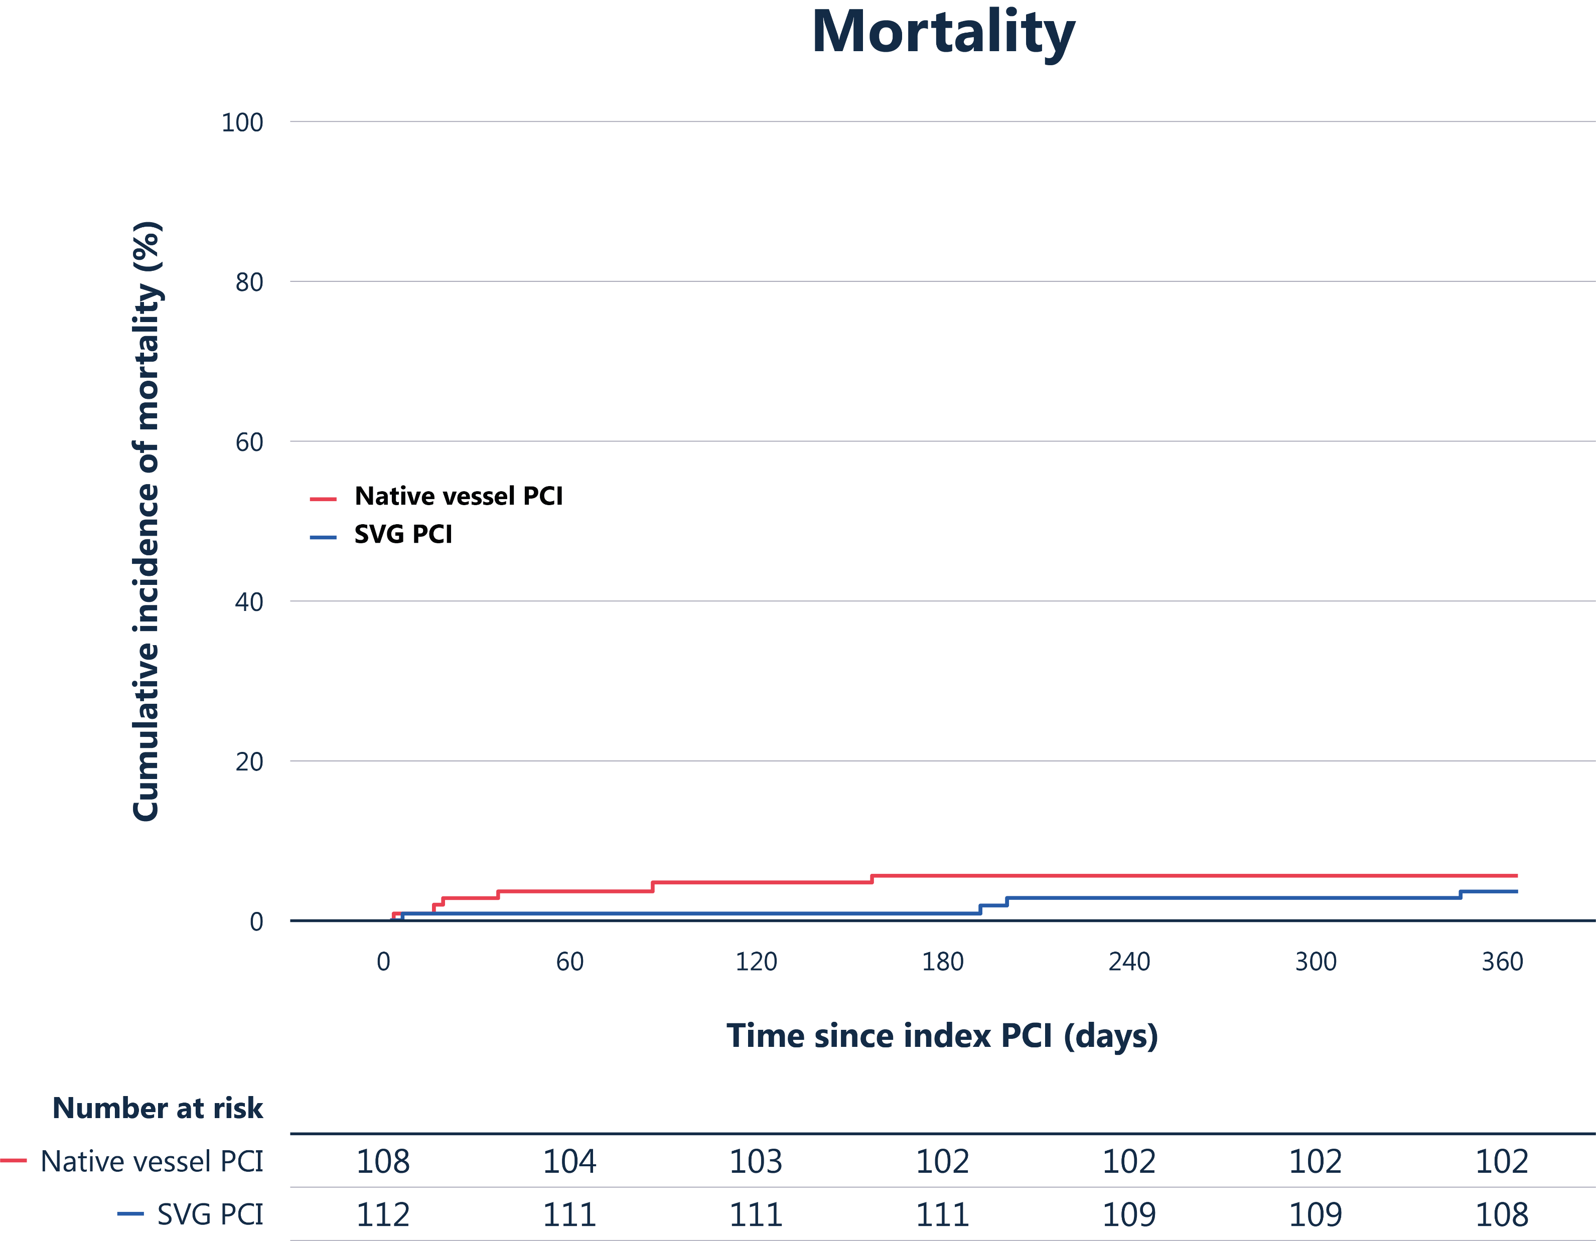
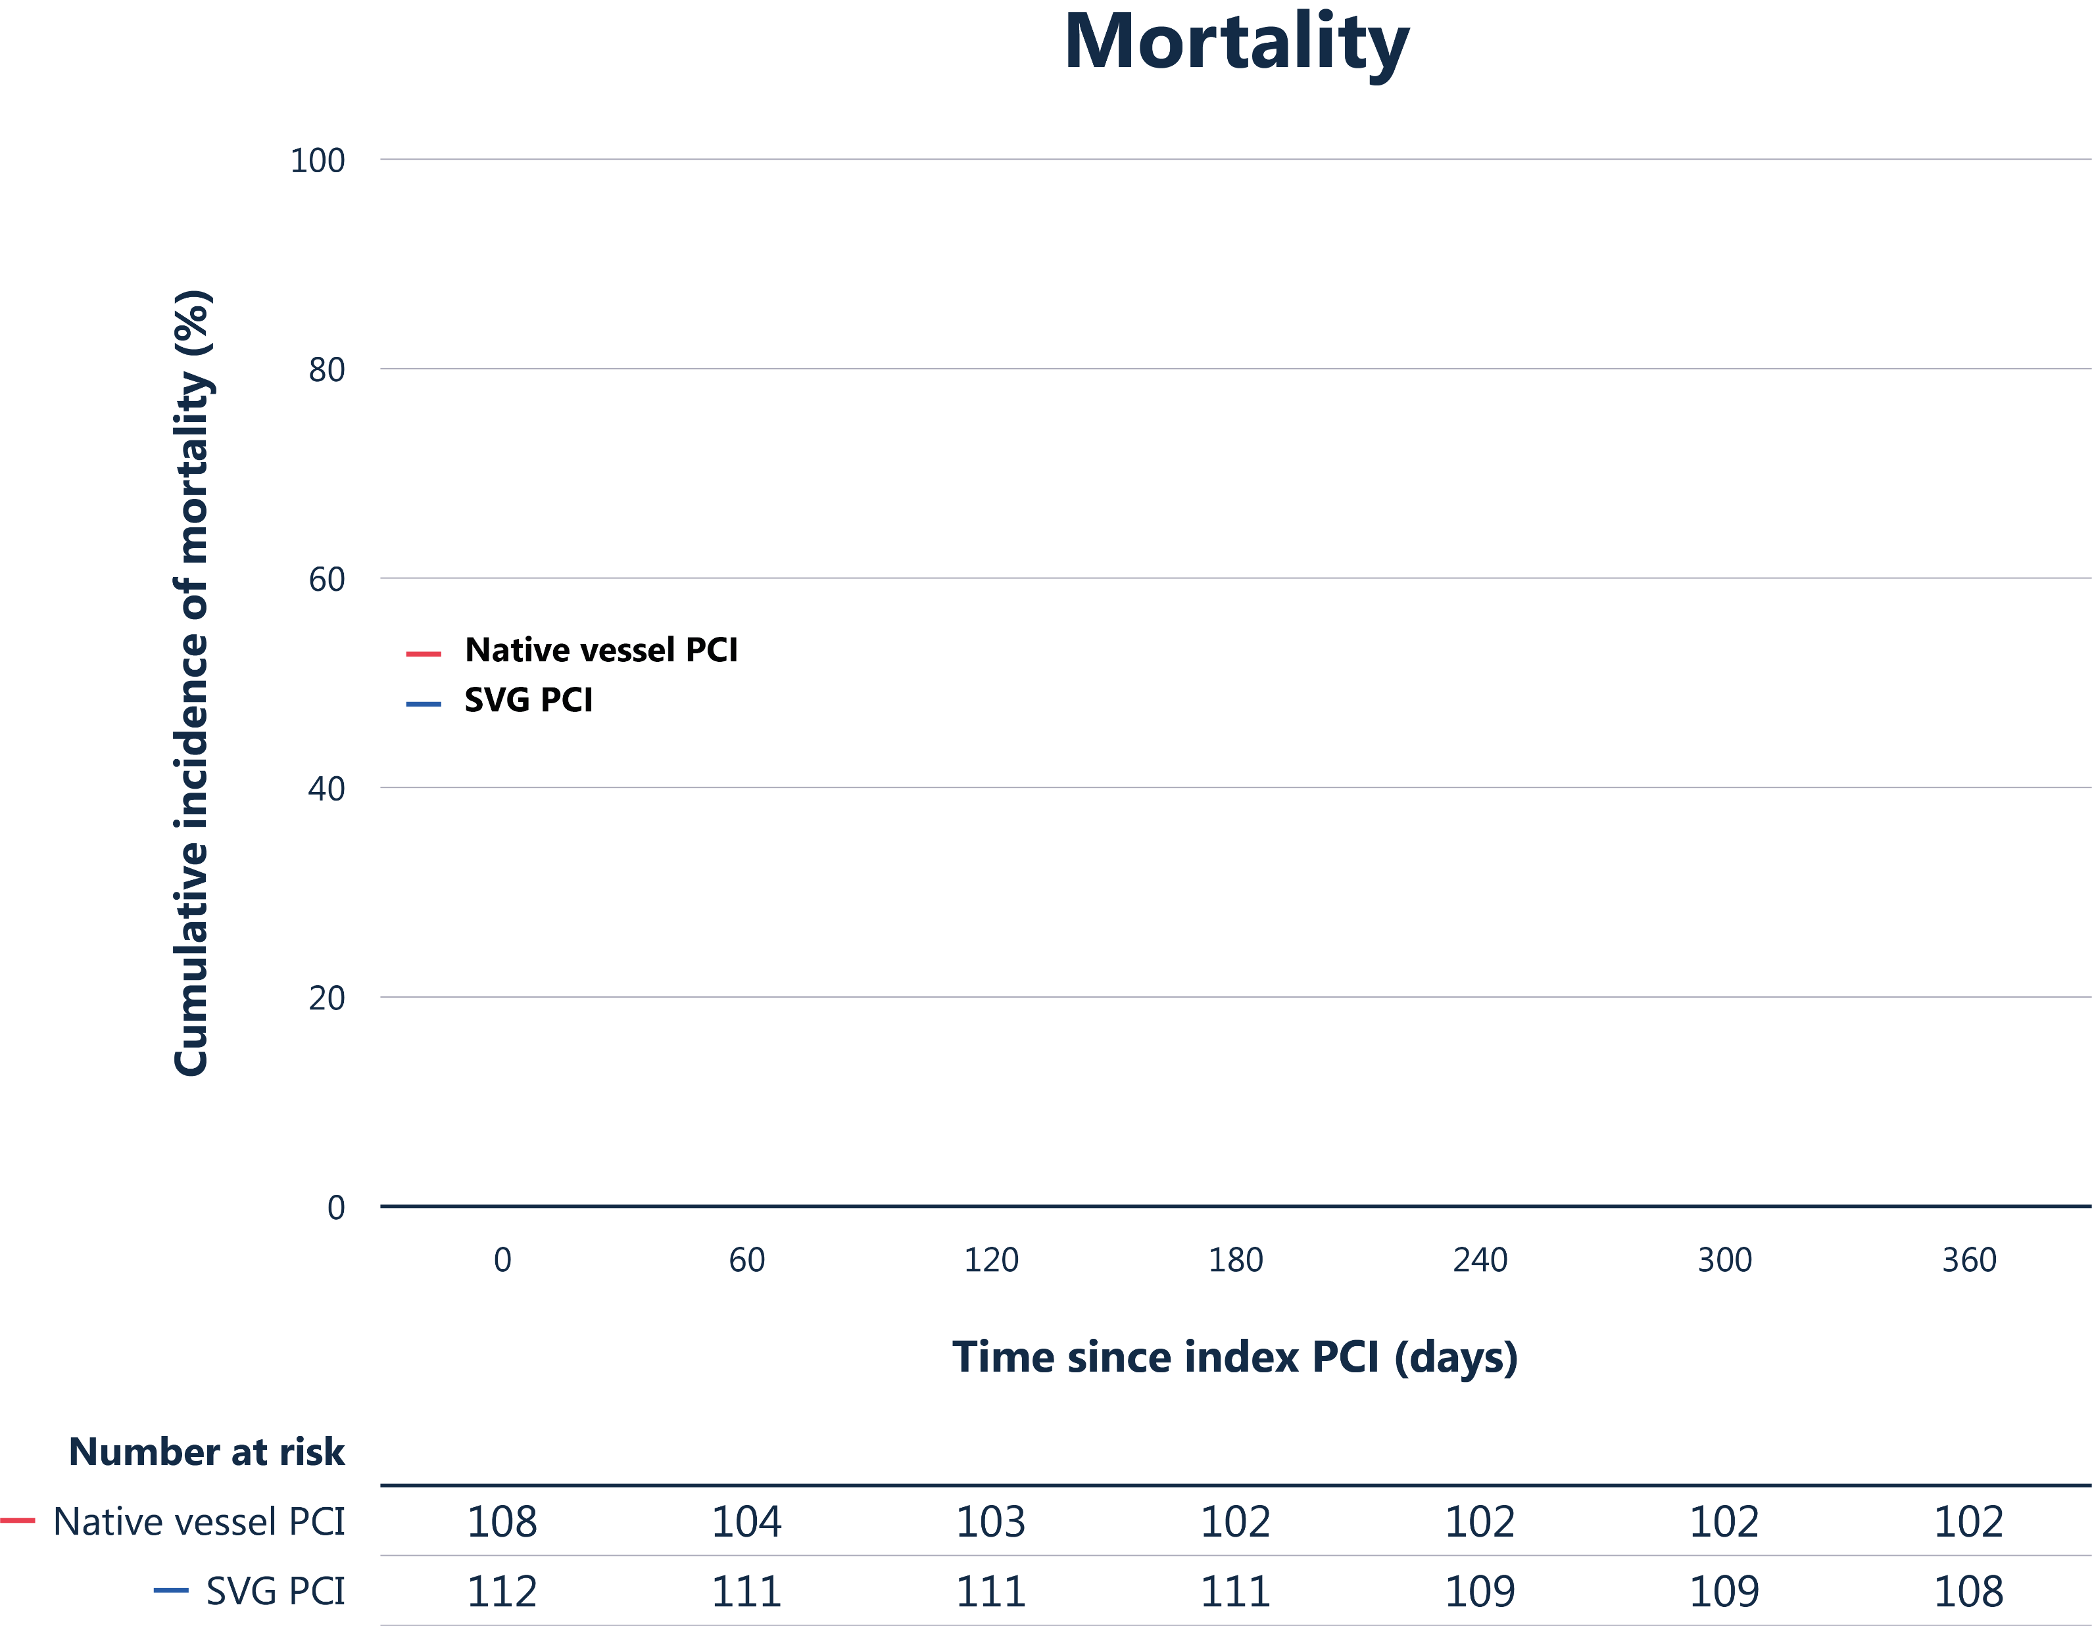
All-cause mortality
Mortality
Mortality
Hazard ratio 1.59 (95% CI 0.45 - 5.64)
Log-rank p = 0.468
Cumulative incidence of mortality (%)
Native vessel PCI
SVG PCI
5.6%
3.6%
Time since index PCI (days)
Event rates are Kaplan Meier estimates | Comparison by unadjusted Cox regression and log-rank test

Slide 16
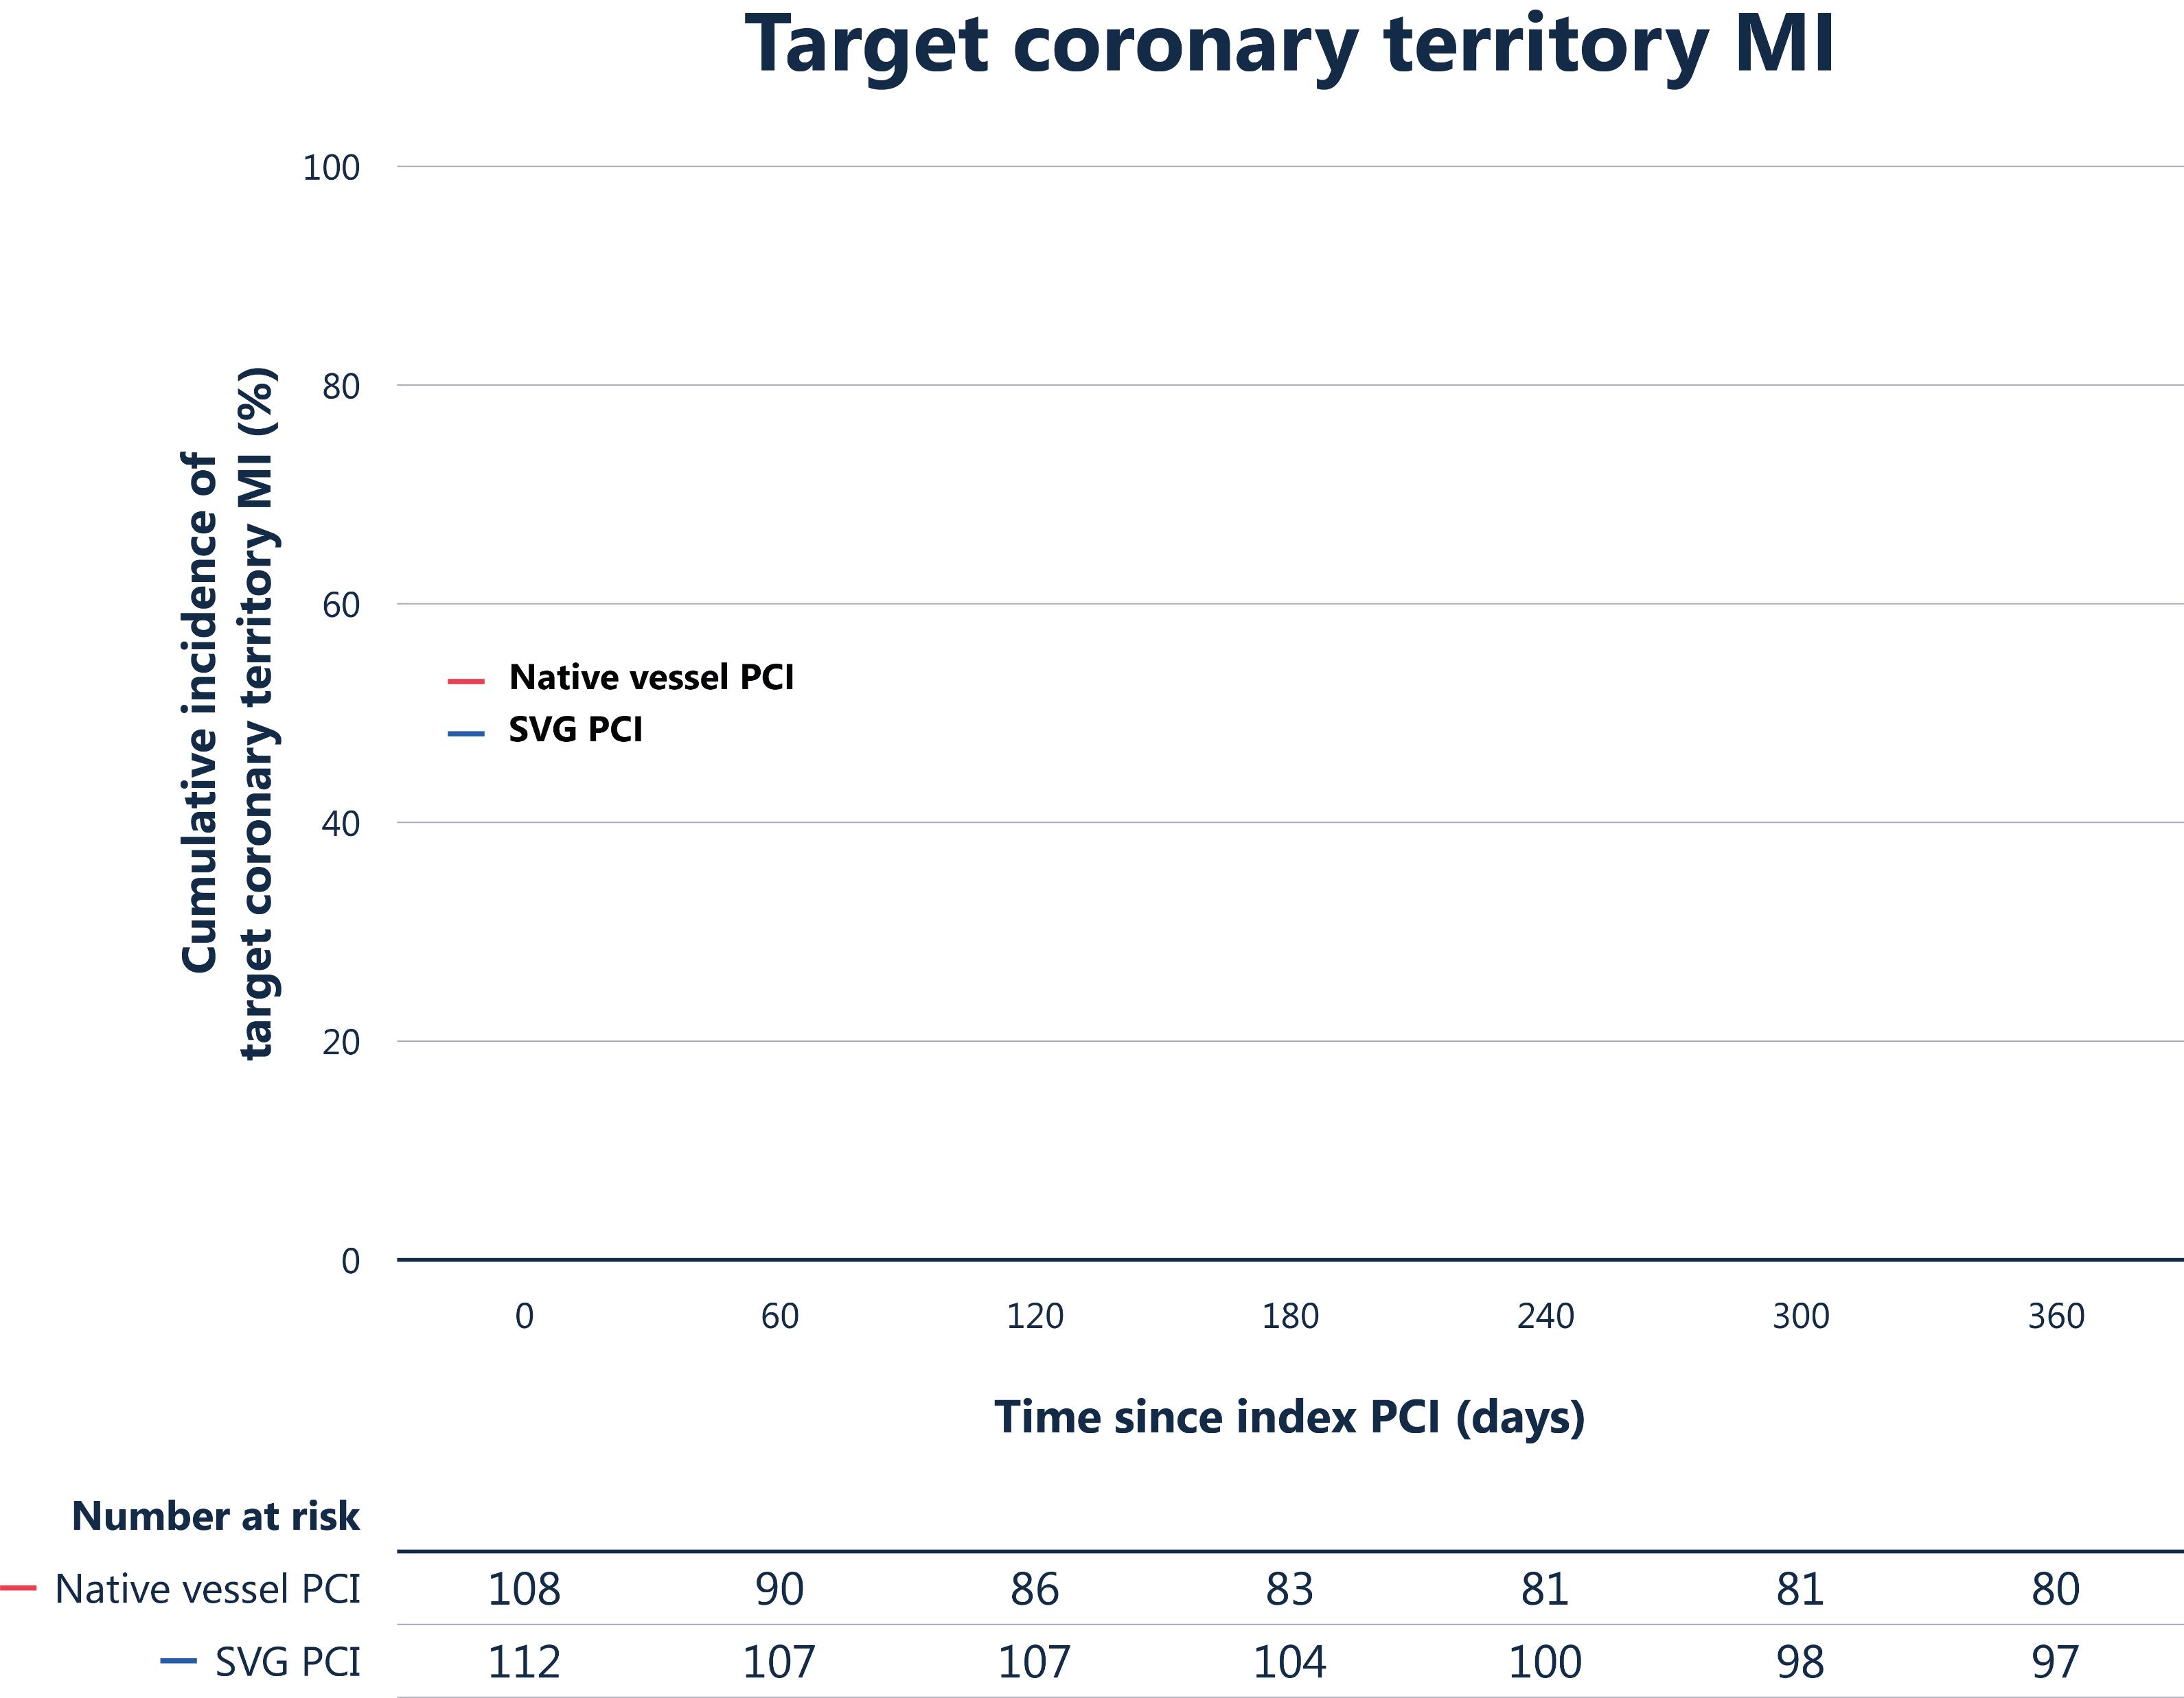
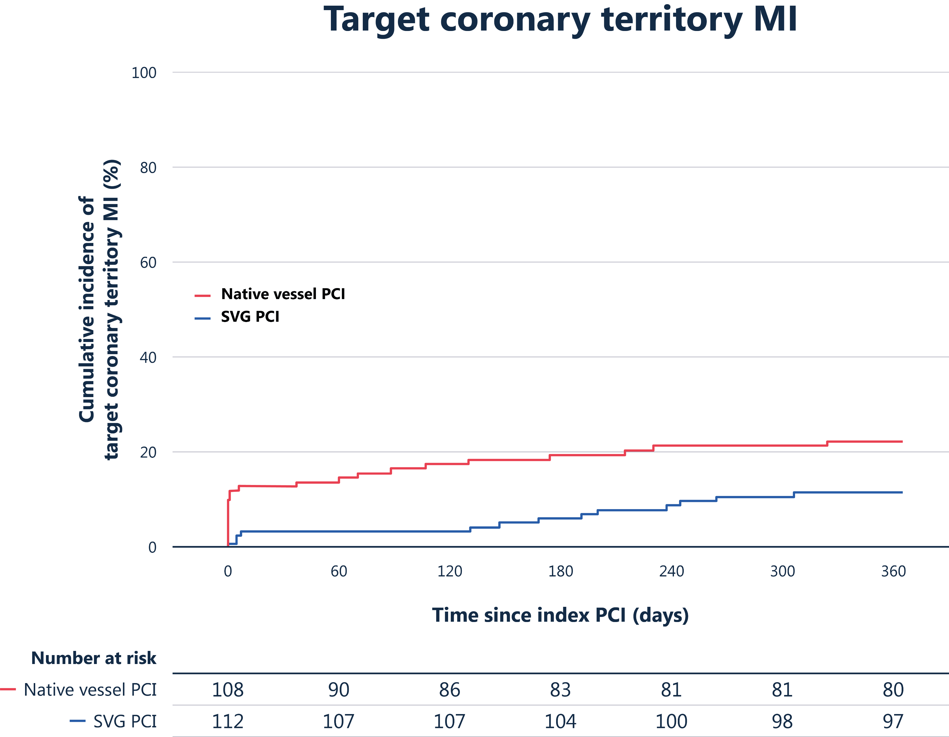
Target coronary territory MI
Target coronary territory MI
Hazard ratio 2.12 (95% CI 1.08 - 4.17)
Log-rank p = 0.024
Cumulative incidence of
target coronary territory MI (%)
Native vessel PCI
SVG PCI
22.6%
11.7%
Time since index PCI (days)
Event rates are Kaplan Meier estimates | Comparison by unadjusted Cox regression and log-rank test

Slide 17
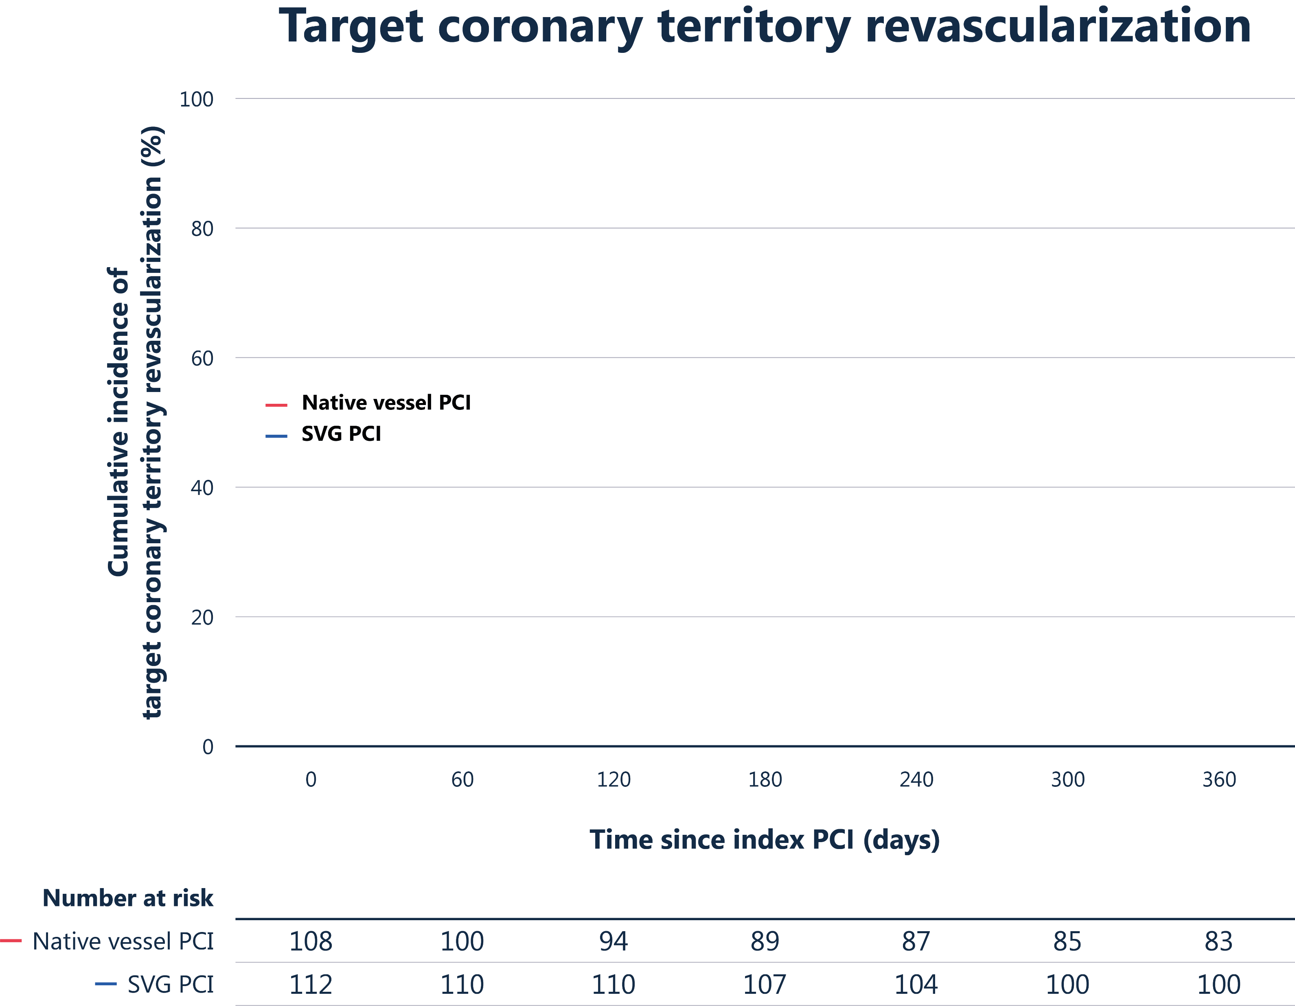
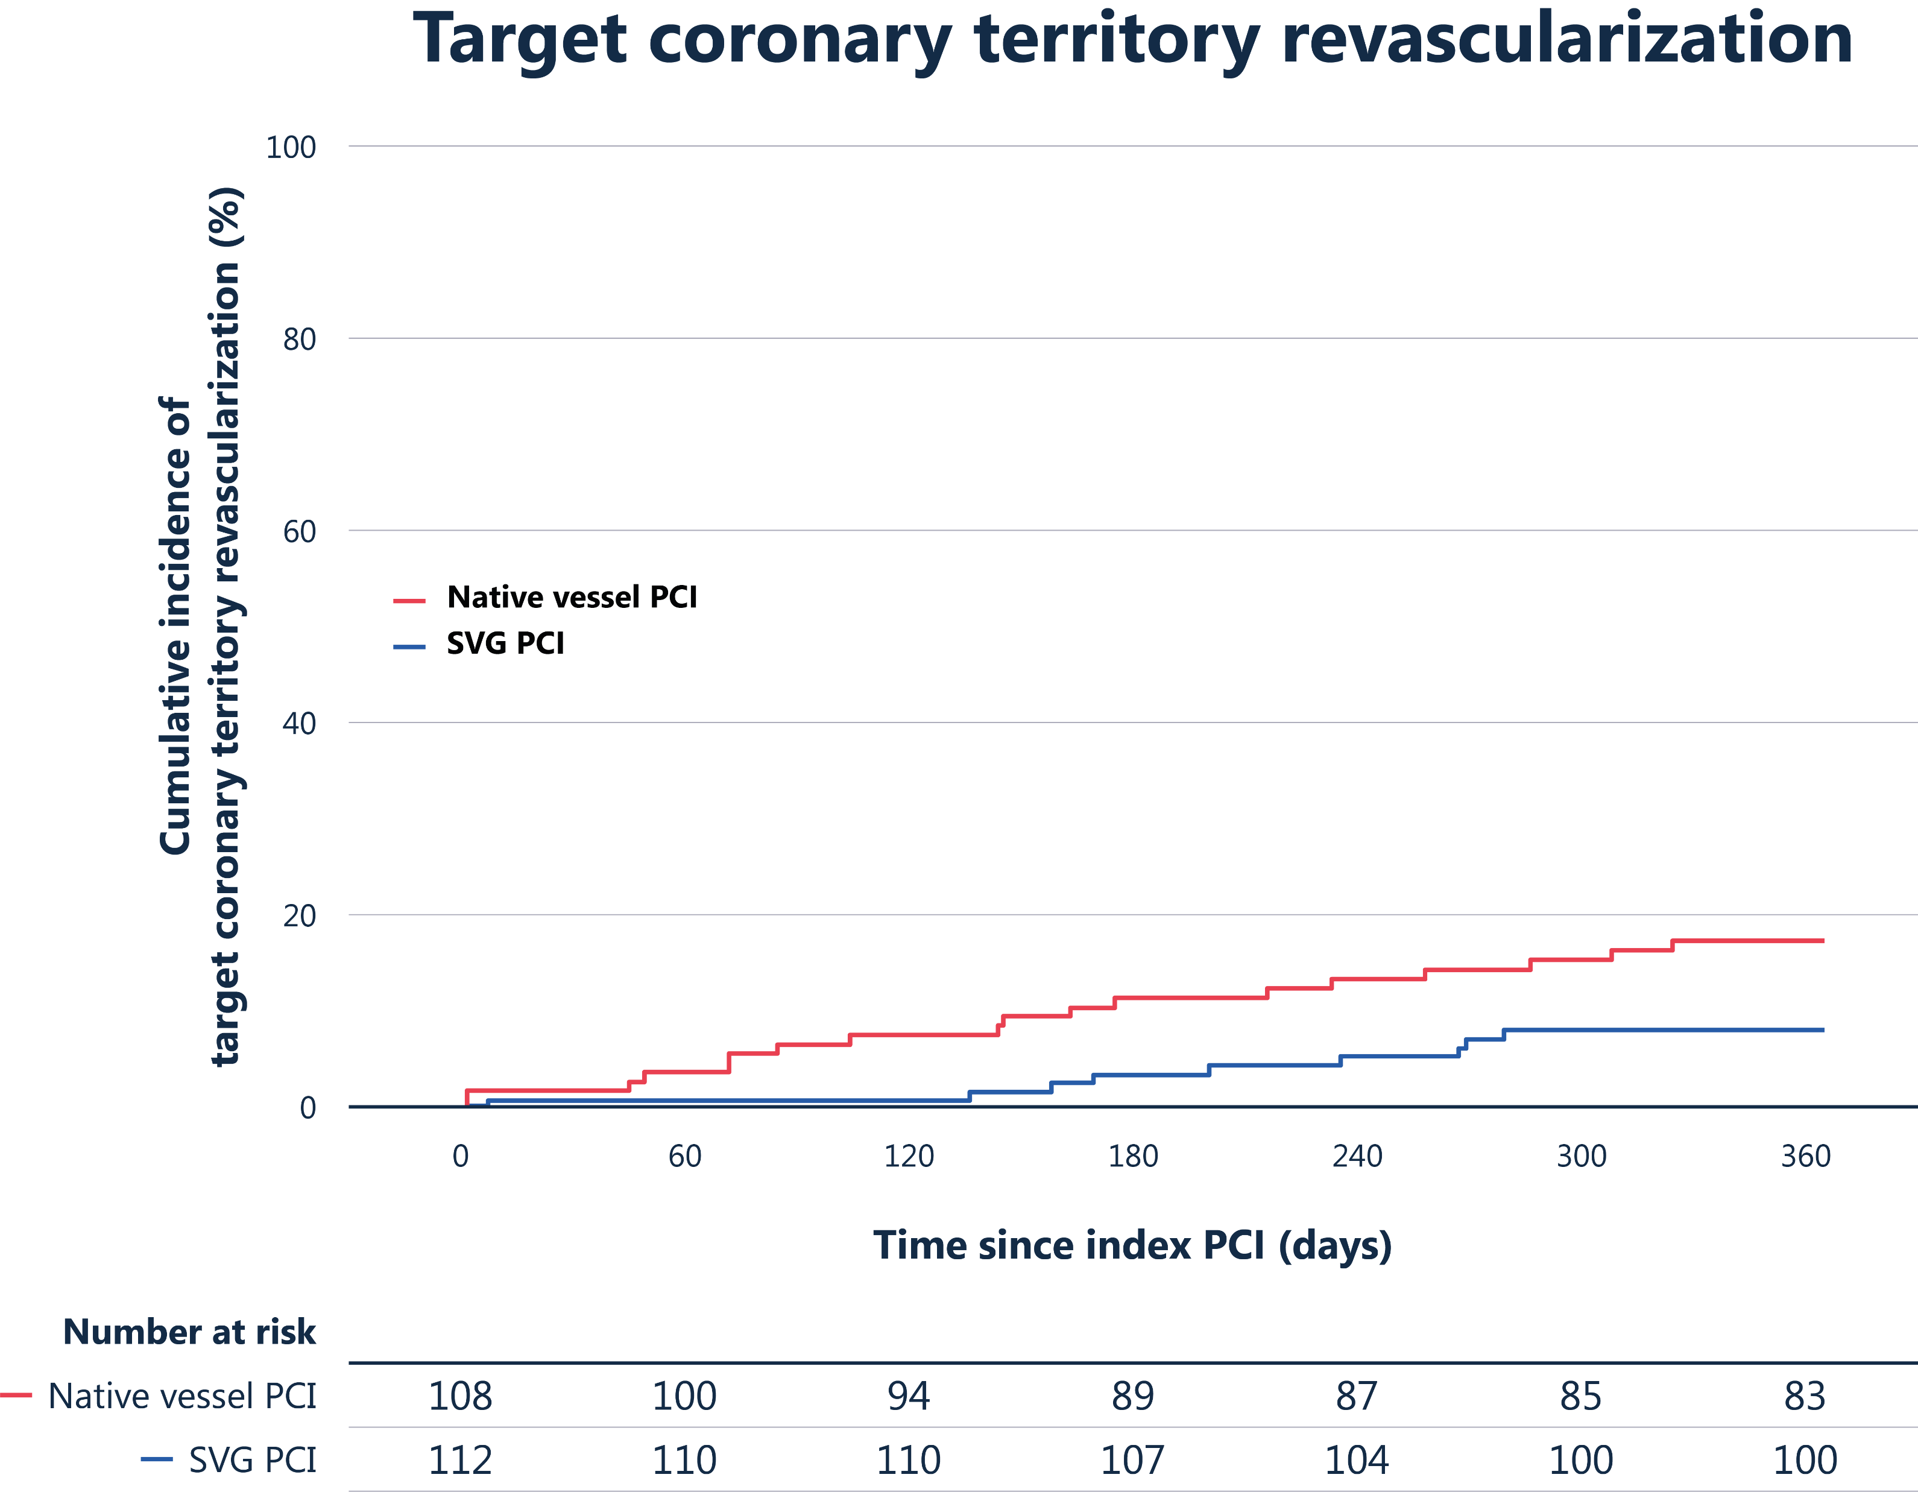
Target coronary territory revascularization
Target coronary territory revascularization
Cumulative incidence of
target coronary territory revascularization (%)
Hazard ratio 2.19 (95% CI 1.02 – 4.72)
Log-rank p = 0.039
Native vessel PCI
SVG PCI
18.4%
9.1%
Time since index PCI (days)
Event rates are Kaplan Meier estimates | Comparison by unadjusted Cox regression and log-rank test

Slide 18




Study limitations
N = 220
584
Early study termination
Sufficient to reliably detect differences in the occurrence of MACE
Open-label design
May have influenced clinical decisions
Selected population
Early graft failure, occlusive SVG disease or high-risk SVGs excluded

Slide 19
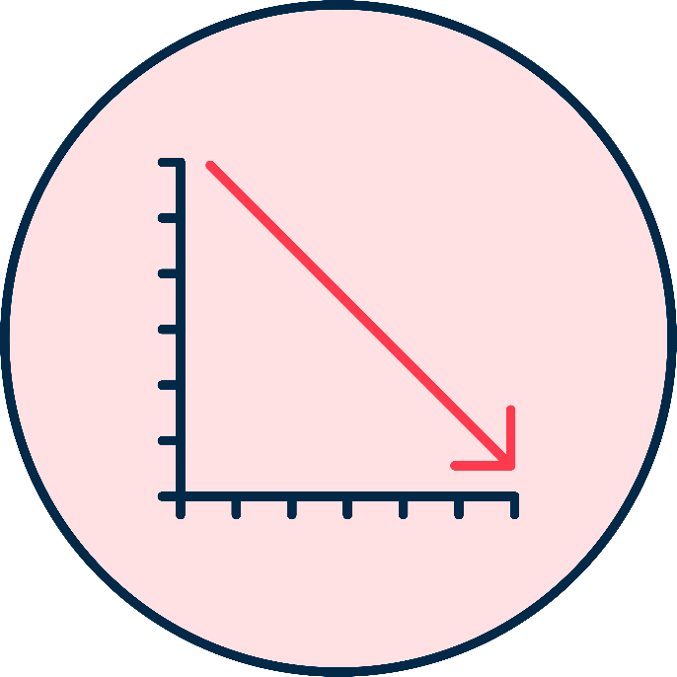





Summary
PROCTOR is the first randomized trial
Comparing clinical outcomes between a strategy of native coronary artery PCI and SVG PCI
SVG PCI showed lower MACE (at 1Y)
Lower rates of PCI-related MI and clinically driven target coronary territory revascularization
Findings apply to selected patients
Both PCI strategies considered technically feasible for PCI, high prevalence of complex native CTO lesions
Results challenges current guidelines
At 1-year clinical follow-up
Long term results awaited
To determine whether the early clinical advantage observed with SVG PCI is maintained over time

Slide 20
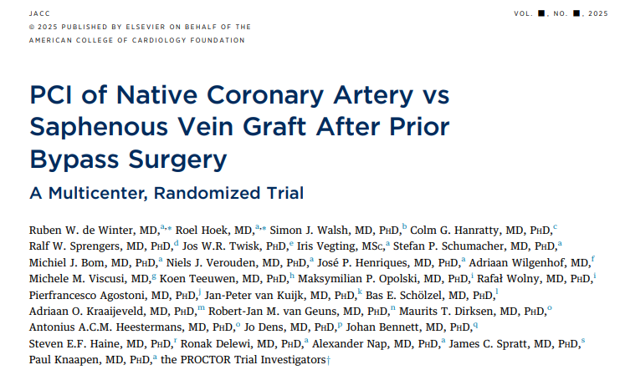
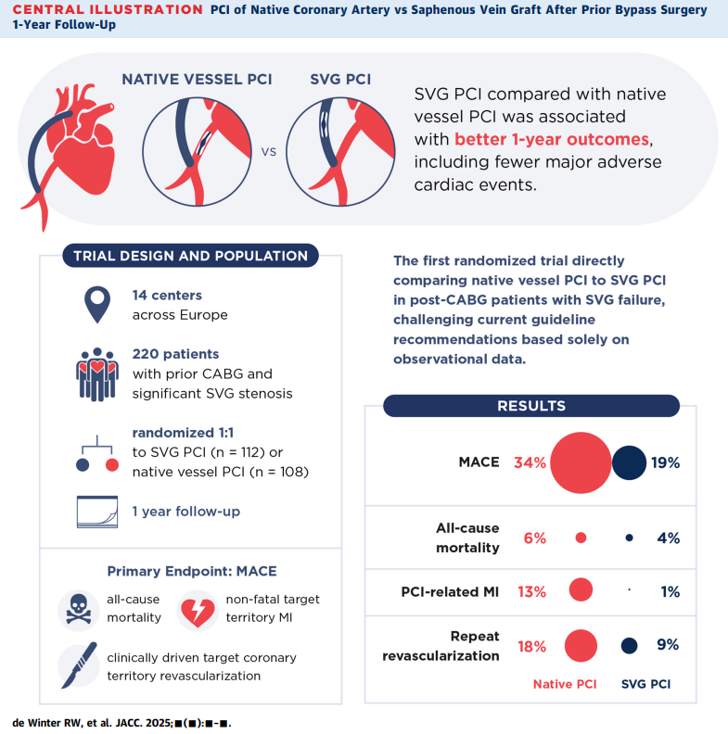
Now available online in JACC

Slide 21
Thank you to all the patients, sites, and investigators
Study organization
Steering committee | Paul Knaapen, Alexander Nap, Ralph W. Sprengers, Simon J. Walsh, Colm G. Hanratty, James C. Spratt
Lead investigators | Ruben W. de Winter, Roel Hoek
Principle investigators | Paul Knaapen, James C. Spratt
Study sponsor | Dept. of Cardiology, Amsterdam UMC, The Netherlands
Trial funding | Abbott Vascular International BVBA, Diegem, Belgium
Clinical research organisation (CRO) | KCRI, Miechowska 5B, 30-055 Krakow, Poland
Trial statisticians | Jos W.R. Twisk, Ronak Delewi
Data safety monitoring board (DSMB) | Peter C. Smits (Chair), Jan G.P. Tijssen, Jur M. ten Berg, Jorrit Lemkes
Clinical event committee (CEC) | Mohamed S. Rahman, Karel T. Koch, Joanna J. Wykrzykowska
Angiographic expert assessors | Adriaan Wilgenhof, Michele Viscusi
Address for correspondence: Ruben W. de Winter, MD, PhD Research fellow | R.w.dewinter@amsterdamumc.nl | Dept. of Cardiology, Amsterdam UMC, The Netherlands

