Slide 1
The ShortCUT Trial:
Shockwave Lithotripsy Compared to Cutting Balloon Treatment in
Calcified Coronary Artery Disease
Suzanne J. Baron MD MSc
Massachusetts General Hospital, Boston MA
Baim Institute for Clinical Research, Boston MA
On Behalf of the ShortCUT Investigators

Slide 2
Disclosure of Relevant Financial Relationships
Within the prior 24 months, I have had a financial relationship with
a company producing, marketing, selling, re-selling, or distributing healthcare products used by or on patients:
Nature of Financial Relationship | Ineligible Company
Grant/Research Support | Acarix Abiomed Boston Scientific Corp
Consultant Fees/Honoraria | Abbott Boston Scientific Corp Edwards LifeSciences HeartFlow | Medtronic Picardia Shockwave Zoll Medical
All relevant financial relationships have been mitigated
Faculty disclosure information can be found on the app

Slide 3
Background
The presence of significant coronary lesion calcification has been associated with increased procedural complexity and poorer short and long-term clinical outcomes after PCI
There are multiple balloon-based specialty devices used for calcium modification; however, there are limited direct comparisons between these devices, many of which have different mechanisms of action and carry substantial differences in cost
To date, no adequately powered randomized trial has compared intravascular lithotripsy to other balloon-based devices for the treatment of calcified coronary artery disease

Slide 4
Objective
To evaluate the safety, efficacy and procedural cost of cutting balloon angioplasty compared with intravascular lithotripsy in patients with moderate-to-severely calcified coronary lesions undergoing percutaneous coronary intervention

Slide 5
Study Design
Patients with Significantly Calcified CAD Undergoing IVUS-Guided PCI
Planned Rotational Atherectomy
No Planned Rotational Atherectomy
Randomize 1:1
Randomize 1:1
Cutting Balloon
“Rota-Cut”
IVL
“Rota-Shock”
Cutting Balloon
IVL
PCI with DES
Primary Endpoint: Post-procedural minimal stent area (MSA) at site of maximal Ca⁺⁺
(IVUS Core Lab Adjudicated)
ClinicalTrials.gov #: NCT06089135

Slide 6
Key Inclusion & Exclusion Criteria
Inclusion Criteria | Exclusion Criteria
Presentation with stable angina or NSTE-ACS with flat or down-trending biomarkers De novo native lesion > 70% or 50-70% with evidence of hemodynamic significance Significant calcification defined either as: Radio-opacities involving both sides of arterial wall > 5mm at lesion site > 270º arc of Ca⁺⁺ > 5mm length on HD-IVUS 360º arc of Ca⁺⁺ on HD-IVUS | STEMI within 30 days LVEF < 25% Cardiogenic shock or anticipated requirement for mechanical/pharmacological support Excessive tortuosity in vessel or other anatomic considerations precluding intravascular imaging Evidence of dissection in target vessel prior to randomization

Slide 7
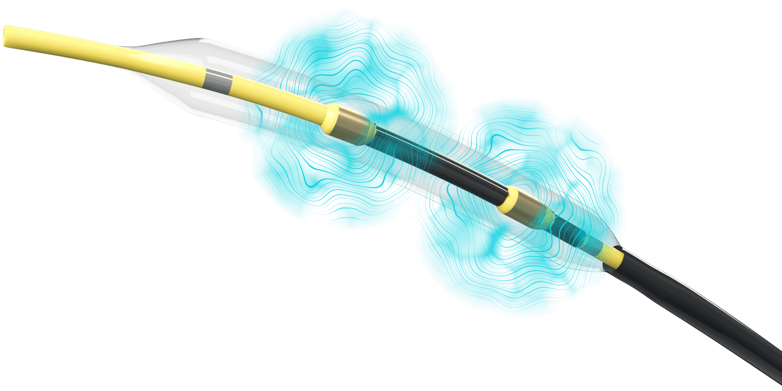
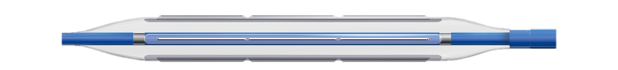
Study Interventions
Intravascular Lithotripsy | Cutting Balloon
Device sized 1:1 to reference vessel diameter # of pulses delivered at operator discretion | Device sized 0.5mm smaller than reference vessel diameter High pressure inflation (e.g. 16-20 atm)
High-Definition 60 Hz IVUS
Strongly recommended prior to randomization Mandatory after randomized device use (pre-stent implantation) & at procedure completion

Slide 8
Primary Study Endpoint
Statistical Considerations
Non-inferiority design with reflex superiority testing of primary endpoint (MSA at site of maximal calcification)
  Hypothesis: Cutting balloon angioplasty will be non-inferior to IVL
Sample size assumptions
  Study powered to assess primary endpoint in both planned and no-planned atherectomy arms
  Assumed mean MSA 6.5mm² with SD 2.5mm² and non-inferiority margin of 1.2mm²
  Sample size of 206 in each arm (412 total) provides 90% power to detect non-inferiority assuming 10% of IVUS images not evaluable

Slide 9
Key Secondary Endpoints
Clinical and Angiographic Endpoints | Intravascular Imaging Endpoints
Procedural Cost Strategy Success Stent delivery with a residual stenosis < 20% in the absence of significant angiographic complication and not having to use an alternative calcium modification device In-Hospital and 30-day MACCE Composite of all-cause death, unplanned urgent target vessel revascularization, unplanned cardiothoracic surgery, spontaneous myocardial infarction or stroke/TIA | Stent expansion (%) At site of maximal calcification Within entire stented segment Calcium fractures after randomized treatment Presence vs. Absence Number observed Significant residual stenosis (any stent area < 4.5mm²)

Slide 10
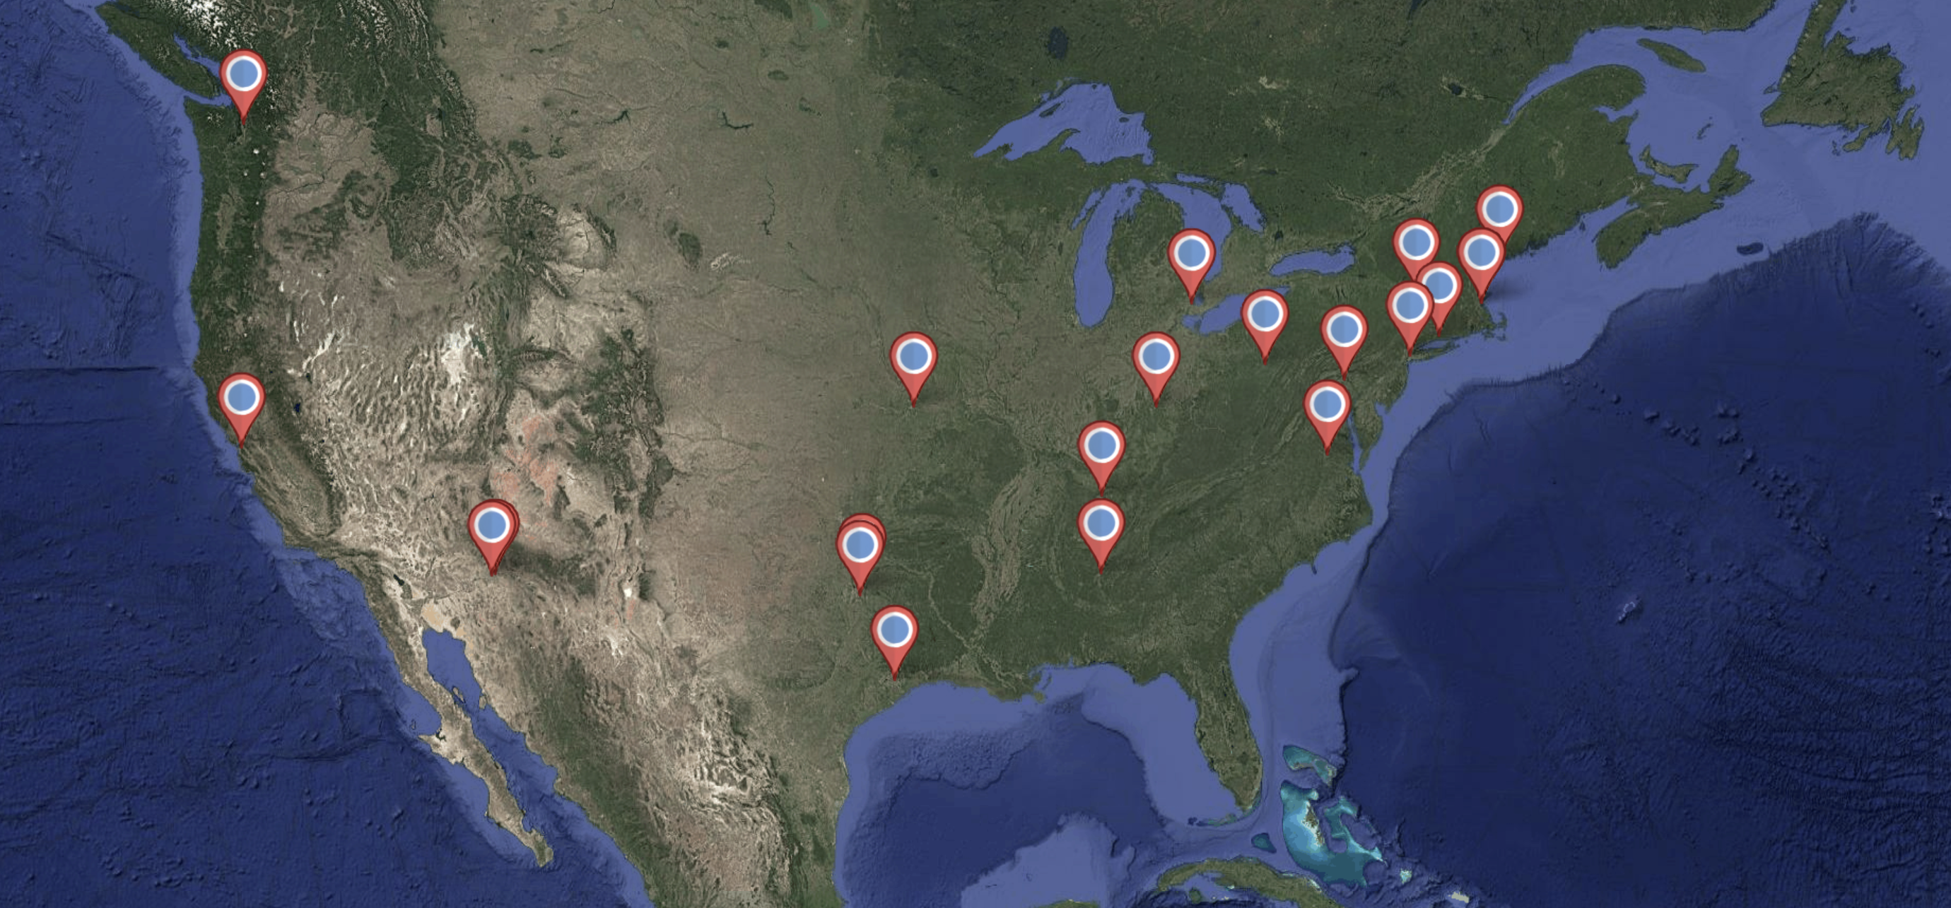
413 Pts Enrolled at 21 Sites in United States
University of Washington (6)
Capital Cardiology (1)
Maine Medical Center (28)
Henry Ford
Hospital (71)
University of Pittsburgh (12)
Massachusetts General Hospital (19)
Beth Israel Deaconess
Medical Center (11)
Christ
Hospital (15)
Yale University (11)
WellSpan (13)
Columbia University Medical Center (30)
St. Luke’s Mid America Heart Institute (29)
Vanderbilt University (2)
University of California
San Francisco (8)
Baylor, Scott & White – Plano (31)
University of Virginia (26)
Banner Health (16)
HonorHealth (3)
Baylor, Scott & White – Dallas (64)
University of Alabama
Birmingham (12)
Houston Methodist (5)

Slide 11
Study Flow
413 Patients Randomized
Planned Rotational Atherectomy
N = 208
No Planned Rotational Atherectomy
N = 205
7 Unanalyzable IVUS
8 Unanalyzable IVUS
Included in Primary Endpoint Analysis
Subjects = 201
Lesions = 214
Included in Primary Endpoint Analysis
Subjects = 197
Lesions = 216

Slide 12
Baseline Characteristics
Total Study Population
 | Intravascular Lithotripsy N = 207 Subjects | Cutting Balloon N = 206 Subjects
Age (yrs) | 72.1 ± 9.3 | 72.2 ± 9.5
Male Sex | 75.8% | 74.3%
Diabetes Mellitus | 44.1% | 46.1%
Renal Insufficiency On Dialysis | 25.7% 5.9% | 24.4% 5.9%
Prior PCI | 44.1% | 51.0%
Prior CABG | 14.9% | 18.6%
LVEF (%) | 53.3 ± 11.5 | 54.6 ± 10.9
Indication for PCI Stable Angina Unstable Angina NSTEMI | 85.5% 6.8% 7.7% | 82.0% 8.3% 9.7%
p = NS for all comparisons

Slide 13
Lesion Characteristics – Site Reported
Total Study Population
 | Intravascular Lithotripsy N = 218 Lesions | Cutting Balloon N = 212 Lesions
Target Lesion Vessel LMCA LAD LCx RCA | 4.0% 44.2% 16.9% 34.8% | 5.0% 41.0% 17.6% 36.5%
Target Lesion Stenosis (%) CTO present | 87.4 ± 9.8 12.5% | 88.8 ± 8.9 13.5%
Target Lesion Length (mm) | 34.2 ± 21.7 | 34.4 ± 22.8
Reference Vessel Diameter (mm) | 3.5 ± 0.5 | 3.4 ± 0.5
p = NS for all comparisons

Slide 14
Lesion Characteristics – IVUS Core Lab
Total Study Population
 | Intravascular Lithotripsy N = 218 Lesions | Cutting Balloon N = 212 Lesions
Reference Vessel Diameter (mm) | 4.2 ± 0.8 | 4.1 ± 0.9
Total Length of Calcium (mm) | 29.3 ± 18.4 | 30.3 ± 20.2
Maximum Arc of Calcium (º) | 346.5 [260,360] | 337.5 [260,360]
Arc of Calcium 0-269º 270-359º 360º | 25.7% 24.8% 49.5% | 26.0% 25.5% 48.6%
Nodular Calcification | 25.0% | 25.2%
p = NS for all comparisons

Slide 15
Procedural Characteristics
Total Study Population
 | Intravascular Lithotripsy N = 207 Subjects | Cutting Balloon N = 206 Subjects | P-Value
Total Procedure Time (min) | 109.3 ± 53.3 | 105.8 ± 54.2 | 0.51
Femoral Access | 65.2% | 54.9% | 0.04
# Lesions Treated | 1.4 ± 0.7 | 1.4 ± 0.7 | 0.57
# Lesions Randomized | 1.1 ± 0.3 | 1.1 ± 0.3 | 0.60
Randomized Device Use
Maximum Balloon Diameter (mm) | 3.5 ± 0.5 | 3.1 ± 0.5 | < 0.001
# of Inflations | 8.5 ± 3.8 | 3.8 ± 2.5 | < 0.001
Maximum Inflation Pressure (atm) | 5.5 ± 3.5 | 17.0 ± 3.5 | < 0.001
# of IVL Pulses | 90.0 [60,120] | n/a | n/a

Slide 16
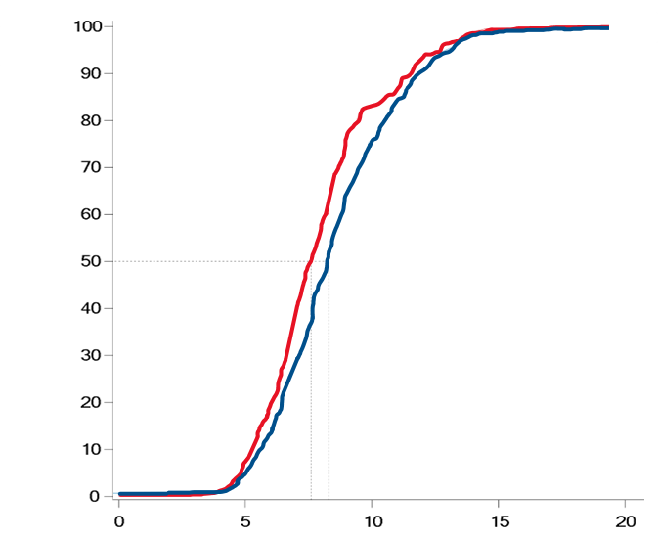
Primary Study Endpoint: Total Cohort
Post-Procedural MSA at Site of Max Ca⁺⁺
 | Intravascular Lithotripsy | Cutting Balloon
# of Lesions | 218 | 212
Mean ± SD | 8.6 ± 2.5 | 8.0 ± 2.4
Median [IQR] | 8.3 [6.7,9.9] | 7.6 [6.4,9.0]
Difference (1-sided 97.5% CI) | 0.6 (∞, 1.1) mm²
P-Value (Non-Inferiority)* | 0.007
P-Value (Superiority) | 0.993
P-Value for Interaction (Atherectomy; Non-Atherectomy) | 0.044
Cutting Balloon
Frequency (%)
Intravascular
Lithotripsy
MSA (mm²)
* Non-inferiority Margin 1.2mm

Slide 17
Imaging Secondary Endpoints
Total Cohort
 | Intravascular Lithotripsy N = 218 Lesions | Cutting Balloon N = 212 Lesions | P-Value
MSA within Entire Stent (mm²) | 7.1 ± 2.2 | 6.9 ± 2.1 | 0.25
Evidence of Calcium Fracture | 77.4% | 78.9% | 0.72
# of Calcium Fractures | 2.9 ± 1.9 | 2.6 ± 1.6 | 0.30
Stent Expansion at Site of Maximum Ca⁺⁺ (%) | 97.7 ± 24.0 | 97.7 ± 25.9 | 0.99
Minimum Stent Expansion (%) | 80.5 ± 18.8 | 83.5 ± 20.5 | 0.12
Residual Stenosis (any stent area < 4.5mm²) | 7.7% | 9.3% | 0.60
IVUS Core-Lab Adjudicated

Slide 18
Key Clinical Secondary Endpoints
Total Cohort
 | Intravascular Lithotripsy N = 207 Subjects | Cutting Balloon N = 206 Subjects | P-Value
Complication associated with Randomized Device Dissection Perforation Abrupt Closure Balloon Rupture | 0.9% 0.0% 0.0% 3.1% | 2.7% 0.5% 0.0% 2.3% | 0.34
Intraprocedural Adverse Events * | 1.0% | 1.0% | 1.00
Strategy Success ** | 89.7% | 89.2% | 0.88
In-Hospital MACCE | 1.0% | 1.0% | 1.00
30-Day MACCE | 2.9% | 2.9% | 1.00
* Composite of death, emergency CT surgery, shock requiring MCS, stroke, or type III/IV/V coronary perforation
** Stent delivery with a residual stenosis < 20% in the absence of significant angiographic complication and not having to use alternative calcium modification device

Slide 19
Procedural Cost: Target Vessel
Total Cohort
Total Procedural Cost Difference
$3632 (95% CI: $2833 to $4418)
p < 0.001
Total Procedural Cost

Slide 20
Procedural Cost: Target Vessel
Total Cohort
Total Procedural Cost Difference
$3632 (95% CI: $2833 to $4418)
p < 0.001
P < 0.001

Slide 21
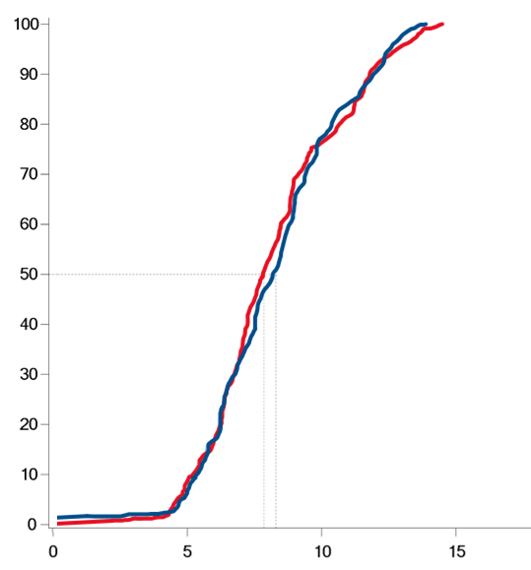
Atherectomy Cohort
Post-Procedural MSA at Site of Max Ca⁺⁺
 | Intravascular Lithotripsy | Cutting Balloon
# of Lesions | 107 | 107
Mean ± SD | 8.4 ± 2.3 | 8.3 ± 2.5
Median [IQR] | 8.3 [6.5,9.9] | 7.9 [6.4,9.8]
Difference (1-sided 97.5% CI) | 0.1 (∞, 0.8) mm²
P-Value (Non-Inferiority)* | < 0.001
P-Value (Superiority) | 0.622
Cutting Balloon
“Rota-Cut”
Intravascular
Lithotripsy
“Rota-Shock”
Frequency (%)
MSA (mm²)
* Non-inferiority Margin 1.2mm

Slide 22
Key Secondary Endpoints
Planned Atherectomy Cohort
 | Intravascular Lithotripsy N = 103 Subjects | Cutting Balloon N = 105 Subjects | P-Value
Selected Imaging Endpoints MSA within Stented Segment (mm²) Stent Expansion at site of Max Ca⁺⁺ (%) Evidence of Calcium Fracture Residual Stenosis | 7.1 ± 2.0 92.4 ± 28.3 78.6% 7.8% | 7.2 ± 2.1 96.4 ± 26.6 83.7% 7.7% | 0.52 0.30 0.38 1.00
Complication associated with Randomized Device | 1.8% | 2.7% | 0.60
Strategy Success * | 89.4% | 92.9% | 0.48
30-Day MACCE | 2.9% | 3.8% | 1.00
Total Procedural Cost (Target Vessel) | $15,369 | $10,980 | < 0.001
* Stent delivery with a residual stenosis < 20% in the absence of significant angiographic complication and not having to use alternative calcium modification device

Slide 23
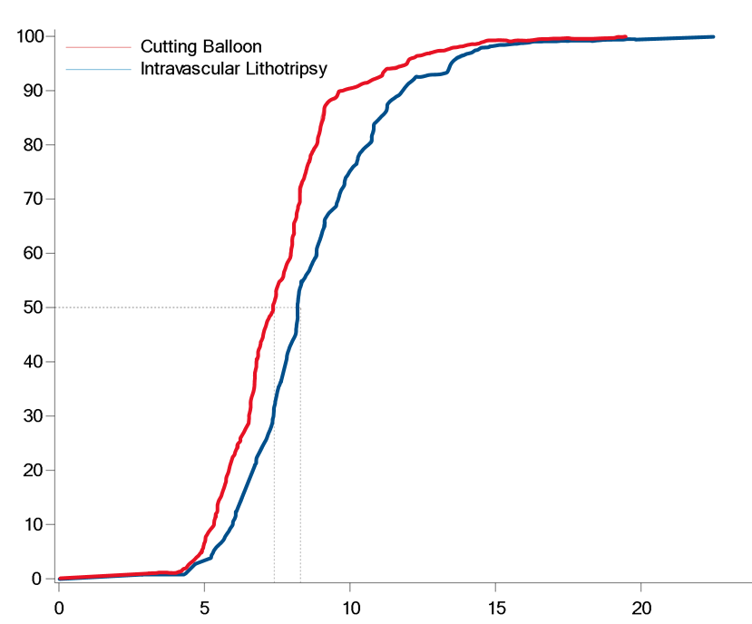
Non-Atherectomy Cohort
Post-Procedural MSA at Site of Max Ca⁺⁺
Cutting Balloon
 | Intravascular Lithotripsy | Cutting Balloon
# of Lesions | 111 | 105
Mean ± SD | 8.8 ± 2.7 | 7.7 ± 2.3
Median [IQR] | 8.3 [7.2,10.0] | 7.4 [6.3,8.5]
Difference (1-sided 97.5% CI) | 1.1 (∞, 1.8) mm²
P-Value (Non-Inferiority)* | 0.399
Frequency (%)
Intravascular
Lithotripsy
MSA (mm²)
* Non-inferiority Margin 1.2mm

Slide 24
Other Imaging Secondary Endpoints
No Planned Atherectomy Cohort
 | Intravascular Lithotripsy N = 111 Lesions | Cutting Balloon N = 105 Lesions | P-Value
MSA within Entire Stent (mm²) | 7.2 ± 2.3 | 6.5 ± 2.2 | 0.03
Stent Expansion at Site of Maximum Ca⁺⁺ (%) | 101.1 ± 21.3 | 98.1 ± 27.1 | 0.23
Minimum Stent Expansion (%) | 83.1 ± 19.0 | 82.2 ± 22.1 | 0.77
Evidence of Calcium Fracture | 76.2% | 74.7% | 0.87
# of Calcium Fractures | 2.3 ± 1.5 | 2.3 ± 1.2 | 0.66
Residual Stenosis (any stent area < 4.5mm²) | 7.6% | 11.1% | 0.47
IVUS Core-Lab Adjudicated

Slide 25

No Planned Atherectomy Cohort
Impact of Reference Vessel Size
Calculation of Indices of Optimal Stent Implantation
    Minimal Stent Area (mm²): ($\frac{Minimal lumen diameter}{2}$)² x π
    Stent Expansion (%): ($\frac{MSA}{Ideal Lumen Area}$) x 100
  MSA, but not stent expansion, is affected by reference vessel size
 | Intravascular Lithotripsy N = 111 Lesions | Cutting Balloon N = 105 Lesions | P-Value
Site-Reported Vessel Diameters (mm)
Reference Vessel Diameter | 3.5 ± 0.5 | 3.4 ± 0.5 | 0.069
IVUS Core Lab Adjudicated Vessel Size Pre-Preparation (mm)
Mean Reference Lumen Diameter | 3.0 ± 0.6 | 2.9 ± 0.5 | 0.093

Slide 26
No Planned Atherectomy Cohort
Impact of Reference Vessel Size
Calculation of Indices of Optimal Stent Implantation
    Minimal Stent Area (mm²): ($\frac{Minimal lumen diameter}{2}$)² x π
    Stent Expansion (%): ($\frac{MSA}{Ideal Lumen Area}$) x 100
  MSA, but not stent expansion, is affected by reference vessel size
 | Intravascular Lithotripsy N = 111 Lesions | Cutting Balloon N = 105 Lesions | P-Value
Site-Reported Vessel Diameters (mm)
Reference Vessel Diameter | 3.5 ± 0.5 | 3.4 ± 0.5 | 0.069
IVUS Core Lab Adjudicated Vessel Size Pre-Preparation (mm)
Mean Reference Lumen Diameter | 3.0 ± 0.6 | 2.9 ± 0.5 | 0.093
Primary Endpoint ADJUSTED for Mean Reference Lumen Diameter
Difference in MSA at Site of Max Ca⁺⁺ | 0.6 (∞, 1.2) mm²

Slide 27
Key Secondary Endpoints
No Planned Atherectomy Cohort
 | Intravascular Lithotripsy N = Subjects | Cutting Balloon N = Subjects | P-Value
Complication associated with Randomized Device | 3.6% | 1.8% | 0.574
Strategy Success * | 90.5% | 85.5% | 0.312
30-Day MACCE | 2.9% | 2.0% | 1.00
Total Procedural Cost (Target Vessel) | $10,885 | $7,776 | < 0.001
* Stent delivery with a residual stenosis < 20% in the absence of significant angiographic complication and not having to use alternative calcium modification device

Slide 28
Limitations
All procedures were guided by intravascular imaging with experienced operators
Cutting balloon therapy was delivered strictly by protocol, which included sizing the balloon at 0.5mm smaller than RVD and inflating at high pressures
Angiographic outcomes beyond procedure conclusion and clinical outcomes beyond 30 days were not tracked, so whether differences in late lumen loss or longer-term clinical outcomes could emerge between the two groups is unknown

Slide 29
Summary
Cutting balloon angioplasty was non-inferior to IVL with regards to minimal stent area at the site of maximum Ca⁺⁺ in the total study population
There was no differences in stent expansion, presence of calcium fractures, strategy success, intraprocedural adverse events or MACCE out to 30 days between IVL and cutting balloon angioplasty
Procedural cost was significantly higher with IVL use in all analyses
When the primary endpoint analysis was stratified by atherectomy plan:
  Planned Atherectomy: Findings were similar to the overall study cohort
  No Planned Atherectomy: Cutting balloon angioplasty did not meet non-inferiority, however this may have been partly due to differences in vessel size between groups, as stent expansion and indices of fracture were similar

Slide 30
Conclusion
Cutting balloon angioplasty is a reasonable and less costly option when compared with intravascular lithotripsy for the treatment of significantly calcified coronary lesions treated with imaging-guided PCI

