Slide 1
Randomized Trial of a Sirolimus Eluting Balloon versus Repeat Drug-Eluting Stenting or Balloon Angioplasty
for Coronary In-stent Restenosis
SELUTION4ISR Clinical Trial
ClinicalTrials.gov ID NCT04280029
Donald E. Cutlip MD, on behalf of the SELUTION4ISR investigators

Slide 2
Disclosure of Relevant Financial Relationships
Within the prior 24 months, I, Donald E. Cutlip, have had a financial relationship with a company producing, marketing, selling, re-selling, or distributing healthcare products used by or on patients:
Nature of Financial Relationship |  | Ineligible Company
Grant / Research Support |  | Cordis (MedAlliance), Corvia Medical
Consultant Fees / Honoraria |  | Boston Scientific
All Relevant Financial Relationships have been mitigated
Faculty disclosure information can be found on the app

Slide 3
Background
After drug-eluting stents, in-stent restenosis (ISR) occurs in 4-8% of patients within one year and continues in over 1% of patients annually (>10% of PCI is ISR)
Although DES has a Class 1A recommendation, many technologies have been explored to avoid deploying multiple layers of stent
Paclitaxel drug-coated balloons (DCBs) have emerged as a new option for ISR treatment relative to POBA in clinical studies
Sirolimus has a wider therapeutic window, but development had previously been delayed due to complexities of drug delivery and tissue uptake

Slide 4
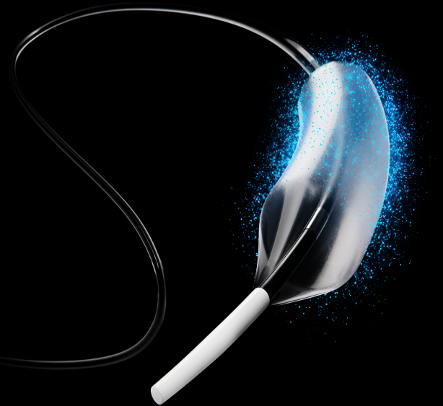
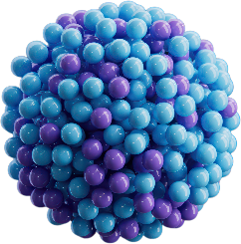


Study Device
SELUTION SLR Drug-Eluting Balloon
MicroReservoirs
∼4 µm spheres of sirolimus mixed with biodegradable polymer
Controlled release of sirolimus
Proprietary Phospholipid Coating
Phospholipid blend containing and protecting MicroReservoirs at 1 μg/mm² sirolimus dose
Enhanced drug transfer efficiency
*Device not approved and available for sale in the US
SELUTION SLR Drug-Eluting Balloon delivers sustained drug release that maintains therapeutic tissue concentration for 90 days¹
¹ T Tanaka et al, Cardiovasc Revasc Med 2025: S1553-8389(25)00464-6

Slide 5
SELUTION4ISR Trial Design – Key Points
  Goal: To demonstrate a DEB approach in ISR can achieve non-inferiority to standard of care (SOC) without the addition of another stent layer
  Key Trial Design Considerations:
  Randomized, multi-center, single blind, active control, non-inferiority trial
  Active control designed as standard of care (SOC) in the United States based on NCDR¹ PCI registry data¹ indicating ~80% DES and 20% plain balloon angioplasty (BA)
  Operator required to select control treatment prior to randomization. BA group closed after 20% cap reached
¹Moussa et al. J Am Coll Cardiol 2020;76:1521-31

Slide 6
Why SOC Control?
Designed to mirror device use in NCDR registry report (2020) ¹
Randomization to DES → concern with investigator reluctance; population limited to single layer ISR
Randomization to plain balloon angioplasty → concern with random assignment to a known inferior treatment
Operator selection of balloon angioplasty control limited to 20% and allowed comparison with a predominant repeat DES strategy
¹Moussa et al. J Am Coll Cardiol 2020;76:1521-31

Slide 7
Study Organization
Principal Investigators
Donald E. Cutlip, MD
Beth Israel Deaconess Medical Center, Boston, MA
Roxana Mehran, MD
Icahn School of Medicine at Mount Sinai, New York, NY
Steering Committee
Chair: Ron Waksman, MD
MedStar Washington Hospital, Washington, D.C.
Donald E. Cutlip, MD
Roxana Mehran, MD
George Adams, MD, (CMO, Cordis)
Angiography Core Laboratory
Serge Korjian, MD
Baim Institute, Boston, MA
OCT Core Laboratory
Eric Osborn, MD, PhD.
Baim Institute, Boston, MA
DSMB Chair
Andreas Baumbach, MD
St. Bartholomew's Hospital, London, England
CEC Chair
Hector M Garcia-Garcia, MD
MedStar Washington Hospital, Washington, D.C.
Funding and Study Sponsor
Cordis, through its affiliate, M.A. MedAlliance SA

Slide 8




SELUTION4ISR Top Enrollers
PRINCIPAL INVESTIGATOR & INSTITUTION
PATIENTS ENROLLED

Slide 9


Key Inclusion and Exclusion Criteria
  Key Inclusion Criteria
  Key Exclusion Criteria
Age ≥ 18 years
Stable or unstable angina, functional testing demonstrating ischemia, or stabilized non-ST elevation MI
Eligible for DAPT
>1 year life expectancy
Single target lesion within native coronary artery
Target lesion within prior BMS or DES and not >5 mm from proximal or distal edge
Diameter stenosis >50 and <100%
Lesion length ≤ 26mm; RVD ≥ 2.0 and ≤ 4.5 mm
STEMI within 30 days
Bifurcation requiring side branch treatment
>2 layers of previous stent
Total occlusion or thrombus present
>30% diameter stenosis or dissection > NHLBI Type C after pretreatment

Slide 10
Randomization and Study Procedure
Pre Study Procedure
All patients received: ASA ≥ 150 mg pre-procedure P2Y12 inhibitor pre or within 1 hour post
IVUS or OCT required pre-treatment
Pre-treatment with any approved device for residual stenosis <30%
Operator selection of DES or BA control pre- randomization – limit of 20% BA
Randomization stratified by: center, BMS/DES ISR, and 1 vs. 2 layers prior stent
Study Procedure
SELUTION DEB Balloon inflated (nominal) for goal 60 seconds and minimum 30 seconds No additional PCI or intracoronary imaging DAPT 1 month
DES Standard practice Post-dilation and intracoronary imaging encouraged to optimize result DAPT 6 months*
Balloon Angioplasty Additional BA if required for optimal result DAPT 1 month
*DAPT <6 months if high bleeding risk; P2Y12 monotherapy if required oral anticoagulation

Slide 11
Primary Endpoint and Statistical Analysis
Primary Endpoint
Target Lesion Failure (cardiac death, target vessel MI*, clinically driven TLR)
Non-inferiority (primary analysis in per protocol population)
Non-inferiority of proportions analyzed by non-informative Bayesian method requiring posterior probability of 97.5% (~one-sided alpha 0.025); Non-inferiority margin = 10%
Assumed event rate 12% per group; 5% loss to FU
84% power, sample size = 418 patients
Analysis repeated in intention-to-treat population
Including analyses adjusting for missing data (time-to-event, multiple imputation, and tipping point)
*Peri-procedural by SCAI and post-procedure by 4th UDMI

Slide 12
Study Flow – Consort Diagram
Screened
N = 1,508
Excluded (1,090)
No eligible lesion (716)
>30% residual stenosis (15)
Other I/E criteria (359)
Randomized
N = 418
SELUTION DEB
N = 210
SOC (DES / BA)
N = 208
Excluded from Per Protocol (13)
Missing endpoint FU (8)
Non-cardiac death (4)
I/E violation (1)
Excluded from Per Protocol (15)
Missing endpoint FU (12)
Non-cardiac death (2)
No assigned treatment (1)
Per Protocol
N = 197
Per Protocol
N = 193

Slide 13
Baseline Clinical Characteristics (ITT)
Characteristic | SELUTION DEB N = 210 | SOC N = 208
Age (years, median, IQR) | 68 (63-75) | 71 (63-76)
Female (N, %) | 39 (19%) | 55 (26%)
Diabetes (N, %) | 90 (43%) | 89 (43%)
Hypertension (N, %) | 195 (93%) | 193 (93%)
Hyperlipidemia (N, %) | 190 (90%) | 186 (89%)
Prior MI (N, %) | 104 (50%) | 101 (49%)
Current smoker (N, %) | 33 (16%) | 30 (14%)

Slide 14
Baseline Lesion Characteristics (ITT)
Characteristic | SELUTION DEB N = 210 | SOC N = 208
Number of prior stents at target lesion
One - N (%) | 167 (80%) | 168 (81%)
Two - N (%) | 43 (20%) | 40 (19%)
Prior DES at target lesion | 185 (88%) | 192 (92%)
Target lesion location - N (%)
Left anterior descending | 83 (40%) | 80 (39%)
Circumflex | 53 (25%) | 47 (23%)
Right coronary artery | 73 (35%) | 74 (36%)
Restenosis Pattern - N (%)
Focal | 78 (39%) | 81 (43%)
Diffuse | 116 (58%) | 101 (53%)
Proliferative | 5 (3%) | 8 (4%)

Slide 15
Baseline Quantitative Angiography (ITT)
Characteristic | SELUTION DEB N = 210 | SOC N = 208
Lesion length⁺ (mm) | 12.3 ± 6.0 | 11.9 ± 5.6
Reference vessel diameter⁺ (mm) | 2.51 ± 0.50 | 2.55 ± 0.56
Minimum lumen diameter⁺ (mm) | 0.87 ± 0.33 | 0.88 ± 0.36
Percent diameter stenosis⁺ (%) | 65.34 ± 12.02 | 65.49 ± 11.14
⁺Core lab reported

Slide 16
Procedural Angiographic Results (ITT)
PRE RANDOMIZED TREATMENT
Characteristic | SELUTION DEB N = 210 | SOC N = 208
Intravascular Imaging – N (%) | 206 (98%) | 202 (97%)
Pre-treatment device - N (%)
Plain balloon angioplasty | 184 (88%) | 176 (85%)
Cutting Balloon | 58 (28%) | 70 (34%)
Scoring Balloon | 33 (16%) | 39 (19%)
Maximum device length (mm) | 13.83 ± 4.71 | 13.22 ± 4.09
Maximum balloon diameter (mm) | 3.12 ± 0.56 | 3.09 ± 0.66
Maximum inflation pressure (ATM) | 19.04 ± 6.41 | 19.37 ± 8.34
Minimum lumen diameter⁺ (mm) | 1.98 ± 0.44 | 1.94 ± 0.51
Percent diameter stenosis⁺ (%) | 23.25 ± 12.36 | 25.01 ± 13.98
⁺Core lab reported

Slide 17
Procedural Angiographic Results (ITT)
POST STUDY DEVICE RESULTS
Characteristic | SELUTION DEB N = 210 | SOC N = 208
Maximum device length (mm) | 21.5 ± 6.0 | 19.2 ± 7.5*
Maximum balloon diameter (mm) | 3.2 ± 0.5 | 3.3 ± 0.5
Maximum inflation pressure (ATM) | 10.2 ± 3.7 | 16.1 ± 5.6*
Minimum lumen diameter⁺ (mm) | 2.22 ± 0.44 | 2.47 ± 0.52*
Percent diameter stenosis⁺ (%) | 16.74 ± 9.48 | 11.58 ± 9.75*
Procedure time (minutes) | 54.2 ± 23.6 | 59.5 ± 31.0
⁺Core lab reported
*p<0.05

Slide 18


Primary Endpoint Results: TLF at 1-Year
Per Protocol (PP)
Intention to Treat (ITT)
16.2%
15.2%
14.5%
13.5%
SELUTION DEB
SOC
SELUTION DEB
SOC
Difference = 1.7%
95% Credible Interval (-5.5% – 8.9%)
Posterior Probability for non-inferiority 98.8%
Difference = 1.8%
95% Credible Interval (-4.9% – 8.5%)
Posterior Probability for non-inferiority 99.18%
SELUTION DEB is non-inferior to SOC, including ~80% DES

Slide 19
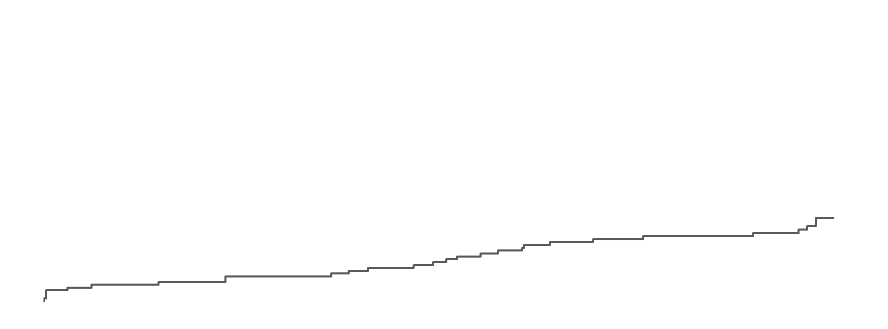
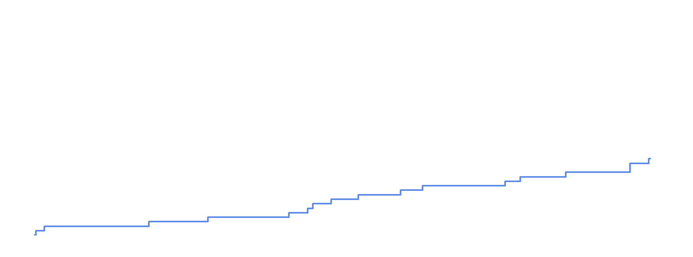
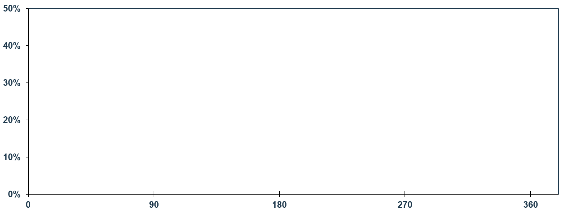
Cumulative Incidence: TLF (ITT)
SELUTION DEB 15.2% vs. SOC 13.5%
HR: 1.14 (0.69, 1.90)
Logrank p-value: 0.608
Cumulative TLF Rate (%)
Time Post-Procedure (days)
SELUTION DEB
SOC
# at risk
SELUTION DEB | 210 | 201 | 187 | 177 | 101
SOC | 208 | 197 | 190 | 175 | 109

Slide 20
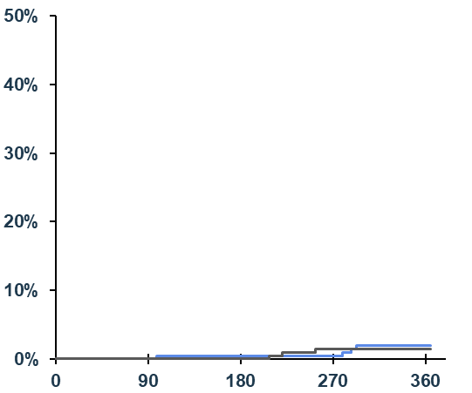
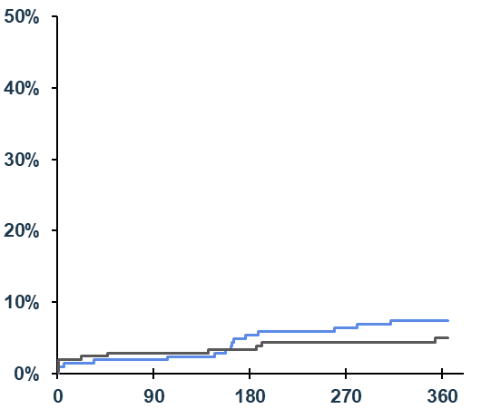
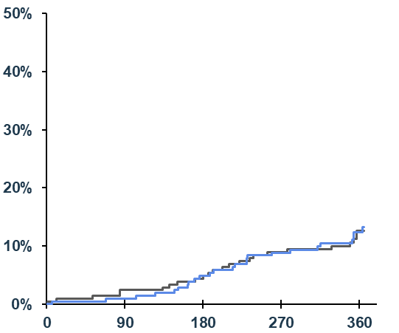
Cardiac Death, TV-MI, CD-TLR (ITT)
Cardiac Death
TV-MI
CD-TLR
SELUTION DEB 1.9% vs. SOC 1.4%
HR: 1.31 (0.29, 5.87)
Logrank p-value: 0.720
SELUTION DEB 7.1% vs. SOC 4.8%
HR: 1.50 (0.67, 3.34)
Logrank p-value: 0.318
SELUTION DEB 11.9% vs. SOC 11.5%
HR: 1.04 (0.59, 1.82)
Logrank p-value: 0.888
Cumulative Cardiac Death Rate (%)
Cumulative TV-MI Rate (%)
Cumulative CD-TLR-TRate (%)
Time Post-Procedure (days)
Time Post-Procedure (days)
Time Post-Procedure (days)
# at risk
SELUTION DEB | 210 | 207 | 202 | 199 | 122
SOC | 208 | 206 | 203 | 194 | 127
210 | 203 | 191 | 186 | 113
208 | 200 | 196 | 186 | 120
210 | 205 | 192 | 181 | 104
208 | 201 | 194 | 178 | 112
SELUTION DEB
SOC

Slide 21
Secondary and Safety Endpoints (ITT)
Endpoint | SELUTION DEB N = 210 | SOC N = 208
All-Cause Mortality, N (%) | 9 (4%) | 5 (2%)
Cardiac Death, N (%) | 4 (2%) | 3 (1%)
All Myocardial Infarction, N (%) | 17 (8%) | 13 (6%)
Target vessel MI, N (%) | 15 (7%) | 10 (5%)
Peri-procedural, N (%) | 2 (1%) | 4 (2%)
Post-procedure, N (%) | 13 (6%) | 7 (3%)
All TLR, N (%) | 27 (13%) | 26 (13%)
Clinically-driven TLR, N (%) | 25 (12%) | 24 (12%)
Stent (lesion) thrombosis N (%) | 4 (2%) | 4 (2%)
Definite, N (%) | 2 (1%) | 3 (1%)
Probable, N (%) | 2 (1%) | 1 (1%)
Bleeding (BARC 2-5), N (%) | 16 (8%) | 21 (10%)

Slide 22
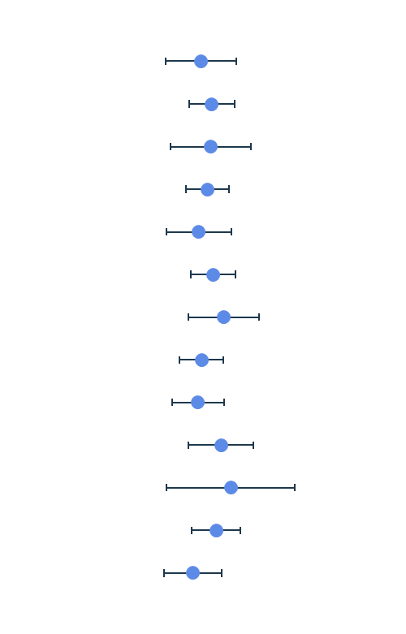
Subgroup Analysis – Forest Plot (ITT)
Subgroup |  | SELUTION DEB | SOC | Relative Risk Difference | RR (95% CI) | Interaction p-value
Age | >75 | 7/44 (16) | 10/60 (17) |  | 0.95 (0.39 – 2.31) | 0.632
 | <= 75 | 25/166 (15) | 18/148 (12) |  | 1.24 (0.7 – 2.18)
Sex | Female | 6/39 (15) | 7/55 (13) |  | 1.21 (0.44 – 3.32) | 0.882
 | Male | 26/171 (15) | 21/153 (14) |  | 1.11 (0.65 – 1.89)
Medical History of Diabetes | No Diabetes | 10/120 (8) | 11/119(9) |  | 0.9 (0.4 – 2.04) | 0.464
 | Diabetes | 22/90 (24) | 17/89 (19) |  | 1.28 (0.73 – 2.24)
Reference Vessel Diameter | > 2.75 | 11/67 (16) | 7/71 (10) |  | 1.67 (0.69 – 4.04) | 0.302
 | <= 2.75 | 21/143 (15) | 21/137 (15) |  | 0.96 (0.55 – 1.67)
Lesion Length | < 10mm | 14/93 (15) | 17/99 (17) |  | 0.88 (0.46 – 1.68) | 0.43
 | 10 - 20mm | 14/92 (15) | 8/82 (10) |  | 1.56 (0.69 – 3.53)
 | > 20 mm | 4/24 (17) | 2/24 (8) |  | 2 (0.4 – 9.91)
Number of Stent Layers | One | 22/167 (13) | 16/168 (10) |  | 1.38 (0.75 – 2.54) | 0.242
 | Two | 10/43 (23) | 12/40 (30) |  | 0.78 (0.38 – 1.59)
0.01
0.1
1
10
100
FAVORS SELUTION DEB
FAVORS SOC

Slide 23
TLF by Selected Randomization
 | Randomized to DES |  | Randomized to BA
 | SELUTION DEB N = 163 | DES N = 154 | SELUTION DEB N = 34 | BA N = 39
Target Lesion Failure, N (%) | 25 (15.3%) | 11 (7.1%) | 7 (20.6%) | 17 (43.6%)

Slide 24
Limitations
The 10% non-inferiority margin is high relative to the event rate and must be interpreted in context of clinical benefit (avoiding an additional stent layer)
Current results and interpretation are limited to 1 year follow-up and differences may emerge over time
Patients with more than 2 layers of previous stents were not included
Blended control group reflecting a contemporary standard of care in the United States

Slide 25
Conclusions
  SELUTION DEB is the first and only DEB to demonstrate non-inferiority against a SOC (including 80% DES) for the treatment of ISR
  SELUTION DEB is a safe and effective alternative to SOC (~80% DES and 20% BA) ISR treatment avoiding additional layers of stent
  The role of DEB versus DES for lifetime management of ISR will be studied through long-term follow-up

