Slide 1

Immediate Instantaneous Wave-Free Ratio Guided Versus Deferred Cardiac Magnetic Resonance Imaging Guided Revascularization of Non-Culprit Lesions in Patients with Acute STEMI
A Randomized Superiority Trial
Robin Nijveldt, MD, PhD and Niels van Royen, MD, PhD for the iMODERN investigators

Slide 2
Disclosure of Relevant Financial Relationships
Within the prior 24 months, I have had a financial relationship with a company producing, marketing, selling, re-selling, or distributing healthcare products used by or on patients:
Nature of Financial Relationship | Ineligible Company
Grant/Research Support | Philips Volcano, Biotronik
Consultant Fees/Honoraria | Pfizer, BMS, Sanofi, Daiichi Sankyo
Individual Stock(s)/Stock Options | none
Royalties/Patent Beneficiary | none
Executive Role/Ownership Interest | none
Other Financial Benefit | none
All relevant financial relationships have been mitigated.
Faculty disclosure information can be found on the app

Slide 3
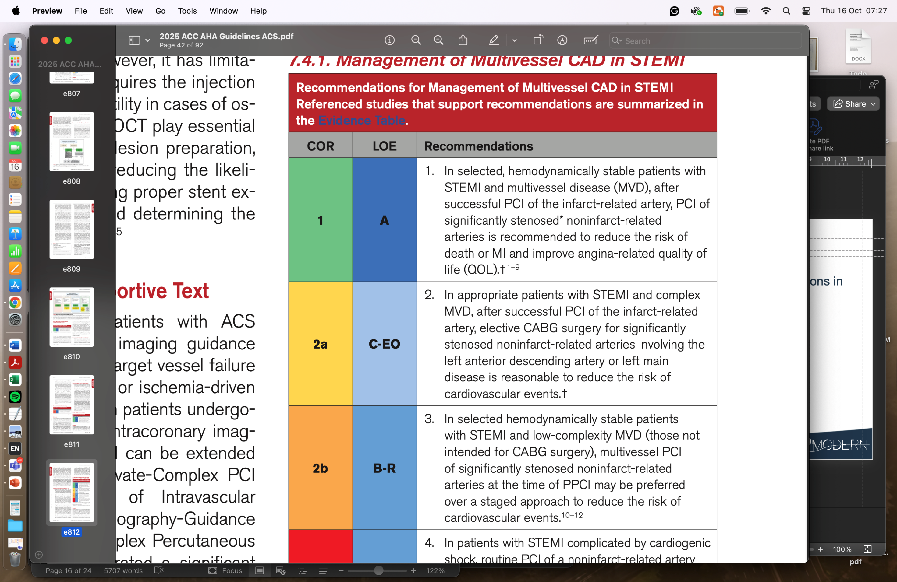
Background I
Guidelines recommend revascularization of non-culprit lesions in ST-segment elevation myocardial infarction (STEMI) and multivessel disease (2025 ACC/AHA/ACEP/NAEMSP/SCAI)
Notes:
2

Slide 4
Background II
Guidelines suggest performing non-culprit PCI during the initial revascularization procedure (2025 ACC/AHA/ACEP/NAEMSP/SCAI)
Notes:
3

Slide 5
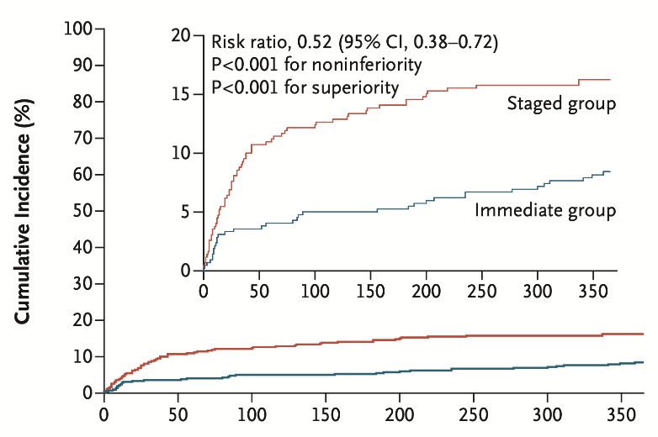
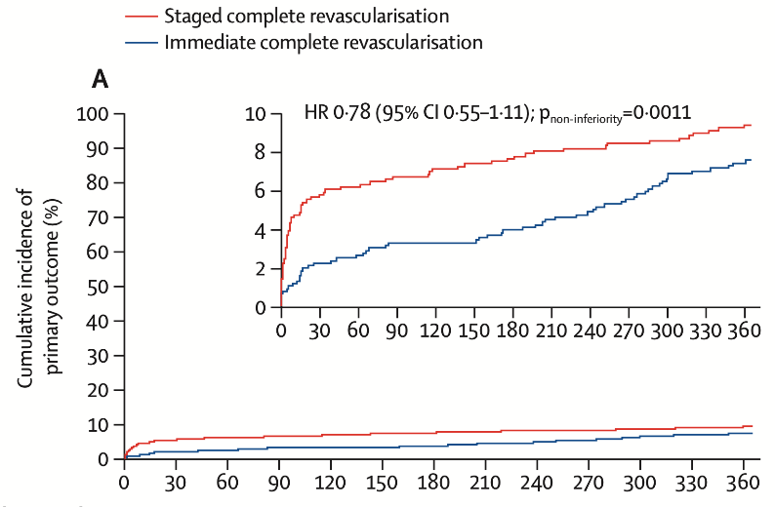
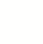
Background III
Noninferiority trials suggested preference for immediate, however:
benefit driven by unplanned revascularization in immediate non-culprit PCI
60% NSTEMI in BIOVASC, no difference at 24 months
n = 840
n = 1525
2023 NEJM Stähli et al. MULTISTARS AMI
2023 Lancet Diletti et al. BIOVASC
Notes:
4

Slide 6

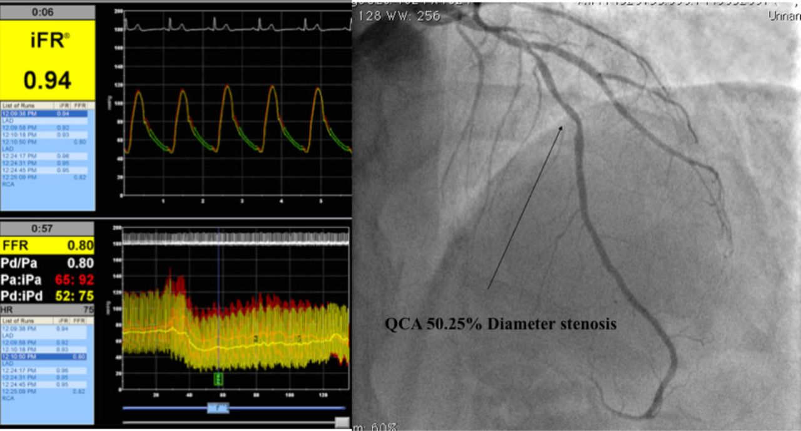
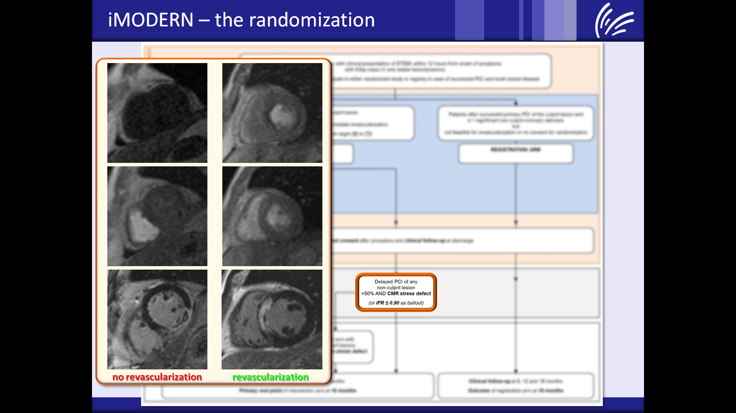
Aim
To compare immediate instantaneous wave-free ratio (iFR)-guided PCI with deferred CMR-guided PCI in STEMI and multivessel disease
immediate iFR-guided PCI
deferred CMR-guided PCI <6wks
3-year follow-up
Notes:
5

Slide 7

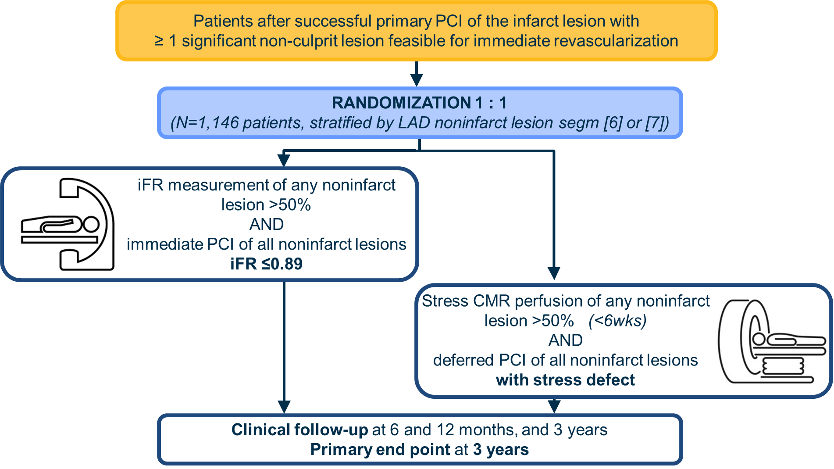
instantaneous wave-free ratio guided Multivessel revascularizatiOn During percutaneous coronary intervEntion for acute myocaRdial iNfarction
ClinicalTrials.gov number NCT03298659

Slide 8
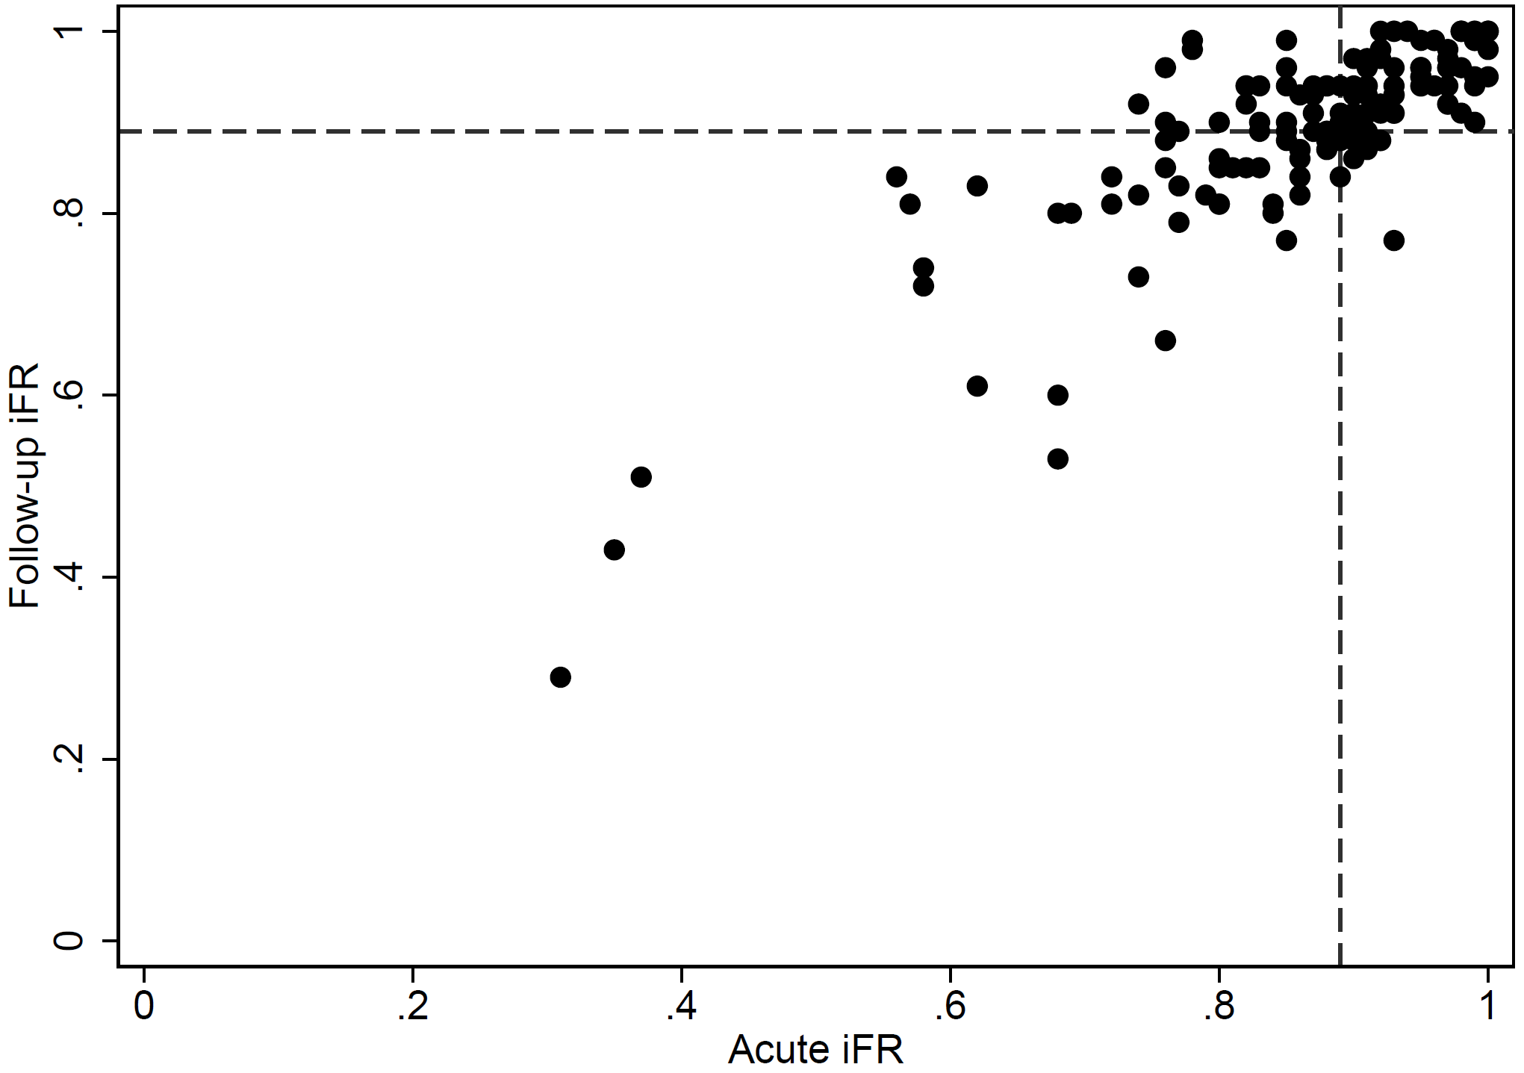
Methods I
iFR in STEMI:
iFR acute correlates well with stable phase, less symptoms/shorter procedure
FFR slightly understimates, iFR slightly overestimates
Thim et al. JACC int 2017
van der Hoeven et al. JAMA cardiol 2019
Notes:
7
No need for adenosine – less stenting compared to angiography guided

Slide 9
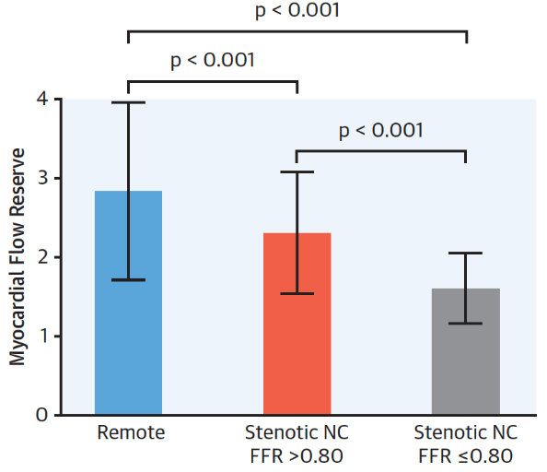
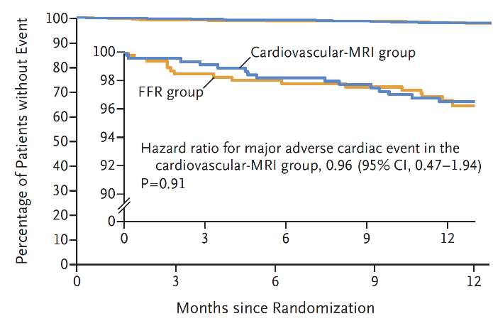
Methods II
CMR compared to physiology guidance:
CMR noninferior to FFR (MR-INFORM), 50% referral to angiography
Moderate-good agreement in non-culprit lesion assessment FFR/CMR
2019 N Engl J Med, Nagel et al. – MR INFORM
J Am Coll Cardiol Img, 2020, Everaars et al.
Notes:
8
Non-invasive apprach

Slide 10
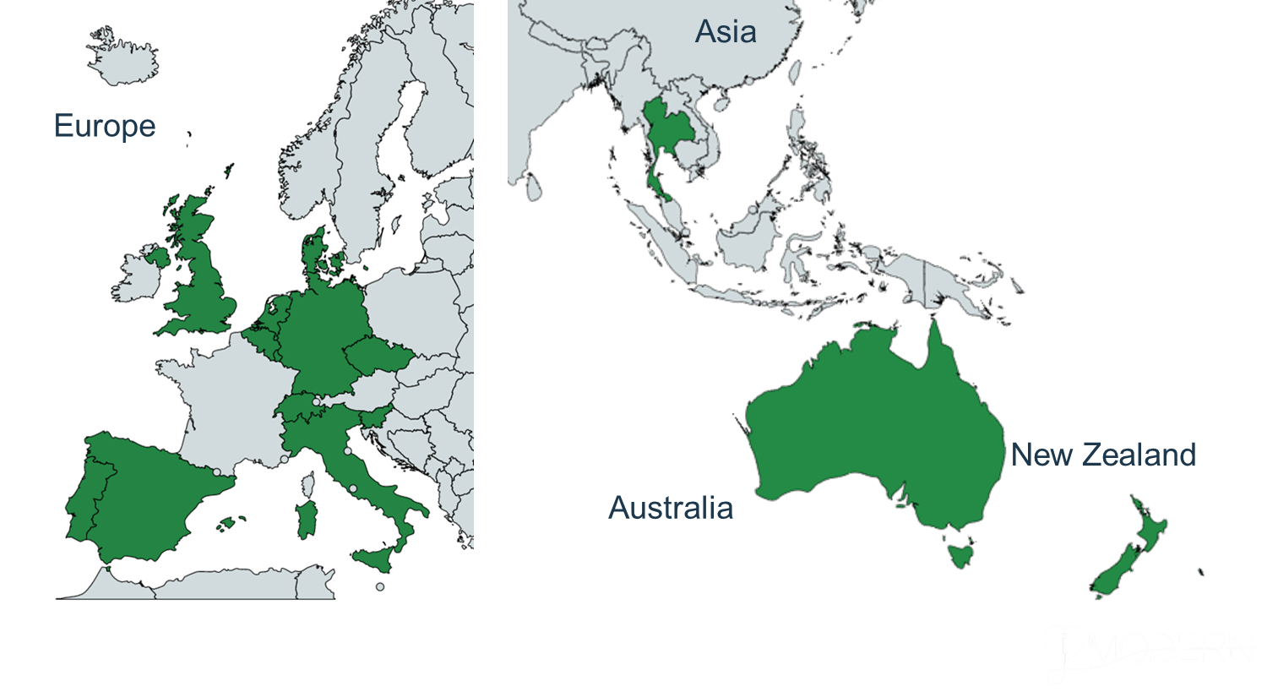
Participating Sites (41)
Belgium
UZ Gent
Spain
Hospital Clinico Universitario de Valencia
Hospital Clinico San Carlos
University Hospital Vall d’Hebron
Portugal
Centro Hospitalar de Lisboa Ocidental
Hospital Prof. Doutor Fernando Fonseca
University Hospital Santa Maria
Czech Republic
ICRC, St. Anne´s Faculty Hospital
Luxembourg
Centre Hospitalier de Luxembourg
Germany
Robert Bosch Hospital
Slovenia
UMC Ljubljana
Italy
IRCCS Humanitas
Clinica Polispecialistica San Carlo
Switzerland
Geneva University Hospitals
Kantonsspital Aarau
Kantonsspital St. Gallen
United Kingdom
Imperial NHS Trust
Freeman Hospital
Royal United Hospitals Bath
Essex Cardiothoracic Centre
Barts Health
University Hospitals Bristol
Manchester University Hospital
Australia
Royal North Shore And North Shore Private Hospitals
Alfred Health
New Zealand
Christchurch Hospital
Thailand
King Chulalongkorn Memorial Hospital
Ramathibodi Hospital
The Netherlands
Radboudumc
AmsterdamUMC
Tergooi Hospitals
Maastricht UMC
Zuyderland
Onze Lieve Vrouwe Gasthuis
Amphia Hospitals
Rijnstate Hospital
University Medical Center Groningen
Haaglanden MC
Treant Scheper Hospital
Canisius Wilhelmina Hospital
Denmark
Aarhus University Hospital
Notes:
9

Slide 11
iMODERN Investigators
Robin Nijveldt, Michael Maeng, Casper W.H. Beijnink, Jan J Piek, Rasha K. Al-Lamee, Luís Raposo, Sergio Bravo Baptista, Javier Escaned, Justin Davies, Igor Klem, Raymond Kim, Bahram Yosofi, Robert-Jan M. van Geuns, Christian A. Frederiksen, Lars Jakobsen, Abdelilah el Barzouhi, Dirk J. van der Heijden, Mustafa Ilhan, Saman Rasoul, Stijn Brinckman, Colette Saraber, Daniel A Jones, Steffen E. Petersen, Tomaž Podlesnikar, Matjaž Bunc, Marcel A.M. Beijk, Lieuwe H. Piers, Johannes B van Rees, Henry Seligman, Graham Cole, Juan F. Iglesias, Sophie Degrauwe, Arnoud van ’t Hof, Erik Lipsic, Gabija Pundziute-do Prado, Pairoj Chattranukulchai, Suphot Srimahachota, José F. Rodríguez-Palomares, Bruno Garcia del Blanco, Johannes Rigger, Lucas Joerg, Martijn Meuwissen, Mark Krouwels, Lennaert Kleijn, Rutger Anthonio, Antonio Ferreira, Bruno Pereira, Andrei Codreanu, Francois Philippe, Lorenzo Monti, Francesco Amata, René J. van der Schaaf, Loek van Heerebeek, Juan Sanchis, Maria Pilar Lopez-Lereu, Guido Belli, Jan G.P. Tijssen, Kare Tang, Swamy Gedela, Manish Motwani, Magdi El-Omar, Pedro Cardoso, Ana Almeida, Tobias Fuchs, Antony Walton, Shane Nanayakkara, Tom Johnson; Ana Bustos, Pavit Pienvichit, Tarinee Tangcharoen, Ravinay Bhindi, Rebecca Kozor, Daniel Devos, Benny Drieghe, Roman Panovský, Ota Hlinomaz, Vijay Kunadian, Adam McDiarmid, Aniket Puri, Ross Keenan, Peter Ong, Heiko Mahrholdt, Daniel Augustine, Dan McKenzie, Marc Gomes, Troels Thim, Niels van Royen Henk Everaars, Jacqueline L. Vos, Yvonne Koop, Lissa Gunsing, Niekbachsh Mohammadnia, Rick Volleberg, Paul F.A. Teunissen, Nikita van Zadelhof

Slide 12

Trial Organization
Executive Steering Committee
Rasha K. Al-Lamee, Sergio Baptista, Justin Davies, Javier Escaned, Michael Maeng, Robin Nijveldt, Jan J. Piek, Luis Raposo, Niels van Royen, Troels Thim
Contract Research Organization
Data Safety Monitoring Board
Stefan James, Frank Rademakers, Jan G.P. Tijssen (chair)
Clinical Events Committee
Pankaj Garg, Karim Al-Azizi, Alexander Rothman, William Gray, Menko-Jan de Boer
Core Laboratories
Duke Cardiovascular Magnetic Resonance Center, Durham, USA
Mycardium AI Ltd, Liverpool, UK
Cerebria Physiology Core Laboratory, UK
Notes:
11
Non-invasive apprach

Slide 13
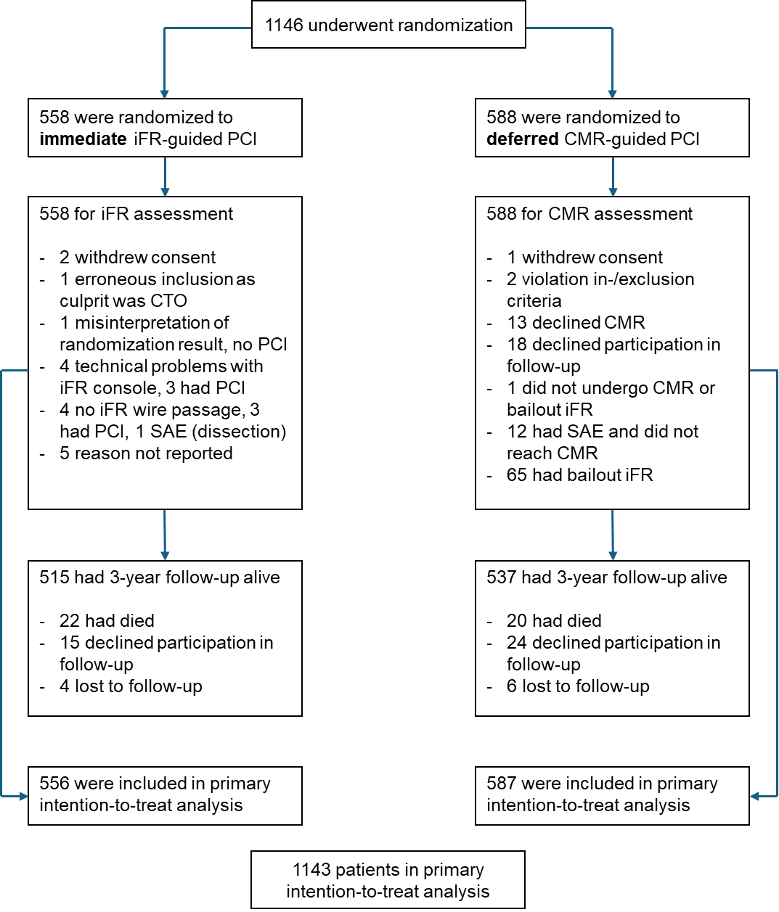
Consort Diagram

Slide 14
Baseline Characteristics
 | direct iFR n = 556 | deferred CMR n = 587
Male | 77.8 | 77.6
Age (years) | 63 ± 11 | 63 ± 11
Body Mass Index | 27.4 ± 4.5 | 27.2 ± 4.3
Obesity (%) | 26.1 | 20.6
Hypertension (%) | 69.2 | 63.8
Diabetes Mellitus (%) | 13.2 | 15.4
Smoking History (%) | 25.0 | 23.0
History of stroke (%) | 2.9 | 2.7
eGFR <60 (%) | 10.1 | 9.7
COPD (%) | 4.7 | 5.0
LV dysfunction (%) | 83 | 84

Slide 15
Procedural Characteristics
 | direct iFR n = 556 | deferred CMR n = 587
Culprit LAD (%) | 41.9 | 37.2
Culprit RCx (%) | 18.0 | 17.5
Culprit RCA (%) | 40.1 | 45.2
Non-culprit lesion per patient | 1.4 ± 0.6 | 1.5 ± 0.8
Residual SYNTAX score | 6.9 ± 4.3 | 7.1 ± 4.7
Patients with positive non-culprit lesion (%) | 43.7 | 21.8
Patients with PCI of positive lesion (%) | 42.6 | 18.7
Type A non-culprit lesion (%) | 10 | 14
Type B1 non-culprit lesion (%) | 42 | 41
Type B2 non-culprit lesion (%) | 20 | 18
Type C non-culprit lesion (%) | 28 | 27
Time to non-culprit C+NC PCI (days) | 0.0 | 40 (28 - 58)
Total procedural time C+NC (minutes) | 75.4 ± 33.3 | 90.0 ± 43.7
Total Stent length all (mm) | 48.7 ± 29.7 | 42.1 ± 27.7

Slide 16
Primary End Point
100
80
100
Composite of
all-cause death
recurrent MI
hospitalization for heart failure
60
9.8%
Percentage of patients without MACE
90
9.3%
40
iFR
CMR
HR 0.95 (95% CI 0.65-1.40) P = 0.8073
80
20
0
180
360
540
720
900
1080
0
0
90
180
270
360
450
540
630
720
810
900
990
1080
Time after index procedure (days)
No. at risk
iFR
CMR
556
588
530
552
525
545
519
541
516
538
508
535
506
532
504
530
501
528
498
522
494
513
490
512
479
497

Slide 17
Primary End Point Components
100
100
100
90
90
90
iFR
CMR
HR 1.04 (95% CI 0.58-1.88)
iFR
CMR
HR 0.98 (95% CI 0.59-1.63)
iFR
CMR
HR 0.24 (95% CI 0.07-0.84)
80
80
80
0
180
360
540
720
900
1080
0
180
360
540
720
900
1080
0
180
360
540
720
900
1080
All-cause death
Recurrent MI
HF hospitalization

Slide 18
Unplanned Revascularization
100
iFR
CMR
HR 1.02 (95% CI 0.68-1.55)
80
60
40
20
0
0
90
180
270
360
450
540
630
720
810
900
990
1080
No. at risk
iFR
CMR
556
587
527
553
520
542
513
536
509
532
Time after index procedure (days)
499
524
496
519
494
516
492
516
488
511
484
505
479
503
468
487

Slide 19
Secondary Outcomes
 | direct iFR n = 556 | deferred CMR n = 587 | Hazard Ratio (95% CI)
Composite (all-cause-death, MI, HF) 6mo | 4.0% | 4.4% | 0.92 (0.52, 1.63)
All-cause Death 6mo | 1.3% | 1.9% | 0.66 (0.26, 1.71)
Recurrent MI 6mo | 2.6% | 1.7% | 1.47 (0.65, 3.31)
Hospitalization for Heart Failure 6mo | 0.4% | 1.6% | 0.23 (0.05, 1.07)
Cardiac Death 3yr | 1.9% | 2.0% | 0.95 (0.40, 2.23)
Target Lesion Failure 3yr | 10.2% | 10.5% | 0.98 (0.67, 1.41)
Stroke 3yr | 1.0% | 2.1% | *
Transient Ischemic Attack 3yr | 0.3% | 1.45 | *
Major Bleeding 3yr | 1.9% | 1.1% | 1.73 (0.63, 4.75)
Unstable Angina 3yr | 3.3% | 3.9% | 0.84 (0.44, 1.59)
Stent Thrombosis 3yr | 9 (1.7) | 3 (0.6) | 3.11 (0.84, 11.49)
Notes:
For TIA and stroke, the proportional hazards assumptions were not met

Slide 20
As-Treated Analysis
 | direct iFR n = 610 | deferred CMR n = 472 | Hazard Ratio (95% CI)
Composite (all-cause-death, MI, HF) | 9.1% | 7.8% | 1.15 (0.75, 1.76)
All-cause Death | 3.9% | 2.2% | 1.61 (0.75, 3.44)
Recurrent MI | 5.4% | 5.2% | 1.08 (0.64, 1.84)
Hospitalization for Heart Failure | 0.7% | 1.7% | 0.43 (0.13, 1.43)
iFR-guided PCI, regardless of timing PCI, compared with all patients undergoing CMR-guided PCI
Notes:
all patients undergoing iFR-guided PCI, regardless of the timing of the intervention, were compared with all patients undergoing CMR-guided PCI

Slide 21
Per-Protocol Analysis
 | direct iFR n = 514 | deferred CMR n = 397 | Hazard Ratio (95% CI)
Composite (all-cause-death, MI, HF) | 9.3% | 8.8% | 1.03 (0.66, 1.61)
All-cause Death | 4.0% | 2.6% | 1.44 (0.66, 3.12)
Recurrent MI | 5.4% | 5.7% | 0.98 (0.55, 1.72)
Hospitalization for Heart Failure | 0.6% | 2.1% | 0.32 (0.08, 1.20)
iFR-guided PCI: PCI <24hrs + immediate PCI for lesions with >90% stenosis, PCI in iFR-positive, and no PCI in iFR-negative
CMR-guided PCI: CMR < 6wks + PCI if positive CMR, or no PCI if negative CMR
Notes:
the iFR-guided PCI group included: patients who underwent immediate PCI for lesions with >90% stenosis, iFR-positive patients who received PCI, and iFR-negative patients who did not receive PCI; PCI was performed within 24 hours;
CMR-guided PCI group, which included patients who underwent CMR within 6 weeks and received PCI if the CMR result was positive, or did not receive PCI if the CMR result was negative.

Slide 22
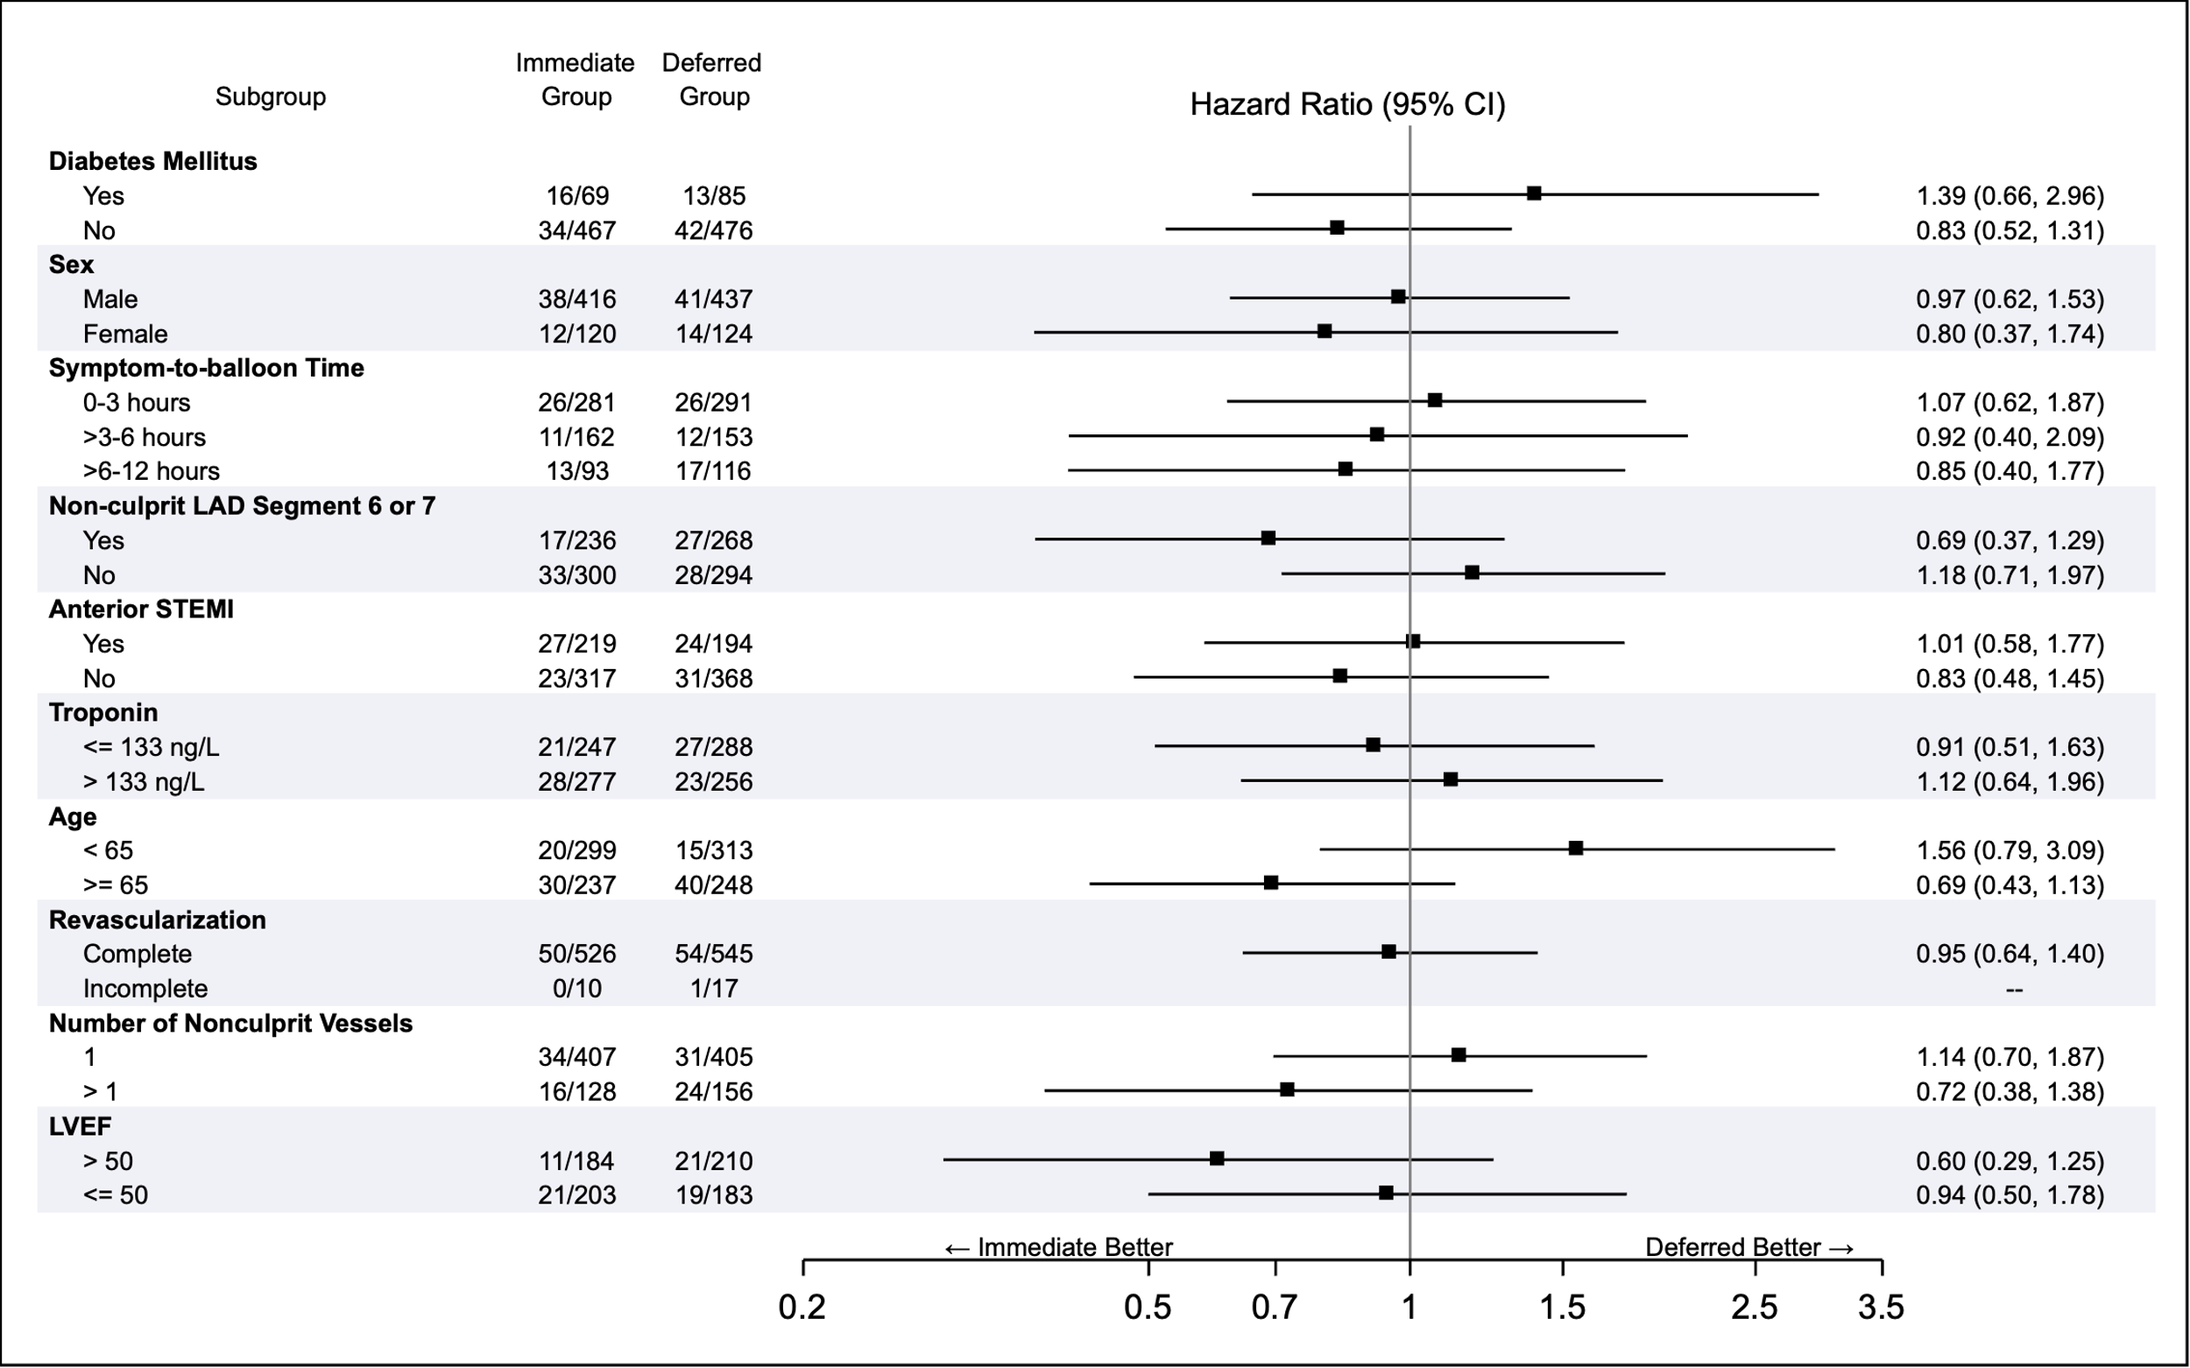
Subgroup Analysis

Slide 23
Conclusion
The iMODERN trial showed that immediate iFR-guided PCI was not superior to deferred stress MRI-guided PCI of non-culprit lesions for the composite endpoint
(all-cause death, recurrent MI, and hospitalization for heart failure at 3 years)
in patients with STEMI and multivessel disease
Notes:
22

