Slide 1
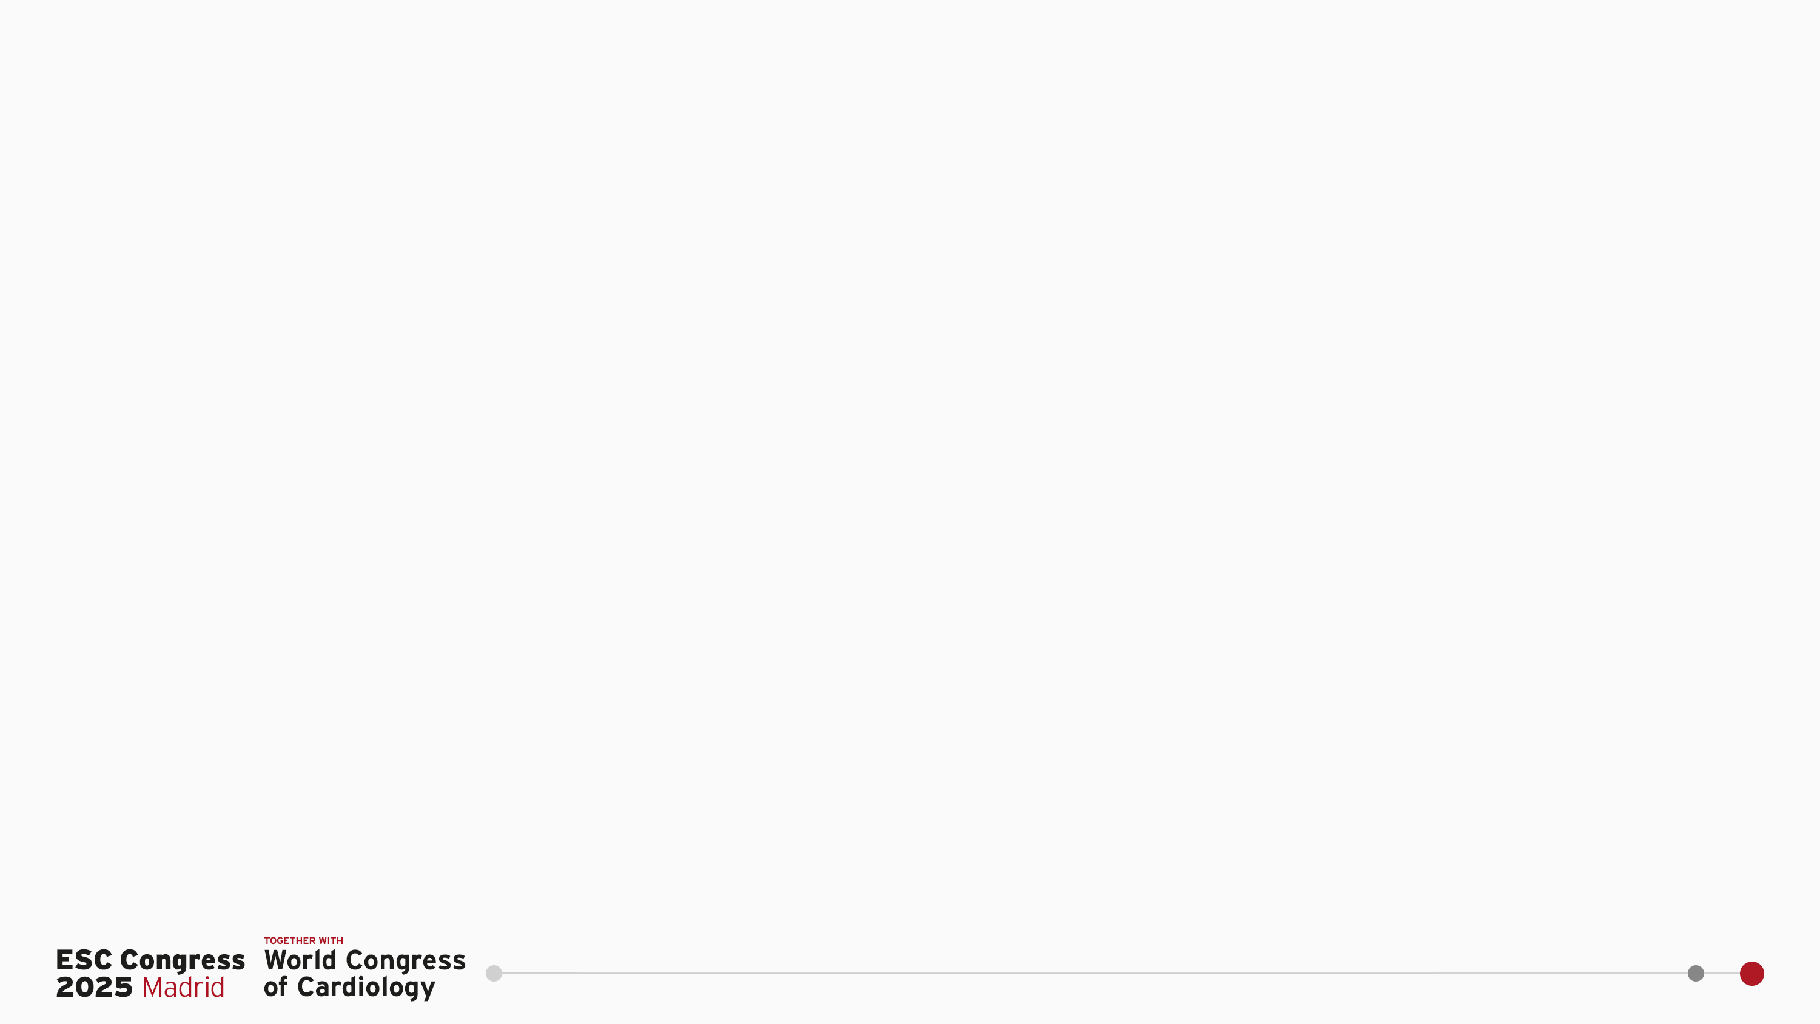


Prevention And Reduction of Adverse outcomes in Chagasic Heart failUre Trial Evaluation: The PARACHUTE-HF Trial
Renato D. Lopes, MD, PhD
on behalf of the PARACHUTE-HF Investigators

Slide 2
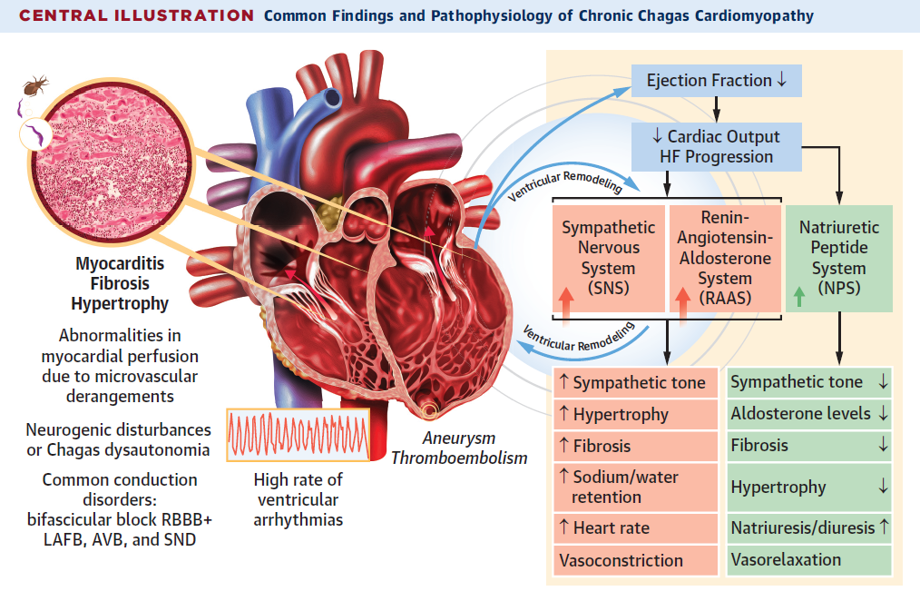
Heart failure caused by Chagas disease has unique characteristics, higher mortality rates and no evidence-based treatment
Lower prevalence of hypertension and diabetes¹
Worse health-related quality of life¹
Higher prevalence of prior stroke and pacemaker implantation¹
Higher hospitalization and mortality rates compared to other heart failure etiologies¹⁻⁵
No clinical trial evidence to guide treatment⁶
Bocchi EA, et al. J Am Coll Cardiol HF. 2024; 12 (8), 1473-1486
1. Shen L, et al. Circ Heart Fail. 2017; 10(11):e004361; 2. Vilas Boas LGC et al. 2013; International Journal of Cardiology 167, 86–490;
3. Nunes MC, et al. Rev Esp Cardiol. 2010; Jul;63(7):788-97. 4. Bestetti RA, et al. Int J Cardiol. 2013;168:2990–2991;
5. Issa VS, et al. Circ Heart Fail. 2010;3:82–88; 6. Bocchi EA, et al. J Am Coll Cardiol. 2017;70: 1510-1524.

Slide 3



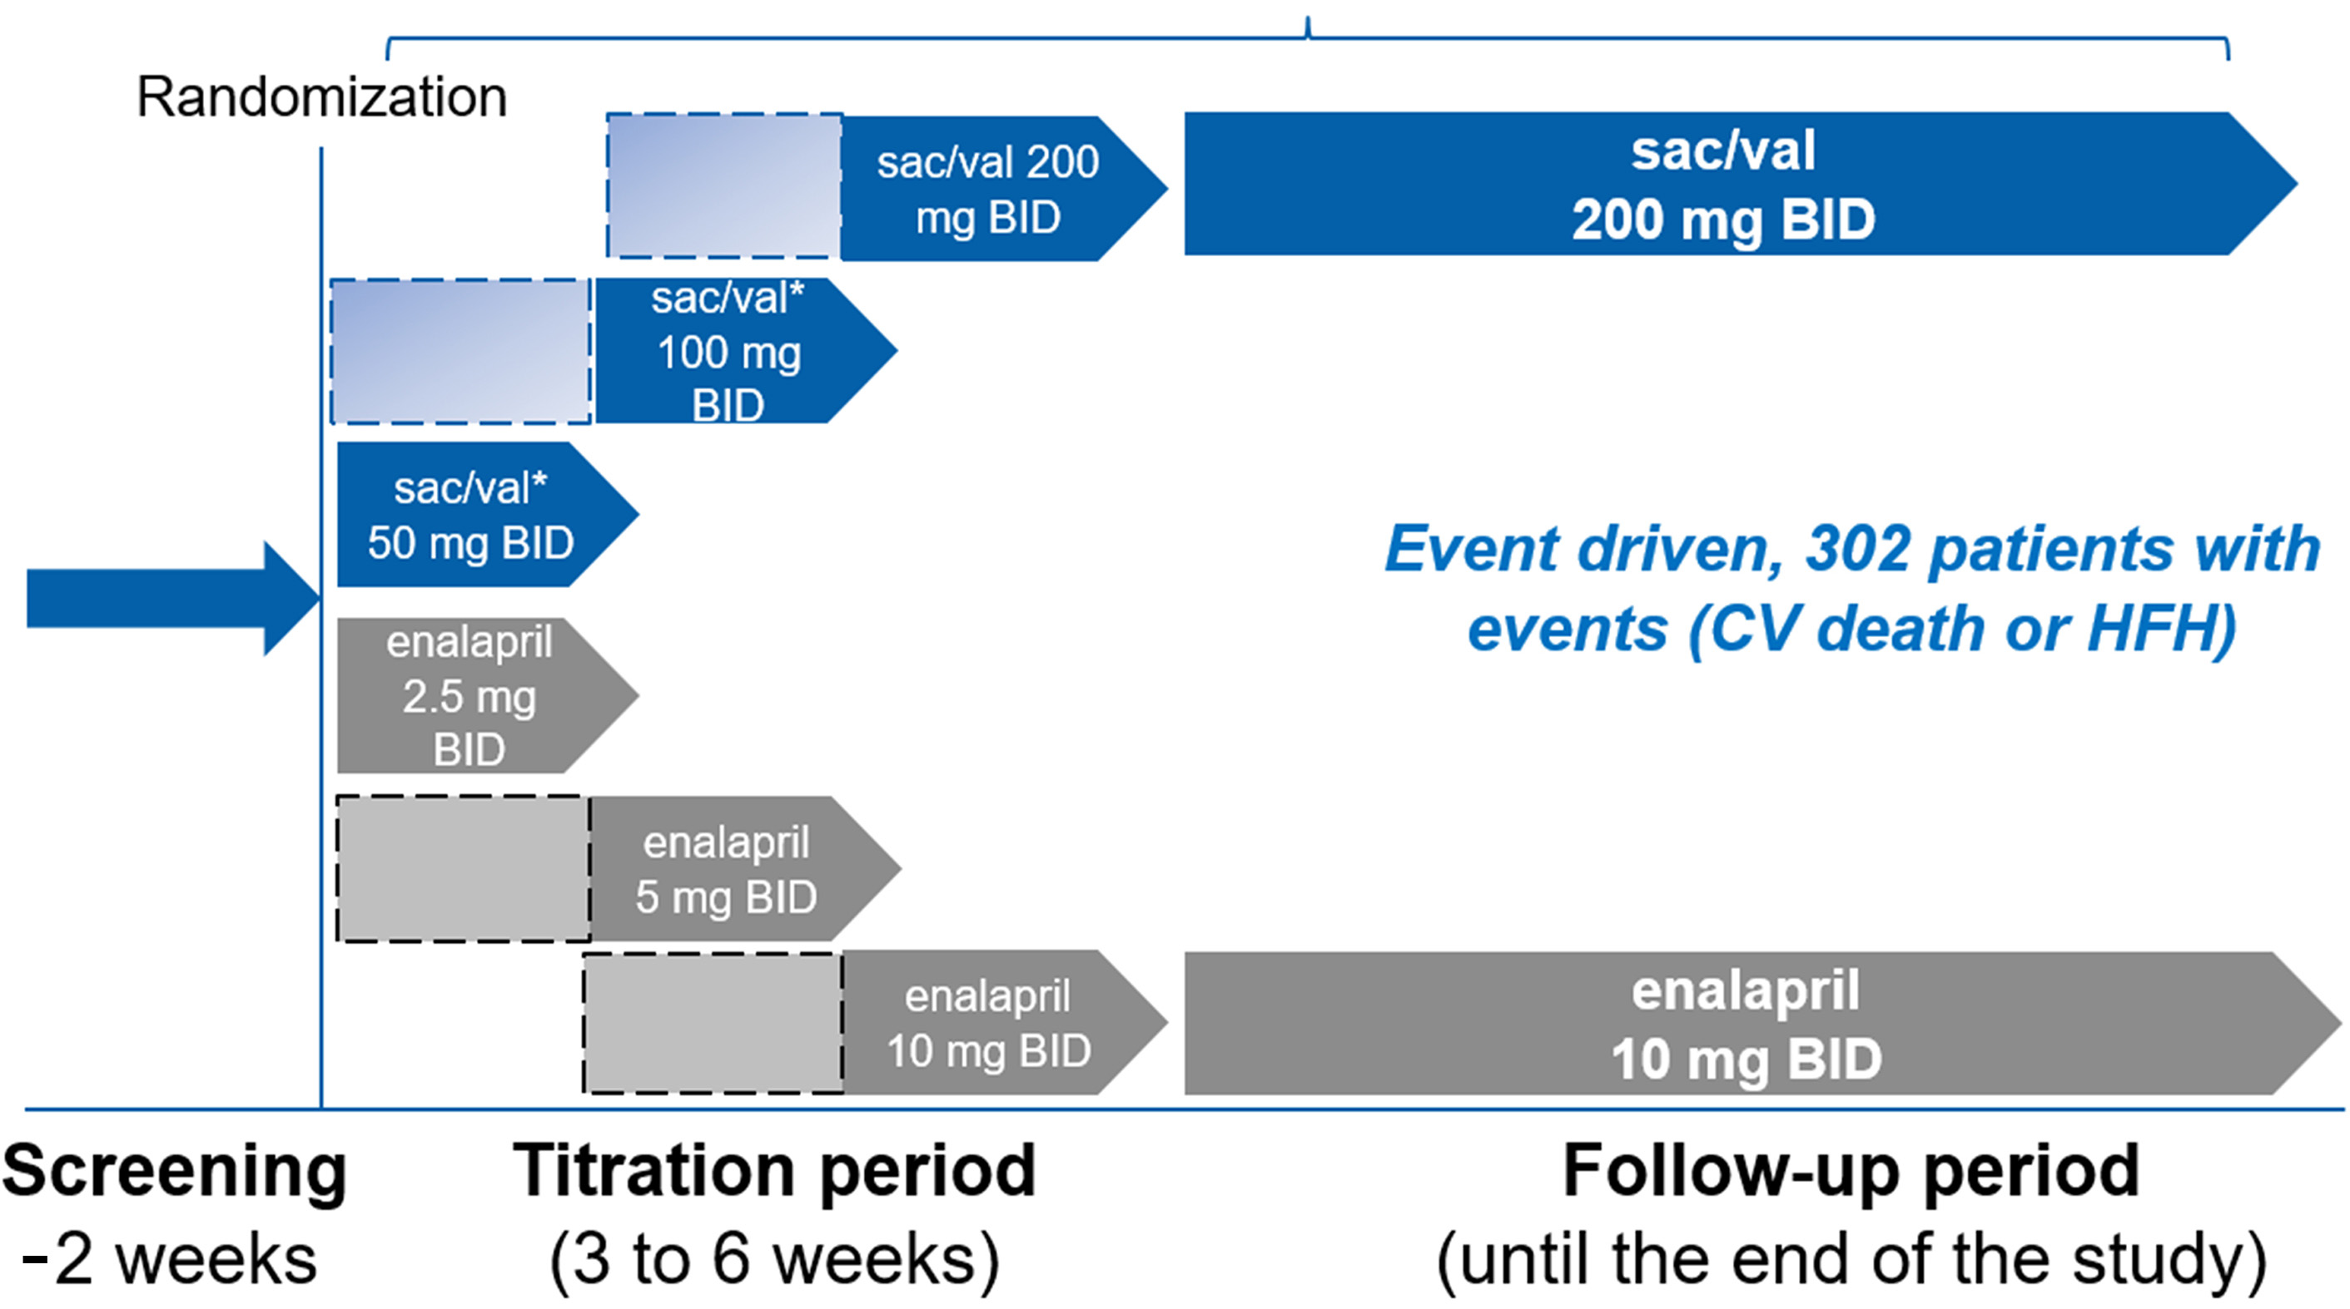
PARACHUTE-HF Trial
Prospective Randomized Open-label Blinded Endpoint PROBE Design
To evaluate the effect of sacubitril/valsartan compared with enalapril in improving a hierarchical composite endpoint including CV death, first HF hospitalization, and reduction in NT-proBNP at Week 12 in participants with heart failure with reduced ejection fraction caused by Chagas disease
Bocchi EA, et al. J Am Coll Cardiol HF. 2024; 12 (8), 1473-1486

Slide 4
Primary objective: To assess superiority of sacubitril/valsartan
vs enalapril in improving a composite hierarchical endpoint
Primary Endpoint: Hierarchically ordered composite endpoint comprising:
Time to CV death
Time to first HF hospitalization
Relative change in NT-proBNP from baseline to Week 12
For each pair comparison:
1
Time to CV death
If there is no winner
2
Time to first HFH
If there is no winner
3
Relative NT-proBNP change at week 12
Winner based on NT-proBNP levels change = more reduction or less increase
To have a winner, the week 12/baseline ratio needs to differ by more than 25% between two participants
Bocchi EA, Echeverria L, Demacq C et al. J Am Coll Cardiol HF. 2024; 12 (8), 1473-1486
4

Slide 5
*Total wins (%) are presented using the unstratified, unmatched win ratio, however, win ratios were derived using Dong’s method stratified by country. CV, cardiovascular; HF, heart failure; NT-proBNP, N-terminal pro–B-type Natriuretic Peptide
212,520 comparisons were made by
pairing participants from each group
Primary endpoint
Sacubitril/Valsartan
Wins
Enalapril
Wins
Win
Difference
Ties
Death due to
CV cause
18.3%
64.2%
17.5%
0.8%
+
Hospitalization
due to HF
7.7%
49.6%
6.9%
0.8%
+
NT-proBNP change at
12 weeks
22.5%
19.9%
7.2%
15.3%
OVERALL WINS
48.5%
31.6%
16.9 %
Stratified Unmatched Win Ratio* [95% CI]: 1.52 [1.28-1.82], p<0.001

Slide 6
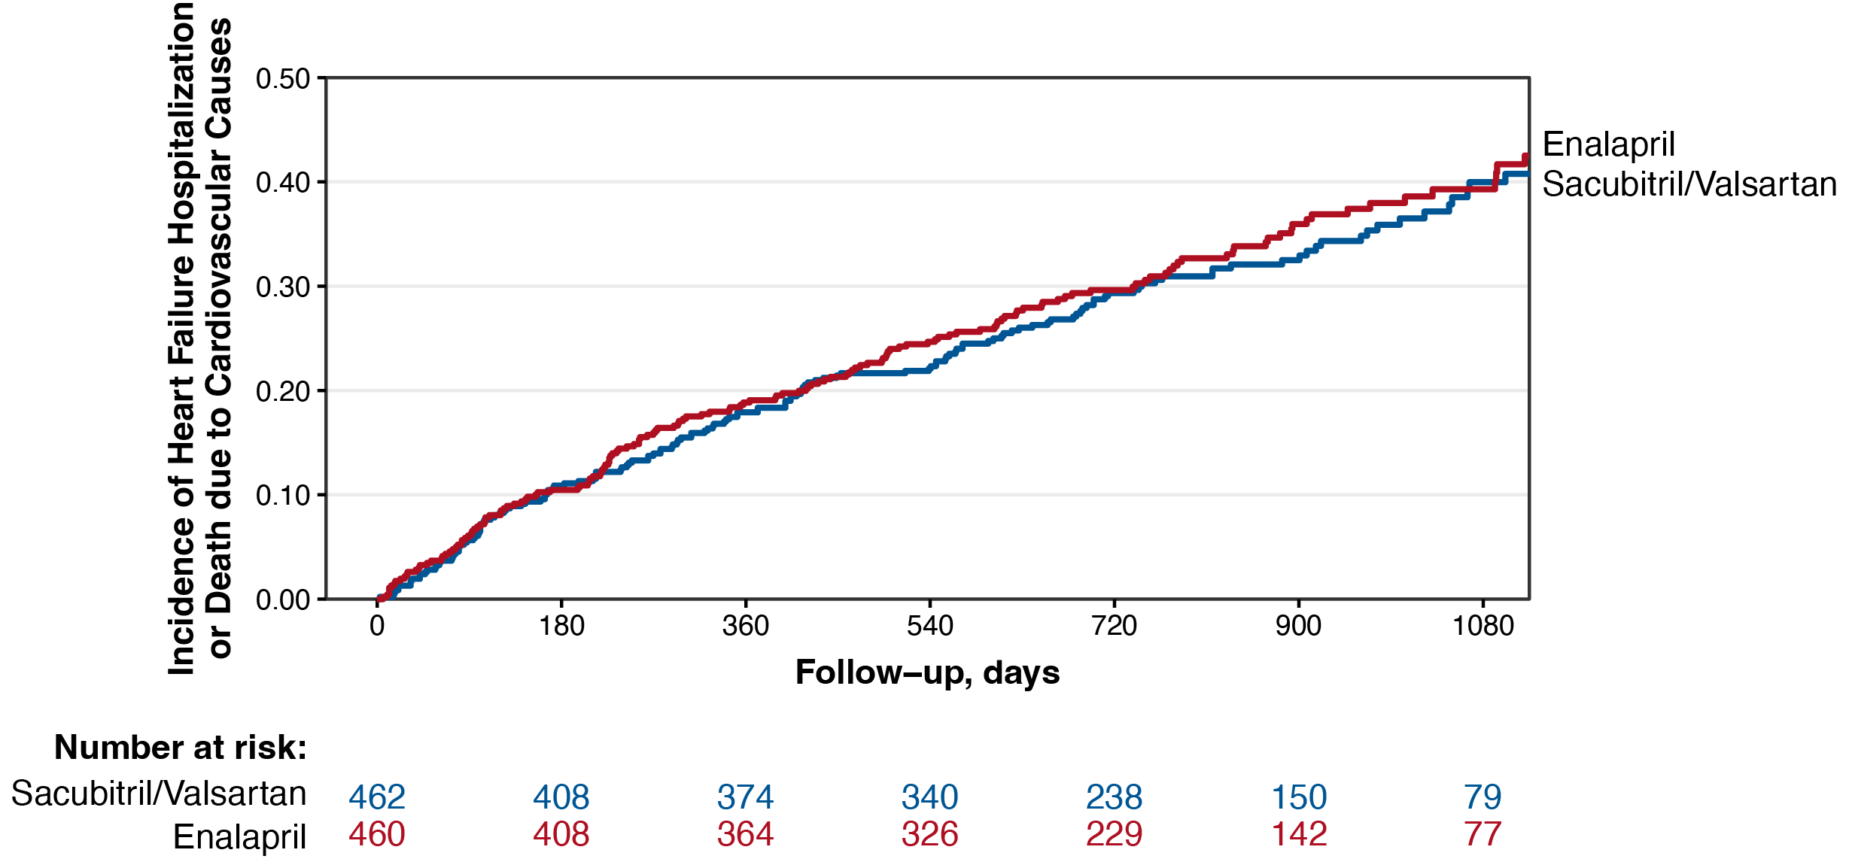
CV death or HF hospitalization
HR = 0.91 [0.73, 1.13]
Enalapril
Sacubitril/Valsartan

Slide 7
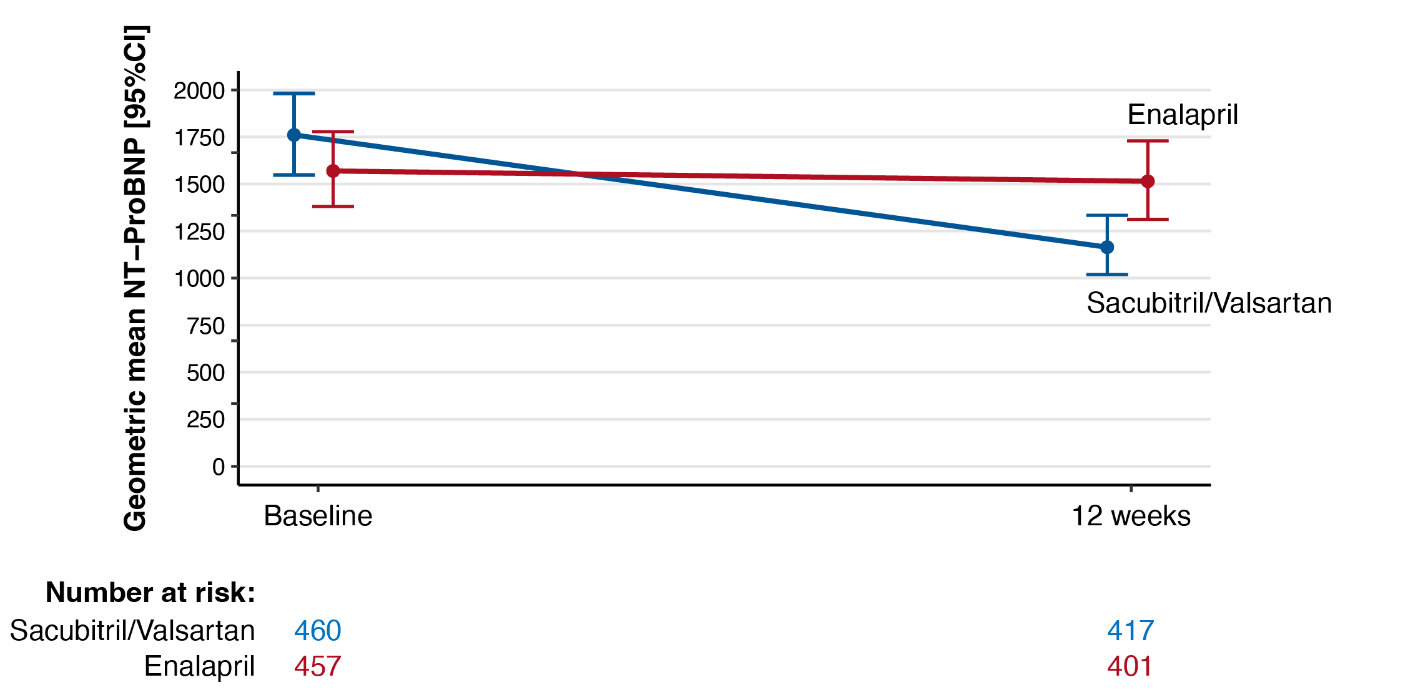
NT-proBNP geometric mean at baseline and 12 weeks
Ratio of adjusted Geometric
Mean change (95%CI):
0.68 (0.62, 0.75)

Slide 8
Summary
EFFICACY
In patients with HFrEF caused by Chagas disease:
Sacubitril/valsartan was superior to enalapril with respect to the hierarchical composite endpoint of cardiovascular death, hospitalization for heart failure, or relative change in NT-proBNP.
These results were primarily driven by a reduction of 32% in the adjusted geometric mean of NT-proBNP levels at week 12.
SAFETY
Sacubitril/valsartan was well tolerated with no new safety findings identified.
LIMITATIONS
Open-label design;
Relatively early (12 weeks) measurement of NT-proBNP.
CV, cardiovascular; HF, heart failure; HFrEF, heart failure with reduced ejection fraction;
NT-proBNP, N-terminal pro–B-type Natriuretic Peptide

