Slide 1



European Society of Cardiology, Late Breaking Science, August 29, Budapest Hall 10
Inflammation and Immune Biomarkers in Cardiovascular Risk Prediction
hsCRP and Long-Term Cardiovascular Outcomes Among 12,530 Women with No Standard Modifiable Risk Factors:
A Primary Prevention Study of the “SMuRF-Less but Inflamed”
Paul Ridker, Gemma Figtree, Vinayaga Moorthy, Samia Mora, Julie E Buring

Slide 2
Conflicts of Interest:
Dr. Ridker has received investigator-initiated research grants from
Kowa, Pfizer, AstraZeneca, Novo Nordisk, NHLBI, NCI
Dr. Ridker has served as a consultant to Agepha, Novartis, Arrowhead, AstraZeneca, CSL Behring, SOCAR, Novo Nordisk, Eli Lilly, New Amsterdam, Cardio Therapeutics, Caristo, Merck, Nodthera, Pfizer, NHLBI, Angiowave, Tourmaline Bio.
Dr Ridker serves on the Peter Munk Advisory Board (University of Toronto), the Leducq Foundation (Paris FR), and the Baim Institute Board (Boston, MA).

Slide 3


Introducing a New Clinical Syndrome “SMuRF-Less but Inflamed”
“SMuRFs” = Standard Modifiable Risk Factors
“SMuRF-Less” = No Standard Modifiable Risk Factors
“SMuRF-Less but Inflamed” = SMuRF-Less + Elevated hsCRP
+ hsCRP
“SMuRFs”
“SMuRF-Less”
“SMuRF-Less but Inflamed”
Ridker ESC Madrid 2025

Slide 4
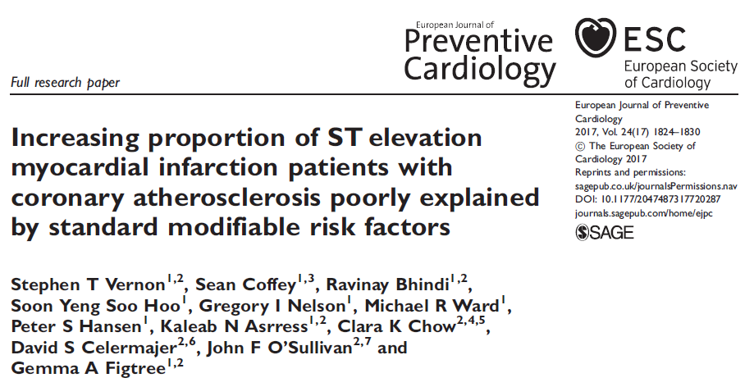
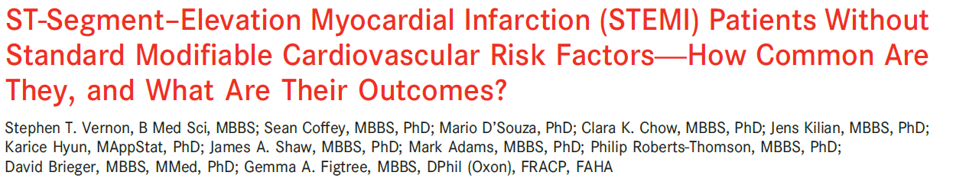
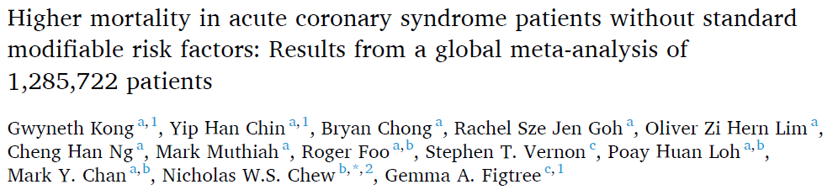
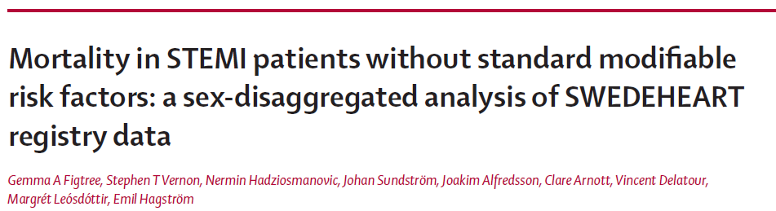
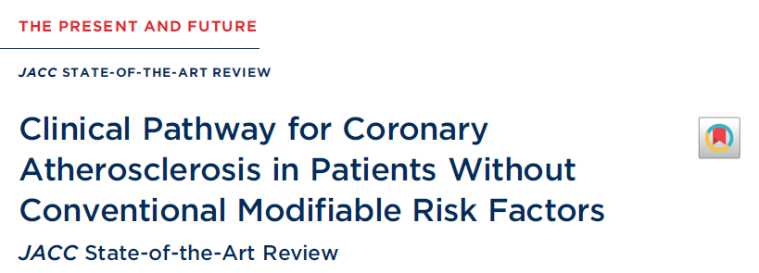
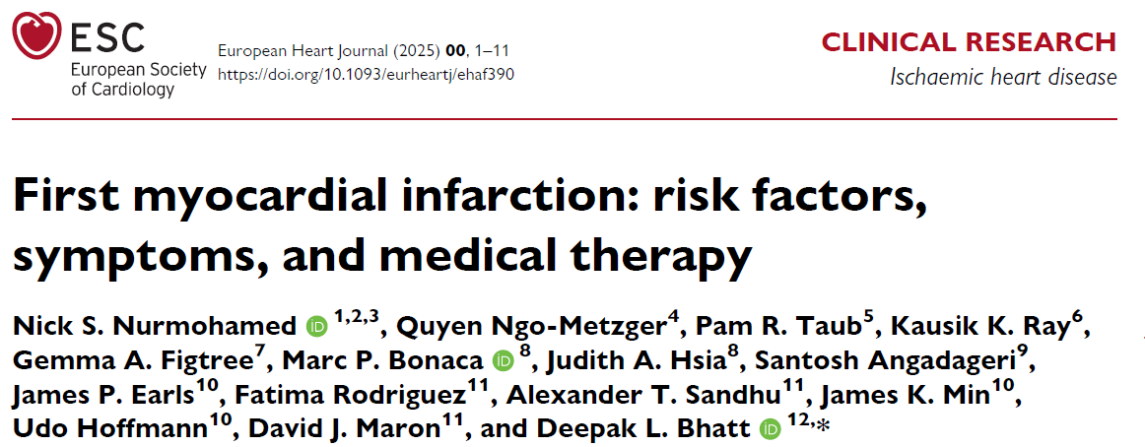
Patients with No Standard Modifiable Risk Factors are Important in Secondary Prevention:
“SMuRF-Less” Patients Suffering MI are Common, Have Increased Mortality, and are Disproportionately Women
J Am Heart Assoc. 2019;8:e013296
Eur J Prev Cardiol 201724:1824-30.
Lancet 2021; 397: 1085–94
Int J Cardiol. 2023;371:432–440.
Ridker ESC Madrid 2025
Eur Heart J 2025 doi.org/10.1093
J Am Coll Cardiol 2023;82:1343–135

Slide 5
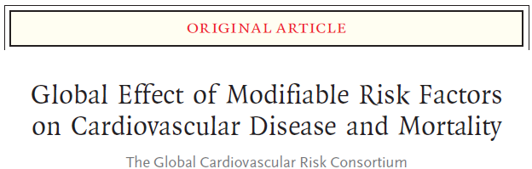
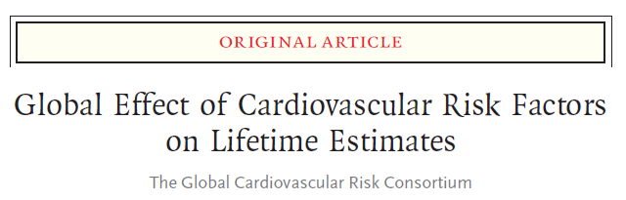
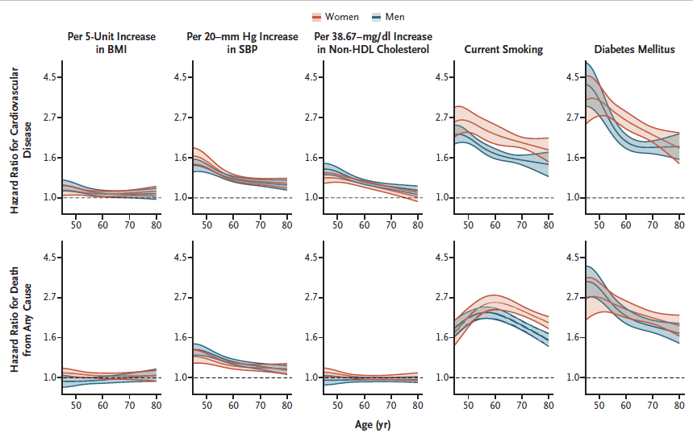
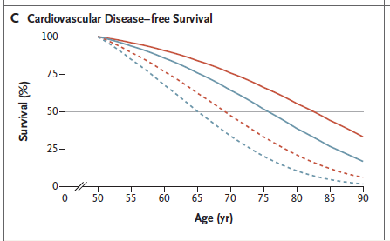

How Important are the SMuRF-Less in Primary Prevention?
N Engl J Med 2023;389:1273-85
N Engl J Med 2025;393:125-138
No Classic Risk Factors
Men
Women
All 5 Classic
Risk Factors
Standard modifiable risk factors account for approximately half of the global burden of cardiovascular disease.
Among participants who had none of the classic risk factors, the
lifetime risk of cardiovascular disease remained substantial.
Ridker ESC Madrid 2025
What biology is driving risk for the other half?

Slide 6
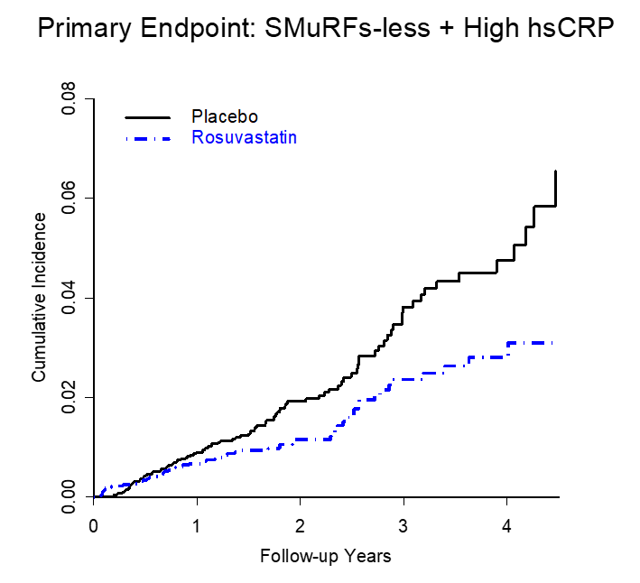
Statin Therapy for the “SMuRF-Less but Inflamed”
Cardiovascular outcomes in the primary prevention JUPITER trial among 8,278 individuals with none of the Standard Modifiable Risk Factors (SMuRFs), adjusted for body mass index and eGFR.
“SMuRF-Less
but Inflamed”
Endpoint | Relative Risk Reduction (%)* | HR * (95%CI)*
Primary Endpoint | 38 % | 0.62 (0.45 – 0.85)
MI | 69 % | 0.31 (0.15 – 0.66)
Stroke | 47 % | 0.53 (0.25 – 1.09
Revascularization | 39 % | 0.61 (0.40 – 0.93)
N = 8,278
*Adjusted for BMI and eGFR
Ridker PM. JACC : Basic Trans Sci 2025 (August 10)
https://doi.org/10.1016/j.jacbts.2025.101318
Ridker ESC Madrid 2025

Slide 7
Hypothesis and Methods: The “SMuRF-Less” Women’s Health Study
We hypothesized that a single baseline measure of hsCRP obtained in mid-life could predict future cardiovascular risk in apparently healthy SMuRF-Less women with no standard modifiable risk factors.
By recent consensus statement (Figtree et al, J Am Coll Cardiol 2023;82:1343–1359), SMuRFs have been defined as having BP < 140/90, LDL-C < 135 mg/dL, no evidence of diabetes, and do not smoke.
We addressed these issues in the NIH-funded Women’s Health Study (WHS^{)1,2,} a prospective cohort which included 12,530 initially healthy SMuRF-Less American women who had hsCRP measured in a blood sample obtained at baseline and who have been followed by our research group for a period of 30 years for centrally adjudicated incident cardiovascular events inclusive of myocardial infarction, coronary revascularization procedures, ischemic stroke, and cardiovascular death.
HL043851, HL080467, and HL099355, CA047988 and CA182913
NEJM 2005;352:1293-1304
JAMA 2005;294:56-65
Ridker ESC Madrid 2025

Slide 8
hsCRP Analysis and Statistical Analysis Plan
hsCRP assayed with a validated high sensitivity assay (Denka Seikan)
Following recent consensus statement (Figtree et al, J Am Coll Cardiol 2023;82:1343–1359), “SMuRF-Less” was
initially defined as BP < 140/90, LDL-C < 135 mg/dL, no evidence of diabetes, and no history of smoking.
We further performed sensitivity analyses using alternative BP thresholds of < 130/80 and LDL-C < 100 mg/dL,
and we performed additional analyses where values for BP and LDL-C were entered as continuous variables
30-year Hazard Ratios (HR) for incident ischemic stroke, CHD, and total CVD events were assessed across
increasing quintiles of hsCRP and using common clinical thresholds for hsCRP (<1, 1 to 3, and > 3 mg/L)
in Cox proportional hazards models, adjusted for age (years), BMI (kg/m2), and eGFR (ml/min/1.73m2).
30-year cumulative incidence curves were constructed with Cox models for each quintile of hsCRP and
for each clinical threshold level of hsCRP, with direct adjustment for covariates.
To address the potential for non-linearity in our data, we repeated our analyses using penalized
smoothing spline models evaluating the 30-year cardiovascular hazards based upon continuous hsCRP levels.
Ridker ESC Madrid 2025

Slide 9
“SMuRF-Less” Women’s Health Study: Baseline Characteristics
12,530 women with no prior history of cardiovascular disease
0 % smokers, 0% diabetes, 0% hypertension, 0% hyperlipidemia
Age 53.2 years
BMI 24.8 kg/m²
eGFR 97.8 ml/min/1.73m²
LDL-C 104 mg/dL
HDL-C 56 mg/dL
TG 100 mg/dL
 | Quintile 1 | Quintile 2 | Quintile 3 | Quintile 4 | Quintile 5
hsCRP (mg/L) | < 0.49 | 0.49 – 1.09 | 1.10 – 2.14 | 2.15 – 4.23 | > 4.23
Ridker ESC Madrid 2025

Slide 10
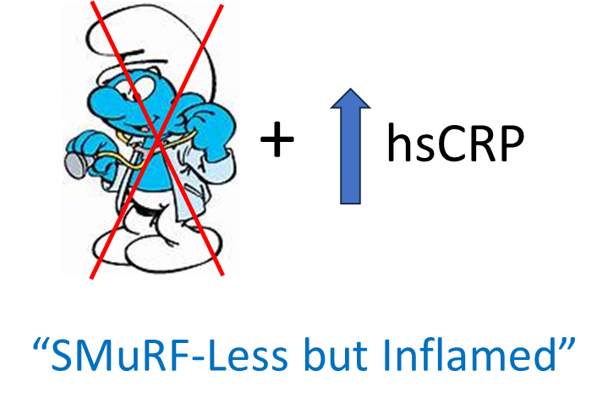
30-Year Age Adjusted Hazard Ratios for
Ischemic Stroke, Cardiovascular Events, and Coronary Heart Disease Events
Among 12,500 Initially Healthy American Women with No Standard Modifiable Risk Factors
According to Baseline Quintile of hsCRP
HR* per Quintile (95%CI)
Stroke 1.14 (1.05-1.25)
CVD 1.15 (1.10-1.21)
CHD 1.21 (1.13-1.29)
HR* per St. Dev. (95%CI)
Stroke 1.19 (1.05-1.34)
CVD 1.23 (1.15-1.31)
CHD 1.32 (1.20-1.45)
Age Adjusted HR
hsCRP (mg/L)
<0.49
0.49-1.09
1.10-2.14
2.15-4.23
> 4.23
Ridker ESC Madrid 2025

Slide 11
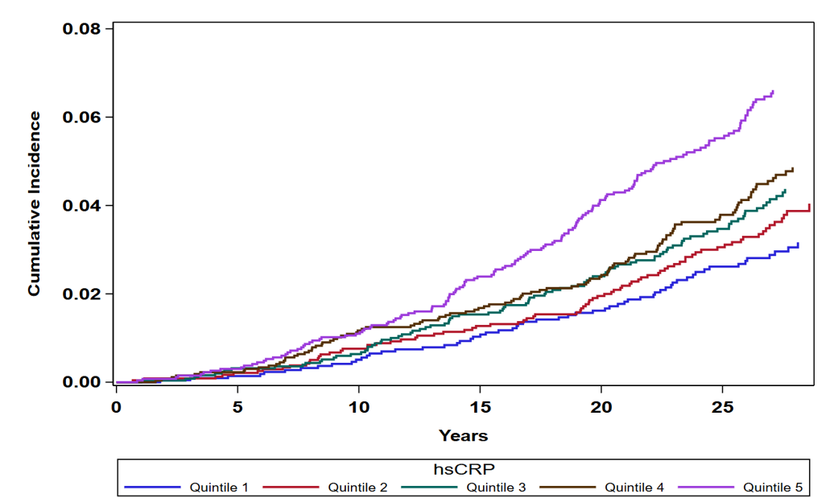
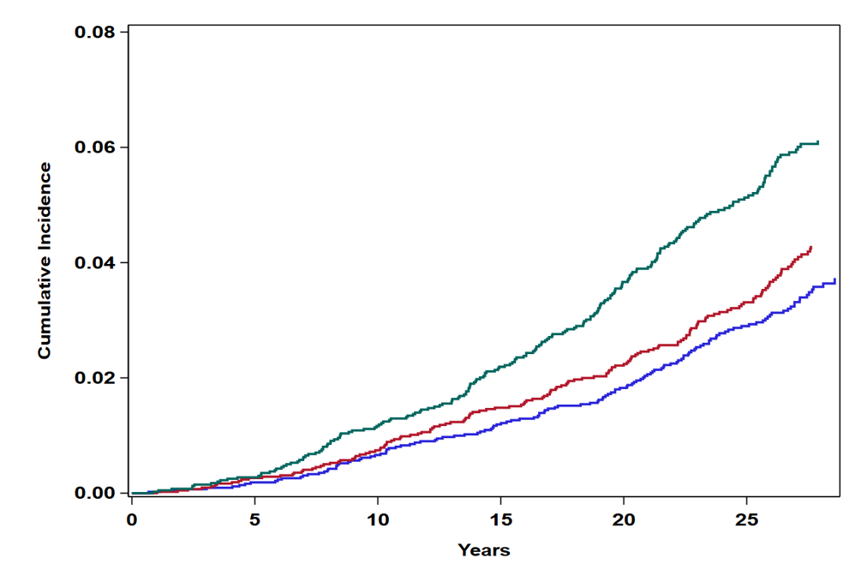
30-Year Age Adjusted Cumulative Incidence of Coronary Heart Disease Events
Among 12,500 Initially Healthy SMuRF-Less Women According to Baseline Level of hsCRP
HR
2.23
1.57
1.41
1.24
1.00
Q5 (> 4.2 mg/L)
HR
1.77
1.18
1.00
Q4 (2.2 – 4.2 mg/L)
> 3 mg/L
1 – 3 mg/L
< 1 mg/L
Q3 (1.1 – 2.1 mg/L)
Q2 (0.5 – 1.1 mg/L)
Q1 (< 0.5 mg/L)
Ridker ESC Madrid 2025

Slide 12
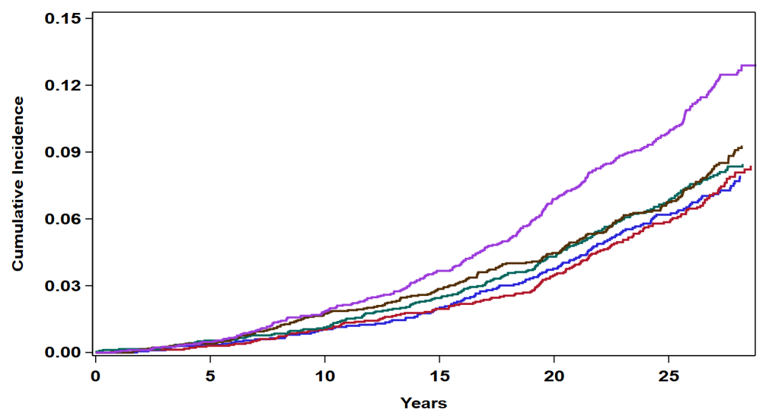
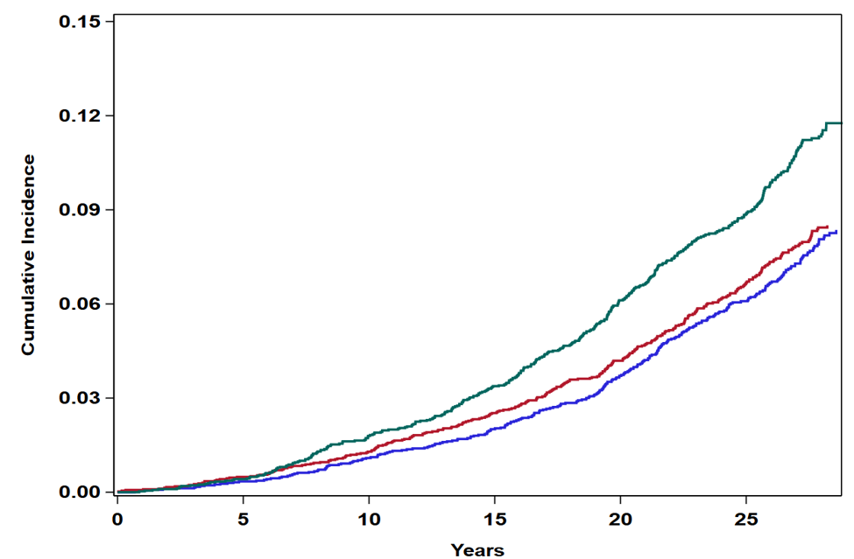
30-Year Age Adjusted Cumulative Incidence of Total Cardiovascular Events
Among 12,500 Initially Healthy SMuRF-Less Women According to Baseline Level of hsCRP
HR
1.74
1.18
1.11
1.01
1.00
Q5 (> 4.2 mg/L)
HR
1.52
1.10
1.00
Q4 (2.2 – 4.2 mg/L)
> 3 mg/L
1 – 3 mg/L
< 1 mg/L
Q3 (1.1 – 2.1 mg/L)
Q2 (0.5 – 1.1 mg/L)
Q1 (< 0.5 mg/L)
Ridker ESC Madrid 2025

Slide 13
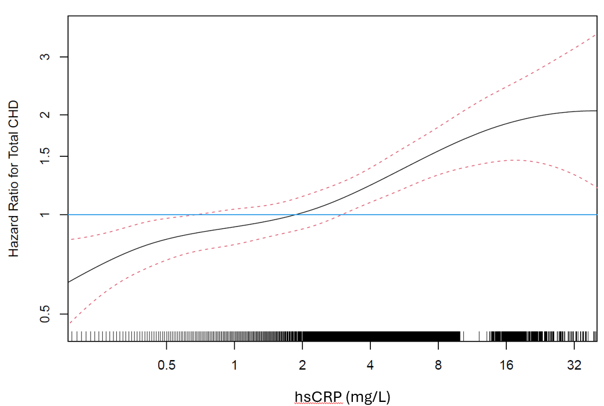
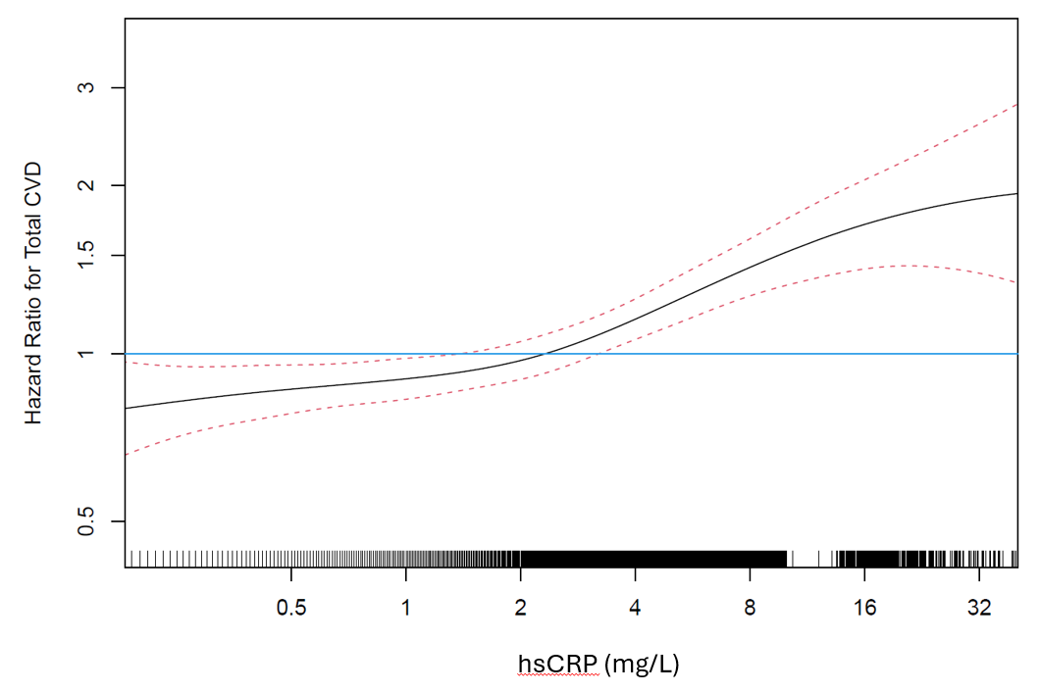
30-Year Covariate Adjusted Hazard Ratios for CHD and CVD Events
Among 12,500 Initially Healthy SMuRF-Less Women
According to Continuous Baseline Levels of hsCRP
Incident CHD
Incident CVD
Ridker ESC Madrid 2025

Slide 14
Additional Findings
The median baseline hsCRP was significantly higher among SMuRF-Less women who developed future CV events when compared to those who did not (P < 0.0001).
The prevalence of baseline hsCRP levels > 3 mg/L was significantly higher among SMuRF-Less women who developed future CV events as compared to those who did not
(P < 0.0001).
Sensitivity analyses varying the thresholds for LDL-C and blood pressure or treating these as continuous variables had minimal impact on outcomes.
No violations of proportional hazards were observed for either incident
CHD (p = 0.43) or incident CVD (p=0.52).
Ridker ESC Madrid 2025

Slide 15

Summary – New Clinical Syndrome “SMuRF-Less but Inflamed”
Over a 30-year horizon, cardiovascular events commonly occur among “SMuRF-Less but Inflamed” women who are otherwise missed by current screening algorithms, a clinically important observation given recent trial data demonstrating that statin therapy reduces risk by 38% among such individuals.
“SMuRF-Less but Inflamed” women with hsCRP > 3 mg/L had a 77 % increased lifetime risk of CHD, a 39% increased lifetime risk of stroke, and a 52% increased lifetime risk of any cardiovascular event when compared to those with hsCRP < 1 mg/L, and are not identified by any current
risk algorithms.
Ridker ESC Madrid 2025

Slide 16

Take Home Messages for ESC Madrid 2025
Doctors will not treat what they do not measure.
While imaging tests can tell us whom to treat,
we need biologically informative biomarkers to
tell us what to treat with.
Abundant prior data supports broad screening for
hsCRP along with LDL-C in both primary and secondary prevention.
“SMuRF-Less but Inflamed” patients are prevalent in your clinic and worthy of your consideration.
Ridker ESC Madrid 2025

Slide 17
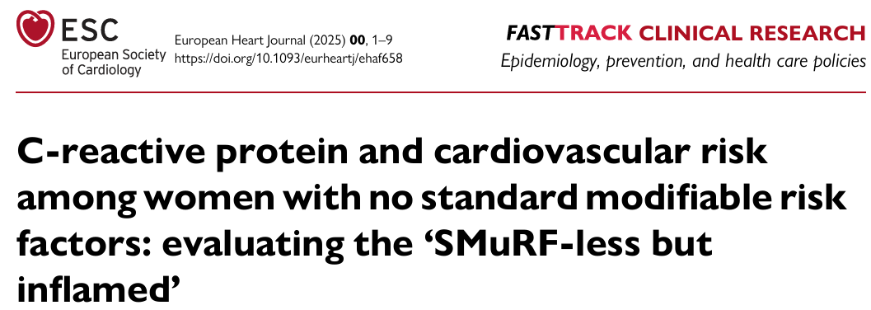
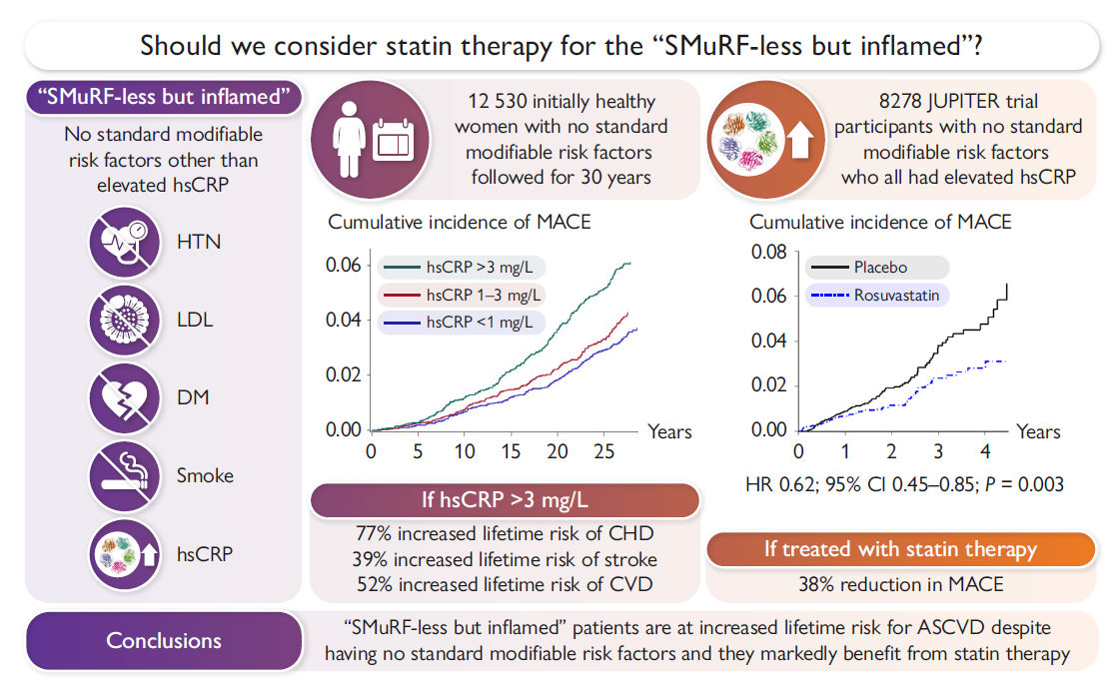
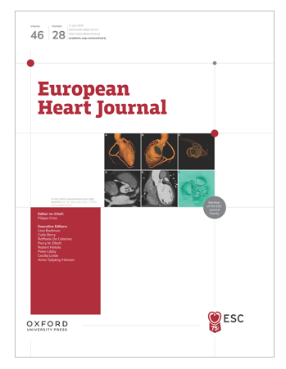
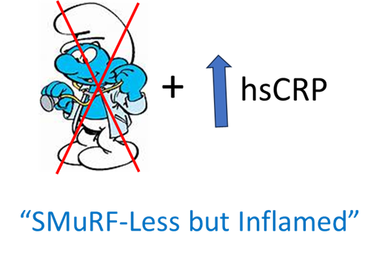
This ESC Congress Fast Track simultaneous publication is now available on-line
Paul M Ridker, Gemma Figtree, M Vinayaga Moorthy,
Samia Mora, Julie E Buring
Ridker ESC Madrid 2025

Slide 18
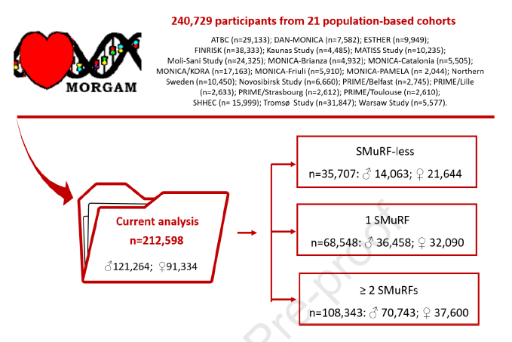
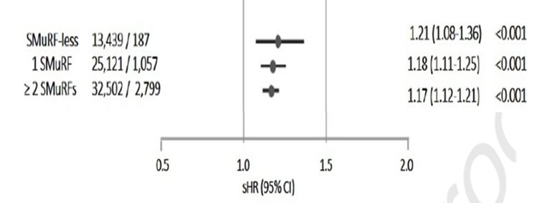
“SMuRF-Less but Inflamed” European MORGAM Study
Inclusive of Women and Men
hsCRP
Arnold N / Koenig W on behalf of the MORGAM Investigators. Occurrence of coronary events in the absence of traditional risk factors: understanding residual risk. Atherosclerosis. 2025 (in press)
Arnold N / Koenig W Quiet Flames: Inflammation Without Traditional Risk Factors. EHJ 2025 (on line)
Ridker ESC Madrid 2025

