Slide 1
Liberal Fluid Intake versus Fluid Restriction in Chronic Heart Failure
The FRESH-UP Study
Roland RJ van Kimmenade
Cardiologist, MD, PhD
@CardioRoland

Slide 2
Disclosures
Novo Nordisk
Roche Diagnostics
Hippocrates Academy

Slide 3
Heidenreich et al. 2022 AHA/ACC/HFSA Guideline for the Management of Heart Failure. J Am Coll Cardiol 2022

Slide 4
Fluid REStriction in Heart Failure vs Liberal Fluid UPtake Study the FRESH-UP Study
Randomized Open-label Multicenter Clinical Trial

Slide 5
Inclusion criteria
Diagnosis of chronic HF according to the ESC guidelines
> 6 months prior to randomization
NYHA class II/III
Age > 18 years

Slide 6
Exclusion criteria
HF hospital admission < 3 months of randomization
Changes in HF medical therapy < 14 days prior to randomization
PCI/CABG or PM/CRT/ICD implantation < 3 months prior to randomization
Hyponatremia at baseline (sodium < 130 mmol/L)
eGFR of < 30mL/min/1.73m² at baseline

Slide 7
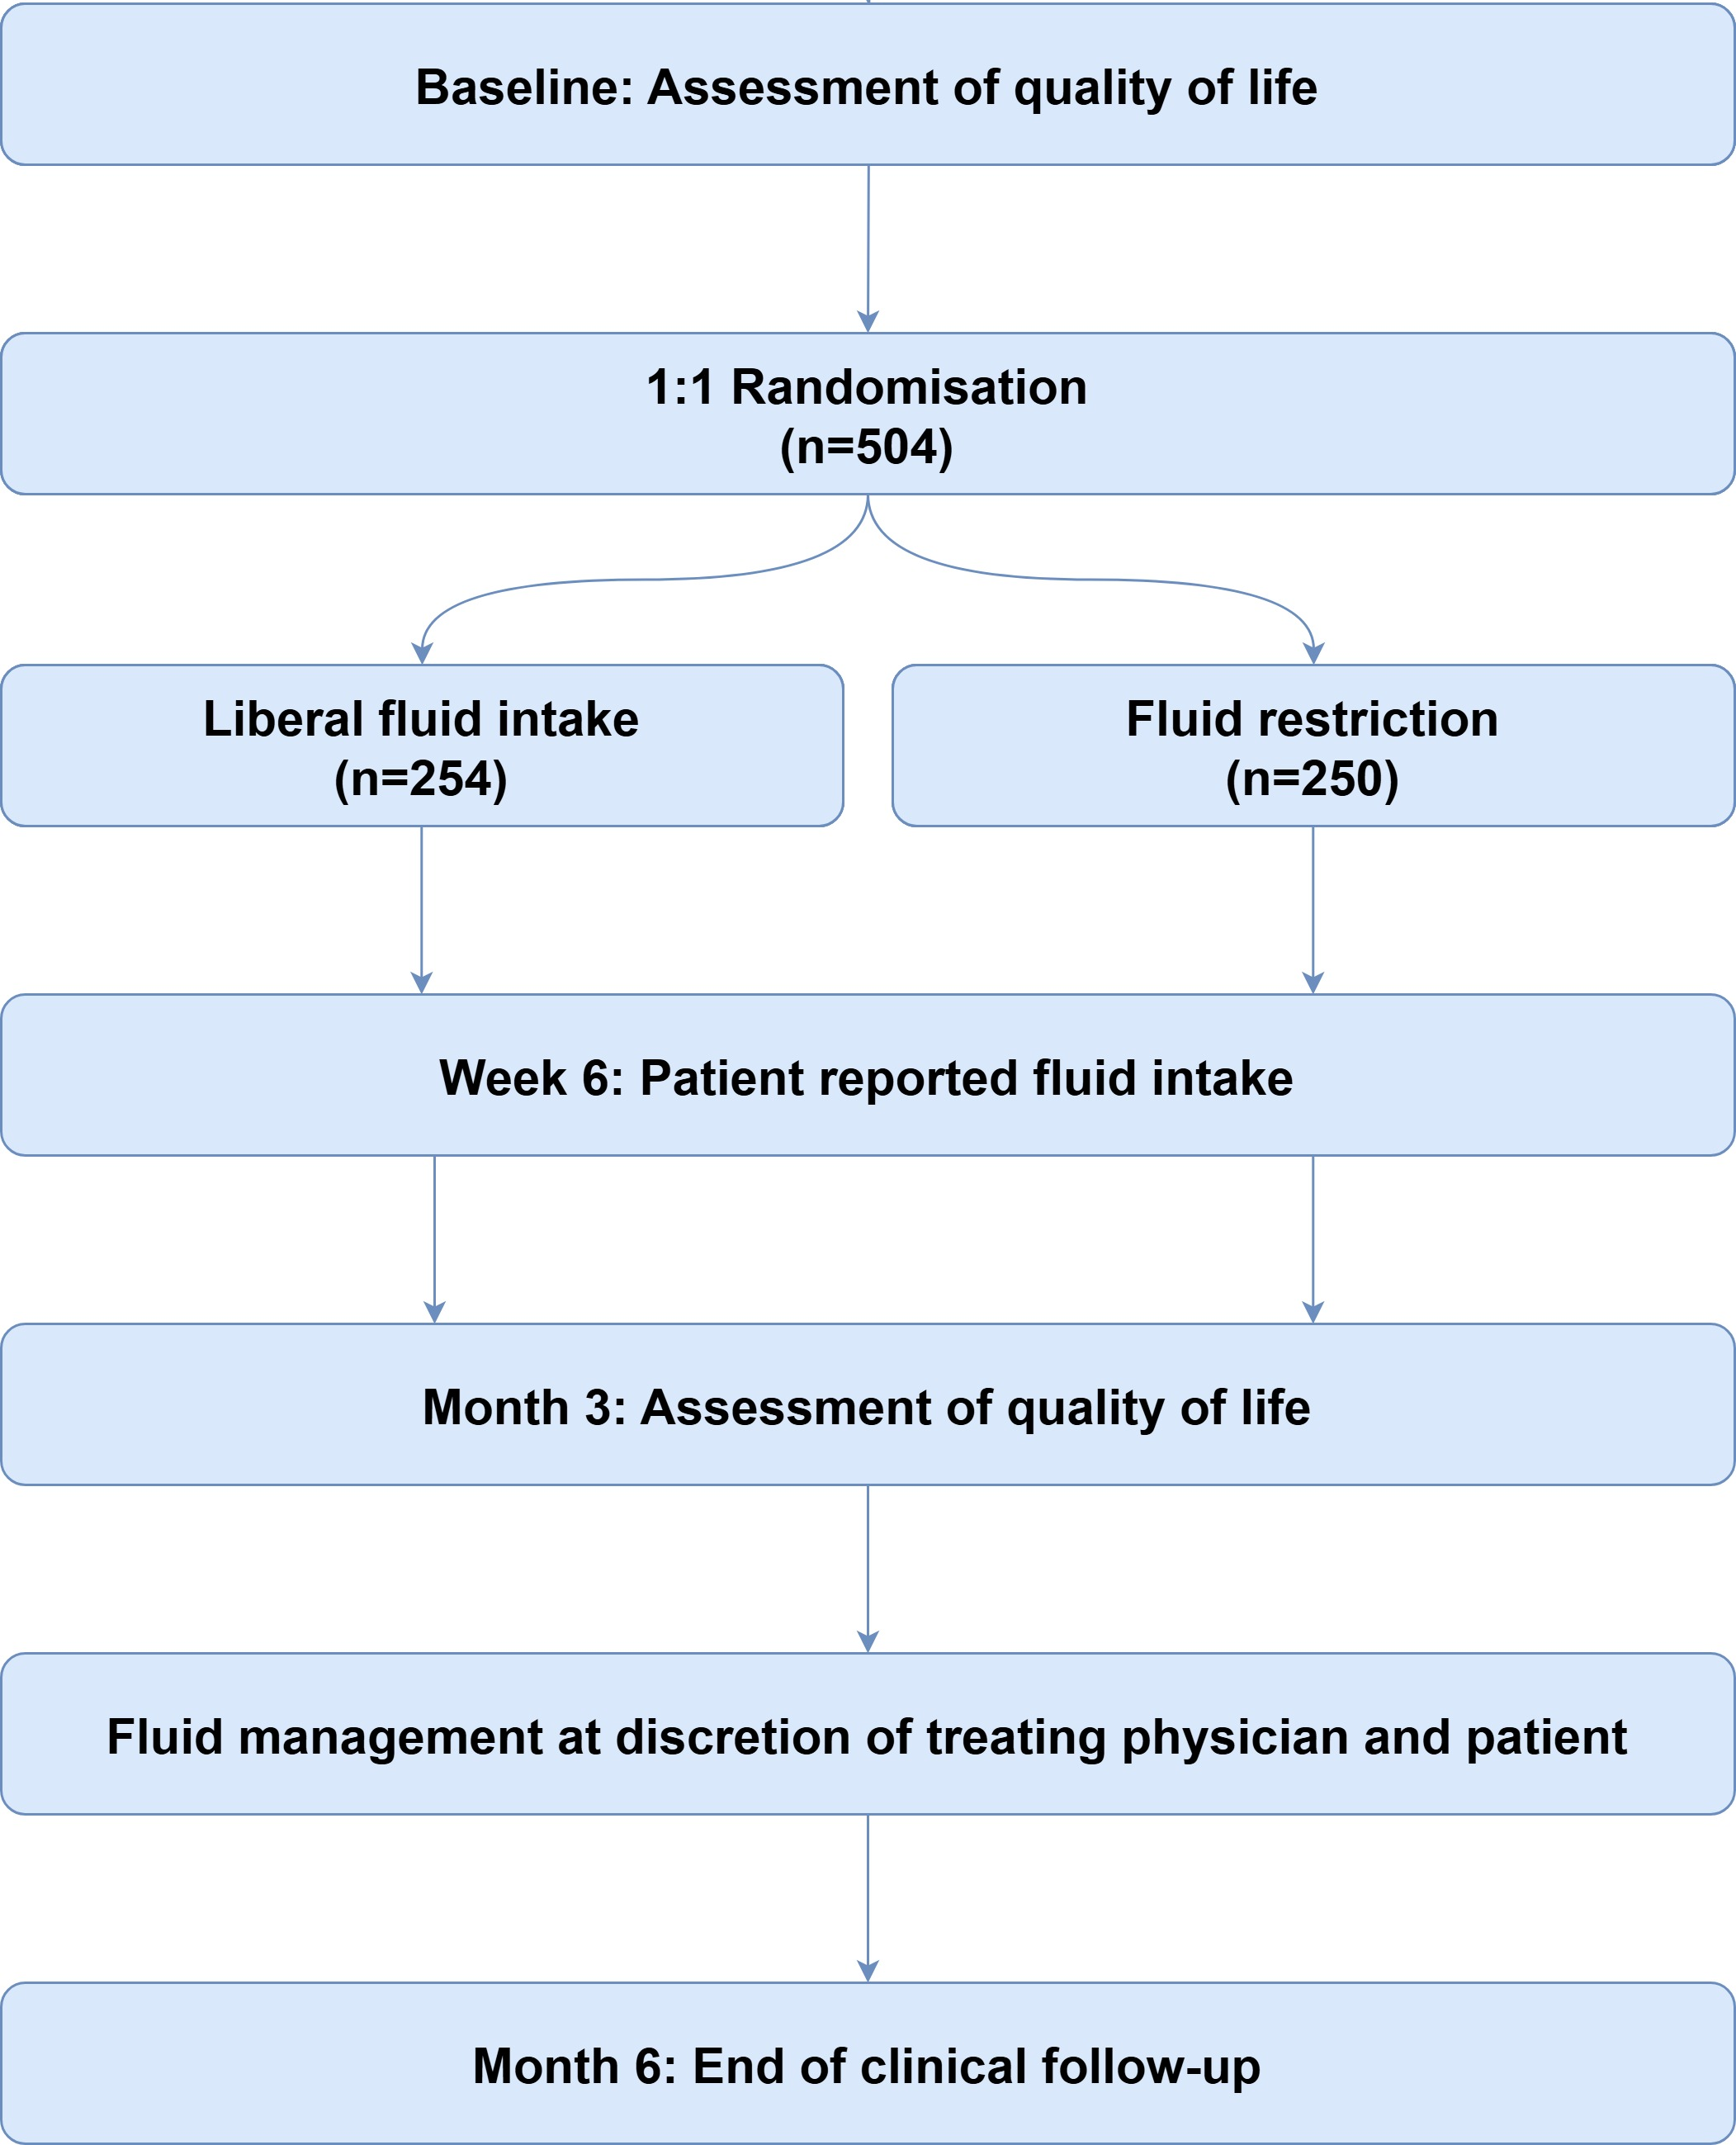
Study Protocol
Recruitment : Between May 17 2021, and June 13, 2024

Slide 8
Primary Outcome
Health status at 3 months as assessed by KCCQ-OSS
Key Secondary Outcome
Thirst distress at 3 months
assessed by the Thirst Distress Scale for patients with HF (TDS-HF)

Slide 9
Patient Characteristics
 | Liberal fluid intake (N = 254) | Fluid restriction (N = 250)
Age, years | 69.4 ± 10.6 | 69.0 ± 10.8
Male | 170 (66.9%) | 169 (67.6%)
White | 247 (97.2%) | 245 (98.0%)
NYHA II | 218 (85.8%) | 221 (88.4%)
NYHA III | 36 (14.2%) | 29 (11.6%)
LVEF % | 40.3 ± 10.9 | 40.2 ± 10.8
HFrEF | 136 (53.5%) | 124 (49.6%)
HFmrEF | 60 (23.6%) | 70 (28.0%)
HFpEF | 58 (22.8%) | 56 (22.4%)
Ischemic heart failure | 108 (42.5%) | 113 (45.2%)
Liberal fluid intake pre study | 124 (48.8%) | 111 (44.4%)
 | Liberal fluid intake (N = 254) | Fluid restriction (N = 250)
Age, years | 69.4 ± 10.6 | 69.0 ± 10.8
Male | 170 (66.9%) | 169 (67.6%)
White | 247 (97.2%) | 245 (98.0%)
NYHA II | 218 (85.8%) | 221 (88.4%)
NYHA III | 36 (14.2%) | 29 (11.6%)
LVEF % | 40.3 ± 10.9 | 40.2 ± 10.8
HFrEF | 136 (53.5%) | 124 (49.6%)
HFmrEF | 60 (23.6%) | 70 (28.0%)
HFpEF | 58 (22.8%) | 56 (22.4%)
Ischemic heart failure | 108 (42.5%) | 113 (45.2%)

Slide 10
Patient Characteristics
 | Liberal fluid intake (N = 254) | Fluid restriction (N = 250)
RAASi | 231 (90.9%) | 241 (96.4%)
ARNI | 149 (58.7%) | 170 (68.0%)
β-blocker | 228 (89.8%) | 222 (88.8%)
MRA | 199 (78.3%) | 204 (81.6%)
SGLT2i | 144 (56.7%) | 162 (64.8%)
Loop diuretics | 133 (52.4%) | 125 (50.0%)
Furosemide equivalent doses per day, mg | 40 [20 – 60] | 40 [20 – 60]
BUN, mmol/l | 8.0 ± 3.1 | 8.0 ± 3.6
eGFR, ml/min/1.73m² | 62.0 ± 17.2 | 62.6 ± 17.4
NT-proBNP, ng/l | 430.0 [194.9 – 1100.0] | 507.4 [193.5 – 1300.0]

Slide 11
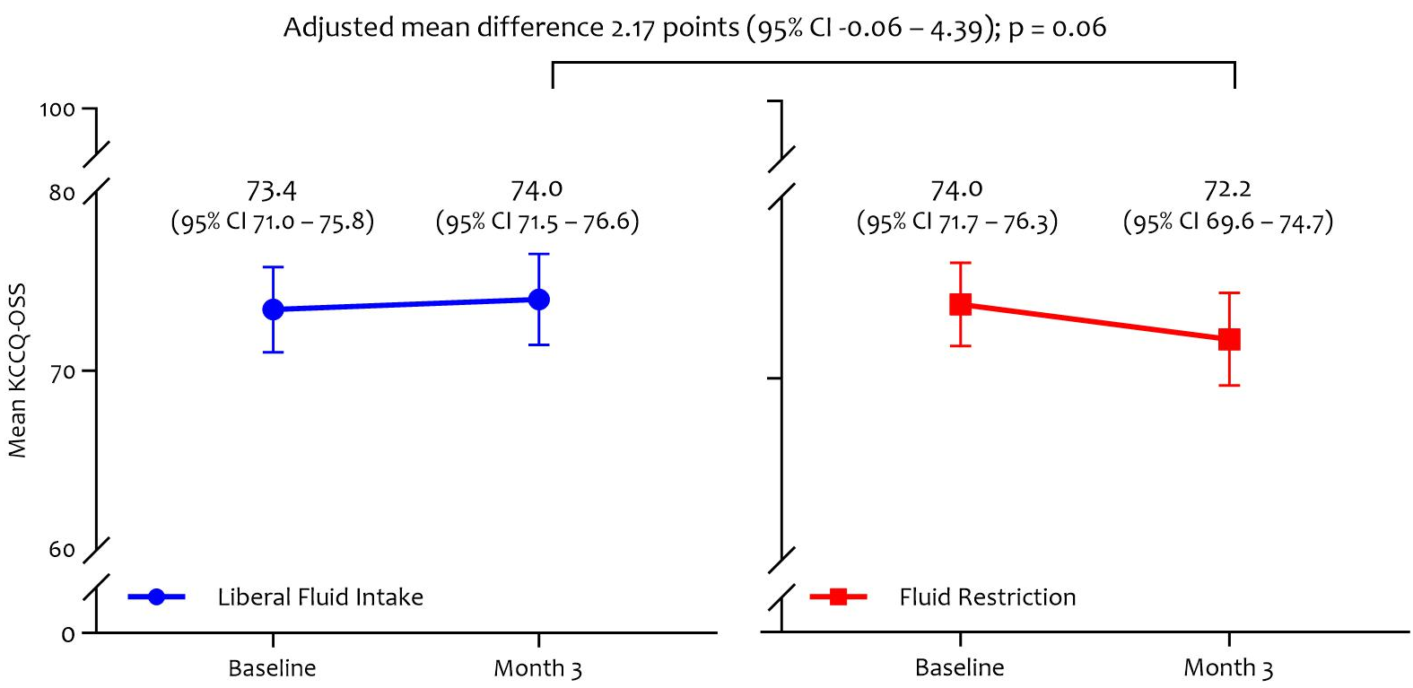
Primary Outcome

Slide 12
Subgroup analysis

Slide 13
Secondary Outcomes
 | Liberal fluid intake (N = 242) | Fluid restriction (N = 233) | P value
Key secondary outcome
Thirst Distress Scale in HF (TDS-HF) | 16.9 (15.8 – 18.0) | 18.6 (17.5 – 19.6) | <0.001
Secondary outcomes
Reported fluid intake (ml) | 1764 [1488 – 2156] | 1480 [1357 – 1561] | <0.001
KCCQ-Total Summary Score | 78.5 (75.9 – 81.1) | 77.2 (74.5 – 79.9) | 0.020
KCCQ-Clinical Summary Score | 75.9 (73.4 – 78.4) | 74.5 (71.9 – 77.1) | 0.032
Death | 1 (0.4%) | 2 (0.8%) | 0.62
All-cause hospitalisation | 20 (7.9%) | 15 (6.0%) | 0.42
Hospitalization for HF | 4 (1.6%) | 4 (1.6%) | 1.00
IV loop diuretics usage | 5 (2.0%) | 7 (2.8%) | 0.54
Acute kidney injury | 3 (1.2%) | 4 (1.6%) | 0.72
Δ NT-proBNP ( ng/L) Baseline – 3M | -7.0 [-90.0 – 100.0] | -1.5 [-98.3 – 133.8] | 0.52
Δ weight (kg) Baseline – 3M | 0.0 [-1.0 – 1.2] | 0.0 [-1.1 – 1.0] | 0.39
Loop diuretics changes during follow-up | 46 (18.1%) | 43 (17.3%) | 0.81

Slide 14
Conclusion
Difference in KCCQ-OS after adjustment for baseline scores after three months was 2.17 (95%CI -0.06–4.39; P=0.06)
in favour of liberal fluid intake, but the primary outcome was not met
Thirst distress was higher in the fluid restriction group
No differences were observed for safety events between groups
The FRESH-UP study questions the effects of fluid restriction in chronic heart failure

Slide 15
Acknowledgements
Steering Committee
Roland van Kimmenade, Frank Gommans,
Louise Bellersen, Hans-Peter Brunner-La Rocca
Tiny Jaarsma, Fabienne Beckers-Wesche
Data Safety Monitoring Board
James L Januzzi jr (chair)
Toni Bayes-Genis
Robby Nieuwlaat
Event Adjudication Committee
Peter van der Meer (chair)
Frederik Verbrugge
Louis Handoko
Dr Frank Gommans
Drs Job Herrmann
Radboudumc: Lisette Baltussen, Marjolein Verdijk
Louise Bellersen, Carlijne Hassing, Laura Rodwell
Maastricht UMC+: Fabienne Beckers – Wesche,
Hans-Peter Brunner-La Rocca
Zuyderland: Sandra Sanders-van Wijk, Mick Hoen,
Karin Drummen- Hermans
Rijnstate: Sascha Peerlings, Leonard Voorhout, Ron Pisters
Ziekenhuis Groep Twente: Manon Jongebloed-Westra,
Gerard Linssen
Bernhoven: Bas Bekkers
Jeroen Bosch Ziekenhuis: Martijn van Eck
Grants & Support
Dutch Heart Foundation
Academic Alliance Fund Radboudumc/MUMC+
Netherlands Heart Institute

Slide 16
Herrmann et al. Liberal Fluid Intake versus Fluid Restriction in Chronic Heart Failure: a randomized clinical trial. Nat. Med 2025 in press
DOI : 10.1038/s41591-025-03628-4

Slide 17
Liberal Fluid Intake versus Fluid Restriction in Chronic Heart Failure
The FRESH-UP Study
Roland RJ van Kimmenade
Cardiologist, MD, PhD
@CardioRoland

