Slide 1









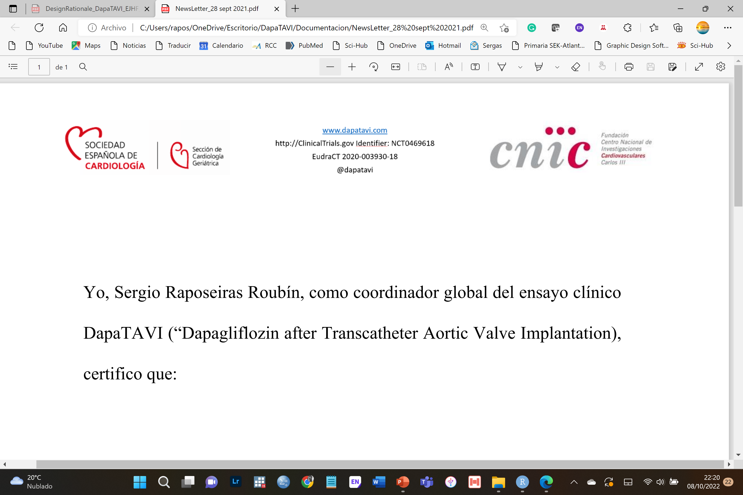
CHICAGO
March 29
Dapagliflozin after Transcatheter Aortic Valve Implantation
Sergio Raposeiras-Roubin, MD, PhD
EudraCT 2020-003930-18
ClinicalTrials.gov Identifier: NCT04696185
SOCIEDAD
GALLEGA DE
CARDIOLOGÍA
@DapaTAVI @S_Raposeiras
Notes:
Ladies and gentlemen, dear colleagues, on behalf of DapaTAVI investigators, it is a pleasure for me to present the results of DapaTAVI trial, the first randomized clinical trial comparing dapagliflozin vs no dapagliflozin in patients with aortic stenosis undergoing TAVI.

Slide 2



Disclosures
DapaTAVI is an independent trial
SOCIEDAD
GALLEGA DE
CARDIOLOGÍA
All authors declare no conflicts of interest related to this study
FUNDING: DapaTAVI received partial financial from unrestricted grants from the Spanish Government [Instituto de Salud Carlos III (ISCIII; FIS PI19/01882)], the Castilla-León Government [Gerencia Regional de Salud de la Junta de Castilla y León y Fondos FEDER (2459/A/21; GRS 2459/A/21, 2022)], the Spanish Society of Cardiology (SEC/FEC-INV-CLI 21/004) and the Galician Society of Cardiology (SOGACAR 2022).
Promotors: Spanish Society of Cardiology and Spanish National Center for Cardiovascular Research
Sergio Raposeiras-Roubín, MD, PhD
Notes:
I have nothing to declare, as the DapaTAVI trial is an independent investigator-initiated trial, promoted by the Spanish Society of Cardiology and the Spanish National Center for Cardiovascular Research.

Slide 3
Background
AORTIC STENOSIS is one of the most common VHD
Despite TAVI, PATIENTS STILL FACE HIGH RATES OF HEART FAILURE
TAVI has changed how aortic stenosis is managed
SGLT2i have shown benefit in all spectrum of HF
Patients with HF secondary to VHD or undergoing valvular interventions were excluded from RCT with SGLT2i
Patients undergoing TAVI tend to be elderly
Patients > 80 years are underrepresented in RCT with SGLT2i
Sergio Raposeiras-Roubín, MD, PhD
Notes:
AORTIC STENOSIS is one of the most common valvular heart diseases in Western countries with an INCREASING PREVALENCE because of population aging. TAVI has changed how aortic stenosis is managed.
However, despite TAVI use, PATIENTS STILL FACE HIGH RATES OF HEART FAILURE after TAVI, especially during the first year.
SGLT-2 INHIBITORS have been shown to reduce HF rates in all-spectrum of heart failure.
Because of this, they are RECOMMENDED by BOTH EUROPEAN AND AMERICAN CLINICAL PRACTICE guidelines in all patients with HF.
However, patients with HF secondary to severe valvular disease or undergoing valvular intervention were excluded from clinical trials with SGLT-2 inhibitors.
Moreover, patients undergoing TAVI tend to be older patients, and patients over 80 years are also underrepresented in clinical trials with SGLT-2 inhibitors.

Slide 4
Background
We need evidence on EFFICACY of SGLT2i in TAVI patients
We need evidence on SAFETY of SGLT2i in very elderly patients
Sergio Raposeiras-Roubín, MD, PhD
Notes:
Therefore, we need evidence on the efficacy and safety of SGLT-2 inhibitors in patients undergoing TAVI and in elderly patients.

Slide 5

Trial design
Prospective Randomized Open Blinded Endpoint (PROBE) controlled trial
Independent and pragmatic
The protocol was approved by the Galician Clinical Research Ethics Committee (approval number 2020/434), the Spanish Agency of Medicines and Medical Devices (AEMPS 20-0748), and the investigational review boards at each of the participating sites.
The trial was registered in both ClinicalTrials.gov (NCT04696185) and the European Clinical Trials Database (EUDRACT 2020-003930-18).
Dapagliflozin
Randomization 1:1
Stratified by the presence of diabetes mellitus, a LVEF≤40%, and an eGFR 25-75 ml/min/1.73 m2
At time of hospital discharge after TAVI or within 14 days of discharge.
No
Dapagliflozin
SOCIEDAD
GALLEGA DE
CARDIOLOGÍA
Sergio Raposeiras-Roubín, MD, PhD
Notes:
With this background, we conducted the DapaTAVI clinical trial, a pragmatic, prospective, randomized, open-label, blinded endpoint trial that randomize patients to receive or not Dapagliflozin.

Slide 6
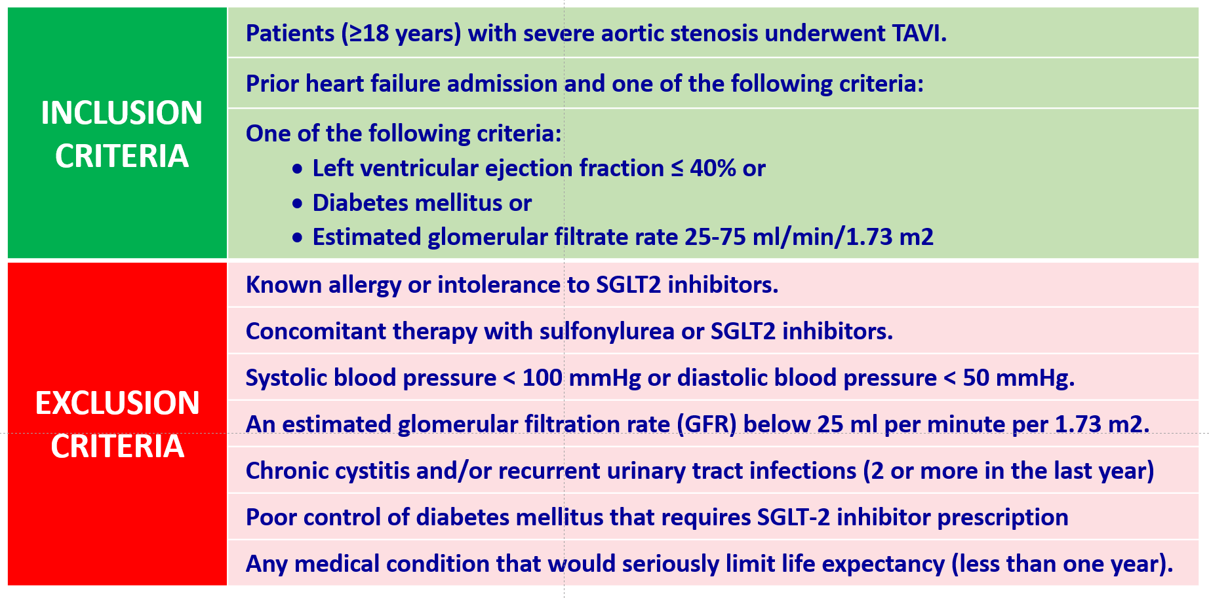
Inclusion/Exclusion Criteria
Sergio Raposeiras-Roubín, MD, PhD
Notes:
INCLUSION CRITERIA were patients with severe aortic stenosis undergoing TAVI with prior HF hospitalization and one for the following conditions: left ventricular ejection fraction ≤ 40%, diabetes or moderate renal insufficiency.
EXCLUSION CRITERIA were any contraindication to dapagliflozin, major hypotension, severe renal dysfunction, chronic urinary tract infections, or current therapy with SGLT-2 inhibitors.

Slide 7
Endpoints
PRIMARY ENDPOINT
Composite of all-cause death or worsening HF (defined as any hospitalization for HF or urgent HF visit requiring iv diuretics)
SECONDARY ENDPOINTS
All-cause death
Cardiovascular death
Composite of hospitalization for HF or cardiovascular death
Hospitalization for HF and urgent HF visit requiring iv diuretics
3 months
1 year
Telephone interviews
Review of medical records
National vital status registries
Clinical outcomes were externally adjudicated by a clinical panel blinded to treatment
Sergio Raposeiras-Roubín, MD, PhD
Notes:
CLINICAL OUTCOMES were externally adjudicated by a clinical panel blinded to treatment.
The primary end-point was the composite of all-cause death or worsening heart failure, defined as any hospitalization for heart failure and urgent heart failure visit requiring intravenous diuretics.
The secondary end-points included the incidence rate of the individual components of the primary outcome, cardiovascular mortality, the composite of hospitalization for heart failure or cardiovascular death, and the total number of heart failure rehospitalizations.
The assessment of clinical outcomes was performed at 3 and 12 months.

Slide 8
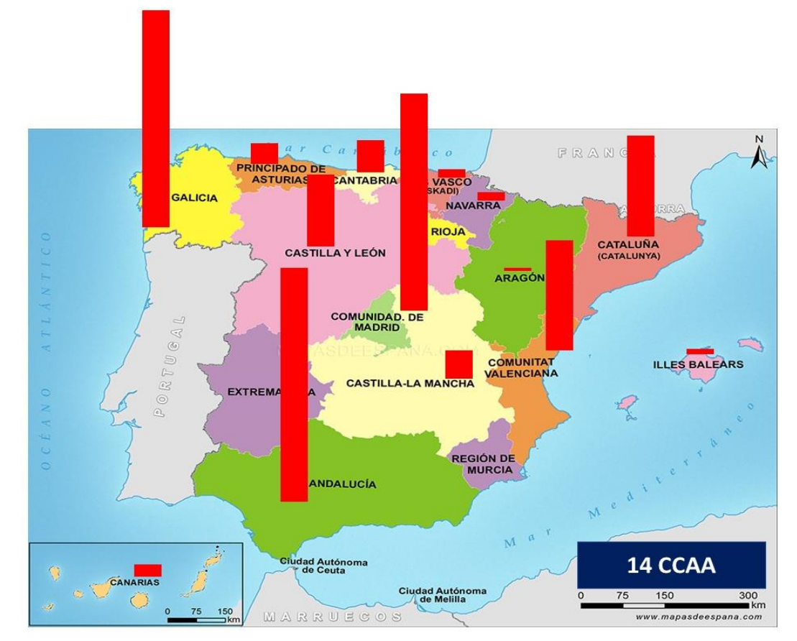
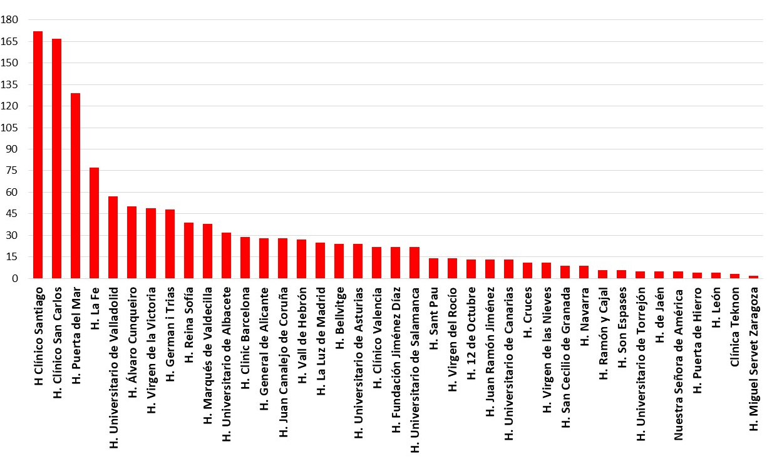
Study population
Multicenter: 39 centers across Spain
1,257
Recruitment by center
39 HOSPITALS
Number of patients
January
2021
December
2023
SPAIN
14 regions
Sergio Raposeiras-Roubín, MD, PhD
Notes:
A total of 1257 patients were included in DapaTAVI trial across 39 hospitals in Spain between January 2021 and December 2023.

Slide 9
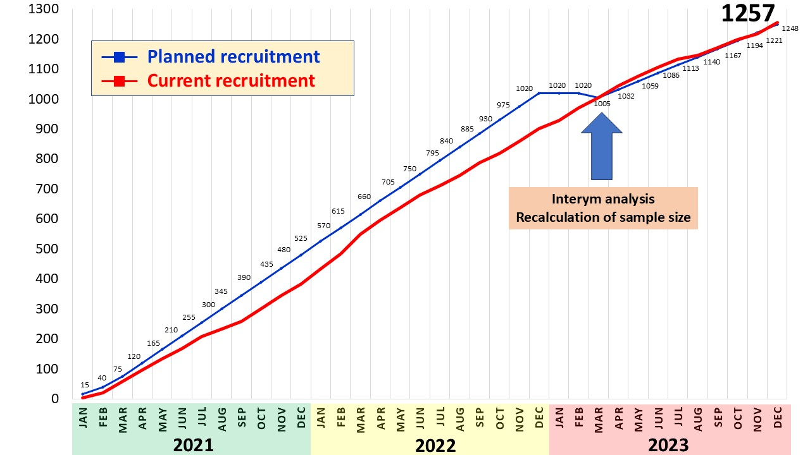

Recruitment
Recruitment rate
23%
1,020
1,257
CALCULATION OF SAMPLE SIZE
Anticipated event of primary composite outcome:
30% in control group
Dapagliflozin associated with 30% RRR (80% power)
Estimated loss during follow-up of 5%
Sergio Raposeiras-Roubín, MD, PhD
Notes:
IT IS IMPORTANT TO NOTE THAT THE initial planned total sample size was 1,020 patients but we have to expand THE SAMPLE SIZE because of an expected low rate of primary end-point.

Slide 10
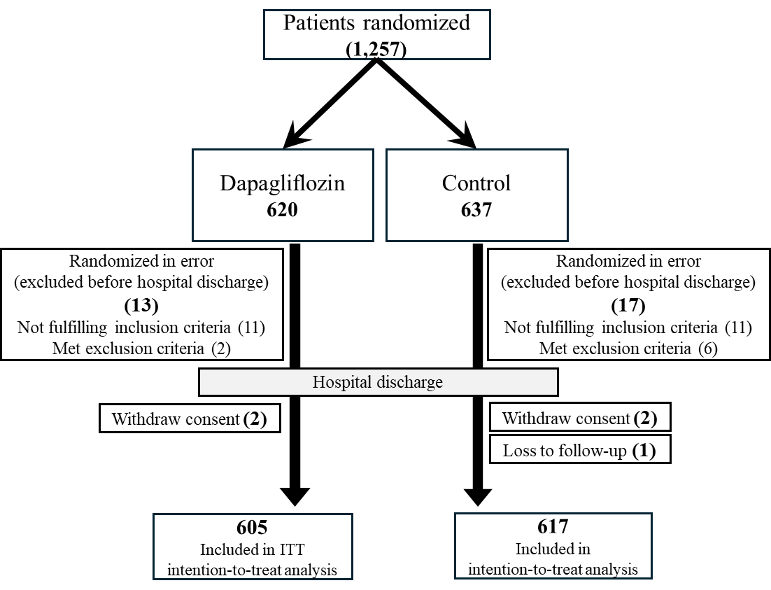
Patient flow
© Copyright 2025
Sergio Raposeiras-Roubín, MD, PhD
Notes:
620 were assigned to dapagliflozin and 637 to standard care.
30 PATIENTS WERE EXCLUDED FOR THE FINAL ANALYSIS BECAUSE THE DID NOT FULFILL THE INCLUSION/EXCLUSION CRITERIA, 4 PATIENTS WITHDREW THEIR CONSENT AND 1 PATIENT WAS LOST TO FOLLOW-UP).
So, finally, 605 patients were analyzed in the dapagliflozin arm and 617 in the control arm.

Slide 11
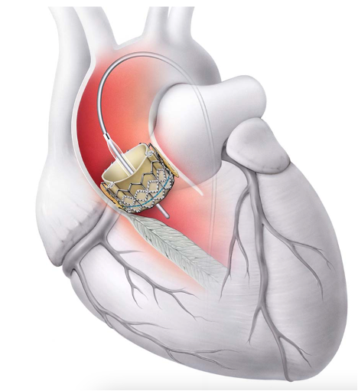
Randomization and cross-overs
Total crossover rate = 12%
Dapagliflozin
N=605
103
(17%)
Crossovers
Stopping treatment with dapagliflozin during the follow-up
2 days (1-4)
No
Dapagliflozin
N=617
43
(7%)
Crossovers
RANDOMIZATION
Initiation of STGL-2 inhibitors for reasons other than HF
Sergio Raposeiras-Roubín, MD, PhD
Notes:
The median time from the TAVI to randomization was 2 days.
In the dapagliflozin arm, 17% STOPPED DAPAGLIFLOZIN TREATMENT DURING FOLLOW-UP, whereas in the control group, 7% STARTED SGLT-2 INHIBITORS DURING FOLLOW-UP FOR REASONS OTHER THAN HF.

Slide 12
Baseline Characteristics
Characteristic | Dapagliflozin Group (N = 605) | Control Group (N = 618*)
Age — yr | 82.4±5.6 | 82.4±5.5
Female sex — no. (%) | 299 (49.4) | 305 (49.4)
Diabetes mellitus type 2 — no. (%) | 264 (43.6) | 273 (44.2)
Hypertension — no. (%) | 518 (85.6) | 519 (84.0)
Coronary artery disease — no. (%) | 237 (39.2) | 197 (31.9)
Previous myocardial infarction — no. (%) | 51 (8.4) | 52 (8.4)
Prior stroke — no. (%) | 61 (10.1) | 69 (11.2)
Peripheral artery disease — no. (%) | 51 (8.4) | 43 (7.0)
Atrial fibrillation — no. (%) | 250 (41.3) | 274 (44.3)
Estimated GFR — ml/min/1.73 m2 | 56.0±16.4 | 56.4±16.3
Left ventricular ejection fraction — % | 54.9±12.3 | 54.8±12.1
New-onset bundle branch block — no. (%) | 151 (32.0) | 146 (32.6)
Pacemaker implantation — no. (%) | 105 (19.3) | 103 (19.0)
Post-TAVI aortic regurgitation grade 3+ — no. (%) | 27 (4.5) | 37 (6.0)
* 1 patient was lost to follow-up
Sergio Raposeiras-Roubín, MD, PhD
Notes:
BASELINE CHARACTERISTICS appeared balanced between both groups.

Slide 13
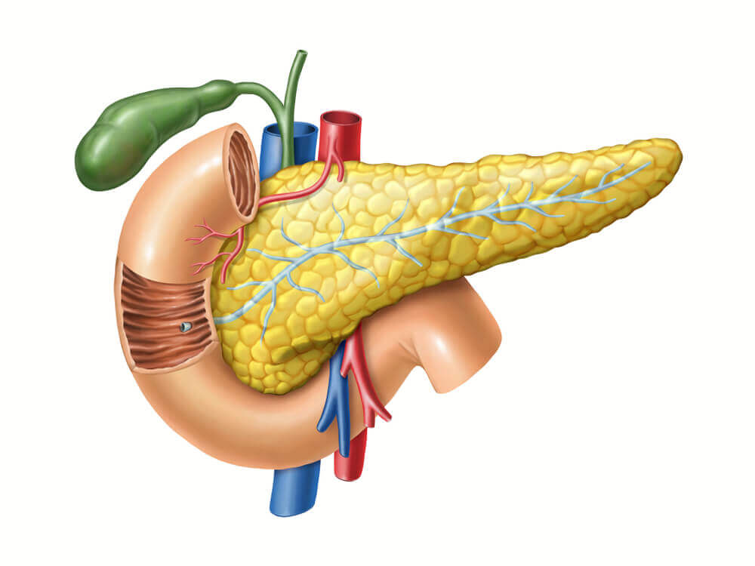
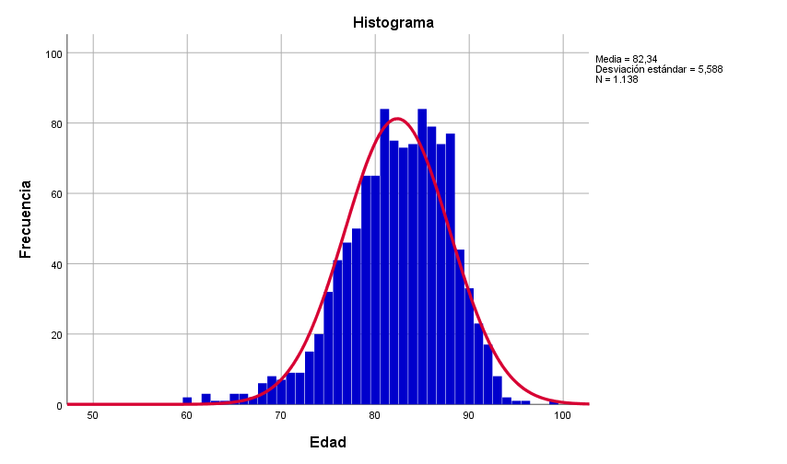


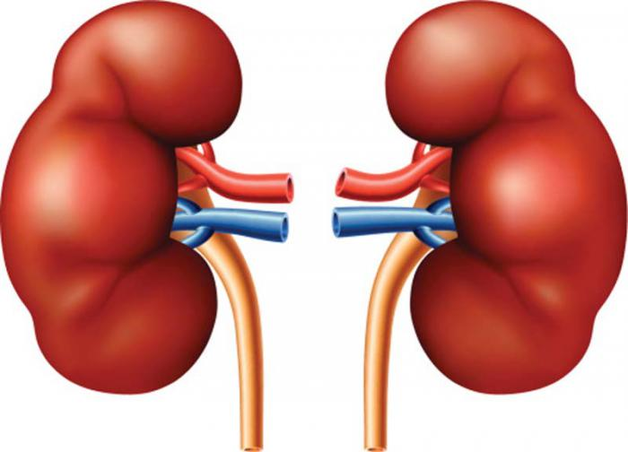
Baseline Characteristics
49.4% women
43,9%
(n=537)
82,4 ± 5,5 years
Median 83 years (IQR 79-86)
Diabetes
Frequency
17%
(n=212)
LVEF ≤ 40%
From 60 to 99 years
88,6%
(n=1,084)
Age (years)
7,4% ≥ 90 y
CKD-EPI 25-75
Sergio Raposeiras-Roubín, MD, PhD
Notes:
Interestingly, the age of the patients ranged from 60 to 99 years, with a mean age of 82 years. In addition, almost half of the patients were women.
43.9% had diabetes, 17% systolic dysfunction, and most of them had any degree of renal dysfunction.

Slide 14
RESULTS: Primary end-point (intention to treat analysis)
Control Group: 124 patients (20.1%)
Dapagliflozin Group: 91 patients (15.0%)
HR 0.72 (95% CI 0.55-0.95)
P=0.018
© Copyright 2025
Sergio Raposeiras-Roubín, MD, PhD
Notes:
AND NOW WE COME TO THE RESULTS OF THE STUDY.
Regarding the primary end-point, THE COMPOSITE OF ALL-CAUSE DEATH OR WORSENING HF occurred in 124 patients (20.1%) in control group and in 91 patients (15%) in the dapagliflozin group, with a hazard ratio of 0.72 and a significant P value of 0.018.

Slide 15
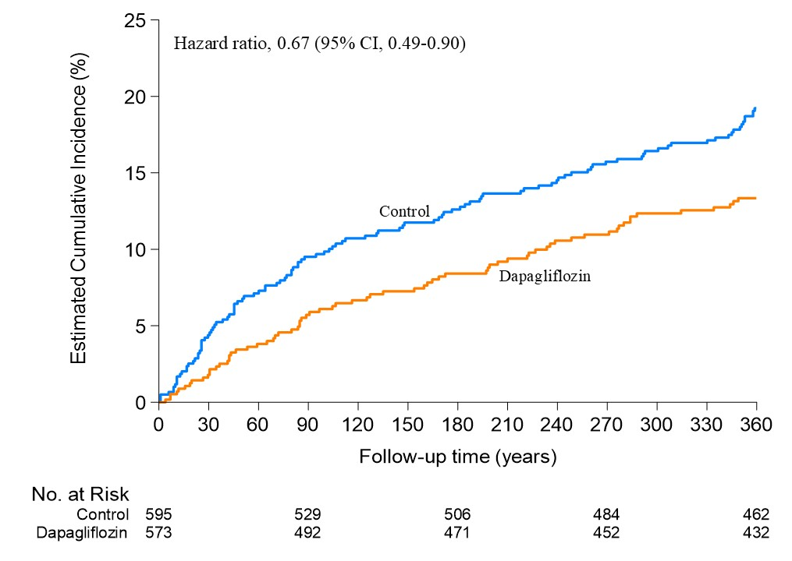
RESULTS: Primary end-point (per protocol analysis)
HR 0.67 (95% CI 0.49-0.90)
© Copyright 2025
Sergio Raposeiras-Roubín, MD, PhD
Notes:
Results were similar in the per-protocol analysis.

Slide 16
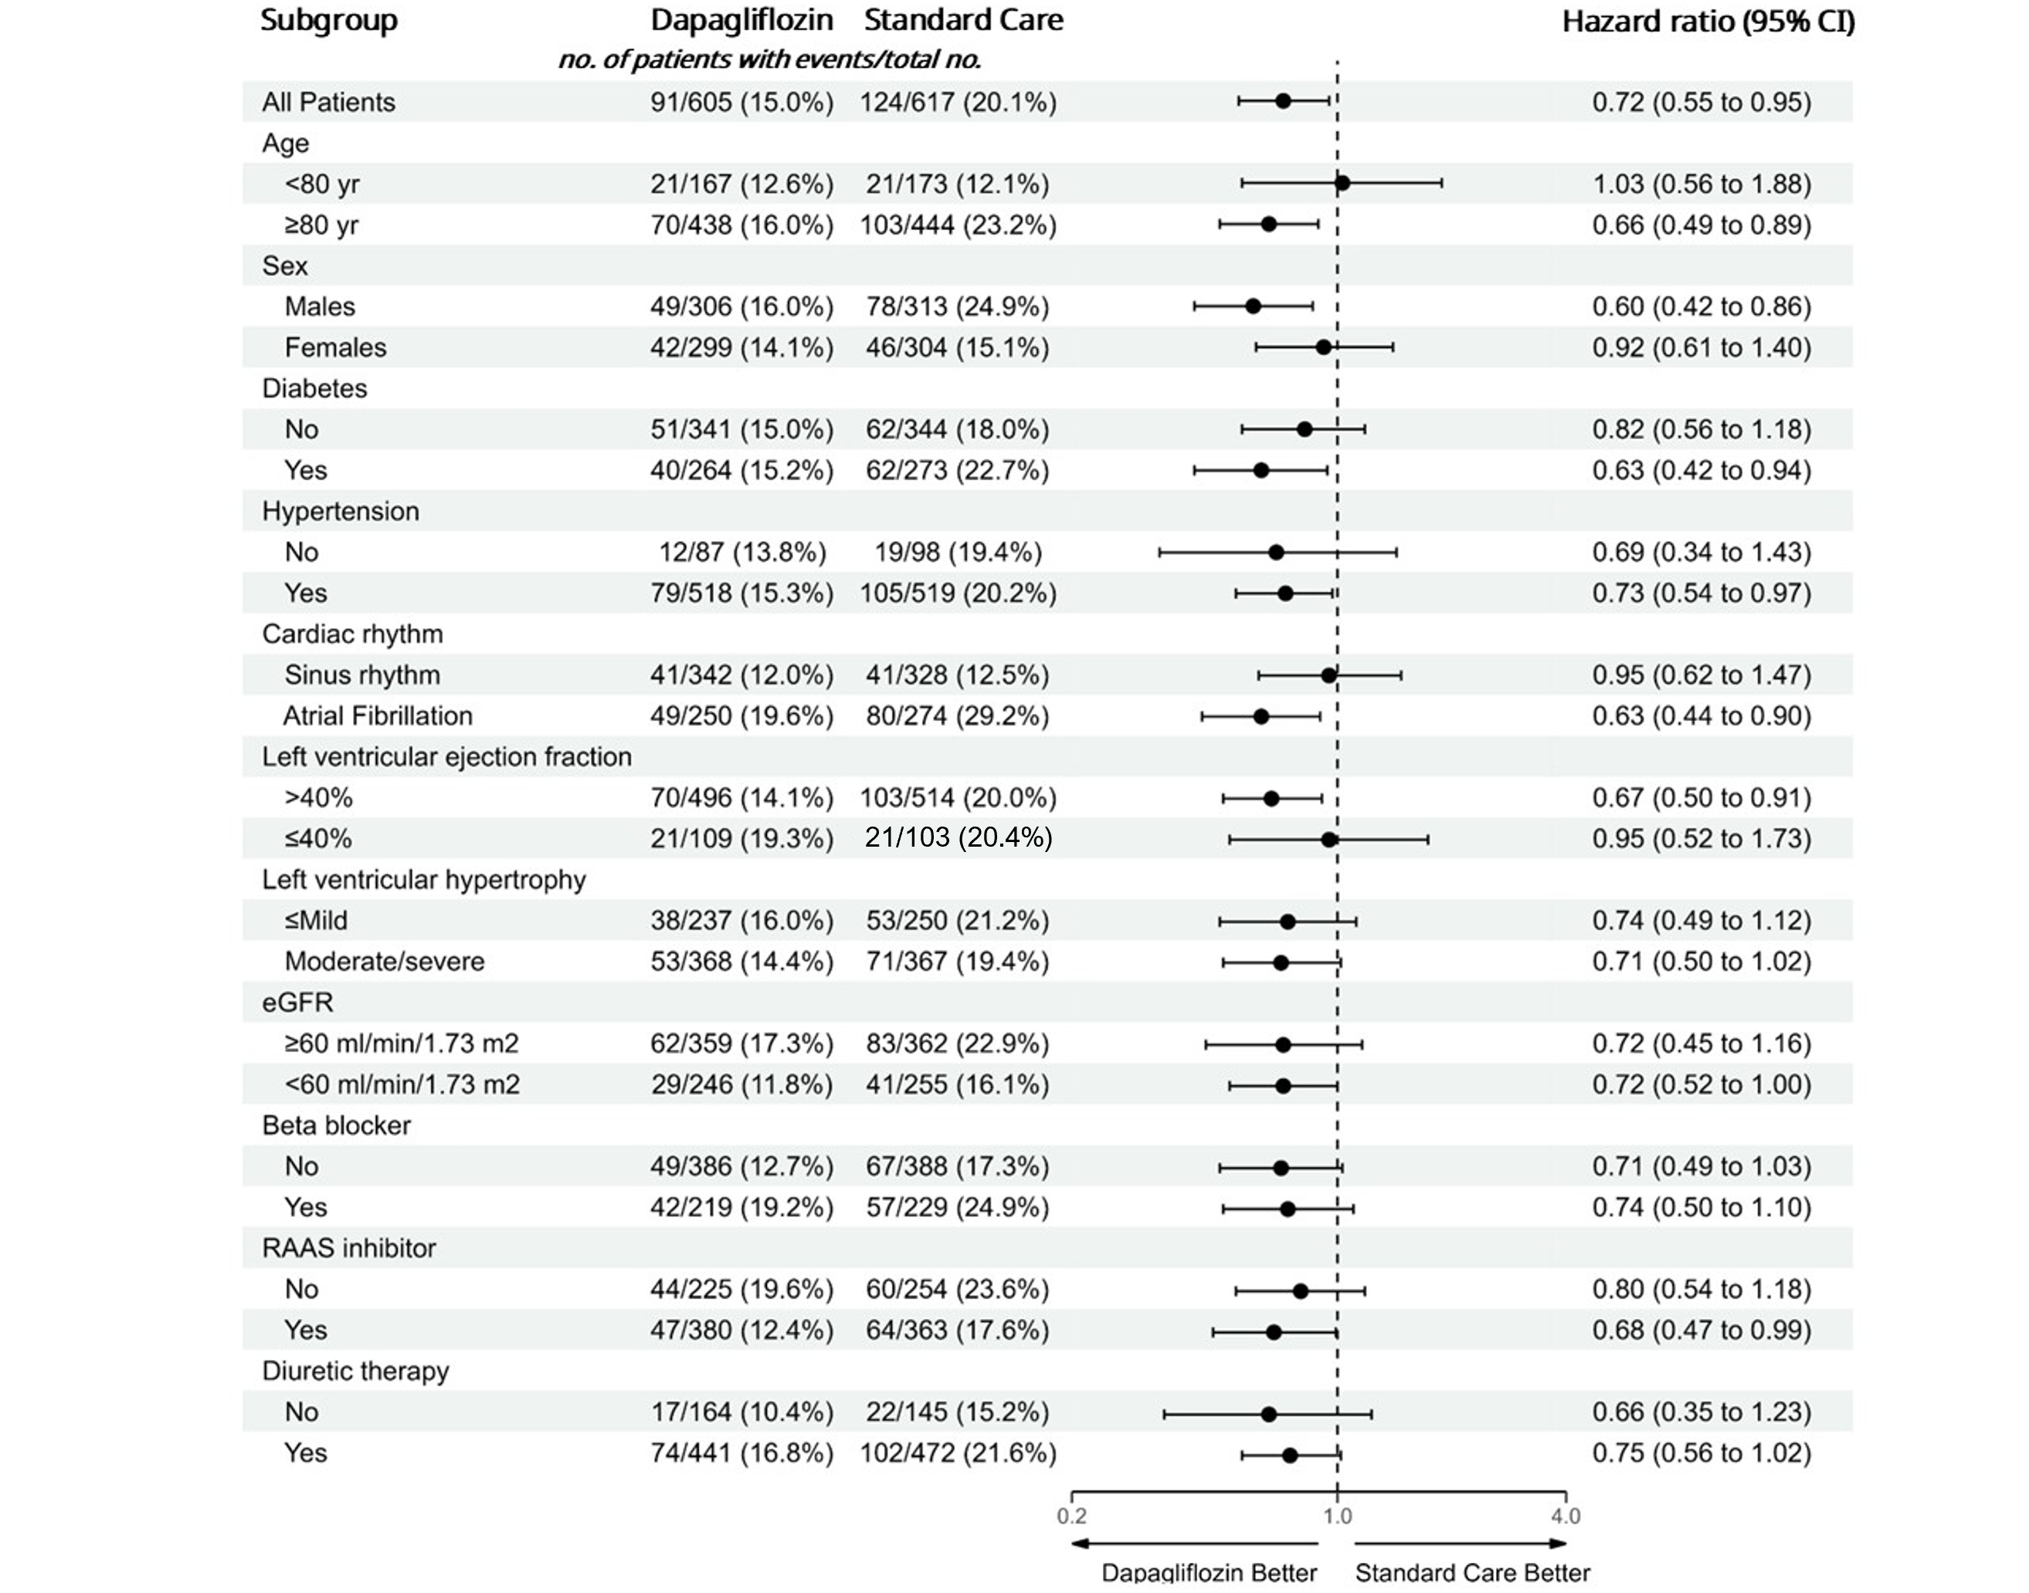
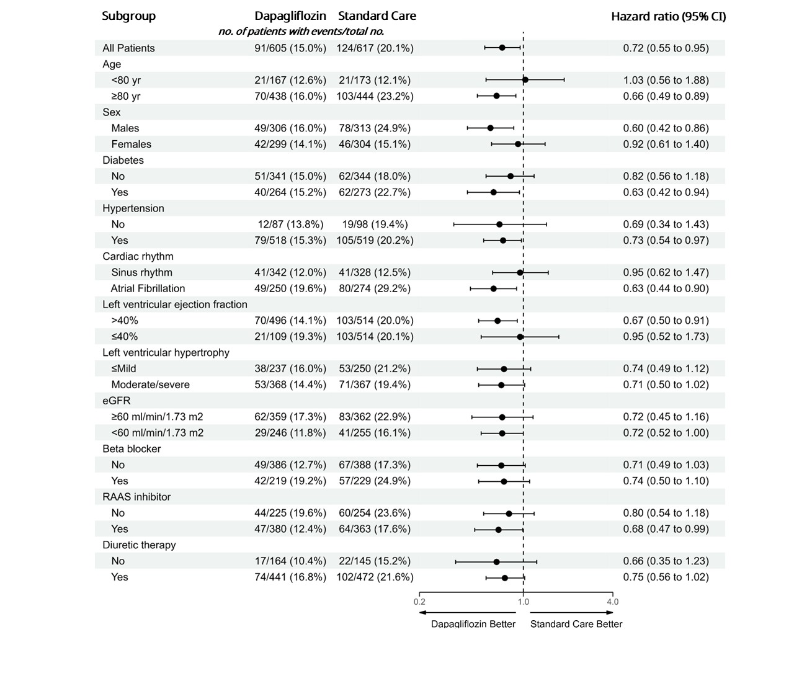
RESULTS: Subgroup analysis
The effect of dapagliflozin on the primary outcome also appeared consistent across prespecified subgroups
© Copyright 2025
Sergio Raposeiras-Roubín, MD, PhD
Notes:
The effect of dapagliflozin on the primary outcome also appeared consistent across prespecified subgroups, including patients with diabetes, systolic dysfunction or renal insufficiency.

Slide 17
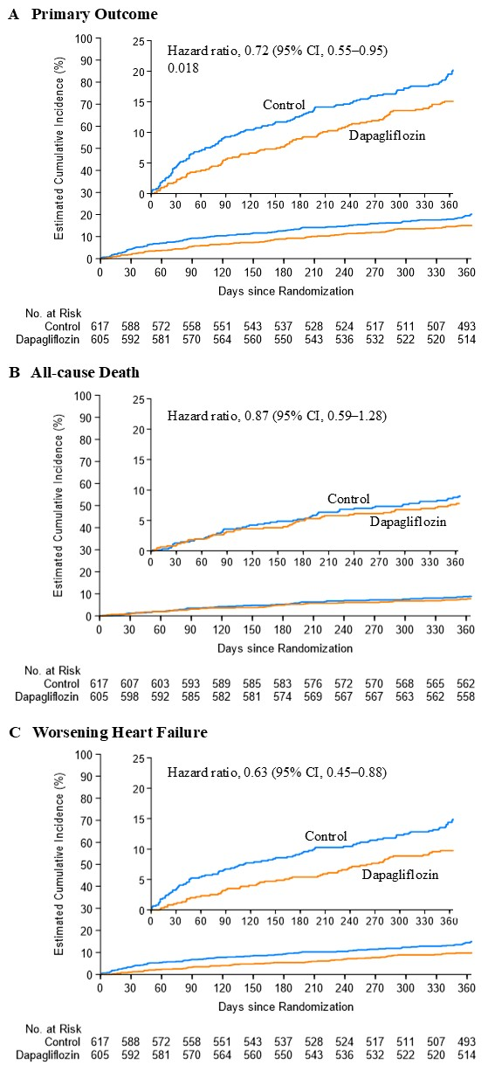
RESULTS: Secondary end-points
All-cause Death
Worsening HF
Control Group: 56 patients (9.1%)
Control Group: 89 patients (14.4%)
Dapagliflozin Group: 47 patients (7.8%)
Dapagliflozin Group: 57 patients (9.4%)
HR 0.87 (95% CI 0.59-1.28)
HR 0.63 (95% CI 0.45-0.88)
© Copyright 2025
Sergio Raposeiras-Roubín, MD, PhD
Notes:
There was no difference for all-cause death between both groups, but THERE WAS A significant DIFFERENCE FOR WORSENING HF, WITH A 37% REDUCTION IN DAPAGLIFLOZIN ARM.

Slide 18

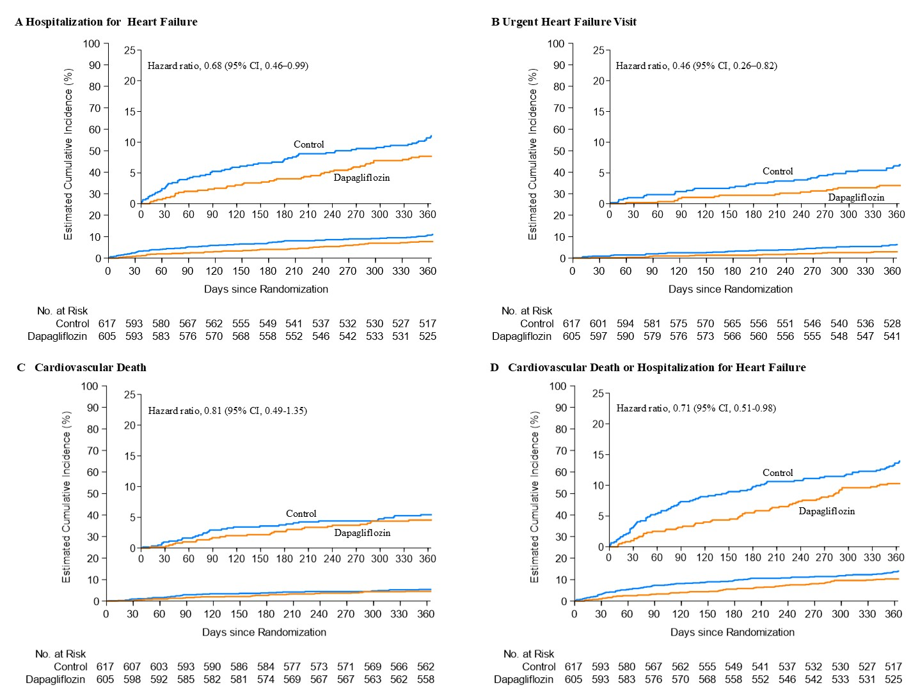

RESULTS: Secondary end-points
Hospitalization for HF
Urgent HF Visit
HR 0.68 (95% CI 0.46-0.99)
HR 0.46 (95% CI 0.26-0.82)
Cardiovascular Death
CV Death or Hospitalization for HF
HR 0.81 (95% CI 0.49-1.35)
HR 0.71 (95% CI 0.51-0.98)
© Copyright 2025
Sergio Raposeiras-Roubín, MD, PhD
Notes:
The benefit of dapagliflozin was in reducing both heart failure hospitalizations and urgent visits for HF.
There was no benefit of dapagliflozin in reducing cardiovascular death, but THERE WAS BENEFIT IN REDUCING THE SECONDARY COMPOSITE OUTCOME OF HOSPITALIZATION FOR HF OR CARDIOVASCULAR DEATH.

Slide 19
RESULTS: Safety end-points
End Point | Dapagliflozin Group (N = 605) |  | Standard care Group (N = 617) |  | P-value
 | Value | Incidence | Value | Incidence
 |  | no. of events per 100 patient-yr |  | no. of events per 100 patient-yr
Genitourinary infections | 94 | 15.5 | 71 | 11.5 | 0.04
Genital infections | 11 | 1.8 | 3 | 0.5 | 0.03
Urinary infections | 83 | 13.7 | 68 | 11.0 | 0.15
Relevant urinary infections | 17 | 2.8 | 11 | 1.8 | 0.23
Bacteremia | 31 | 5.1 | 32 | 5.2 | 0.96
Hypotension | 40 | 6.6 | 22 | 3.6 | 0.01
Syncope | 22 | 3.6 | 13 | 2.1 | 0.11
Ketoacidosis | 0 | 0 | 0 | 0 | -
Major Hypoglycemia | 4 | 0.7 | 8 | 1.3 | 0.26
Necrotizing fasciitis | 0 | - | 0 | - | -
Non-traumatic amputation | 5 | 0.8 | 4 | 0.6 | 0.72
Cancer | 30 | 5 | 22 | 3.6 | 0.23
Sergio Raposeiras-Roubín, MD, PhD
Notes:
For safety end-points, genital infections and symptomatic hypotension were more common in dapagliflozin group, but there were not difference for other adverse events, including urinary tract infections or bacteremia.

Slide 20
CONCLUSION
Among patients with aortic stenosis undergoing TAVI and at high risk for heart failure, dapagliflozin reduced the incidence of all-cause death or worsening heart failure compared to standard care
Sergio Raposeiras-Roubín, MD, PhD
Notes:
In conclusion, among patients with aortic stenosis undergoing TAVI at high risk of heart failure, dapagliflozin reduced the incidence of all-cause death or worsening HF

Slide 21

Acknowledgments
LIST OF INVESTIGATORS: Hospital Clínico Santiago: Diego López Otero, Xoan Carlos Sanmartín Pena, Javier López País, José Ramón Gonzalez Juanatey. Hospital Clínico San Carlos: Luis Nombela Franco, Gabriela Tirado, Carlos Real, Nieves Gonzalo López, Pablo Salinas Sanguino, Pilar Jiménez Quevedo, Antonio Fernández Ortiz. Hospital Puerta del Mar: Livia Gheorge, German Calle, Alejandro Gutierrez Barri. Hospital La Fe Valencia: Francisco Ten Morro, Elena Sánchez Lacuesta, Bernabé López Ledesma, Jorge Sanz-Sánchez. Hospital Universitario de Valladolid: Ignacio Amat Santos, Carlos Baladrón Zorita, José Raúl Delgado Arana, Alejandro Barrero, Sandra Santos, Esther Sanz Patiño, Javier Gómez-Herrero, Clara Fernandez-Cordón, Mario García Gómez, Marcelo Rodriguez, Akash Jain. Hospital Álvaro Cunqueiro: Sergio Raposeiras Roubín, Pablo Domínguez-Erquicia, Rodrigo Estévez-Loureiro, Lucía Riobóo Lestón, Ana Ledo, Antonio De Miguel, Saleta Fernández, Víctor Jiménez Díaz, Berenice Caneiro Queija, Alberto Ortiz, Guillermo Bastos, Rocío González Ferreiro, Inmaculada González Bermúdez, Juan Ocampo Míguez, Rafael Cobas Paz, Andrea Lizancos, Francisco Calvo. Hospital Virgen de la Victoria: Antonio Jesús Muñoz García, Erika Muños García, Juan H Alonso Briales, Javier Alcaide. Hospital German Trias i Pujol: Victoria Vilalta del Olmo, Eduard Fernandez Nofrerias, Xavier Carrillo Suares, Edgar Fadeuilhe Grau. Hospital Reina Sofía: Manuel Pan Álvarez, Soledad Ojeda, Javier Suarez de Lezo, Jorge Perea, Francisco J. Hidalgo. Hospital Marqués de Valdecilla: José María De la Torre, Gabriela Veiga Fernández. Hospital Universitario de Albacete: Juan Gabriel Córdoba Soriano, Jesús Jiménez Mazuecos, Arsenio Gallardo López. Hospital Clinic Barcelona: Ander Regueiro, Endaitz Estebanez, Pedro Cepas. Hospital General de Alicante: Pascual Bordes Siscar, Juan Miguel Ruiz Nodar, Miriam Sandín Rollán, Juan Quiles, Raquel Ajo Ferrer, María Ajo Ferrer, Marta Herrero, Vicente Mainar, José Valencia Martín, Javier Pineda Rocamora, Fernando J. Torres Mezcua, Teresa Lozano Palencia. Hospital Juan Canalejo de Coruña: Jorge Salgado Fernández, Xacobe Flores Ríos, Elizabet Méndez Eirín, María Soto Núñez.Hospital Vall de Hebrón: Bruno García, Ignacio Ferreira, Aitor Uribarri, Ricardo Palma. Hospital La Luz de Madrid: Roberto Martín Reyes, Jorge Palazuelos Molinero, Daniele Gemma, Ana Lucía Rivero Monteagudo. Hospital Bellvitge: Rafael Romaguera, Josep Comin Colet, Joan A. Gomez-Hospital. Hospital Universitario de Asturias: Cesar Morís, Pablo Avanzas, Ana Ayesta. Hospital Clínico Valencia: Sergio García Blas, Juan Sanchis Forés, Julio Núñez Villota, Gema Miñana Escriva, Ernesto Valero Picher, Jesskika González D´Gregorio, Agustín Fernández Cisnal, Clara Bonanad Lozano. Hospital Universitario Fundación Jiménez Díaz: Borja Ibáñez, Sandra Gómez-Talavera, Juan A Franco-Peláez, Felipe Navarro del Amo, Antonio Piñeiro, Paloma Avila, José A. Esteban-Chapel, María López Álvarez, Alba Vega-Viyuela, José Tuñón.Hospital Universitario de Salamanca: Ignacio Cruz, Javier Moreiras, Pablo Antúnez-Muíños, Sergio López-Tejero.Hospital Sant Pau: Dabit Arzamendi, Lluis Asmarats. Hospital Virgen del Rocío: Manuel Villa Gil-Ortega, Nieves Romero Rodríguez, Alba Abril Molina, Elena Jiménez Xarrié, Antonio Delgado Ariza, Carlos Millán Rodríguez, Belén de la Fuente Perdomo. Hospital 12 de Octubre: Fernando Sarnago Cebada, Agustín Albarrán, Felipe Díez-del Hoyo. Hospital Juan Ramón Jiménez: José Francisco Díaz Fernández, Santiago Camacho Freire. Hospital Universitario de Canarias: Francisco Bosa Ojeda, Geoffrey Yanes Bowden, Belén de la Fuente Perdomo. Hospital Cruces: Roberto Mata, Juan Carlos Astorga Burgo. Hospital Virgen de las Nieves: Eduardo Molina Navarro, Rocio Parrilla Linares, María Molina Jiménez, Teresa Bretones. Hospital San Cecilio de Granada: Juan Caballero Borrego, Manuel López Pérez. Hospital Navarra: Valeriano Ruiz Quevedo, Raul Ramallal Martínez, Guillermo Sanchez Elvira, Pablo Bazal Chacon, Raul Millán Segovia. Hospital Ramón y Cajal: Ángel Sánchez Recalde, María Abellás, Luis Manuel Domínguez Rodríguez. Hospital Son Espases: Vicente Peral Disdier, Antonio Morcuende González, Raul Millán Segovia, Marcos Pascual Sastre, Jaume Maristany Daudert. Hospital Universitario de Torrejón: Eduardo Alegría-Barrero. Hospital de Jaén: Javier Torres-Llergo, Rosa Fernández Olmo, Miguel Puentes Chiachío, Jesús Marchal Martínez. Hospital Nuestra Señora de América: Gisela Feltés. Hospital Puerta de Hierro: Jose Antonio Fernández Díaz, Marta Cobo. Hospital León: Carlos Cuellas, María López Benito, Felipe Fernández Vázquez, Armando Pérez de Prado, María Cruz Ferrer, María Thiscal, Angeles Gelines Garcia Fernandez. Clínica Teknon: Gustavo David Jimenez Britez. Hospital Miguel Servet Zaragoza: Juan Sánchez-Rubio Lezcano, José Antonio Diarte de Miguel, María Cruz Ferrer Gracia
Thanks to all patients and DapaTAVI family
†DapaTAVI Colaborators: Pablo Domínguez-Erquicia, María Melendo-Viu, María Cespón-Fernández, Rodrigo Estévez-Loureiro, Javier López-Pais, José Ramón González-Juanatey, Gabriela Tirado, Alejandro Gutierrez-Barri, Jorge Sanz-Sánchez, Javier Gómez-Herrero, Erika Muñoz García, Xavier Carrillo Suares, Manuel Pan-Álvarez, Gabriela Veiga-Fernández, Jesús Jiménez Mazuecos, Juan Miguel Ruiz Nodar, Xacobe Flores Rios, Ignacio Ferreira, Jorge Palazuelos Molinero, Pablo Avanzas, Juan Sanchís, Antonio Piñeiro Lozano, Javier Moreiras, Lluis Asmarats Serra, Manuel Villa Gil-Ortega, Fernando Sarnago Cebada, José Francisco Díaz Fernández, Geoffrey Yanes Bowden, Roberto Blanco Mata, María Molina Jiménez, Manuel López Pérez, Raul Ramallal Martínez, Luis Manuel Domínguez Rodríguez, Antonio Morcuende González, Juan Ruiz-García, Rosa Fernández Olmo, Marta Cobo, María López Benito, José Antonio Diarte de Miguel, Juan Carlos SanMartín Pena, Diana Pereiro Montes, Carlos Real, Nieves Gonzalo López, Pablo Salinas Sanguino, Pilar Jiménez Quevedo, Antonio Fernández Ortiz, German Calle, Bernabé López Ledesma, Francisco Ten Morro, Elena Sánchez Lacuesta, Clara Fernandez-Cordón, Mario García Gómez, Marcelo Rodriguez, Akash Jain, Lucía Riobóo Lestón, Ana Ledo, Antonio De Miguel, Saleta Fernández, Víctor Jiménez Díaz, Berenice Caneiro Queija, Alberto Ortiz, Guillermo Bastos, Juan Ocampo Míguez, Andrea Lizancos, Francisco Calvo, Juan H Alonso Briales, Javier Alcaide, Edgar Fadeuilhe Grau, Eduard Fernandez Nofrerias, Javier Suarez de Lezo, Jorge Perea, Francisco J. Hidalgo, Arsenio Gallardo López, Vicente Mainar, José Valencia Martín, Javier Pineda Rocamora, Fernando J. Torres Mezcua, Juan Manuel Quiles Granado, Teresa Lozano Palencia, Miriam Sandín Rollán, Juan Quiles, Raquel Ajo Ferrer, María Ajo Ferrer, Marta Herrero, Elizabet Méndez Eirín, María Soto Núñez, Aitor Uribarri, Ricardo Palma, Daniele Gemma, Ana Lucía Rivero Monteagudo, Ana Ayesta, Clara Bonanad Lozano, Paqui Esteve Claramunt, Regina Blanco del Burgo, Daznia Bompart, Gema Miñana Escriva, Ernesto Valero Picher; Jesskika González D´Gregorio, Agustín Fernández Cisnal, Luis Nieto Roca, Sandra Gómez Talavera, Felipe Navarro del Amo, Antonio Piñero, Paloma Ávila, José A. Esteban-Chapel, José Tuñón, María López Álvarez, Alba Vega-Viyuela, Pablo Antúnez-Muíños, Sergio López-Tejero, Rocio Parrilla Linares, Alba Abril Molina, Elena Jiménez Xarrié, Antonio Delgado Ariza, Carlos Millán Rodríguez, Belén de la Fuente Perdomo, Maria Abellas, Guillermo Sanchez Elvira, Pablo Bazal Chacon, Raul Millán Segovia, Marcos Pascual Sastre, Jaume Maristany Daudert, Angeles Gelines Garcia Fernandez, Miguel Puentes Chiachío, Jesús Marchal Martínez, Felipe Fernández Vázquez, Armando Pérez de Prado, María Cruz Ferrer Gracia, Ana García-Álvarez, Pablo García-Pavía, Noemí Escalera.
SOCIEDAD
GALLEGA DE
CARDIOLOGÍA
Sergio Raposeiras-Roubín, MD, PhD
Notes:
Many thanks to all the patients and researchers who made this trial possible.

Slide 22
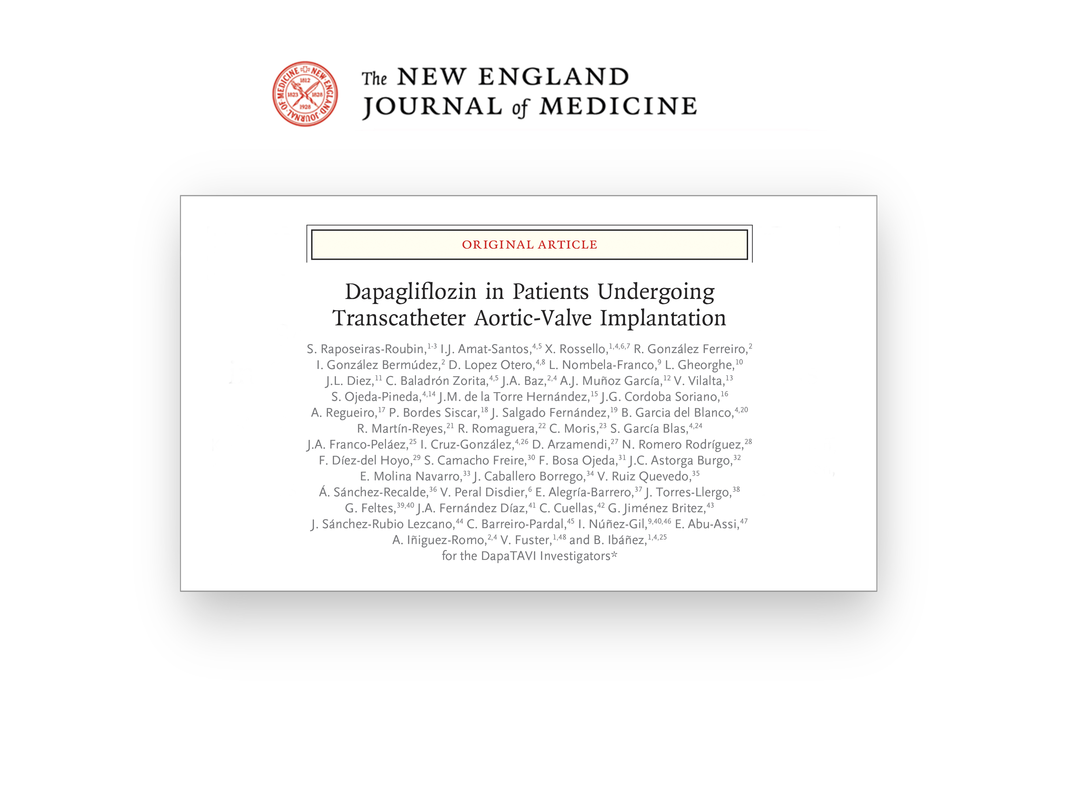

Publication
Sergio Raposeiras-Roubín, MD, PhD
Notes:
Many thanks to all the patients and researchers who made this trial possible.

