Slide 1
STRIDE Semaglutide and walking capacity in people with symptomatic peripheral artery disease and type 2 diabetes: A phase 3b, double-blind, randomized, placebo-controlled trial Marc P. Bonaca, Andrei-Mircea Catarig, Kim Houlind, Bernhard Ludvik, Joakim Nordanstig, Chethana Kalmady Ramesh, Neda Rasouli, Harald Sourij, Alex Videmark, and Subodh Verma, for the STRIDE Trial Investigators American College of Cardiology Scientific Sessions 2025 Late-Breaking Clinical Trial March 29, 2025
STRIDE

Slide 8
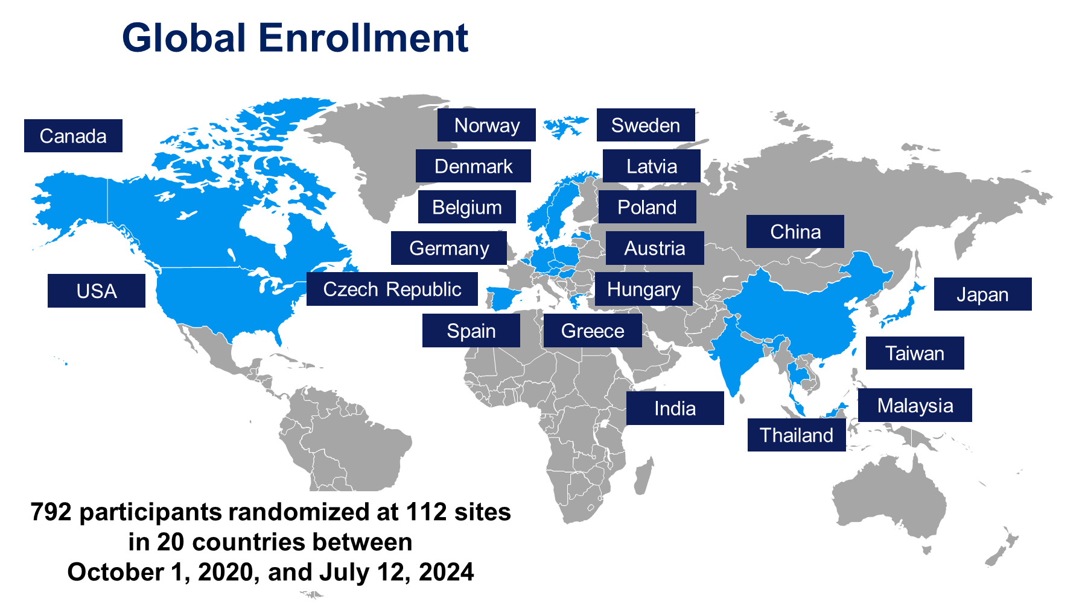

Slide 9
Disposition
>93% completed trial
<10 lost to follow up per arm
Primary analysis ITT
Screened
N=1363
Not randomized
571
Screening failure
533
Patient decision
38
Randomized
N=792
Semaglutide 1.0 mg
Placebo
n=396
n=396*
Did not complete treatment
57 (14.4%)
Did not complete treatment
43 (10.9%)*
Adverse events
28 (7.1%)
Adverse events
17 (4.3%)
Protocol deviation
1 (0.3%)
Protocol deviation
1 (0.3%)
Lost to follow-up
3 (0.8%)
Lost to follow-up
3 (0.8%)
Physician decision
1 (0.3%)
Physician decision
0
Other
24 (6.1%)
Other
21 (5.3%)
Did not complete the trial
30 (7.6%)
Did not complete the trial
17 (4.3%)
Withdrawal by participant
18 (4.5%)
Withdrawal by participant
12 (3.0%)
Lost to follow-up
8 (2.0%)
Lost to follow-up
5 (1.3%)
Physician decision
4 (1.0%)
Physician decision
0
Completed trial
Completed trial
n=366 (92.4%)
n=379 (95.7%)
Completed treatment
Completed treatment
n=339 (85.6%)
n=353 (89.1%)
Without rescue
n=329 (83.1%)
Without rescue
n=336 (84.8%)
With rescue
n=10 (2.5%)
With rescue
n=17 (4.3%)
Rescue medication
n=3 (0.8%)
Rescue medication
n=6 (1.5%)
Rescue revascularization
n=8 (2.0%)
Rescue revascularization
n=11 (2.8%)
*One participant was not exposed to treatment. ITT, intention-to-treat.

Slide 10
Baseline Characteristics
 | Semaglutide 1.0 mg (n=396) % | Placebo (n=396) %
Age – yr – median | 68 | 68
Female | 27 | 22
White | 65 | 70
Asian | 33 | 28
BMI – kg/m² – median | 29 | 28
<27 | 37 | 35
Current smoker | 24 | 27
Previous smoker | 45 | 48
Hypertension | 86 | 90
Prior myocardial infarction | 15 | 22
NYHA Class I–II | 14 | 14
HbA_{1c} – % – median (IQR) | 7.0 (6.5–7.8) | 7.2 (6.5–8.1)*
eGFR – mL/min/1.73 m² – median (IQR) | 89.0 (70.0–99.0) | 87.0 (67.0–98.5)
LDL – mg/dL – geometric mean (CV)† | 69.2 (0.5) | 68.7 (0.5)
Metformin | 80 | 81
SGLT2i | 37 | 33
Insulin | 30 | 34
Statins | 83 | 82
Ezetimibe and/or PCSK9i | 16 | 15
Aspirin or P2Y₁₂ inhibitor | 73 | 74
Direct oral anticoagulants or VKA | 13 | 12
Cilostazol | 11 | 11
Weight
Smoking
Medical
Therapy
*N=395; †n=381 and n=376 for semaglutide and placebo, respectively. Data shown are percentages unless stated otherwise. ASCVD, atherosclerotic cardiovascular disease; BMI, body mass index; CV, coefficient of variation; eGFR, estimated glomerular filtration rate; HbA_{1c}, glycated hemoglobin; IQR, interquartile range; LDL, low-density lipoprotein; MI, myocardial infarction; NYHA, New York Heart Association; P2Y₁₂, purinergic receptor P2Y₁₂; PCSK9i, proprotein convertase subtilisin/kexin type 9; SGLT2i, sodium–glucose cotransporter-2 inhibitor; VKA, vitamin K antagonist.

