Slide 1
5-Year Outcomes After Transcatheter or Surgical Aortic Valve Replacement in Low-Risk Patients With Aortic Stenosis
Evolut Low Risk Trial
Michael J. Reardon, MD¹ and John K. Forrest, MD²
On behalf of the Evolut Low Risk Trial Investigators
¹Methodist DeBakey Heart and Vascular Center, Houston, TX
²Yale University School of Medicine, New Haven, Connecticut, USA

Slide 2
Disclosure of Relevant Financial Relationships
Within the prior 24 months, I have had a relevant financial relationship with a company producing, marketing, selling, re-selling, or distributing healthcare products used by or on patients:
Nature of Financial Relationship | Ineligible Company
Grant/Research Support | Abbott, Boston Scientific, WL Gore Medical, and Medtronic
All relevant financial relationships have been mitigated.
Faculty disclosure information can be found on the app

Slide 3
Study Administration
Principal Investigators
Executive Committee
Michael Reardon, MD
Methodist DeBakey
Heart and Vascular Center
John Forrest, MD
Yale University
School of Medicine
Michael Reardon, MD
Methodist DeBakey
Heart and Vascular Center
John Forrest, MD
Yale University
School of Medicine
G. Michael Deeb, MD
University of Michigan
Health Systems
Steven Yakubov, MD
OhioHealth Riverside
Methodist Hospital
Steering Committee
David Adams, Stanley Chetcuti, G. Michael Deeb, John Forrest, John Heiser, William Merhi, Mubashir Mumtaz, Daniel O’Hair, Jon Resar, Joshua Rovin, Michael Reardon, Paul Teirstein, Steven Yakubov, George Zorn
Screening Committee: Michael Reardon, G. Michael Deeb, Steven Yakubov, Robert Stoler, Thomas Gleason
Echo Core Laboratory: Mayo Clinic
Clinical Events Committee: BAIM Institute
CT Core Laboratory: St. Paul’s Hospital
Statistical Analyses: Medtronic
Sponsor: Medtronic

Slide 4
Background
Transcatheter aortic valve replacement (TAVR) has emerged as the leading procedure for treating symptomatic severe aortic stenosis in the United States, irrespective of the patient's surgical risk
The Evolut Low Risk Trial (NCT02701283) is a multinational, prospective, randomized, interventional study comparing the safety and efficacy of TAVR with Evolut to surgery in low-risk patients with severe aortic stenosis with a 10-year follow-up
We recruited patients at a predicted surgical mortality of 3% or less, with anatomy suitable for both TAVR and surgery
Since these are low risk patients, we have committed to reporting our data frequently
The availability of intermediate- and long-term data assessing TAVR against surgery in low surgical risk aortic stenosis patients is limited

Slide 5
Objective
To evaluate 5-year outcomes with Evolut vs surgery in patients from the Evolut Low Risk trial

Slide 6
Evolut Low Risk Trial design
Prospective, randomized interventional trial conducted at 86 international sites
Severe trileaflet aortic stenosis
Key eligibility
Low predicted risk of death (<3%) from surgery by heart team assessment
Anatomy suitable for both TAVR and surgery
1:1 Randomization
May 2016 to May 2019
Evolut TAVR (N=730)
Surgery (N=684)
1414 patients treated
Primary Endpoint: Composite of all-cause mortality or disabling stroke at 2 years
Planned 10 years of follow-up

Slide 7
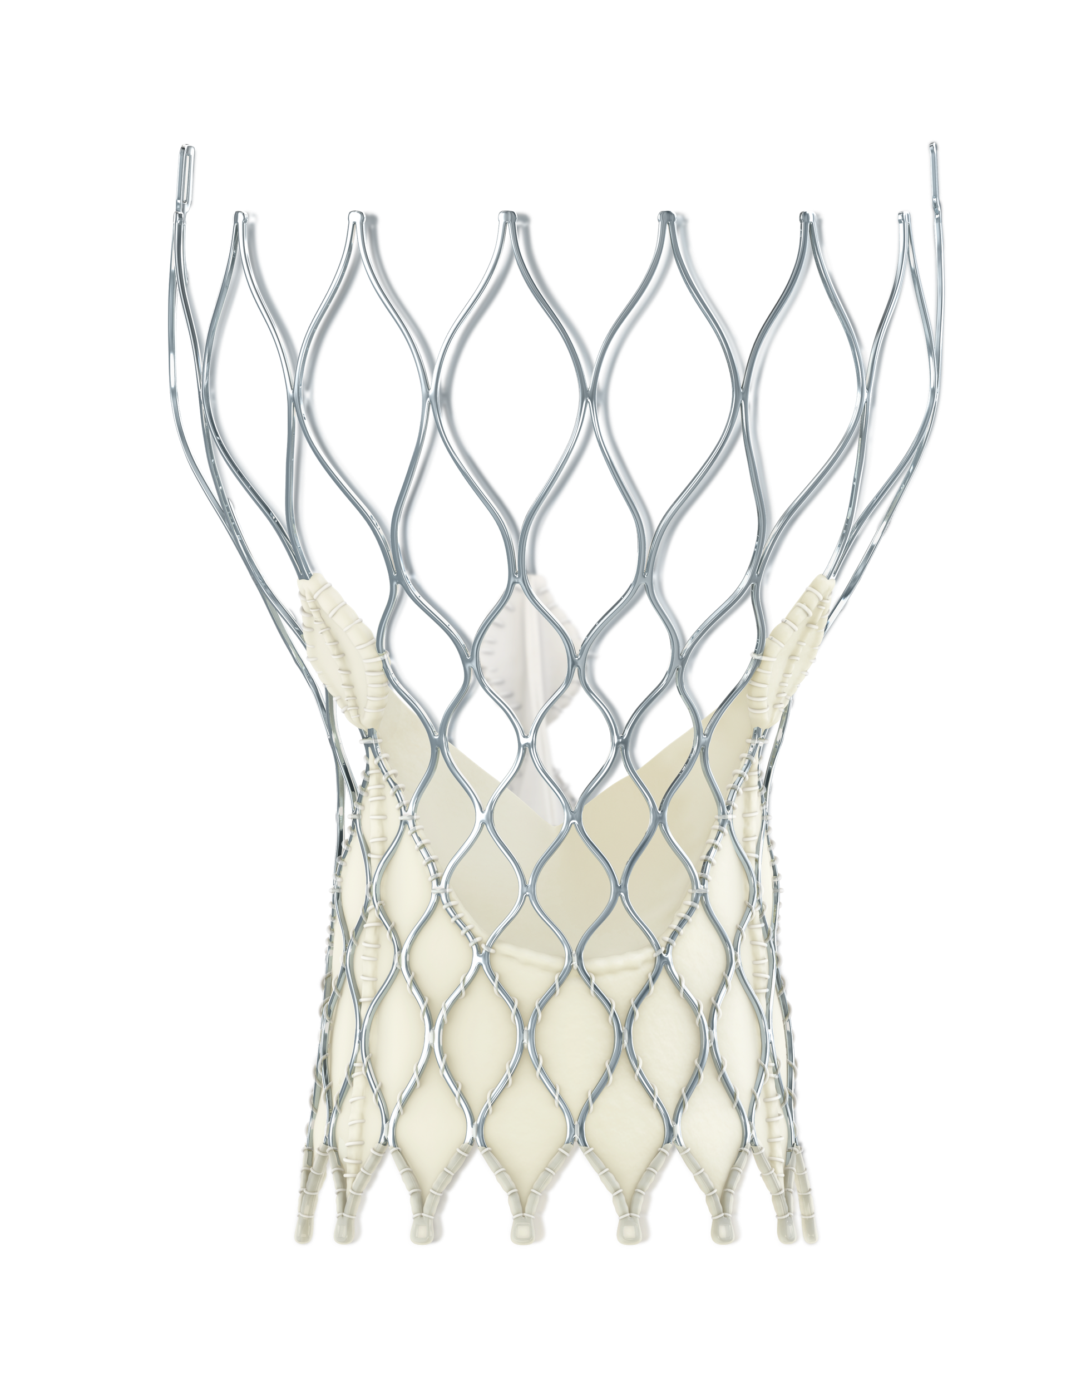
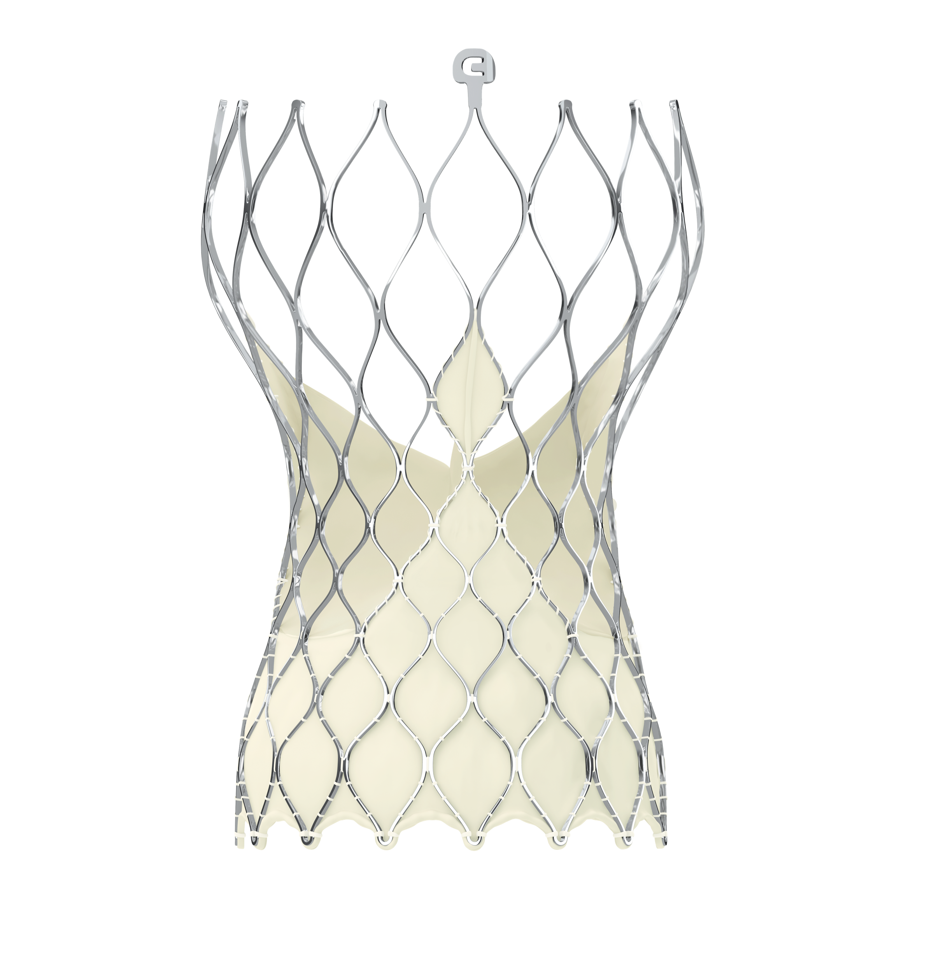
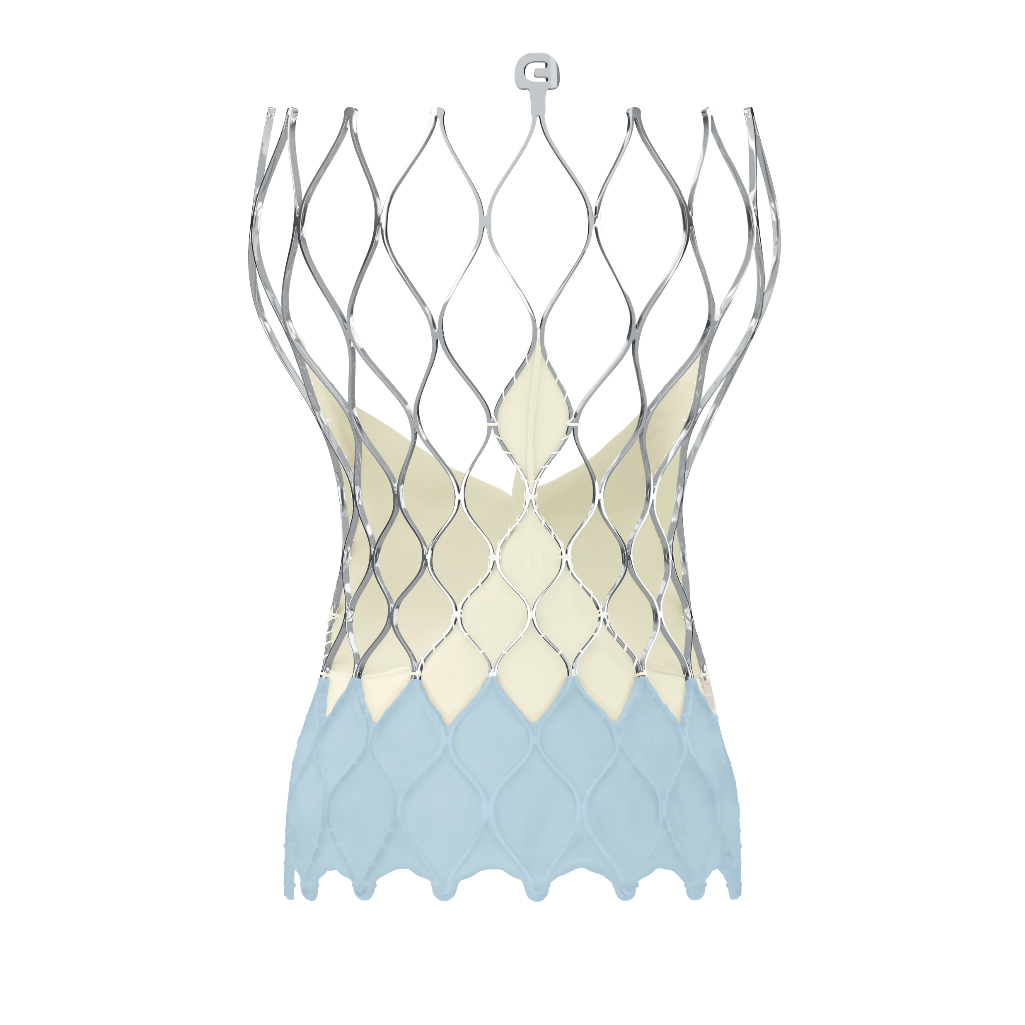
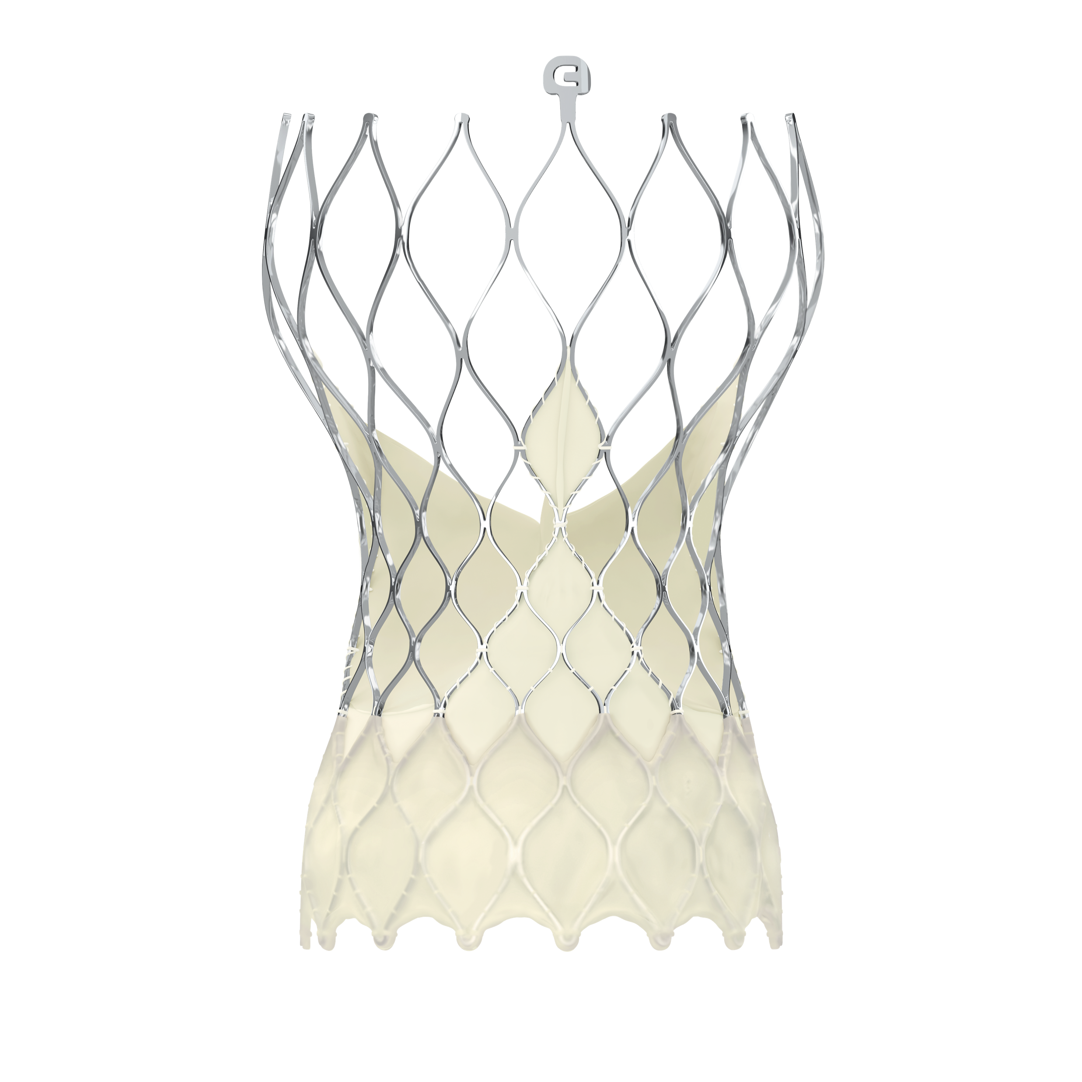
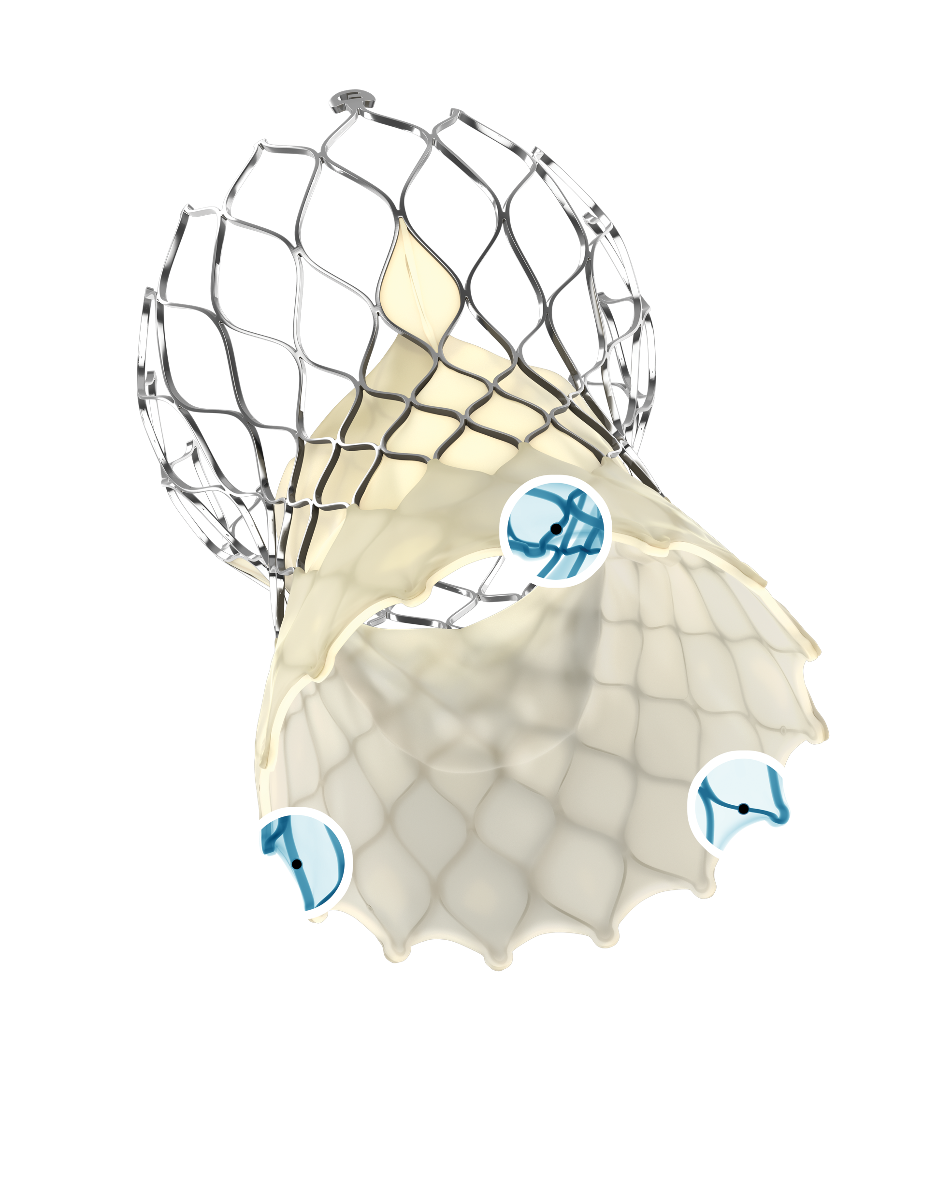
Evolution of Evolut Transcatheter Aortic Valves
Evolut Low Risk Trial Valves
Subsequent Generations
3.6%
73.0%
23.4%
CoreValve™ 2014
Evolut™ R
2015
Evolut™ PRO 2017
Evolut™ PRO+ 2019
Evolut™ FX 2022
Evolut™ FX+ 2024
First self-expanding TAVR valve
Recapturability
Lower delivery profile
Consistent radial force
Reduction in paravalvular leak
Lower delivery profile
Large valve PVL performance
Greater precision and control
Radiopaque markers deployment depth and commissure location
Ease of use
Larger window for enhanced coronary access
Same valve performance as the CoreValve/Evolut platform

Slide 8
US Study Sites (N = 61)
Univ. of Michigan
Univ. of Pittsburgh
Swedish MC
Spectrum Health
St. John Hospital
Strong Memorial
Oregon Health & Science Univ.
Sanford MC
Case MC
Univ. Vermont MC
Baystate MC
Mass General
Beth Israel Deaconess
Abbott NW
St. Joseph’s Hospital
Yale New Haven Hospital
North Shore Univ. Hospital
St. Lukes/Aurora
St. Francis Hospital
Mercy General Hospital
The Mount Sinai MC
Univ. of Utah
Mercy Medical Ctr
Loyola
Riverside Methodist & OSU
Geisinger MC
El Camino
U Pittsburg Pinnacle Health
Lehigh Valley Hospital
Univ. of Colorado Hospital
St. Vincent
Johns Hopkins, MedStar Union, & Univ. of Maryland MC
Univ. of Kansas
Good Samaritan
Winchester MC
Jewish Hospital
Bon Secours Heart & Vascular Institute
Mercy Hospital
Vanderbilt
Duke Univ.
Los Robles Hospital
Wake Forest Baptist MC
Keck Hospital
Abrazo Arizona Heart Hospital
Integris Baptist MC
Scripps Hospital
Piedmont Heart Institute
Medical Univ. of South Carolina
Baylor Heart & Vascular
Methodist DeBakey & Baylor College of Medicine
Tallahassee Research Institute
Methodist Hospital
CV Institute of the South
Morton Plant
Lee Memorial Health System
Delray Medical Center
Univ. of Miami

Slide 9
International: Canada, Europe, Japan, Australia, New Zealand (N = 25)
CHRU de Lille
Jacques Cartier
St. Antonius Hospital
Erasmus
Catherina Hospital
Sapporo Higashi Tokushukai Hospital
Clinique Pasteur
IUCPQ
McGill University & Montreal Heart Institute
Sendai Kousei Hospital
Toronto General Hospital, Sunnybrook Health & London Health Sciences
Sakakibara Heart Institute
Kokura Memorial Hospital
Shonan Kamakura General Hospital
Teikyo University Hospital
Osaka University Hospital
National Cerebral and Cardiovascular Center
Waikato Hospital
Royal North Shore
Fiona Stanley Hospital
St. Vincent’s Hospital
The Alfred Hospital & MonashHeart

Slide 10
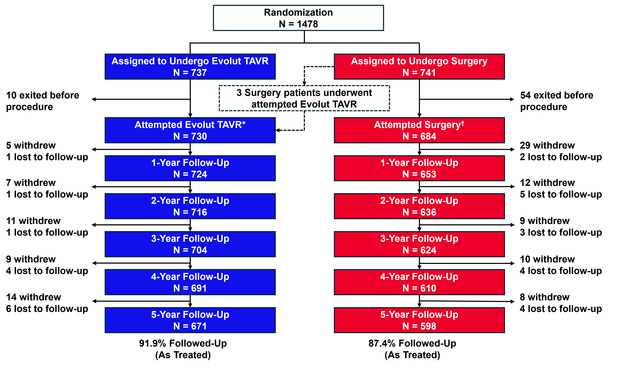
Patient Flow
*Evolut R: 73%; Evolut Pro: 23.4%; CoreValve: 3.6%. †Edwards: 56.7%; Abbott: 18.6%; LivaNova: 13.8%; Medtronic: 10.9%.

Slide 11
Baseline Characteristics
 | Evolut (N=730) | Surgery (N=684)
Age – yr | 74.1 ± 5.8 | 73.7 ± 5.9
Age <70 yr | 21.4% | 24.0%
Age <65 yr | 5.8% | 7.0%
Female sex | 36.4% | 34.1%
STS-PROM score | 2.0% ± 0.7 | 1.9% ± 0.7
NYHA functional class
III | 24.8% | 27.8%
IV | 0.1% | 0.4%
Hypertension | 84.8% | 82.6%
Chronic lung disease, COPD | 15.1% | 18.0%
Previous coronary artery bypass graft | 2.5% | 2.0%
Previous percutaneous coronary intervention | 14.1% | 12.9%
Previous myocardial infarction | 6.7% | 4.8%
Atrial fibrillation/atrial flutter | 15.4% | 14.4%
Pre-existing permanent pacemaker or defibrillator | 3.3% | 4.0%
Left ventricular ejection fraction | 61.7% ± 7.9 | 61.9% ± 7.7
Continuous variables reported as mean ± standard deviation and categorical variables were presented as percentages. There were no significant differences (P<0.05) in baseline characteristics between trial groups.

Slide 12
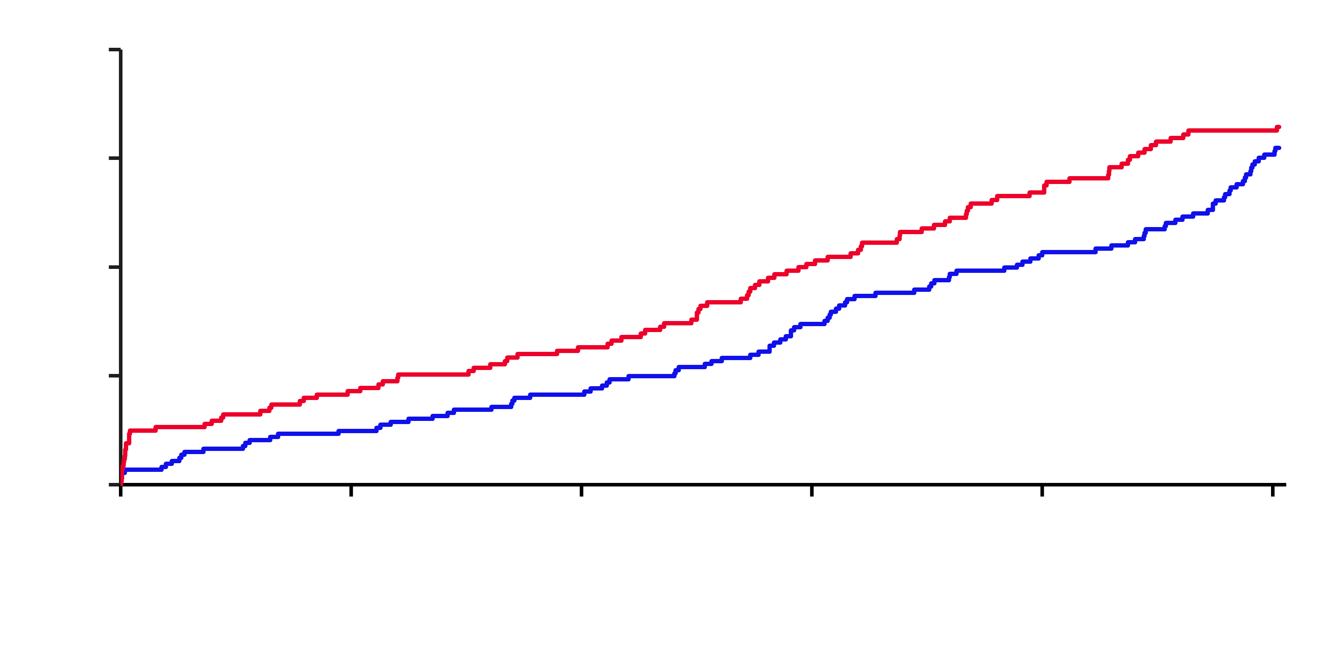
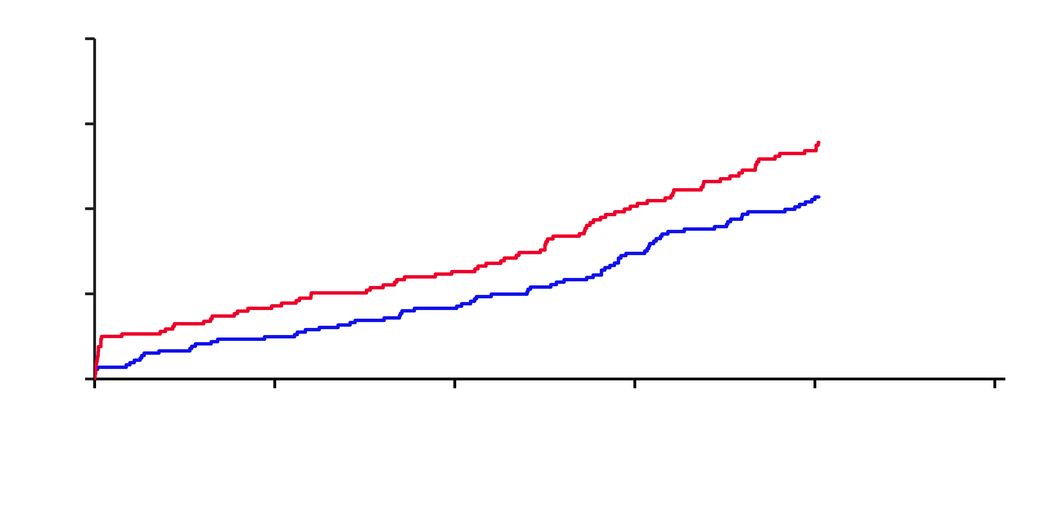
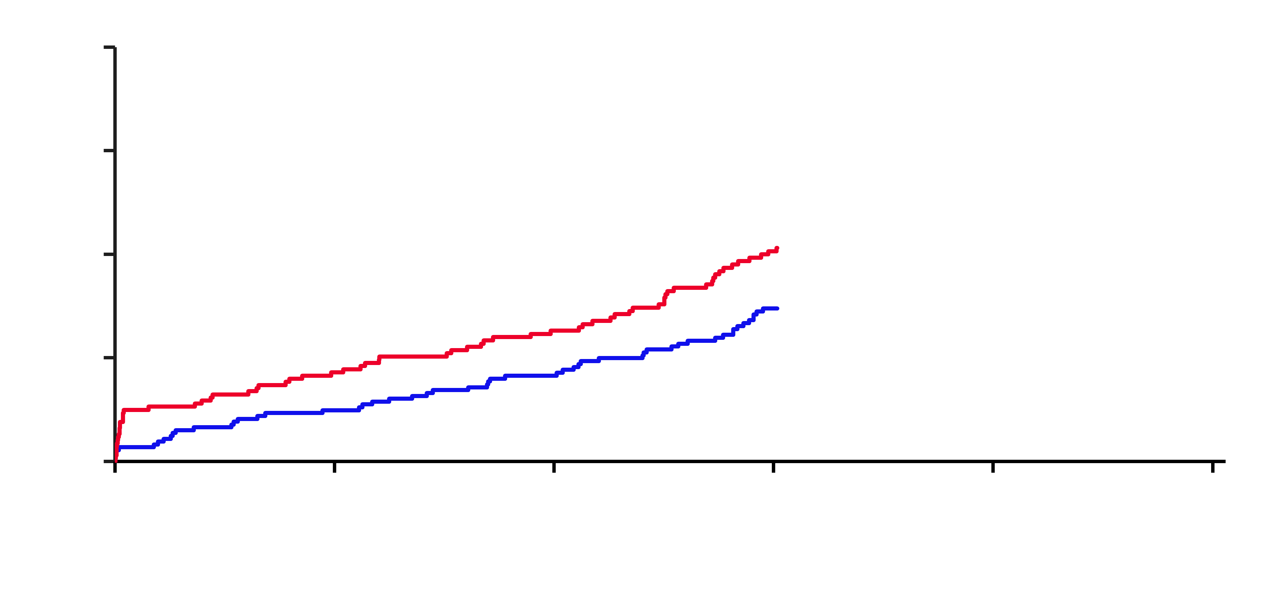
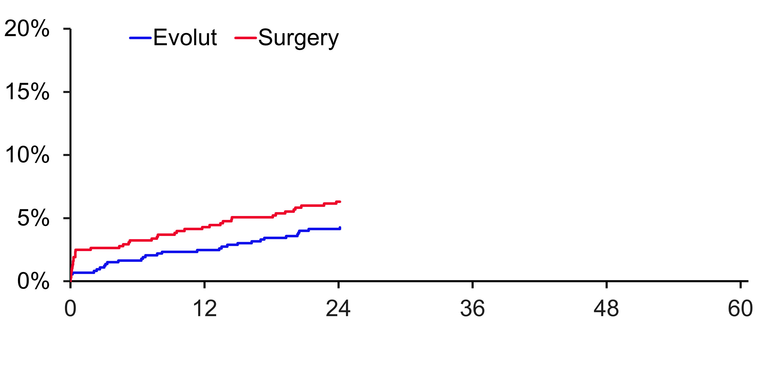
Primary Endpoint: All-cause Mortality Or Disabling Stroke
All-Cause Mortality or Disabling Stroke
16.4%
Log-rank p-value at 5Y = 0.47
13.9%
15.5%
10.3%
10.7%
6.3%
7.4%
4.3%
Months Since Procedure
 |  |  |  |  |  |  | 542
 |  |  |  |  |  |  | 475
 |  |  |  |  | 651
 |  |  |  |  | 558
Evolut | 730 | 715 | 706 | 685
Surgery | 684 | 648 | 627 | 595
 |  |  |  |  |  | 615
 |  |  |  |  |  | 520

Slide 13
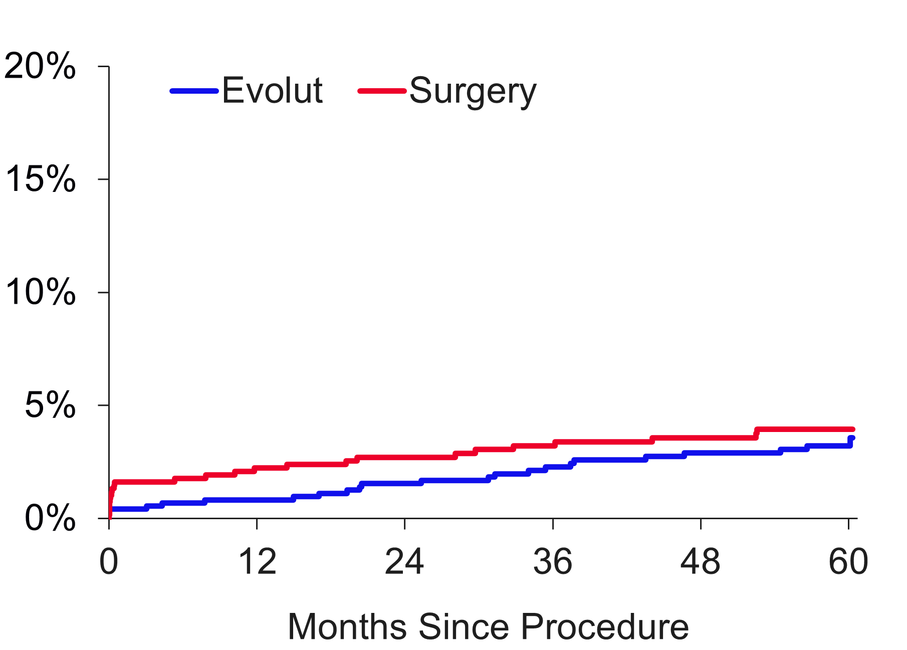
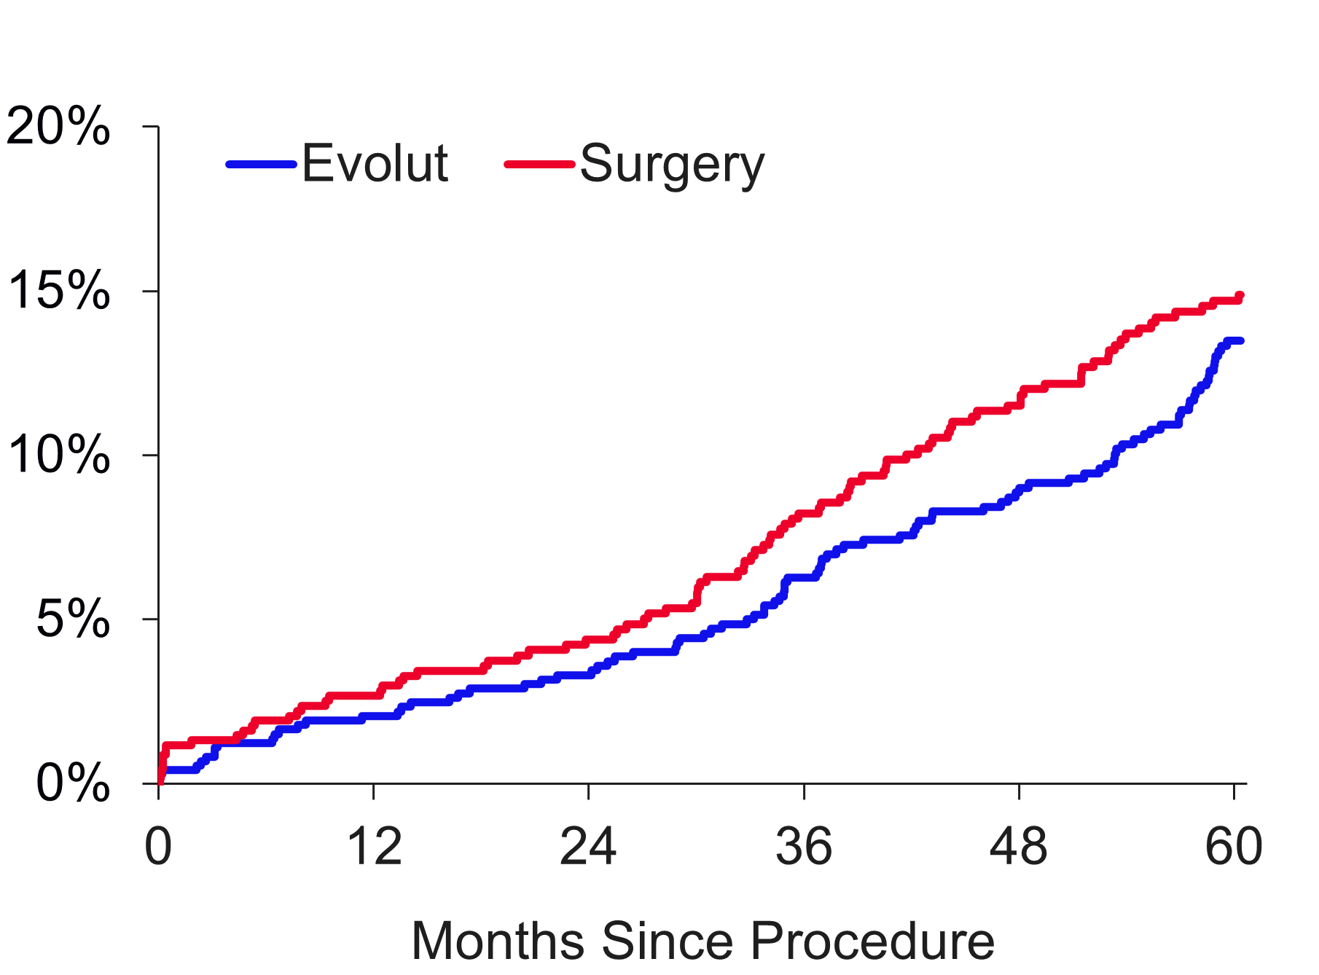
All-Cause Mortality And Disabling Stroke
Disabling Stroke
All-Cause Mortality
Log-rank p-value at 5Y = 0.57
Log-rank p-value at 5Y = 0.39
14.9%
Patients
Patients
13.5%
4.0%
3.6%
Evolut | 730 | 715 | 706 | 685 | 651 | 615 | 542
Surgery | 684 | 648 | 627 | 595 | 558 | 520 | 475
Evolut | 730 | 718 | 709 | 691 | 659 | 626 | 555
Surgery | 684 | 656 | 636 | 605 | 569 | 530 | 482

Slide 14
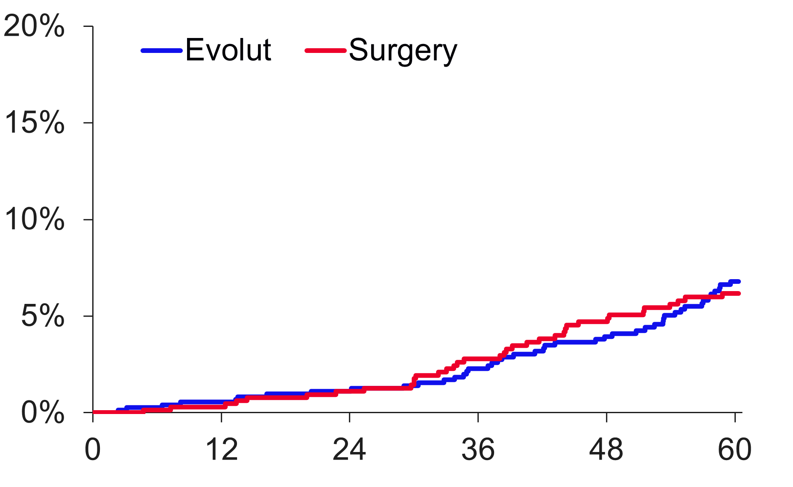
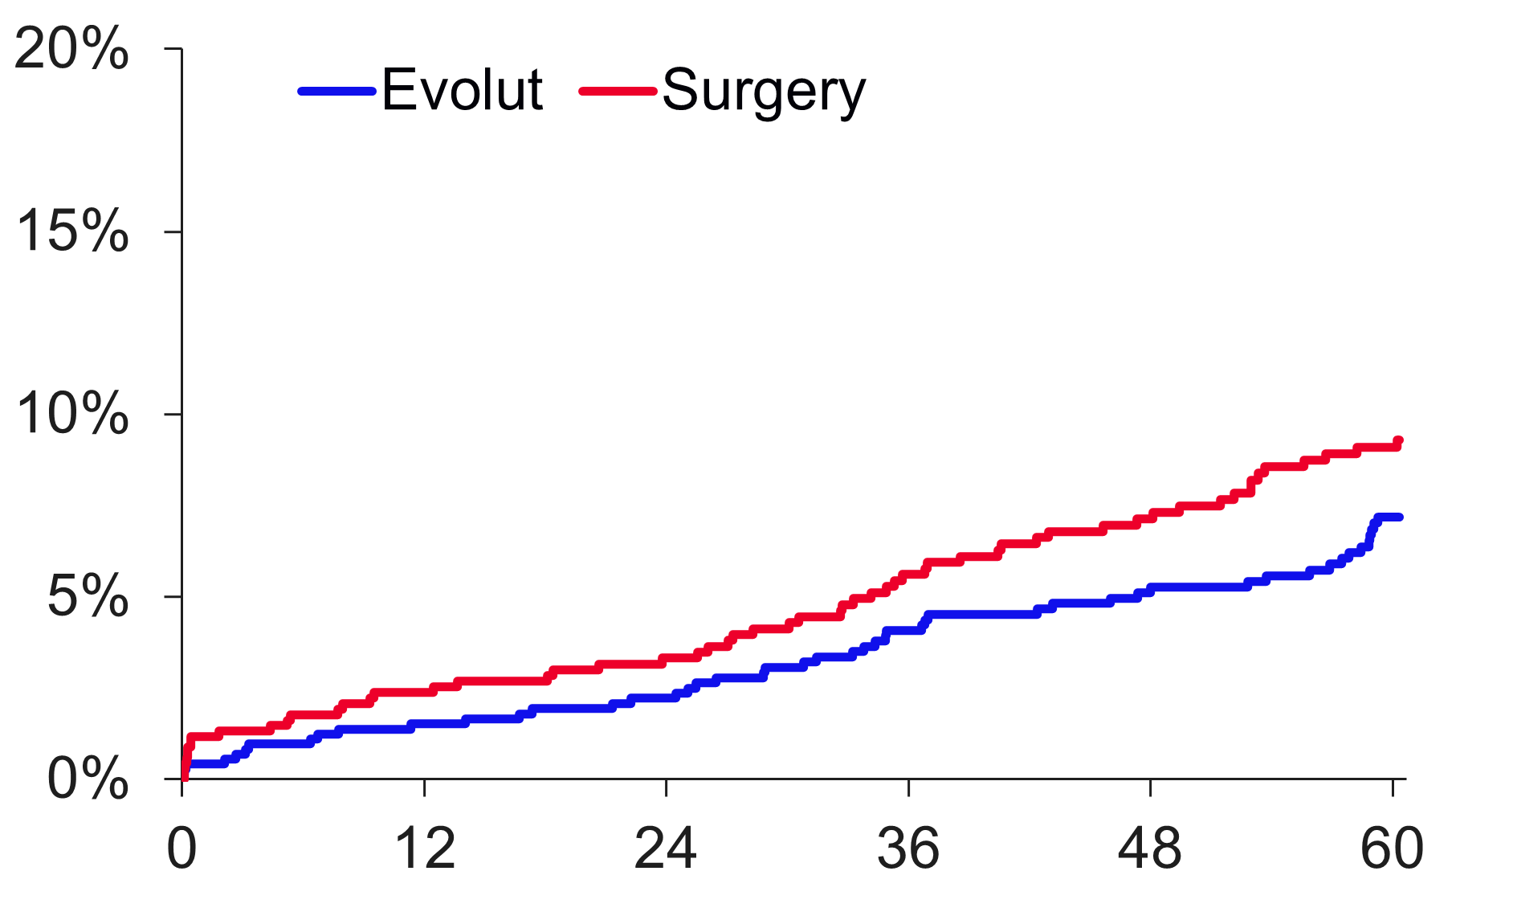
Non-Cardiovascular And Cardiovascular Mortality
Non-Cardiovascular Mortality
Cardiovascular Mortality
Patients
Log-rank p-value at 5Y = 0.73
Log-rank p-value at 5Y = 0.15
5 Years
Δ 2.1%
Patients
2 Years
Δ 1.1%
9.3%
6.8%
6.2%
7.2%
Months Since Procedure
Months Since Procedure
Evolut | 730 | 718 | 709 | 691 | 659 | 626 | 555
Surgery | 684 | 656 | 636 | 605 | 569 | 530 | 482
Evolut | 730 | 718 | 709 | 691 | 659 | 626 | 555
Surgery | 684 | 656 | 636 | 605 | 569 | 530 | 482

Slide 15
5-Year Clinical Outcomes
 | Evolut | Surgery | HR (95% CI) | P Value (log-rank)
All-cause mortality or disabling stroke | 15.5% | 16.4% | 0.90 (0.69, 1.18) | 0.47
All-cause mortality | 13.5% | 14.9% | 0.88 (0.66, 1.17) | 0.39
Cardiovascular death | 7.2% | 9.3% | 0.75 (0.51, 1.11) | 0.15
Non-cardiovascular death | 6.8% | 6.2% | 1.08 (0.70, 1.67) | 0.73
Disabling stroke | 3.6% | 4.0% | 0.85 (0.49, 1.49) | 0.57
Aortic valve hospitalization | 13.9% | 15.1% | 0.89 (0.67, 1.19) | 0.44
Myocardial infarction | 6.0% | 3.6% | 1.63 (0.97, 2.75) | 0.06
Total valve thrombosis | 0.9% | 0.6% | 1.36 (0.38, 4.82) | 0.63
New pacemaker implantª | 27.0% | 11.3% | 2.70 (2.04, 3.55) | <0.001
Total pacemaker implant^{b} | 26.3% | 11.0% | 2.68 (2.04, 3.53) | <0.001
Atrial fibrillation | 16.3% | 41.2% | 0.32 (0.25, 0.39) | <0.001
Reintervention^{c} | 3.3% | 2.5% | 1.30 (0.66, 2.56) | 0.44
Clinical outcomes are presented as Kaplan-Meier % with HR (95% CI). ªPatients with pacemaker or ICD at baseline are not included. Not adjudicated by CEC. ^{b}Patients with pacemaker or ICD at baseline are included. Not adjudicated by CEC. ^{c}One crossover patient (randomized to TAVR but received a surgical intervention) included in surgery group.

Slide 16
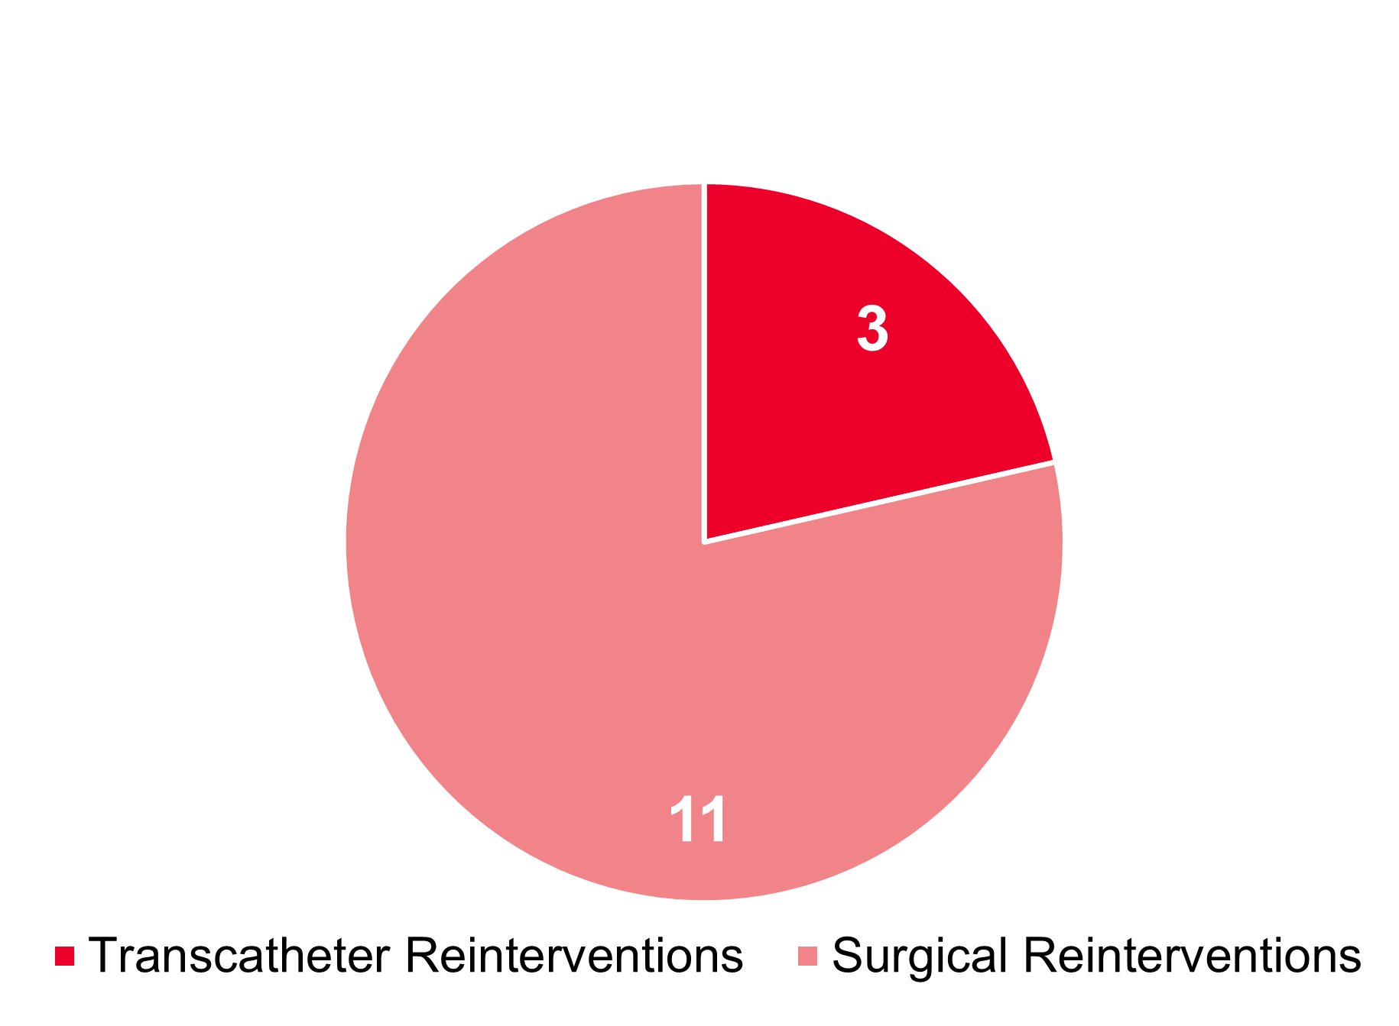
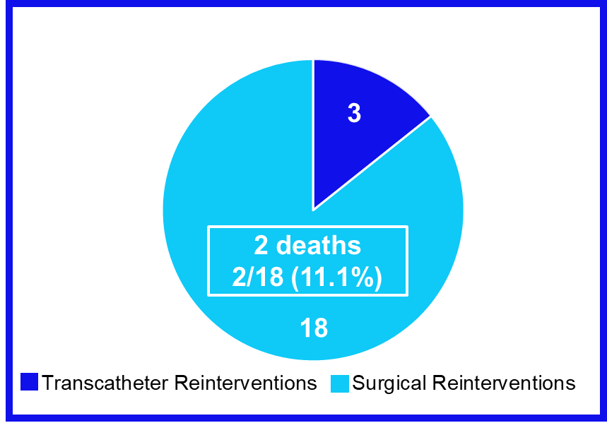
Reinterventions
No difference in reinterventions between Evolut and surgery
 | Evolut | Surgery | P Value (log-rank)
Reintervention | 21 (3.3%) | 14 (2.5%) | 0.44
Surgical | 18 (2.8%) | 11 (2.0%) | 0.34
Transcatheter | 3 (0.5%) | 3 (0.5%) | 0.84
Reinterventions in Evolut arm (N=21)
Reinterventions in surgery arm (N=14)
2 deaths
2/11 (18.2%)

Slide 17
All-Cause Mortality Or Disabling Stroke Subgroup Analysis
Variable | Evolut | Surgery |  |  | HR (95% CI) | P Value
 | KM rate, 5 years
Age, years |  |  |  |  |  | 0.8451
<75 | 11.9% | 13.4% |  |  | 0.87 (0.57-1.33)
≥75 | 18.9% | 19.8% |  |  | 0.91 (0.64-1.29)
Sex |  |  |  |  |  | 0.5366
Female | 12.9% | 12.1% |  |  | 1.05 (0.63-1.76)
Male | 17.0% | 18.6% |  |  | 0.86 (0.63-1.18)
STS-PROM, % |  |  |  |  |  | 0.8263
<2.0 | 12.3% | 12.6% |  |  | 0.94 (0.63-1.41)
≥2.0 | 19.5% | 21.4% |  |  | 0.88 (0.61-1.26)
NYHA |  |  |  |  |  | 0.5851
I/II | 13.4% | 15.0% |  |  | 0.87 (0.62-1.22)
III/IV | 22.1% | 20.2% |  |  | 1.02 (0.64-1.61)
Baseline KCCQ Overall Score |  |  |  |  |  | 0.6475
≤72 | 16.1% | 17.7% |  |  | 0.85 (0.59-1.24)
>72 | 14.7% | 15.0% |  |  | 0.96 (0.65-1.43)
COPD |  |  |  |  |  | 0.5460
Yes | 20.9% | 18.8% |  |  | 1.10 (0.60-2.02)
No | 15.1% | 16.0% |  |  | 0.90 (0.67-1.23)
Baseline Atrial fibrillation/flutter |  |  |  |  |  | 0.5177
Yes | 26.4% | 24.5% |  |  | 1.05 (0.60-1.84)
No | 13.4% | 15.0% |  |  | 0.86 (0.63-1.17)
BMI, kg/m² |  |  |  |  |  | 0.7226
≤30 | 15.6% | 17.4% |  |  | 0.86 (0.59-1.25)
>30 | 15.4% | 15.5% |  |  | 0.95 (0.64-1.41)
0.0
0.1
1.0
10.0
Evolut Better Surgery Better

Slide 18
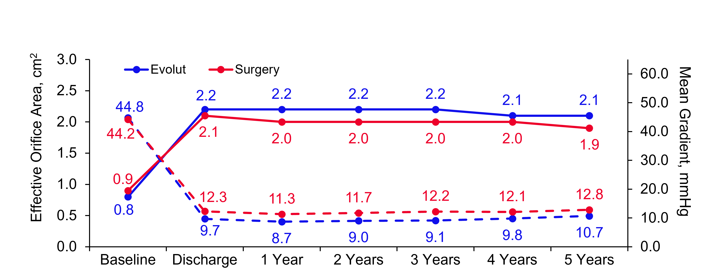
Hemodynamic Valve Performance
EOA and MG
P<0.001 at 5 Years
Time Post Procedure
Evolut EOA | 637 | 577 | 565 | 535 | 495 | 439 | 399
Surgery EOA | 596 | 406 | 525 | 435 | 397 | 370 | 313
Evolut MG | 717 | 704 | 662 | 607 | 549 | 498 | 467
Surgery MG | 679 | 632 | 597 | 515 | 457 | 436 | 387

Slide 19
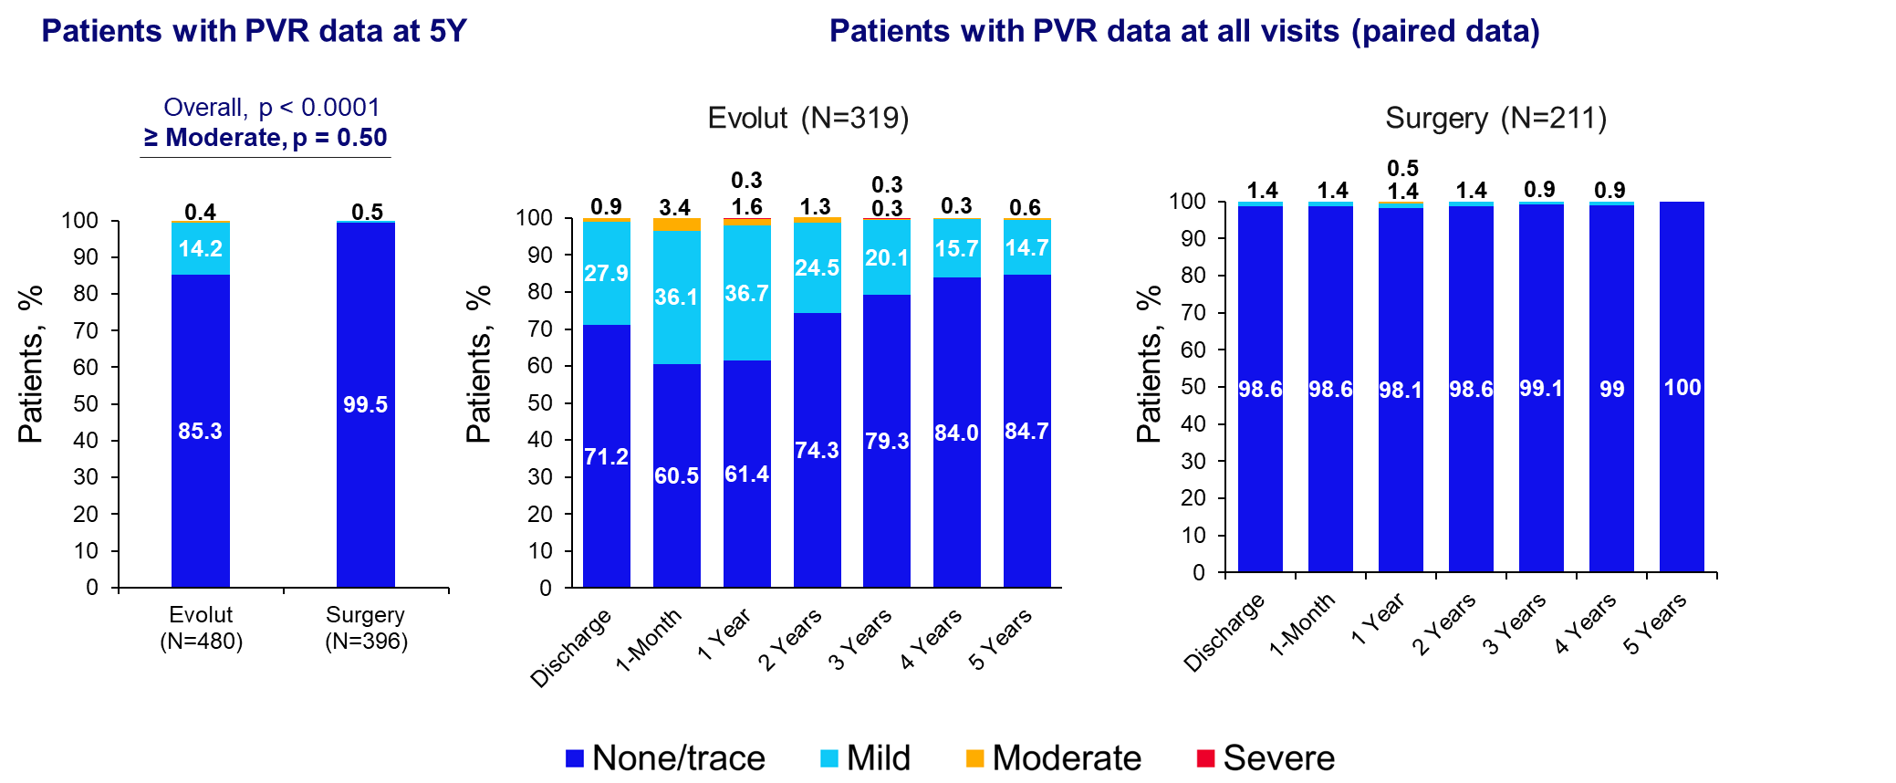
Paravalvular Regurgitation

Slide 20
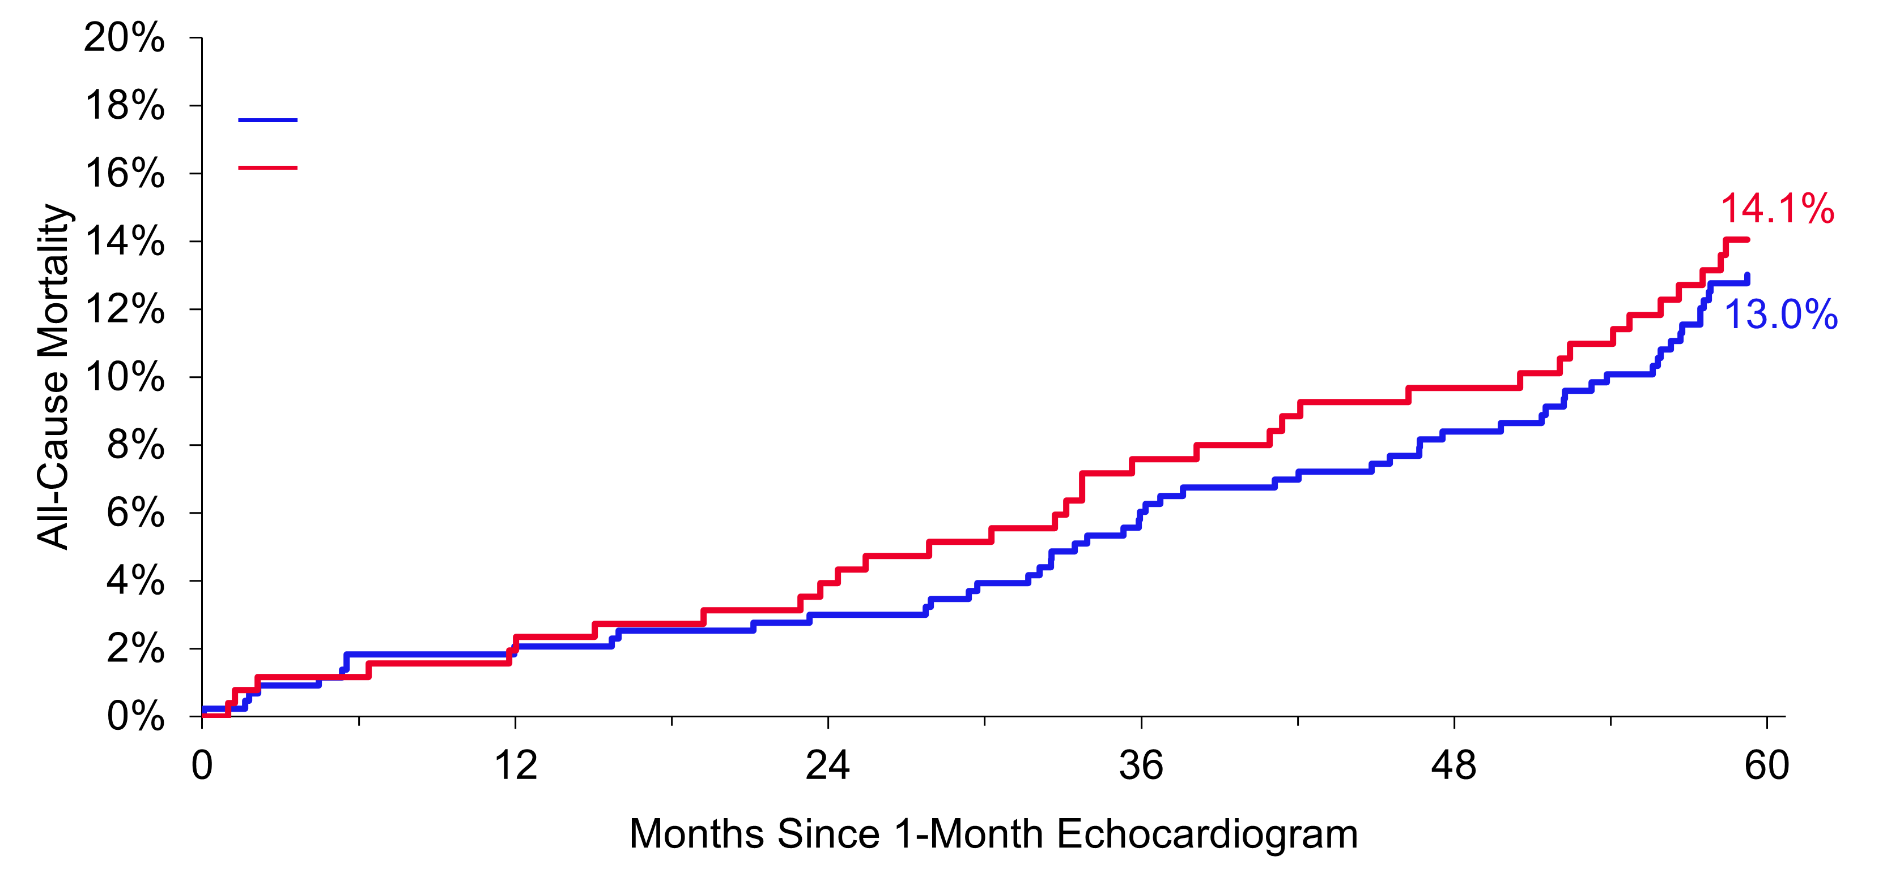
Effect of 1-Month Paravalvular Regurgitation on Mortality in Evolut
Early mild paravalvular regurgitation had no impact on 5-year mortality
 | KM Rate at 5 Years | 95% CI
None/trace PVR at 1 month | 13.0% | 10.1%–16.7%
Mild PVR at 1 month | 14.1% | 10.1%–19.5%
Log-rank p-value = 0.67
PVR at 1 Month
None/trace | 438 | 427 | 424 | 416 | 398 | 384 | 344
Mild | 257 | 254 | 249 | 240 | 221 | 213 | 185

Slide 21
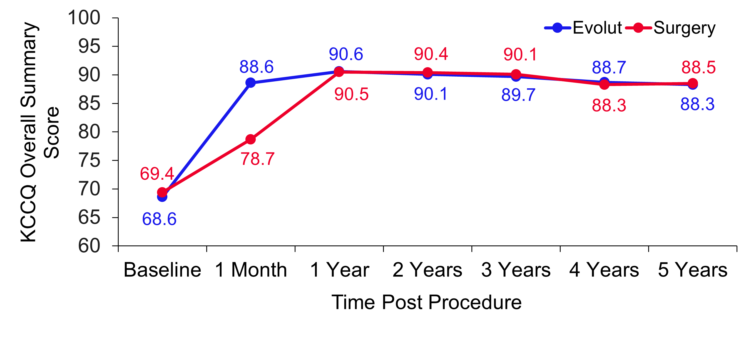
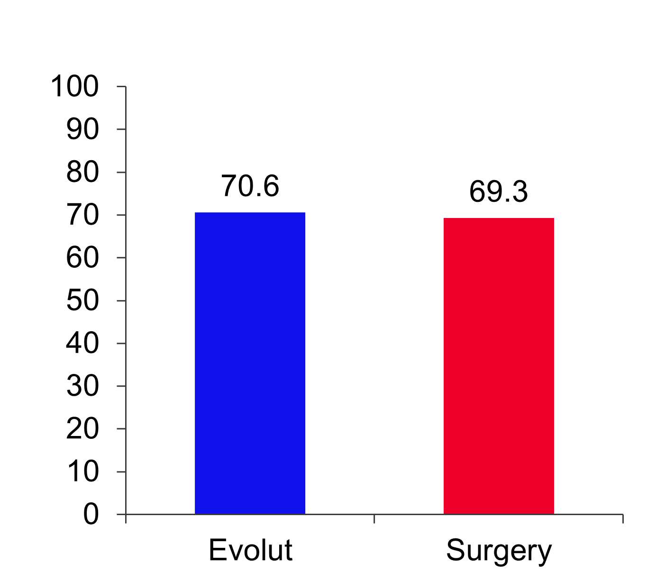
KCCQ Overall Summary Score
Alive and well at 5 Years (alive and KCCQ summary score >75)
Patients, %
Change from Baseline
Evolut | n | 720 | 689 | 661 | 617 | 561 | 520
 | Mean ± SD | 20.0 ± 21.1 | 21.6 ± 20.6 | 20.9 ± 20.8 | 20.1 ± 20.6 | 19.3 ± 20.7 | 18.9 ± 21.9
Surgery | n | 645 | 607 | 565 | 522 | 483 | 445
 | Mean ± SD | 9.2 ± 22.3 | 20.7 ± 20.3 | 20.0 ± 20.0 | 19.3 ± 21.1 | 17.3 ± 20.9 | 17.8 ± 21.7
 | p-value | <0.001 | 0.42 | 0.44 | 0.53 | 0.13 | 0.45

Slide 22
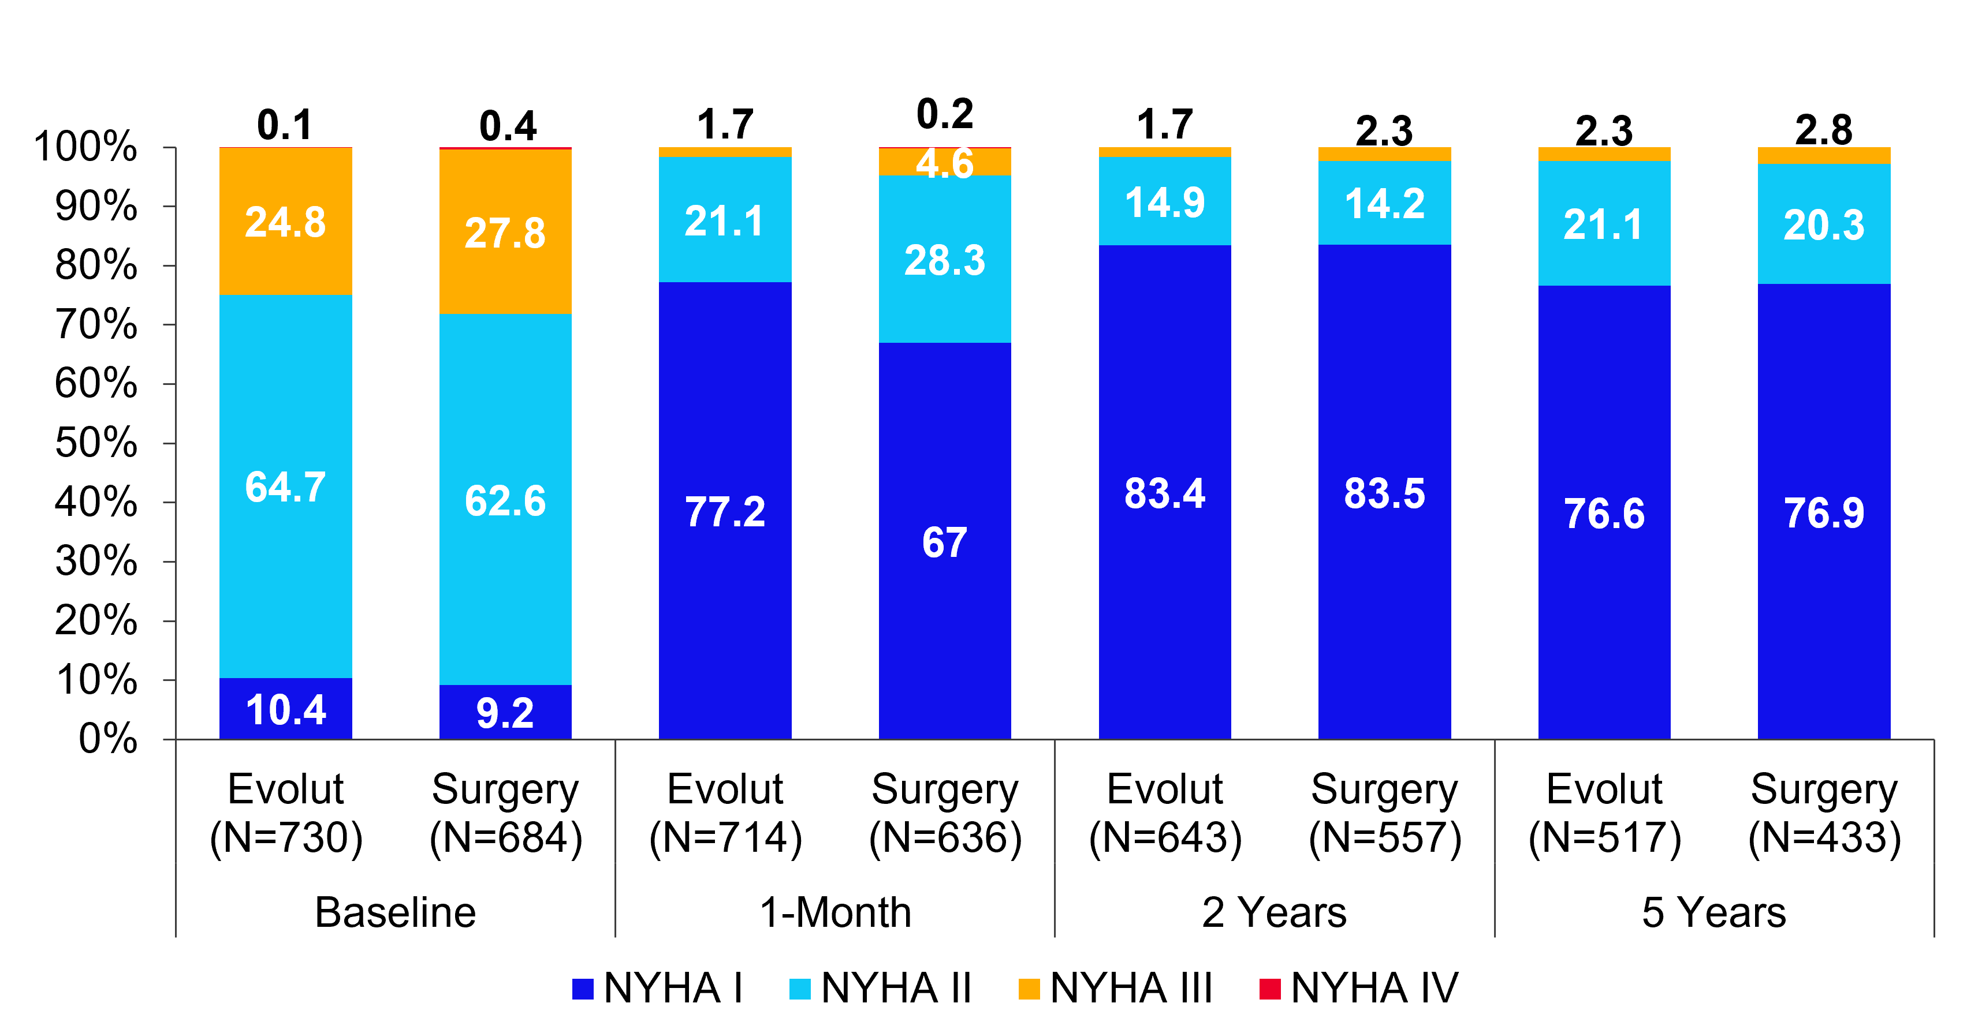
NYHA Classification By Visit
Both Evolut and surgery gave patients good relief from symptoms
Patients, %

Slide 23
Summary
Low surgical risk patients with severe aortic stenosis who were treated with either Evolut or surgery showed comparable rates of all-cause mortality or disabling stroke at 5 years (15.5% Evolut and 16.4% surgery, p=0.47)
Importantly, cardiovascular mortality remains similar for Evolut and surgery at 5 years (Δ at 5 years favoring Evolut: 2.1%)
Sustained significantly lower mean gradients and larger EOAs (p<0.001 for both) with Evolut vs surgery at 5 years
No difference in valve reintervention rates, moderate or greater PVR, or alive and well status at 5 years
The results of the Evolut Low Risk Trial at five years support Evolut as a safe, effective, and durable alternative to surgery for patients with severe aortic stenosis and low surgical risk

Slide 24
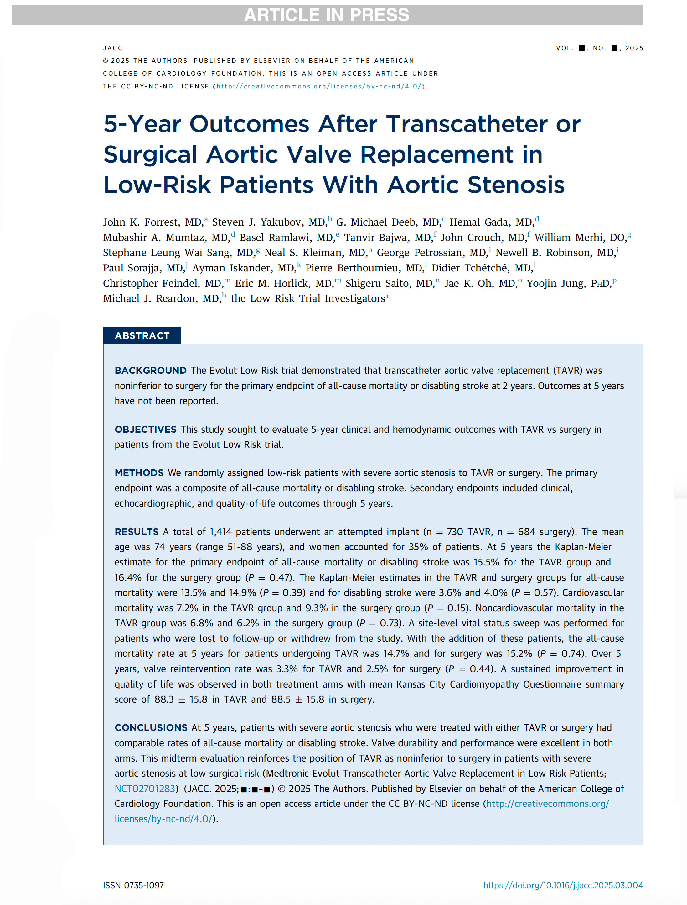
Simultaneously published in JACC

