Slide 1

Lepodisiran: An Extended-Duration
Small-interfering RNA Targeting Lipoprotein(a)
Steven E. Nissen MD MACC
Wei Ni PhD, Xi Shen PhD, Qiuqing Wang MS; Ann Marie Navar MD PhD, Stephen J. Nicholls MBBS PhD, Kathy Wolski MPH, Laura Michael PhD, Axel Haupt MD, John H. Krege, MD
Disclosure
Clinical Trials: AbbVie, Arrowhead, AstraZeneca, Bristol Myers Squibb, Crispr Therapeutics, Eli Lilly, Esperion, Kardigan, Medtronic, New Amsterdam Pharma, Novartis, and Silence Therapeutics.
Companies are directed to pay any honoraria, speaking or consulting fees directly to charity

Slide 2
Background
Lipoprotein(a) is an important genetically-determined risk factor
for ACSVD and AS with no approved pharmacological treatments.
The LPA gene encodes apolipoprotein(a), an essential component required for production of lipoprotein(a).
Lepodisiran is a noncanonical, tetraloop, dicer-substrate, extended-duration siRNA designed to degrade the hepatic mRNA coding for apolipoprotein(a).
The current study is a phase 2 trial examining the safety and efficacy of this siRNA in participants followed for up to 540 days.

Slide 3
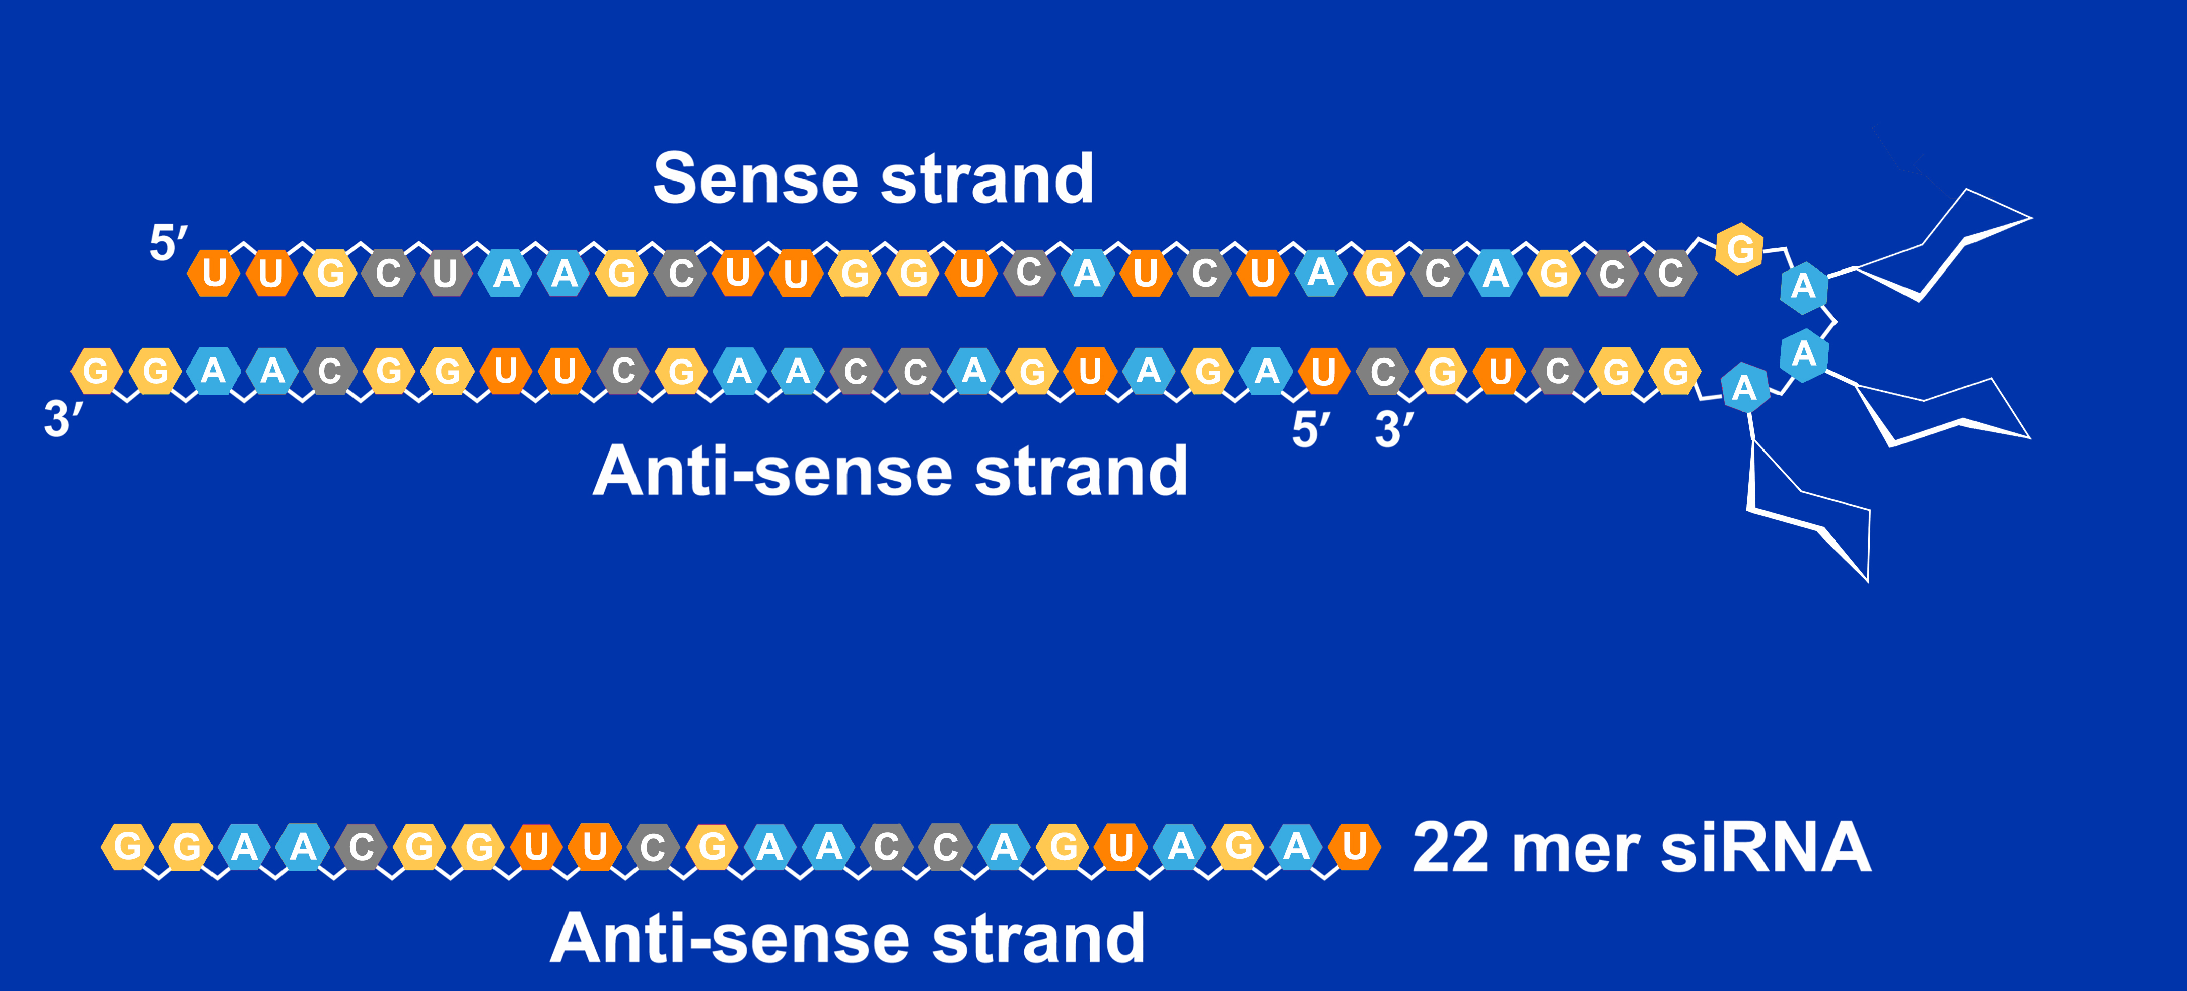
Lepodisiran: A Noncanonical Dicer-Substrate Tetraloop siRNA
GalNAc
Some nucleotides chemically modified for resistance to degradation by ribonucleases

Slide 4
Study Design
320 participants, age ≥40 years, with lipoprotein(a) serum concentration ≥175 nmol/L.
Randomized 1:2:2:2:2 to receive at baseline and day 180:
  Lepodisiran 16 mg + 16 mg
  Lepodisiran 96 mg + 96 mg
  Lepodisiran 400 mg + 400 mg
  Lepodisiran 400 mg + placebo
  Placebo + placebo
Efficacy and safety data collected during 540 days of follow up.

Slide 5
Primary Efficacy and Safety Outcomes
Efficacy assessed as placebo-adjusted time-averaged reductions
in lipoprotein(a) over time intervals:
Primary end point, day 60 to 180
Selected secondary end points, days:
    30 to 180
    30 to 360
    240 to 360
  Effect of treatment regimens on apolipoprotein B
Safety: Investigator reported adverse events, lab evaluations

Slide 6
Selected Baseline Characteristics of Participants
 | Placebo (n=69) | 16/16 mg (n=36) | 96/96 mg (n=74) | 400 mg/ placebo (n=72) | 400/400 mg (n=69)
Age (years) | 64 | 63 | 64 | 62 | 61
Male (%) | 54 | 75 | 53 | 63 | 49
White (%) | 86 | 83 | 78 | 83 | 77
Median Lp(a), nmol/L | 242 | 243 | 262 | 264 | 242
Median LDL-C, mg/dL | 76 | 79 | 79 | 79 | 82
Median Apo B, mg/dL | 75 | 83 | 83 | 79 | 79

Slide 7
End Points: Time-Averaged Change in Lipoprotein(a)
Pooled 400 mg dose groups
Single 400 mg dose
Two 400 mg doses
Primary
End Point
60-180
30-180
30-360
240-360
30-360
240-360
Time Intervals (Days) Following Initial Dose

Slide 8
Placebo-adjusted Absolute Change in Lipoprotein(a)
180
240
300
360
540
Days Following Initial Dose

Slide 9
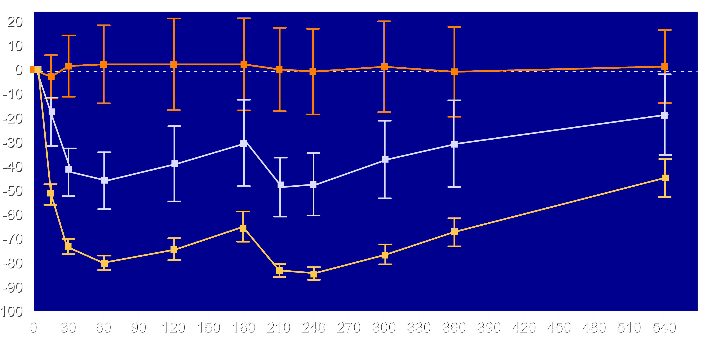

Lipoprotein(a) Changes for Placebo, 16 and 96 mg Doses
Placebo
Lepodisiran 400mg/Placebo
Lepodisiran 400mg/400mg
Lepodisiran 400mg Pooled
Mean Percent Change (95% CI)
Placebo
16 mg
96 mg
-84.7%
Visit Day

Slide 10
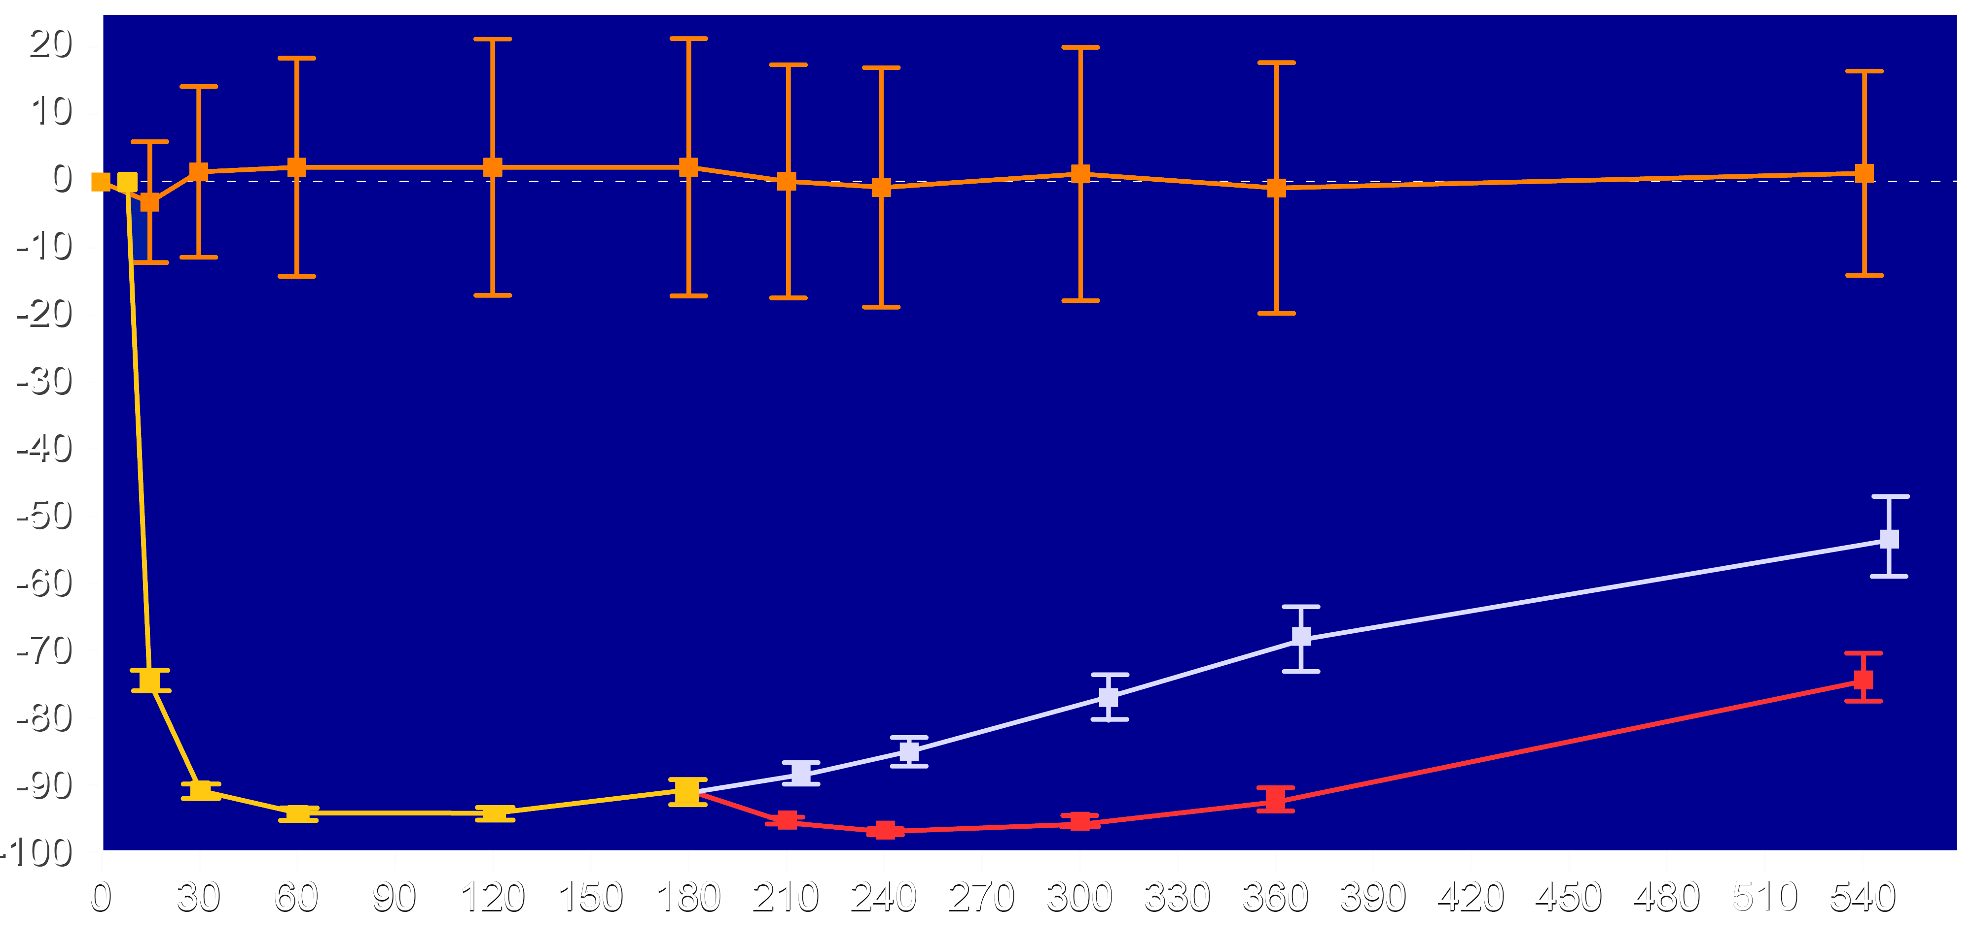
Lipoprotein(a): Placebo, 400 mg x 1, 400 mg x 2 Doses
Mean Percent Change (95% CI)
Placebo
400 mg pooled
Single 400 mg dose
Two 400 mg doses
-53.4%
-90.7%
-74.2%
-96.8%
-91.0%
Visit Day

Slide 11
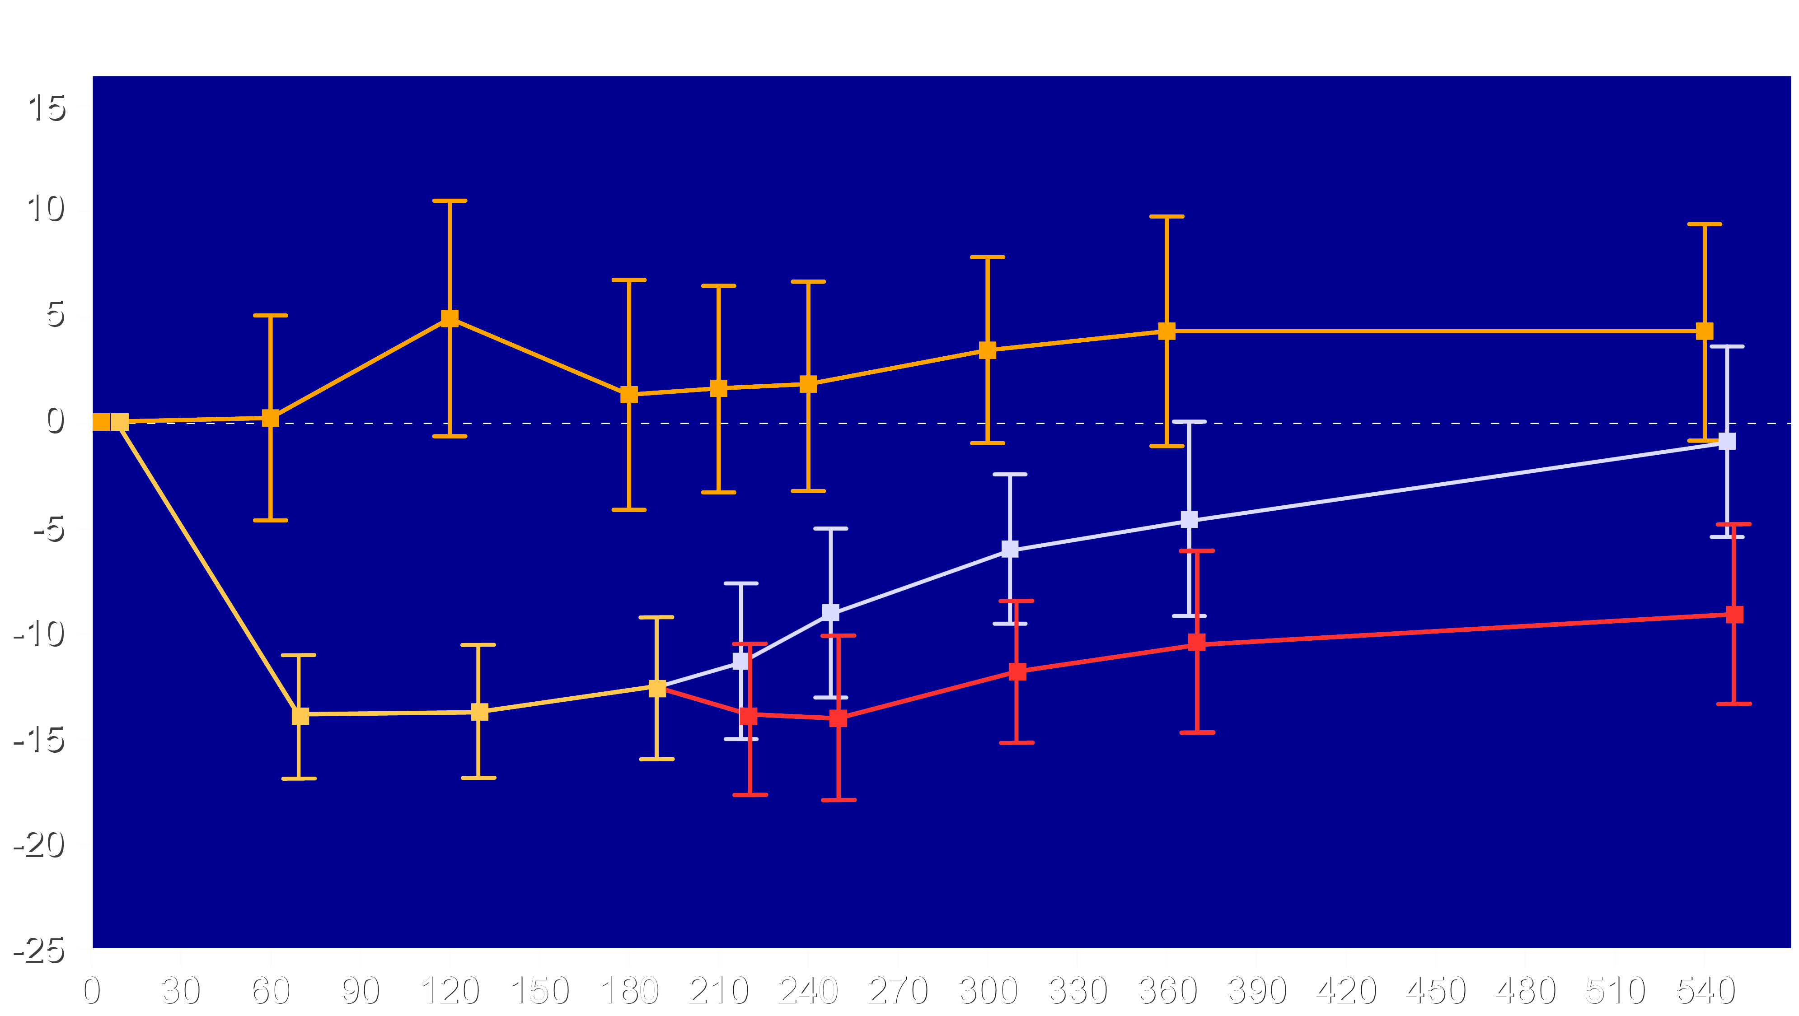
Apolipoprotein B: Placebo, 400 mg x 1, 400 mg x 2 Doses
Mean Percent Change (95% CI)
-12.9%
-15.5%
Placebo
400 mg pooled
Single 400 mg dose
Two 400 mg doses
Visit Day

Slide 12
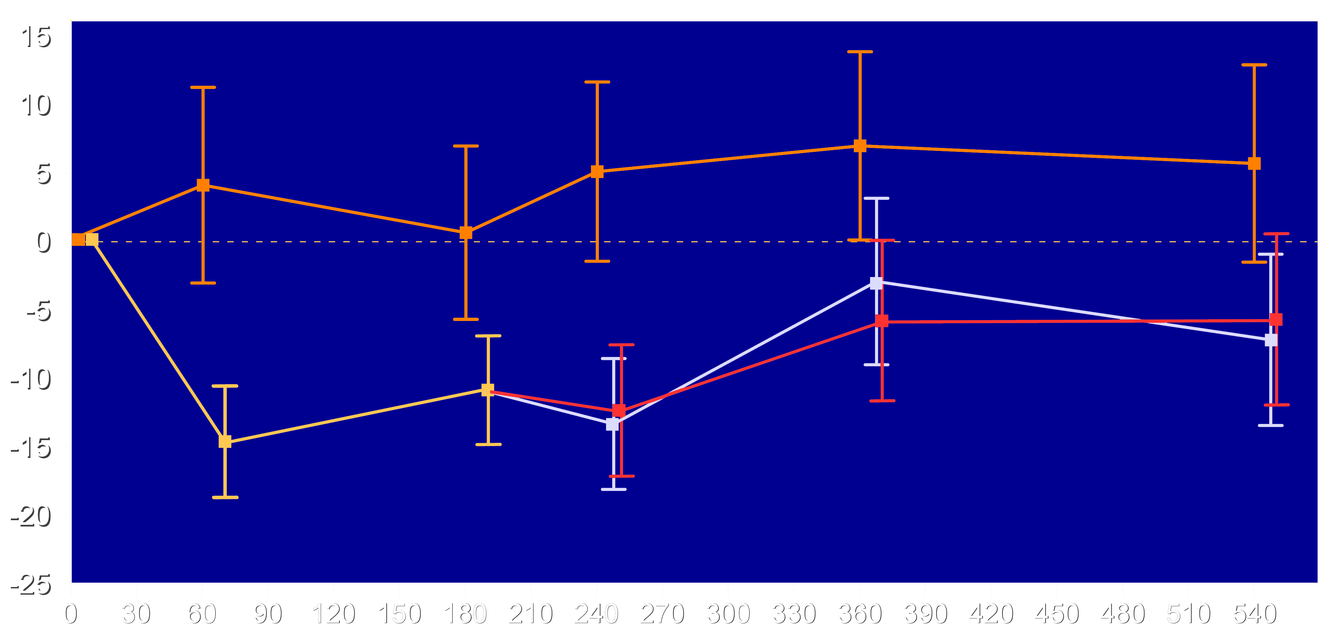
LDL Cholesterol: Placebo, 400 mg x 1, 400 mg x 2 Doses
Mean Percent Change (95% CI)
-16.8%
Placebo
400 mg pooled
Single 400 mg dose
Two 400 mg doses
Visit Day

Slide 13
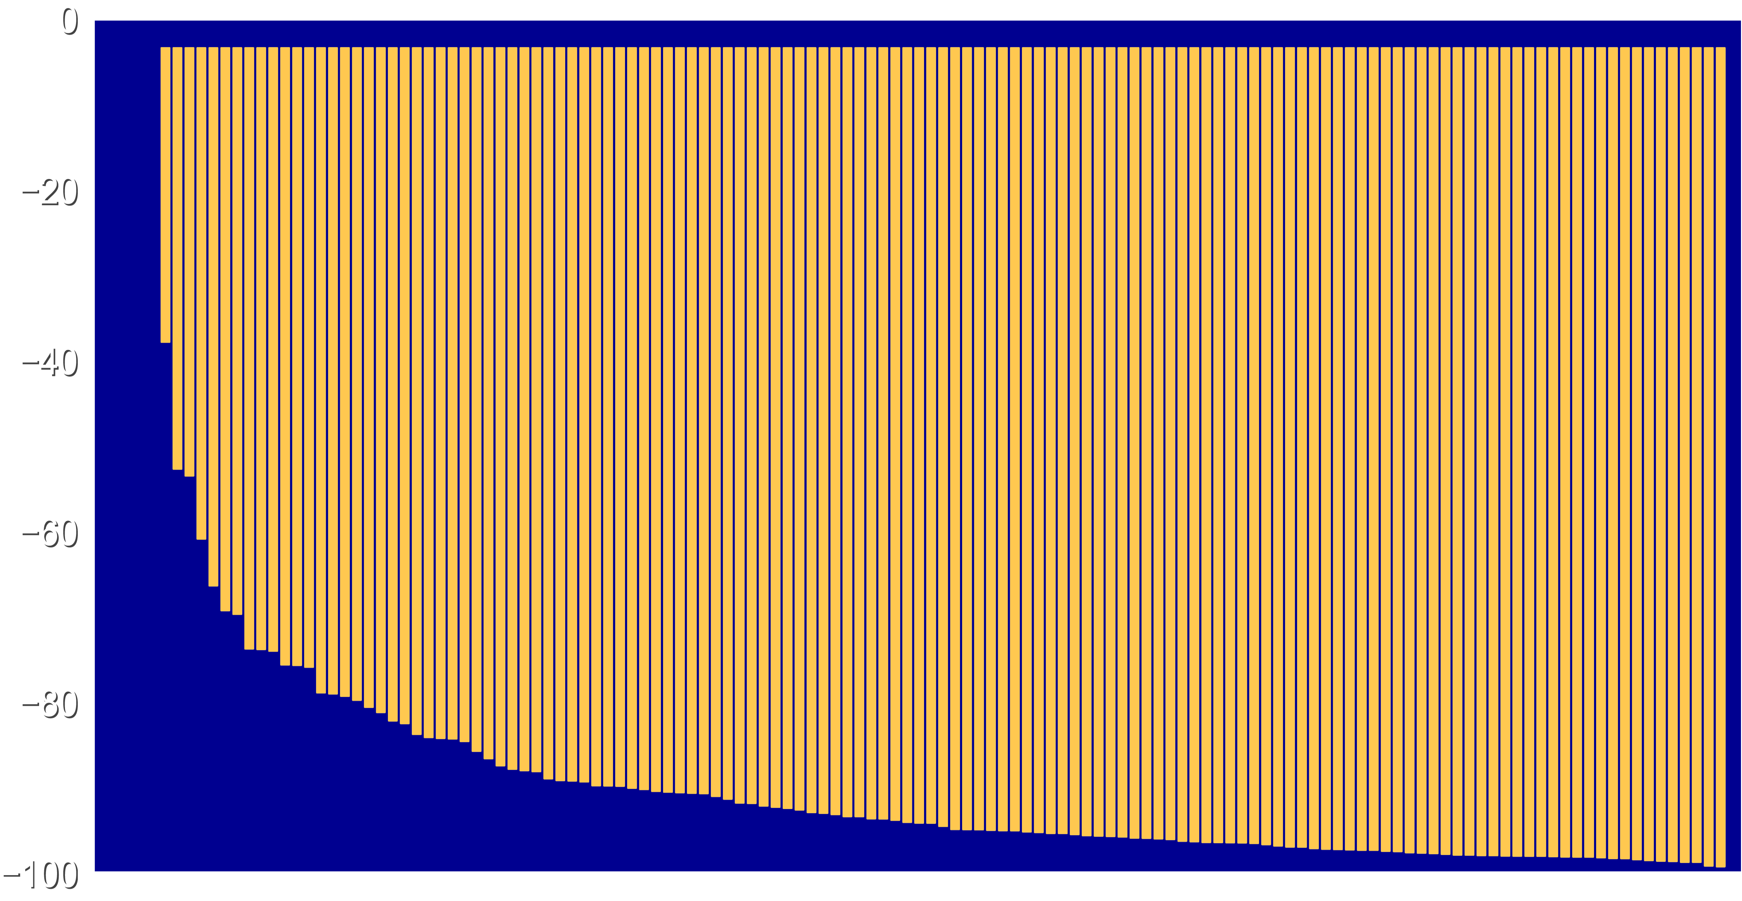
Primary End Point (Days 60 to 180): Pooled 400 mg Dose
Mean Percent Change
Individual Patients

Slide 14
Adverse Events and Laboratory-Related Safety Findings (%)
 | Placebo | 16/ 16 mg | 96/ 96 mg | 400 mg/ placebo | 400/ 400 mg
Treatment emergent adverse events | 84.1 | 52.8 | 67.6 | 76.4 | 78.3
Study drug related TEAE | 1.4 | 2.8 | 12.2 | 11.1 | 17.4
AE leading to withdrawal from treatment | 1.4 | 0 | 0 | 0 | 0
AE leading to withdrawal from study | 0 | 0 | 0 | 0 | 0
Serious adverse event | 8.7 | 2.8 | 12.2 | 11.1 | 15.9
Death | 0 | 2.8 | 0 | 0 | 0
Injection Site Reactions | 1.4 | 0 | 8.1 | 8.3 | 11.6
ALT > 3x ULN | 0 | 2.8 | 2.7 | 0 | 5.8
AST >3 x ULN | 0 | 0 | 2.7 | 0 | 1.4

Slide 15
Limitations
Although generally representative of the affected population, there were few Black participants.
  Because elevated lipoprotein(a) is more common in Black individuals,
  further study in this population will be important.
The prolonged duration of effect of lepodisiran only allowed 2 doses to be studied in this Phase 2 study.
  Effects over a longer observation period will be determined
  in an ongoing Phase 3 cardiovascular outcome trial.

Slide 16
Conclusions
Lepodisiran reduced time-averaged lipoprotein(a) by 93.9% from day 60 to 180 following a single dose of 400 mg with no major safety concerns
Lipoprotein(a) reduction from days 30 to 360 was 88.5% after a single dose and 94.8% after 2 doses (at baseline and day 180).
Lipoprotein(a) levels remained 53.4% below baseline 540 days after a single dose and 74.2% at 360 days after a second dose.
The extended duration of action of lepodisiran will allow infrequent dosing in the ongoing cardiovascular outcome trial.

Slide 17
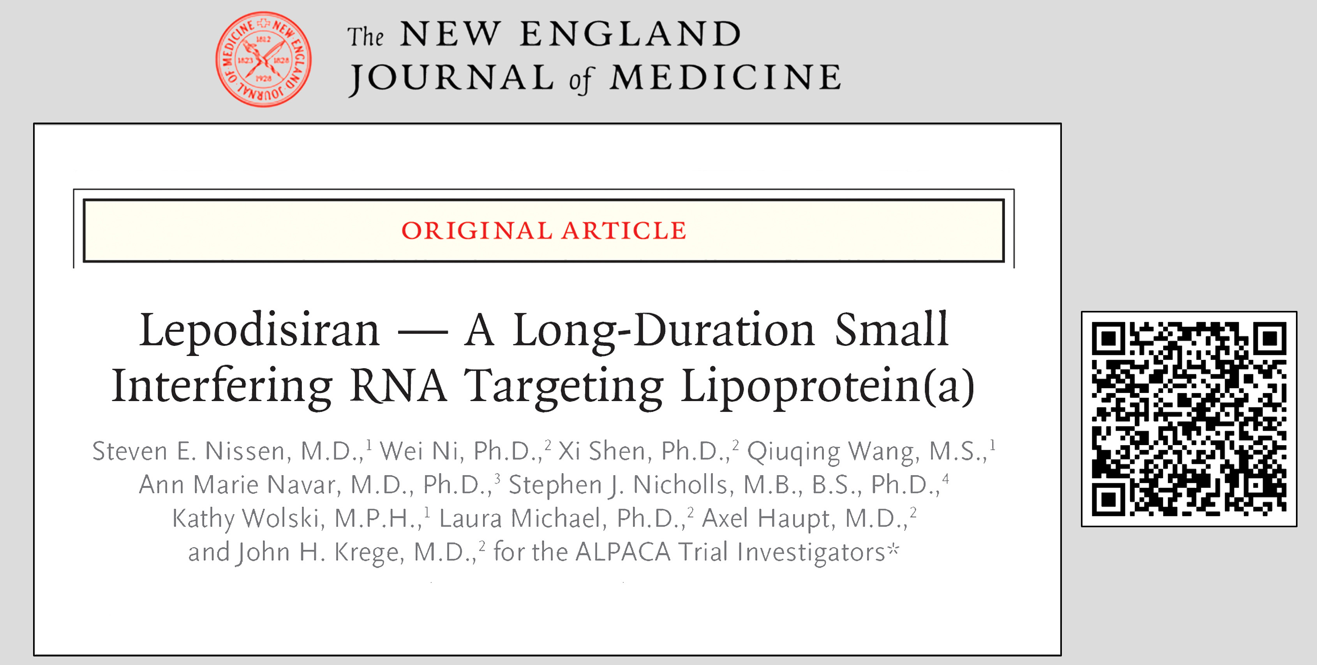
Manuscript Now Accessible via NEJM.org

Slide 18
A Final Thought
Six decades after the discovery of lipoprotein(a), advances in therapeutics have made possible the development of highly effective and durable therapies for reducing lipoprotein(a) serum concentrations. Completion of ongoing Phase 3 cardiovascular outcome trials is now a critical research priority to determine whether these therapies can reduce cardiovascular morbidity and mortality. Patients are waiting.

