Slide 1
Effect of Colchicine on Progression of Known Coronary Atherosclerosis in Patients with STable CoROnary Artery Disease CoMpared to Placebo - EKSTROM Trial
Matthew J. Budoff
Professor of Medicine, UCLA
Endowed Chair of Preventive Cardiology
Los Angeles, California, USA

Slide 2
DISCLOSURES
This study was funded by the Stanley W. Ekstrom Foundation
Matthew Budoff discloses: Grant Support – General Electric, Lilly, Novartis; Speakers bureau Amgen, Amarin, Boehringer Ingelheim, Novo Nordisk, Lilly
No other author has any disclosures

Slide 3
BACKGROUND
Effect of Colchicine on Progression of Known Coronary Atherosclerosis in Patients with STable CoROnary Artery Disease CoMpared to Placebo - EKSTROM Trial
Inflammation plays a pivotal role in all stages of atherosclerotic plaque development.
The Canakinumab Anti-inflammatory Thrombosis Outcomes Study (CANTOS) provided the evidence that targeted anti-inflammatory therapy could improve cardiovascular outcomes.
Search for alternative anti-inflammatory agents that reduce atherosclerotic events in patients with coronary artery disease.

Slide 4
Budoff et al. EHJ 2020

Slide 5
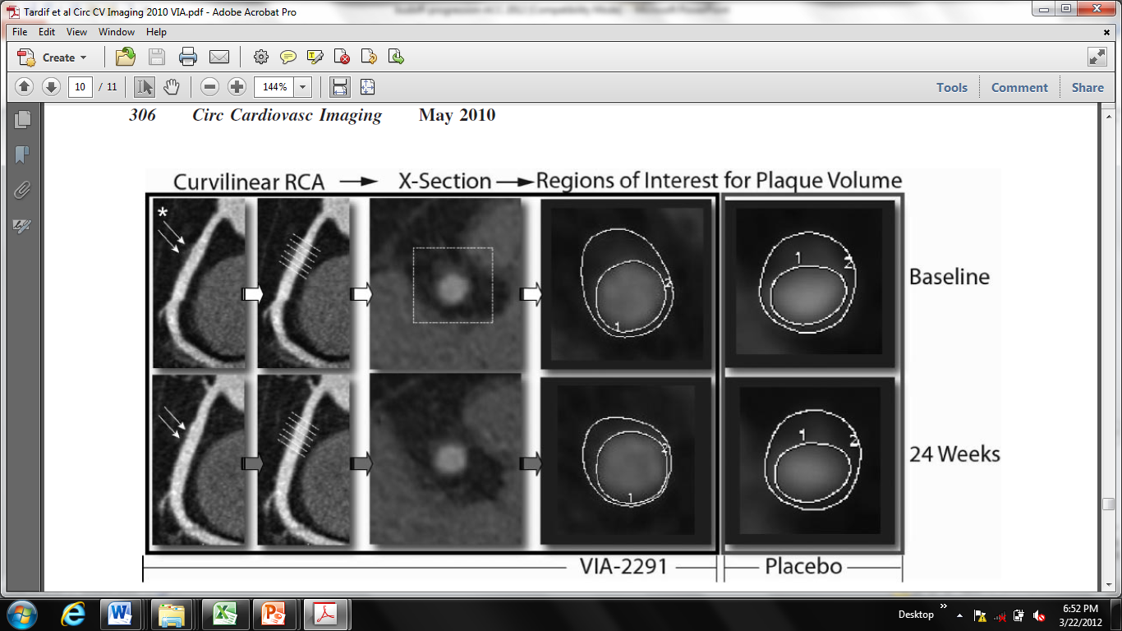
5-Lipoxygenase Inhibitor VIA-2291 Budoff Et al 2012

Slide 6
Changes of CCTA-measured plaque volumes (in mm³) over 6 months.
Plaque Measures | Placebo (n=17) | VIA 2291 (n=39) | P Value
Necrotic Core Plaque Volume | 5.9±20.7 | -9.7±33.3 | 0.0001
Fibrofatty Plaque Volume | 11.1±13.3 | -0.9±2.7 | 0.01
Fibro-calcified Plaque Volume | -0.1±6.22 | -14.3±6.2 | 0.001
Calcified Plaque Volume | 3.9±3.2 | 0.2±0.4 | 0.01
Matsumoto et al 5-Lipoxygenase Inhibitor Clin Card 2017

Slide 7
Vaidya K, et al. JACC CI 2017

Slide 8
Yu et al demonstrated in COLCOT randomized study (128 ACS pts undergoing serial OCT) significant improvement in fibrous cap thickness (p=0.006) and minimal lumen arc (p=0.004) with Colchicine 0.5 as compared to placebo

Slide 9
HYPOTHESIS
Effect of Colchicine on Progression of Known Coronary Atherosclerosis in Patients with STable CoROnary Artery Disease CoMpared to Placebo - EKSTROM Trial
Low Dose Colchicine (0.5 mg/day) will reduce progression of plaque as measured by serial coronary CTA as compared to placebo in persons with stable CAD

Slide 10
INCLUSION AND EXCLUSION CRITERIA
EKSTROM Trial
Inclusion Criteria
Exclusion Criteria
Age 30-85
Proven coronary artery disease; as evidenced by coronary angiography, CT coronary angiography or a Coronary Artery Calcium Score (Agatston score >400)
Clinically stable for at least six months
No major competing co-morbidities or contra-indication to colchicine therapy
Women who are pregnant, breastfeeding or may be considering pregnancy during the study period
Renal impairment as evidenced by a serum creatinine >150 μmol/l or estimated glomerular filtration rate (eGFR) <50 mL/min/1.73 m2
Severe heart failure - systolic or diastolic New York Heart Association Functional classification 3 or 4
Moderate or severe valvular heart disease considered likely to require intervention

Slide 11
STUDY DESIGN
EKSTROM Trial
SUBJECT ENROLLMENT
Endocrinology & Cardiology Clinics
Patients with type 2 diabetes with at least 1 CV risk factor or prior ASCVD
Visit 1
Consent
Screening
H&P
Baseline blood tests
1:1 RANDOMIZATION
BASELINE CCTA
FOLLOW UP CCTA
POST –Trial PERIOD
52 Weeks
Follow up
Blood tests
Quantitative plaque analysis
30 days phone follow up
Colchicine (0.5mg)
or Placebo

Slide 12
PRIMARY AND SECONDARY ENDPOINTS
EKSTROM Trial
The primary endpoint is the rate of change in the volume of low attenuation plaque compared to placebo as evaluated by CCTA.
The secondary objectives:
Rate of change in total plaque volume
Rate of change in total non-calcified plaque, fibro-fatty, fibrous and dense calcified plaques

Slide 13
TRIAL PROFILE
EKSTROM Trial
EKSTROM Trial
Subjects Screened: n=98
Screen Failed
n=14
Randomized Subjects
n=84
Colchicine
n=42
Placebo
n=42
Lost to follow up
n=6
Lost to follow up
n=6
Drug Subjects Completed
n=36
Placebo Subjects Completed
n=36
Total Subjects Completed
n=72

Slide 14
BASELINE CHARACTERISTICS
EKSTROM Trial
 | Colchicine | Placebo | P- value
Demographics | n=36 | n=36
Age (years) | 65.4 ± 6.8 | 63.8 ± 7.8 | 0.360
Body Mass Index (kg/m²) | 26.8 ± 4.6 | 28.3 ± 5.9 | 0.244
Male (%) | 39 (94) | 29 (81) | 0.075
Hispanic / Latino | 25 (69) | 24 (67) | 0.593
Race |  |  | 0.290
White (%) | 19 (53) | 22 (61)
Asian (%) | 7 (19) | 3 (8)
Black or African American (%) | 2 (6) | 4 (11)
Other (%) | 8 (22) | 7 (19)
Follow-up Time (years)+ | 1.1 ± 0.5 | 1.1 ± 0.5 | 0.848

Slide 15
BASELINE CHARACTERISTICS
EKSTROM Trial
 | Colchicine | Placebo | P- value
Risk Factors | n=36 | n=36
Diabetes Mellitus (%) | 3 (8) | 5 (14) | 0.453
Hypertension (%) | 26 (72) | 19 (53) | 0.088
Hyperlipidemia (%) | 28 (78) | 26 (72) | 0.406
Family History of CAD (%) | 20 (56) | 25 (69) | 0.224
Current Smoker (%) | 1 (3) | 2 (6) | 0.590
Past Smoker (%) | 5 (14) | 6 (17) | 0.782
Medications
Atorvastatin | 17 (47) | 13 (36) | 0.322
Rosuvastatin | 9 (25) | 13 (36) | 0.306
ACE Inhibitors | 8 (22) | 4 (11) | 0.343
ARB | 7 (19) | 11 (31) | 0.276
Beta Blockers | 20 (56) | 14 (39) | 0.157
CaCh Blockers | 7 (19) | 6 (17) | 0.759

Slide 16
Results: Plaque Volume Changes at 1 year (Percent Atheroma Volume PAV%)
EKSTROM Trial
p=0.015
p= 0.009
p=0.344
p=0.509
*p reported adjusted for Age, Gender, BMI, Hypertension, Hyperlipidemia, and Baseline Plaque from multivariable linear regression.

Slide 17
hs-CRP levels by treatment
EKSTROM Trial

Slide 18
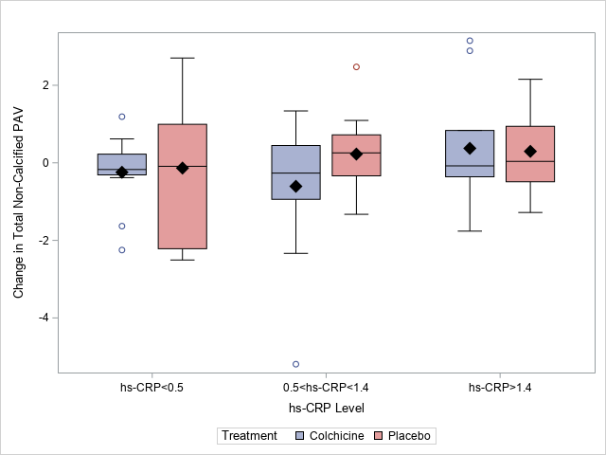
hs-CRP level and PAV changes

Slide 19
LIMITATIONS
A pilot study funded by a Foundation grant, so we were limited in enrollment size to only 84 pts
The individual components showing plaque regression seen with NCP, Fibrofatty and Fibrous plaque with colchicine were not individually statistically significant, likely a power issue
The stable CAD population we enrolled had lower levels of both LAP and C-reactive protein than prior ACS imaging trials done with this therapy

Slide 20
CONCLUSIONS
Low attenuation plaque (LAP) was not significantly reduced, however colchicine reduced total plaque volume significantly compared to placebo at 1 year
Further, colchicine treatment demonstrated trends toward regression of non-calcified plaque, fibrous and fibro-fatty plaque.
Colchicine significantly slowed dense calcium progression as well
C-Reactive protein was significantly reduced by Colchicine 0.5 mg
The plaque effects are independent of baseline c-reactive protein

Slide 21
Prespecified Analysis to be reported
Effects of colchicine on detailed markers of inflammation (HsCRP, IL-18, BDNF, Eotaxin-1, ICAM1, MMP-3, MCP-1, VEGF).
Effects of colchicine on pericoronary adipose tissue (PCAT) volume and attenuation.
Effects of colchicine on epicardial adipose tissue (EAT) volume and density.
Effect of colchicine on endothelial function by Brachial Flow Mediated Dilation (FMD)
Effects of colchicine on hepatic fat (MAFLD)
Effects of colchicine on bone mineral density

