Slide 1
Sotatercept in High-Risk Patients with Pulmonary Arterial Hypertension: Results from Phase 3 ZENITH Study
Marc Humbert, M.D., Ph.D.
Marc Humbert, Vallerie V. McLaughlin, David B. Badesch, H. Ardeschir Ghofrani, J. Simon R. Gibbs, Mardi Gomberg-Maitland, Ioana R. Preston, Rogerio Souza, Aaron B. Waxman, Victor M. Moles, Laurent Savale, Carmine Dario Vizza, Stephan Rosenkranz, Yaru Shi, Barry Miller, Harald S. Mackenzie, Samuel S. Kim, Maria José Loureiro, Mahesh J. Patel, Joerg Koglin, Alexandra G. Cornell, Marius M. Hoeper, for the ZENITH Trial Investigators

Slide 2
Disclosures
Marc Humbert is a consultant for Merck & Co., Inc., Rahway, NJ, USA.
Professor Humbert discloses relationships with 35 Pharma, Aerovate Therapeutics, Inc., AOP Orphan Pharmaceuticals, Bayer, Chiesi Farmaceutici SpA, Ferrer Internacional SA, Gossamer Bio, Janssen Pharmaceuticals, Keros Therapeutics, Liquidia Corp., Novartis, Respira Therapeutics, Roivant Sciences Ltd., and United Therapeutics Corp.
This study was funded by Merck & Co., Inc., Rahway, NJ, USA.

Slide 3
PAH Pathobiology
PAH is driven by pulmonary vascular remodeling due in part to an imbalance between pro-proliferative (ActRIIA; ↑Activin) and anti-proliferative (BMPR-II; ↓BMPs) signaling, leading to vessel wall hyperproliferation.^{1,2}
Progressive vascular narrowing causes increased pulmonary artery pressure and pulmonary vascular resistance while imposing a mechanical burden on the right ventricle.
Normal Pulmonary Artery
PAH Pulmonary Artery
Activin
BMPs
Pulmonary endothelial and smooth muscle cell proliferation³
Sustained vasoconstriction
Inflammation
Activin
BMPs
Vascular
Homeostasis
Increased Vascular
Proliferation
Elasticity, Normal Patency
Rigid, Luminal Narrowing
Adapted from Guignabert C, Humbert M.⁴
ActRIIA: activin receptor type IIA; BMP: bone morphogenetic protein; BMPR-II: bone morphogenetic protein receptor type II; PAH: pulmonary arterial hypertension
1. Tielemans B, et al. Drug Discov Today. 2019;24(3):703-716. 2. Rol N, et al. Int J Mol Sci. 2018;19(9):2585; 3. Schermuly RT, et al. Nat Rev Cardiol. 2011;8(8):443-455; 4. Eur Respir J. 2021;57(2):2002341
Notes:
THIELMANN 2020.pdf/pg2606/col2/para2/ln1-9
ROL 2018.pdf/pg1/para2/ln1-3
GUIGNBERT 2020.pdf/pg11/para1/ln1-5/para2/ln3-5
ROL 2018.pdf/pg5/para1/ln6-14
GUIGNBERT 2020.pdf/pg11/para1/ln14-16
ATKINSON 2002.pdf/pg1676/col1/para1/ln7-18
SWEATT 2018.pdf/pg1/para4/ln1-3
MORRELL 2019.pdf/pg4/para1/ln9-13
YNSTEAD 2009.pdf/pg1360/col2/para3/ln1-6
GUIGNBERT 2020.pdf/pg35/Figure4/Red rectangle
SCHERMULY 2011.pdf/pg444/col1/para1/ln6-10

Slide 4
Sotatercept
First-in-class activin signaling inhibitor approved for PAH. Proposed to reverse pathological remodeling by improving the balance between anti- and pro-proliferative signaling.^{1,2}
In Phase 3 STELLAR, sotatercept as an add-on therapy for PAH patients (WHO FC II and III) significantly improved exercise capacity (6-minute walk distance) and reduced clinical worsening by 84%, with manageable safety.³
It remains unknown if sotatercept can reduce the rates of mortality and major morbidity events such as PAH-related hospitalizations and lung transplantation in patients at high risk of death.
ActRIIA: activin receptor type IIA; BMP: bone morphogenetic protein; IgG1Fc: human immunoglobulin G1 Fc domain; PAH: pulmonary arterial hypertension; WHO FC: World Health Organization functional class
1. Humbert M, et al. N Engl J Med. 2021;384(13):1204 ─ 1215; 2. Yung LM, et al. Sci Transl Med. 2020;12(543):eeaz5660. 3. Hoeper, et al. N Engl J Med. 2023, 388(16):1478─1490

Slide 5
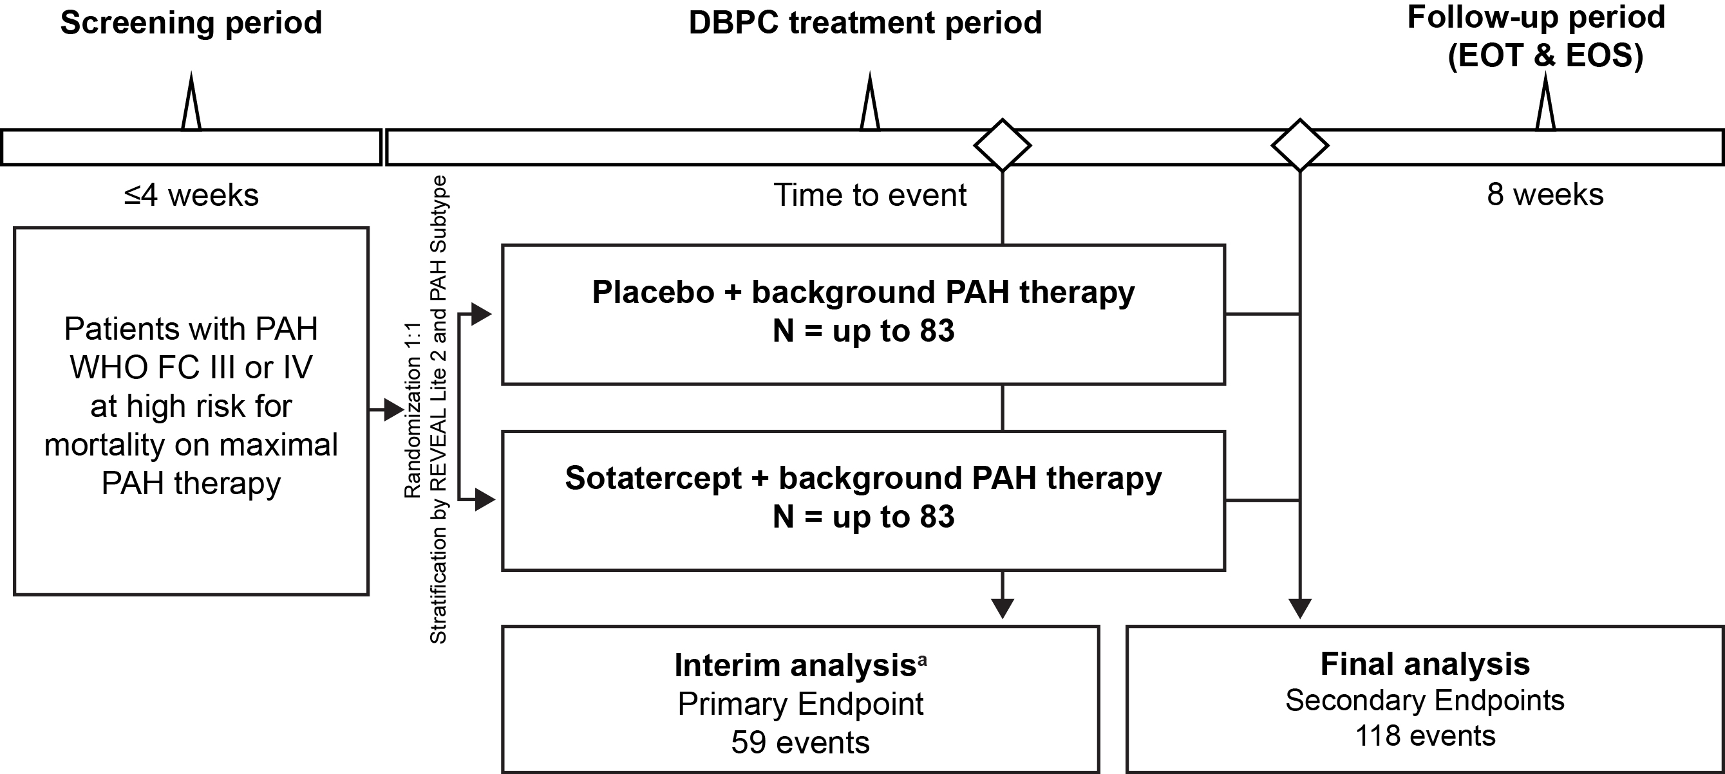
ZENITH (NCT04896008) is a Phase 3 study of Sotatercept in high-risk PAH WHO FC III and IV
Primary Endpoint
Time to first event of all-cause death, lung transplantation, or PAH worsening-related hospitalization of ≥ 24 hours
Secondary Endpoints
Prespecified hierarchical testing
Overall survival
Transplant-free survival
Proportion w/ mortality event
Change in REVEAL Lite 2 @ Wk24
Proportion achieving REVEAL Lite 2 ≤ 7 @ Wk24
Change in NT-proBNP @ Wk24
Change in mPAP @ Wk24
Change in PVR @ Wk24
Proportion who improve WHO FC at end of DBPC
Change in 6MWD @ Wk24
Change in CO @ Wk24
Change in EQ-5D-5L @ Wk24
ªInterim analysis occurred when approximately 50% of the clinical events were accrued (July 26, 2024)
6MWD: 6-minute walk distance; CO: cardiac output; DBPC: double-blind, placebo-controlled; EOS: end of study; EOT: end of trial; EQ-5D-5L: EuroQol 5-Dimension 5-Level; mPAP: mean pulmonary artery pressure; N: number in treatment group; NT-proBNP: N-terminal pro–B-type natriuretic peptide; PAH: pulmonary arterial hypertension; PVR: pulmonary vascular resistance; REVEAL: Registry to Evaluate Early and Long-Term PAH Disease Management ; WHO FC: World Health Organization functional class; Wk24: Week 24

Slide 6
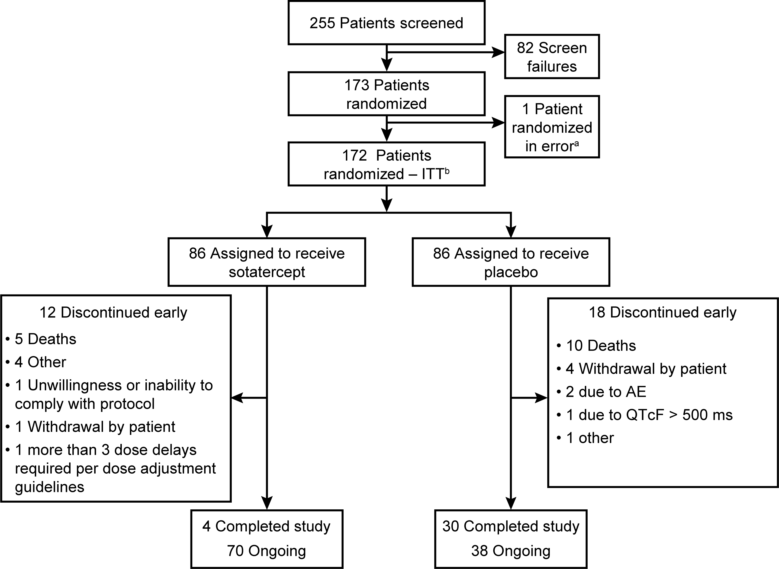
ZENITH: Patient Disposition and Follow-Up Duration
 | Sotatercept (N = 86) | Placebo (N = 86)
Median Follow-up (min, max) ─ months | 10.6 (0.3, 26.1) | 7.1 (0.7, 24.2)
Patients are considered to have completed the study if they experienced an event of PAH worsening-related hospitalization of ≥24 hours or lung transplantation
ªPatient was immediately discontinued (prior to receiving study intervention)
^{b}At the time of data cutoff (July 26, 2024), 155 patients had been randomized for at least 24 weeks
ITT: intention-to-treat; max: maximum; min: minimum; PAH: pulmonary arterial hypertension; QTcF: corrected QT interval using Fridericia’s formula

Slide 7
ZENITH: Patient Baseline Characteristics
Demographic | Sotatercept (N = 86) | Placebo (N = 86)
Female sex — no. (%) | 61 (70.9) | 71 (82.6)
Age — yr, mean ± SD | 55.3 ± 14.3 | 53.5 ± 14.3
Race — No. (%)
White Otherª Missing | 73 (84.9) 12 (14.0) 1 (1.2) | 76 (88.4) 10 (11.6) 0
Time since PAH diagnosis — yr, mean ± SD | 7.2 ± 5.6 | 8.2 ± 6.7
WHO Group 1 PAH Classification — No. (%)
Idiopathic Heritable Associated with connective-tissue disease Drug-induced or toxin-induced Associated with corrected congenital shunts | 42 (48.8) 11 (12.8) 22 (25.6) 6 (7.0) 5 (5.8) | 44 (51.2) 7 (8.1) 26 (30.2) 5 (5.8) 4 (4.7)
WHO FC — No. (%)
III IV | 66 (76.7) 20 (23.3) | 62 (72.1) 24 (27.9)
REVEAL Lite 2 score^{b} — No. (%)
8 9-10 ≥11 | 1 (1.2) 59 (68.6) 26 (30.2) | 3 (3.5) 57 (66.3) 26 (30.2)
Background therapy for PAH — No. (%)
Prostacyclin infusion therapy Double therapy Triple therapy | 53 (61.6) 21 (24.4) 65 (75.6) | 49 (57.0) 27 (31.4) 59 (68.6)
 | Sotatercept (N = 86) | Placebo (N = 86)
6MWD — meter, mean ± SD | 270.3 ± 104.8 | 270.7 ± 99.9
NT-proBNP — pg/mL, mean ± SD | 3603.1 ± 4101.2 | 2687.3 ± 2771.2
PVR — dyn·sec·cm⁻⁵, mean ± SD | 883.2 ± 410.9 | 874.7 ± 344.2
RAP — mmHg, mean ± SD | 11.6 ± 5.4 | 10.7 ± 5.3
PAP — mmHg, mean ± SD | 57.0 ± 13.4 | 55.2 ± 12.1
CO — L/min, mean ± SD | 4.7 ± 1.2 | 4.5 ± 1.4
CI — L/min/m², mean ± SD | 2.6 ± 0.6 | 2.6 ± 0.8
PAWP — mmHg, mean ± SD | 10.0 ± 3.3 | 9.8 ± 3.1
SvO₂ — %, mean ± SD | 61.5 ± 8.7 | 62.1 ± 8.3
Hemoglobin — g/dL, mean ± SD | 12.9 ± 1.9 | 12.9 ± 1.9
eGFR— mL/min/1.73 m², mean ± SD | 65.1 ± 24.6 | 73.5 ± 29.7
ªOther: Black or African American, Asian, American Indian or Alaska Native, or Other; ^{b}REVEAL Lite 2 scores were calculated prior to randomization
6MWD: 6-minute walk distance; CI: cardiac index; CO: cardiac output; eGFR: estimated glomerular filtration rate: N: number of patients in the treatment group; No.: number of patients in the category; NT-proBNP: N-terminal pro–B-type natriuretic peptide; PAH: pulmonary arterial hypertension; PAP: pulmonary artery pressure; PAWP: pulmonary artery wedge pressure; PVR: pulmonary vascular resistance; RAP: right atrial pressure; REVEAL: Registry to Evaluate Early and Long-term PAH Disease Management; SD: standard deviation; SVO₂: mixed venous oxygen; WHO: World Health Organization; WHO FC: World Health Organization functional class; WHO FC III: marked limitation of activity (less than ordinary activity causes symptoms); WHO FC IV: severe limitation of activity (symptoms occur at rest or with minimal activity)

Slide 8
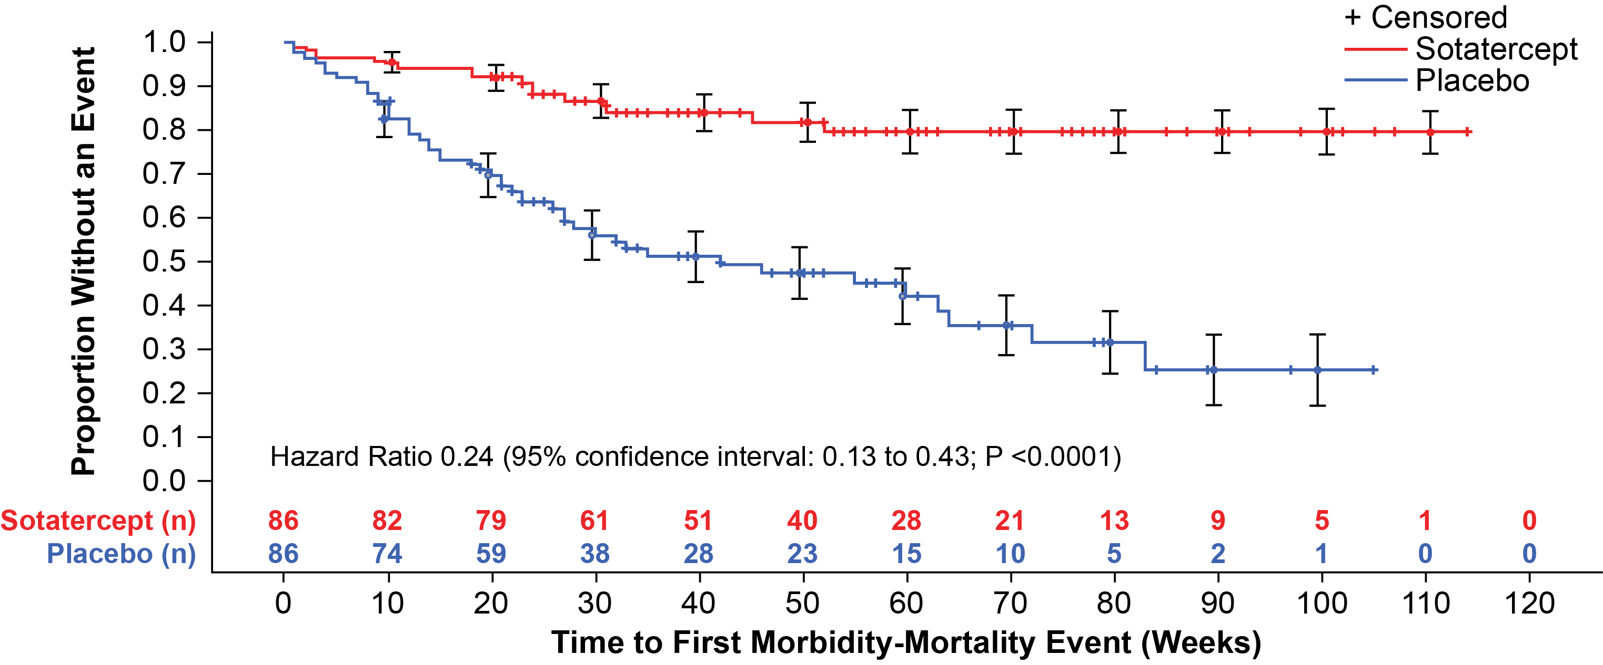
Time to First Major Morbidity-Mortality Event
Sotatercept significantly reduced the relative risk of morbidity-mortality by 76% vs placebo
Kaplan-Meier curves demonstrated early and clear separation
At interim analysis, P <0.0001 crossed the predefined efficacy boundary prompting early trial termination for efficacy

Slide 9
No. (%) of Patients with Components of the Primary Endpoint
When examined as standalone outcomes, each component of the composite endpoint favored sotatercept, consistent with the overall treatment effect
 | Sotatercept (N = 86) | Placebo (N = 86) | HR (95% CI); P value
No. (%) with ≥1 primary event | 15 (17.4) | 47 (54.7) | 0.24 (0.13 to 0.43); <0.0001ª
Components of the primary endpoint^{b}: All-cause death^{c} Lung transplantation PAH worsening-related hospitalization ≥24 hours | 7 (8.1) 1 (1.2) 8 (9.3) | 13 (15.1) 6 (7.0) 43 (50.0)
ªPrimary composite included any first occurrence of a morbidity-mortality event up to the data-cutoff (July 26, 2024). Of the 15 first primary endpoint events in the sotatercept group, 6 were deaths, 1 was a lung transplantation and 8 were PAH worsening-related hospitalizations. Of the 47 first primary endpoint events in the placebo group, 3 were deaths, 1 was a lung transplantation and 43 were PAH worsening-related hospitalizations
^{b}Shows each component of the composite primary endpoint as a standalone outcome. Individual patients could have ≥1 components
^{c}Includes all deaths up to the data-cutoff date (July 26, 2024), except for those occurring after lung transplantation or rollover to LTFU study
CI: confidence interval; HR: hazard ratio; LTFU: long-term follow-up; N: number in treatment group; No.: number; PAH; pulmonary arterial hypertension

Slide 10
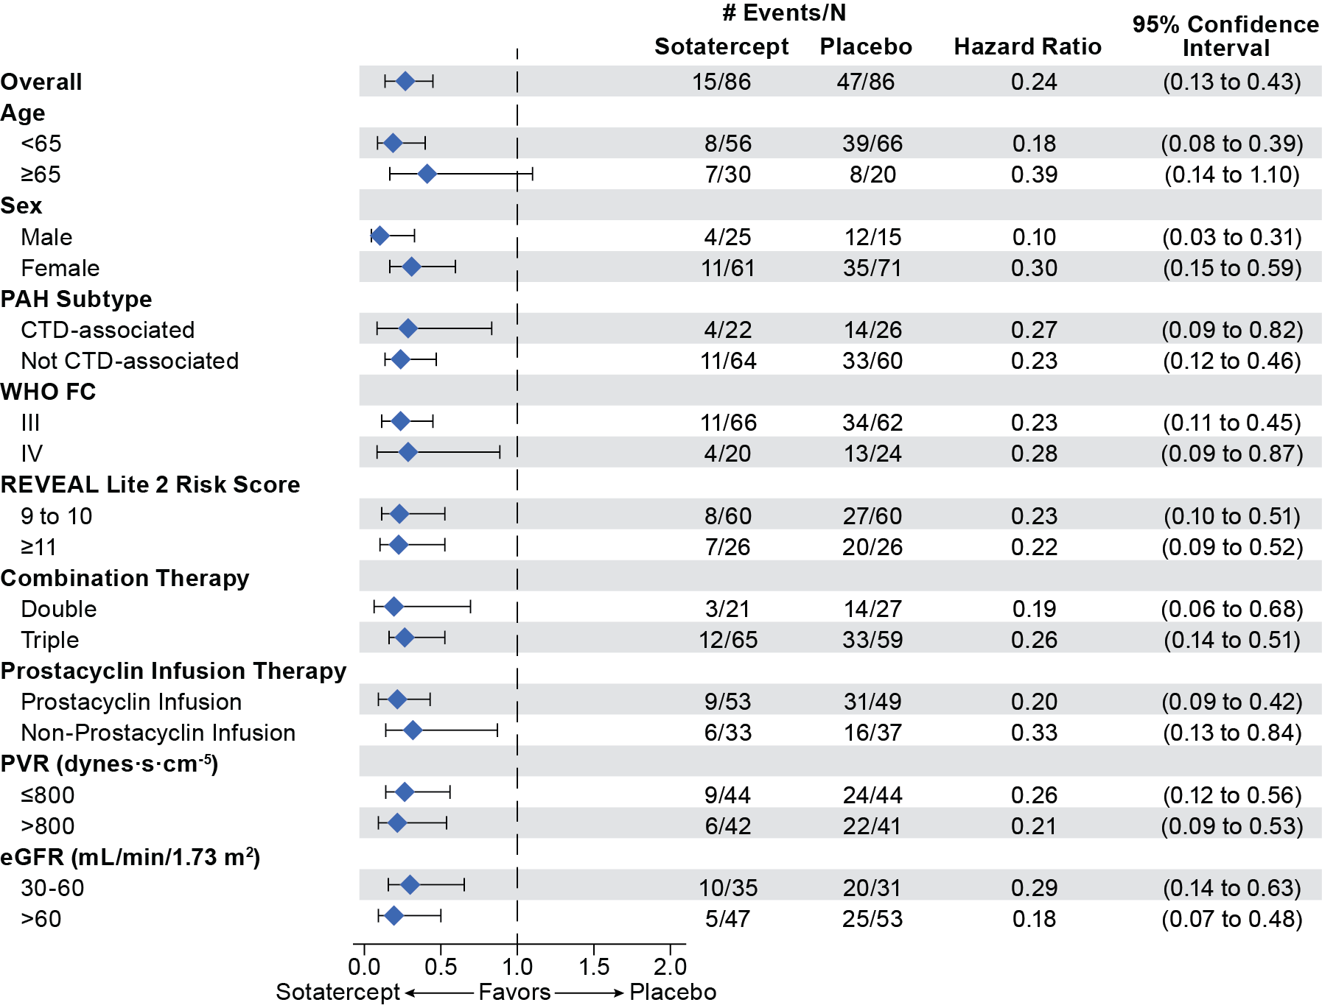
Time to First Major Morbidity-Mortality Event: Subgroup Analysis
Sotatercept demonstrated consistent benefits across prespecified subgroups, with all HRs favoring sotatercept treatment
CTD: connective tissue disease; eGFR: estimated glomerular filtration rate; HR: hazard ratio; N: number in treatment group; PAH: pulmonary arterial hypertension; PVR: pulmonary vascular resistance; REVEAL: Registry to Evaluate Early and Long-term PAH Disease Management; WHO FC: World Health Organization functional class; WHO FC III: marked limitation of activity (less than ordinary activity causes symptoms); WHO FC IV: severe limitation of activity (symptoms occur at rest or with minimal activity)

Slide 11
Secondary Endpoints
Hierarchical testing was prespecified, starting with overall survival (OS) (at IA, α = 0.0021, one-sided). OS did not meet the significance threshold at IA
Subsequent secondary endpoints were not tested, but estimates favored sotatercept across secondary endpoints
 | Secondary Endpoint | Sotatercept vs Placebo
 | Secondary Endpoint | Treatment Estimate (95% CI) | P value^{e}
1 | Overall survival | HR: 0.42 (95% CI: 0.17 to 1.07)^{b} | 0.0313 (1-sided)
2 | Transplant free survival | HR: 0.34 (95% CI: 0.15 to 0.78)^{b} | --
3 | % pts who died | Sotatercept 8.1% vs Placebo 15.1%^{c} | --
4 | Change in REVEAL Lite 2 score Wk24 | -3.1 unitless (95% CI: -4.3 to -1.9)^{c} | --
5 | % pts with low-intermediate REVEAL Lite 2 score (≤7) @ Wk24 | Sotatercept 49.3% vs Placebo 15.3%^{c} | --
6 | Change in NT-proBNP @ Wk24 | -2339.1 pg/mL (95% CI: -3378.7 to -1299.4)^{c} | --
7 | Change in mean PAP @ Wk24 | -21.2 mmHg (95% CI: -27.8 to -14.6)^{c} | --
8 | Change in PVR @ Wk24 | -339.6 dyn·s·cm⁻⁵ (95% CI: -511.1 to -168.1)^{c} | --
9 | % pts who improve WHO FC at end of DBPC treatment period | Sotatercept 55.8% vs Placebo 27.9%^{c} | --
10 | Change in 6MWD @ Wk24 | 63.0 meters (95% CI: 23.2 to 102.7)^{c} | --
11 | Change in CO @ Wk24 | 0.5 L/min (95% CI: -0.2 to 1.2)^{c} | --
12 | Change in EQ-5D-5L index score @ Wk24ª | 0.060 (min, max: -1.020, 0.512) vs 0.007 (-0.358, 0.740)^{d} | --
ªAnalyzed descriptively because patient compliance rate <50%
^{b}HR was derived using Cox proportional hazard regression model. All deaths as first events within the primary composite endpoint were included in the analysis regardless of whether they occurred during or post ZENITH
^{c}Analyzed by aligned rank stratified Wilcoxon test for continuous parameters or Cochran-Mantel-Haenszel method for dichotomous variables
^{d}The values for observed median change (min, max) are shown
^{e}Secondary endpoints were analyzed in the sequential order shown using a gatekeeping method to control type I error rate
© Copyright 2025
6MWD: 6-minute walk distance; CI: confidence interval; CO: cardiac output; DBPC: double-blind, placebo-controlled; EQ-5D-5L: EuroQol 5-Dimension 5-Level; HR: hazard ratio; IA: interim analysis; max: maximum; min: minimum; NT-proBNP: N-terminal pro–B-type natriuretic peptide; PAH: pulmonary arterial hypertension; PAP: pulmonary arterial pressure; pts: patients; PVR: pulmonary vascular resistance; REVEAL: Registry to Evaluate Early and Long-term PAH Disease Management; WHO FC: World Health Organization functional class; Wk24: Week 24

Slide 12
Overall Summary of Safetyª
Follow-up time differed between groups, with a median of 10.6 months for sotatercept vs 7.1 months for placebo
No. (%) of patients | Sotatercept (N = 86) | Placebo (N = 86)
Any AEs | 85 (98.8) | 83 (96.5)
AEs related to treatment | 56 (65.1) | 28 (32.6)
AEs leading to treatment discontinuation | 0 | 4 (4.7)
AEs leading to death^{b} | 5 (5.8) | 12 (14.0)
Severe AEs | 32 (37.2) | 43 (50.0)
Serious AEs | 46 (53.5) | 55 (64.0)
Serious AEs related to treatment | 3 (3.5) | 2 (2.3)
ªAEs had a start date on or after the first dose of treatment and up to 56 days after the last dose of treatment
^{b}The number of patients who died due to an AE differs from the number of deaths assessed for the primary and secondary endpoints that include all-cause death as a component. AEs leading to death were evaluated in the safety set population, with data collected from the first dose to 56 days post-dose
AE: adverse event; N: number of patients in the treatment group; No.: number

Slide 13
Overall Summary of Safetyª (continued)
No. (%) patients | Sotatercept (N = 86) | Placebo (N = 86)
Selected AE of interest or special interest | 74 (86.0) | 59 (68.6)
Bleeding events^{b} | 54 (62.8) | 30 (34.9)
Serious bleeding events^{c} | 5 (5.8) | 4 (4.7)
Cardiac events^{b} | 13 (15.1) | 26 (30.2)
Increased hemoglobin^{b} | 11 (12.8) | 1 (1.2)
Telangiectasia^{b} | 22 (25.6) | 3 (3.5)
AEs with incidence ≥10% in one or more treatment groups^{d}
Epistaxis | 38 (44.2) | 8 (9.3)
Telangiectasia | 22 (25.6) | 3 (3.5)
Gingival bleeding | 9 (10.5) | 2 (2.3)
Vomiting | 11 (12.8) | 5 (5.8)
Back pain | 9 (10.5) | 4 (4.7)
ªData cut-off date July 26, 2024. An AE has a start date on or after the first dose of treatment and up to 56 days after the last dose of treatment
^{b}AE of interest or special interest (telangiectasia) are medical concepts searched using predefined MedDRA queries or groupings of preferred terms. Only those AEs of interest or special interest in which the point estimate(s) for the between-group differences excluded zero are shown
^{c}Cases of serious anemia (2 from the placebo group) were excluded from the serious bleeding event category to focus on events where bleeding was confirmed
^{d}AEs occurring in ≥10% in one or more treatment group with an incidence of at least 5 percentage points greater with sotatercept vs placebo are shown
AE: adverse event; MedDRA:Medical Dictionary for Regulatory Activities; N: number of patients in the treatment group; No.: number

Slide 14
Summary of Results
ZENITH was stopped early at the prespecified interim analysis for efficacy
Sotatercept reduced morbidity-mortality risk by 76% vs placebo (HR: 0.24 [95% CI: 0.13 to 0.43];
P <0.0001) despite maximal background therapy
When examined as standalone outcomes, each component of the primary endpoint favored sotatercept:
All-cause death: 8.1% vs 15.1%
Lung transplantations: 1.2% vs 7.0%
PAH-related hospitalizations: 9.3% vs 50.0%
Findings were consistent with the overall treatment effect across prespecified subgroups
While overall survival did not meet the strict statistical threshold at interim analysis, most secondary endpoints favored sotatercept, including:
Overall survival (HR: 0.42 [95% CI: 0.17 to 1.07]; P =0.0313)
Transplant-free survival (HR: 0.34 [95% CI: 0.15 to 0.78])
Sotatercept led to improvements in key clinical measures (REVEAL Lite 2 risk score, mean PAP, PVR, WHO FC, 6MWD, NT-proBNP)
Safety was manageable, consistent with prior pivotal studies in broader PAH populations,^{1,2} and aligned with current regulatory labels
1. Hoeper, et al. N Engl J Med. 2023, 388(16):1478─1490; 2. Humbert M, et al. N Engl J Med. 2021;384(13):1204 ─ 1215
6MWD: 6-minute walk distance; CI: confidence interval; HR: hazard ratio; NT-proBNP: N-terminal pro–B-type natriuretic peptide; PAH: pulmonary arterial hypertension; PAP: pulmonary artery pressure; PVR: pulmonary vascular resistance; REVEAL: Registry to Evaluate Early and Long-term PAH Disease Management; WHO FC: World Health Organization functional class

Slide 15
Conclusions
ZENITH is the first PAH study designed to assess major morbidity-mortality events and is the first to be stopped early at a prespecified interim analysis for efficacy
Sotatercept significantly reduced the composite of all-cause death, lung transplantation, and PAH-worsening related hospitalization (≥24 hours) in patients with advanced PAH
Kaplan-Meier curves demonstrated early and sustained separation between treatment groups
Safety and tolerability were generally consistent with previous studies^{1,2}
The ongoing SOTERIA study (NCT04796337) will continue to assess long-term safety
Following the ZENITH results, a loss of clinical equipoise for further placebo-controlled investigation of sotatercept in PAH led to the discontinuation of the HYPERION study
PAH: pulmonary arterial hypertension
1. Hoeper, et al. N Engl J Med. 2023, 388(16):1478─1490; 2. Humbert M, et al. N Engl J Med. 2021;384(13):1204 ─ 1215.

Slide 16
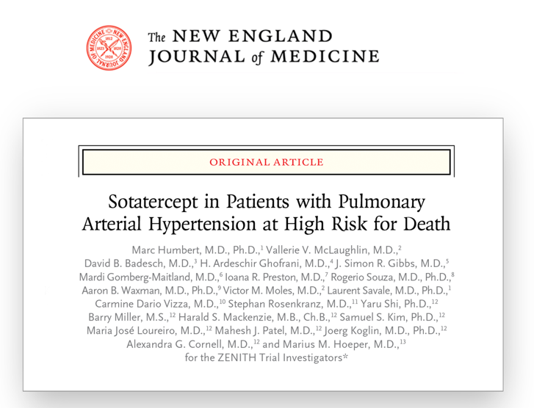
The authors thank the patients and their families, the study investigators, and site personnel.
The ZENITH study paper is available on NEJM.org.
To Download Today’s
Presentation
https://bit.ly/4iuoEVf
To Download the
Manuscript
To Download the
Plain Language Summary
https://bit.ly/4iXbVKP
Copies of this presentation are for personal use only and may not be reproduced without permission from ACC and the presenting author. Requesting content via the QR code or Web link will immediately download the requested content to your device. This presentation is intended as an educational resource and is for the exchange of scientific data to clinical investigators and health care professionals.

Slide 17
Back-up Slides

Slide 18
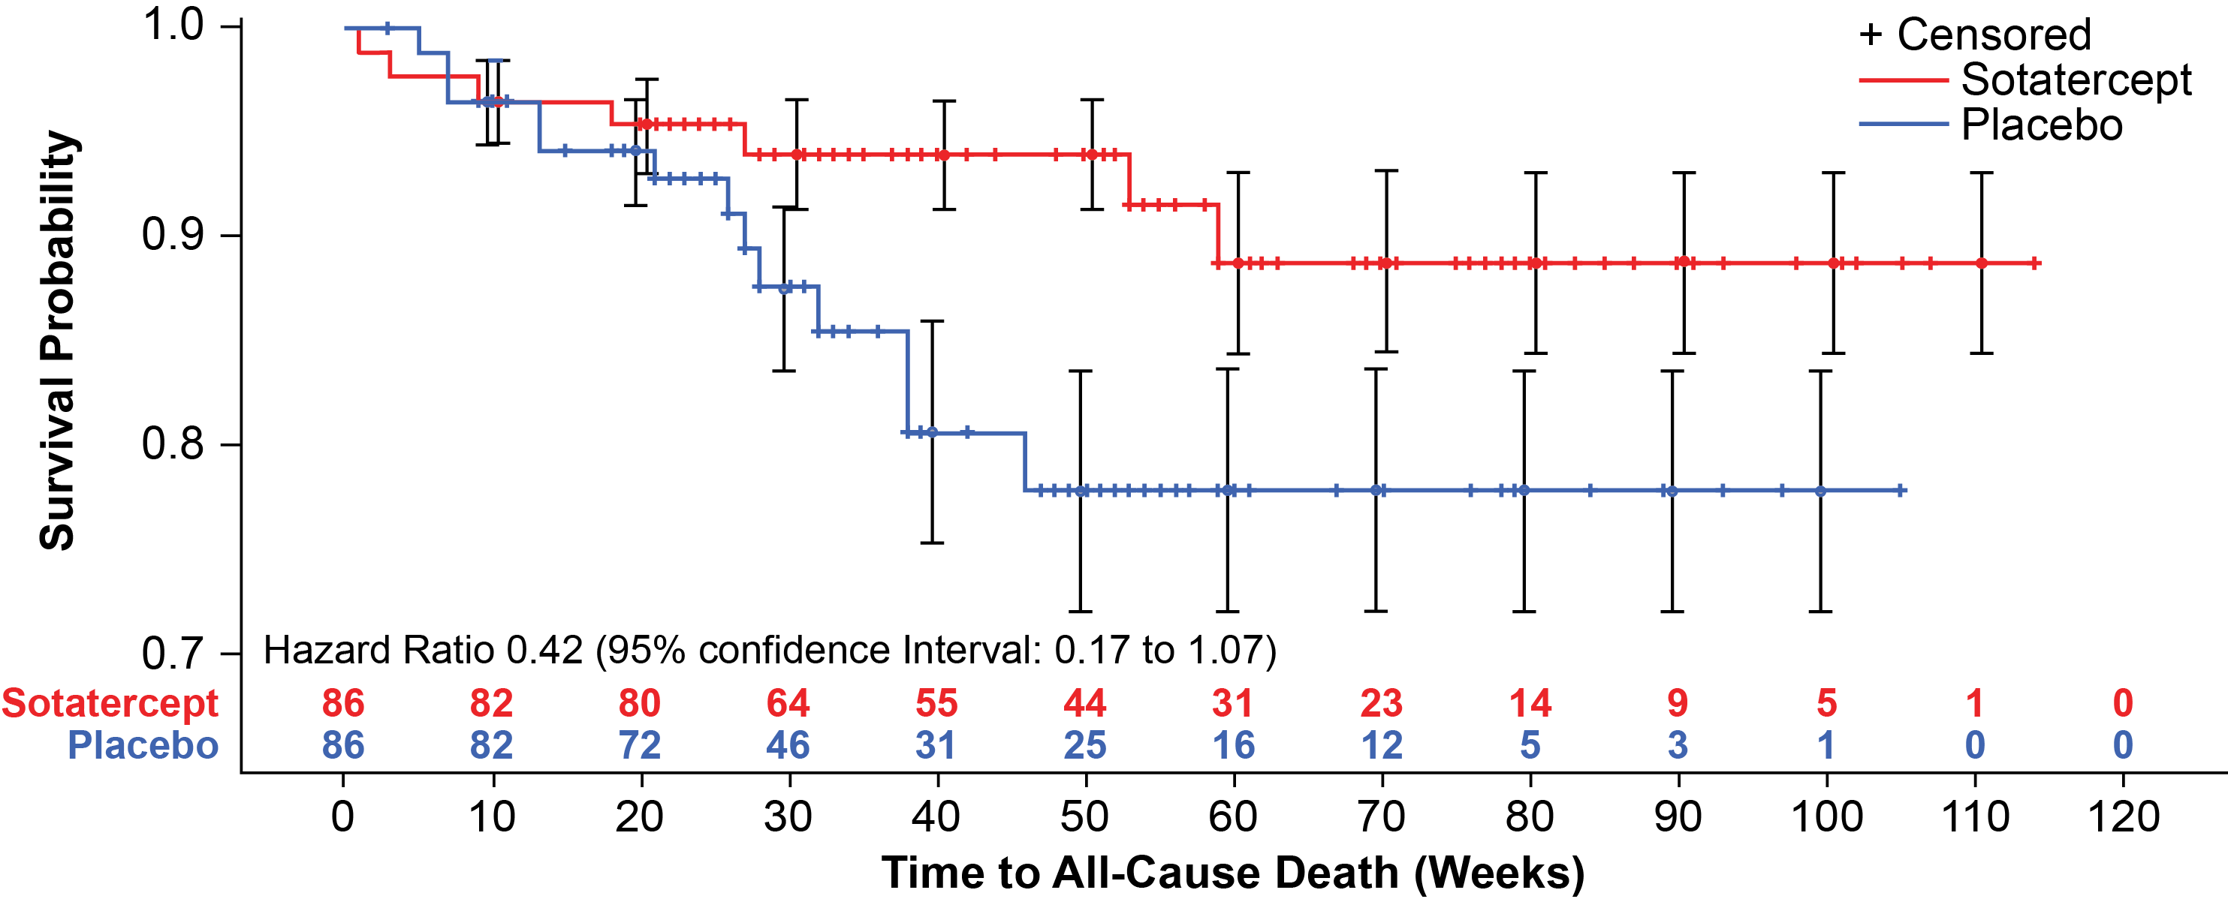
Overall Survival
Overall survival did not meet statistical significance (P <0.0021, [1-sided]) but showed a 58% relative reduction in all-cause death
No. (%) | Sotatercept (N = 86) | Placebo (N = 86) | HR (95% CI); P value
Overall Survival (All-cause death)ª | 7 (8.1) | 13 (15.1) | 0.42 (0.17 to 1.07); 0.0313
ªIncludes all deaths up to the data-cutoff date (July 26, 2024), except for those occurring after lung transplantation or enrollment in SOTERIA
CI; confidence interval; HR: hazard ratio; N: number of patients in the treatment group; No.: number

Slide 19
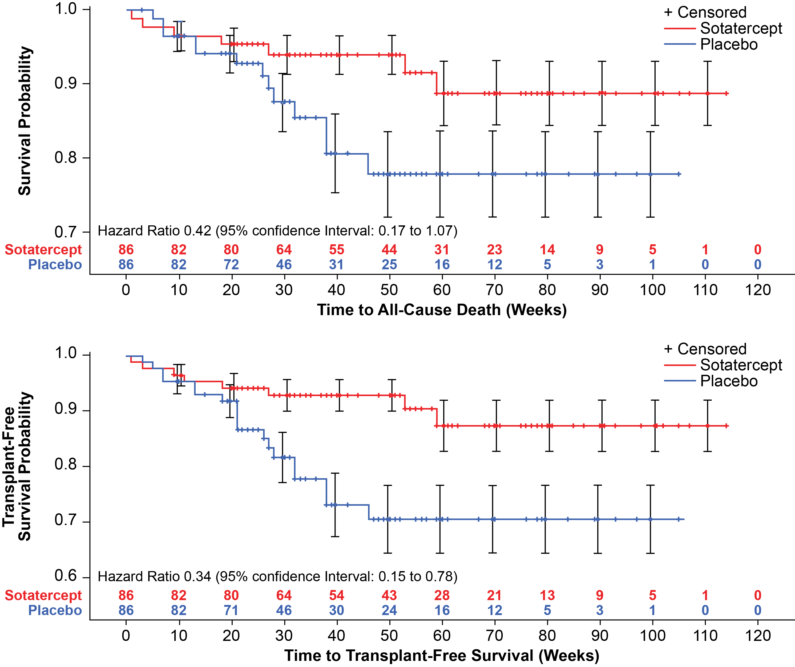
Overall Survival and Transplant-free Survival
No. (%) | Sotatercept (N = 86) | Placebo (N = 86) | HR (95% CI); P value
Overall Survival (All-cause death)ª | 7 (8.1) | 13 (15.1) | 0.42 (0.17 to 1.07); 0.0313
Transplant-Free Survivalª | 8 (9.3) | 19 (22.1) | 0.34 (0.15 to 0.78); --
ªIncludes all deaths up to the data-cutoff date (July 26, 2024), except for those occurring after lung transplantation or enrollment in SOTERIA
Overall survival did not meet statistical significance (P <0.0021) but showed a 58% relative reduction in all-cause mortality risk
Transplant free survival was not tested due to hierarchical testing strategy but showed a 66% relative reduction in risk of all-cause death or lung transplantation
CI; confidence interval; HR: hazard ratio; N: number of patients in the treatment group; No.: number; --: not tested per hierarchical testing strategy framework

