Slide 1
ALLiance for secondary prevention after an acute coronary syndrome:
A multicenter fully nurse-coordinated intensive intervention program.
The ALLEPRE trial
Giulia Magnani, on behalf of the ALLEPRE Investigators
MD, PhD
@GMagnaniCardio

Slide 2
BACKGROUND
Acute coronary syndrome is the main contributor to the burden of cardiovascular (CV) disease, which still remains the principal cause of global morbidity and mortality¹.
Pharmacological treatment, lifestyle modifications, and controlling CV risk factors reduce CV events recurrence, but real-world evidence indicates that secondary CV prevention remains suboptimal².
The involvement of nurses in CV prevention programs have previously led to positive short-term results, but there is a lack of long-term data and measurable benefits³.
¹Roth GA, et al. J Am Coll Cardiol. 2020;76:2982–3021
²Cannon CP, et al. JAMA Cardiol. 2021:1060–8.
³Giannuzzi P, et al. Arch Intern Med. 2008;168:2194–204.

Slide 3
TRIAL DESIGN
Patients hospitalized for ACS (STEMI, NSTEMI, UA)
N= 2,057
Standard of care
(SOC)
N=1,026
Nurse coordinated prevention program
(NCPP)
N=1,031
1:1 Randomization prior to hospital discharge
Primary endpoint: a composite of CV death, non-fatal myocardial
infarction or non fatal-stroke at 5 years (max FUP 7 years)
All of the events were adjudicated by an independent Clinical Event Committee
Notes:
We therefore design a pragmatic randomized trial including 2,057 patients hospitalized for ACS and admitted to 7 Cardiology Centers in Emilia-Romagna (Italy). All of the eligible patients were randomized in a 1:1 ratio prior to hospital discharge, to a NCPP or to SOC. The patients randomized to the SOC group followed the standard secondary prevention practices of the hospital to which they were admitted. 3 cardiology visits were scheduled at the same time in both groups.

Slide 4
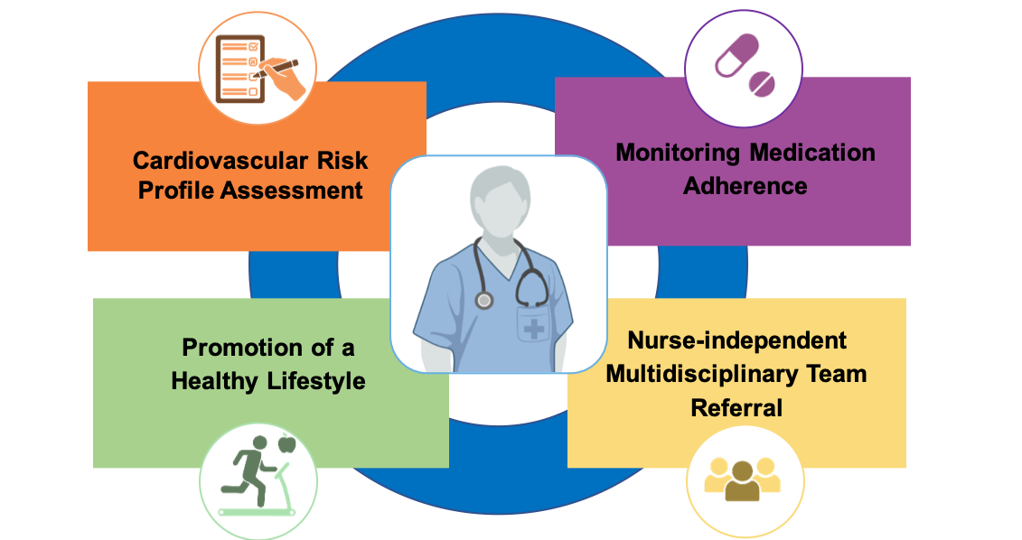
THE NURSE COORDINATED
PREVENTION PROGRAM
NURSE TRAINING
Individual educational sessions
IN-HOSPITAL
1
3
6
12
24
36
48
MONTHS
Notes:
In order to standardize the program, cardiology nurses working full time at the participating centers and involved in the follow-up of ACS patients underwent a centralized in-person training run by a multidisciplinary team The team used a validated multidimensional nursing form to teach the study protocol procedures. A total of 250 nurses were trained and awarded with a certificate in CV prevention.
The NCPP consisted of 9 individual educational sessions with a trained nurse: an in-hospital session just before discharge and eight subsequent sessions over 4 years. During these sessions, the nurses assessed each patient’s CV risk profile, lifestyles and medications adherence using a standardised case report form. As first-level intervention, the nurses provided personalised risk factor and lifestyle counselling, involving the caregiver; as second-level interventions, the nurses independently activated a multidisciplinary medical network of specialists in order to treat traditional CV risk factors and offering psychological support as needed.

Slide 5
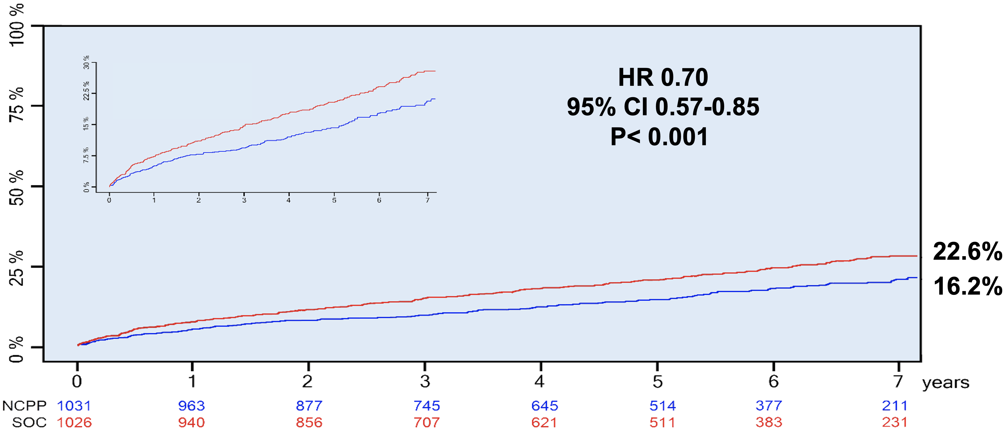
PRIMARY ENDPOINT
Composite of CV death, first occurrence of non-fatal MI, or non-fatal stroke at 7 years (MACE)
22.6%
16.2%
Notes:
This the PEP of the study a composite of. In the SOC arm the event rate was 22.6%. In the NCPP arm the event rate was 16.2 %. This led to a HR of 0.70 with a significant p-value less than 0.001.
The NCPP provided therefore a 30% RRR of the PEP. The benefit of the structured intensive NCPP emerged early and further accrued over time. At the end of FUP, the average BMI, physical exercise intensity and medication adherence were significantly improved in the NCPP group, whereas there was no significant changes in mean LDL-c, SBP, glycated hemoglobin or smoking cessation.

Slide 6
CONCLUSIONS
The ALLEPRE trial demonstrates that a fully NCPP significantly reduces the long-term incidence of the composite endpoint of CV death, non-fatal MI, or stroke in a high-risk ACS population.
The greatest impact of the NCPP was on lifestyle modifications, particularly increased physical activity intensity, BMI control, and improved medication adherence.
Our findings emphasize the critical role of nursing in managing patients with ACS.
Further studies and a cost-effectiveness analysis are needed before implementing the NCPP in the healthcare system.

