Slide 1
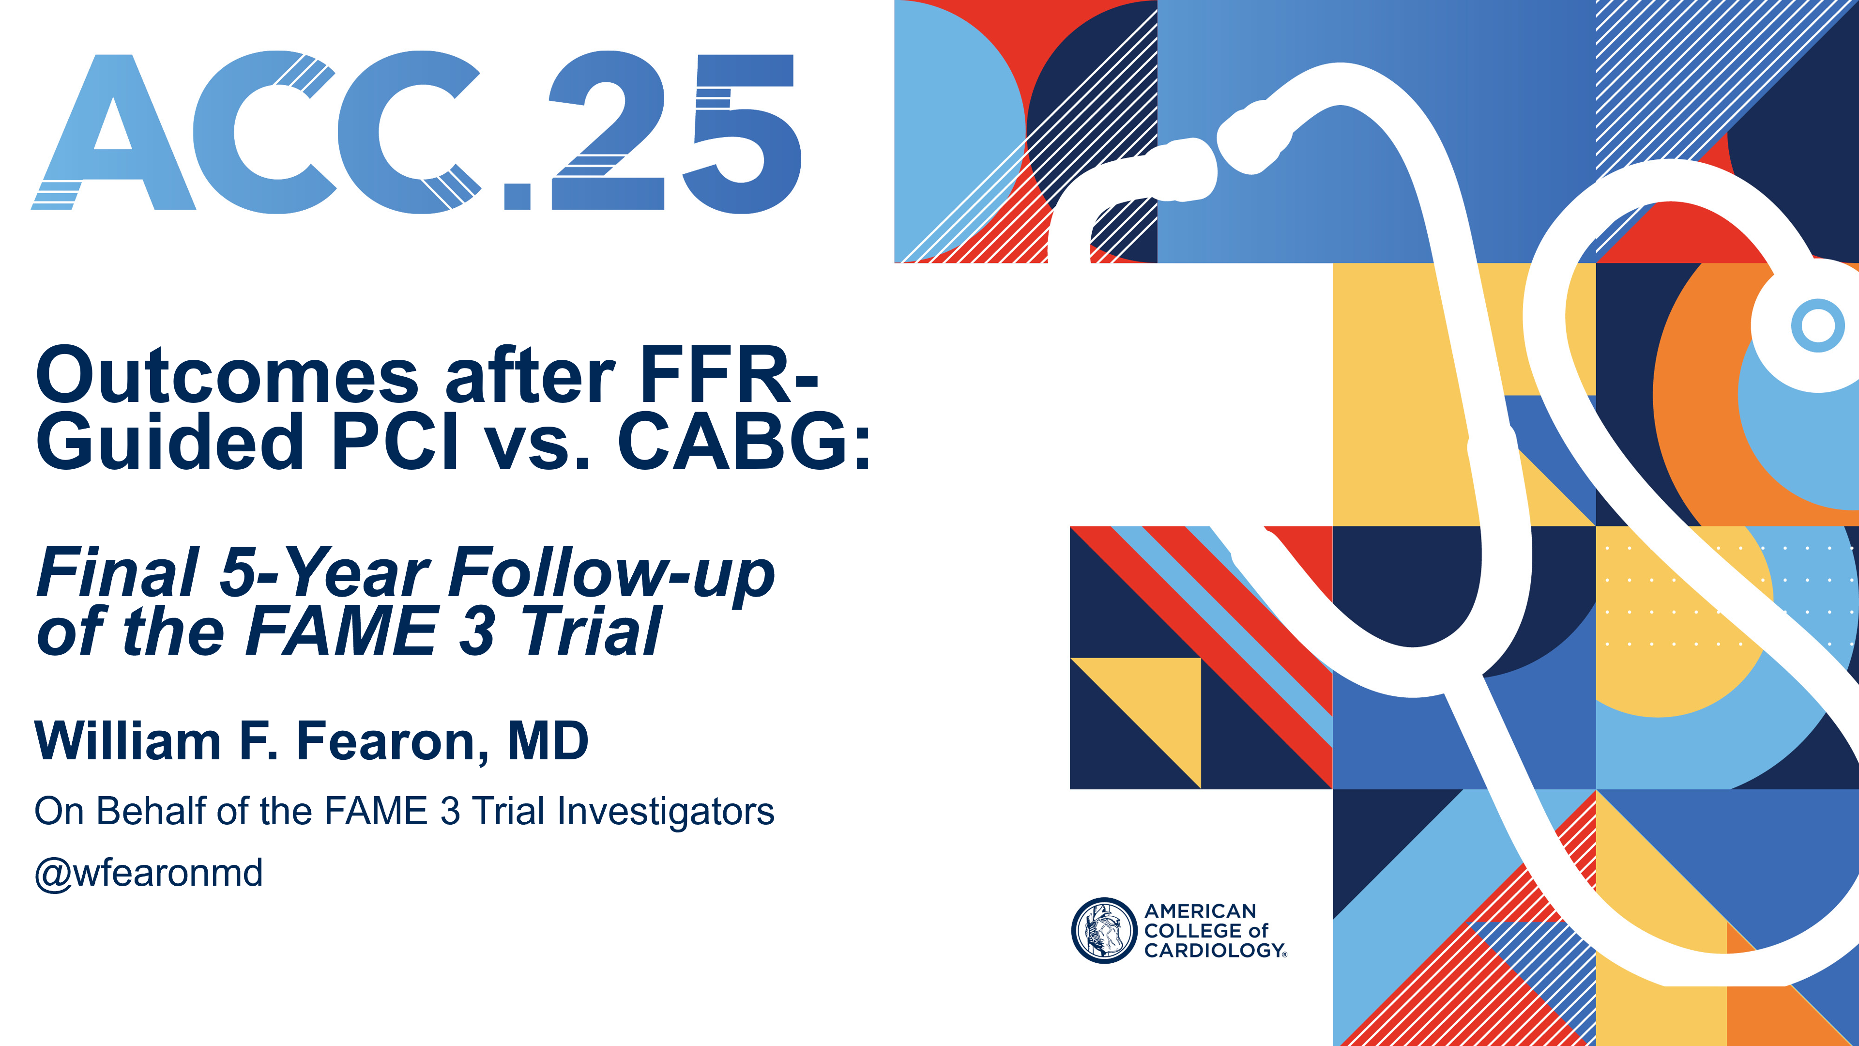

Slide 2
Background
Previous studies in patients with 3-vessel coronary artery disease (3V-CAD) have shown that coronary artery bypass grafting (CABG) results in lower rates of the composite of death, stroke, or myocardial infarction (MI) compared with percutaneous coronary intervention (PCI) at long-term follow-up.¹
These results, however, are outdated given improvements in percutaneous and surgical techniques, and in medical therapy.
¹Head SJ, et al. Eur Heart J 2014;35:2821-30

Slide 3
Background
The Fractional Flow Reserve vs Angiography for Multivessel Evaluation (FAME) 3 trial compares fractional flow reserve (FFR)-guided PCI using a current-generation drug-eluting stent (DES) with contemporary CABG, both in conjunction with guideline-directed medical therapy.
At one year, PCI failed to meet the primary endpoint of non-inferiority compared with CABG with respect to the composite of death, stroke, MI, or repeat revascularization.¹
¹New Engl J Med 2022;386:128-137

Slide 4
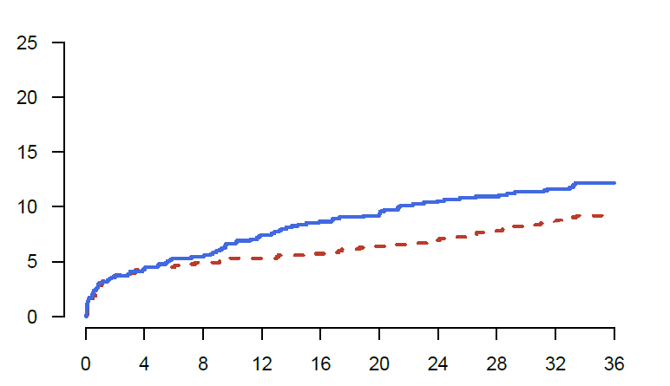
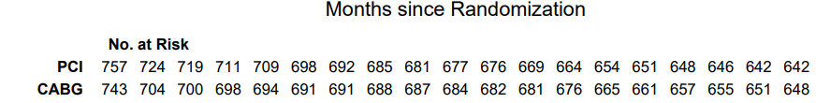
Background
Prespecified Key Secondary Endpoint: Death, Stroke, or MI at 3 years
PCI
HR 1.3 (0.98−1.83)
p=0.07
12.0%
9.2%
CABG
Zimmermann FM, et al. Circulation 2023;148:950-958

Slide 5
Background
In older studies, the improved outcomes after CABG continued to increase with longer-term follow-up.¹
In this study, we report the prespecified, final 5-year follow-up of the FAME 3 trial for the clinically important outcome of death, stroke, or MI.
¹Head SJ, et al. Eur Heart J 2014;35:2821-30

Slide 6
Study Organization
Sponsor | Stanford University
Funding | Research grants from Medtronic, Inc. and Abbott Vascular, Inc.
Steering Committee | William Fearon, MD (Chair), Bernard De Bruyne, MD, PhD, Nico Pijls, MD, PhD, Keith Oldroyd, MD, Michael Reardon, MD, Joseph Woo, MD, Olaf Wendler, MD, Alan Yeung, MD
Study Coordination | genae (now IQVIA) and Frederik Zimmermann, MD
Clinical Events Committee | Ken Mahaffey, MD (Chair), Stanford University
Data Safety Monitoring Board | Morton Kern, MD (Chair), University of California, Irvine
Angio Core Lab | Yuhei Kobayashi, MD, Stanford University/Albert Einstein
Data Analysis | Manisha Desai, PhD (Chair), Victoria Ding, MS, Stanford University

Slide 7
Study Design
Investigator-initiated, multicenter, randomized, controlled study
All Comers with 3V-CAD (not involving Left Main)
amenable to PCI and CABG by Heart Team
at 48 centers in Europe, North America, Australia and Asia
FFR-Guided PCI
stent all lesions with FFR ≤0.80
(N=750)
CABG
based on coronary angiogram
(N=750)
Primary Endpoint of this Report:
5-year incidence of Death/Stroke/MI

Slide 8
Patient Eligibility
Key Inclusion Criteria
Key Exclusion Criteria
Three vessel CAD:
  ≥ 50% diameter stenosis in 3 major epicardial vessels (visual estimation, no Left Main involvement)
  Amenable to revascularization by both PCI and CABG (Heart Team)
Cardiogenic shock
Recent STEMI (within 5 days)
LV ejection fraction < 30%

Slide 9
Procedural Requirements
FFR-Guided PCI
CABG
Preload with P2Y12 inhibitor and high dose statin
FFR measured with intracoronary or intravenous adenosine
PCI (Medtronic Resolute stent) only if FFR ≤ 0.80 (Abbott pressure wire)
Post-PCI FFR measurement recommended
DAPT for ≥ 6 months
FFR-guided CABG not mandated, but FFR information from diagnostic angiogram could be used
Pre-treatment with aspirin and high dose statin recommended
On- or off-pump CABG acceptable
LIMA graft attempted in all cases
Complete arterial revascularization strongly recommended

Slide 10
Statistical Analysis
Data were analyzed on an intention to treat basis.
Original trial assumptions:^{1,2}
  12% event rate with CABG (based on SYNTAX)
  Noninferiority margin set at a hazard ratio of 1.65
  One-sided 2.5% significance level
  Original sample size: 712 subjects (1,424 total) with 90% power
The primary outcome of this analysis, the composite of death, stroke, or MI assessed at five years was prespecified, but not explicitly powered or adjusted for multiple comparisons.
¹ Zimmermann FM, et al. Am Heart J 2015;170:619-626
² Zimmermann FM, et al. Am Heart J 2019;214:156-157

Slide 11
Patient Flowchart
1500 patients enrolled
757 randomly assigned to FFR-guided PCI
742 underwent PCI
743 randomly assigned to CABG
690 underwent CABG
33 discontinued study
26 lost to follow-up
7 withdrew consent
47 discontinued study
30 lost to follow-up
17 withdrew consent
724 (96%) remained* in the study at 5 years
696 (94%) remained* in the study at 5 years
757 included in intention-to-treat analysis
743 included in intention-to-treat analysis
* Randomised patients who had either completed follow-up within the protocol-specified timeframe or were deceased.

Slide 12
Baseline Characteristics
Variable | PCI (n=757) | CABG (n=743)
Age | 65 ± 8 years | 65 ± 8 years
Male | 81% | 83%
Caucasian | 94% | 92%
HTN | 71% | 75%
Dyslipidemia | 69% | 72%
Current Tobacco Use | 19% | 18%
Diabetes | 28% | 29%
Insulin dependent | 7% | 8%
ACS presentation | 40% | 39%
EF≤50% | 18% | 18%
Prior PCI | 13% | 14%

Slide 13
Procedural Characteristics
Variable | PCI (n=757) | CABG (n=743)
Time to procedure | 4 days | 13 days
Procedure duration | 87 min | 197 min
Length of hospital stay | 3 days | 11 days
Number of lesions | 4.3 | 4.2
≥1 Chronic occlusion | 21% | 23%
≥1 Bifurcation lesion | 69% | 66%
SYNTAX Score | 26 | 26
Low (0-22) | 32% | 35%
Intermediate (23-32) | 50% | 48%
High (>33) | 18% | 17%

Slide 14
Procedural Characteristics
Variable | PCI (n=757)
% Lesions FFR measured | 82%
FFR>0.80 | 24%
Staged procedure | 22%
Number of stents | 3.7±1.9
Total stent length | 80 mm
Intravascular imaging | 12%
FFR measured after PCI | 60%
Variable | CABG (n=743)
FFR measured prior to CABG | 10%
# of distal anastomoses | 3.4±1.0
Multiple arterial grafts | 25%
LIMA | 97%
Off-Pump surgery | 24%

Slide 15
Medical Therapy at Five Years
Any antiplatelet agent ~90% (anticoagulants not recorded)
Statin >91%
Beta blocker >70%
ACE I/ARB >70%
No major differences between the two groups

Slide 16
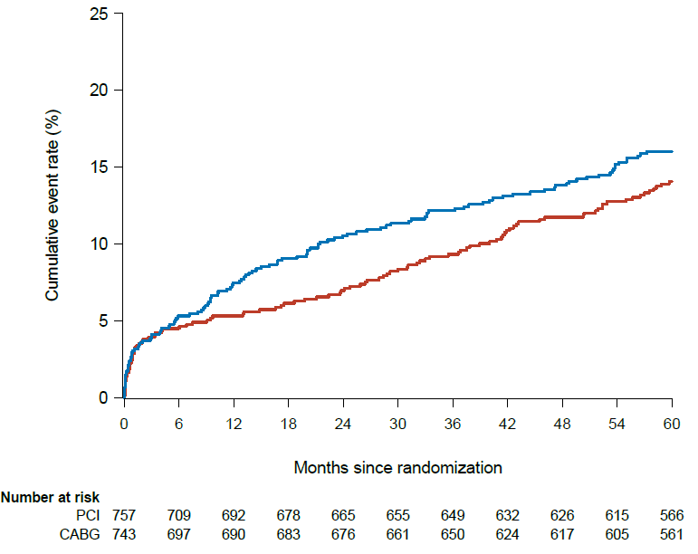
Primary Endpoint: Death, Stroke, or MI at 5 years
HR 1.16 (95% CI 0.89−1.52); p=0.27
PCI
16.0%
14.1%
CABG

Slide 17
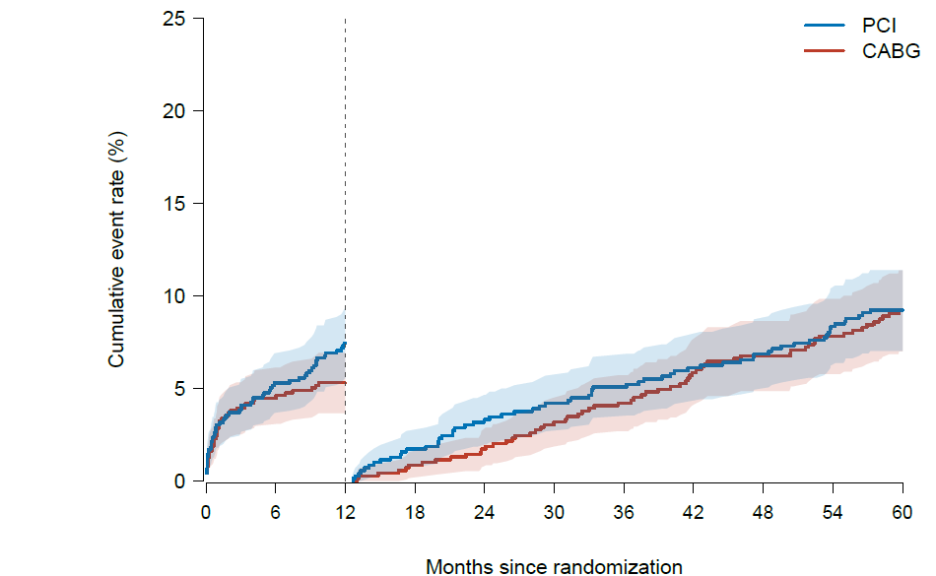
Landmark Analysis of Death, Stroke, or MI
HR 0.99 (95% CI 0.69−1.41)

Slide 18
Secondary Endpoints
Endpoint | PCI (n=757) | CABG (n=743) | Hazard Ratio
Death | 7.2% | 7.2% | 1.0 (0.7-1.5)
Cardiac death | 2.0% | 1.4%
Stroke | 1.9% | 3.0% | 0.7 (0.3-1.3)
MI | 8.2% | 5.3% | 1.6 (1.0-2.4)
Procedural | 1.9% | 1.2%
Spontaneous | 6.3% | 4.1%
Repeat Revascularization | 15.6% | 7.8% | 2.0 (1.5-2.8)
Death, stroke, MI, or repeat revascularization | 25.3% | 18.2% | 1.4 (1.2-1.8)
Death, stroke, or MI (SCAI)* | 20.0% | 23.7% | 0.9 (0.7-1.1)
*Using the Society for Cardiovascular Angiography and Interventions definition for procedural MI

Slide 19
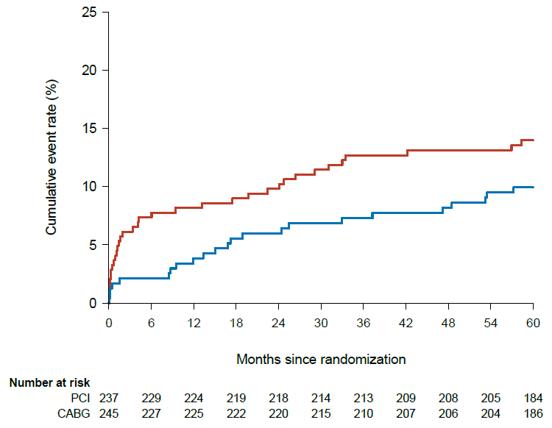
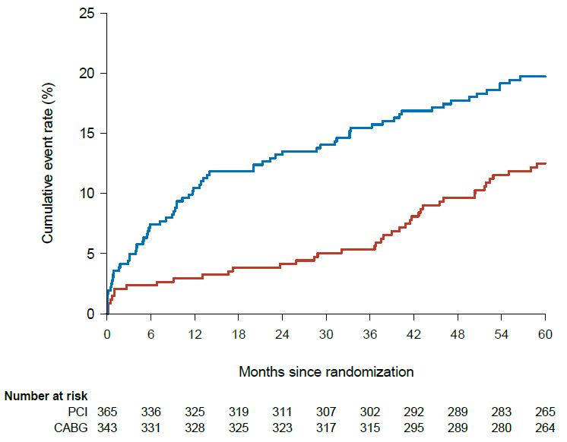
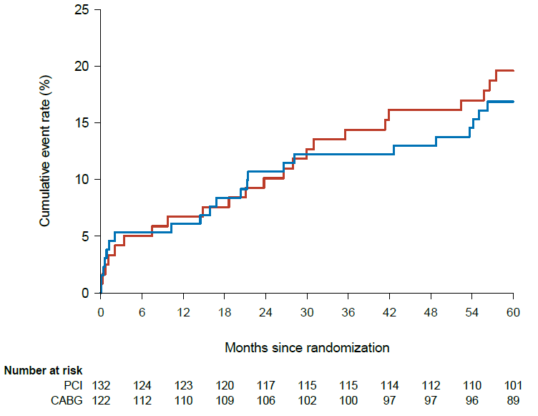
Death, Stroke, or MI Based on SYNTAX Score
HR 1.64 (95% CI 1.11−2.43)
HR 0.83 (95% CI 0.43−1.60)
HR 0.72 (95% CI 0.42−1.24)
PCI
CABG
CABG
PCI
PCI
CABG
LOW (<23)
SYNTAX SCORE
INTERMEDIATE (23-32)
SYNTAX SCORE
HIGH (>32)
SYNTAX SCORE

Slide 20
FAME 3 Compared with the SYNTAX Trial
Variable | FAME 3 | SYNTAX
Age | 65 years | 65 years
Male | 82% | 78%
Diabetes | 29% | 25%
Insulin Dependent | 8% | 10%
Hypertension | 73% | 67%
Dyslipidemia | 70% | 78%
Current Tobacco Use | 19% | 20%
ACS presentation | 39% | 29%
EF≤50% | 18% | 20%
Prior PCI | 14% | 0%
Number of Lesions | 4.3 | 4.4
SYNTAX Score | 26 | 29

Slide 21
FAME 3 Compared with the SYNTAX* Trial
Death, Stroke, or MI at 5 Years
p<0.001
% Death, Stroke or MI
p=0.27
Head SJ, et al. Eur Heart J 2014;35:2821-30 *3V-CAD Cohort

Slide 22
FAME 3 Compared with the SYNTAX* Trial
Death at 5 Years
p=0.006
% Deceased
p=0.96
Head SJ, et al. Eur Heart J 2014;35:2821-30 *3V-CAD Cohort

Slide 23
Limitations
This is a prespecified secondary endpoint of a study in which the primary endpoint was not met.
Follow-up is limited to 5 years.
The study included relatively few women, Black and other underrepresented patient populations.
Intravascular imaging was utilized in only 12% in the PCI arm.

Slide 24
Conclusions
In patients with 3V-CAD, there is no significant difference in the composite of death, stroke, or MI after FFR-Guided PCI with a current generation DES in comparison with CABG after 5 years.
  The incidence of death in the two groups was the same.
  The incidence of MI was higher after PCI (2.9% absolute difference).
  In a landmark analysis, after one year, there was no late accrual of benefit with CABG.
  These results differ strikingly from the 3V-CAD cohort in the SYNTAX trial, where the composite of death, stroke, or MI was significantly higher after PCI, as was the incidence of death alone.

Slide 25
Clinical Implications
The difference in outcomes at 5 years between PCI and CABG has narrowed likely due to improved stent technology, the routine application of FFR-guided PCI, and greater adherence to guideline-directed medical therapy.
Patients with lower coronary anatomic complexity (based on the SYNTAX score) do better with PCI, while patients with greater anatomic complexity do better with CABG.

Slide 26
Clinical Implications
The FAME 3 trial provides contemporary data regarding outcomes after FFR-guided PCI using current-generation DES compared with CABG in patients with 3V-CAD, which can facilitate improved shared decision-making between physicians and patients.

Slide 27


Slide 28
Thank you!
The FAME 3 Steering Committee would like to thank the study participants, the site research coordinators and all of the co-investigators for their tireless effort.
I would like to especially thank Dr. Frederik Zimmermann for his amazing effort and partnership on this trial for the past 11 years.
Thank You!

