Slide 1
Two-year Outcomes Of Transcatheter Tricuspid Valve Edge-to-Edge Repair For Tricuspid Regurgitation: The TRILUMINATE Pivotal Trial
Saibal Kar, MD, on behalf of the TRILUMINATE Pivotal Trial investigators
Program Director, Cardiovascular disease fellowship
Los Robles Regional Medical Center, Thousand Oaks, CA
National Physician Leader, Interventional Cardiology, HCA Healthcare, USA

Slide 2
Disclosures
Grants and institutional research support: Abbott, Boston Scientific, and Edwards Lifesciences
Consulting fees/honoraria: Abbott, Boston Scientific, W.L. Gore, and Medtronic
Steering committee member: Abbott (TRILUMINATE Pivotal)
National principal investigator: Abbott (EXPAND, REPAIR MR)
The TRILUMINATE Pivotal trial was funded by Abbott; ClinicalTrials.gov number, NCT03904147.

Slide 3
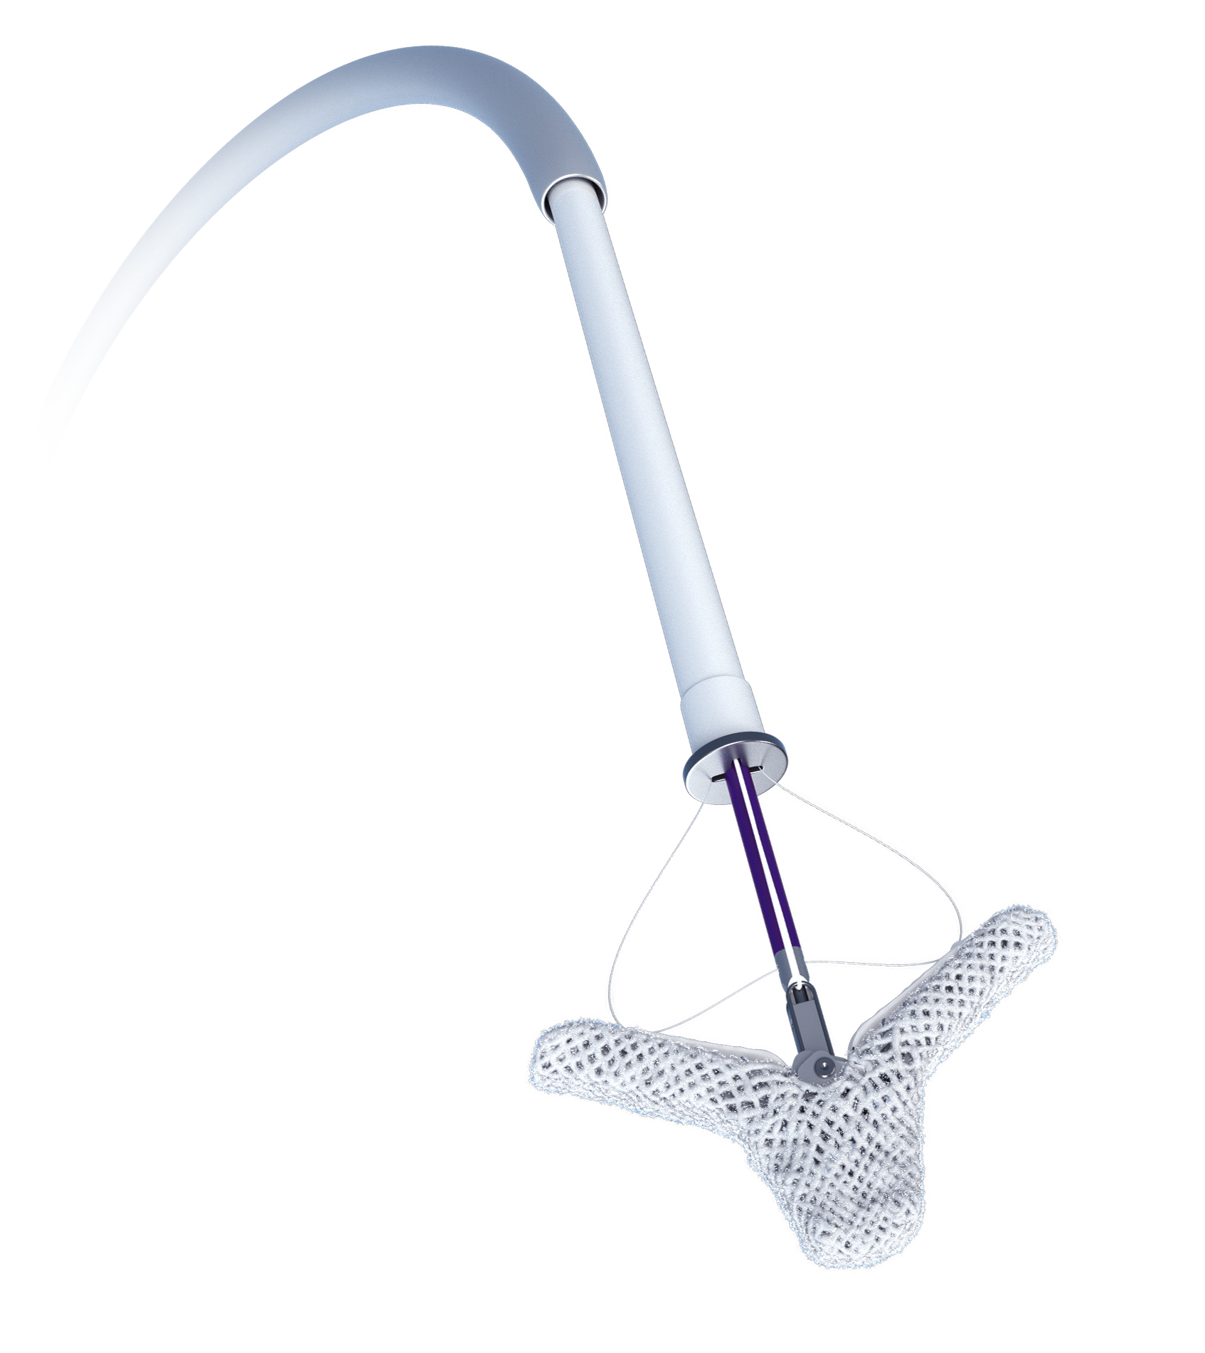
The TRILUMINATE Pivotal Trial
The first randomized controlled trial to evaluate tricuspid TEER in patients with symptomatic, severe TR despite optimized medical therapy.
The primary endpoint (evaluated at 1 year follow-up) showed tricuspid TEER with the TriClip device was superior to medical therapy alone, driven by improvements in health status with no differences in mortality or heart failure hospitalization (HFH).¹
However, a favorable trend in HFH was seen in the later enrollment at 1 year.²
The TriClip device (Abbott)
¹ Sorajja P, Whisenant B, Hamid N, et al. Transcatheter Repair for Patients with Tricuspid Regurgitation. N Engl J Med. 2023;388(20):1833-1842.
² Tang GHL, Hahn RT, Whisenant BK, et al. Tricuspid Transcatheter Edge-to-Edge Repair for Severe Tricuspid Regurgitation: 1-Year Outcomes From the TRILUMINATE Randomized Cohort. J Am Coll Cardiol. 2025;85(3):235-246.

Slide 4
Study Design
Design
Prespecified 2-year Endpoints (ITT)
1:1 randomization between TriClip device and medical therapy
Total of 572 subjects randomized
Primary endpoint met¹
Crossover to device treatment allowed after 1-year follow-up if trial inclusion criteria still met
Recurrent Heart Failure Hospitalizations (HFH) at 24 months
Freedom from all-cause mortality, tricuspid valve surgery, and tricuspid valve intervention at 24 months
Additional 2-year Outcomes
Adverse events, tricuspid regurgitation grade, health status
¹ Sorajja P, Whisenant B, Hamid N, et al. Transcatheter Repair for Patients with Tricuspid Regurgitation. N Engl J Med. 2023;388(20):1833-1842. HF, heart failure.

Slide 5
Study Design
TRILUMINATE Pivotal Randomized Cohort (N=572)
Prespecified 2-year Endpoints (ITT)
Recurrent Heart Failure Hospitalizations (HFH) at 24 months
Freedom from all-cause mortality, tricuspid valve surgery, and tricuspid valve intervention at 24 months
Device Arm(TriClip + medical therapy) (N=285)
Control (medical therapy) (N=287)
1 Year Visit Completed (N=244)
1 Year Visit Completed (N=241)
TriClip after 1 Year Visit (Crossover) (N=142)
Additional 2-year Outcomes
2 Year Visit Completed (Device) (N=209)
2 Year Visit Completed (“Pure” Control) (N=57)
Adverse events, tricuspid regurgitation grade, health status
Prespecified 2-year endpoints were performed intention-to-treat (ITT).

Slide 6
Baseline Characteristics
Characteristic | Device N=285 | Control N=287
Age (years) | 78.1 ± 7.9 | 78.1 ± 7.6
Female | 58.9% | 58.9%
Atrial Fibrillation | 82.8% | 92.7%
CRT, CRT-D, ICD, or Permanent Pacemaker | 16.5% | 16.4%
Previous Aortic and/or Mitral Intervention | 37.9% | 34.5%
HFH Within 1 Year Before Enrollment | 24.9% | 22.6%
NYHA Class III/IV | 56.1% | 54.0%
KCCQ Score | 55.6 ± 22.9 | 54.6 ± 23.8
6-Minute Walk Distance (m) | 240.5 ± 116.4 | 249.6 ± 125.5
Functional TR Etiology | 95.7% | 93.9%
Torrential TR¹ | 48.7% | 51.5%
Left Ventricular Ejection Fraction (%) | 59.4 ± 9.0 | 59.7 ± 9.2
Based on 5-grade scale from ¹Hahn RT, Zamorano JL. Eur Heart J Cardiovasc Imaging 2017;18:1342-3. Data shown as % or mean±standard deviation.CRT, cardiac resynchronization therapy; CRT-D, CRT device; HFH, heart failure hospitalization; ICD, implantable cardiac defibrillator; KCCQ, Kansas City Cardiomyopathy Questionnaire; NYHA, New York Heart Association; TR, tricuspid regurgitation.

Slide 7
Tricuspid Regurgitation Severity (Paired)
INTENTION-TO-TREAT
Device (N=172)
Control (N=155)
84% moderate or less
Paired data shown. Patients with tricuspid valve surgery are excluded.
Notes:
TR worsens in Control patients by 1 year.

Slide 8
Tricuspid Regurgitation Severity (Paired)
INTENTION-TO-TREAT
Device (N=172)
Control (N=155) Includes patients who crossed over before 2-year follow-up (60% of control patients)
84% moderate or less
Paired data shown. Patients with tricuspid valve surgery are excluded.
Notes:
Explain that crossover occurred.
84% of Device patients had moderate or less TR at 2 years. This was sustained from 1 year.
63% of Control patients had moderate or less TR at 2 years; however, ITT is shown. This includes the 60% of patients who crossed over after 1-year follow-up.

Slide 9
Prespecified Endpoint: Heart Failure Hospitalizations
INTENTION-TO-TREAT
0.52 (127 events)
Mean Cumulative Function (Average number of events/patient)
Device
Control
At risk
Days
Control
287
261
247
226
190
Prespecified secondary endpoint from joint frailty model; intention-to-treat (ITT) analysis shown. HFH, heart failure hospitalization; HFH does not include hospitalization for crossover procedure.
Notes:
The hazard ratio from the prespecified Joint Frailty Model was 0.72, with a one-sided upper confidence limit of 0.93 (p=0.02), indicating a relative risk reduction of 28% with device treatment. This reduction was significant even when tested by a two-sided 95% confidence interval (hazard ratio 0.72 [0.53, 0.98], p=0.04).
The annualized rate of recurrent HFH through 2 years was analyzed as a sensitivity analysis and a significantly lower rate in the Device vs Control group (0.19 [95% CI: 0.15, 0.23] vs 0.26 [95% CI: 0.22, 0.31] events/patient-year, p=0.02) was observed, with the divergence in these rates beginning after 1-year follow-up.

Slide 10
Prespecified Endpoint: Heart Failure Hospitalizations
INTENTION-TO-TREAT
one-sided p=0.02
0.52 (127 events)
0.38 (95 events)
Mean Cumulative Function (Average number of events/patient)
Device
Control
At risk
Days
Control
287
261
247
226
190
Device
285
265
253
238
205
28% relative risk reduction in HFH with TriClip device treatment, HR 0.72 (two-sided 95%CI [0.53, 0.98])
Prespecified secondary endpoint from joint frailty model; intention-to-treat (ITT) analysis shown. CI, confidence interval, HFH, heart failure hospitalization, HR, hazard ratio. HFH does not include hospitalization for crossover procedure.
Notes:
Crossover procedure does not count as HFH, this benefit was observed despite many Control patients crossing over after 1-year follow-up.
The hazard ratio from the prespecified Joint Frailty Model was 0.72, with a one-sided upper confidence limit of 0.93 (p=0.02), indicating a relative risk reduction of 28% with device treatment. This reduction was significant even when tested by a two-sided 95% confidence interval (hazard ratio 0.72 [0.53, 0.98], p=0.04).
The annualized rate of recurrent HFH through 2 years was analyzed as a sensitivity analysis and a significantly lower rate in the Device vs Control group (0.19 [95% CI: 0.15, 0.23] vs 0.26 [95% CI: 0.22, 0.31] events/patient-year, p=0.02) was observed, with the divergence in these rates beginning after 1-year follow-up.

Slide 11
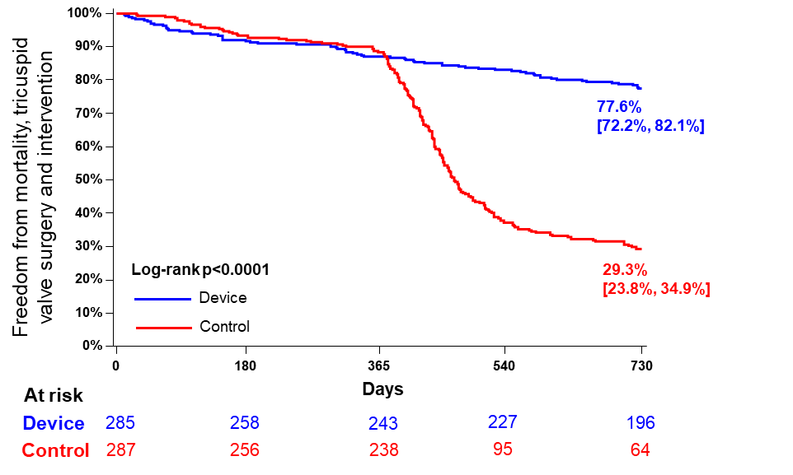
Prespecified Endpoint: Freedom from All-cause mortality, TV Surgery, TV Intervention
INTENTION-TO-TREAT
Difference driven by transcatheter intervention in Control group (crossover procedure) after 1 year. Rates of all-cause mortality and tricuspid valve (TV) surgery not statistically different between groups.
Component | Device N=285 | Control N=287 | p-value
Composite All-cause mortality Tricuspid valve surgery Transcatheter intervention | 22.4% (62) 17.9% (49) 2.3% (6) 3.8% (10) | 70.7% (185) 17.1% (45) 4.3% (11) 61.5% (142) | <0.0001
Prespecified secondary endpoint; intention-to-treat (ITT) analysis shown. TV, tricuspid valve.
Notes:
Freedom from all-cause mortality, tricuspid valve surgery, and tricuspid valve intervention post-index procedure through 2 years was significantly higher in the Device vs Control group (77.6 [95% CI: 72.2%, 82.1%]% vs 29.3% [95% CI: 23.8%, 34.9%], p<0.0001), driven by differences in the rate of tricuspid valve intervention (Device: 3.8%, Control: 61.5%).
Rates of all-cause mortality (Device: 17.9%, Control: 17.1%) and tricuspid valve surgery (Device: 2.3%, Control: 4.3%) through 2 years were not statistically different between groups.

Slide 12
Both 2-year Prespecified Endpoints Met
INTENTION-TO-TREAT
Reduction in annualized HFH at 24 months in Device group (p=0.02).
Higher freedom from all-cause mortality, tricuspid valve surgery, and transcatheter intervention at 24 months in Device group, driven by transcatheter interventions in the Control group (p<0.0001).
Notes:
Both prespecified endpoints were met.

Slide 13
Safety Through Two Years
INTENTION-TO-TREAT
Adverse Event through 2 Years | Device N=285 | Control N=287
Stroke | 1.9% | 2.5%
Transient ischemic attack | 1.7% | 1.0%
Cardiogenic shock | 0.4% | 1.3%
New conduction disturbance requiring permanent pacemaker | 5.5% | 4.2%
Device embolization | 0% | 0%
Device thrombosis | 0% | 0%
Data shown as Kaplan Meier time-to-event (%). Intention-to-treat (ITT) analysis shown.
Notes:
Through 2 years, no instances of embolization or thrombosis. Very low rate of new pacemakers (if anything, shows disease progression and does not reflect device complications).

Slide 14
Crossover Analysis
Crossover to TriClip device treatment permitted after 1-year follow-up if original inclusion criteria still met
Notes:
Patients who still met original inclusion criteria were eligible for crossover procedure (TriClip device) after 1-year follow-up. This procedure did not count as an HFH.

Slide 15
Timing of Crossover Procedure
Within 6 months of 1-year visit
Of the 241 Control patients eligible for crossover after 1-year follow-up, 142 (59%) patients crossed over prior to 2-year follow-up
92% (130/142) of crossover procedures occurred within 6 months of the 1-year visit
1.0
0.9
0.8
0.7
0.6
Percent of Control Patients with Crossover Procedure (%)
0.5
0.4
0.3
0.2
0.1
0.0
0
30
180
365
Time After 1 Year Visit (Days)
Notes:
60% of patients crossed over, most within 6 months of eligibility.

Slide 16
Characteristics Prior to Crossover
Variable at 1 Year (Prior to Crossover) | Patients who Crossed Over N=142 | Patients who did not Crossover N=94
Torrential TR | 65.2% | 41.5%
NYHA III/IV | 47.5% | 30.4%
KCCQ Change (baseline to 1YR) | 0 ± 18 | 7 ± 18
6MWD Change (baseline to 1YR) | -22 ± 103 | -1 ± 90
HFH (events/patient-year) | 0.17 | 0.07
Diuretic Dose Change (baseline to 1YR) | +22 mg | +5 mg
Patients who crossed over were more symptomatic with a higher prevalence of torrential TR and more HFH prior to crossover.
Includes patients eligible for crossover (completed 1-year follow-up), patients with tricuspid valve surgery are excluded. TR, tricuspid regurgitation; NYHA, New York Heart Association; KCCQ, Kansas City Cardiomyopathy Questionnaire; 6MWD, 6-minute walk distance; HFH, heart failure hospitalization.
Notes:
Crossover patients were more symptomatic, had more HFH events in year prior, and had a greater change increase in diuretic dose change at 1-year follow-up compared with patients who did not crossover.

Slide 17
Safety of Procedure at Crossover
Adverse Events through 30 days | Device Group N=281 | Crossover N=142
Major Adverse Events Cardiovascular mortality New-onset renal failure Non-elective cardiac surgery Endocarditis requiring surgery | 0.4% 0.7% 0% 0% | 0.7% 1.4% 0% 0%
Other Adverse Events Major bleeding Single leaflet device attachment Device embolization Device thrombosis Myocardial infarction Stroke New conduction disturbance requiring permanent pacemaker | 3.2% 5.7% 0% 0% 0% 0.4% 0.9% | 2.8% 5.6% 0% 0% 0% 0% 0%
Discharge to Home | 97.9% | 97.2%
All-cause Mortality | 0.4% | 1.4%
Heart Failure Hospitalization | 2.5% | 3.5%
Data shown as %.
Notes:
Despite crossover patients being “sicker” due to delayed treatment, the procedure was still safe with minimal safety events.
There were 2 deaths following crossover: 1) one was related to procedure, 2) one was not related to device or procedure

Slide 18
Tricuspid Regurgitation Grade After Crossover
Device (N=172)
Crossover (N=111)
“Pure” Control (N=44)
(crossovers excluded)
p<0.0001
p=0.38
p=0.65
p<0.0001
p=0.55
p=0.68
84% moderate or less
81% moderate or less after crossover
21% moderate or less
Paired data shown. “Pure” control includes patients who remain on medical therapy alone. Patients with tricuspid valve surgery are excluded from all groups.
Notes:
Crossover patients had more torrential TR prior to crossover (compared with Device group) yet 81% had moderate or less after TriClip procedure. 1/5 of remaining “pure” control patients had moderate or less at 2 years.

Slide 19
Health Status Through 2 Years
Change in KCCQ Score
(Follow-Up –Baseline)
Baseline
30 Days
1 Year
2 Years
Control eligible for crossover after 1-year follow-up visit
Mean and 95%CI and paired data shown. “Pure” control includes patients who remain on medical therapy alone. Patients with tricuspid valve surgery are excluded. KCCQ improvements were sustained in Device patients (changes from baseline to 30 days, 1 year, and 2 years were not significantly different, p=0.06).
Notes:
“Pure controls” represent only ~20% of entire control group – some patients did do well on medical therapy alone.1/3 of these patients had TR reduction (prior slide) and may have also experienced benefit from being in clinical trial + more touchpoints with healthcare system

Slide 20
Conclusions
At 2 years, treatment with the TriClip device reduced HFH compared with medical therapy (despite crossovers in the Control group).
Improvements in TR severity and quality of life were sustained in Device patients through 2 years.
TriClip therapy is safe through 2 years and upon crossover.
Control patients, whose symptoms and health status had worsened prior to crossover, benefited from TriClip device with improvements in TR severity and quality of life.

Slide 21
Circulation. 2025; [published online ahead of print]. DOI: 10.1161/CIRCULATIONAHA.125.074536
Two-year outcomes of transcatheter edge-to-edge repair for severe tricuspid regurgitation: The TRILUMINATE Pivotal Randomized Controlled Trial
Saibal Kar, MD; Raj R. Makkar, MD; Brian K. Whisenant, MD; Nadira Hamid, MD; Hursh Naik, Md; Peter Tadros, MD; Matthew J. Price, MD; Gagan Singh, MD; Jonathan G. Schwartz, MD; Samir Kapadia, MD,; Oluseun Alli, MD; Samuel Horr, MD; Puvi Seshiah, MD; Wayne Batchelor, MD; Brandon M. Jones, MD; Mustafa I. Ahmed, MD; Raymond Benza, MD; Ulrich Jorde, MD; Vinod H. Thourani, MD; Andrew A. Ghobrial, MD; Gilbert H. L. Tang, MD; Phillip M. Trusty, PhD; Dina Huang, PhD; Rebecca T. Hahn, MD; David H. Adams, MD; Paul Sorajja, MD; for the TRILUMINATE Pivotal Investigators Circulation
https://www.ahajournals.org/do10.1161/CIRCULATIONAHA.125.074536

