Slide 1
Angiopoietin-Like 3 Antibody Therapy in Patients with Suboptimally Controlled Hyperlipidemia: A Phase 2 Study
Xiaojie Xie
MD, PhD, FACC
Department of Cardiology,
Second Affiliated Hospital, Zhejiang University School of Medicine,
State Key Laboratory of Transvascular Implantation Devices,
Heart Regeneration and Repair Key Laboratory of Zhejiang Province, Hangzhou, China

Slide 2
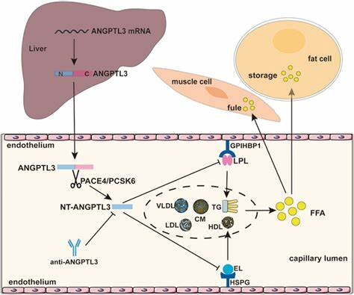
Rationale
Low-density lipoprotein cholesterol (LDL-C) and triglyceride (TG) are important risk factors for atherosclerotic cardiovascular disease.¹
Angiopoietin-like 3 (ANGPTL3) is involved in the regulation of lipid metabolism and can reduce the clearance of TG and LDL-C by inhibiting lipoprotein lipase and endothelial lipase.^{2, 3}
SHR1918 is an ANGPTL3 monoclonal antibody developed to inhibit ANGPTL3 activity, thereby lowering the serum levels of TG and LDL-C.
1 J Am Heart Assoc. 2023;12(11):e028892. 2 Clin Pharmacol. 2022;14:49-59. 3 FASEB J. 2024;38(1):e23399.

Slide 3
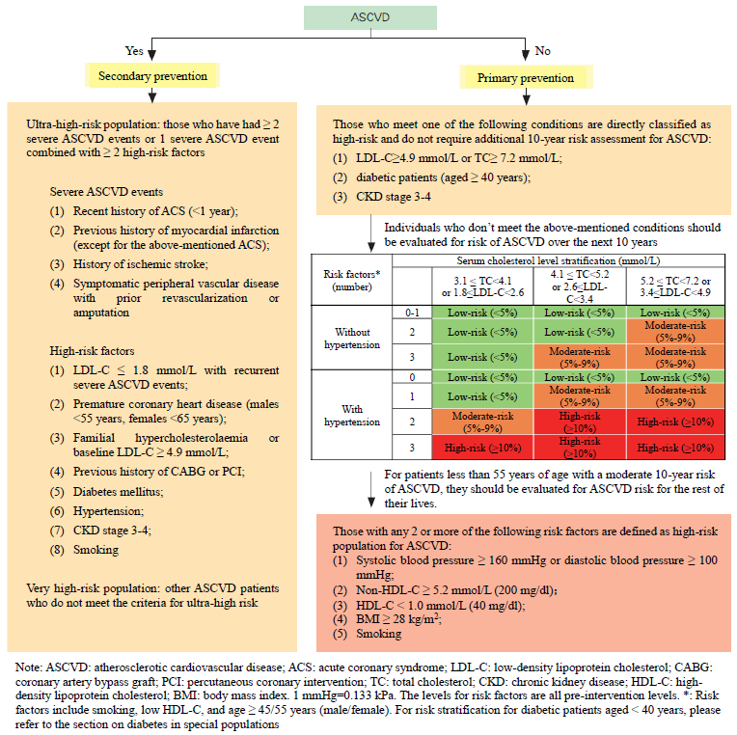
Objective
The aim of this study was to assess the lipid-altering efficacy and safety of SHR-1918 in moderate or higher risk of atherosclerotic cardiovascular disease (ASCVD) patients with suboptimally controlled hyperlipidemia on backgroud lipid-lowering medication.
2023 China Guidelines for Lipid Management. J Geriatr Cardiol 2023; 20(9): 621–663

Slide 4
Study design
(ClinicalTrials.gov: NCT06109831)
A multicenter, randomized, double blind, placebo-controlled phase 2 trial
P ASCVD patients with suboptimally controlled hyperlipidemia
I Subcutaneous injection of SHR1918 on 4 dosing regimen
C Matching placebo respectively
O Primary: % change in LDL-C level from baseline to W16
Secondary: absolute change from baseline to W16 in LDL-C and TG
overall/subgroup proportions of patients achieving LDL-C targets at W16 and 52/56
% change in TG, HDL-C, non-HDL-C, Lp(a), ApoA1, ApoB levels from baseline to W16
absolute and % change from baseline to W52/56 in LDL-C, TG, HDL-C, non-HDL-C, Lp(a), ApoA1, and ApoB
Safety: PE, vital signs, 12-lead ECG, laboratory tests, AEs, and injection site reactions
T 56 or 60 weeks

Slide 5
Study design
Stable diet, lifestyle and background IIT
SHR1918 150mg Q4W（n=64）
SHR1918 150mg Q4W
Run-in of LFD, lifestyle, and LLT
Placebo 150mg Q4W（n=16）
SHR1918 150mg Q4W
SHR1918 300mg Q4W（n=64）
SHR1918 300mg Q4W
Placebo300mg Q4W（n=16）
SHR1918 300mg Q4W
SHR1918 600mg Q4W（n=64）
SHR1918 600mg Q4W
Placebo 600mg Q4W（n=16）
SHR1918 600mg Q4W
SHR1918 600mg Q8W（n=64）
SHR1918 600mg Q8W
Placebo 600mg Q8W（n=16）
SHR1918 600mg Q8W
W0
Randomization
W16
Primary/secondary endpoints
W52/W56
W56/W60
Screening
(≤2 Weeks）
Run-in
(4~8 Weeks)
Treatment
（16 Weeks）
Extension treatment
（36 Weeks/40 Weeks）
Post-treatment follow-up
（4 Weeks）

Slide 6
 | SHR1918 150mg Q4W (n = 67) | SHR1918 300mg Q4W (n = 66) | SHR1918 600mg Q4W (n = 66) | SHR1918 600mg Q8W (n = 67) | Placebo (n = 67)
Age,y | 59.2 (11.2) | 57.2 (10.1) | 56.4 (10.6) | 57.2 (9.9) | 58.6 (7.7)
Male | 39 (58.2) | 40 (60.6) | 46 (69.7) | 42 (62.7) | 36 (53.7)
T2DM | 27 (40.3) | 23 (34.8) | 19 (28.8) | 25 (37.3) | 24 (35.8)
Body Mass Index (kg/m²) | 26.5 (4.3) | 27.2 (4.1) | 26.2 (3.7) | 26.1(3.7) | 25.8 (3.5)
ASCVD Risk, %
Moderate Risk | 5 ( 7.5) | 5 ( 7.6) | 11 (16.7) | 3 ( 4.5) | 7 (10.4)
High Risk | 29 (43.3) | 24 (36.4) | 28 (42.4) | 20 (29.9) | 16 (23.9)
Very High Risk | 19 (28.4) | 26 (39.4) | 22 (33.3) | 24 (35.8) | 19 (28.4)
Extremely High Risk | 23 (34.3) | 21 (31.8) | 14 (21.2) | 20 (29.9) | 25 (37.3)
Lipid-Lowering Therapy
Statin | 67(100) | 66(100) | 66(100) | 67(100) | 66(98.5)
Moderate Intensity | 65(97.0) | 62(93.9) | 62(93.9) | 66(98.5) | 63(94.0)
High Intensity | 2(3.0) | 4(6.1) | 4(6.1) | 1(1.5) | 3(4.5)
Cholesterol Absorption Inhibitors | 9 (13.4) | 7 (10.6) | 8 (12.1) | 8 (11.9) | 7 (10.4)
PCSK9 Inhibitors | 0 ( 0.0) | 0 ( 0.0) | 0 ( 0.0) | 1 ( 1.5) | 2 ( 3.0)
Lipid Parameters
LDL-C,mmol/L | 2.8± 1.0 | 2.7± 0.8 | 2.8±0.9 | 2.9±1.2 | 2.8±1.1
< 1.8 | 5 ( 7.5) | 6 ( 9.1) | 5 ( 7.6) | 8 (11.9) | 5 ( 7.5)
1.8 ≤ LDL - C < 2.6 | 29 (43.3) | 28 (42.4) | 25 (37.9) | 25 (37.3) | 28 (41.8)
≥ 2.6 | 33 (49.3) | 32 (48.5) | 36 (54.5) | 34 (50.7) | 34 (50.7)
TG,mmol/L | 1.8±0.9 | 1.7±0.9 | 1.8±0.9 | 1.6±0.8 | 1.7±0.9
< 1.7 | 37 (55.2) | 42 (63.6) | 38 (57.6) | 44 (65.7) | 42 (62.7)
≥ 1.7 | 30 (44.8) | 24 (36.4) | 28 (42.4) | 23 (34.3) | 25 (37.3)

Slide 7
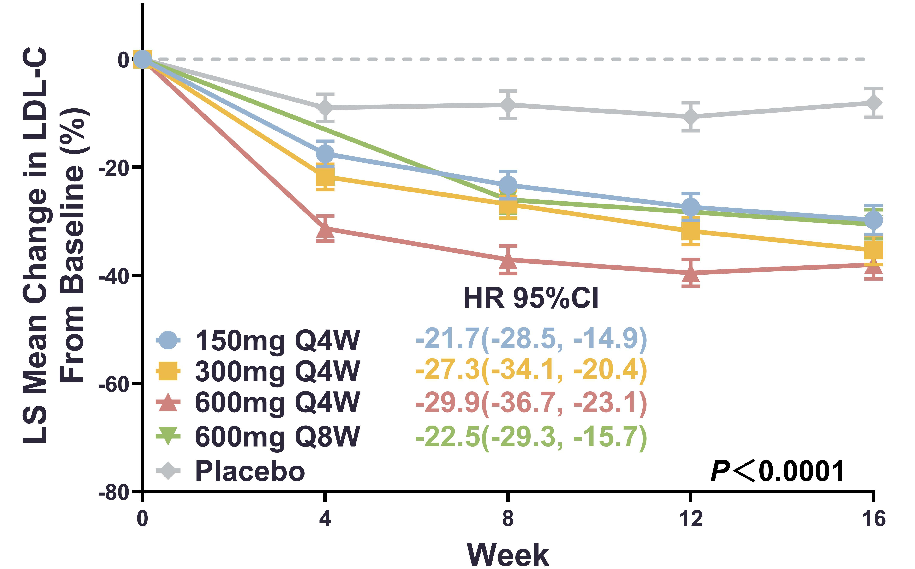
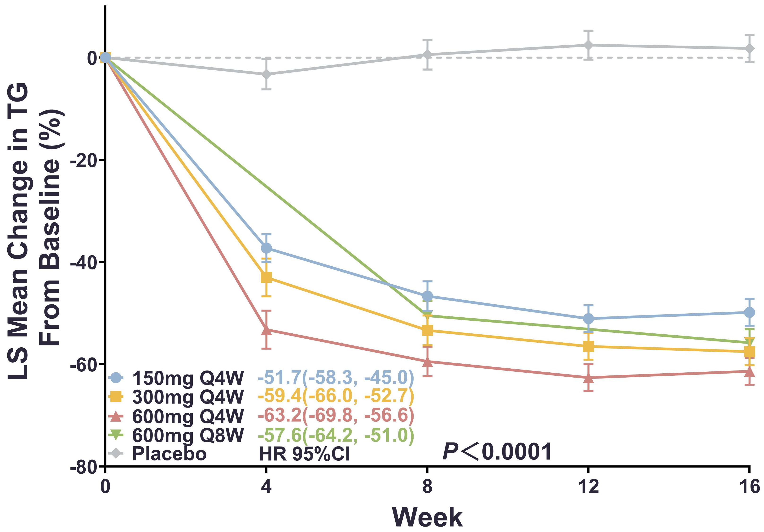
Results-1
SHR1918 injection significantly reduced percentage LDL-C levels from baseline, compare to placebo.
SHR1918 injection significantly reduced percantage TG levels, compared to placebo.
LS:least-squares

Slide 8
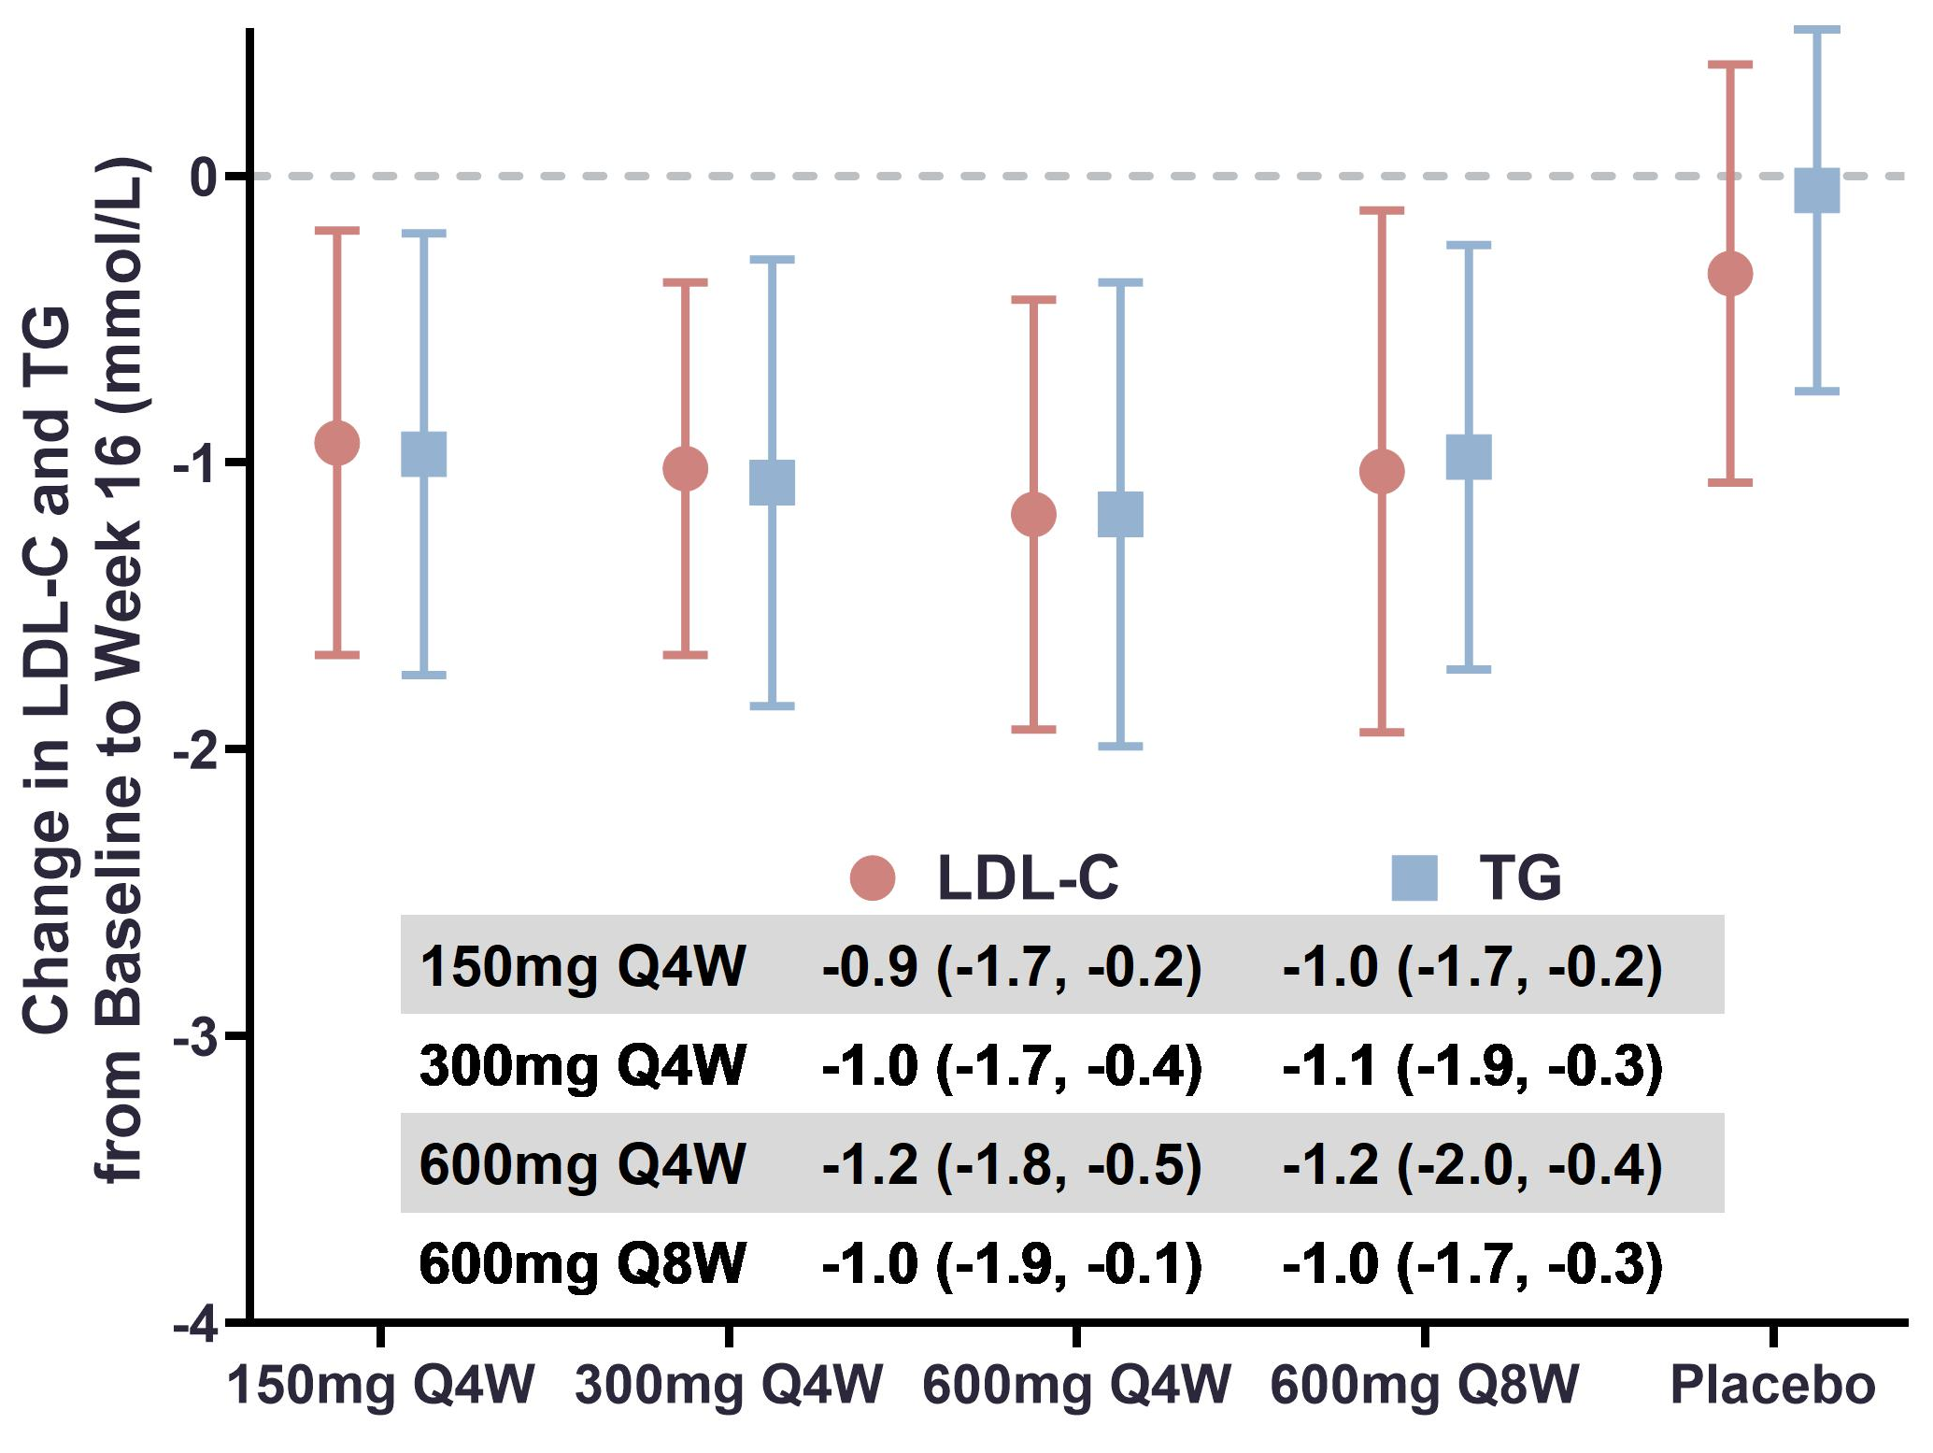
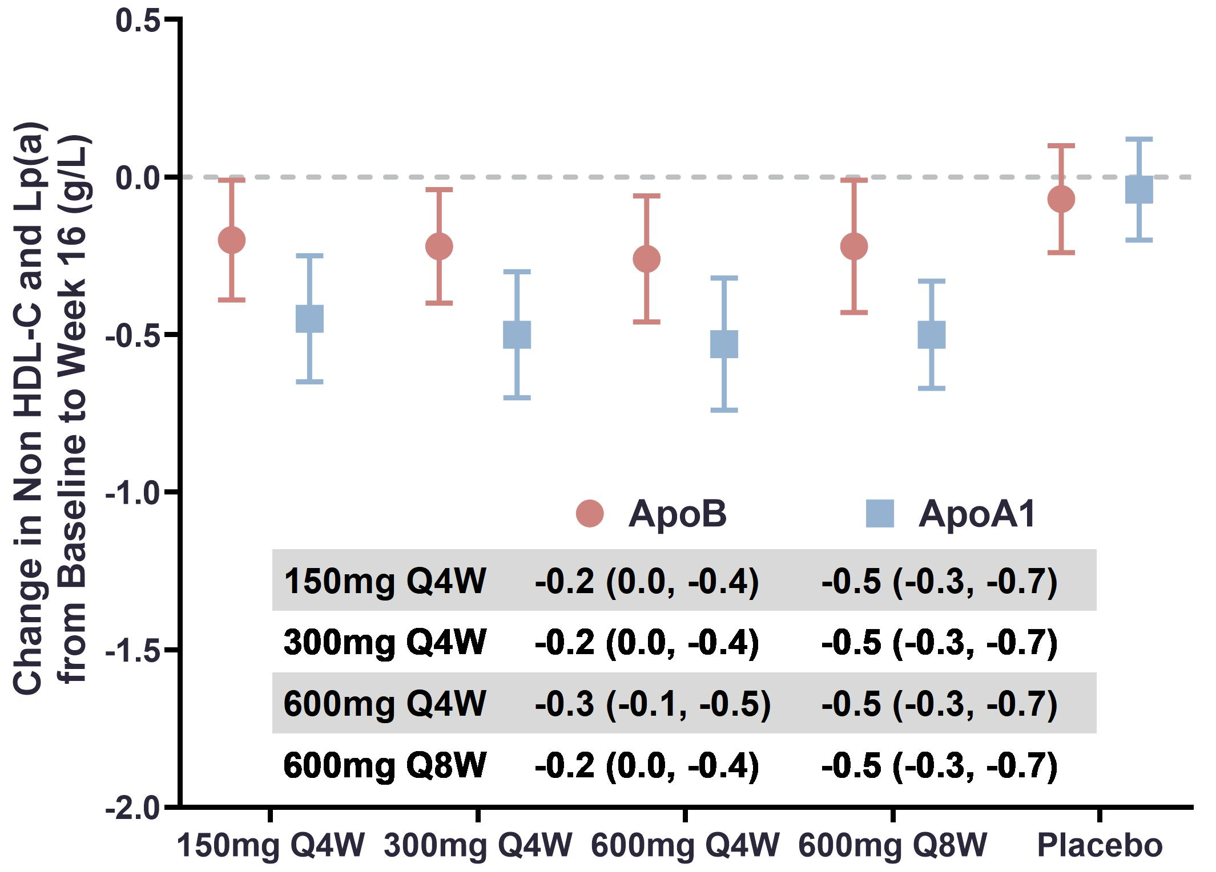
Results-2
Absolute reductions in LDL-C and TG levels were observed in pts with SHR1918 injection.
Absolute reductions in ApoB and ApoA1 levels were observed in pts with SHR1918 injection.

Slide 9
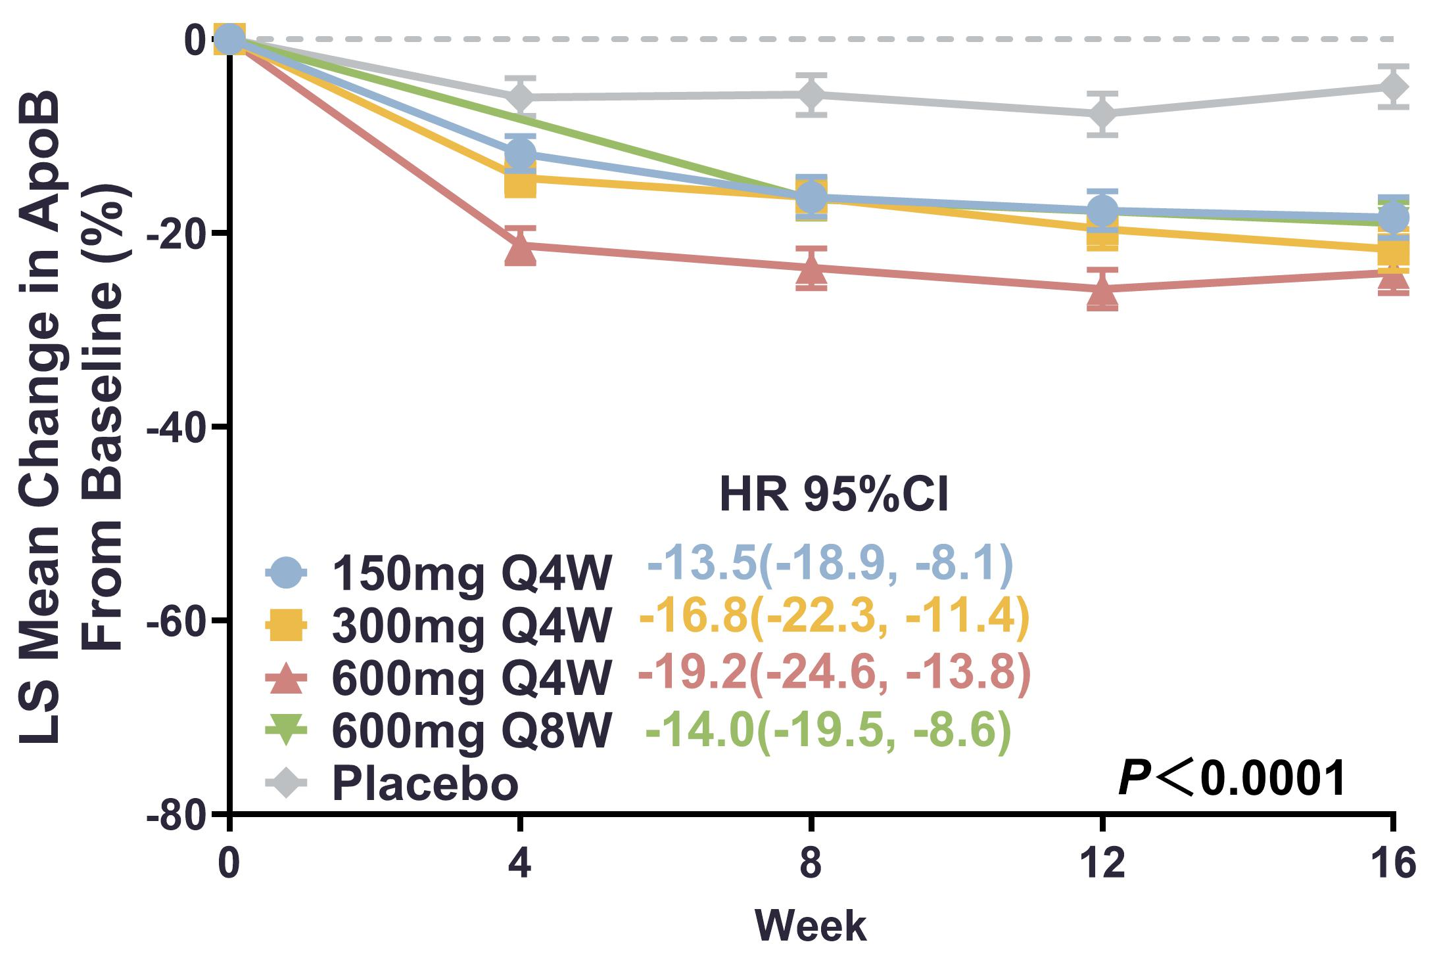
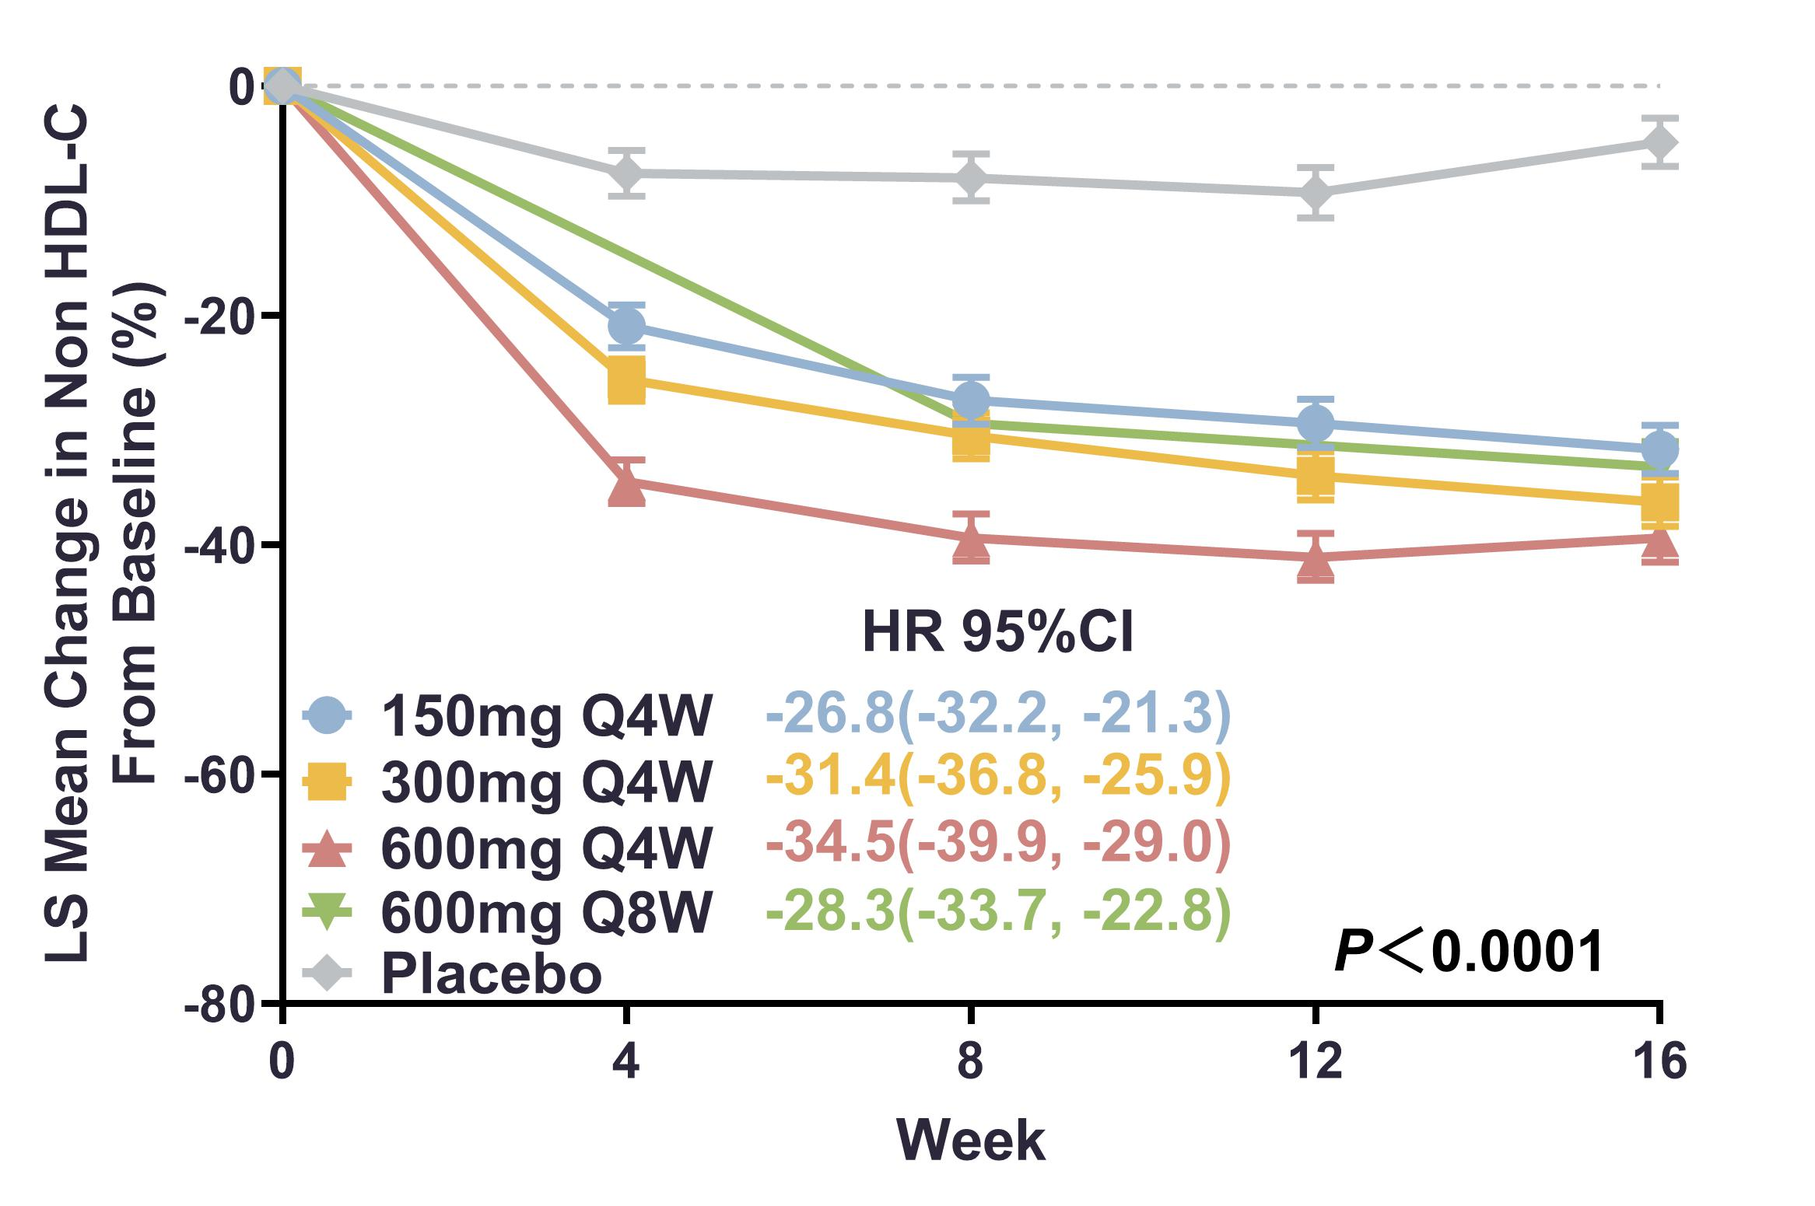
Results-3
SHR1918 injection significantly reduced percentage ApoB levels from baseline, compare to placebo.
SHR1918 injection significantly reduced percantage non-HDL-C levels, compared to placebo.
LS:least-squares

Slide 10
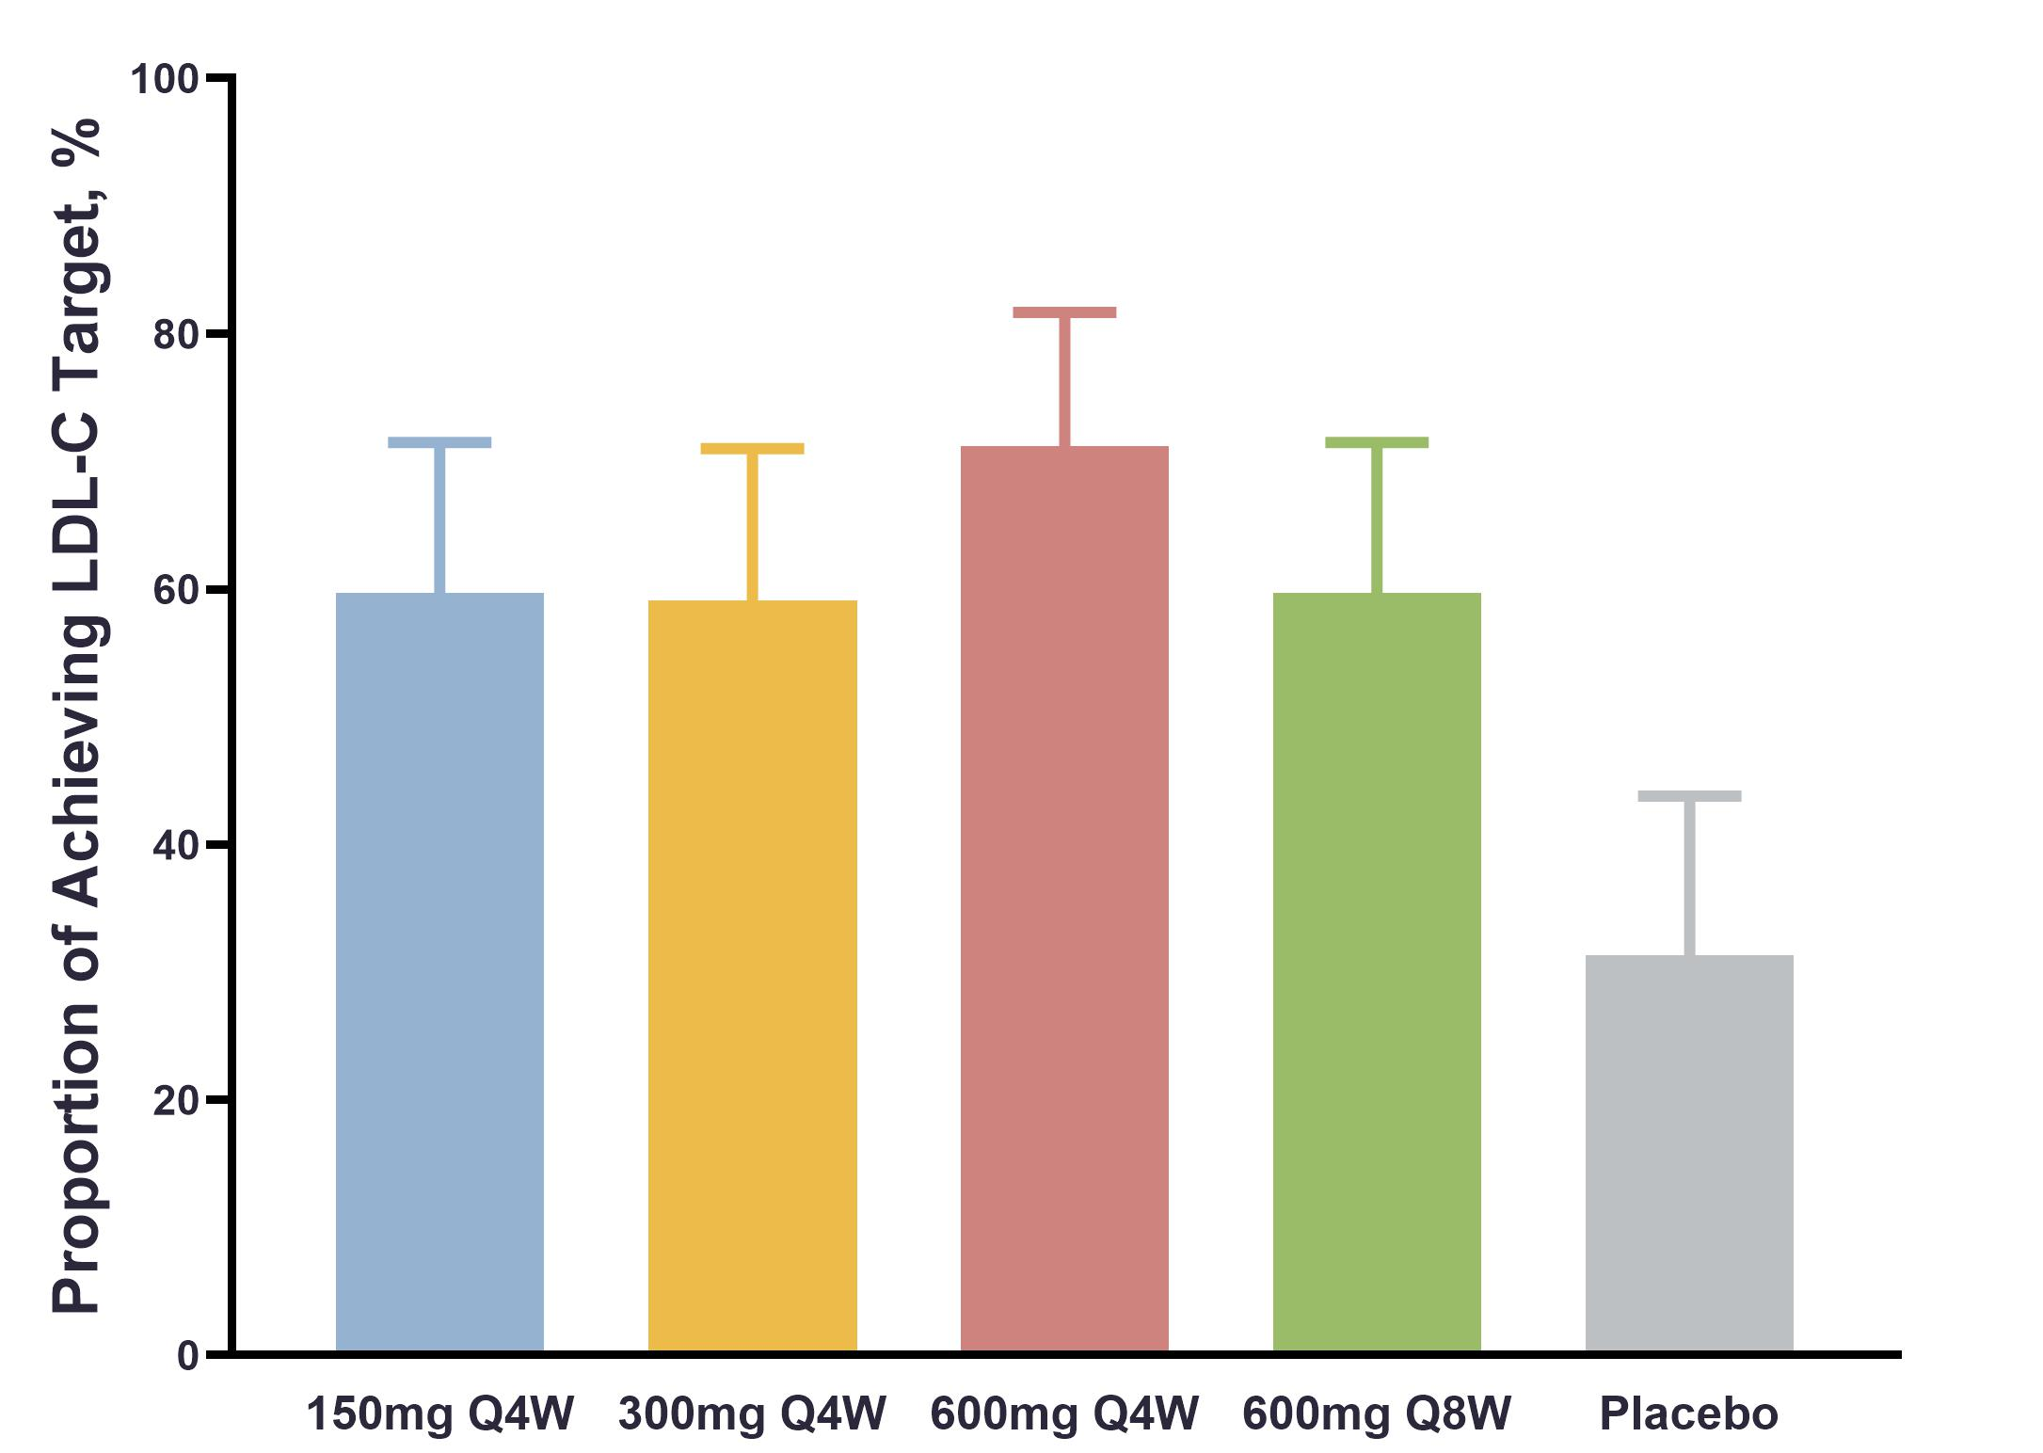
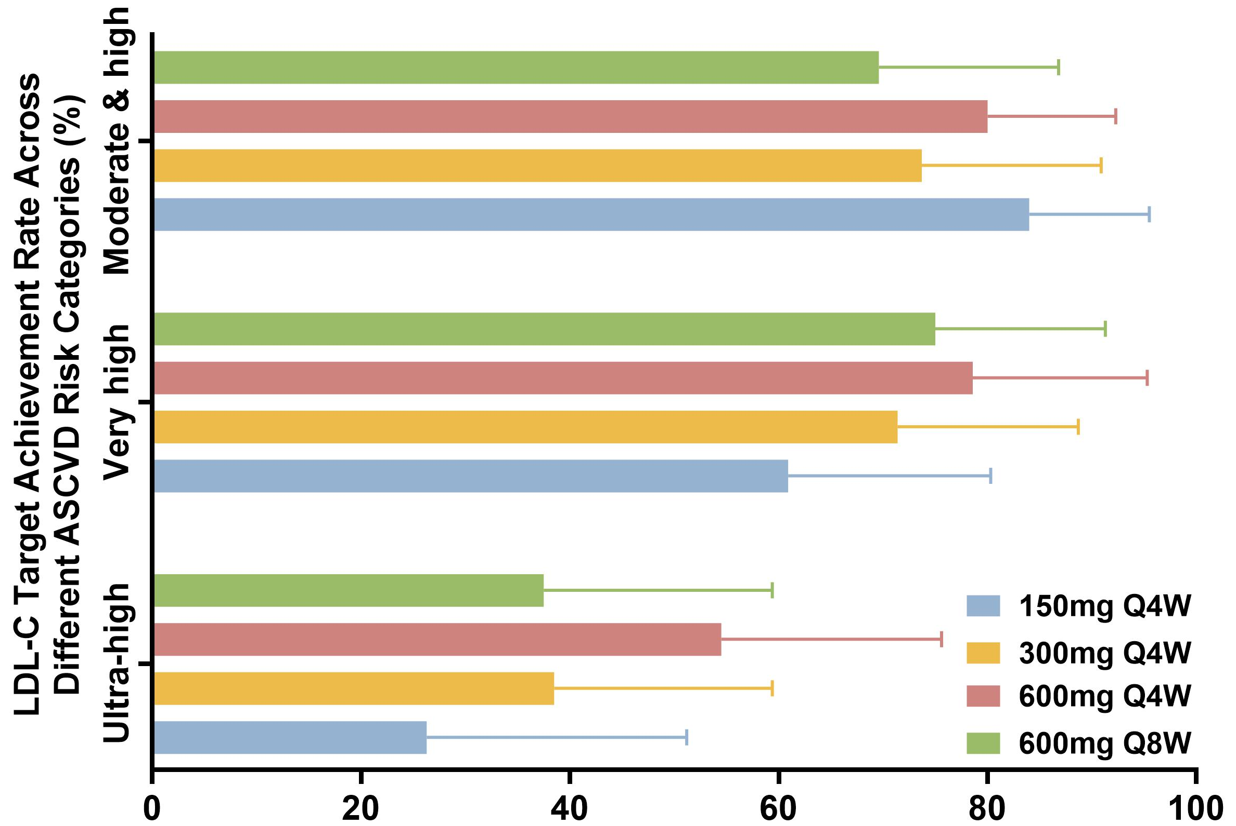
Results-2
LDL-C target achievement rate in the SHR1918 groups ranged 59.1% to 71.2%, higher than that in the placebo groups (30.8% to 31.2%)
LDL-C achievement rate was higher in moderate, high, and very high ASCVD risk patients (60.9% to 84.0%) than in ultra-high risk group (26.3% to 54.5%)

Slide 11
Safety
Treatment-emergent adverse events were comparable between the two groups
 | SHR – 1918 (n = 266) | Placebo (n = 67)
Any TEAEs | 145 (54.5) | 29 (43.3)
Mild | 108 (40.6) | 24 (35.8)
Moderate | 28 (10.5) | 4 ( 6.0)
Severe | 9 ( 3.4) | 1 ( 1.5)
SAE | 11 ( 4.1) | 2 ( 3.0)
Treatment-Related SAE | 1 ( 0.4) | 1 ( 1.5)
TEAE Leading to Treatment Discontinuation | 6 ( 2.3) | 0 ( 0.0)
TEAE Leading to Death | 1 ( 0.4) | 0 ( 0.0)
Any TRAE | 52 (19.5) | 9 (13.4)
Mild | 45 (16.9) | 8 (11.9)
Moderate | 6 ( 2.3) | 0 ( 0.0)
Severe | 1 ( 0.4) | 1 ( 1.5)
TRAE Leading to Treatment Discontinuation | 3 ( 1.1) | 0 ( 0.0)
TRAE Leading to Death | 0 ( 0.0) | 0 ( 0.0)

Slide 12
Common TEAEs
TEAEs occurring in ≥2% of patients receiving either SHR1918 or placebo
 | SHR - 1918 (n = 266) | Placebo (n = 67)
Hyperuricemia | 19 ( 7.1) | 6 ( 9.0)
Type 2 Diabetes Mellitus | 0 ( 0.0) | 2 ( 3.0)
Injection Site Reactions | 9 ( 3.4) | 0 ( 0.0)
Asthenia | 2 ( 0.8) | 2 ( 3.0)
Blood CPK Increased | 10 ( 3.8) | 4 ( 6.0)
Blood Glucose Increased | 7 ( 2.6) | 1 ( 1.5)
ALT Increased | 6 ( 2.3) | 0 ( 0.0)
Proteinuria Detected | 6 ( 2.3) | 0 ( 0.0)
Blood Creatinine Increased | 3 ( 1.1) | 2 ( 3.0)
Blood Urea Increased | 0 ( 0.0) | 2 ( 3.0)
Dizziness | 6 ( 2.3) | 2 ( 3.0)
Sinus Bradycardia | 8 ( 3.0) | 2 ( 3.0)
Ventricular Extrasystole | 2 ( 0.8) | 2 ( 3.0)
Upper Respiratory Tract Infection | 7 ( 2.6) | 2 ( 3.0)
Nausea | 2 ( 0.8) | 2 ( 3.0)
TRAEs occurring in ≥2% of patients receiving either SHR 1918 or placebo
 | SHR - 1918 (n = 266) | Placebo (n = 67)
Hyperuricemia | 7 ( 2.6) | 2 ( 3.0)
Injection Site Reactions | 9 ( 3.4) | 0 ( 0.0)
Blood CPK Increased | 0 ( 0.0) | 2 ( 3.0)
Nausea | 2 ( 0.8) | 2 ( 3.0)
TEAE = treatment-emergent adverse event
TRAE = treatment-related adverse event

Slide 13
Conclusions
SHR-1918 demonstrated favorable efficacy in reducing both LDL-C and TG levels at moderate or higher risk of ASCVD patients, with a manageable safety profile during the core treatment period.
These findings support SHR-1918 as a potential therapeutic option for hyperlipidemia on standred lipid-lowing treatment.
Future long-term studies and broader clinical applications will be needed to further validate its efficacy and safety.

Slide 14
Acknowledgements
All participants and their families
All investigators and research personnel who conducted this trial
Sponsor: Jiangsu Hengrui Pharmaceuticals Co., Ltd

