Slide 1


Aggressive Risk factor REduction STudy for Atrial Fibrillation (ARREST-AF) implications for ablation outcomes: A Randomized Clinical Trial
Rajeev K. Pathak, Adrian D. Elliott, Dennis H. Lau, Melissa E. Middeldorp, Dominik Linz, John L. Fitzgerald, Aashray Gupta, Jonathan P. Ariyaratnam, Varun Malik, Jean Jacques Noubiap, Walter P. Abhayaratna, Jonathan M. Kalman, Prashanthan Sanders
Centre for Heart Rhythm Disorders, University of Adelaide and Royal Adelaide Hospital, Adelaide, South Australia; Melbourne Health and University of Melbourne, Melbourne; Victoria; Australian National University, Canberra Heart Rhythm Foundation, Australian Capital Territory, Australia

Slide 2
Disclosures
Nothing to disclose

Slide 3
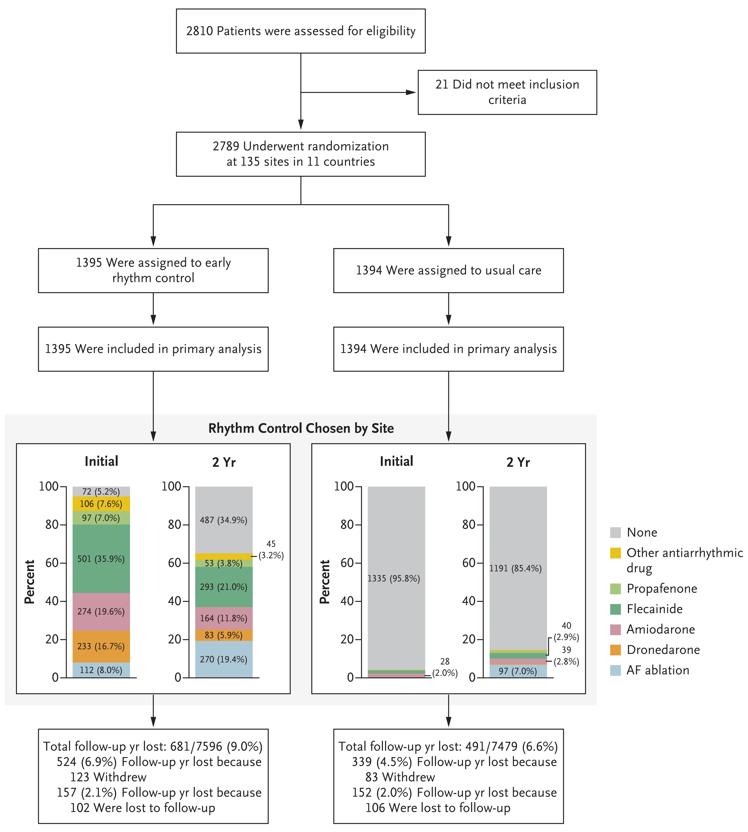
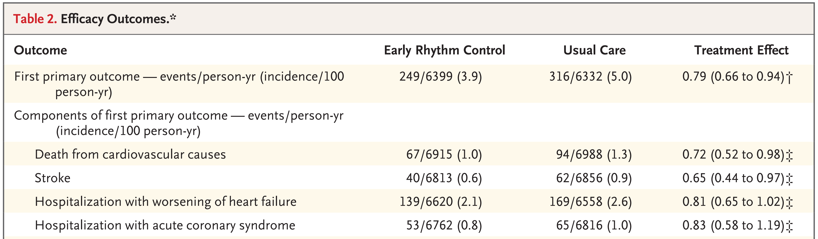
Rhythm Control in AF
CABANA Trial (Per-protocol & Sub analysis)
Reduced death
Improvement in QOL
Reduced hospitalization
Largest benefit seen in patients < 65 years
Prevent AF progression
1: EAST-AFNET Study, Kirchhof P et al. N Eng J Med 2020
2: CABANA Study, Packer D et.al JAMA 2019

Slide 4
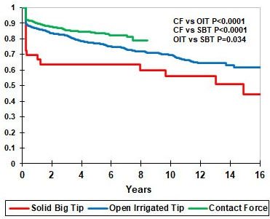
Catheter ablation of AF is effective but shows attrition in success over time
Multiple Ablation Procedure outcome
12 Months outcomes of AF ablation: 90% AF freedom
1.5-3% pa attrition in success
Attrition persist despite advances in mapping & ablation technologies
Years of follow up
Winkle et.al Heart Rhythm 2023

Slide 5
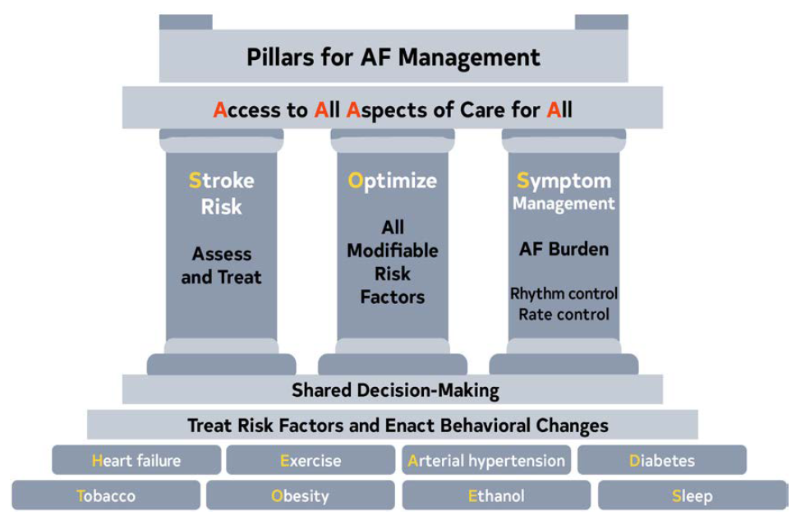
Risk Factors and AF
Central Pillar of AF Management
ARREST-AF Cohort Study
RFM
87%
48%
Control
P<0.001
2023 ACC/AHA/HRS AF Guidelines, Circulation 2024
Pathak RK et al. JACC 2014

Slide 6
Hypothesis
ARREST-AF RCT
Multi-Centre Randomized Clinical Trial
Aggressive risk factor management, results in reduction in AF recurrence and improves outcome of AF Ablation
Aims
Arrhythmia recurrence following catheter ablation
Quality of life as assessed by AFSS

Slide 7
Inclusion Criteria
Exclusion Criteria
Paroxysmal or persistent AF undergoing de novo AF ablation
Age ≥ 18 years and ≤ 80 years
BMI ≥ 27 kg/m²
Waist circumference ≥ 100 cm (male), ≥ 90cm (female)
≥ 1 cardiovascular risk factors
Participation in a weight loss program
Serious underlying cardiovascular, medical or psychiatric disorder
Malabsorption disorder
Diabetes on insulin therapy
Endocrinopathy
Gallbladder disease
Remoteness to clinic
Unable or not willing to provide informed consent

Slide 8

Consecutive Patients
Symptomatic AF
N=290
Exclusion Criteria (168)
BMI <27 (80)
Cardiomyopathy (12)
Other WL program (5)
Thyroid disease (5)
Severe medical condition (5)
Valvular disease (6)
Lived interstate (20)
Declined (35)
Patients with BMI ≥ 27 +≥ 1 risk factors (HTN, DM, OSA, Lipids)
N=122
Loop Recorder Implant
Randomisation to Aggressive Risk Factor Management
ANZCTR : ACTRN12613000444785
Baseline Investigations
7-day Holter+ Echo+ Bloods
Usual Care
N=60
LRFM Group
N=62
Mean Follow up : 12.3 ± 1.1 Months
Follow Up Investigations
7-day Holter + Echo+ Bloods
Follow Up 3 monthly + AF HM Monitoring

Slide 9




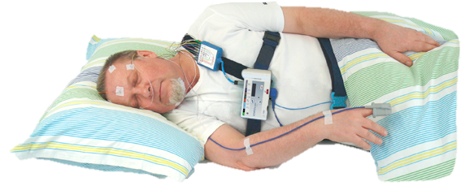


Comprehensive Risk Factor Management for AF
WEIGHT TARGET
Target: ≥10% weight loss
BMI <27 kg/m²
Avoid fluctuation
EVALUATE
Diet plan
Current activity levels
Educate – permanent change
EXERCISE TARGET
30mins, 3-4 x per week
Activity increase to 200mins/week
EVALUATE
Diet
Glucose tolerance test
DM TARGET
Dietary changes
Start Metformin: if HbA1c >6.5% @ 3mths
Endocrinologist if required
EVALUATE
BP diary
Exercise stress test for intolerance
Record 2-3 x daily
BP TARGET
<130/80mmHg (rest)
<200/100mmHg (exercise)
ACEI or ARB if required
Sodium reduction
WEIGHT LOSS & EXERCISE
GLYCEMIC
CONTROL
BLOOD
PRESSURE
EVALUATE
Overnight sleep study
OSA TARGET
CPAP if AHI ≥30
or ≥20/hr with resistant HT
or daytime sleepiness
CPAP adherence checks
EVALUATE
Cholesterol
levels
Diet
LIPID TARGET
Dietary changes
@3mths: Start statins if LDL>100mg/dl
Add fibrates if TG>200mg/dl
Start fibrates if TG>500mg/dl
Comprehensive Risk
Factor Management
OSA
DYSLIPIDEMIA
SMOKING
ALCOHOL
EVALUATE
Assess smoking status
SMOKING TARGET
Cease all forms of tobacco
EVALUATE
Assess intake
ALCOHOL TARGET
Reduction to ≤30g/week
Complete abstinence if required
Middeldorp ME et al. Heart 2020

Slide 10
Baseline Characteristics | Usual Care (n=60) | LFRM (n=62)
Female Sex – no. (%) | 21 (35) | 19 (30.6)
Age - yrs | 59±10 | 62±9
Persistent AF – no. (%) | 34 (56.7) | 38 (61.3)
Cardiovascular risk Factor
Body Mass Index – kg/m² | 33.6±5.4 | 32.8±5.3
Hypertension – no. (%) | 45 (75) | 44 (71)
Type 2 diabetes mellitus – no. (%) | 9 (15.0) | 8 (12.9)
Obstructive sleep apnoea – no. (%) | 27 (45) | 22 (35.5)
History of smoking – no. (%) | 22 (36.7) | 25 (40.3)
Excess alcohol consumption – no. (%) | 21 (35.0) | 22 (35.5)
Echocardiographic Parameters
Indexed left atrial volume (mL/m2) | 36.0±9.7 | 35.7±9.2
Left ventricular ejection fraction (%) | 59.7±9.2 | 59.8±7.0

Slide 11
Impact on Risk Factors
 | Usual Care N = 60 |  | LRFM N = 62 |  | P Value
Body Weight (Kg) | 103.0±19.2 | 102.9±21.8 | 99.2±14.5 | 90.2±13.3 | <0.001
Systolic Blood Pressure (mmHg) | 127.8±13.9 | 131.7±13.8 | 137.6±13.9 | 124.5±15.6 | <0.001
Fasting Plasma Glucose (mmol/L) | 6.0±1.9 | 5.8±1.8 | 5.5±1.2 | 5.3±0.9 | 0.22
Mean LDL Level (mg/dL) | 2.8±0.9 | 2.6±0.9 | 2.6±0.9 | 2.6±0.8 | 0.72
Mean TG Level (mg/dL) | 1.4±0.6 | 1.3±0.9 | 1.5±0.9 | 1.3±0.6 | 0.63
Exercise Capacity (METs) | 7.8±2.3 | 8.0±2.1 | 7.9±2.4 | 8.9±2.4 | 0.003
Indexed left atrial volume (mL/m²) | 35.7±9.2 | 31.4±9.7 | 36.0±9.7 | 31.6±5.5 | 0.98
Interventricular septal thickness (cm) | 1.1±0.2 | 1.0±0.2 | 1.0±0.1 | 1.0±0.2 | 0.55

Slide 12
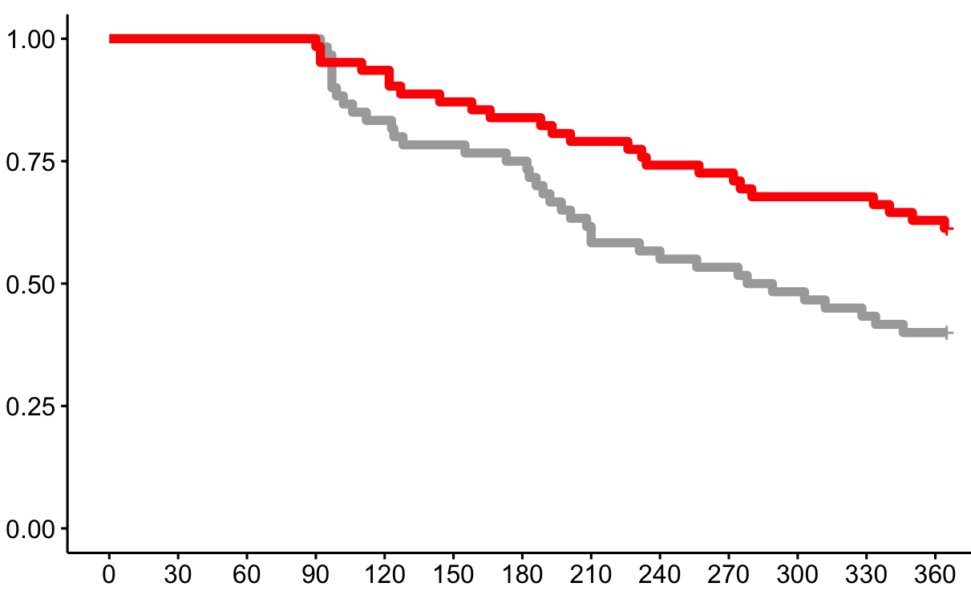

Primary Outcome: Single Procedure Drug Free AF Freedom
Arrhythmia Free Survival
61.3%
40%
HR: 0.53 (95% CI: 0.32-0.89), P=0.03
Time in Days

Slide 13
Secondary Outcome: Symptom Burden & Severity
AFSS Questionnaire
P<0.001
P<0.001
P=0.025
Symptom Frequency
Symptom Duration
Symptom Severity
Baseline
12-months
Baseline
12-months
Baseline
12-months

Slide 14
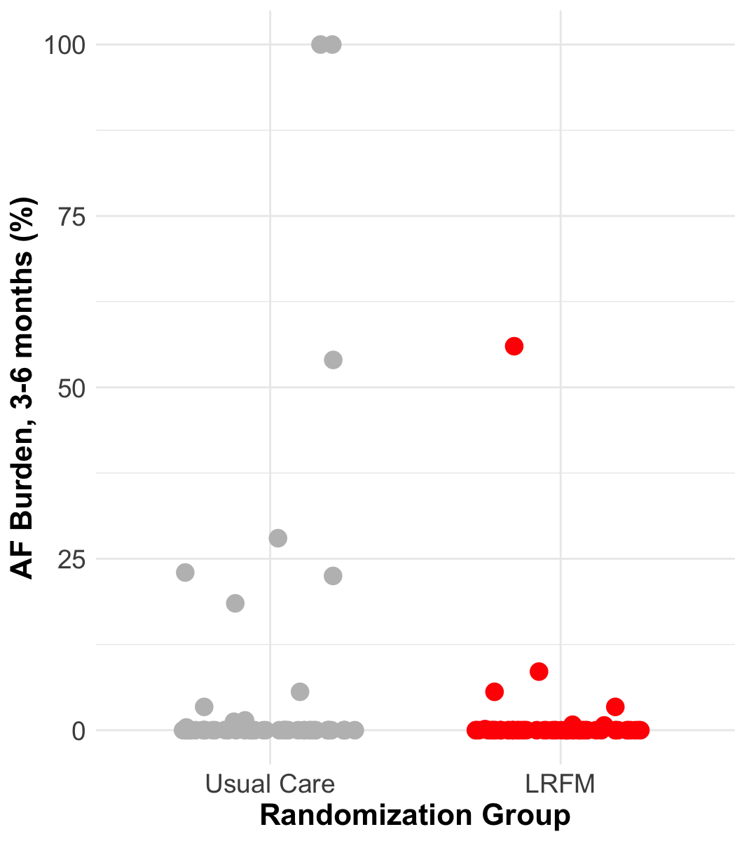
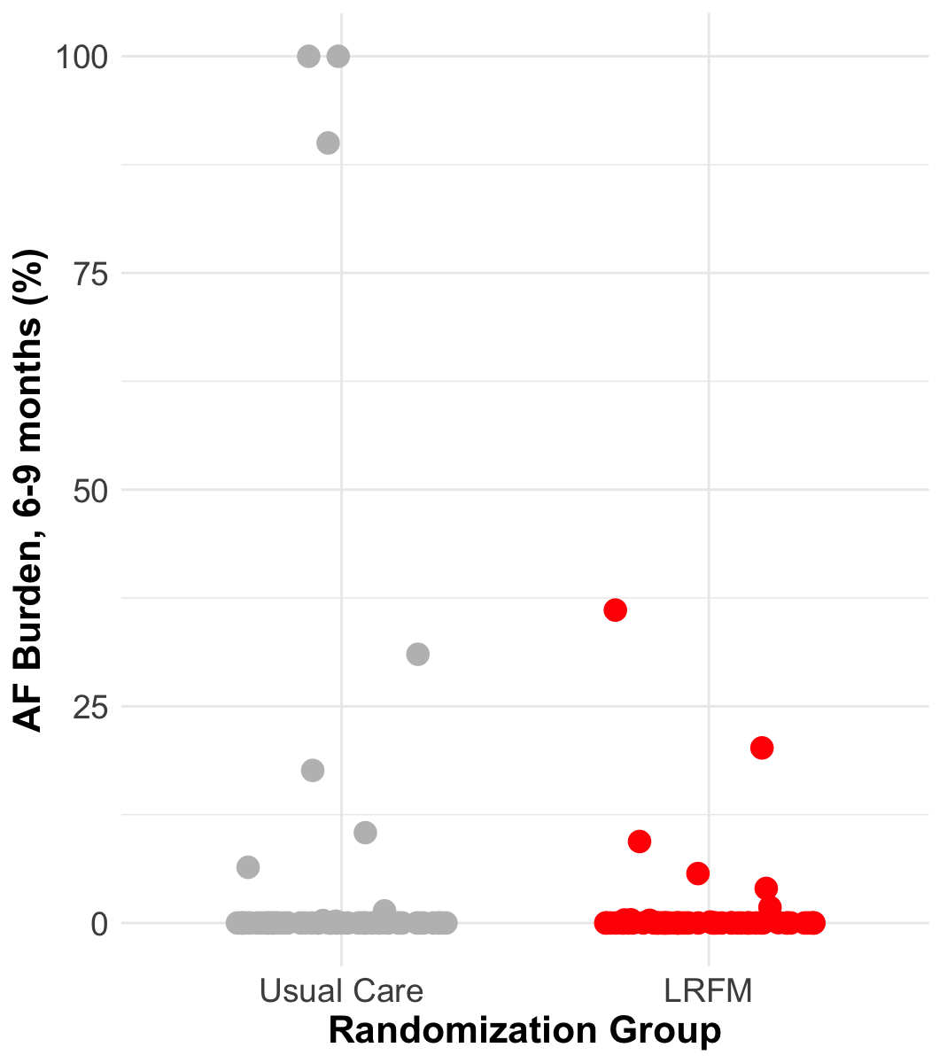
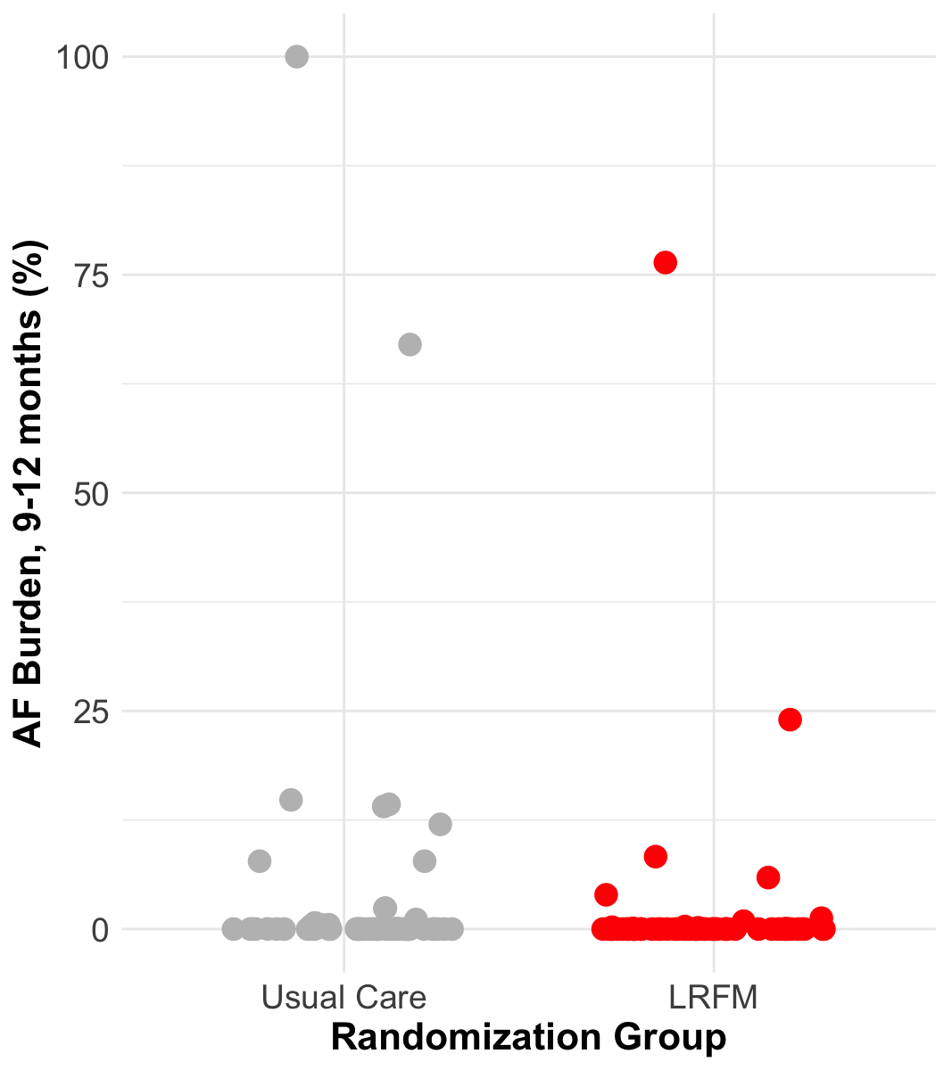
AF Burden : Loop Recorder
3-6 months
6-9 months
9-12 months
AF Burden (%)
AF Burden (%)
AF Burden (%)
Usual Care
LFRM
Usual Care
LFRM
Usual Care
LFRM
Notes:
Highlighting the effectiveness of catheter ablation

Slide 15
Limitations
Not evaluated the feasibility of the intervention in other geographies, culturally and racially diverse populations or healthcare systems
Cannot provide insight into the relative contribution of each risk factor or variable treatment targets
Study was not powered to detect a difference in secondary endpoints such as cardiovascular events

Slide 16
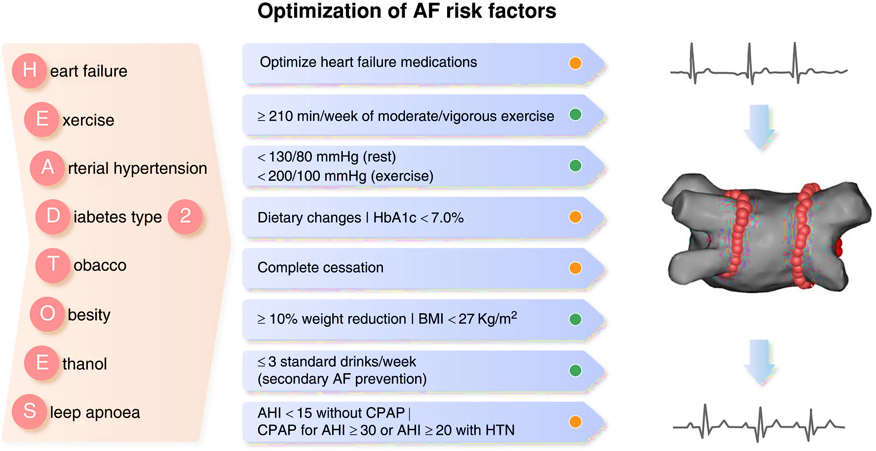
Conclusion
Optimization of AF Risk factors
In patients undergoing AF ablation, comprehensive lifestyle and risk factor management results in improved
Freedom from AF
Symptoms burden
Risk factor profile
AF Ablation Consensus, Heart Rhythm 2024

