Slide 1

AMERICAN HEART ASSOCIATION SCIENTIFIC SESSIONS 2024
Myeloperoxidase Inhibition with Mitiperstat in HFpEF and HFmrEF: Primary Results of the ENDEAVOR Randomized Clinical Trial
Sanjiv J. Shah, MD, on behalf of co-authors:
Lars H. Lund, MD, PhD; Carolyn S.P. Lam, MD, PhD;
Patricia Ely Pizzato, MD; Erik Michaelsson, PhD;
Andrea Mattsson, PhD; Hans Ericsson, PhD;
Stephan Baldus, MD; PhD
Author affiliations: Northwestern University (SJS); Karolinska University Hospital (LHL);
National Heart Centre Singapore (CSPL); AstraZeneca (PEP, EM, AM, HE); University of Cologne (SB)
ENDEAVOR was funded by AstraZeneca (clinicaltrials.gov identifier: NCT04986202)

Slide 2
Presenter disclosures
Research funding:
  NIH U54 HL160273, X01 HL169712, R01 HL140731, R01 HL149423
  AHA # 24SFRNPCN1291224
  AstraZeneca, Boston Scientific, Corvia, Pfizer
Consulting / advisory board / steering committee:
  Abbott, Alleviant, AstraZeneca, Amgen, Axon Therapies, BaroPace, Bayer, Boehringer-Ingelheim, Boston Scientific, BMS, Corvia, Cytokinetics, Diastol Therapeutics, Edwards, Eidos, Gordian, Imara, Impulse Dynamics, Intellia, Ionis, Lilly, Merck, Metabolic Flux, Novartis, Novo Nordisk, Pfizer, Prothena, Regeneron, Rivus, Sardocor, Secretome, Shifamed, Tectonic, Tenax, Tenaya

Slide 3
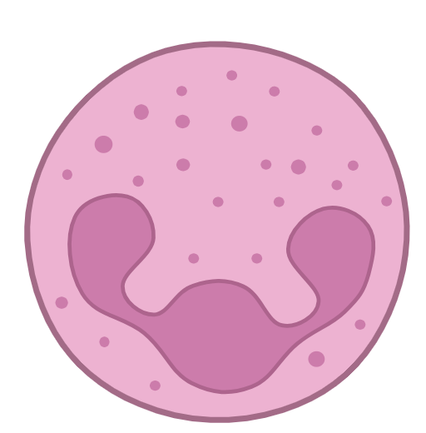
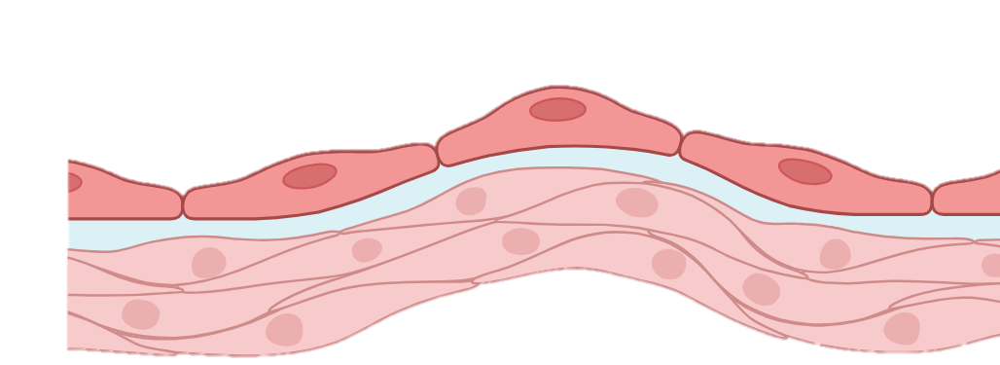


Myeloperoxidase (MPO) in HFpEF
Comorbidities
Infections
Environmental stressors
SATELLITE: Phase 2A RCT of MPO inhibition in HFpEF
N=23 patients with HFpEF; mitiperstat 5 mg vs. placebo
75% reduction in MPO activity vs. placebo (P<0.001)
12% reduction in NTproBNP vs. placebo (P=0.37)
22-meter improvement in 6MWD vs. placebo (P=0.41)
6.3-point improvement KCCQ-OSS (P=0.067)
INNATE IMMUNITY
TRIGGERED
Neutrophils
MPO
MPO electrostatically binds to proteoglycans in vascular wall
Vascular SMCs
Impaired vasodilation
Reduced perfusion
Cardiomyocytes
Hypertrophy
Impaired relaxation
Fibroblasts
Collagen deposition
Interstitial fibrosis
MPO + H₂O₂ → $↑↑$ROS
Lund LH Lam CSP, Pizzato PE…Shah SJ. Eur J Heart Fail 2023
Lam CSP, Lund LH, et al. J Card Fail 2023; Michaelsson E, et al. JACC Heart Fail 2023

Slide 4
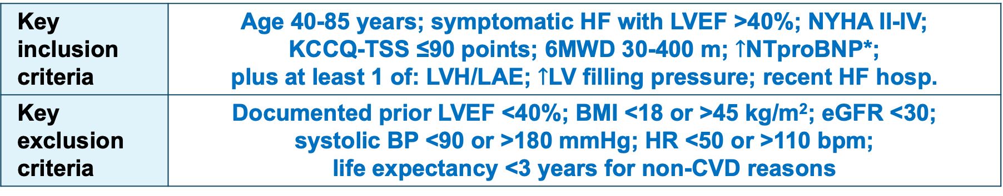
ENDEAVOR trial: Overview
Phase 2b, randomized, double-blind, multicenter RCT
International trial conducted at 142 sites in 18 countries
N=709, randomized 1:1:1 to 48-week treatment with:
  Mitiperstat 2.5 mg, mitiperstat 5.0 mg, or placebo
Key inclusion criteria | Age 40-85 years; symptomatic HF with LVEF >40%; NYHA II-IV; KCCQ-TSS ≤90 points; 6MWD 30-400 m; $↑$NTproBNP*; plus at least 1 of: LVH/LAE; $↑$LV filling pressure; recent HF hosp.
Key exclusion criteria | Documented prior LVEF <40%; BMI <18 or >45 kg/m²; eGFR <30; systolic BP <90 or >180 mmHg; HR <50 or >110 bpm; life expectancy <3 years for non-CVD reasons
*Thresholds for NTproBNP elevation varied based on (1) BMI, and (2) presence or absence of AF at screening
Lund LH Lam CSP, Pizzato PE…Shah SJ. Eur J Heart Fail 2023

Slide 5
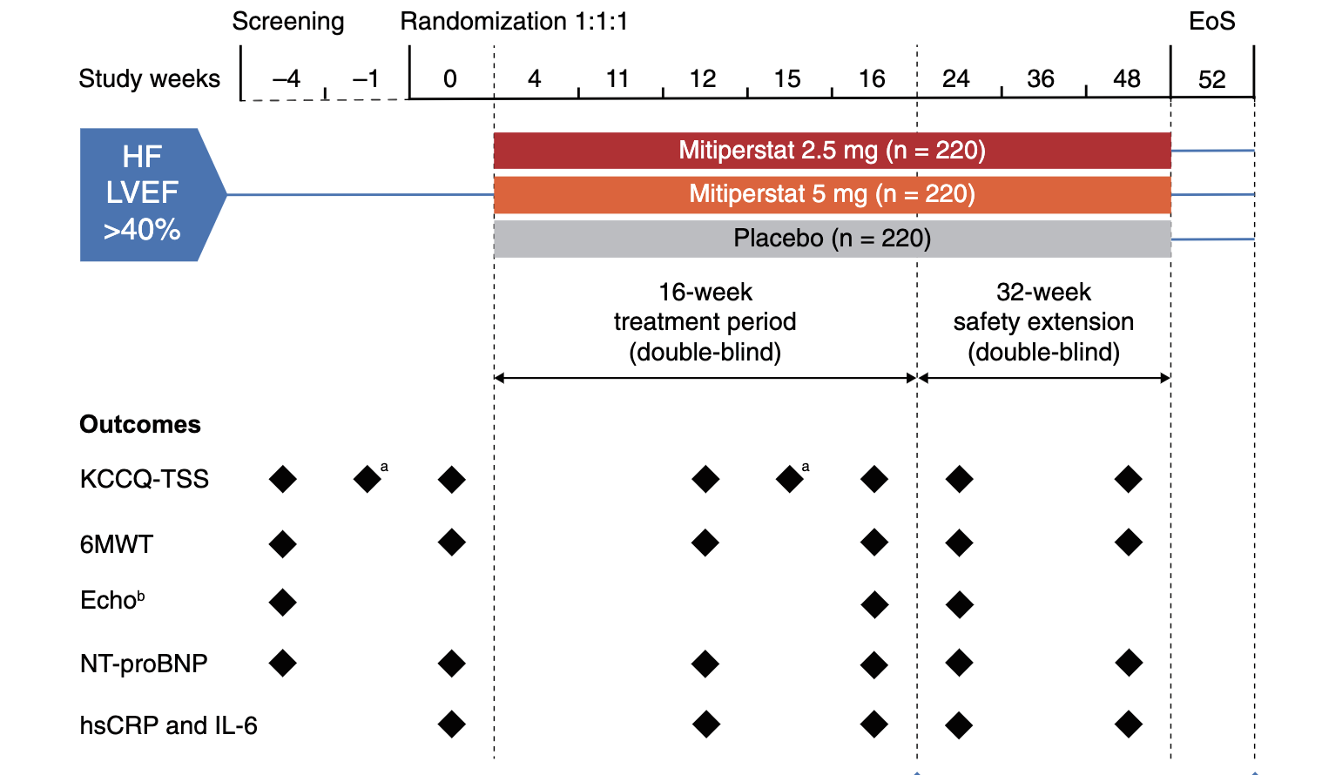

ENDEAVOR trial design
Detailed study design info: ENDEAVOR design paper
ªCompleted by participant at home on the tablet provided during three consecutive days in study weeks −1 and 15.
^{b}If not possible on same day as screening visit, then within 1-2 days for screening or 7 days for follow-up visits. 6MWT, 6-min walk test; Echo, echocardiography; EoS, end of study; HF, heart failure; hsCRP, high-sensitivity C-reactive protein; IL-6, interleukin-6; KCCQ-TSS, Kansas City Cardiomyopathy Questionnaire Total Summary Score; LVEF, left ventricular ejection fraction; NT-proBNP, N-terminal pro- B-type natriuretic peptide.
Lund LH Lam CSP, Pizzato PE…Shah SJ. Eur J Heart Fail 2023

Slide 6
Efficacy and safety endpoints
Category | Endpoint | Time point
Primary efficacy | Dual co-primary: KCCQ-TSS and 6MWD | 16 weeks
Secondary efficacy | KCCQ-TSS and 6MWD | 24, 48 weeks
 | Biomarkers: NTproBNP, hsCRP, IL-6 | 16, 24, 48 weeks
 | Echo: LV GLS, LAVI, LVMI | 16, 24 weeks
Exploratory efficacy | Time to first CV event (composite of HF hospitalizations, urgent HF visit requiring IV diuretics, MI, all-cause death) | 0-52 weeks
Safety | Treatment-emergent adverse events | 0-52 weeks
 | Maculopapular rash (AE of special interest) | 0-52 weeks
Power calculation: Based on estimated total sample size of 660 with 10% dropout = 600 evaluable randomized patients (n=200 in each of the 3 treatment arms [n=400 combined mitiperstat groups]), the trial had 85% power at 2-sided α=0.05 to detect ≥6.0-point difference for KCCQ-TSS and ≥21-m difference for 6MWD between groups (based on estimated SD=20 points for KCCQ-TSS and SD=70 m for 6MWD).
Lund LH Lam CSP, Pizzato PE…Shah SJ. Eur J Heart Fail 2023

Slide 7
Participant disposition
1539 enrolled, underwent screening
711 randomized
828 excluded
795 did not meet inclusion criteria or met exclusion criteria
8 withdrew prior to randomization
25 excluded for other reasons
235 assigned to
mitiperstat 2.5 mg
240 assigned to
mitiperstat 5.0 mg
236 assigned to
placebo
1 randomized but not treated*
1 randomized but not treated*
234 started treatment
240 started treatment
235 started treatment
46 discontinued treatment
13 due to an AE, 7 due to study-specific discontinuation criteria, 23 due to participant decision, 3 for other reasons
44 discontinued treatment
15 due to an AE, 16 due to study-specific discontinuation criteria, 10 due to participant decision, 3 for other reasons
31 discontinued treatment
13 due to an AE, 1 due to study-specific discontinuation criteria, 14 due to participant decision, 3 for other reasons
188 completed treatment
196 completed treatment
204 completed treatment
17 withdrawn from study
10 due to death
3 due to physician decision
4 due to participant decision
6 withdrawn from study
3 due to death
1 due to physician decision
2 due to participant decision
16 withdrawn from study
10 due to death
2 due to physician decision
4 due to participant decision
218 completed
the study
234 completed
the study
220 completed
the study

Slide 8
Baseline characteristics
Characteristic |  | Mitiperstat 2.5 mg (n=234) | Mitiperstat 5 mg (n=240) | Placebo (n=235)
Demographics | Age, years | 72.5±7.3 | 72.1±7.1 | 72.5±7.8
 | Female | 45.7% | 49.6% | 40.9%
 | BMI, kg/m² | 30.4±5.9 | 30.5±5.7 | 30.5±5.4
 | Systolic BP, mmHg | 128.0±14.6 | 127.9±16.2 | 130.7±14.6
Comorbidities | Atrial fibrillation/flutter | 65.8% | 63.8% | 65.5%
 | Diabetes mellitus | 42.3% | 40.4% | 36.6%
 | Hypertension | 89.7% | 93.3% | 95.7%
 | Obesity | 49.6% | 52.1% | 54.5%
HF characteristics | NYHA class II/III | 73.1% / 26.5% | 79.2% / 20.8% | 76.2% / 23.0%
 | KCCQ-TSS, points | 56.7±17.7 | 59.7±16.8 | 58.6±16.7
 | 6-minute walk distance, m | 277.2±77.7 | 283.5±78.0 | 290.3±75.1
 | Prior HF hospitalization | 49 (20.9) | 40 (16.7) | 48 (20.4)
 | LVEF, %-units | 54.5±8.9 | 54.2±8.8 | 54.1±8.6

Slide 9
Baseline characteristics
Characteristic |  | Mitiperstat 2.5 mg (n=234) | Mitiperstat 5 mg (n=240) | Placebo (n=235)
Labs | NTproBNP, pg/ml [median (IQR)] | 958 (492-1543) | 877 (453-1550) | 825 (517-1535)
 | Neutrophil count, K/ml | 4.7±1.7 | 4.5±1.6 | 4.6±1.6
 | Neutrophil count >4 K/ml | 59.8% | 59.6% | 63.0%
 | eGFR, ml/min/1.73 m² | 63.3±18.9 | 59.9±17.4 | 62.6±17.0
Medications | ACE-inhibitor | 39% | 42% | 39%
 | ARB | 42% | 40% | 43%
 | Sacubitril/valsartan | 2% | 4% | 5%
 | Beta-blocker | 83% | 89% | 88%
 | Loop diuretic | 66% | 69% | 66%
 | MRA | 46% | 42% | 40%
 | SGLT2 inhibitor | 19% | 26% | 18%
 | GLP1 receptor agonist | 4% | 3% | 3%

Slide 10
ENDEAVOR trial: Results

Slide 11
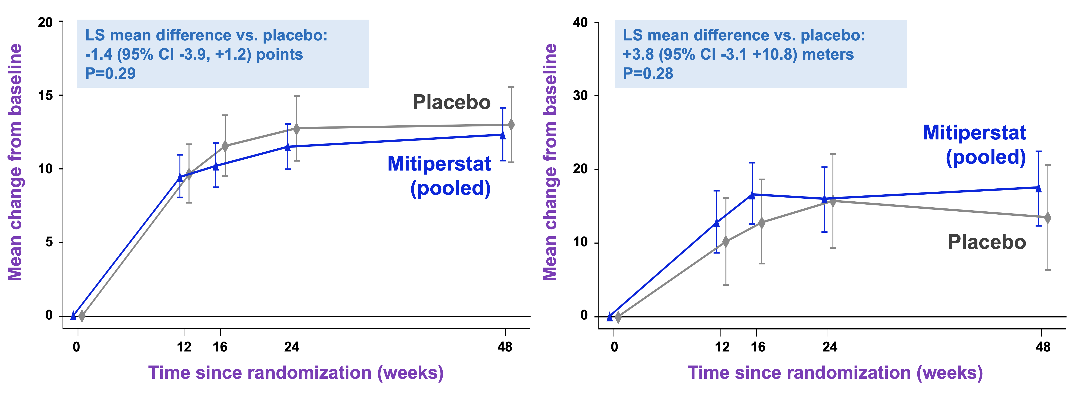
Primary efficacy endpoints
KCCQ-TSS (points)
6MWD (meters)

Slide 12
Secondary efficacy endpoints
No differences between treatment groups for all secondary endpoints:
KCCQ-TSS at 24, 48 weeks: no difference
6MWD at 24, 48 weeks: no difference
NTproBNP at 16, 24, 48 weeks: no difference
hsCRP, IL-6 at 16, 24, 48 weeks: no difference
Echo parameters at 16, 24 weeks: no difference

Slide 13
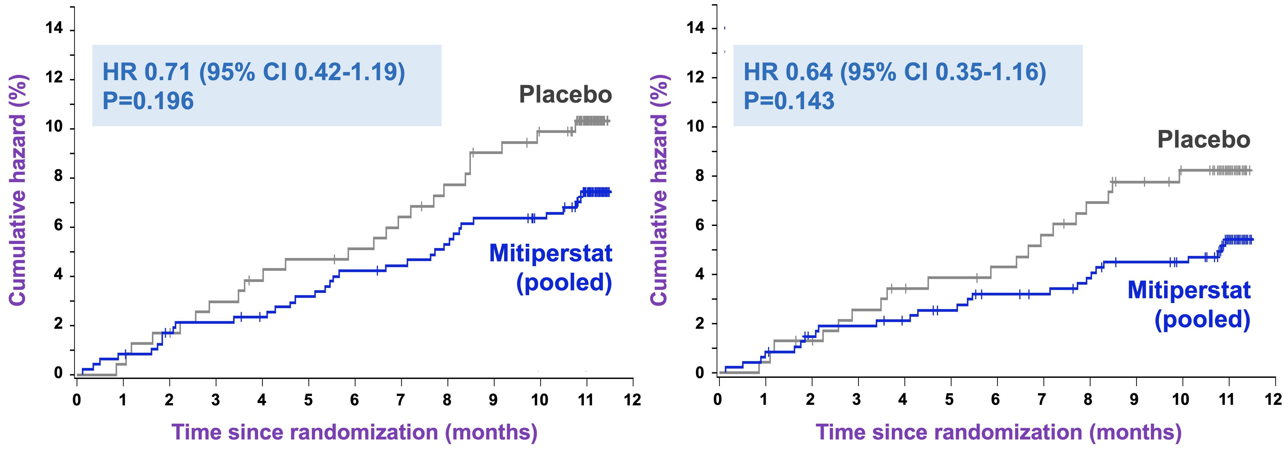
Exploratory endpoints
COMPOSITE OUTCOME
(HF hospitalization, MI, or death)
HF HOSPITALIZATION

Slide 14
Safety: Adverse events
Similar rates of AEs and SAEs (including infections) across treatment groups, except for rash
Adverse event | Mitiperstat 2.5 mg | Mitiperstat 5 mg | Mitiperstat pooled | Placebo
Any adverse event | 73.9% | 75.0% | 74.5% | 73.6%
Any serious adverse event | 25.6% | 23.8% | 24.7% | 23.8%
Infection | 30.8% | 27.5% | 29.1% | 30.2%
Serious infection | 8.1% | 2.9% | 5.5% | 5.5%
Maculopapular rash | 2.6% | 5.4% | 4.0% | 0.4%
Mitiperstat-induced rash: HR 1.97 (95% CI 1.10, 3.55) vs. placebo; rash appears within ~30 days

Slide 15
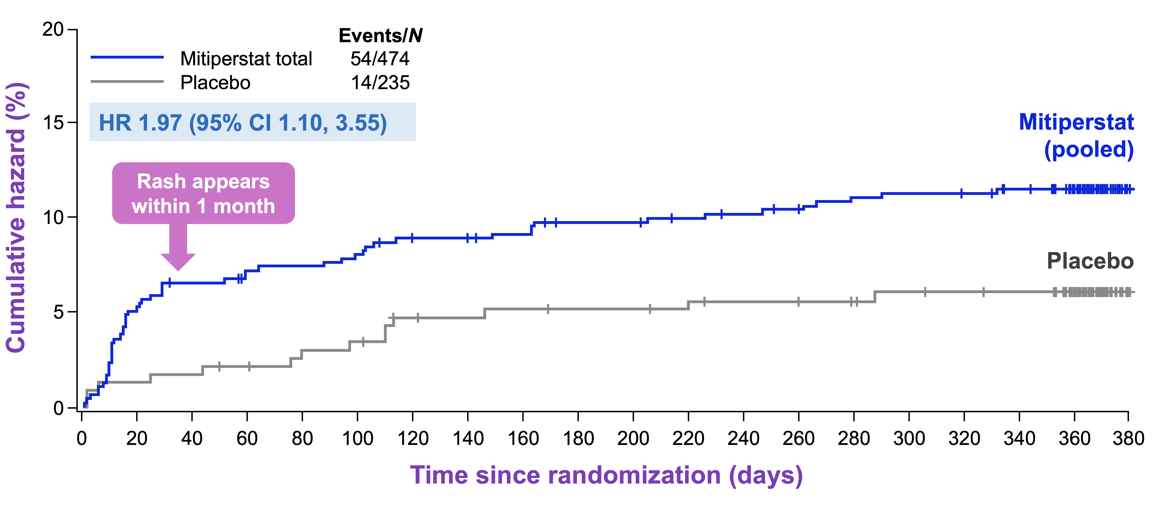
Safety: Skin reaction or rash adverse event

Slide 16
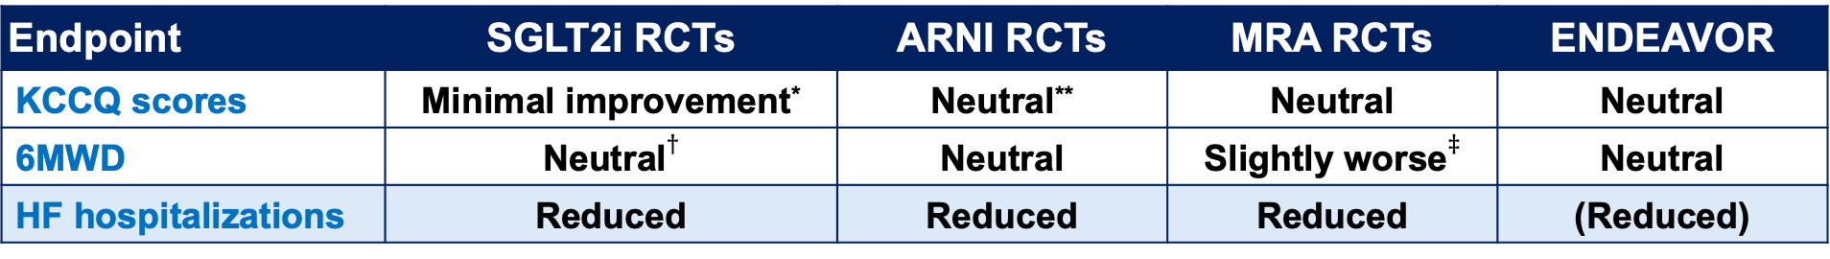
ENDEAVOR results in context
Endpoint | SGLT2i RCTs | ARNI RCTs | MRA RCTs | ENDEAVOR
KCCQ scores | Minimal improvement* | Neutral** | Neutral | Neutral
6MWD | Neutral$†$ | Neutral | Slightly worse$‡$ | Neutral
HF hospitalizations | Reduced | Reduced | Reduced | (Reduced)
*Only 1-2 point improvement in EMPEROR-PEF and DELIVER; neutral in smaller EMPERIAL- and DETERMINE-PEF trials; only PRESERVED-HF showed significant improvement
**Neutral in PARALLAX-HF; borderline slight improvement in PARAGON-HF
$†$Neutral in EMPERIAL- and DETERMINE-Preserved trials; only PRESERVED-HF showed significant improvement
$‡$Based on results of ALDO-DHF trial
Can longitudinal proteomics analysis provide support for potential reduction in HF events?
  ENDEAVOR proteomics substudy
  N=397 patients, 2824 proteins
  Proteins measured using Olink Explore platform at baseline, 16 weeks

Slide 17
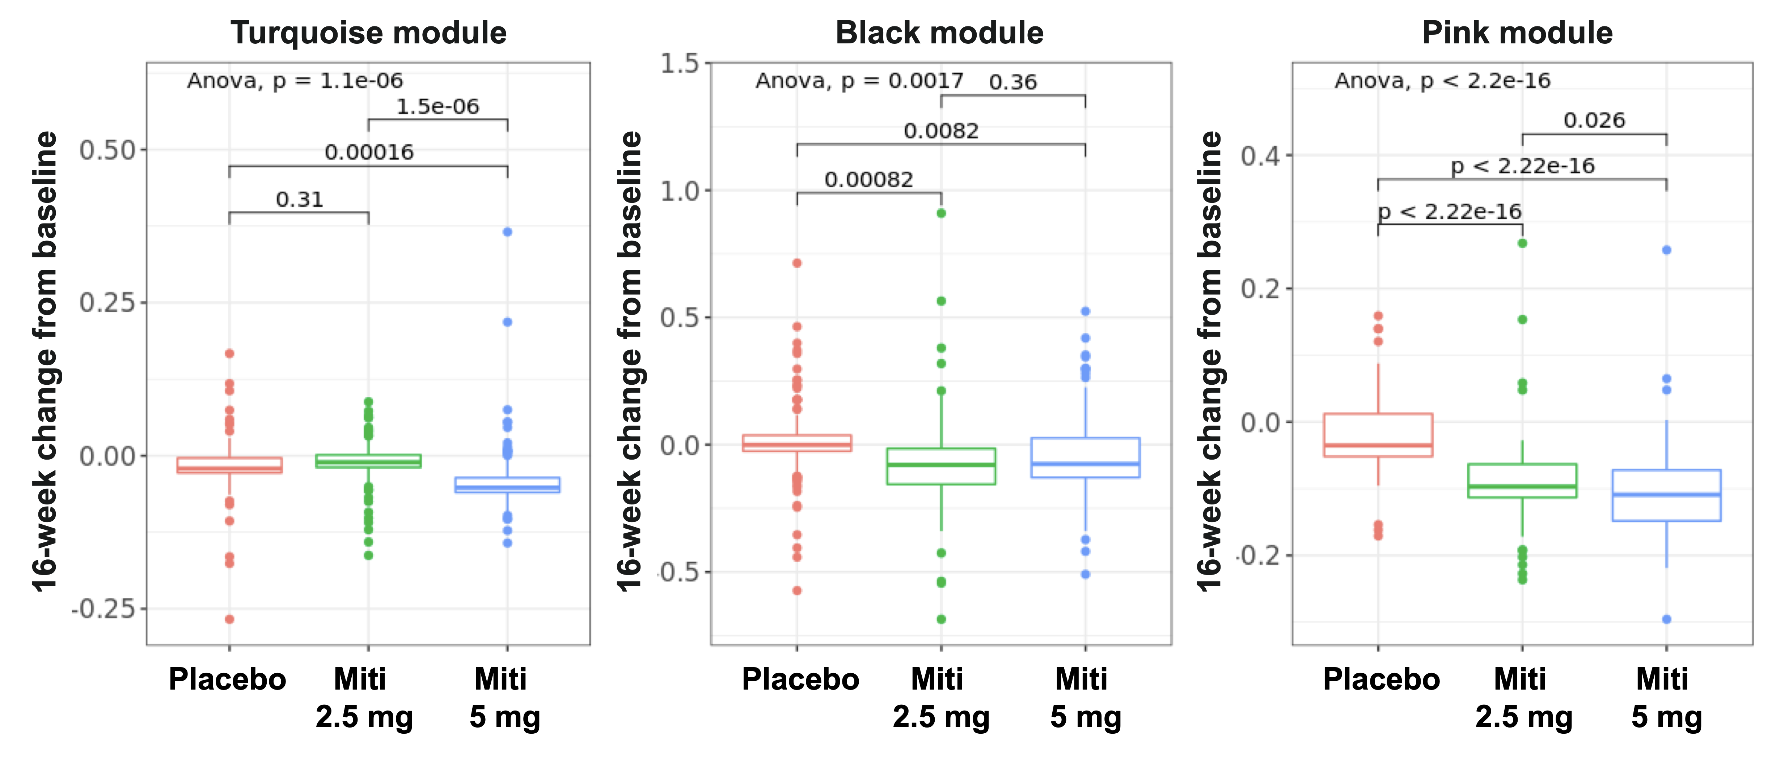
WGCNA: 3 protein clusters change with mitiperstat

Slide 18
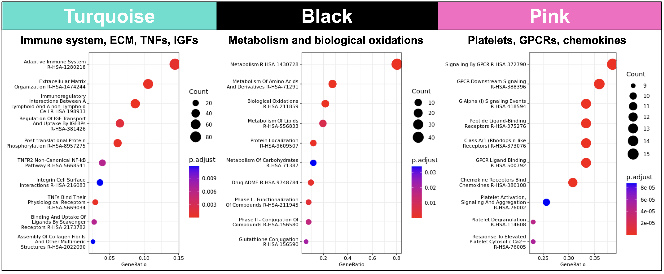
WGCNA: 3 protein clusters change with mitiperstat

Slide 19
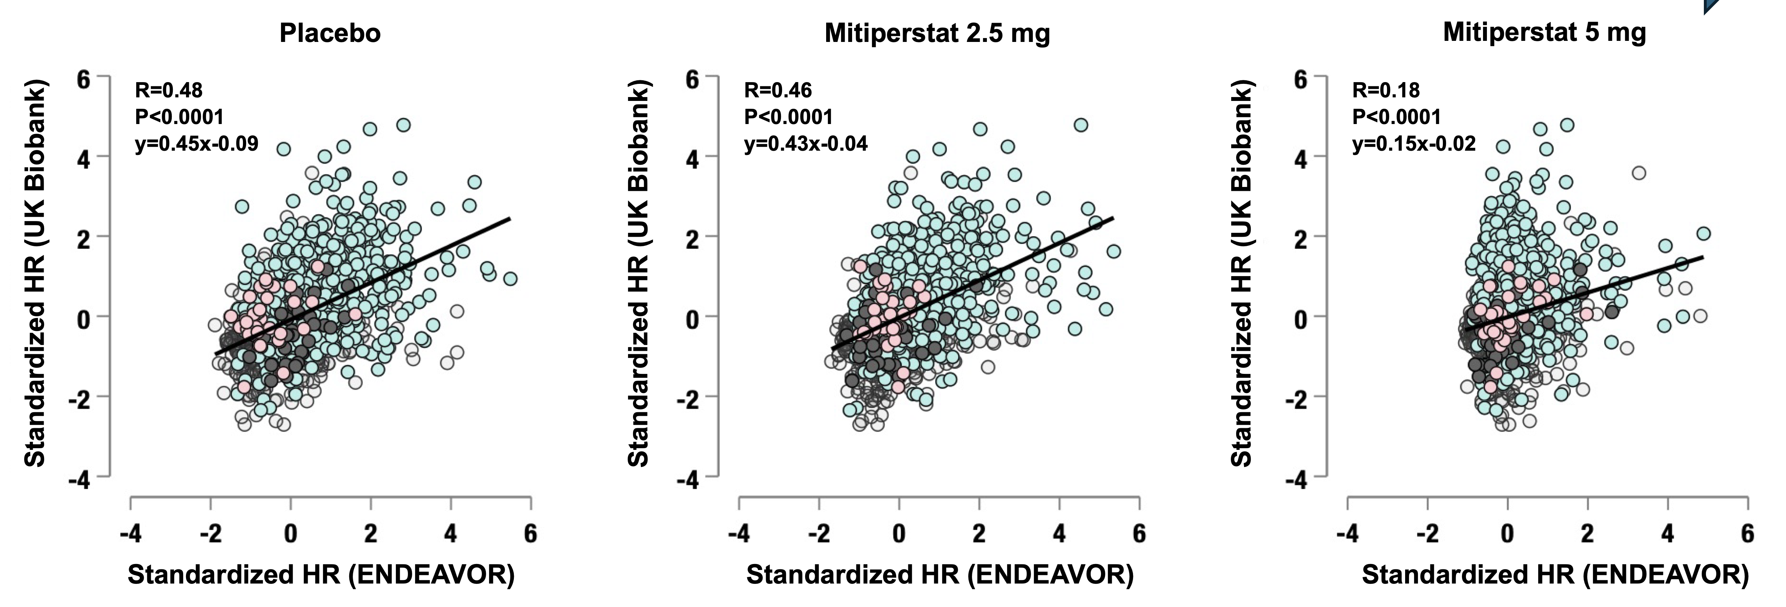
Mitiperstat attenuates effect of high-risk proteins
Comparison of protein-HF risk associations: UK Biobank vs. ENDEAVOR groups
Progressively $↓$correlation of protein-HF hospitalization hazard ratios from placebo to miti 2.5 mg to miti 5 mg

Slide 20
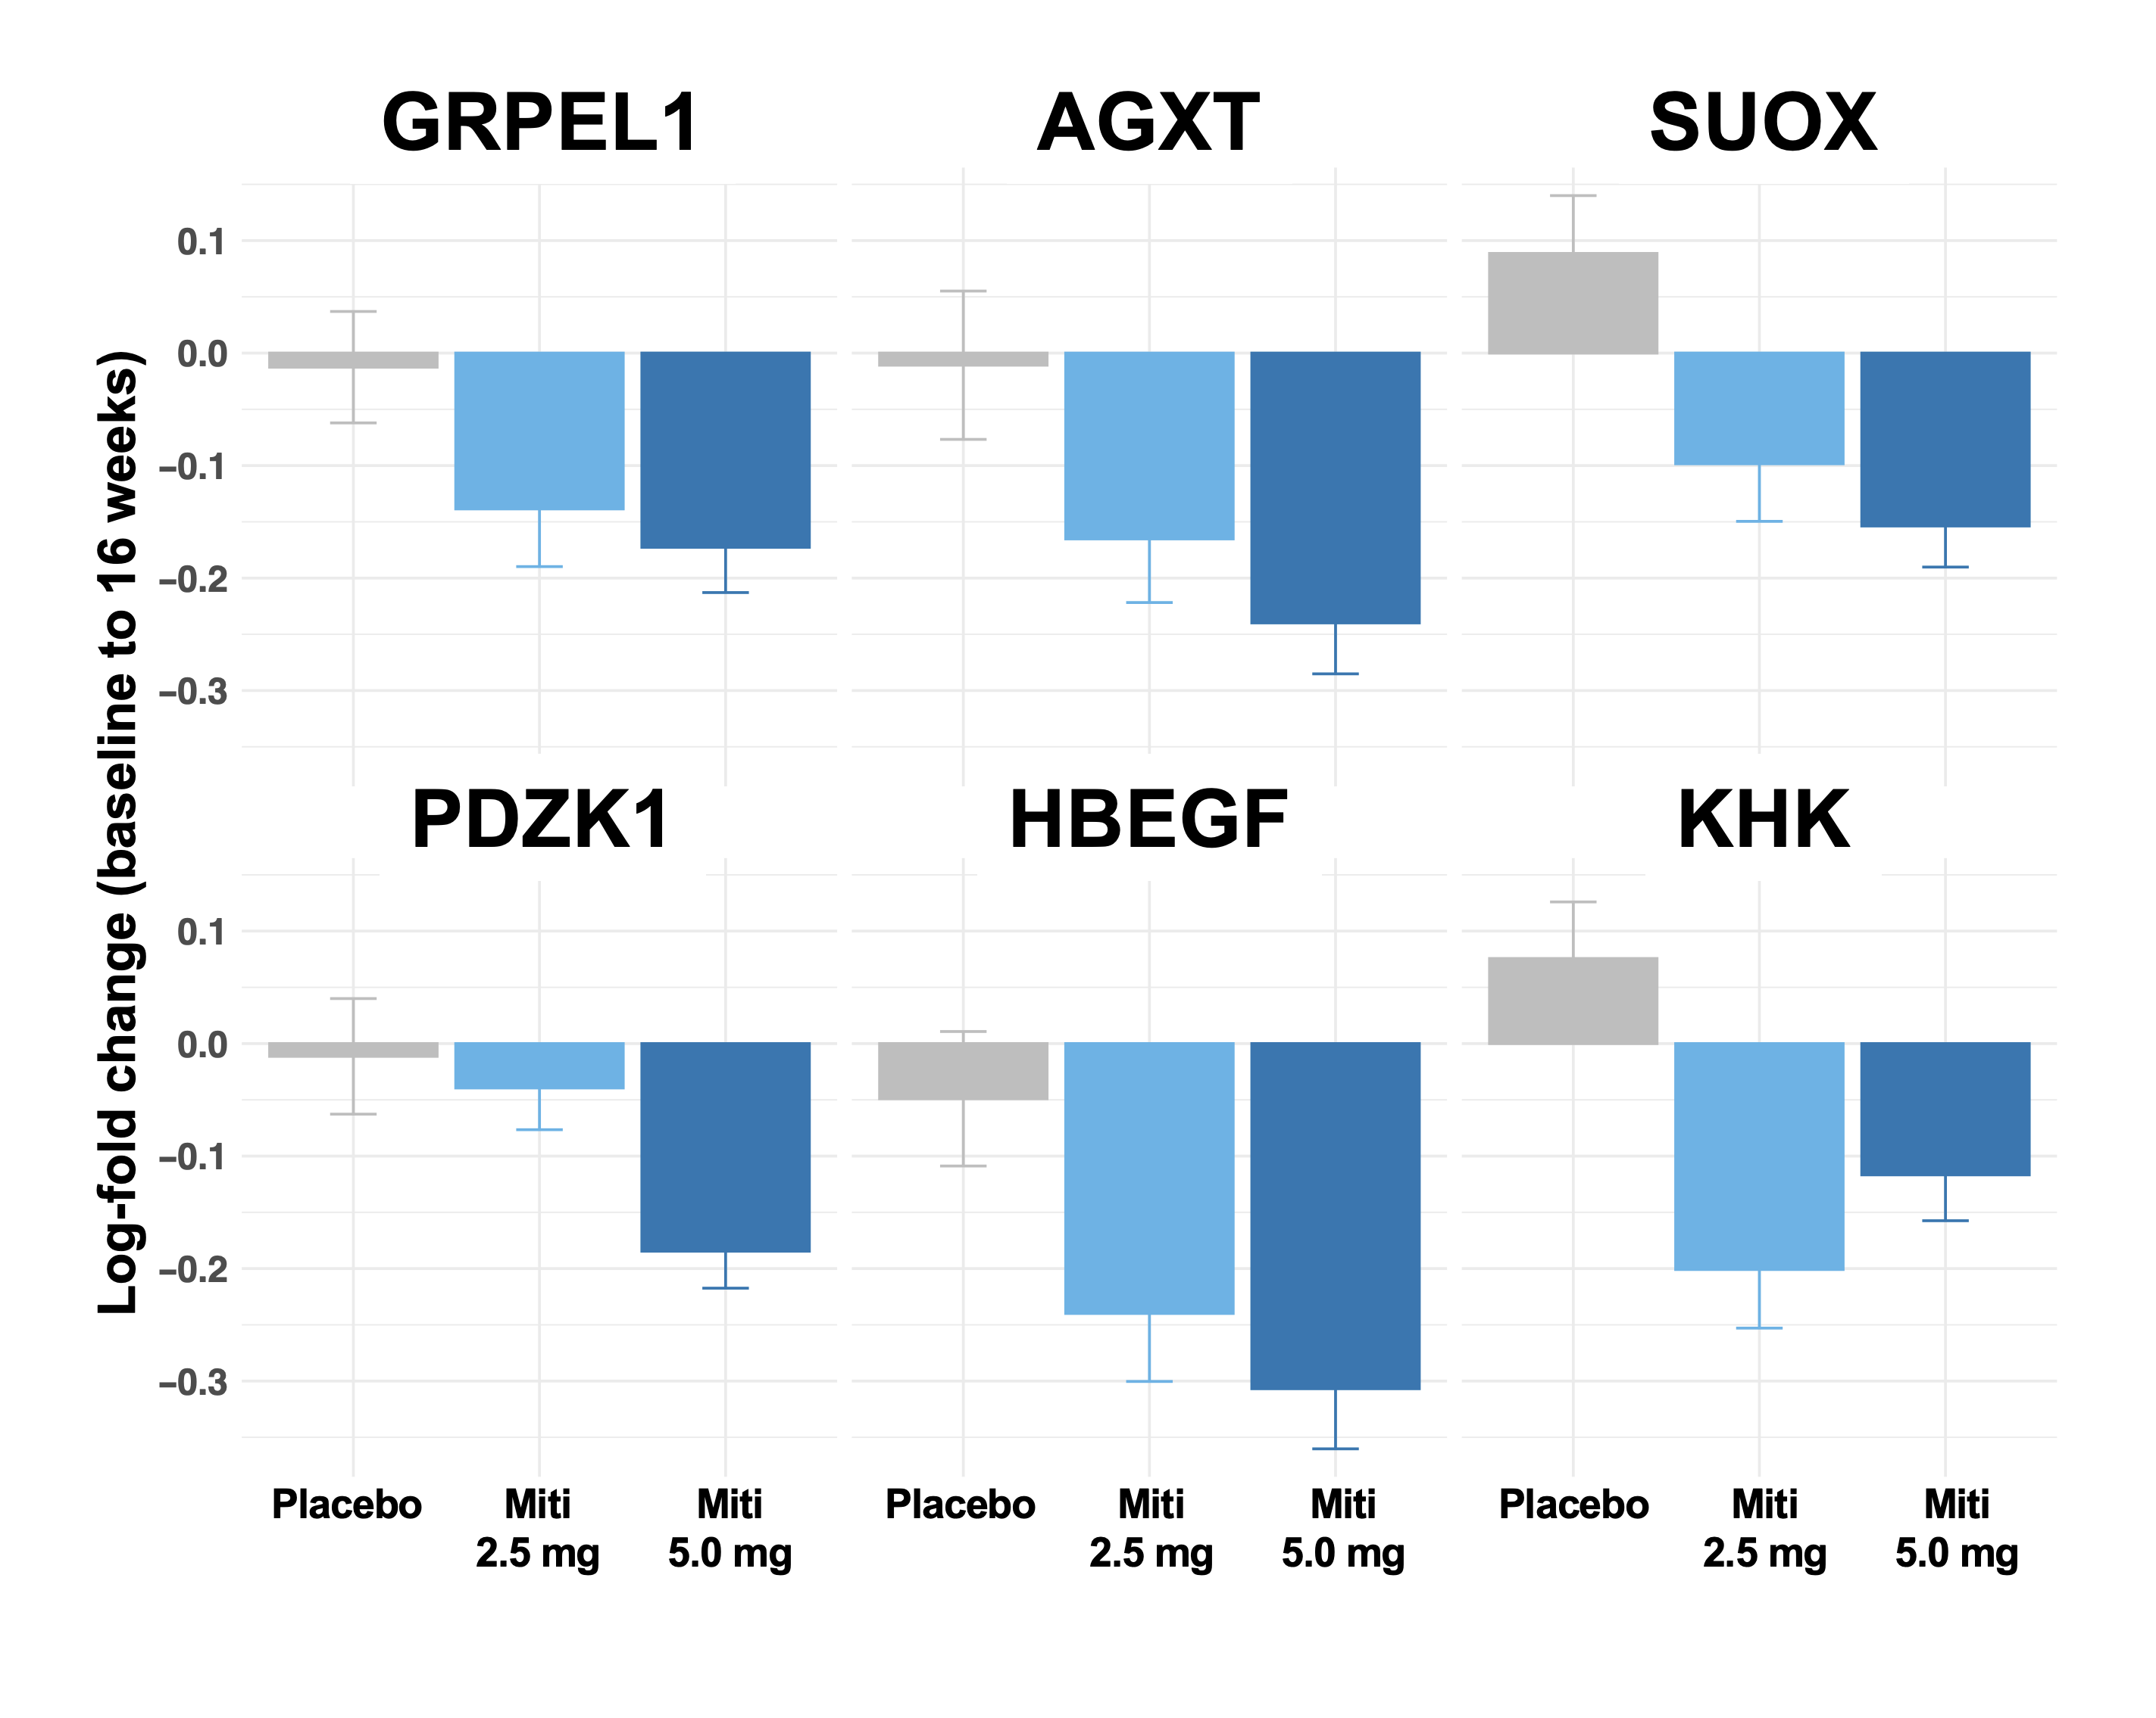
Effect of mitiperstat on individual proteins
Of the top 10 most central “hub proteins” in each of the 3 clusters (n=30 total proteins):
6 changed to a greater extent in mitiperstat vs. placebo groups
(P<0.05, FDR-corrected)

Slide 21
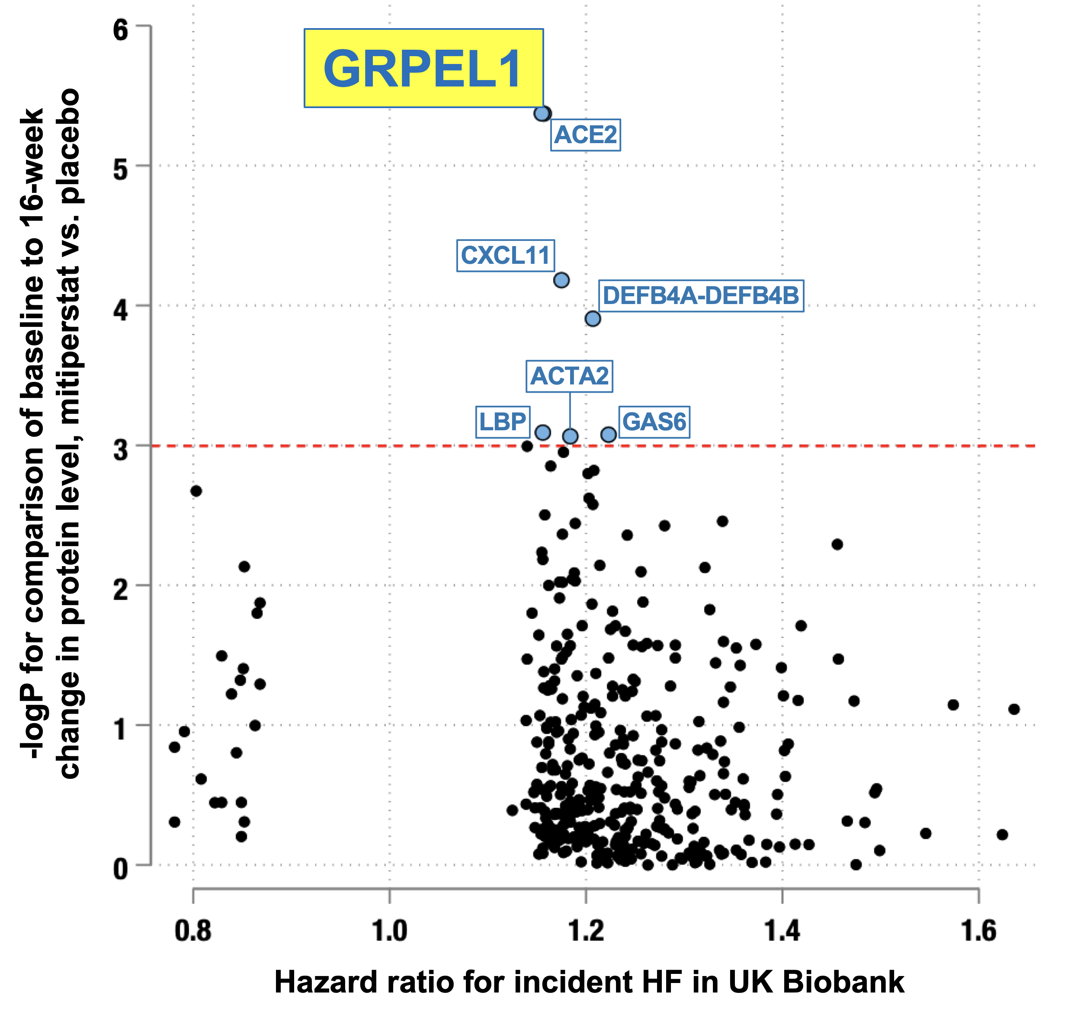
GRPEL1 is associated with incident HF
Of the 6 prioritized proteins, only 1 was associated with incident HF in UK Biobank after Bonferroni correction:
GRPEL1: GrpE protein homolog-1 GrpEL1 is a stress resistance protein that helps maintain mitochondrial protein quality control under stress conditions

Slide 22
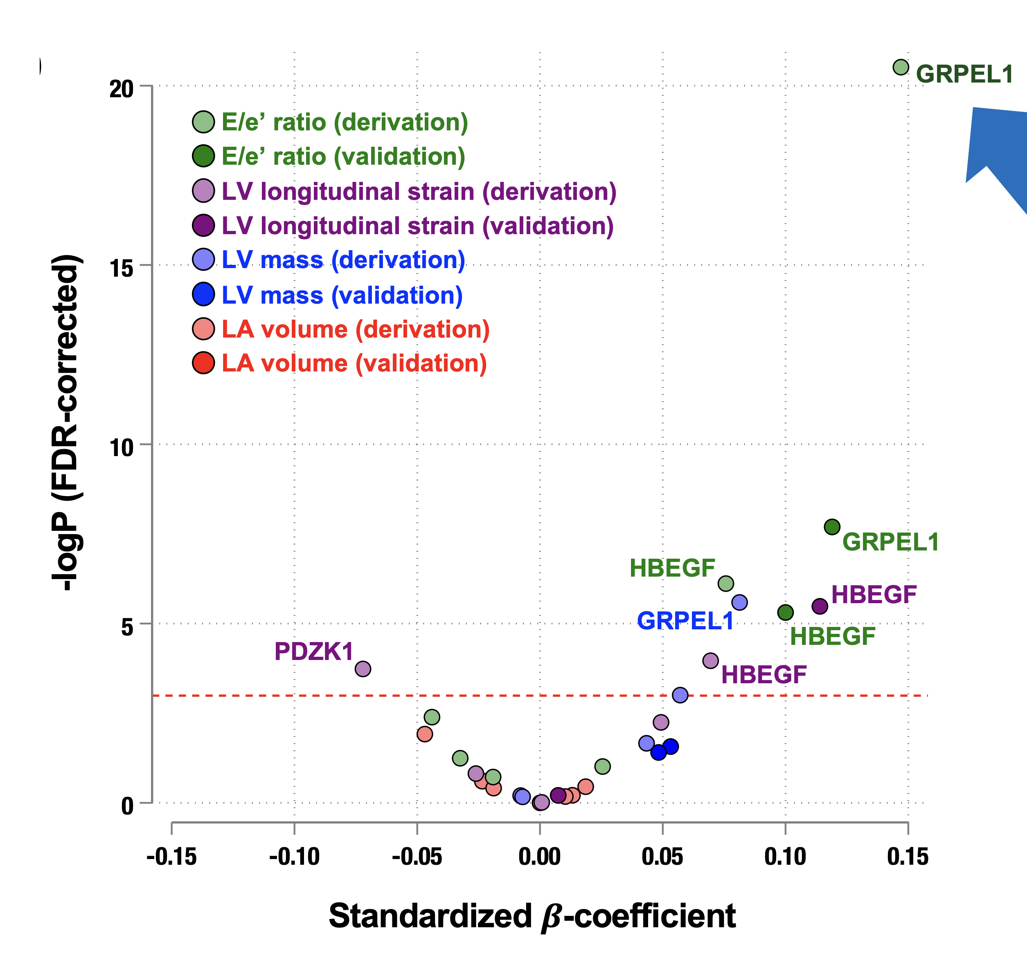
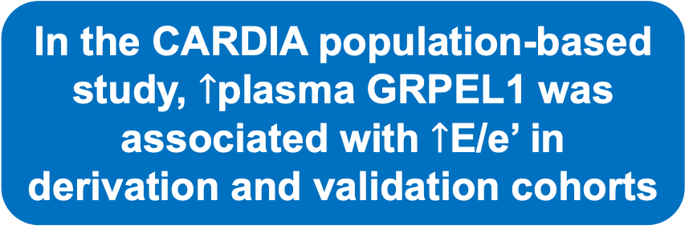

$↑$Plasma GRPEL1 is associated with $↑$E/e’
In the CARDIA population-based study, $↑$plasma GRPEL1 was associated with $↑$E/e’ in derivation and validation cohorts

Slide 23
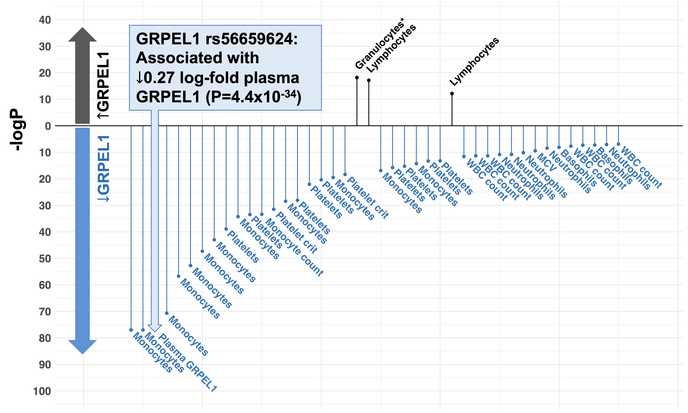

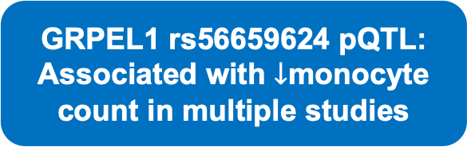
GRPEL1 pQTL PheWAS analysis
In UK Biobank, a different SNP (rs3822270) was the GRPEL1 pQTL most associated with $↑$plasma GRPEL1 (P=3.0x10⁻⁷) and was concordantly associated with
$↑$monocyte count (P=1.6x10⁻²⁴)
GRPEL1 rs56659624 pQTL:
Associated with $↓$monocyte count in multiple studies

Slide 24






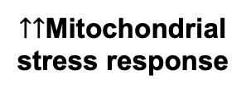

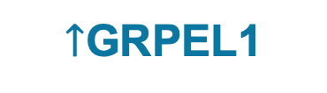
Potential mechanism of $↓$clinical events
Comorbidities
Infections
Environmental stressors
Mitochondrial
UPR triggered
Mitochondria
stabilized
MPO
Transcription of HSP chaperones
$↑$GRPEL1
$↑↑$Mitochondrial
stress response
????
OXIDATIVE
STRESS
Monocyte proliferation
Pro-inflammatory phenotype

Slide 25


Potential mechanism of $↓$clinical events
Comorbidities
Infections
Environmental stressors
Mitochondrial
UPR triggered
Mitochondria
stabilized
MPO
Transcription of HSP chaperones
$↑$GRPEL1
$↑$HF hospitalization,
$↑$death
$↑↑$Mitochondrial
stress response
OXIDATIVE
STRESS
Monocyte proliferation
Pro-inflammatory phenotype

Slide 26
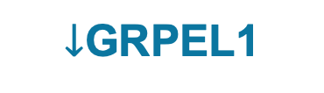
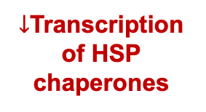

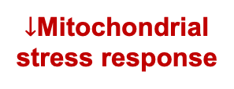
Potential mechanism of $↓$clinical events
MITIPERSTAT
STRESSORS
Mitochondrial
UPR turned off
MPO
$↓$Transcription of HSP chaperones
$↓$GRPEL1
$↓$Mitochondrial
stress response
$↓↓$OXIDATIVE
STRESS
Monocyte pro-repair
phenotype

Slide 27

Potential mechanism of $↓$clinical events
MITIPERSTAT
STRESSORS
Mitochondrial
UPR turned off
MPO
$↓$Transcription of HSP chaperones
$↓$GRPEL1
$↓$HF hospitalization,
$↓$death
$↓$Mitochondrial
stress response
$↓↓$OXIDATIVE
STRESS
Monocyte pro-repair
phenotype

Slide 28
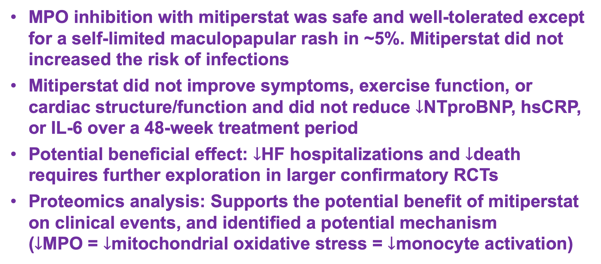
Conclusions
MPO inhibition with mitiperstat was safe and well-tolerated except for a self-limited maculopapular rash in ~5%. Mitiperstat did not increased the risk of infections
Mitiperstat did not improve symptoms, exercise function, or cardiac structure/function and did not reduce $↓$NTproBNP, hsCRP, or IL-6 over a 48-week treatment period
Potential beneficial effect: $↓$HF hospitalizations and $↓$death requires further exploration in larger confirmatory RCTs
Proteomics analysis: Supports the potential benefit of mitiperstat on clinical events, and identified a potential mechanism ($↓$MPO = $↓$mitochondrial oxidative stress = $↓$monocyte activation)

