Slide 1
Effect of Tirzepatide on Major Heart Failure
Outcomes in Patients With Heart Failure
With a Preserved Ejection Fraction and
Obesity: The SUMMIT Trial
Milton Packer, M.D.
for the SUMMIT Trial Study Group
Disclosures: 89bio, Abbvie, Actavis, Altimmune, Alnylam, Amarin, Amgen, Ardelyx, ARMGO, AstraZeneca, Attralus, Biopeutics, Boehringer Ingelheim, Caladrius, Casana, CSL Behring, Cytokinetics, Imara, Lilly, Medtronic, Moderna, Novartis, NovoNordisk, Pharmacocosmos, Regeneron, Salamandra

Slide 2
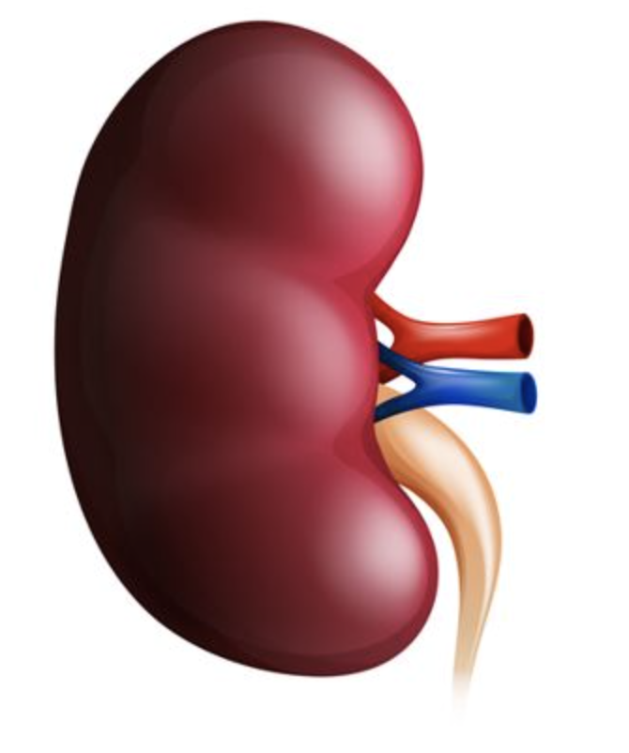
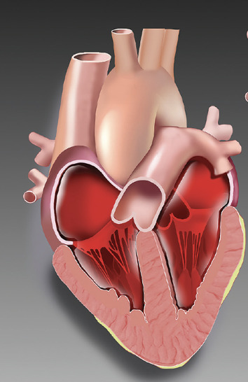
Obesity Is a Major Contributor to Heart Failure
With a Preserved Ejection Fraction
Sodium retention
Plasma volume expansion
Obesity
Filling of
left ventricle
Antinatiuretic effects
Expansion and
biological
transformation of
visceral fat
Altered
synthesis of
adipocytokines
HFpEF
Proinflammatory effects
Ability of left
ventricle to
tolerate filling
Myocardial
injury and fibrosis

Slide 3
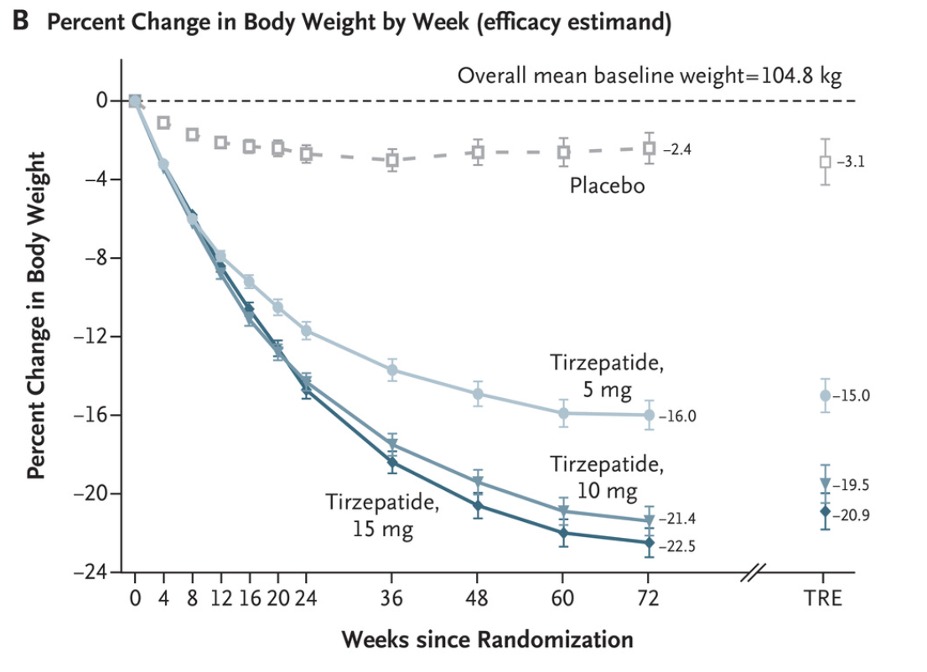
Tirzepatide Produces Substantial
Weight Loss in People With Obesity
SURMOUNT-1
Tirzepatide is a long-acting GIP receptor and GLP-1 receptor agonist
–3.1%
Placebo
Percent change in body weight
Tirzepatide 5 mg
–15.0%
Tirzepatide 10 mg
–19.5%
Tirzepatide 15 mg
–20.9%
N Engl J Med. 2022;387:205-216

Slide 4
SUMMIT: Key Eligibility Criteria
Diagnosis of heart failure with preserved ejection fraction
• Chronic heart failure, LV ejection fraction ≥50%, and body mass index ≥ 30 kg/m²
• One of the following: (1) left atrial enlargement; or (2) elevated LV filling pressures; or (3) NT-proBNP >200 pg/mL in sinus rhythm or >600 pg/mL in atrial fibrillation
Enrichment criteria to identify participants at high risk of events
• 6-minute walk distance ≥ 100 and ≤ 425 meters
• Kansas City Cardiomyopathy Questionnaire Clinical Summary Score ≤80
• Heart failure decompensation within 12 months OR eGFR <70 mL/min/1.73m²

Slide 5
SUMMIT: Randomization and Duration of
Double-Blind Treatment and Follow-Up
Double-blind treatment for up to 3 years
Median duration of
follow-up
104 (IQR: 66-126) weeks
Placebo
Screening
Tirzepatide
starting dose 2.5 mg/week
uptitrated by 2.5 mg/week every 4 weeks
(as tolerated) until 15 mg/week by 20 weeks
Randomization
52 weeks
Double-blind treatment was to be maintained until last patient completed 52 weeks

Slide 6
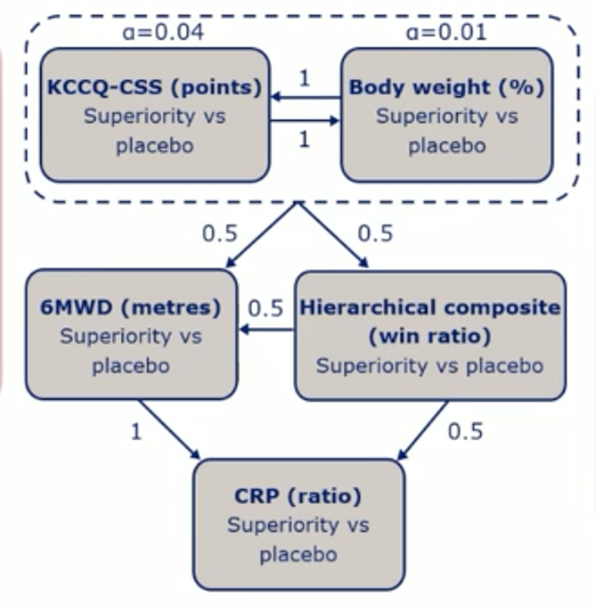
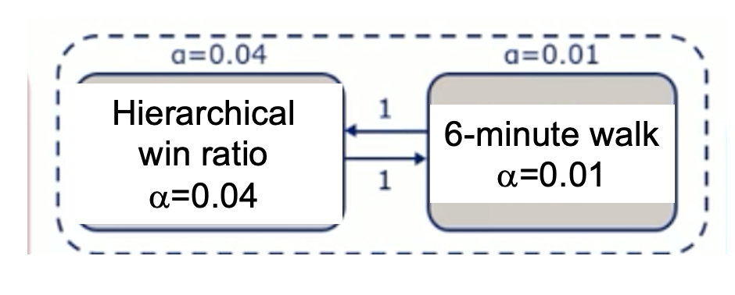
SUMMIT Primary Endpoint Designation
Final Primary Endpoints
Original Primary Endpoints
Hierarchical
composite
(win ratio)
α=0.04
Cardiovascular death or worsening
heart failure events
α=0.04
KCCQ-CSS
at 52 weeks
α=0.01
6-minute
walk distance
α=0.01
CV death or worsening heart failure events
α=0.04
KCCQ-CSS
at 52 weeks
α=0.01
6-minute walk
α=0.01
Hierarchical composite of death, worsening heart failure events,
changes in 6-minute walk distance and change in KCCQ health status
Initial projections
10% annual rate of an event, a 20-30% reduction in worsening heart failure, with no effect on cardiovascular death.
Cardiovascular death or worsening heart failure events for
duration of the trial
Change in KCCQ-CSS health status
at 52 weeks
Change in 6-minute walk distance
Prior primary endpoints
demoted to secondary endpoints

Slide 7
SUMMIT Primary Endpoint Designation
Final Primary Endpoints
(blinded change initiated
≈ 1 year prior to study end)
Original Primary Endpoints
Hierarchical
composite
(win ratio)
α=0.04
Cardiovascular death or worsening
heart failure events
α=0.04
6-minute
walk distance
α=0.01
CV death or worsening heart failure events
α=0.04
KCCQ-CSS
at 52 weeks
α=0.01
6-minute walk
α=0.01
KCCQ-CSS
at 52 weeks
α=0.01
20-30% risk reduction
Hierarchical composite of death, worsening heart failure events,
changes in 6-minute walk distance and change in KCCQ health status
Cardiovascular death or worsening heart failure events for
duration of the trial
Change in KCCQ-CSS health status
at 52 weeks
Change in 6-minute walk distance
Prior primary endpoints
demoted to secondary endpoints
Motivated by report of hazard ratio of 0.08 for heart failure outcomes based on 13 events,
observed in STEP-HFpEF, presented at ESC 2023

Slide 8
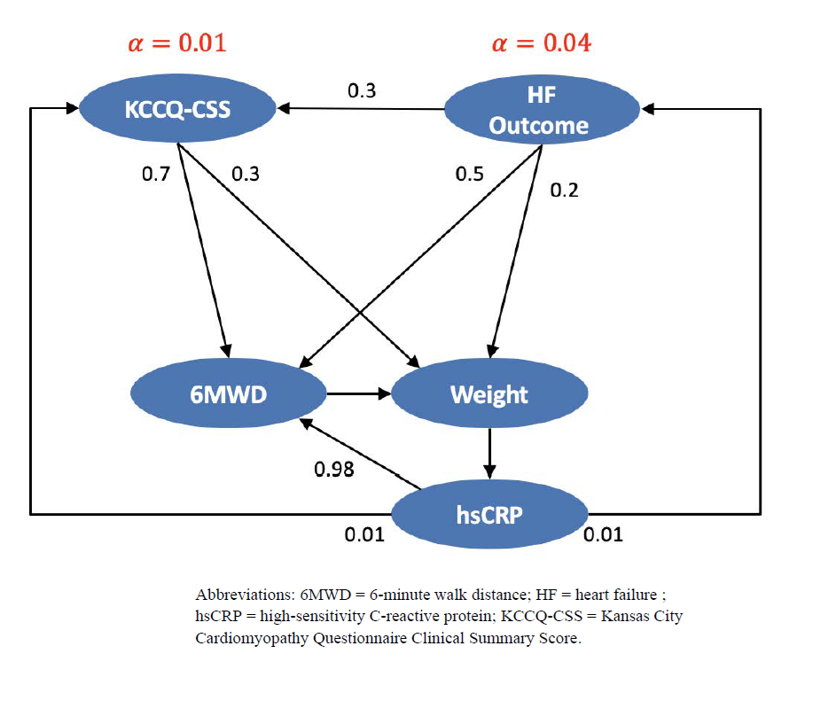
SUMMIT: Endpoints, Monitoring and Adjudication
Worsening heart failure
events were adjudicated
by a blinded Clinical Events
Committee
Clinical deterioration
as evidenced by
worsening symptoms
of heart failure requiring
– Hospitalization
– Urgent IV drug therapy
– Oral diuretic intensification
Changes in oral diuretics without worsening heart failure were NOT designated as an event.
α = 0.01
α = 0.04
KCCQ-CSS
Cardiovascular
death or worsening
heart failure events
KCCQ-CSS
CV death or worsening heart failure events
Key Secondary Endpoints
α protected
6-minute
walk distance
Body
weight
High sensitivity
C-reactive Protein
hsCRP
Safety was monitored by a Data and Safety Monitoring Committee
Sponsor: Eli Lilly and Company. NCT04847557

Slide 9
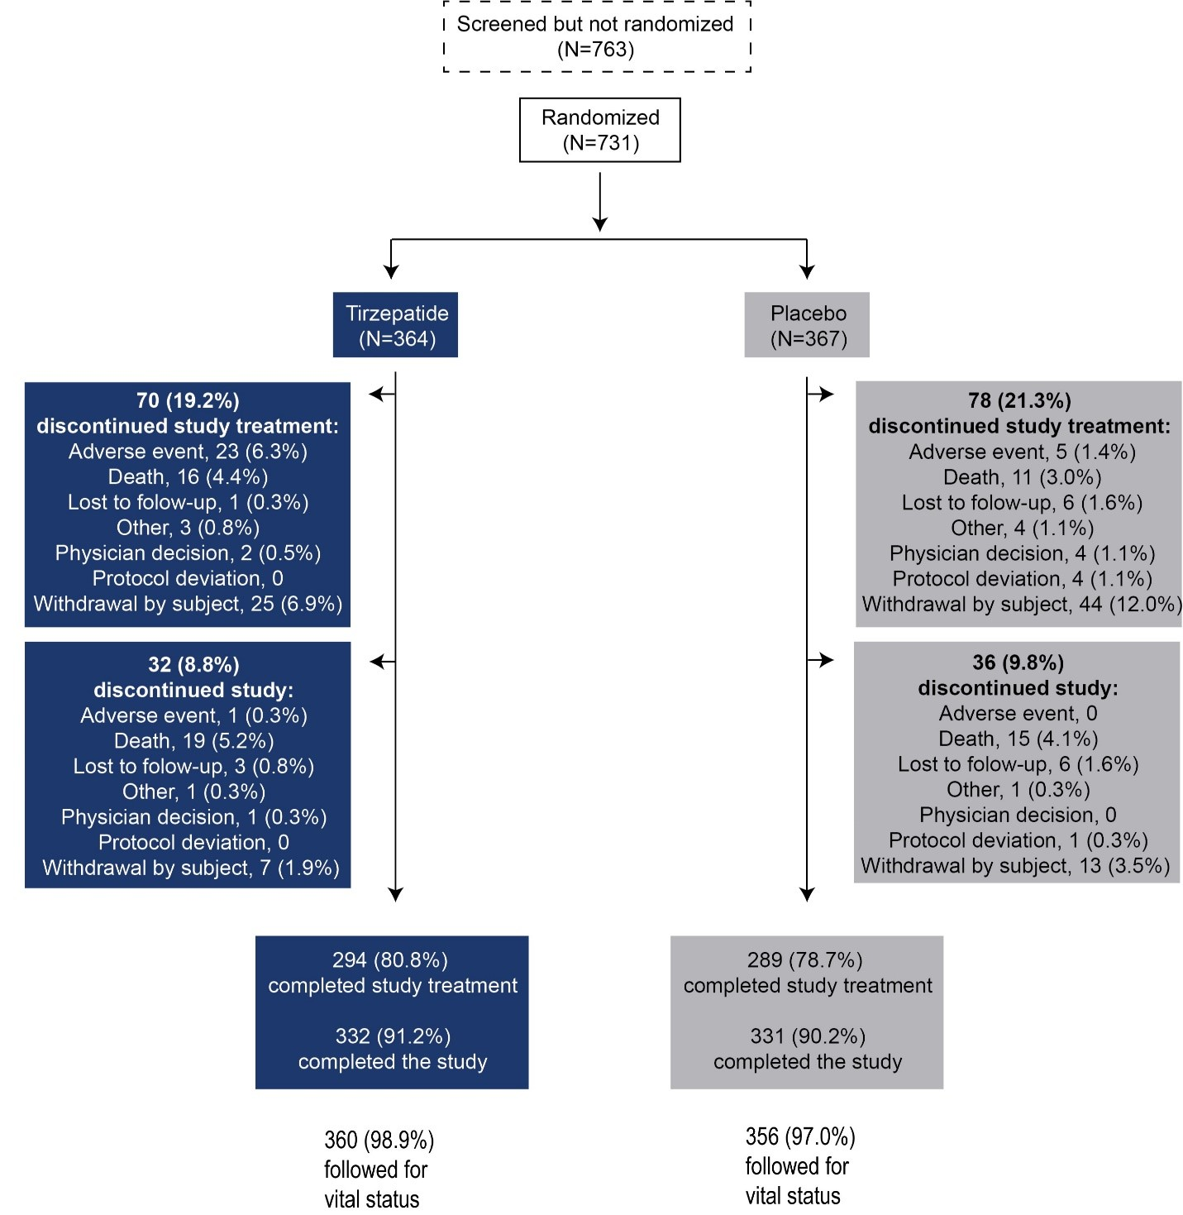
SUMMIT CONSORT Diagram
Screened
(n=1494)
Screened (N=1494)
Randomized
(n=731)
At 129 sites
in 9 countries
70 (19.2%)
Discontinued study treatment
(most commonly due to adverse event or patient withdrawal)
Tirzepatide
(n=364)
Placebo
(n=367)
78 (21.3%)
Discontinued study treatment
(most commonly
due to patient withdrawal)
32 (8.8%)
Did not attend final
study visit
(most commonly due to death
or patient withdrawal)
36 (9.8%)
Did not attend final
study visit
(most commonly due to death or patient withdrawal)
360 (98.9%)
followed for vital status
356 (97.0%)
followed for vital status
Missing vital status
4 tirzepatide, 11 placebo

Slide 10
SUMMIT: Baseline Characteristics
Characteristic | Tirzepatide (n=364) | Placebo (n=367)
Age | 65.5 ± 10.5 | 65.0 ± 10.9
Women | 200 (54.9%) | 193 (52.6%)
Race, non-white | 108 (29.7%) | 111 (30.2%)
Hispanic or Latino | 195 (53.6%) | 205 (55.9%)
Body mass index (kg/m²) | 38.3 ± 6.4 | 38.2 ± 7.0
Left ventricular ejection fraction (%) | 61.0 ± 6.5 | 60.6 ± 6.2
NT-proBNP (median, pg/mL) | 196 (56, 488) | 169 (64, 476)
History of type 2 diabetes | 174 (47.8%) | 178 (48.5%)
eGFR (ml/min/1.73 m²) | 64.5 ± 23.7 | 64.3 ± 23.5
KCCQ-CSS | 53.9 ± 17.9 | 53.2 ± 19.0
6-minute walk distance (m) | 305 ± 80 | 301 ± 84
Heart failure decompensation within 12 months | 171 (47.0%) | 172 (46.9%)
High-sensitivity C-reactive protein (mg/dl) | 5.8 ± 8.5 | 5.8 ± 8.4
Systolic blood pressure (mmHg) | 128 ± 13 | 128 ± 14
Cardiovascular medications
Diuretic | 267 (73.4%) | 271 (73.8%)
RAS and neprilysin inhibitor | 293 (80.5%) | 295 (80.4%)
Beta blocker | 245 (67.3%) | 263 (71.7%)
Mineralocorticoid receptor antagonist | 131 (36.0%) | 125 (34.1%)
SGLT2 inhibitor | 69 (19.0%) | 57 (15.5%)

Slide 11
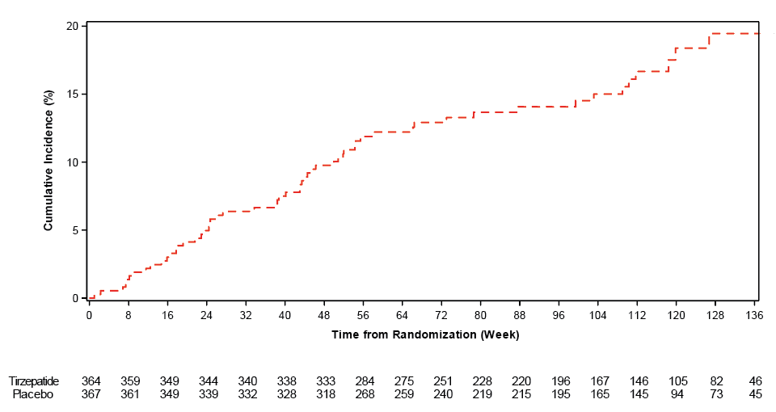
SUMMIT Primary Endpoint: Time-to-First-Event for Cardiovascular Death or Worsening Heart Failure (α=0.04)
20
Placebo
15
Cumulative Incidence (%)
8.8 events per
100 patient-years
15.3% of all patients
10
5
0
0
16
32
48
64
80
96
112
128
Time From Randomization (Weeks)

Slide 12
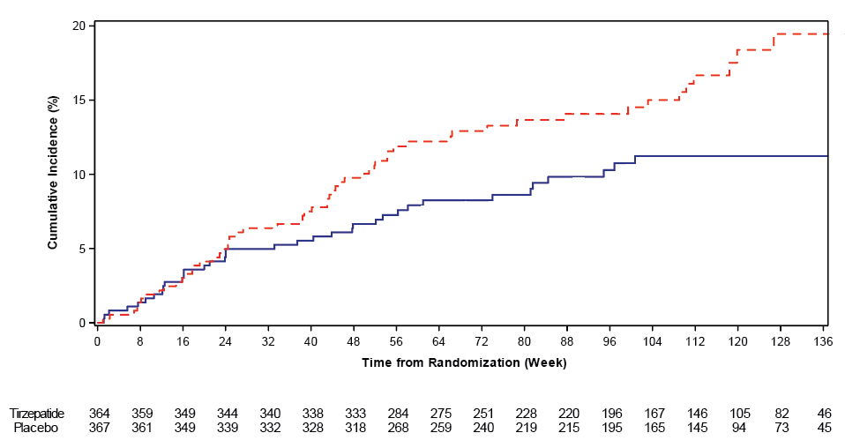
SUMMIT Primary Endpoint: Time-to-First-Event for Cardiovascular Death or Worsening Heart Failure (α=0.04)
20
Hazard ratio
0.62 (0.41-0.95)
P = 0.026
56 events (15.3%)
8.8 events per
100 patient-years
Placebo
15
Cumulative Incidence (%)
10
Tirzepatide
36 events (9.9%)
5.5 events per
100 patient-years
5
0
0
16
32
48
64
80
96
112
128
Time From Randomization (Weeks)

Slide 13
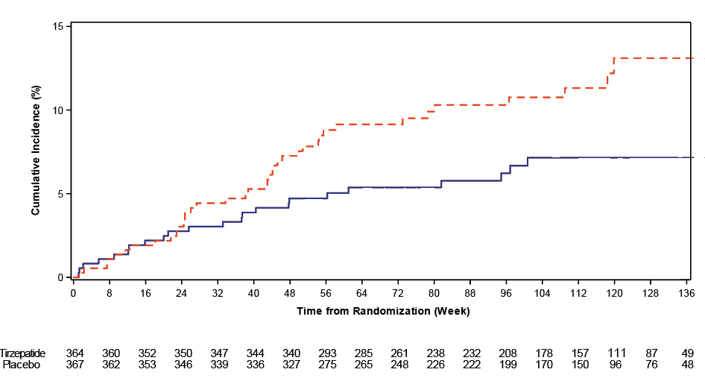
SUMMIT: Cardiovascular Death or Worsening Heart Failure Requiring Hospitalization or Urgent IV Drugs (α=0.04)
Primary Events Treated With Oral Diuretic Intensification Are Omitted From Analysis
15
Hazard ratio
0.57 (0.34-0.95)
P = 0.03
Placebo
10
Cumulative Incidence (%)
5
Tirzepatide
0
0
16
32
48
64
80
96
112
128
Time From Randomization (Weeks)

Slide 14
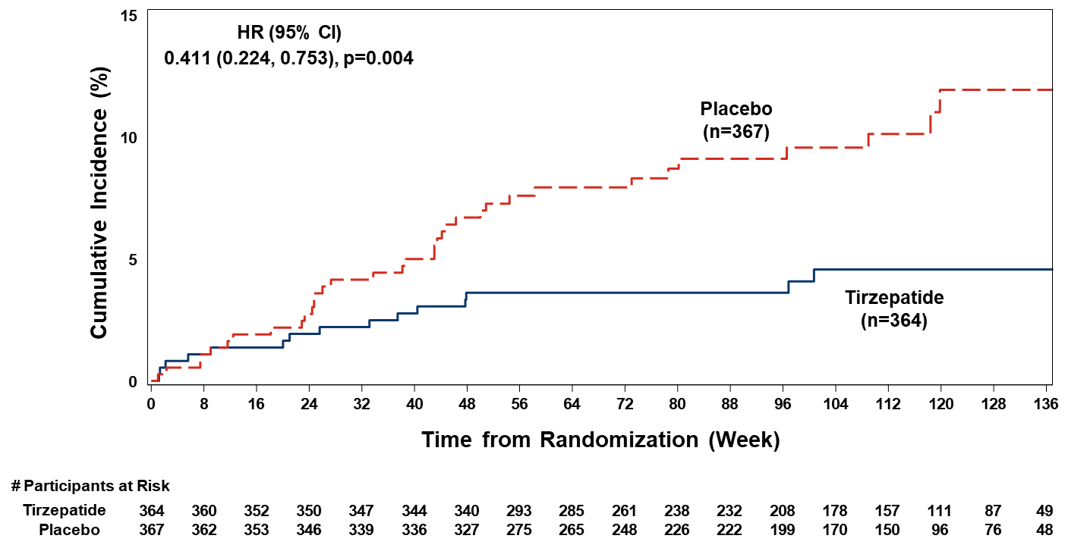
Effect of Tirzepatide on Worsening Heart Failure Requiring Hospitalization or Urgent Intravenous Drugs for Heart Failure
15
Hazard ratio
0.41 (0.22-0.75)
P = 0.004
Placebo
Hazard ratio for
hospitalizations for
heart failure
HR 0.44
(0.22-0.87)
P = 0.018
10
Cumulative Incidence (%)
5
Tirzepatide
0
0
16
32
48
64
80
96
112
128
Time From Randomization (Weeks)

Slide 15
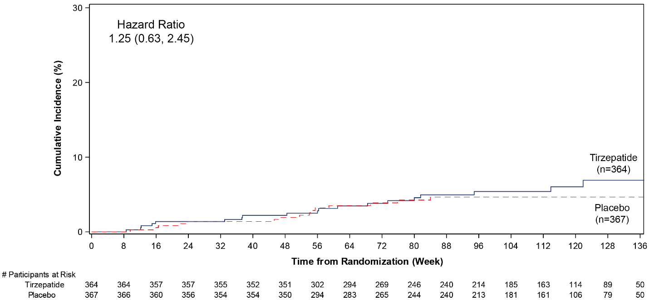
SUMMIT: Effect of Tirzepatide on All-Cause Mortality
 | Tirzepatide | Placebo
Cardiovascular | 8 | 5
Undetermined | 2 | 0
Non-cardiovascular | 9 | 10
Missing vital status | 4 | 11
30
Hazard ratio
1.25 (0.63-2.45)
20
Cumulative Incidence (%)
10
Tirzepatide
Placebo
0
0
16
32
48
64
80
96
112
128
Time From Randomization (Weeks)

Slide 16
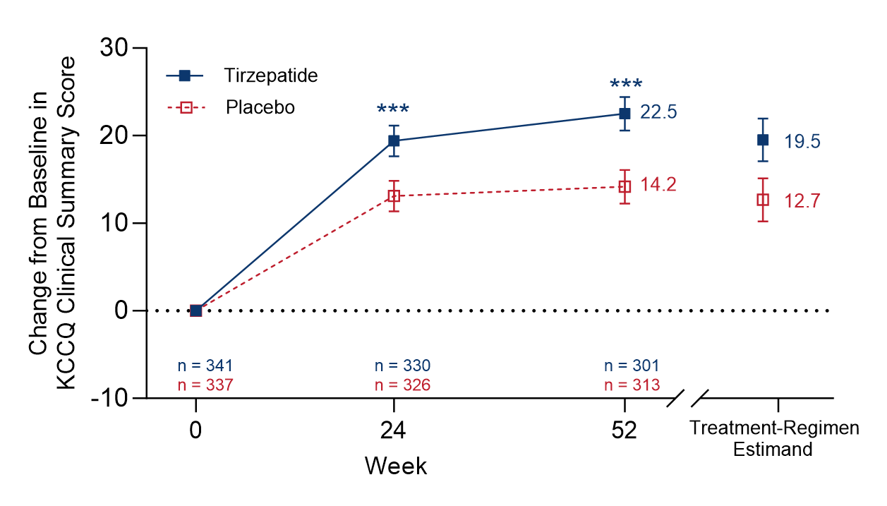
SUMMIT Co-Primary Endpoint: Effect of Tirzepatide
on Health Status (KCCQ-CSS) at 52 Weeks (α=0.01)
Tirzepatide
Placebo
Between-group median difference at 52 weeks
6.9 (3.3, 10.6), P < 0.001

Slide 17
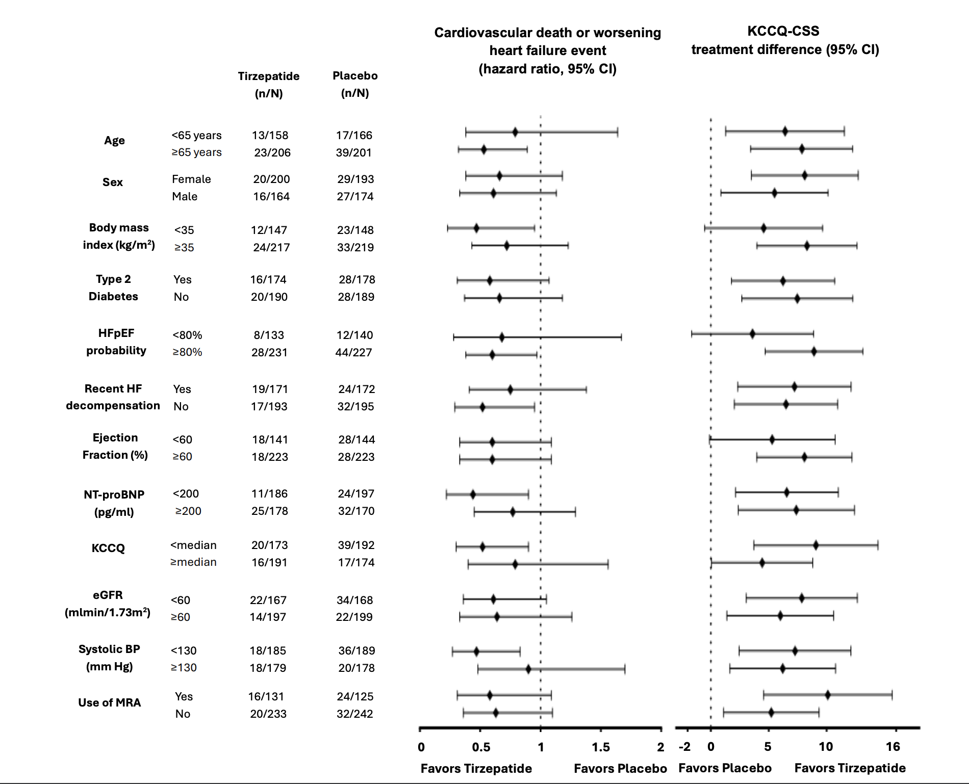
SUMMIT Primary Endpoints: Effects in Subgroups
Cardiovascular death
or worsening heart
failure event
KCCQ-CSS
Age
Sex
Body mass
index
History of
diabetes
HFpEF-ABA
score
Recent
worsening
Ejection
fraction
NT-pro
BNP
KCCS-CSS
eGFR
Systolic BP
Use of MRA
Favors
tirzepatide
Favors
placebo
Favors
tirzepatide

Slide 18
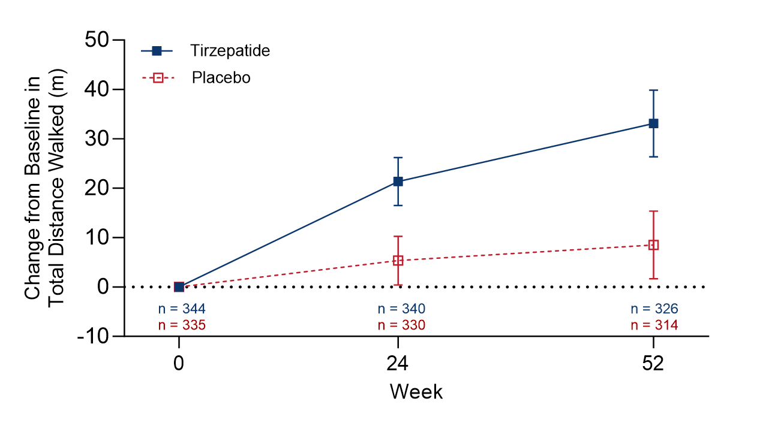
SUMMIT: 6-Minute Walk Distance (α Protected)
Tirzepatide
+ 18.3 meters (9.9, 26.7)
at 52 weeks
P < 0.001
Placebo

Slide 19
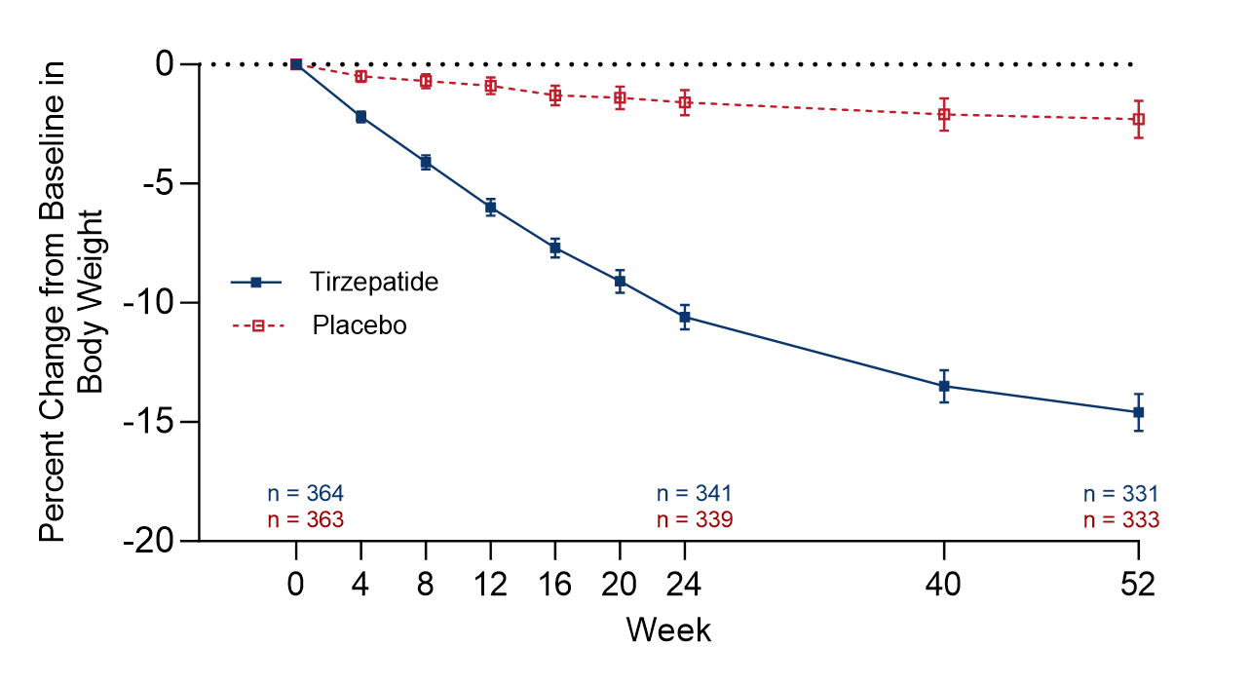
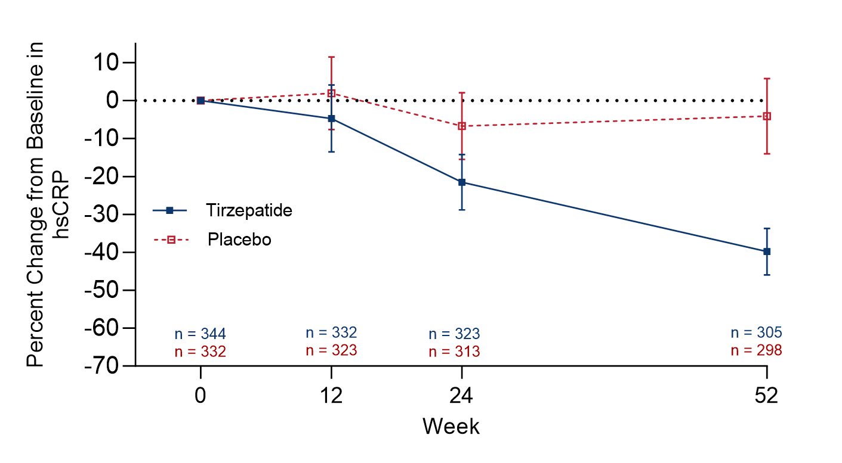
SUMMIT: Body Weight and High Sensitivity
C-Reactive Protein (α Protected)
Body Weight
hsCRP
Placebo
Placebo
% Change in Body Weight
% Change in hsCRP
Tirzepatide
Tirzepatide
– 11.6%
(–12.9, –10.4)
P < 0.001
– 34.9%
(–45.6, –22.2)
P < 0.001
Weeks
Weeks
Treatment differences at 52 weeks

Slide 20
SUMMIT: Summary of Safety
 | Tirzepatide (n=364) | Placebo (n=367)
Patients with serious adverse event | 96 (26.4) | 94 (25.6)
Cardiac failure | 15 (4.1) | 30 (8.2)
Patients who discontinued study medication due to non-fatal adverse event | 23 (6.3) | 5 (1.4)
Patients with at least one adverse event | 313 (86.0) | 279 (76.0)
Diarrhea | 67 (18.4) | 23 (6.3)
Nausea | 62 (17.0) | 24 (6.5)
Constipation | 54 (14.8) | 22 (6.0)
Decreased appetite | 38 (10.4) | 6 (1.6)
Vomiting | 38 (10.4) | 8 (2.2)
Urinary tract infection | 36 (9.9) | 22 (6.0)
COVID-19 | 34 (9.3) | 41 (11.2)
Dizziness | 34 (9.3) | 18 (4.9)
Atrial fibrillation | 23 (6.3) | 12 (3.3)
Dyspepsia | 23 (6.3) | 8 (2.2)
Hypotension | 22 (6.0) | 11 (3.0)
Cardiac failure | 21 (5.8) | 32 (8.7)
Upper abdominal pain | 20 (5.5) | 7 (1.9)
Anemia | 19 (5.2) | 18 (4.9)
Gastrointestinal symptoms resulted in discontinuation of treatment in 4% of the tirzepatide group.

Slide 21
The SUMMIT Trial: Conclusions
• The SUMMIT trial is the first trial in patients with HFpEF and obesity with major heart failure outcomes as the primary prespecified endpoint.
• Tirzepatide reduced the composite of cardiovascular death and worsening heart failure events by 38% (P=0.026) — an effect driven by a decreased risk of worsening heart failure events requiring hospitalization or urgent intravenous drug therapy. This benefit was consistent in all predefined subgroups.
• Tirzepatide had meaningful and highly significant effects to improve KCCQ-CSS scores and 6-minute walk distance and to reduce systemic inflammation.
• The safety profile of tirzepatide in SUMMIT was consistent with the safety profile from prior tirzepatide clinical trials.

Slide 22
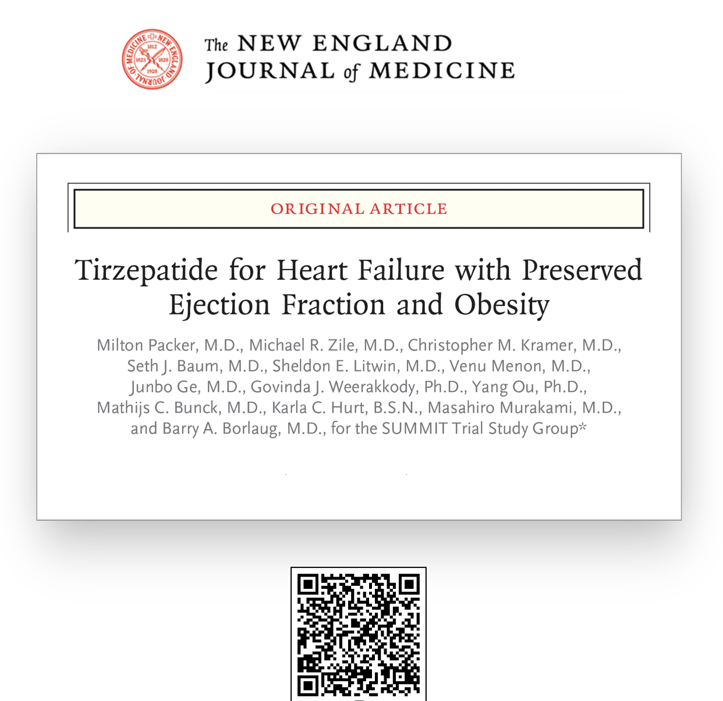
Borlaug et al. Mechanisms,
cardiac injury and
renal function
Zile et al. Extended heart
failure endpoints
Kramer et al. CMR substudy.
LV mass and paracardiac
adipose tissue

