Slide 1
Phase 2 Trial of Zerlasiran: Multiple doses of an siRNA Targeting Lipoprotein(a) over 60 weeks
Steven E. Nissen MD MACC
Qiuqing Wang, MS; Stephen J. Nicholls MBBS PhD; Ann Marie Navar, MD PhD; Kausik K Ray, MD, MPhil; Gregory G. Schwartz MD, PhD; Michael Szarek, PhD; Erik S.G. Stroes, MD, PhD; Roland Troquay, MD; Jannick A.N. Dorresteijn, MD PhD; Henry Fok, MBBS, PhD; David A. Rider, PhD; Steven Romano, MD; Kathy Wolski, MPH; and Curtis Rambaran MBBS MD
Disclosure
Consulting: Many pharmaceutical companies
Clinical Trials: AbbVie, Arrowhead, AstraZeneca, Bristol Myers Squibb, Encarda, Eli Lilly, Esperion, Medtronic, New Amsterdam, Novartis, Silence Therapeutics.
Companies are directed to pay any honoraria, speaking or consulting fees directly to charity so that neither income nor a tax deduction is received.

Slide 2
Background
Lipoprotein(a) is a causal risk factor for ASCVD and aortic stenosis containing Apo B covalently bound to apo(a).
Lp(a) concentrations are largely determined by the LPA gene which produces the mRNA that encodes for apo(a).
Zerlasiran is a GalNAc-conjugated siRNA that targets the mRNA responsible for hepatic production of apo(a).
The long duration effect of siRNA therapeutics make determination
of the optimal dose and dosing interval challenging.
The current study is a 60-week Phase 2 dose-finding trial of zerlasiran.

Slide 3
Study Design
Trial enrolled adults with lipoprotein(a) ≥125 nmol/L at high risk
of ASCVD events.
Five dose groups (randomized 1:1:2:2:2) to subcutaneous:
  Placebo Q16 weeks x 3 doses
  Placebo Q24 weeks x 2 doses
  Zerlasiran 300 mg Q16 weeks x 3 doses
  Zerlasiran 300 mg or 450 mg Q24 weeks x 2 doses.
Lipoprotein(a), LDL-C, and Apo B measured during 60 weeks follow up. Safety labs and adverse events collected at each visit.

Slide 4
Outcomes
Primary end point:
  Time-averaged lipoprotein(a) concentration from baseline
  to 36 weeks evaluating both peak and trough drug effects.
    Different from studies that report maximal reduction.
Secondary end points:
  Time-averaged changes in other lipids including LDL-C and Apo B
  Time-averaged lipoprotein(a) from baseline to 48 and 60 weeks.

Slide 5
Selected Baseline Characteristics of Participants
 | 450 mg Q24wk x 2 (N=45) | 300 mg Q16wk x 3 (N=42) | 300 mg Q24wk x 2 (N=44) | Pooled Placebo (n=47)
Age (years) | 63.8 | 63.1 | 64.5 | 63.6
Female (%) | 24% | 26% | 30% | 23%
White | 80% | 91% | 82% | 92%
Median Lp(a), nmol/L | 216 | 221 | 225 | 203
Mean LDL-C, mg/dL | 71 | 69 | 69 | 64
Mean Apo B, mg/dL | 75 | 77 | 75 | 72

Slide 6
Mean Time-Averaged Changes: Baseline to 36 Weeks

Slide 7
Mean Time-Averaged Changes: Baseline to 48 Weeks

Slide 8
Mean Time-Averaged Changes: Baseline to 60 Weeks

Slide 9
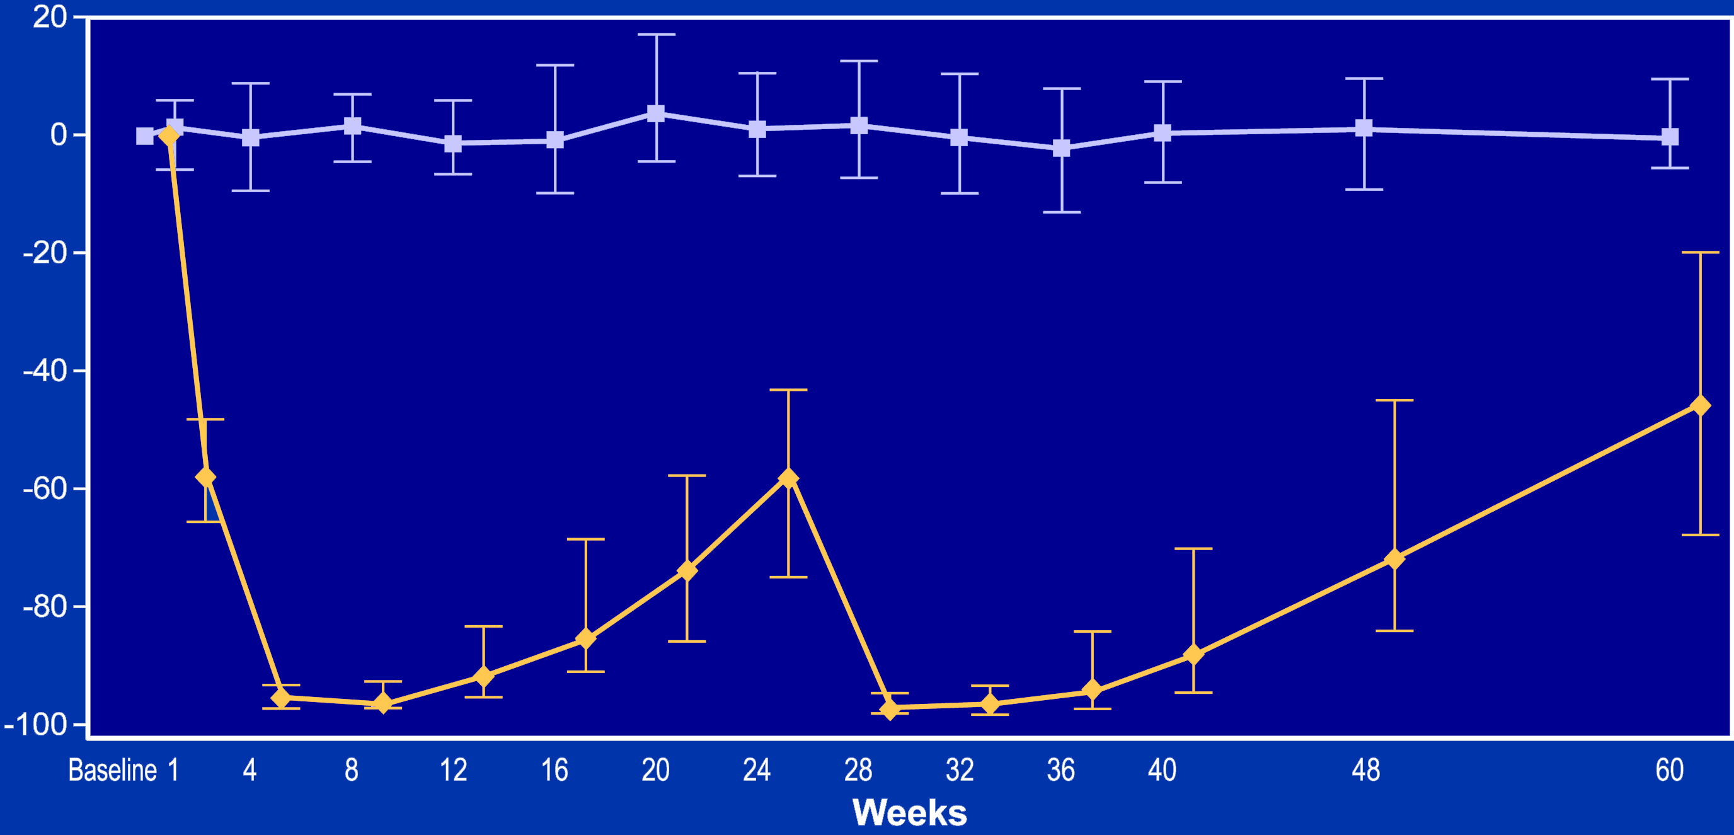

Lipoprotein(a): Zerlasiran 450 mg Q24 Weeks for 2 Doses
Lipoprotein(a) Percent Reduction (%)
-57.7%
-71.7%
-97.2%

Slide 10
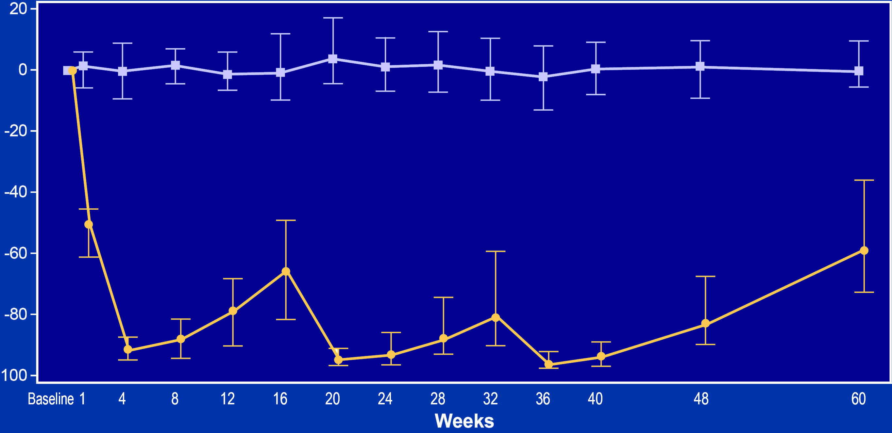
Lipoprotein(a): Zerlasiran 300 mg Q16 Weeks for 3 Doses
Lipoprotein(a) Percent Reduction (%)
-65.7%
-80.7%
-83.2%
-96.4%

Slide 11
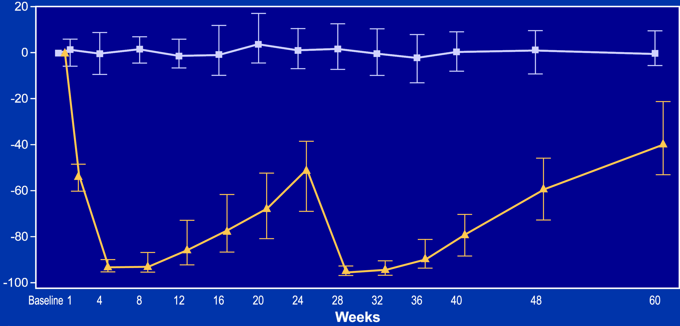
Lipoprotein(a): Zerlasiran 300 mg Q24 weeks for 2 Doses
Lipoprotein(a) Percent Reduction (%)
-50.9%
-59.5%
-95.7%

Slide 12
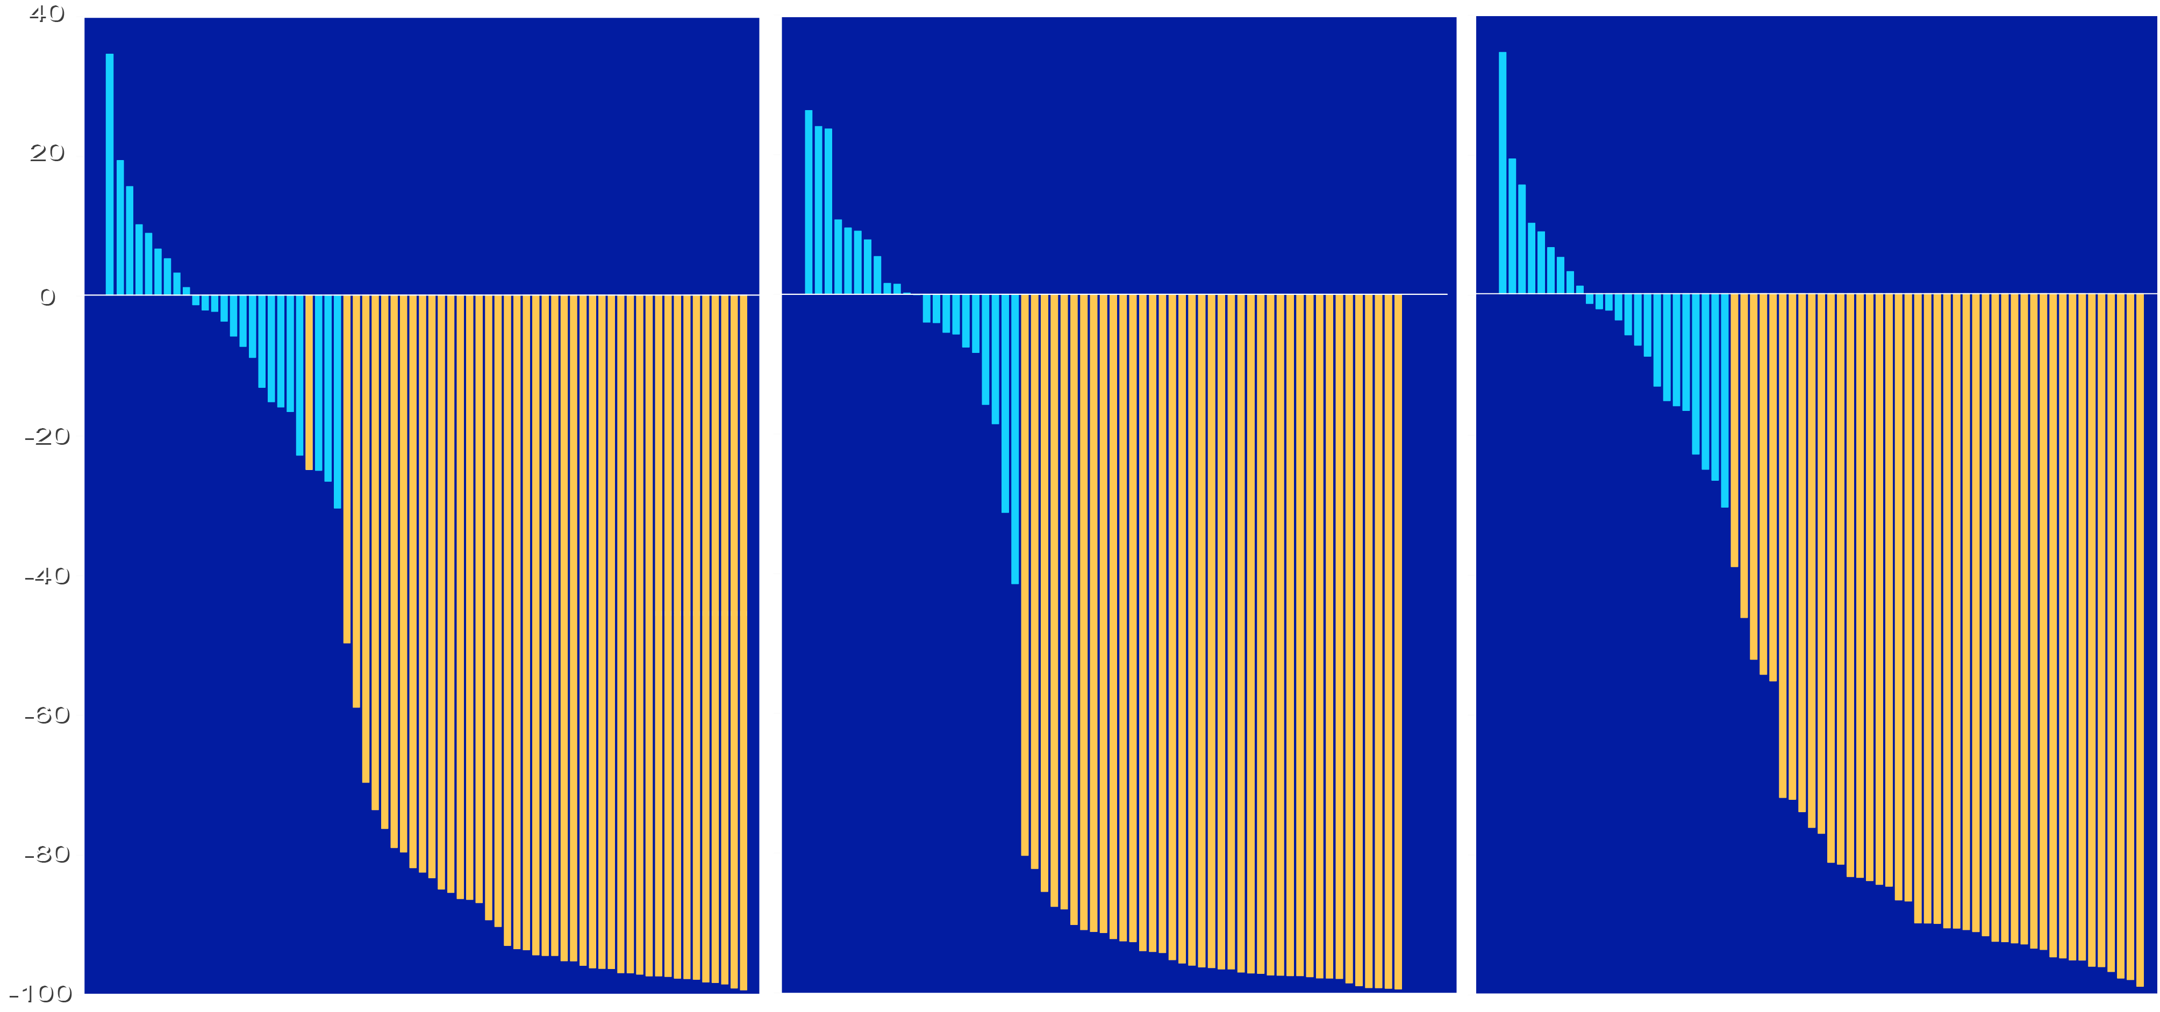
Waterfall Plots: Consistency of Lipoprotein(a) Lowering
450mg Q 24 weeks x 2 doses
300mg Q 16 weeks x 3 doses
300mg Q 24 weeks x 2 doses
Percent Reduction in Lipoprotein(a) at Week 36, %
Zerlasiran
Placebo

Slide 13
Zerlasiran Safety: Treatment Emergent Adverse Events
 | 450 Q 24w (n=45) | 300 Q16w (n=42) | 300 Q24 w (n=44) | Pooled Placebo (n=47
Most common treatment emergent adverse events, n (%)
Headache | 6 (13.3) | 5 (11.9) | 3 (6.8) | 2 (4.3)
Nasopharyngitis | 6 (13.3) | 3 (7.1) | 6 (13.6) | 2 (4.3)
Urinary Tract Infection | 3 (6.7) | 5 (11.9) | 1 (2.3) | 4 (8.5)
Influenza | 1 (2.2) | 4 (9.5) | 3 (6.8) | 4 (8.5)
Malaise | 4 (8.9) | 6 (14.3) | 0 (0) | 1 (2.1)
Serious Adverse Events Deemed Related to Study Drug | 0 (0) | 0 (0) | 0 (0) | 0 (0)
Serious Adverse Events Leading to Withdrawal | 1 (2.2) | 2 (48) | 0 (0) | 0 (0)

Slide 14
Limitations
The trial enrolled primarily White, male participants.
Because Black patients have higher lipoprotein(a) levels, effects of zerlasiran in non-White patients needs further study.
This Phase 2 study was moderate in size (180 patients),
not large enough to rule out uncommon adverse effects.
Only 2 doses were administered in the Q24 week groups,
not enough to reach steady state lipoprotein(a) levels.

Slide 15
Conclusions
Subcutaneous injection of 300 or 450 mg of zerlasiran
every 16 or 24 weeks reduced time-averaged lipoprotein(a) levels by ~80-85% during 36 to 60 weeks follow up.
Zerlasiran also reduced time-averaged LDL-C by ~25-30%
and Apo B by ~10-15%.
Following multiple doses, each subsequent dose further reduced lipoprotein(a) levels, potentially allowing less frequent administration in Phase 3.
No major safety or tolerability concerns emerged.

Slide 16
A Final Thought
Elevation of lipoprotein(a) has been an elusive disorder for which no effective treatments have been available. Emerging therapies, including RNA interference, represents a highly promising approach for management of increased lipoprotein(a). If current trials demonstrate a reduction morbidity/mortality, identification and treatment of these patients will become a critical public health priority.

Slide 17
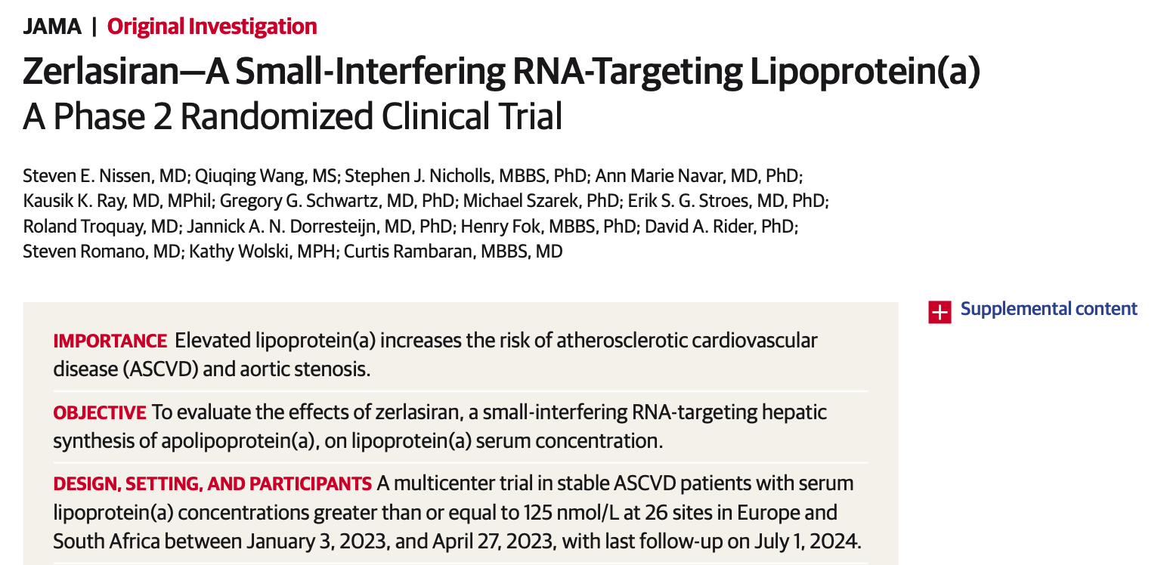

Manuscript Now Accessible Via jamanetwork.com

