Slide 1
Effects of Sacubitril-Valsartan on Prevention of Cardiotoxicity in High-Risk Patients Undergoing Anthracycline Chemotherapy The SARAH Trial
Marcely Gimenes Bonatto, MD
on behalf of all SARAH trial Investigators
Trial Identification UTN code: U1111-1274-1961
No sponsorship

Slide 2
Disclosures
Disclosure of financial relationships refers to speaker engagements, participation in clinical studies, advisory board roles, and travel support.
Marcely Gimenes Bonatto, M.D. – Speaker: Novartis, AstraZeneca, Boehringer, Bayer, Merck, Novo Nordisk, Viatris

Slide 3
Background
Anthracycline
Dose-dependent risk of cardiotoxicity, ranging from 10% to 65%, which may limit treatment or increase morbidity
Cardiotoxicity
Sacubitril-Valsartan

Slide 4
HypothesES
Sacubitril-Valsartan is effective in preventing cardiotoxicity in high-risk patients undergoing anthracycline treatment

Slide 5
SARAH Trial
Methodological aspects
Inclusion criteria
Exclusion criteria
Design: Single-center, randomized, double-blind, prospective, placebo-controlled clinical trial.
Study period: March 2022 - August 2024
Center: Erasto Gaertner Hospital, Curitiba, Brazil.
Sample size = 100 patients
Randomization according to the predicted cumulative ANT dose.
Follow-up: 24 weeks
∙ Patients over 18 years of age with cancer undergoing ANT chemotherapy and who had an increase in high-sensitivity troponin I (hs-TnI) above the 99th percentile after any ANT chemotherapy session.
∙ Inability to assess LV function ∙ Previous chemotherapy or radiotherapy
∙ Presence of cardiomyopathy, coronary artery disease, moderate to severe valve disease
∙ Contraindication to the use of sacubitril/valsartan (angioedema, renal artery stenosis, GFR<30 mL/min/m², K >5.0 mmol/L, pregnant women
∙ SBP <100 mmHg
∙ Use of RAAS inhibitors or beta-blockers

Slide 6
SARAH TRIAL DESIGN
A Double-Blind Randomized Placebo-Controlled Clinical Trial
Clinical evaluation
Laboratory tests and Biomarkers (Hs-TnI, NT-proBNP)
Imaging = Echocardiography and Cardiac magnetic Resonance (CMR)
Assessments

Slide 7
SARAH TRIAL DESIGN
Sacubitril-Valsartan for Prevention of Anthracycline-Induced Cardiotoxicity in High-Risk Patients
Primary Endpoint
Incidence of a greater than 15% reduction in global longitudinal strain (GLS) of the left ventricle after 24 weeks of treatment with ARNi or placebo.
Secondary Endpoint
Incidence of cardiotoxicity defined as >10% decrease in left ventricular ejection fraction (LVEF) resulting in a final value <53%
Variations in echocardiographic and CMR parameters such as ventricular dimension and function, parameters of diastolic function, changes in ventricular mass, GLS variation, alterations in extracellular matrix and interstitial fibrosis.
Increases in biomarkers (hs-TnI and NT-ProBNP)
Composite of clinical events (symptomatic HF, HF hospitalization, death, or heart transplant).
Adverse events

Slide 8
SARAH Trial
Patient Enrollment and Randomization
Intention-to-treat analysis

Slide 9
SARAH Trial
Baseline Characteristics

Slide 10
Primary endpoint
SARAH Trial met the Primary Endpoint
Relative Risk Reduction = 77%
NNT = 5.59
The differences between groups occurred independently of risk factors such as:
mean indexed cumulative dose of ANT, HER2 positivity, presence of hypertension and age

Slide 11
SECONDARY ENDPOINT
GLS variation after 24 Weeks

Slide 12
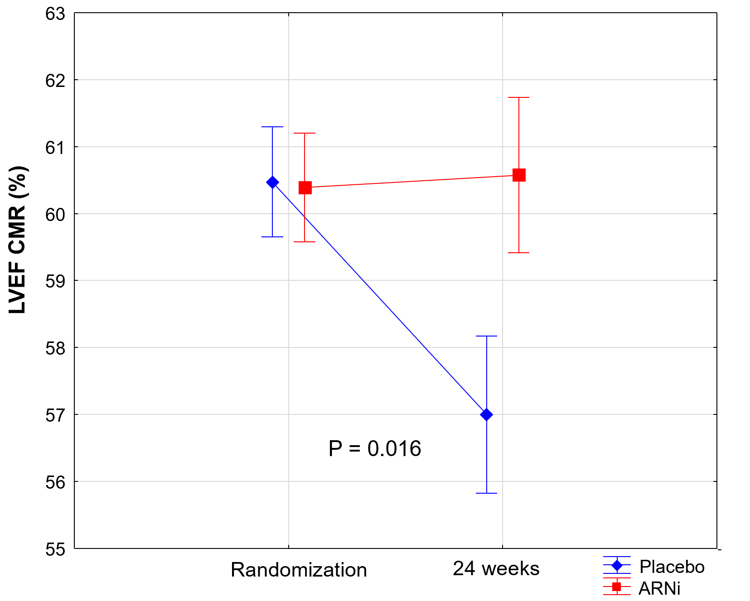
Secondary endpoints
Echo and CMR parameters after 24 Weeks
LVEF CMR (%)
Other secondary endpoints, such as variations in Echo or CMR parameters, were similar between groups.

Slide 13
Exploratory endpoint
Left Ventricular Dysfunction Evaluated by Echo and CMR
ARNi reduced the risk of ventricular dysfunction after 24 weeks

Slide 14
SECUNDARY ENDPOINT
Clinical Events after 24 Weeks
Lower rate of clinical events with no difference between groups

Slide 15
SECUNDARY ENDPOINT
Safety Endpoints and Variations in Hemodynamic and Laboratory Parameters

Slide 16
Limitations
StrENGHTS
Design (randomized, double-blind, placebo-controlled) contributes to reliable evidences
New approach to identify high-risk patients for cardiotoxicity with low-dose anthracyclines
Early detection of ventricular dysfunction
New monitoring techniques including hs-TnI, GLS, and CMR.
Single center study
Follow-up of 24 weeks
Limited sample size

Slide 17
CONCLUSION
ARNi group in SARAH trial showed:
Reduced cardiotoxicity: assessed by GLS reduction greater than >15% in patients with elevated hs-TnI after ANT therapy.
Improved remodeling: Showed better parameters involved in LV remodeling in ECHO (LVEDV with a trend toward LVEF) and CMR (LVEF and LVESV) compared to placebo.
Safety: Well-tolerated with no serious adverse events
The SARAH TRIAL is the first study to demonstrate the cardioprotective potential of ARNi in high-risk patients receiving ATN therapy.

Slide 18
Thank you

