Slide 1
Randomized Study Comparing PK/PD Properties of a Novel Intranasal Formulation of Bumetanide to Oral and IV Formulations
Daniel Bensimhon | MD
Medical Director, Advanced HF/MCS Program
Cone Health
Greensboro, NC

Slide 2
DISCLOSURES
Within the past 24 months, I or my spouse/partner have had a financial interest/arrangement or affiliation with the organization(s) listed below.
Affiliation/Financial Relationship | Company
Consulting Fees/Speaker Bureaus | Pfizer/BMS, Janssen, Boehringer Ingelheim/Lilly, Bayer, AstraZeneca, Sensible Medical, scPharmaceuticals, Caption Health, Zoll-Itamar
Scientific Advisory Boards | Corstasis, AquaPass
Major Stock Shareholder/Equity | scPharmaceuticals, Sensible Medical
Ownership/Founder | Ventricle Health

Slide 3
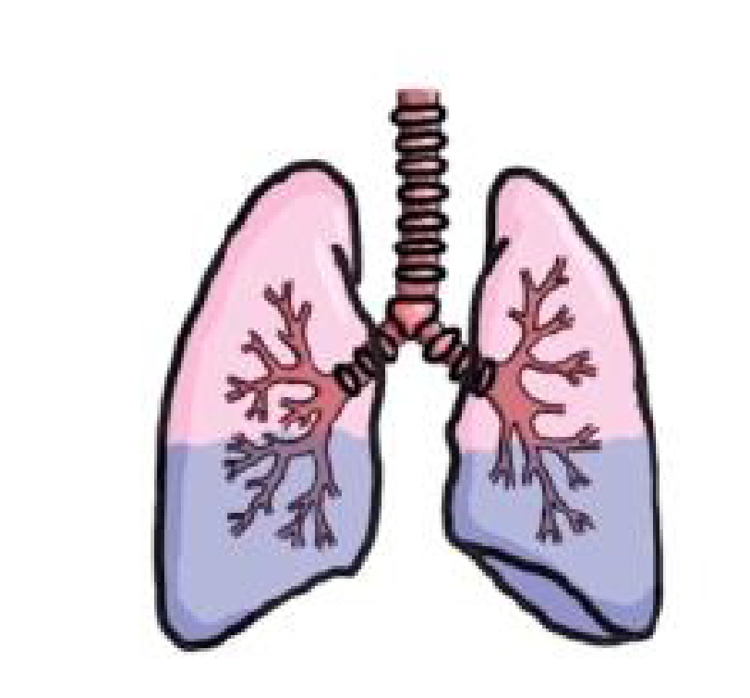
THE ROLE OF CONGESTION IN HF
Most common cause of symptoms
Most common reason patients seek medical attention
Most common reason for hospital admission
Associated with reduced QoL
Persistent congestion at discharge is associated with worse outcomes and hospital readmission

Slide 4
CONGESTION & CLINICAL OUTCOMES

Slide 5
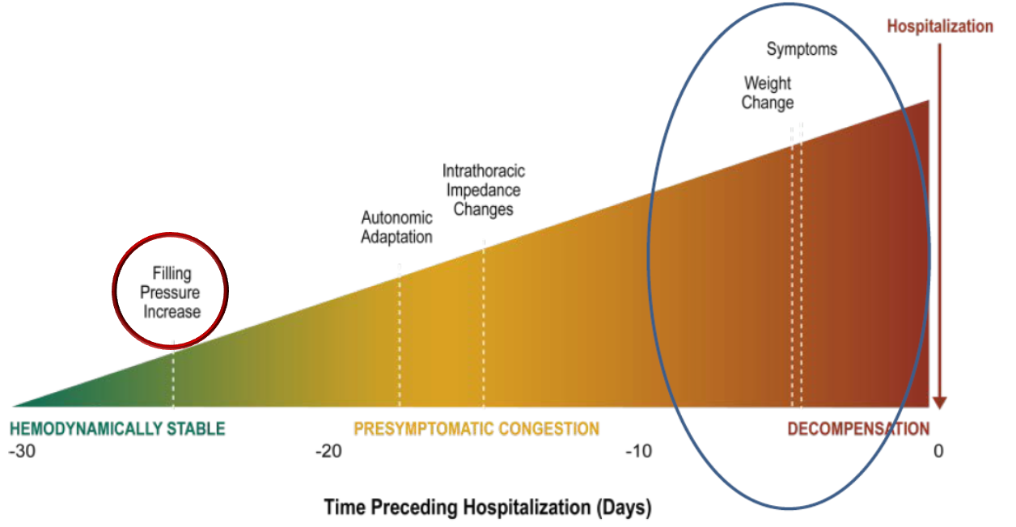
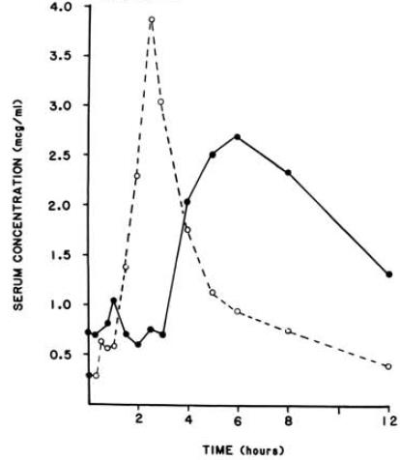
ORAL DIURETIC RESISTANCE
Declining bioavailability or oral diuretics
Representative serum concentration time profile
after oral administration of 160 mg furosemide
1. Modified from: Adamson PB. Curr Heart Fail Rep. 2009;6:287-292. 2. Mullens W, et al. Eur J of Heart Fail. 2019;21(2):137-55.

Slide 6
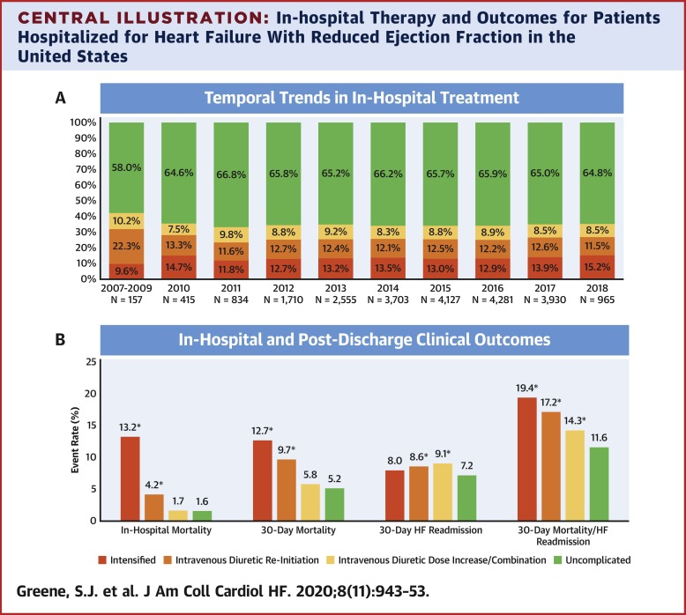
THE COST OF DIURETIC RESISTANCE
Nearly 2/3 of all HF hospitalizations are uncomplicated and are required simply for IV diuretics @ a cost ~$17K per admission

Slide 7
CAN ALTERNATE DELIVERY SYSTEMS OVERCOME DIURETIC RESISTANCE?
Precedent in other disease states with flares

Slide 8
RSQ-777-02: PIVOTAL PK/PD TRIAL DESIGN
TRIAL STRATEGY
INTERVENTIONS
ENDPOINTS
Randomized, Open-label, Five-period, Crossover Study in Healthy Adult Volunteers to Characterize Safety, Tolerability, Relative Bioavailability & Pharmacodynamics of Bumetanide Nasal Spray (RSQ-777) in Comparison with Oral and IV Bumetanide
Primary:
C-max of oral vs nasal formulations
AUC for C-plasma of oral vs nasal
Secondary:
Safety (ECG, vitals, labs, TEAEs)
AUC & C-max for nasal vs IV
Tmax, T_{1/2}, V_{dist}, plasma clearance & absolute bioavailability
Urine output
RSQ-777: Bumetanide Nasal Spray (BNS) 0.5mg/Device

Slide 9
RSQ-777-02 METHODOLOGY & BASELINE CHARACTERISTICS
68 Healthy volunteers housed in facility for 10d
Randomized to 1:4 Rx strategies
R= PO Bumetanide
T = BNS
IV = IV Bumetanide
48-hr washout period between interventions
Intensive PK sampling (23 samples per Rx)
Total urine, naturesis & K excretion
Electrolytes 8 & 36hr after each Rx. ECG & vitals monitored
DEMO | R/T/R/T/IV (N=17) | T/R/T/R/IV (N=18) | IV/R/T/R/T (N=16) | IV/T/R/T/R (N=17) | All (N=68)
Age (years)
Mean | 36.5 | 39.7 | 39.2 | 38.9 | 38.6
SD | 9.74 | 7.97 | 7.64 | 9.98 | 8.78
Median | 36.0 | 39.0 | 37.0 | 36.0 | 36.5
Minimum | 18 | 29 | 30 | 21 | 18
Maximum | 54 | 55 | 55 | 55 | 55
Gender [n(%)]
Female | 6 (35.3) | 7 (38.9) | 5 (31.3) | 5 (29.4) | 23 (33.8)
Male | 11 (64.7) | 11 (61.1) | 11 (68.8) | 12 (70.6) | 45 (66.2)
Race [n(%)]
White | 10 (58.8) | 12 (66.7) | 7 (43.8) | 12 (70.6) | 41 (60.3)
Black/AA | 4 (23.5) | 4 (22.2) | 7 (43.8) | 4 (23.5) | 19 (27.9)
Asian | 2 (11.8) | 2 (11.1) | 2 (12.5) | 1 (5.9) | 7 (10.3)
Other | 1 (5.9) | 0 | 0 | 0 | 1 (1.5)
Ethnicity [n(%)]
Hispanic/Latino | 5 (29.4) | 7 (38.9) | 5 (31.3) | 5 (29.4) | 22 (32.4)
Not H/L | 12 (70.6) | 11 (61.1) | 11 (68.8) | 12 (70.6) | 46 (67.6)
Sequence | Treatments | N
1 | R-T-R-T-IV | 17
2 | T-R-T-R-IV | 18
3 | IV-R-T-R-T- | 16
4 | IV-T-R-T-R | 17
Source: RSQ- 777-02 CSR

Slide 10
RSQ-777-02 BNS COMPARED TO IV AND PO BUMETANIDE
Methods: Pharmacokinetic Measurements
An indwelling, catheter with K2 EDTA anticoagulant was placed in one arm and blood samples (2 mL samples per blood draw) were collected at the following time points:
IV formulation: 0 (pre-dose), 2 mins ± 1 min, 5 mins ± 1 min, 10 mins ± 1 min, 15 mins ± 3 mins, 30 mins ± 3 mins, 45 mins ± 3 mins, 1 h ± 3 mins, 1.5 h ± 3 mins, 2 h ± 3 mins, 2.5 h ± 5 mins, 3 h ± 5 mins, 4 h ± 5 mins, 6 h ± 5 mins, 8 h ± 5 mins, 12 h ± 5 mins, 24 h ± 15 mins, and 36 h ± 15 mins post each dose. Samples drawn within one hour after dosing should be taken from the contralateral arm to the one used for drug administration.
IN formulation: 0 (pre-dose), 5 mins ± 1 min, 10 mins ± 1 min, 15 mins ± 3 mins, 30 mins ± 3 mins, 45 mins ± 3 mins, 1 h ± 3 mins, 1.5 h ± 3 mins, 2 h ± 3 mins, 2.5 h ± 5 mins, 3 h ± 5 mins, 4 h ± 5 mins, 6 h ± 5 mins, 8 h ± 5 mins, 12 h ± 5 mins, 24 h ± 15 mins, and 36 h ± 15 mins post each dose.
Oral formulation: 0 (pre-dose), 10 mins ± 1 min, 15 mins ± 3 mins, 30 mins ± 3 mins, 45 mins ± 3 mins, 1 h ± 3 mins, 1.5 h ± 3 mins, 2 h ± 3 mins, 2.5 h ± 5 mins, 3 h ± 5 mins, 4 h ± 5 mins, 6 h ± 5 mins, 8 h ± 5 mins, 12 h ± 5 mins, 24 h ± 15 mins, and 36 ± 15 mins post each dose.
Source: RSQ- 777-02 CSR

Slide 11
RSQ-777-02 BNS COMPARED TO IV AND PO BUMETANIDE
Methods: Pharmacodynamic Measurements and Parameters
Spontaneous urine voids were collected over a 24-hours period using collection intervals 0 to 2 hours, 2 to 4 hours, 4 to 6 hours, 6 to 8 hours, 8 to 12 hours, and 12 to 24 hours post-dose intervals (24-hr urine collection).
The volume of urine voided per collection period was recorded.
Electrolytes were measured in all urine collections including voided pre-dose sample to evaluate natriuresis and excretion of other electrolytes as an additional pharmacodynamic measure.
Urine electrolyte testing included sodium, potassium, albumin, and creatinine concentrations
Source: RSQ- 777-02 CSR

Slide 12
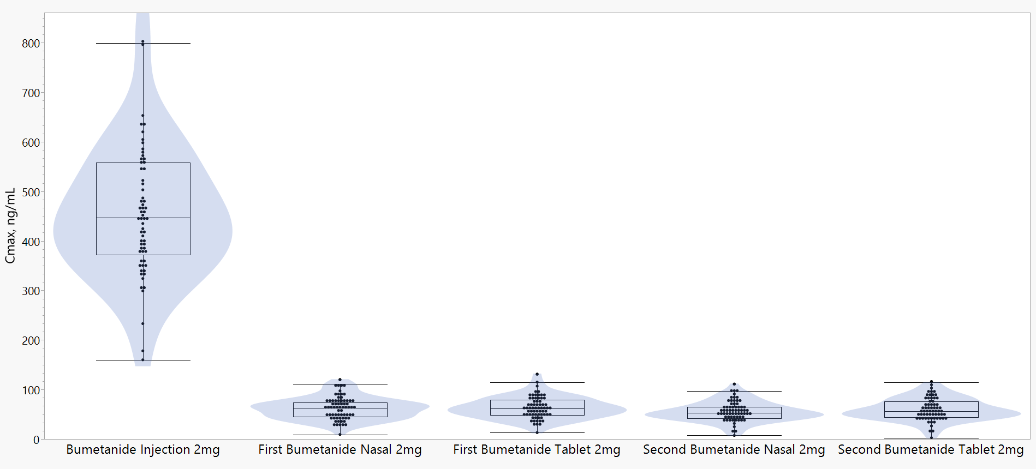
RSQ-777-02 BNS COMPARED TO IV AND PO BUMETANIDE
Results – Cmax, Bioequivalent to PO Bumetanide
Source: RSQ- 777-02 CSR

Slide 13
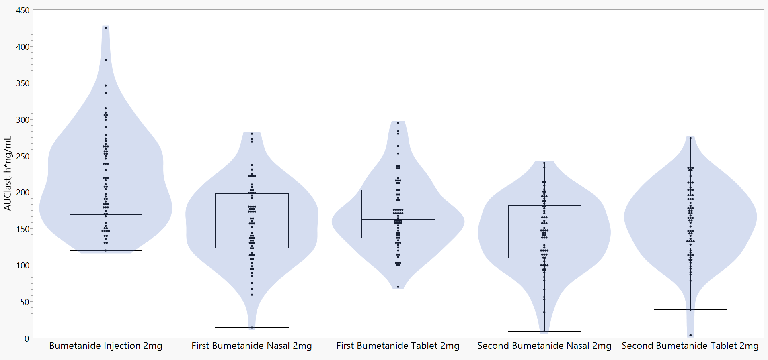
RSQ-777-02 BNS COMPARED TO IV AND PO BUMETANIDE
Results – AUC, Bioequivalent to PO Bumetanide
Source: RSQ- 777-02 CSR

Slide 14
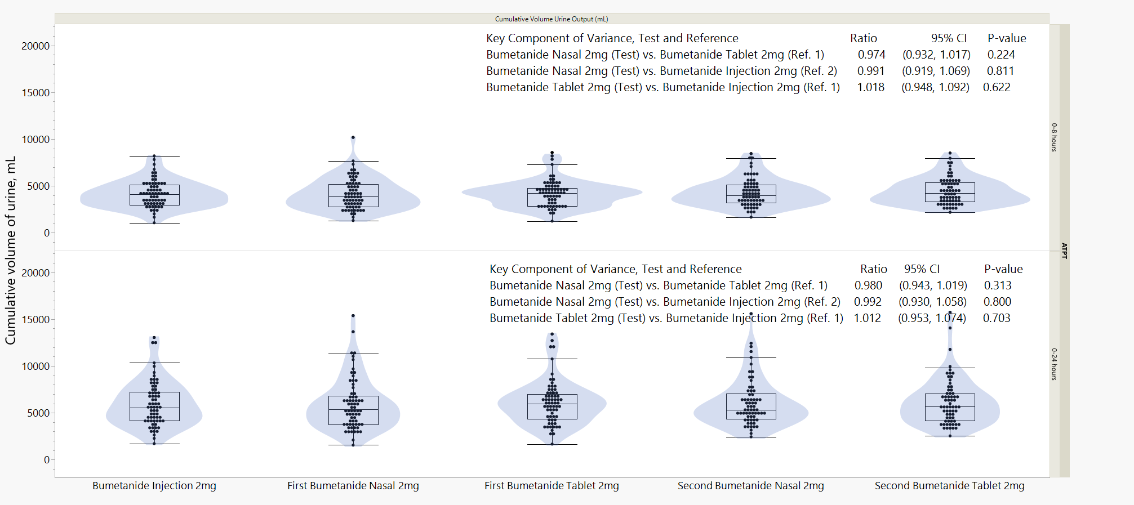
RSQ-777-02 BNS COMPARED TO IV AND PO BUMETANIDE
Results – Cumulative Urine Output Comparison
0-8
0-24
Source: RSQ- 777-02 CSR

Slide 15
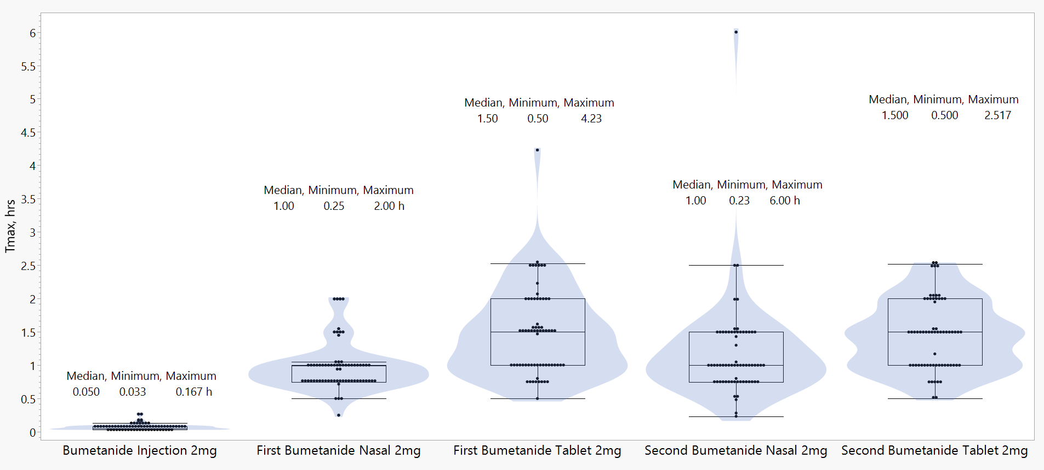
RSQ-777-02 BNS COMPARED TO IV AND PO BUMETANIDE
Results – Tmax 33% Faster vs. PO Bumetanide
Source: RSQ- 777-02 CSR

Slide 16
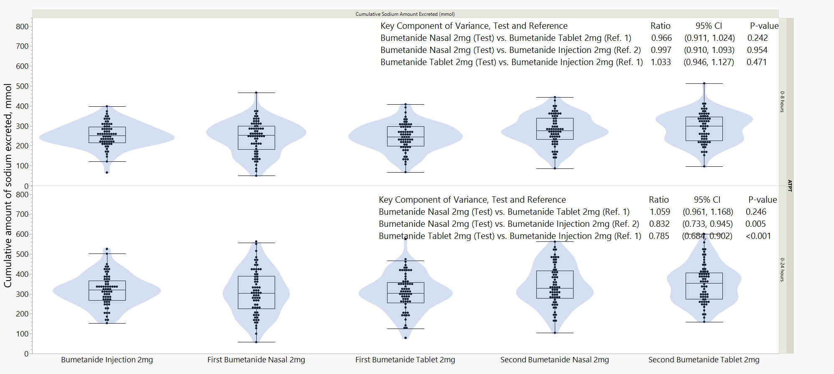
RSQ-777-02 BNS COMPARED TO IV AND PO BUMETANIDE
Results – Cumulative Sodium Excretion Comparison
Source: RSQ- 777-02 CSR

Slide 17
RSQ-777-02 BNS COMPARED TO IV AND PO BUMETANIDE
Results – Safety and Treatment Emergent Adverse Events
Source: RSQ- 777-02 CSR

Slide 18
CONCLUSIONS
Among a diverse group of healthy adults, BNS was well tolerated, safe, and had equivalent pharmacodynamic efficacy (urine/sodium output) compared to IV and PO administration.
BNS represents a novel, safe, self (or caregiver) administered parenteral diuretic option for patients who are unable to oral medications.
Studies evaluating the comparative effectiveness of BNS versus oral and IV formulation in congested (HF) patients are forthcoming.

Slide 19
Circulation. 2024; [published online ahead of print] DOI: 10.1161/CIRCULATIONAHA.124.072949
Randomized Study Comparing a Novel Intranasal Formulation of Bumetanide to Oral and Intravenous Formulations
Andrew P Ambrosy, M.D; Daniel Bensimhon, M.D.; Galina Bernstein, PHD; Brian Kolski, M.D.; Joel Neutel, M.D.; Benjamin Esque, B.S.; Eric Adler, M.D.
Circulation
https://www.ahajournals.org/doi/ 10.1161/CIRCULATIONAHA.124.072949

Slide 20
THANK YOU

