Slide 1




Electronic Nudges to Increase Influenza Vaccination among Patients with A History of Myocardial Infarction:
Insights from the NUDGE-FLU Program
Ankeet S. Bhatt, MD, MBA, ScM
Research Scientist, Kaiser Permanente Northern California Division of Research
Assistant Professor, Kaiser Permanente Bernard J. Tyson School of Medicine
Adjunct Professor, Stanford University School of Medicine
American Heart Association 2024 Scientific Sessions
Chicago, IL, USA
November 17, 2024

Slide 2

Disclosures
Ankeet S. Bhatt has received consulting fees from Sanofi Pasteur, Merck, and Novo Nordisk.
NUDGE-FLU was funded by Sanofi Pasteur.
NUDGE-FLU-2 and NUDGE-FLU-CHRONIC had no external funding.

Slide 3
Background
Influenza infection is associated with significant morbidity and mortality worldwide.
Influenza increases the risk of cardiovascular events, including acute
myocardial infarction (AMI).^{1,2}
The Influenza Vaccination After Myocardial Infarction (IAMI) trial found influenza vaccination vs. placebo reduced major adverse cardiac events (MACE),
leading to strong recommendations for vaccination in CV guidelines.^{3,4}
However, vaccination rates remain suboptimal in patients with AMI.⁵
There is an urgent need for new strategies to improve vaccination rates
in this high-risk cohort.
¹Kwong JC et. al. N Eng J Med. 2018.
²Hegde SM et. al. JAMA Netw Open. 2023.
³Frobert O et. al. Circulation. 2021.
⁴Byrne RA et. al. Eur Heart J. 2023.
⁵Ghandi GR et. al. JAMA Cardiol. 2021.

Slide 4

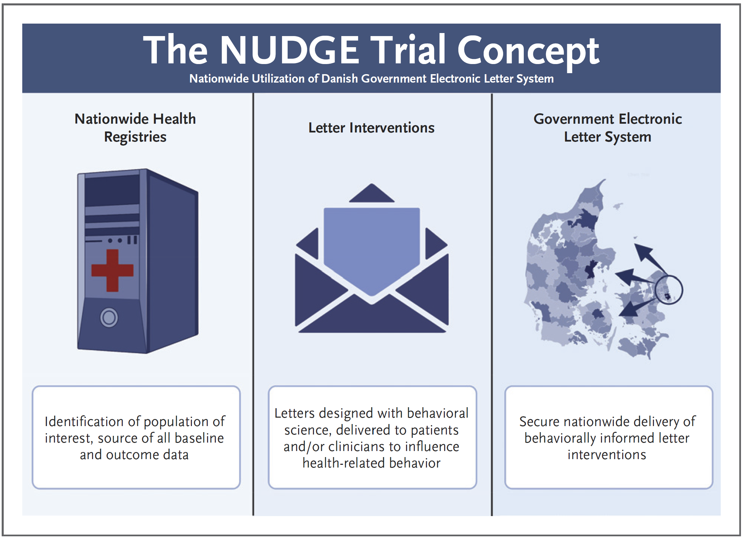
Background
Nudges for behavior change¹
Denmark as a learning lab²
“A nudge is a simple change which may alter behavior without restricting choice.”
¹Thaler RH, & Sunstein, CR. Yale University Press. 2008.; ²Johansen et. al. NEJM Evid. 2024.

Slide 5

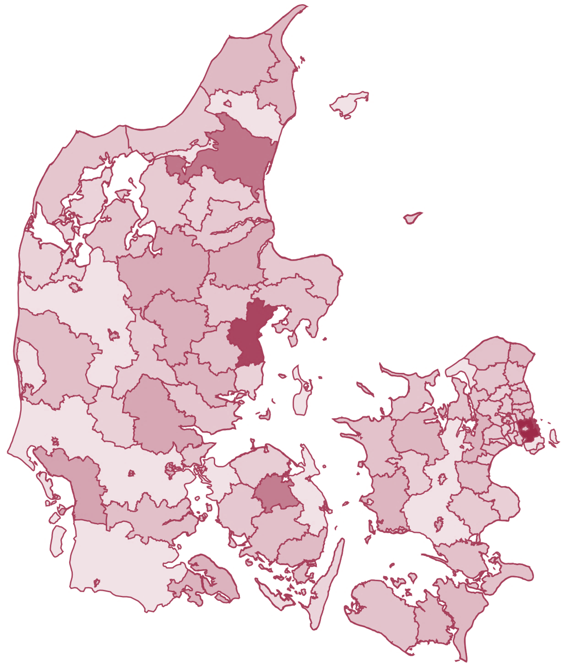

NUDGE-FLU
2022-2023
Influenza Season
Usual Care
1⁰ Endpoint
Influenza Vaccination
Age ≥ 65 years
N = 964,870
9 Different Behavioral Science-Informed Letters

Slide 6
NUDGE-FLU-2
2023-2024
Influenza Season
Usual Care
1⁰ Endpoint
Influenza Vaccination
Age ≥ 65 years
N=881,373
6 Different Behavioral Science-Informed Letters

Slide 7
NUDGE-FLU-CHRONIC
2023-2024
Influenza Season
Usual Care
1⁰ Endpoint
Influenza Vaccination
Age 18-64 years + Chronic Condition
N = 299,881
6 Different Behavioral Science-Informed Letters

Slide 8
The NUDGE-FLU Program
NUDGE-FLU | NUDGE-FLU-2 | NUDGE-FLU-CHRONIC
2022-2023
Influenza Season
2023-2024
Influenza Season
2023-2024
Influenza Season
Age ≥ 65 years
N = 964,870
Age ≥ 65 years
N = 881,373
Age 18-64 years + Chronic Condition
N = 299,881
1⁰ Endpoint: Influenza Vaccination Available Free-of-Charge

Slide 9
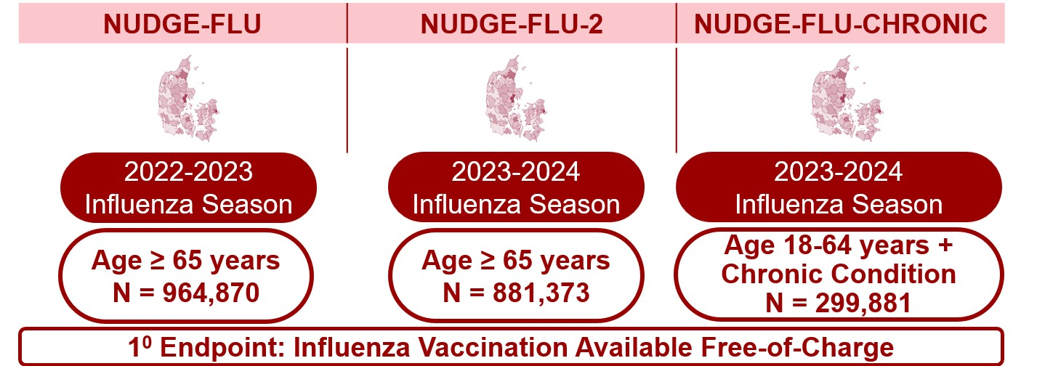
The NUDGE-FLU Program
Total Number of Randomizations: 2,146,124
Patients with a History of AMI: 59,458

Slide 10




Methods
In this prespecified analysis, we examined the effects of electronic, letter-based nudges vs.
usual care on influenza vaccine uptake by history of AMI.
AMI was defined as an overnight hospitalization with ICD-10: I21 as primary diagnosis code
within 10 years from randomization.
Pooled treatment effects estimated using binomial regression models with identity link,
adjustment for trial, and 2-way clustered standard errors at the household and participant levels.
Effect modification by recency of AMI assessed by restricted cubic spline modeling
using a Poisson model.

Slide 11
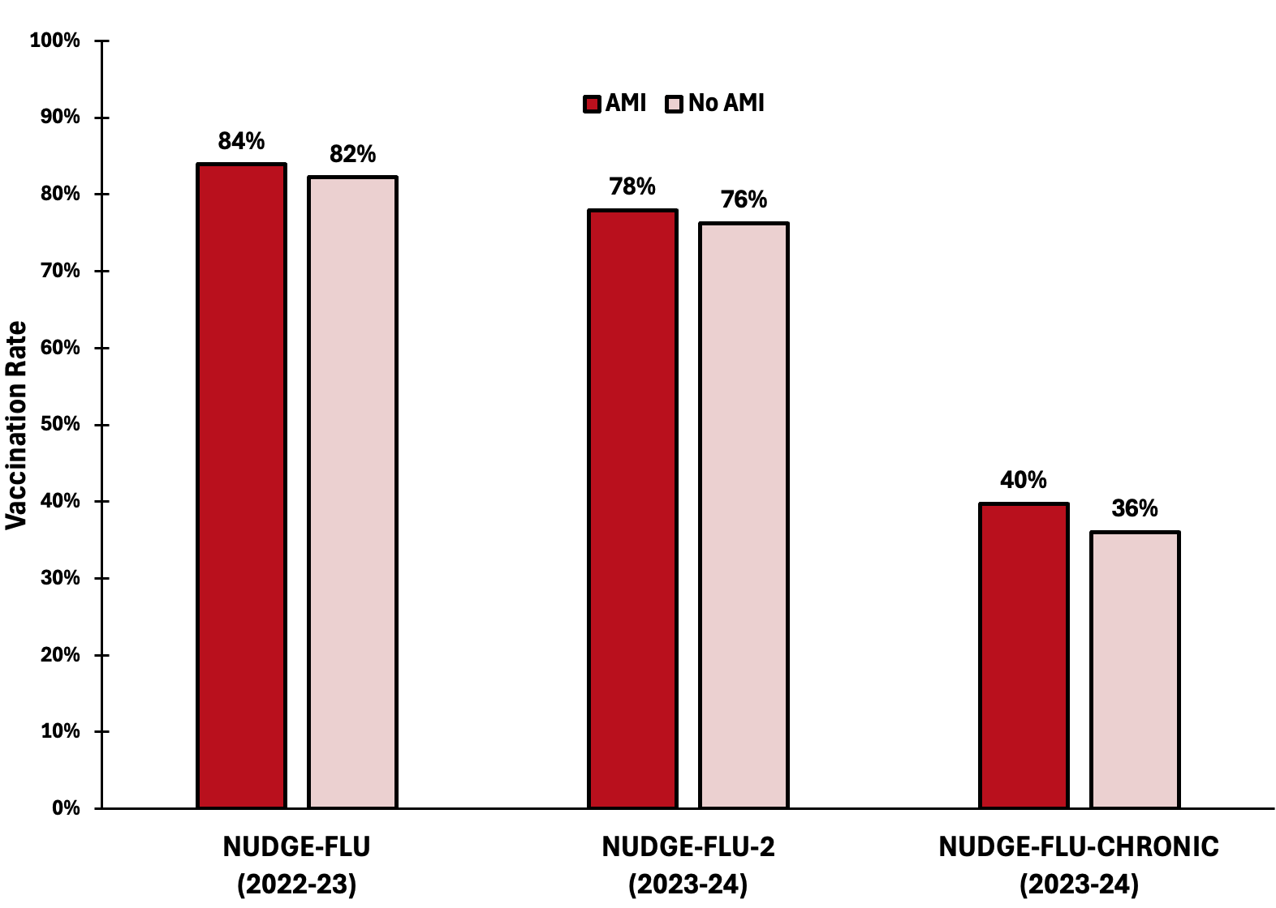
Baseline Vaccination RATES by AMI Status

Slide 12
Baseline Characteristics by AMI Status
 | NUDGE-FLU |  | NUDGE-FLU-2 |  | NUDGE-FLU-CHRONIC
Characteristic | No AMI | AMI | No AMI | AMI | No AMI | AMI
N | 939,806 | 25,064 | 858,739 | 22,634 | 28,8121 | 11,760
Age, mean (SD) | 73 (69-78) | 75 (70-79) | 73 (67-78) | 75 (70-80) | 52 (39-59) | 58 (53-61)
Male sex (%) | 48 | 72 | 47 | 71 | 46 | 78
Heart failure (%) | 2.9 | 24 | 3.0 | 24 | 3.2 | 21
Atrial fibrillation (%) | 9.6 | 20 | 9.8 | 19 | 6.5 | 7.0
Hypertension (%) | 57 | 89 | 58 | 89 | 34 | 79
Diabetes (%) | 13 | 24 | 14 | 28 | 24 | 33
COPD (%) | 4.3 | 8.9 | 4.2 | 8.5 | 3.4 | 4.1
AMI = Acute Myocardial Infarction; COPD = Chronic Obstructive Pulmonary Disease.

Slide 13
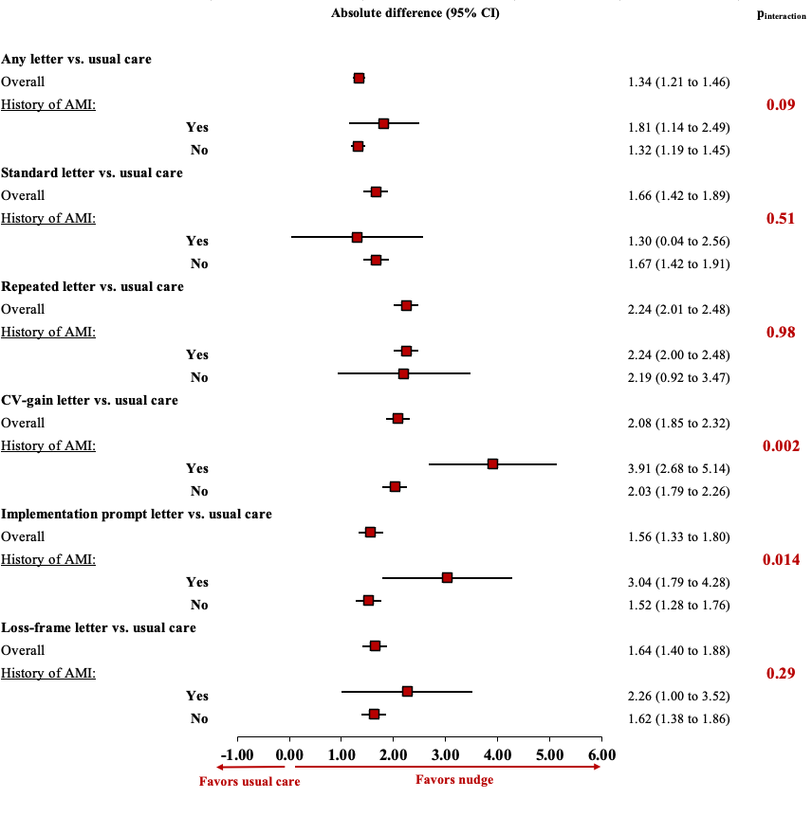
NUDGE-FLU POOLED by AMI Status
Absolute Difference (95% CI)
P_{interaction}

Slide 14
CV-Gain FRAME Nudge
CV-Gain Frame Letter:
“In addition to its protection
against influenza infection, vaccination also seems to protect against cardiovascular disease such as heart attacks and heart failure.”

Slide 15
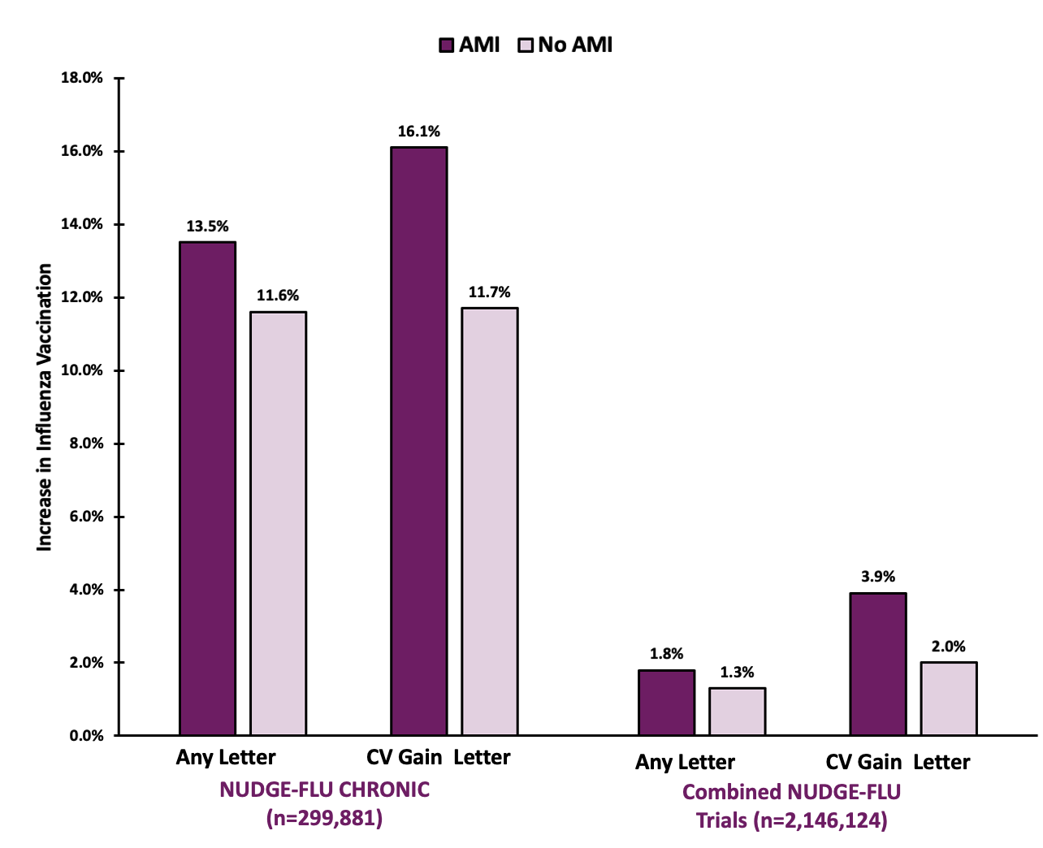



Effects of CV-Gain Nudge by AMI Status
P_{int} = 0.006
P_{int} = 0.002
P_{int} = 0.002

Slide 16
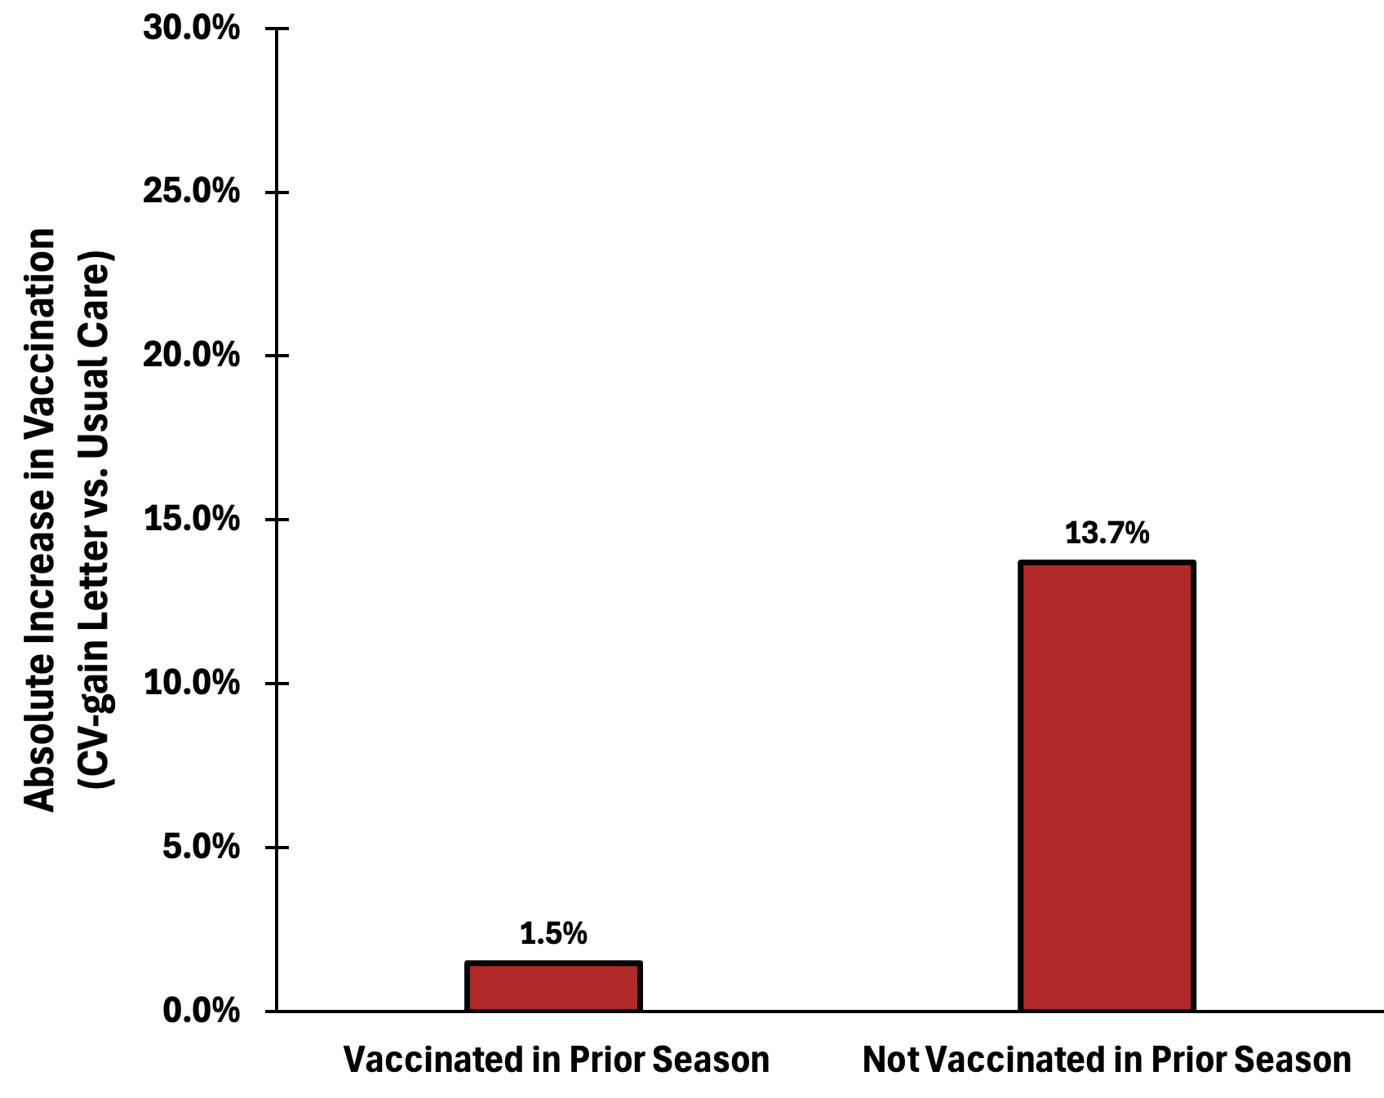
In PTS with AMI, CV-Gain Nudge was More Effective Among those Not Vaccinated in Prior Season
P_{int} = <0.001
P_{int} = <0.001
P_{int} = 0.002
P_{int} = 0.09

Slide 17
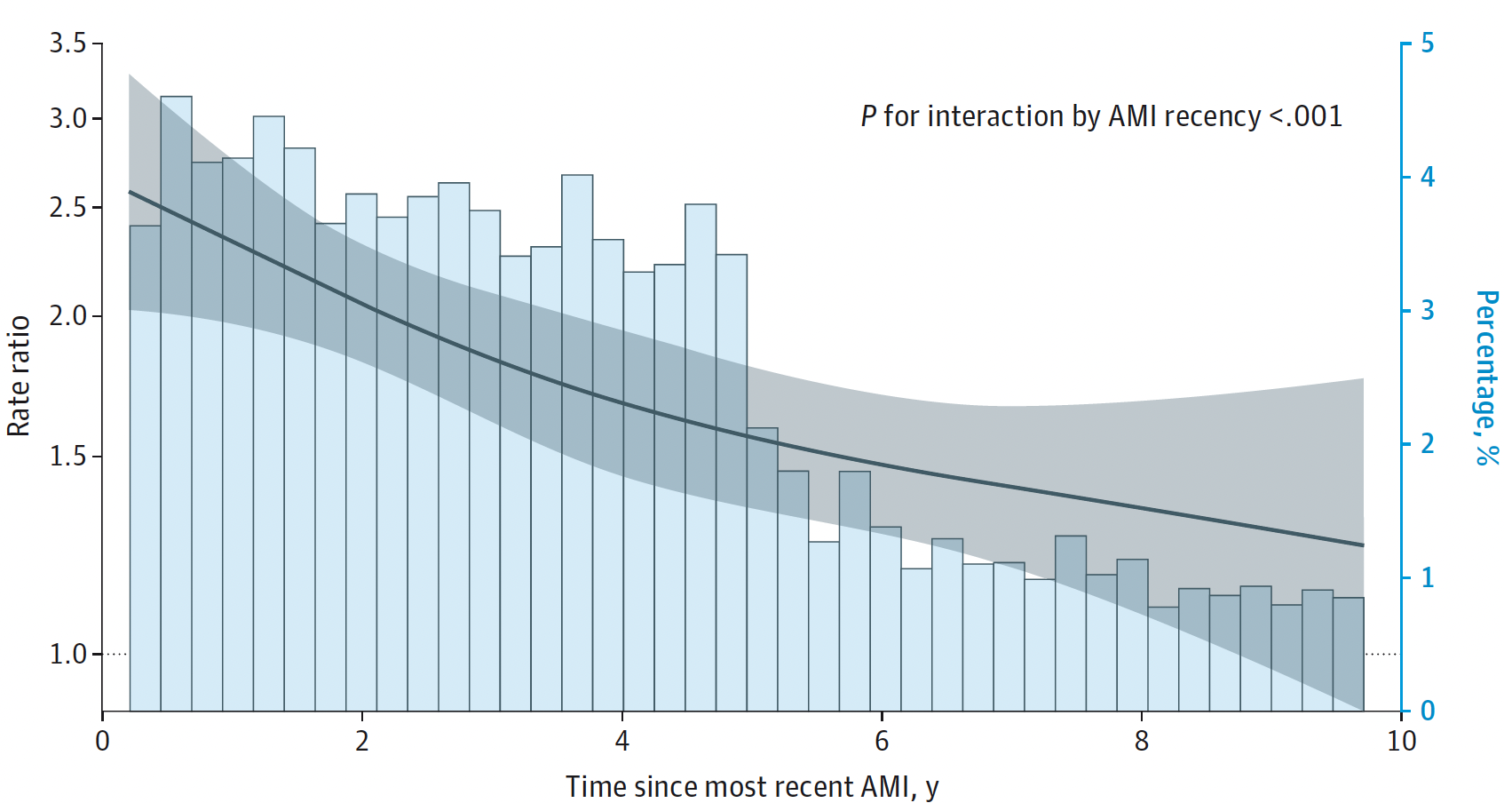
In Younger PTS, CV-Gain Nudge was More Effective Among those with More Recent AMI
NUDGE-FLU-CHRONIC
(CV-Gain vs. Usual Care)
Effect_{AMI ≤12mo} = +26%
Effect_{AMI >12mo} = +14%
P_{interaction} = 0.006

Slide 18
Conclusions
In a pooled analysis of 3 trials with >2 million patients across a broad Danish population, behaviorally informed, electronically delivered messaging emphasizing the potential cardiovascular benefits of influenza vaccination improved vaccination uptake.
Improvements were larger in patients with a history of AMI, in whom there is a strong recommendation for vaccination in clinical guidelines.
Among patients with AMI, messaging was particularly effective in potentially vaccine-hesitant populations & in younger patients with recent AMI.
If validated, a cardiovascular-focused messaging strategy should be employed as a simple, scalable, and effective tool to improve vaccination in patients
with AMI.

Slide 19
Acknowledgements
Copenhagen University Hospital
Tor Biering-Sørensen
Niklas Dyrby Johansen
Daniel Modin
Kira Hyldekær Janstrup
Pradeesh Sivapalan
Jens Ulrik Stæhr Jensen
Manan Pareek
Copenhagen University Hospital – Rigshospitalet
Lars Køber
Brigham and Women’s Hospital
Muthiah Vaduganathan
Safia Chatur
Brian L. Claggett
Scott D. Solomon
Aarhus University Hospital
Carsten Schade Larsen
Odense University Hospital
Lykke Larsen
Zealand University Hospital
Lothar Wiese
Aalborg University Hospital
Michael Dalager-Pedersen
Statens Serum Institut
Cyril Jean-Marie Martel

Slide 20

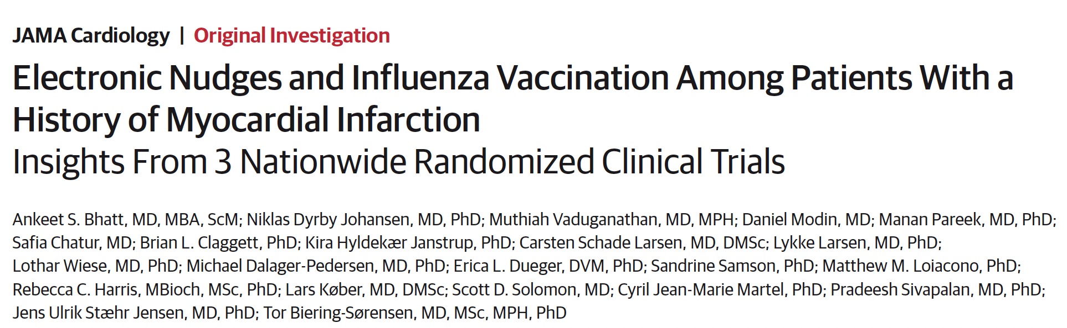

Simultaneous Publication
Published online November 17, 2024
AHA Scientific Sessions (AHASS) 2024

Slide 21
Thank you

