Slide 1
A Randomized Phase 2 Trial of an Oral Disrupter of the Assembly of Lipoprotein(a) Particles
Stephen J. Nicholls¹, Wei Ni², Grace M. Rhodes², Steven E. Nissen³, Ann Marie Navar⁴, Laura F. Michael², Axel Haupt² and John H. Krege²
¹Victorian Heart Institute, Monash University, Melbourne, Australia
²Eli Lilly and Company, Indianapolis, USA
³Cleveland Clinic Coordinating Center for Clinical Research, Cleveland Clinic, Cleveland, USA
⁴UT Southwestern Medical Center, Dallas, USA

Slide 2
Disclosures
Research support: AstraZeneca, Amgen, Anthera, Eli Lilly, Esperion, Novartis, Cerenis, The Medicines Company, Resverlogix, InfraReDx, Roche, Sanofi-Regeneron and LipoScience
Consulting and honoraria: AstraZeneca, Akcea, Eli Lilly, Anthera, Omthera, Merck, Takeda, Resverlogix, Sanofi-Regeneron, CSL Behring, Esperion, Boehringer Ingelheim, Cyclarity, Daiichi Sankyo, CSL Seqirus, Vaxxinity

Slide 3
Lp(a) and Cardiovascular Disease
Lp(a) likely plays a causal role in both atherosclerotic and calcific aortic valve disease.
Oxidized phospholipids carried on Lp(a) may confer its additional cardiovascular risk.
There are currently no pharmacological therapies approved to lower Lp(a) levels.
Most therapies in development are injectable nucleic acid based agents that inhibit apo(a) synthesis.

Slide 4
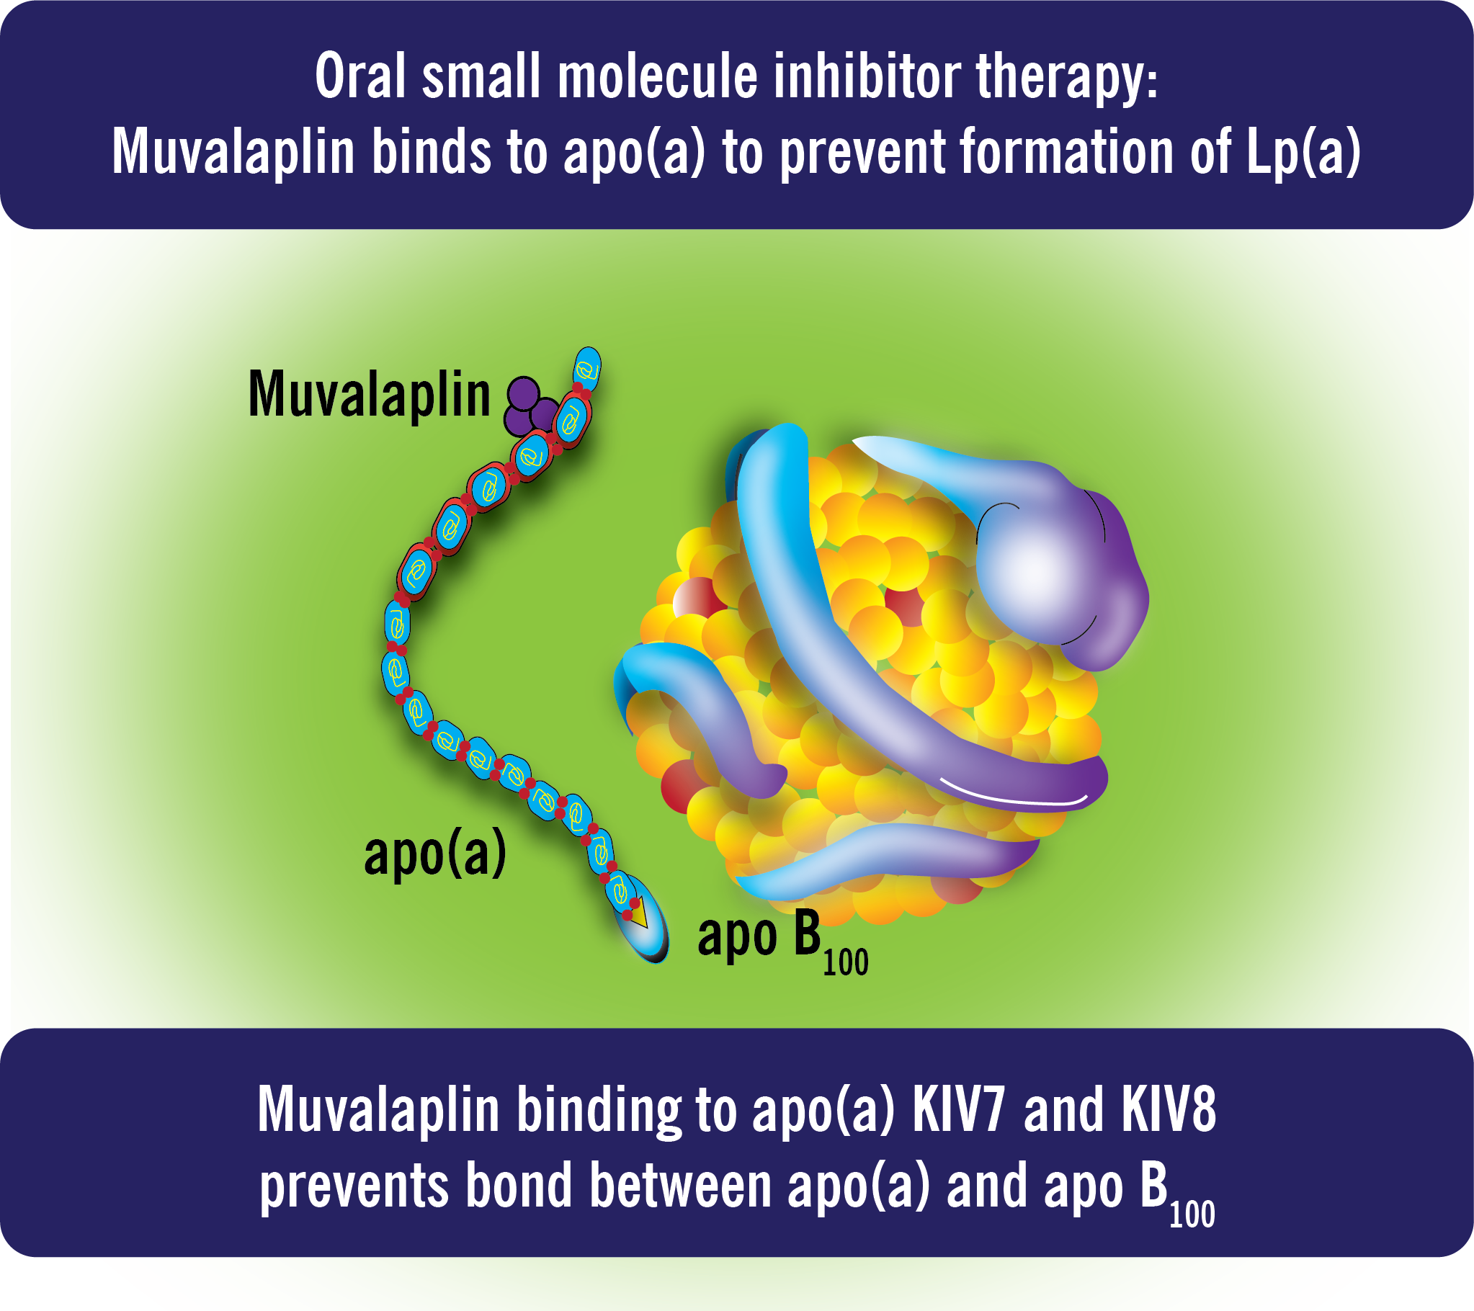
Role of Muvalaplin in Lp(a) Inhibition
Muvalaplin is an oral agent that disrupts bonding of apo(a) and apoB leading to reduced formation of Lp(a).
Daily oral muvalaplin up to 800 mg for 14 days was well tolerated and demonstrated placebo adjusted Lp(a) lowering by up to 65% in a phase 1 study.

Slide 5
Objective
To evaluate the dose effects of muvalaplin on Lp(a) levels, safety and tolerability in a phase 2 trial of patients with elevated Lp(a) levels and high risk for cardiovascular events

Slide 6
Study Design
Participants ≥40 years of age
High risk for cardiovascular events
Coronary artery disease
Ischemic stroke
Peripheral artery disease
Type 2 diabetes
Familial hypercholesterolemia
Serum Lp(a) ≥175 nmol/L
Stable dose of lipid-lowering therapy for at least 4 weeks

Slide 7
Measurement of Lp(a)
Current commercially available Lp(a) assays use antibodies to apo(a) to estimate Lp(a) levels – apo(a) assay.
These assays will also detect free apo(a) and apo(a) bound to muvalaplin, overestimating Lp(a) levels with treatment.
A sandwich assay using antibodies to apo(a) and apoB can detect intact Lp(a) particles with apo(a) bound to apoB – intact Lp(a) assay.
The primary analysis evaluated the changes in Lp(a) from baseline to week 12 using both Lp(a) assays.

Slide 8
Demographics
Parameter | Placebo (N=67) | Muvalaplin
 |  | 10 mg (N=34) | 60 mg (N=64) | 240 mg (N=68)
Age (yrs) | 63.0 | 66.5 | 67.0 | 66.0
Females (%) | 28.4 | 32.4 | 34.4 | 35.3
BMI (kg/m²) | 27.6 | 27.5 | 27.4 | 26.1
Coronary disease (%) | 65.7 | 79.4 | 76.6 | 73.5
Stroke (%) | 6.0 | 5.9 | 3.1 | 7.4
Type 2 diabetes (%) | 22.4 | 32.4 | 37.5 | 41.2
Familial hypercholesterolemia (%) | 10.4 | 5.9 | 9.4 | 14.7
Statin use (%) | 89.6 | 100 | 87.5 | 91.2

Slide 9
Baseline Biochemistry
Parameter |  | Placebo (N=67) | Muvalaplin
 |  |  | 10 mg (N=34) | 60 mg (N=64) | 240 mg (N=68)
Lp(a)
 | Intact assay (nmol/L) | 234.2 | 211.0 | 198.2 | 223.5
 | Apo(a) assay (nmol/L) | 252.9 | 258.2 | 238.8 | 259.4
LDL cholesterol (mg/dL) |  | 70.7 | 78.0 | 70.3 | 69.7
ApoB (mg/dL) |  | 75.5 | 79.5 | 74.2 | 77.3
hsCRP (mg/L) |  | 1.0 | 1.5 | 1.0 | 0.8

Slide 10
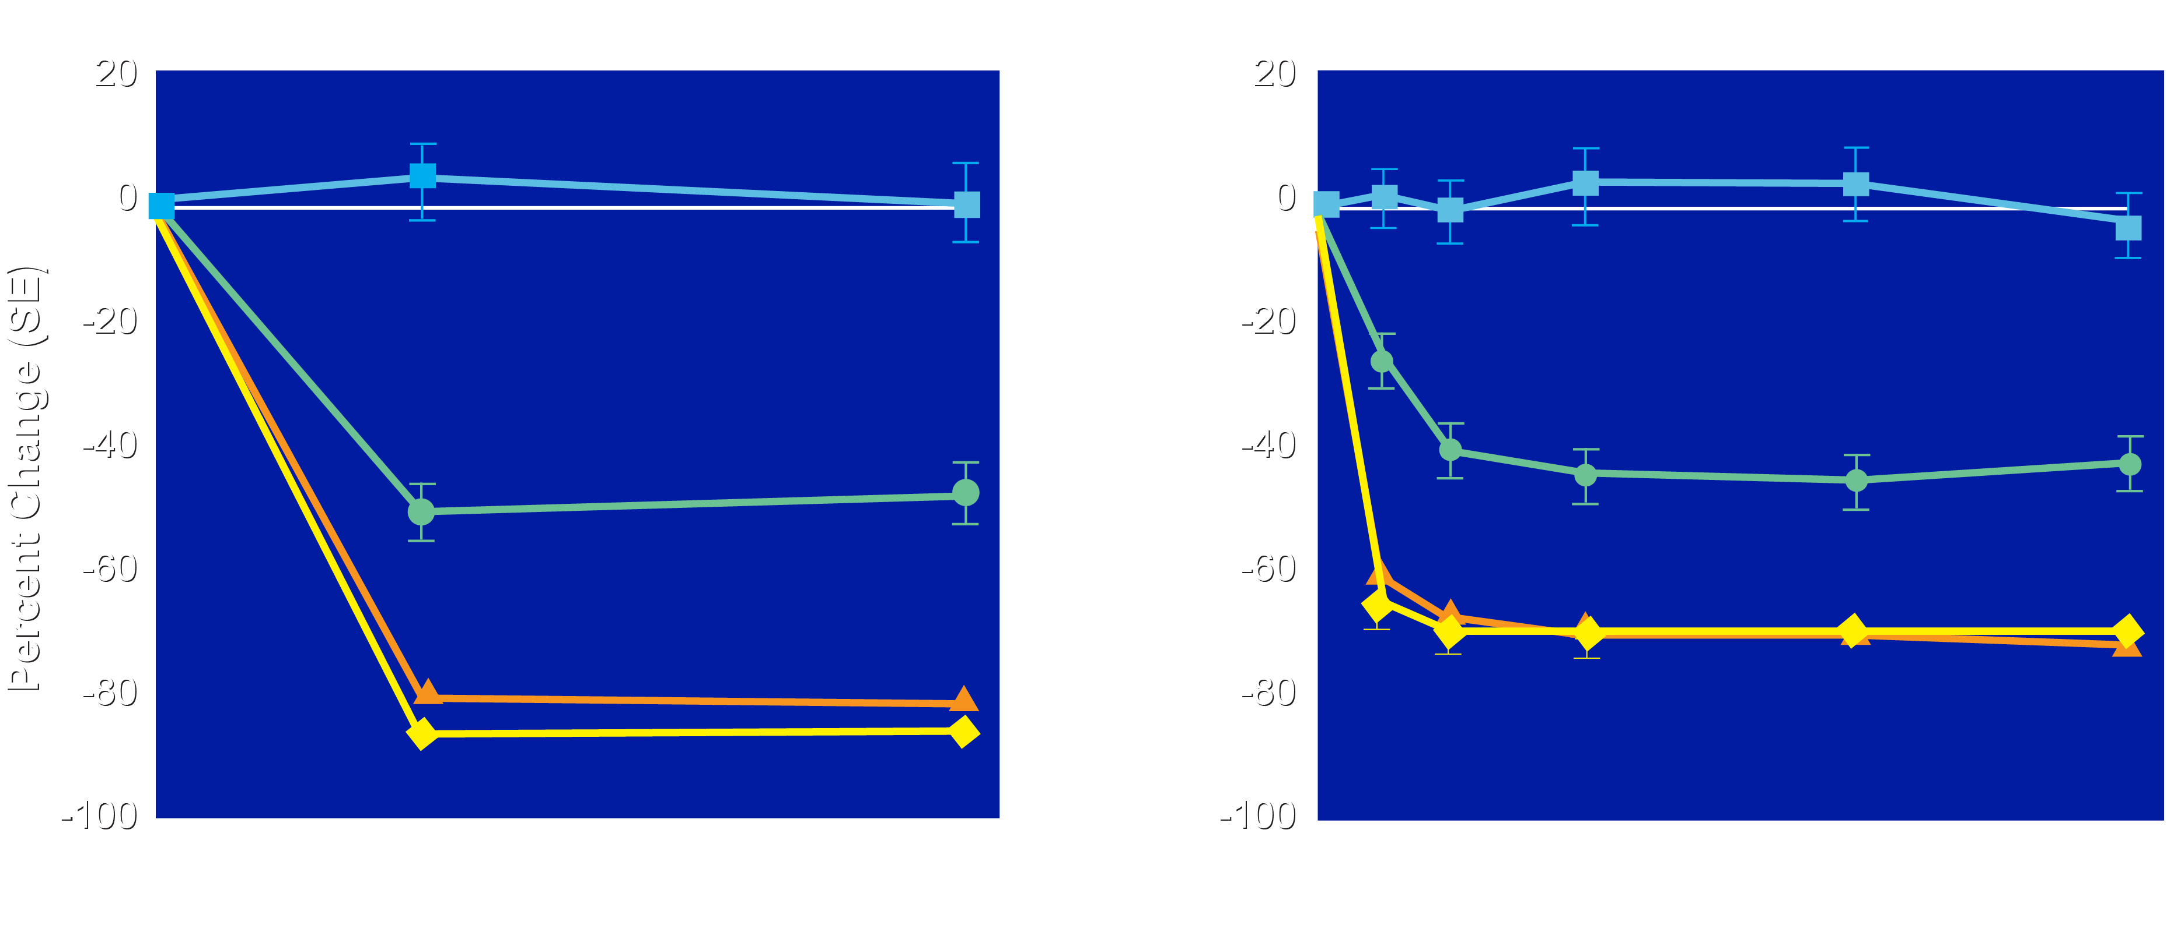
Percent Change in Lp(a) with Muvalaplin
Percent Change in Lp(a) Concentration (Intact Lp(a) Assay)
Percent Change in Lp(a) Concentration (Apo(a) Assay)
Placebo
Muvalaplin 10 mg
Muvalaplin 60 mg
Muvalaplin 240 mg
Placebo
Muvalaplin 10 mg
Muvalaplin 60 mg
Muvalaplin 240 mg

Slide 11
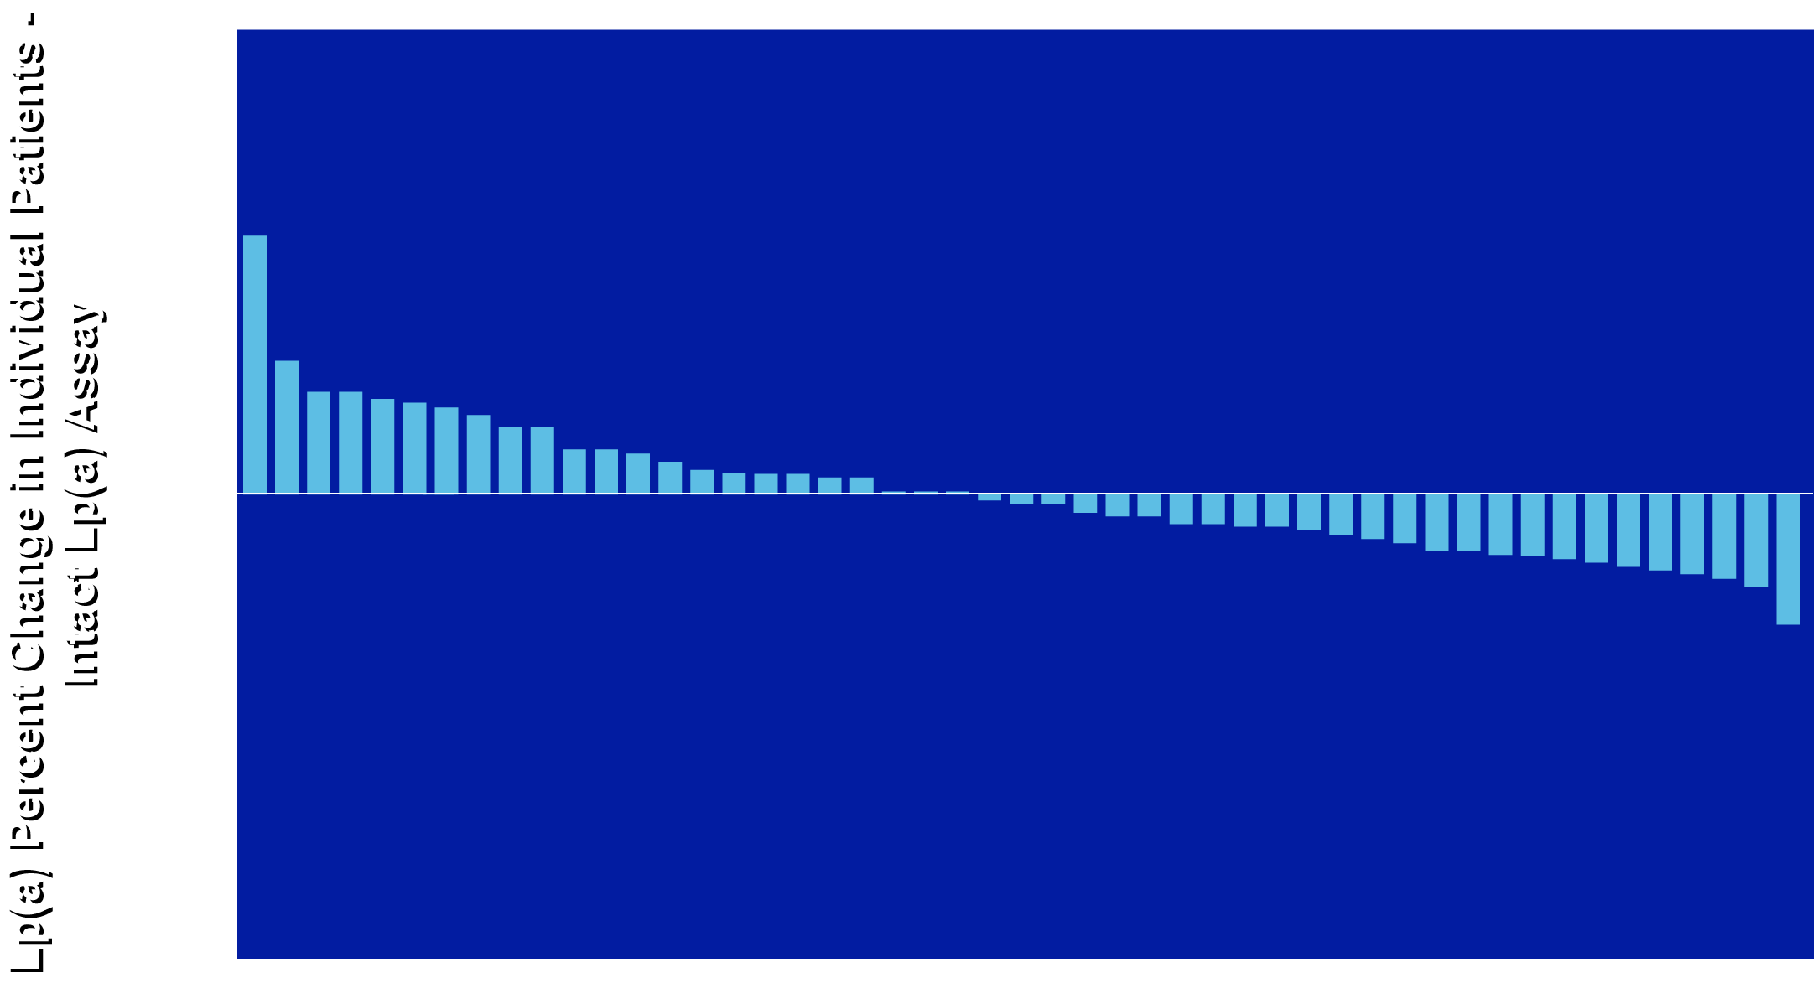
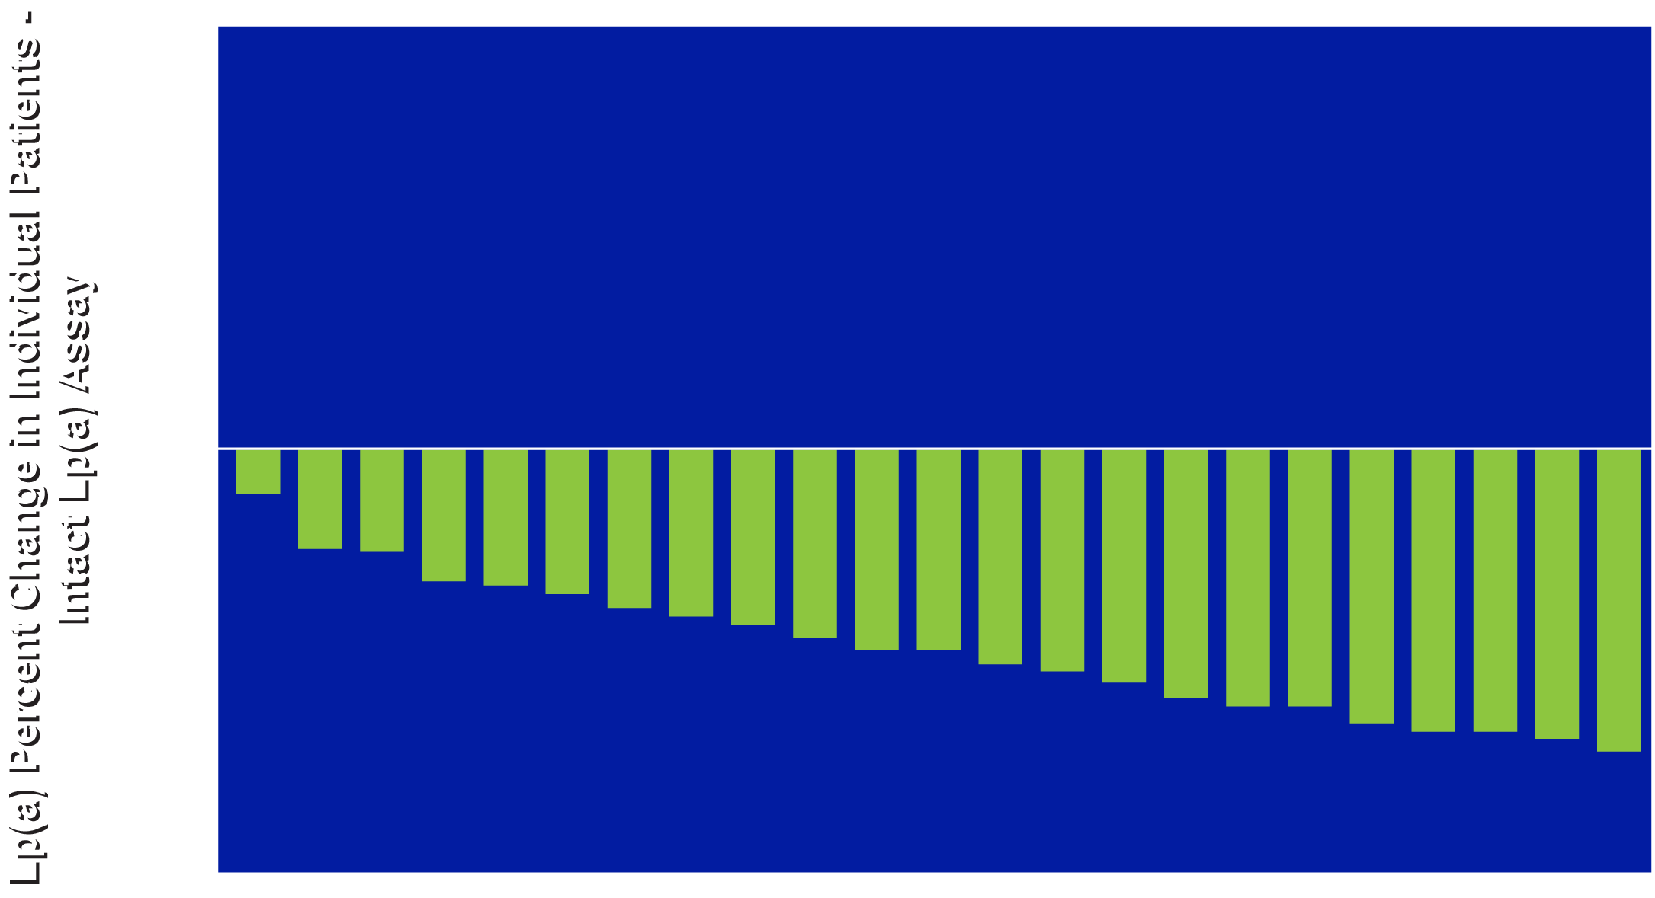
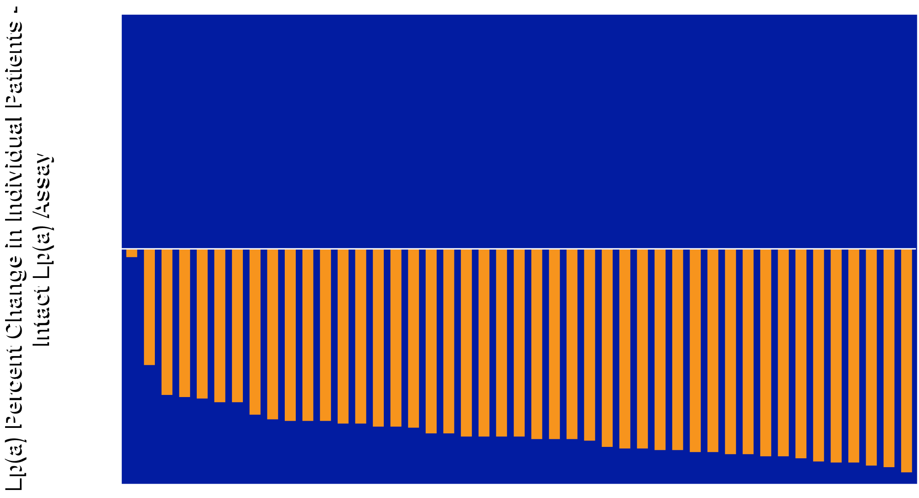
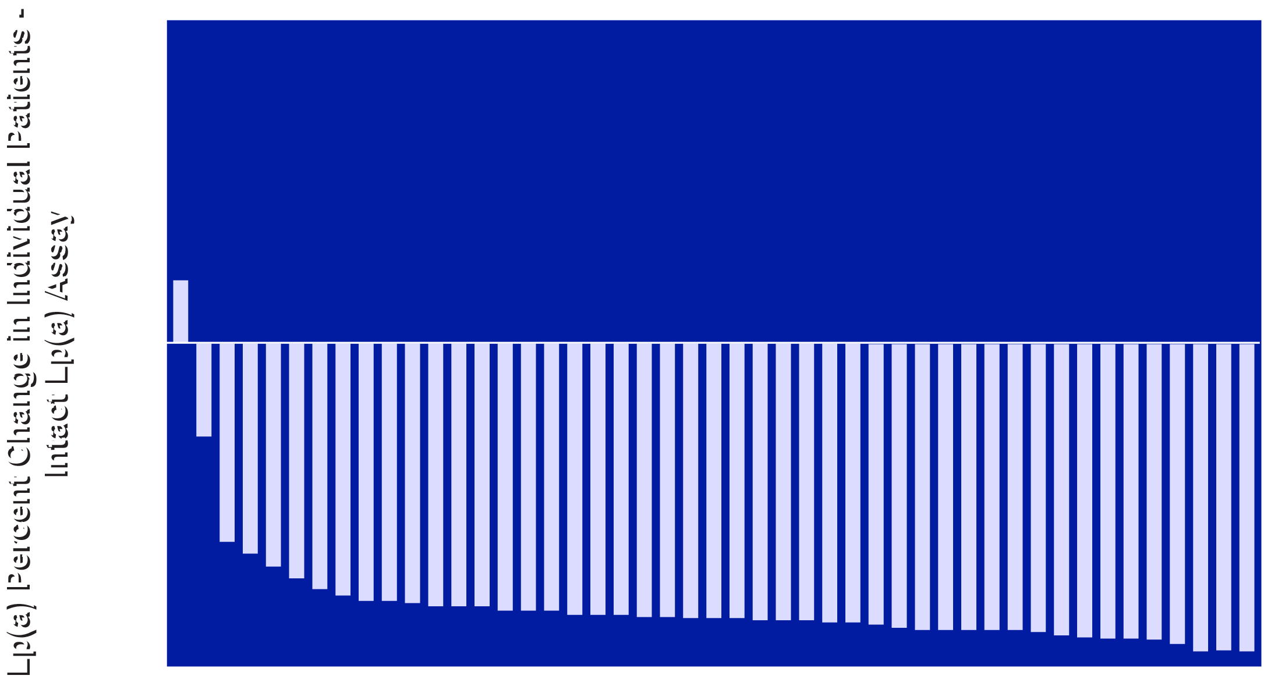
Individual Changes in Lp(a) Using the Intact Lp(a) Assay at Week 12
Placebo
Muvalaplin 10mg
Muvalaplin 60mg
Muvalaplin 240mg

Slide 12
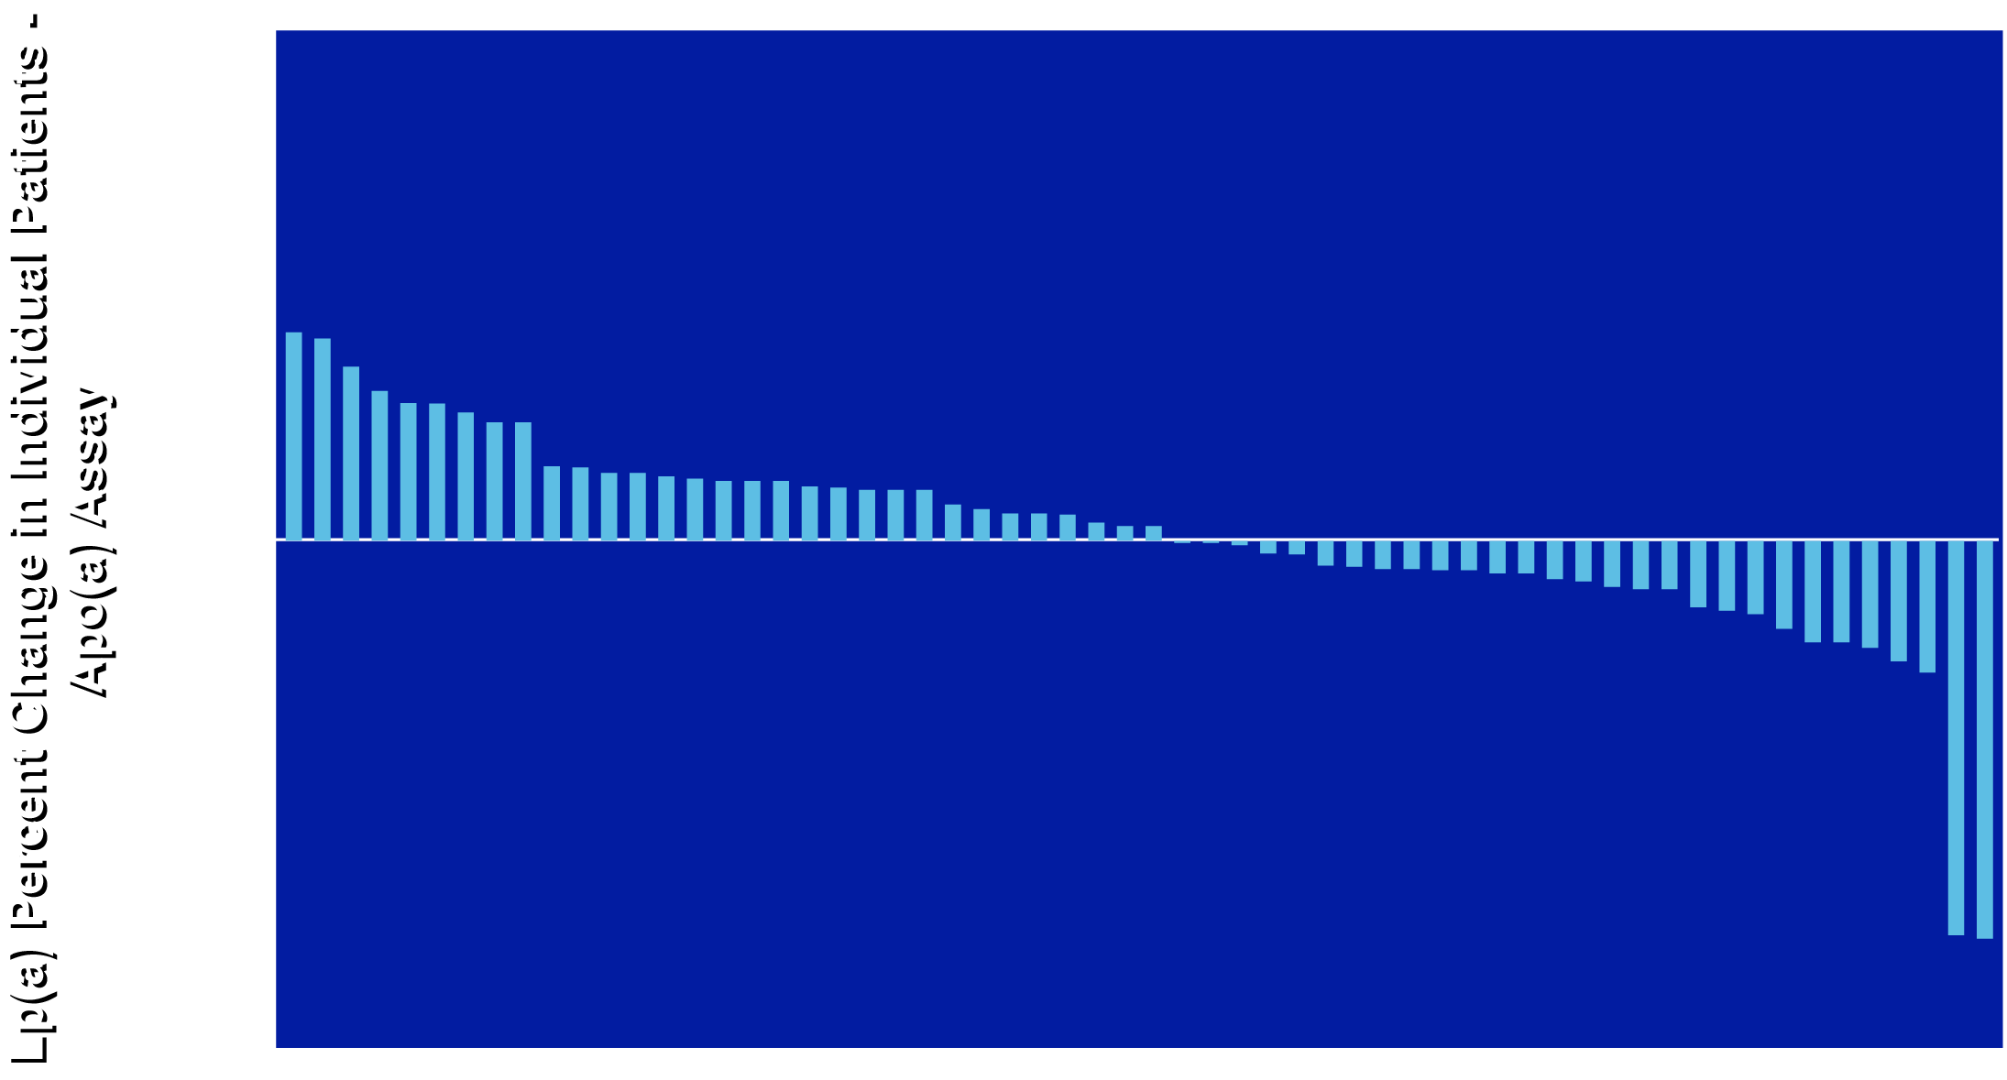
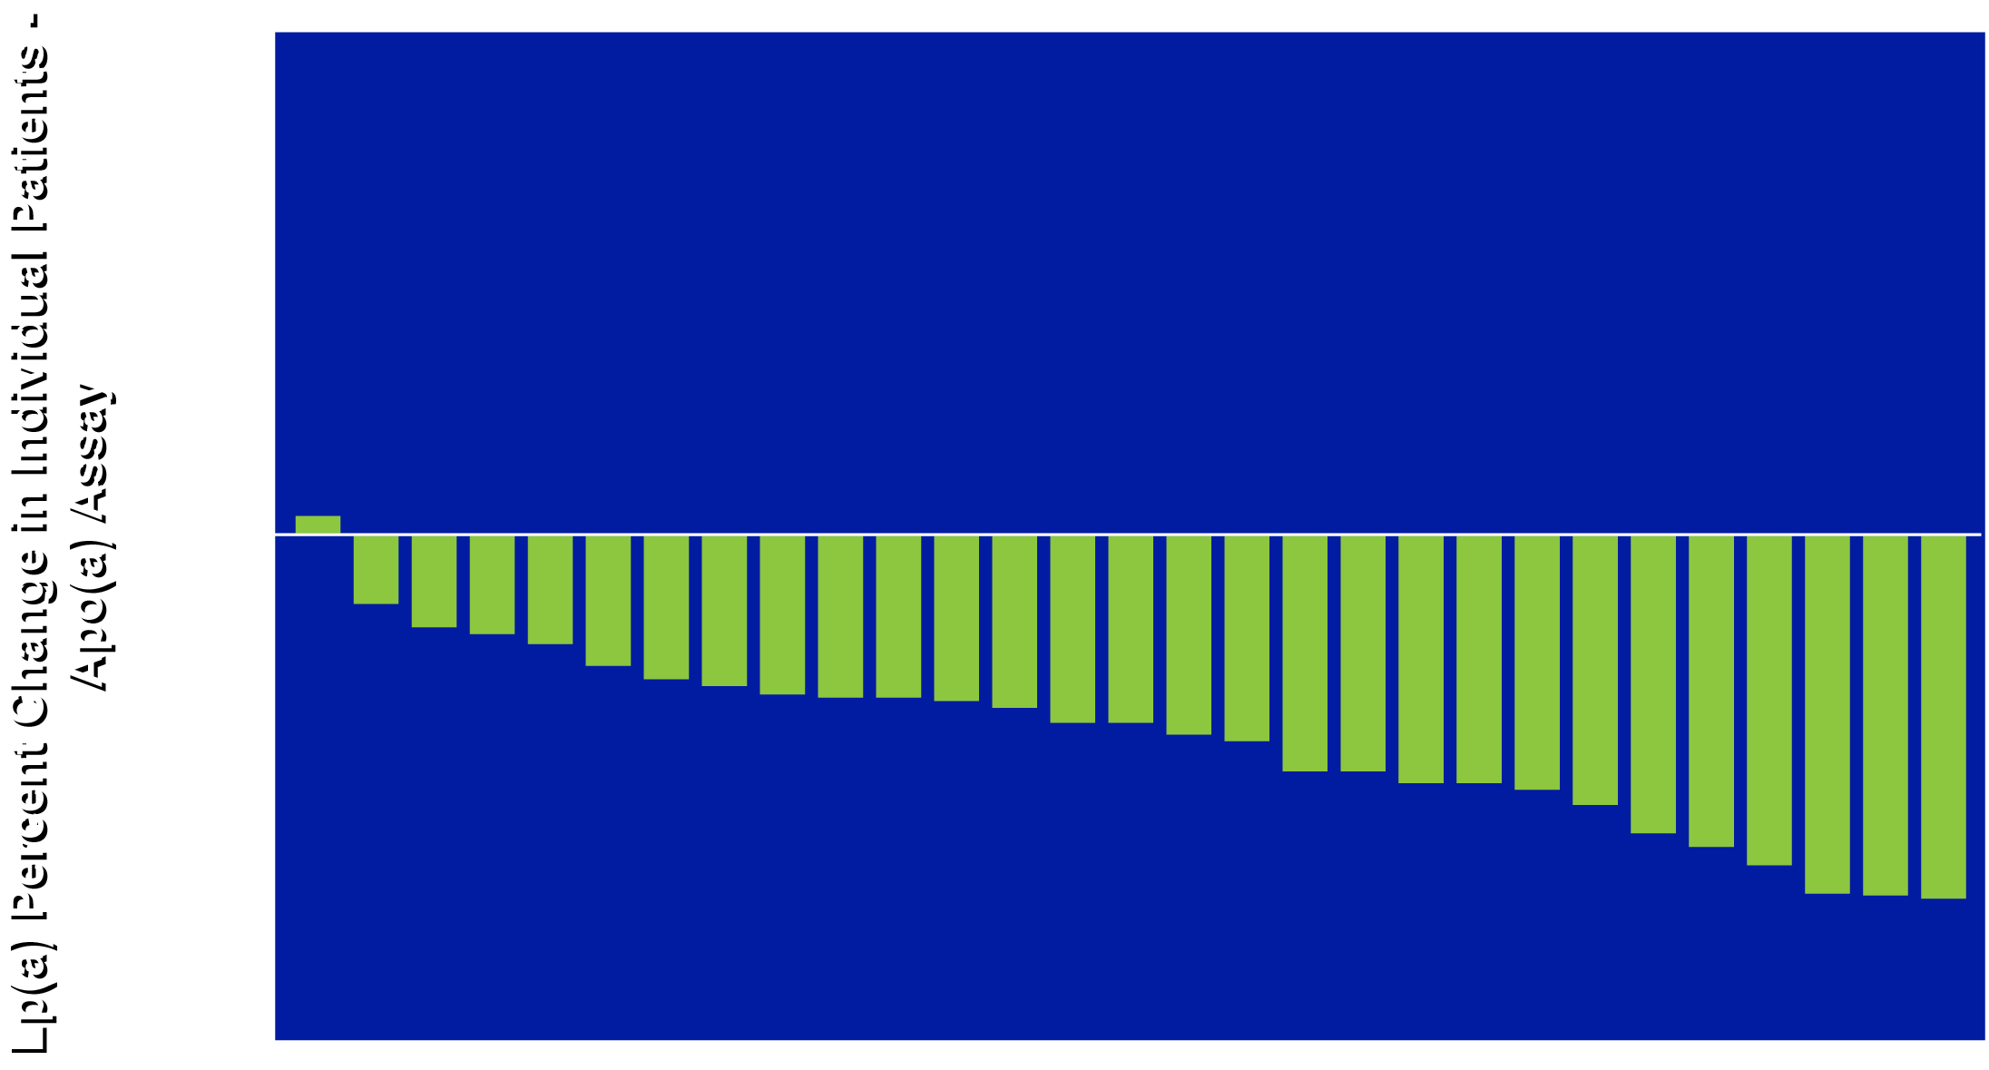
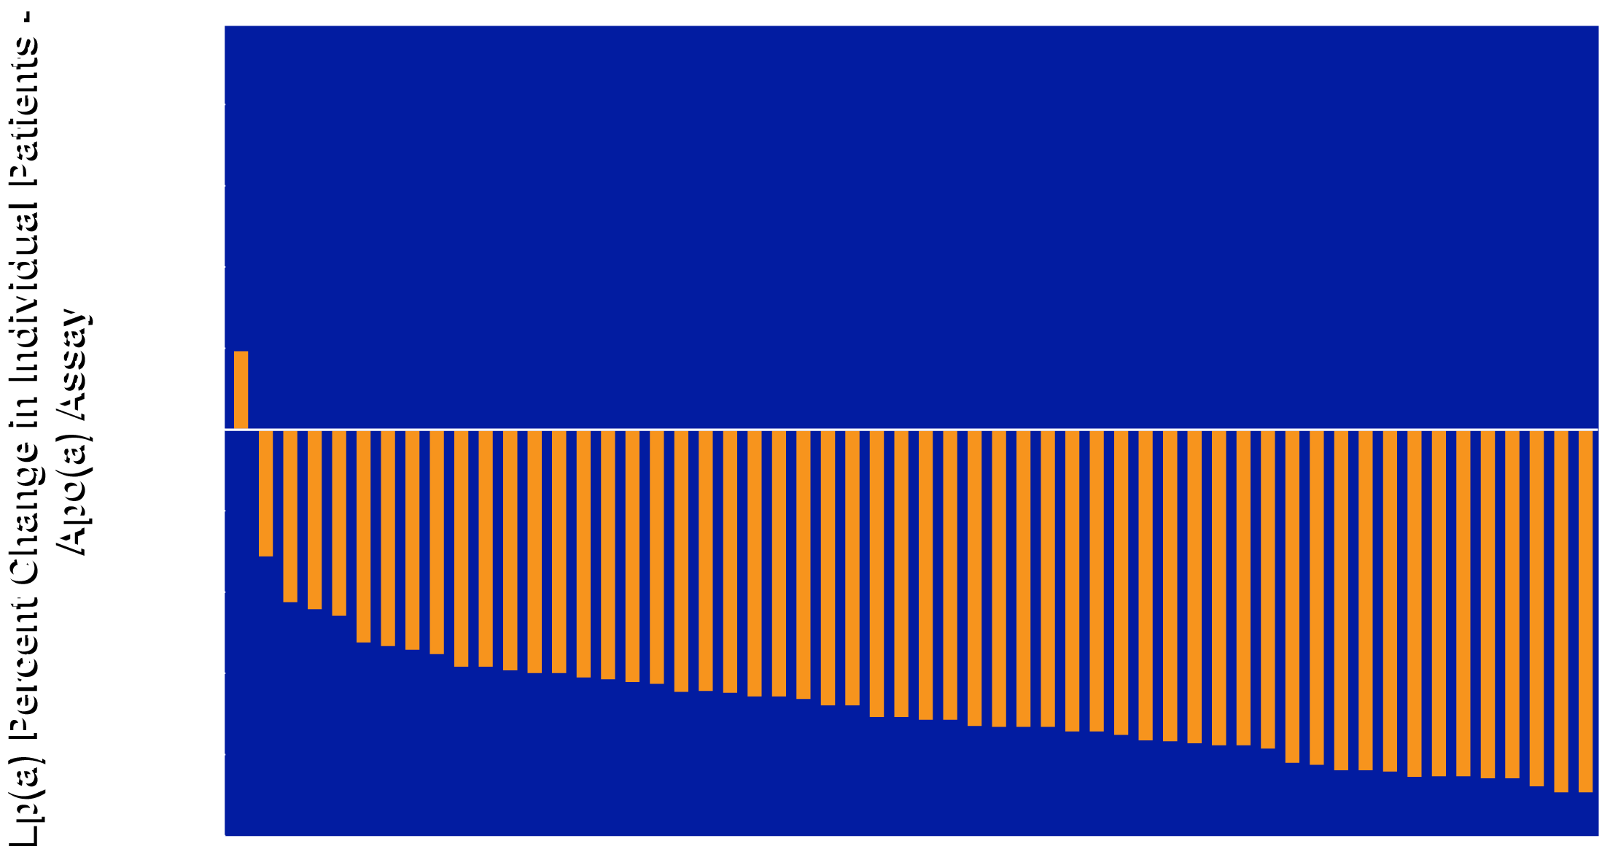
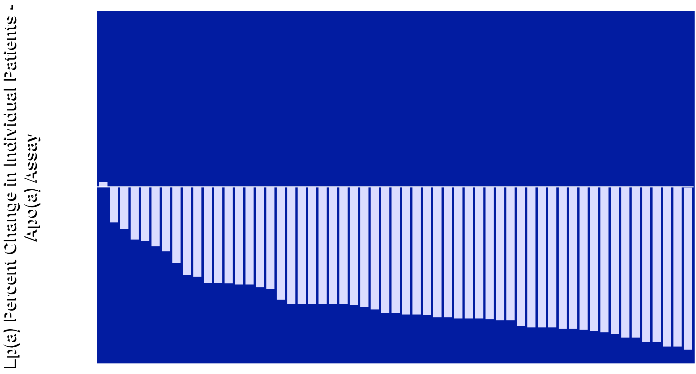
Individual Changes in Lp(a) Using the Apo(a) Assay at Week 12
Placebo
Muvalaplin 10mg
Muvalaplin 60mg
Muvalaplin 240mg

Slide 13
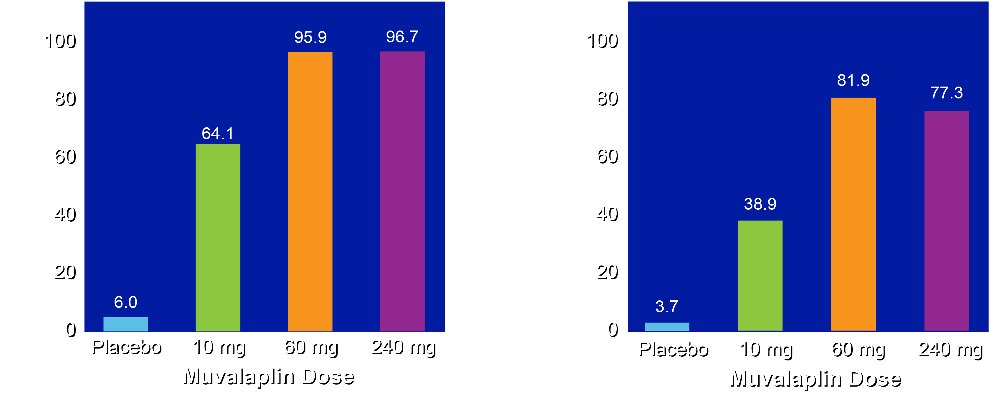
Percent of Patients Achieving a Lp(a) <125 nmol/L with Muvalaplin
Patients with Lp(a)
Concentration <125 nmol/L at Week 12
(Intact Lp(a) Assay)
Patients with Lp(a)
Concentration <125 nmol/L at Week 12
(Apo(a) Assay)

Slide 14
Percentage Change in Biochemical Parameters at Week 12
Parameter | Placebo (N=67) | Muvalaplin
 |  | 10 mg (N=34) | 60 mg (N=64) | 240 mg (N=68)
LDL cholesterol (%) | 1.7 | -9.7 | -14.6 | -20.0
ApoB (%) | -1.7 | -10.5 | -14.5 | -17.6
hsCRP (%) | -9.9 | 21.9 | -2.4 | -15.4

Slide 15
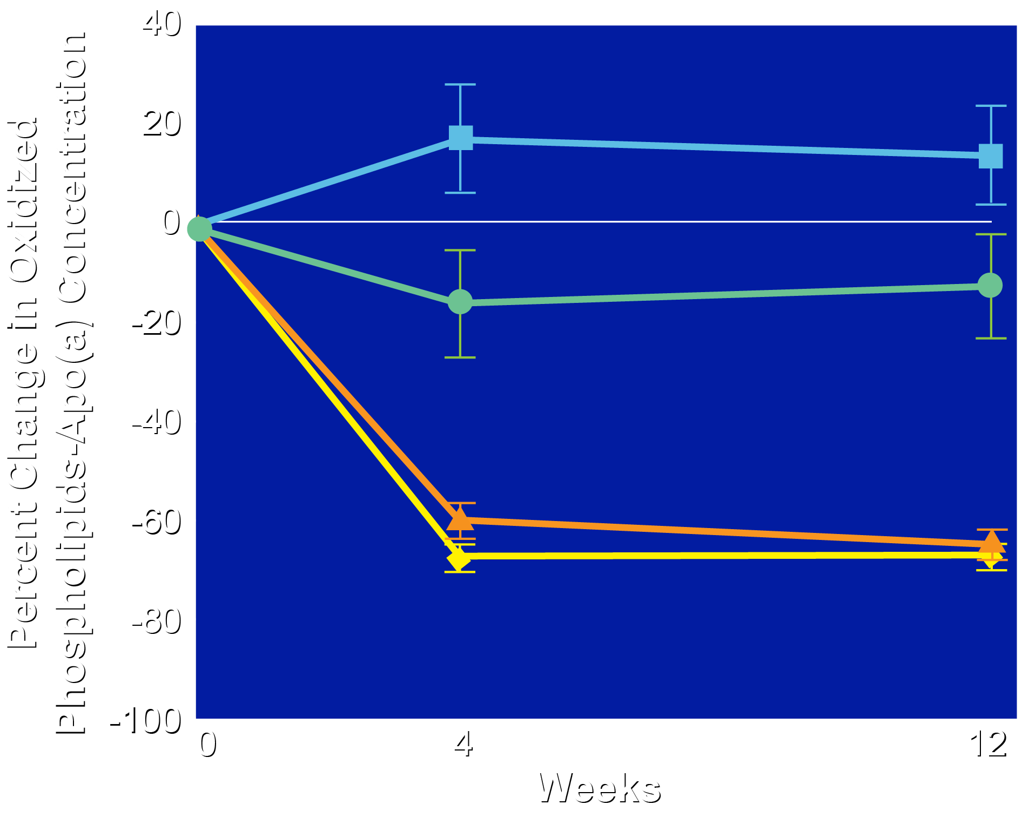
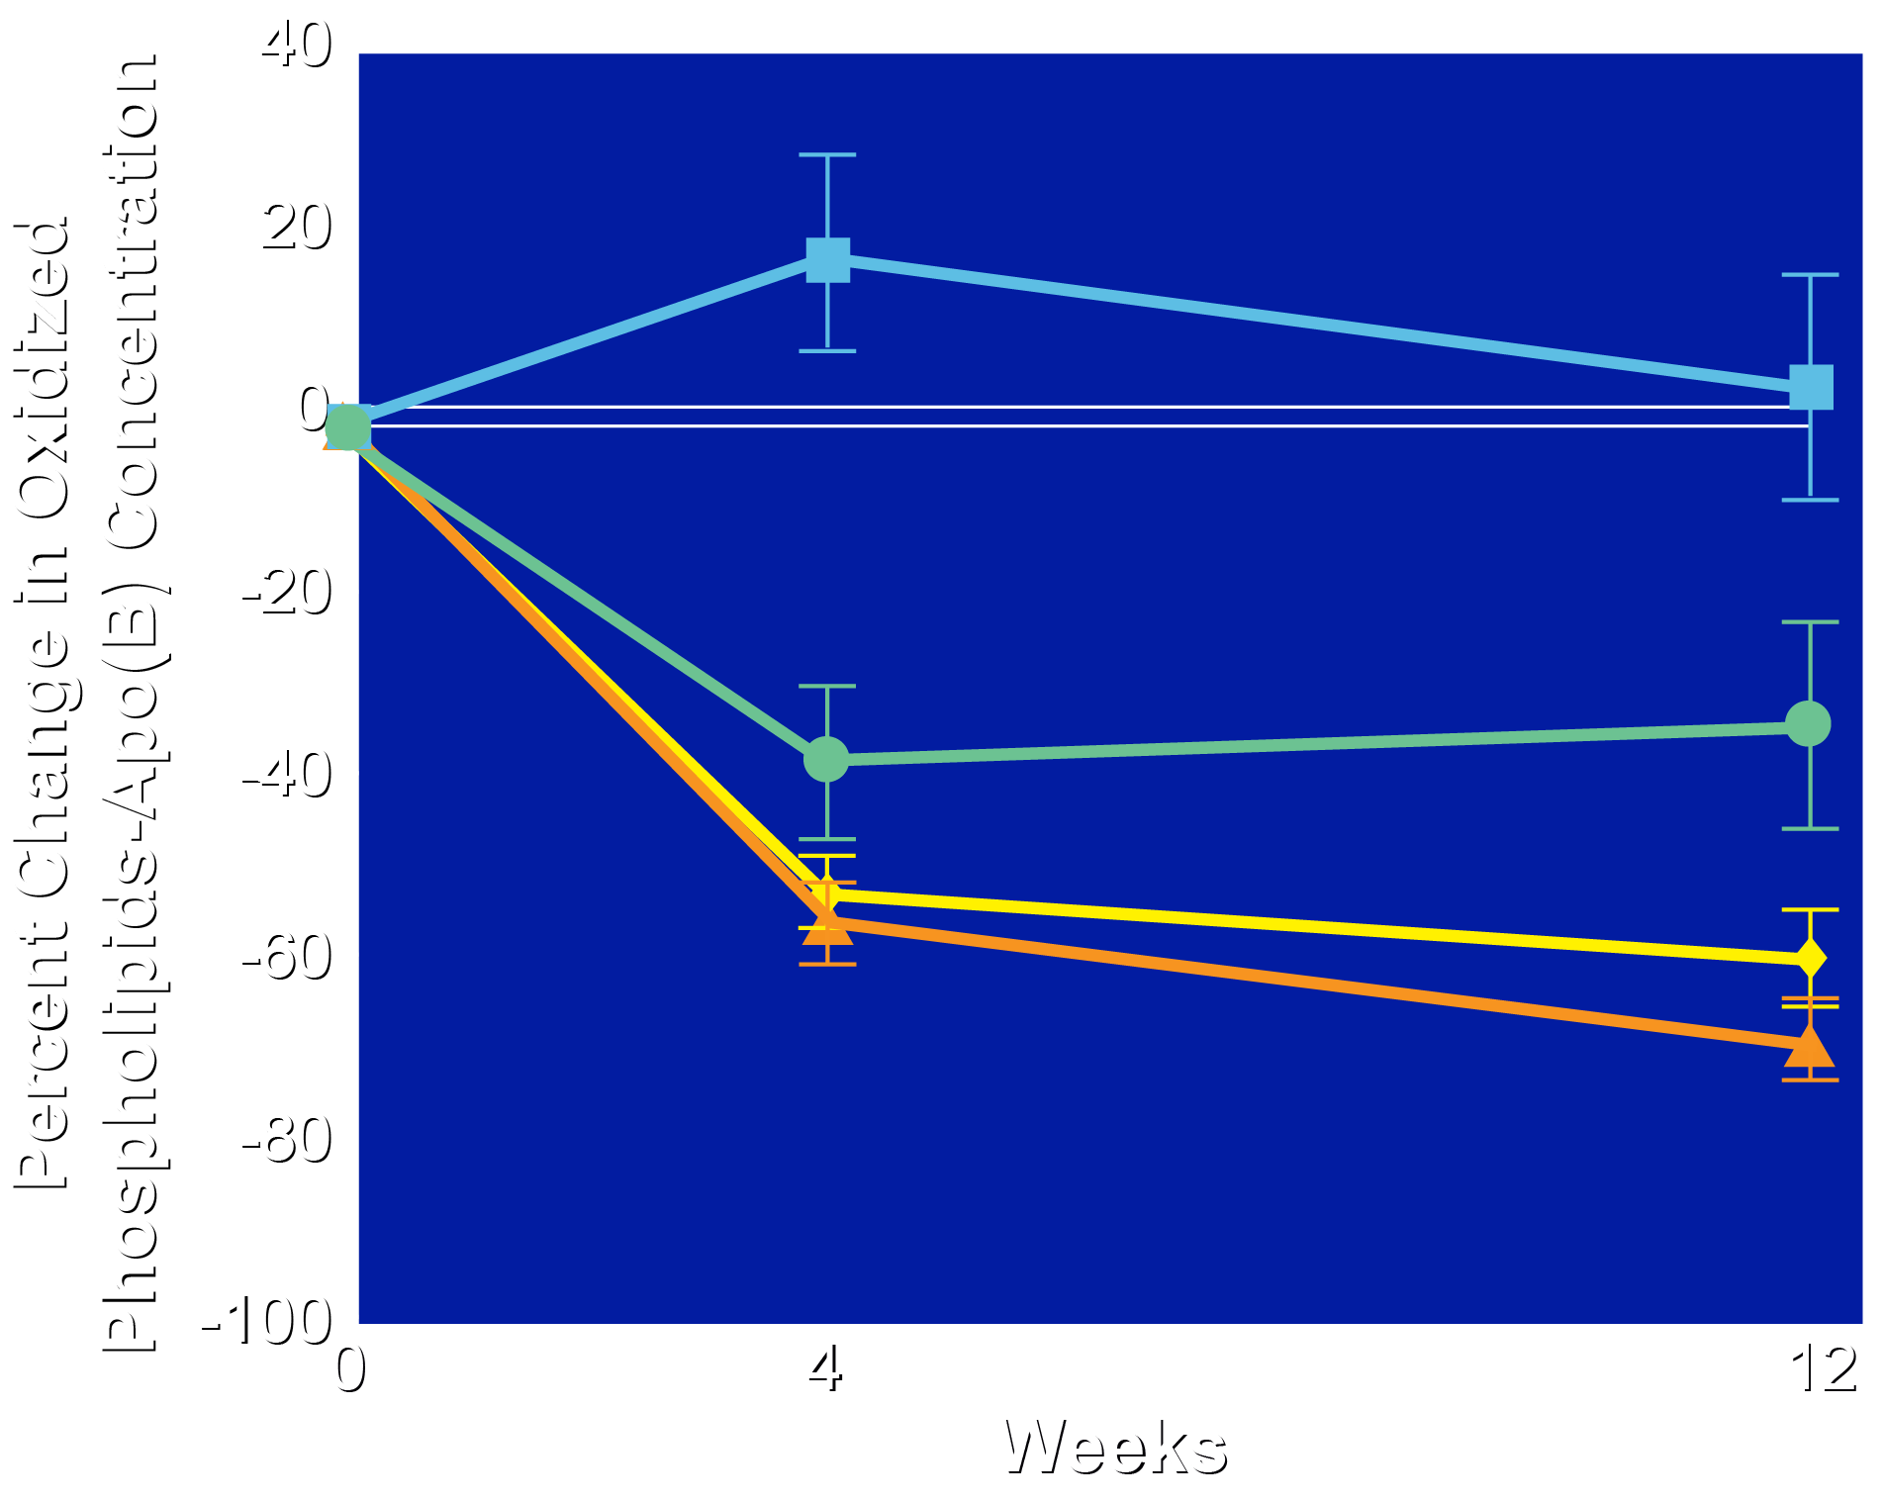
Effect of Muvalaplin on Levels of Oxidized Phospholipids
oxPL-apo(a)
oxPL-apoB
Placebo
Muvalaplin 10 mg
Muvalaplin 60 mg
Muvalaplin 240 mg
Placebo
Muvalaplin 10 mg
Muvalaplin 60 mg
Muvalaplin 240 mg

Slide 16
Safety and Tolerability
Parameter |  | Placebo (N=67) | Muvalaplin
 |  |  | 10 mg (N=34) | 60 mg (N=64) | 240 mg (N=68)
Adverse events (%) |  | 52.2 | 52.9 | 49.2 | 51.5
 | Related to treatment (%) | 14.9 | 5.9 | 14.3 | 14.7
 | Leading to discontinuation (%) | 1.5 | 0 | 0 | 8.8
Serious adverse events (%) |  | 6.0 | 5.9 | 3.2 | 2.9
AST >3x ULN (%) |  | 0 | 0 | 0 | 1.5
ALT >3x ULN (%) |  | 1.5 | 0 | 3.2 | 1.5
Change plasminogen activity (%) |  | 3.0 | -1.5 | 0.7 | 0.9

Slide 17
Limitations
As the study evaluated the effect of muvalaplin for 12 weeks the impact of longer treatment requires further evaluation.
The intact Lp(a) assay is not yet available in clinical practice and continues to undergo validation.
It remains to be determined if apo(a) bound to muvalaplin has any biological effects.
The primary analysis excluded those who permanently discontinued study drug, although a modified intent to treat analysis showed similar Lp(a) lowering.
Whether Lp(a) lowering reduces CV risk and the degree of lowering required for such benefit remains to be determined.

Slide 18
Summary
Muvalaplin resulted in placebo-adjusted reductions in Lp(a) by up to 85.8% with the intact Lp(a) assay and by up to 70.0% with the traditional apo(a) assay.
Muvalaplin resulted in placebo-adjusted reductions in apoB by up to 16.1% and LDL cholesterol by up to 21.3%.
Muvalaplin resulted in placebo-adjusted reductions in oxidized phospholipids associated with apo(a) by up to 73.0% and apoB by up to 67.2%.
Muvalaplin was well tolerated by patients.
The longer term impact of muvalaplin on Lp(a) levels and cardiovascular outcomes will require additional studies.

Slide 19
Stephen J. Nicholls, MBBS, PhD; Wei Ni, PhD; Grace M. Rhodes, PhD; Steven E. Nissen, MD; Ann Marie Navar, MD, PhD; Laura F. Michael, PhD; Axel Haupt, MD, PhD; John H. Krege, MD
Oral Muvalaplin for Lowering of Lipoprotein(a)
A Randomized Clinical Trial
Published online November 18, 2024
American Heart Association Scientific Sessions

