Slide 1
Early and Long Term Colchicine After Acute Myocardial Infarction: CLEAR SYNERGY OASIS 9
Sanjit Jolly MD, MSc on behalf of CLEAR investigators

Slide 2
Disclosure of Relevant Financial Relationships
Within the prior 24 months, I have had a financial relationship with
a company producing, marketing, selling, re-selling, or distributing healthcare products used by or on patients:
Nature of Financial Relationship | Ineligible Company
Grant/Research Support | Boston Scientific
Consultant Fees/Honoraria | Teleflex, Asahi, Shockwave, Abiomed
Individual Stock(s)/Stock Options | None
Royalties/Patent Beneficiary | None
Executive Role/Ownership Interest | None
Other Financial Benefit | None
All relevant financial relationships have been mitigated.
Faculty disclosure information can be found on the app

Slide 3
CLEAR SYNERGY OASIS 9 Funding
Funded by grants CIHR, PHRI and Boston Scientific

Slide 4
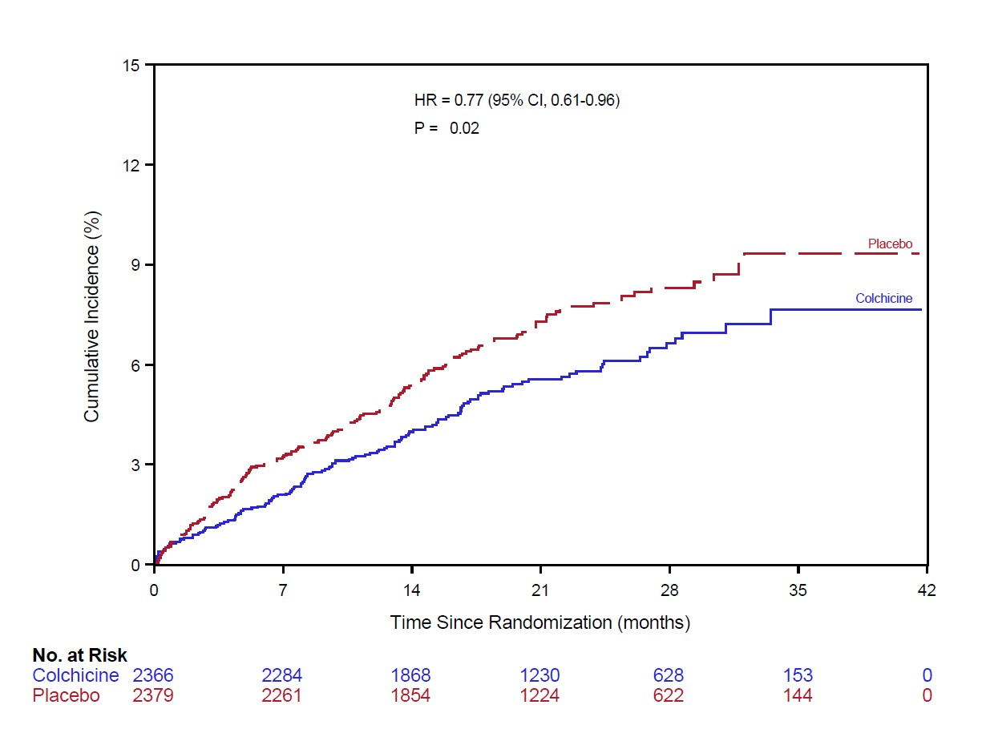
Two Recent Trials Showing Benefit for Colchicine in CAD
COLCOT- Acute MI (N=4745, 301 events)
LODOCO2- stable CAD (N=5522, 451 events)
Hazard ratio 0.77 (95% CI 0.61-0.96)
Tardif JC, et al. NEJM. 2019;381:2497-2505.
Nidorf M, et al. NEJM 2020; 5;383(19):1838-1847.

Slide 5
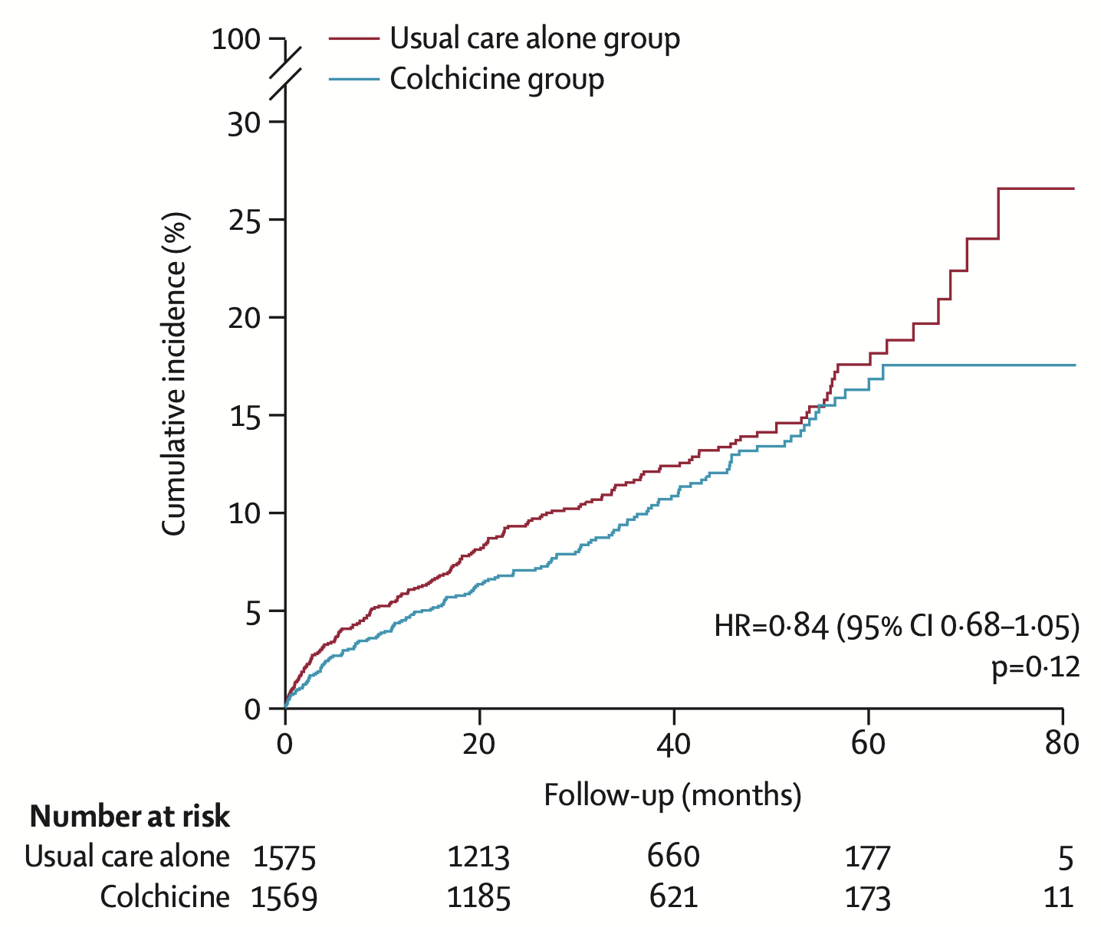
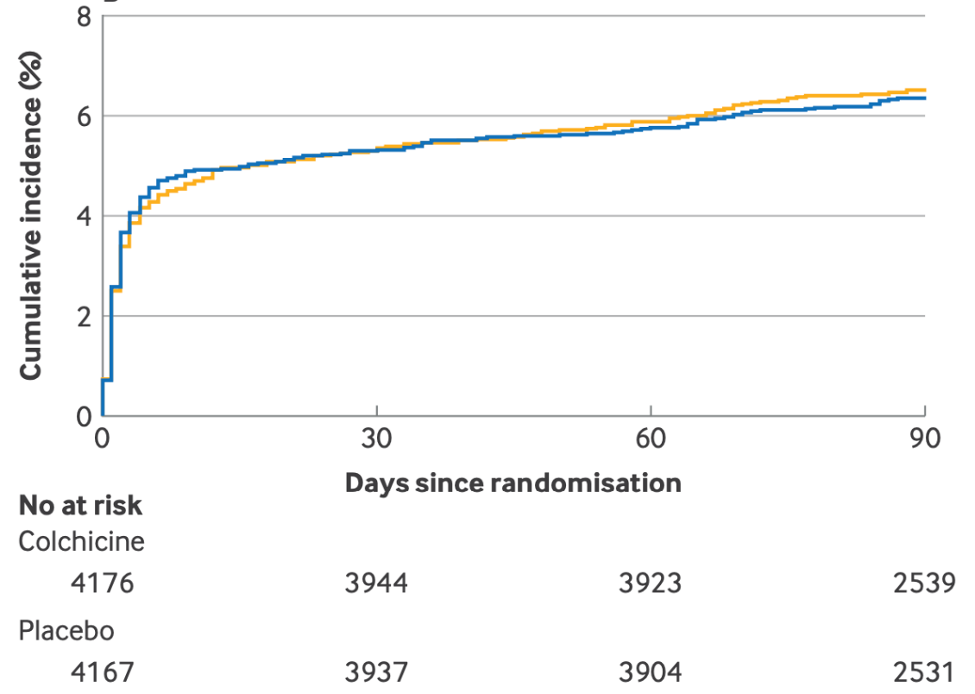

Cerebrovascular Disease: No Difference
CONVINCE (N = 3154, MACE+, 338 events)
CHANCE3 (N = 8343, all stroke, 534 events)
HR 0.84 (95%CI 0.68-1.05)
HR 0.98 (95%CI 0.83-1.16
Kelly, P, et al. Lancet 2024; 404: 125-133.
Li, J, et al. BMJ 2024; 385.
4

Slide 6
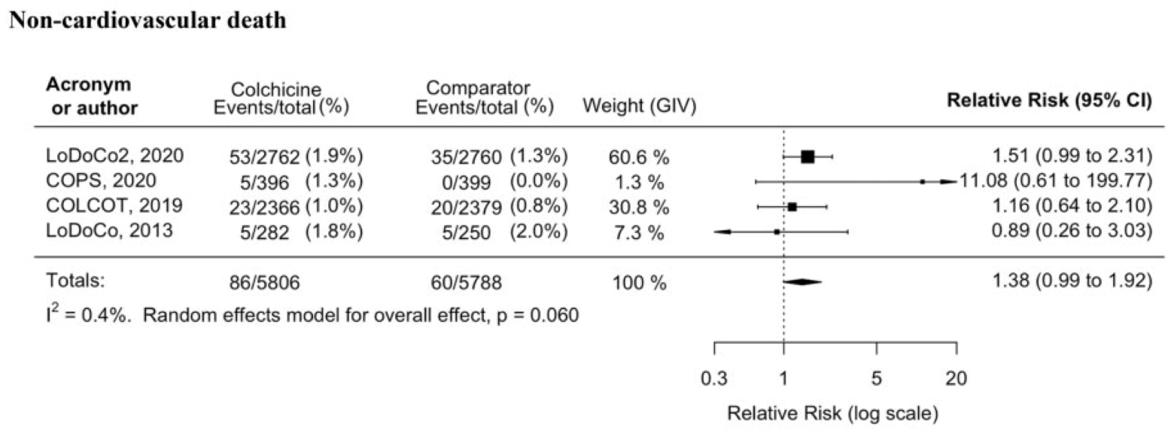
Does Colchicine Increase Non-CV Death?
Meta-analysis
5

Slide 7
Rationale
CLEAR trial started prior to results of COLCOT trial
Larger trial with significantly more events and power
Replication of prior results important for Class I indications

Slide 8
Primary Objective
In patients with STEMI or large NSTEMI:
Does a routine colchicine compared to placebo long term reduce the composite of CV death, MI, stroke or ischemia driven revascularization

Slide 9

CLEAR OASIS 9 Trial
7000 patients diagnosed with Acute Myocardial Infarction (MI) referred for PCI
SYNERGY stent recommended for use when available*
Randomized within 72 hours of PCI 2x2 Factorial
Colchicine
Placebo
Randomized
Spironolactone
Placebo
Spironolactone
Placebo
Primary Outcome
Colchicine vs. placebo: Composite of CV death, MI, stroke or ischemia driven revascularization over duration of follow-up
Notes:
Fix arrows and centre

Slide 10
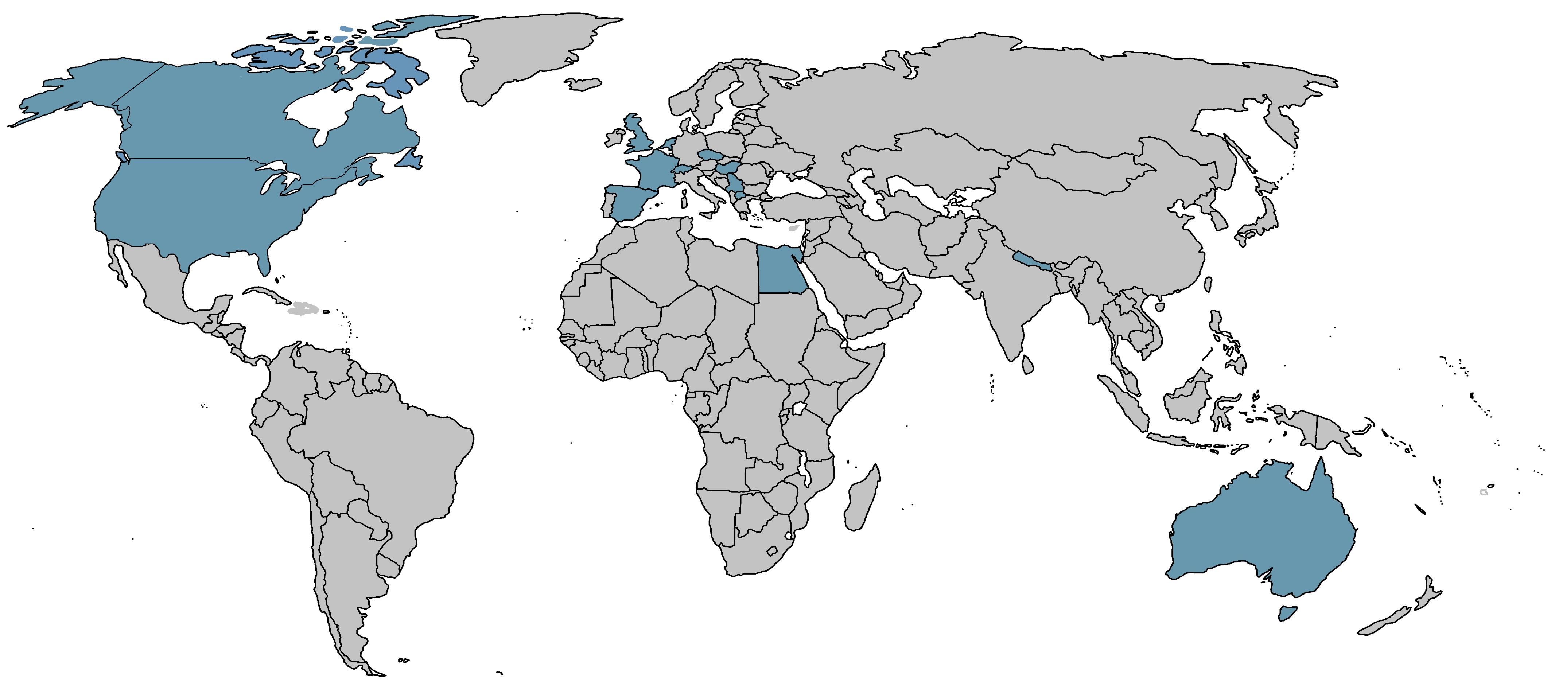
CLEAR Recruitment from 104 Sites in 14 Countries
North America
2022
Europe
4715
Nepal
123
Egypt
143
Australia
59
7,062 patients randomized between February 2018 and November 2022

Slide 11
Study Power and Follow Up
Study power: 80% power for a 25% RRR for a 9% control event rate
Analysis: Intention-to-treat Cox proportional hazards model, stratified by STEMI vs. NSTEMI and spironolactone vs. placebo, accounting for competing risk
Sensitivity: On treatment analysis
Follow up: 99.4% in both groups

Slide 12
Baseline Characteristics
 | Colchicine N=3528 | Placebo N=3534
Mean Age | 60.6 | 60.7
Female | 20.5% | 20.2%
STEMI | 95.3% | 94.8%
NSTEMI | 4.7% | 5.2%
Diabetes | 18.7% | 18.3%
Prior MI | 8.8% | 9.2%

Slide 13
Medications at Discharge
 | Colchicine N=3528 | Placebo N=3534
Aspirin | 97.2% | 96.3%
Clopidogrel | 41.9% | 42.4%
Ticagrelor | 45.7% | 44.5%
PrasugreI | 10.8% | 11.7%
ACE or ARB | 77.9% | 78.3%
Statin | 96.6% | 96.7%
SLGT2 inhibitor | 3.1% | 2.9%

Slide 14
Initial PCI Procedure
 | Colchicine N=3528 | Placebo N=3534
Bare metal stent | 0.3% | 0.2%
Drug-eluting stent | 96.3% | 95.8%
Angioplasty only | 3.0% | 3.4%
Number of stents (median) | 1.0 | 1.0
Stent length (mm) mean | 23.8 | 23.8
Stent diameter (mm) mean | 3.2 | 3.1
Multivessel coronary disease | 49.2% | 49.3%

Slide 15
CRP was Significantly Reduced with Colchicine
12
11
N=1244, LSM(95%CI)=10.3 (9.4, 11.1)
10
N=1248, LSM(95%CI)=10.0 (9.2, 10.9)
9
8
CRP (mg/L)
7
N=1419, LSM(95%CI)=4.3 (3.9, 4.6)
6
5
4
3
N=1384, LSM (95%CI)=3.0 (2.6, 3.47)
Colchicine
2
1
Placebo
Mean Difference (95%CI) = -1.3 ( -1.8, -0.7)
0
Baseline
Timepoint
Month 3

Slide 16
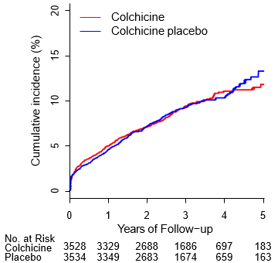
Primary Outcome of CV Death, MI, Stroke of Ischemia Driven
Revascularization
HR 0.99 95% CI 0.85-1.16, p=0.93 (649 primary outcome events)

Slide 17
Primary Outcome
 | Colchicine (N=3528) (%) | Placebo (N=3534) (%) | HR | 95% CI | p
CV death, MI, stroke or ischemia driven revascularization | 9.1% | 9.3% | 0.99 | 0.85-1.16 | 0.93
CV death | 3.3% | 3.2% | 1.03 | 0.80-1.34
MI | 2.9% | 3.1% | 0.88 | 0.66-1.17
Stroke | 1.4% | 1.2% | 1.15 | 0.72-1.84
Ischemia driven revascularization | 4.6% | 4.7% | 1.01 | 0.81-1.17
CV death, MI or stroke | 6.8% | 7.1% | 0.98 | 0.82-1.17
All cause death | 4.6% | 5.1% | 0.90 | 0.73-1.12
Non-CV death | 1.3% | 1.9% | 0.68 | 0.46-0.99
Notes:
Rajibul is working on checking the numbers

Slide 18
On Treatment Analysis
 | Colchicine (N=3488) (%) | Placebo (N=3492) (%) | HR | 95% CI | p
CV death, MI, stroke or ischemia driven revascularization | 7.5% | 7.5% | 0.99 | 0.85-1.16 | 0.93
CV death | 2.7% | 2.5% | 1.04 | 0.80-1.35
MI | 2.3% | 2.4% | 0.89 | 0.67-1.18
Stroke | 1.1% | 1.0% | 1.09 | 0.68-1.75
Ischemia driven revascularization | 3.9% | 3.8% | 1.03 | 0.82-1.29
CV death, MI or stroke | 5.5% | 5.7% | 0.97 | 0.81-1.16
All cause death | 3.4% | 3.8% | 0.90 | 0.70-1.15
Non-CV death | 0.7% | 1.3% | 0.71 | 0.49-1.04
Notes:
Rajibul is working on checking the numbers

Slide 19
Adverse Events
 | Colchicine (N=3528) (%) | Placebo (N=3534) (%) | p
Serious Adverse Events | 6.7% | 7.4% | 0.22
Adverse Events | 31.9% | 31.7% | 0.86
Serious Infection | 2.5% | 2.9% | 0.85
Diarrhea | 10.2% | 6.6% | <0.001
Notes:
Rajibul is working on checking the numbers

Slide 20
Forest Plot of Primary Outcome in Pre-Specified Subgroups (I)
Colchicine
Placebo
Hazard Ratio
P value for
Count/Total (%)
Count/Total (%)
(95% CI)
Interaction
Outcomes
CVD/MI/Stroke/Revas
322/3528(9.1)
327/3534(9.3)
0.98 (0.84-1.15)
Age
0.418
Age>= 65
140/1185(11.8)
135/1214(11.1)
1.06 (0.84-1.34)
Age<65
182/2343(7.8)
192/2320(8.3)
0.93 (0.76-1.14)
Sex
0.384
Female
72/725(9.9)
64/713(9.0)
1.12 (0.80-1.57)
Male
250/2803(8.9)
263/2821(9.3)
0.95 (0.80-1.13)
GFR level
Sex
0.5
GFR>=60
266/3237(8.2)
279/3256(8.6)
0.96 (0.81-1.13)
GFR<60
56/291(19.2)
48/278(17.3)
1.10 (0.75-1.62)
Region
0.951
North America
96/1010(9.5)
95/1012(9.4)
*
0.93 (0.11-7.66)
Europe
216/2356(9.2)
221/2359(9.4)
0.97 (0.81-1.17)
Other region
10/162(6.2)
11/163(6.7)
0.90 (0.38-2.13)
*HR at 1 year using a time-dependent Cox Model to account for the PH assumption violation.
0
0.5
1
1.5
2
2.5
HR (95% CI)
*HR at 1 year using a time-dependent Cox Model to account for the PH assumption violation.

Slide 21
Forest Plot of Primary Outcome in Pre-Specified Subgroups (II)

Slide 22
Conclusions
Acute and long term colchicine did not reduce composite of CV death, MI, stroke or ischemia driven revascularization
Colchicine was associated with an increase in diarrhea
CLEAR is the largest trial of colchicine in acute MI with substantially more events than prior trials

Slide 23
Implications
The role of colchicine post myocardial infarction long term is uncertain

Slide 24
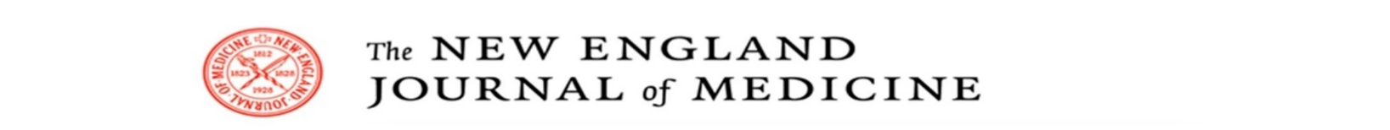
Will be available online at www.NEJM.org soon

Slide 25
Acknowledgements
Operations Committee
S. Jolly (Principal Investigator)
J. Cairns
J.H. Cornel
P.J. Devereaux
J. Eikelboom
R. Storey
S. Yusuf
Steering Committee
S. Jolly | S. Mehta
D. Allocco | G. Montalescot
K. Bainey | R. Moreno
S. Bangdiwala | M. Natarajan
O. Bertrand | S. Pancholy
R. Bhindi | B. Pitt
M. Bossard | Z. Ruzsa
J. Cairns | J.D. Schwalm
W. Cantor | B. Shah
S. Chandran | T. Sheth
J.H. Cornel | S.K. Sharma
P.J. Devereaux | G. Stankovic
J. Eikelboom | R. Storey
T. Henry | L. Thabane
P. Kala | W. Tarhuni
S. Kedev | S. Verma
S. Lavi | R. Welsh
J. Layland | S. Yusuf
Event and Core Lab Adjudication Committee
S. Lavi (chairperson) | J. Kappelle
A. Alhazzani | A. Katsanos
I. Bojovki | M. Keltai
F. Botto | S. Laudari
L. Catanese | A. Mackay
G. Cioffi | H. Mann
D. Conen | A. Mosterd
D. Cvetkovska | G. Novotini
M-A. D’Entremont | D. Petkoska
G. Dutra | N.K. Sherpa
H. Elsayed | S. Szatmari
P. Hajek | D. Topic
J. Healey | N. Vega Servin
G. Helft | I. Westendorp
A. Hillani | P. Widimsky
PHRI Project Office
Study Team
J. Tyrwhitt (Program Manager)
M-A. D’Entremont (Project Officer)
J. Betz
C. Choppick
S. MacRae
M. McClelland
P. Szymkow
Statisticians
S-F. Lee
C. Tang
R. Mian
J. Liu
M. Molec
D. Wijesena
ICT
H. Wilton
Data Monitoring Committee
D. Bhatt (Chair)
S. Rao
P.G. Steg
G. Wells
D. G. Wyse

Slide 26
CLEAR Investigators from 104 Sites in 14 Countries
AUSTRALIA | CANADA (ctd) | EGYPT (ctd) | NETHERLANDS | SERBIA | UNITED KINGDOM | USA
R. Bhindi | A. Hameed | M. Seleem | JH Cornel | G. Stankovic | R. Storey | T. Henry
J. Layland | MB. Iqbal | FRANCE | I. Aksoy | A. Davidovic | A. Ali | S. Abbas
K. Asrress | D. Joyal | G. Montalescot | B. Groenemeijer | D. Sagic | D. Austin | JD. Abbott
H. Kachwalla | S. Kassam | F. Beygui | J. Jasper Focks | I. Srdanovic | M. de Belder | F. Aguirre
W. Wilson | S. Lavi | G. Cayla | M. Kortz | D. Topic | D. Hildick-Smith | M. Bieniarz
CANADA | M. Nguyen | J. Silvain | S. Koudstaal | SPAIN | K. Hogrefe | M. Farbaniec
S. Jolly | A. Pourdjabbar | HUNGARY | G. Linssen | R. Moreno | N. Kukreja | M. Levy
J. Abunassar | J. Shavadia | Z. Ruzsa | P. Nierop | X. Armario | M. Lynch | A. Murthy
S. Amlani | R. Welsh | B. Berta | R. Oemrawsingh | JM. Garcia Ruiz | C. Maart | B. Shah
A. Bagherli | CZECH REPUBLIC | T. Szuk | T. Oosterhof | J. Gomez-Hospital | P. O’Kane | S. Shreenivas
O. Bertrand | P. Kala | MACEDONIA | R. Pisters | A. Iniguez Romo | R. Oliver | A. Shroff
I. Billingsley | O. Hlinomaz | S. Kedev | J. Plomp | E. Molina Navarro | R. Rampat | S. Singh
W. Cantor | A. Schee | V. Asani | D. Schellings | V. Peral Disdier | S. Sharma | T. Smith
J. Charania | P. Tousek | J. Kostov | E. van Beek | N. Ribas Barquet | J. Spratt | R. Waksman
A. Cheema | EGYPT | B. Zafirovska | A. Van der Spank | O. Rodríguez Leor | A. Uddin
AY. Chong | S. Shaheen | NEPAL | J. Van De Swaluw | M. Sabate | T. Wells
A. Czarnecki | W. Tarhuni | SK. Sharma | J. Van Hal | SWITZERLAND
P. Dehghani | K. Eltamawey | CM. Adhikari | M. van Hessen | M. Bossard
V. Dzavik | S. Hussein | RM. Gajurel | J. Vriend | F. Mach
J. Graham | A. Rashwan | SR. Regmi | R. Wal
 | O. Saleh
We thank all investigators,
study coordinators and participants

