Slide 1
CLASP IID Randomized Trial and Registry: Two-Year Outcomes of Transcatheter Edge-to-Edge Repair for Degenerative Mitral Regurgitation
Firas Zahr, MD
Oregon Health & Science University, Portland, OR
on behalf of The CLASP IID Trial and Registry Investigators

Slide 2
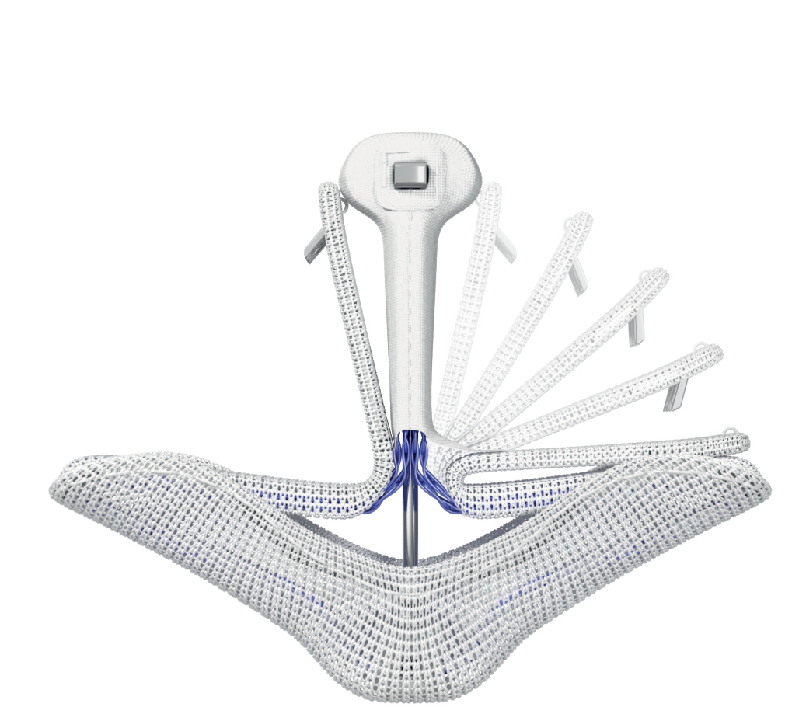
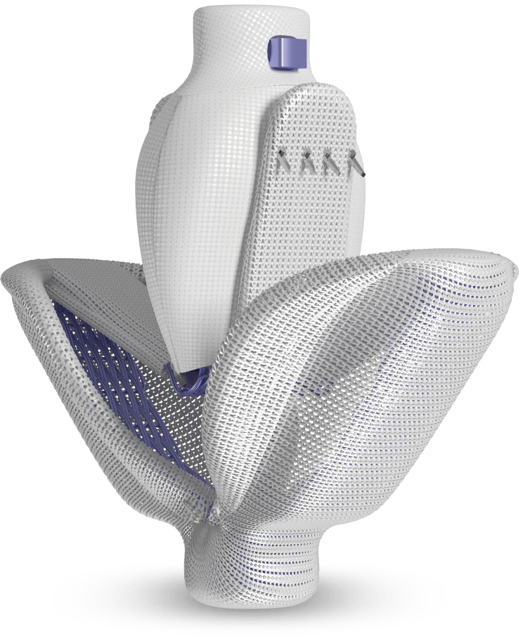
PASCAL Precision Transcatheter Valve Repair System
Each clasp features a single row of retention elements to clasp, reclasp, and preserve leaflets
PASCAL Ace implant
PASCAL implant
Retention elements
Single row of horizontal retention elements in line with collagen fibers
Atraumatic clasping
Allows for independent grasping and optimizing placement
Clasps
Central Spacer
Central spacer and contoured paddles Respect native anatomy to reduce leaflet stress
Paddles
CAUTION: Federal (United States) law restricts this device to sale by or on the order of a physician. See instructions for use for full prescribing information.

Slide 3
Patients with significant symptomatic
degenerative mitral regurgitation (MR 3+ or 4+)
at prohibitive surgical risk
The CLASP IID Trial
Edwards PASCAL TrAnScatheter Valve
RePair System Pivotal Clinical Trial
Prospective, multicenter, multinational, randomized, controlled pivotal trial
Purpose:
Evaluate the safety and effectiveness of the PASCAL transcatheter valve repair system compared to the MitraClip system in significant symptomatic DMR patients at prohibitive risk for surgery.
Trial Oversight:
Central Screening Committee (CSC)
Echocardiographic Core Laboratory
Clinical Events Committee (CEC)
Data Safety Monitoring Board
Deemed suitable for M-TEER by heart team
Echocardiographic core laboratory evaluation and CSC assessment
Deemed suitable for both
PASCAL and MitraClip
Deemed ineligible for randomizationª
CLASP IID Randomized Trial
CLASP IID Registry
2:1 Randomization
PASCAL system
MitraClip system
PASCAL system
Primary Endpoints Met : Non-Inferiority
Safety: Composite of major adverse events at 30 days
Effectiveness: MR ≤2+ at 6 months
Secondary Endpoints Met : Non-Inferiority Effectiveness: MR ≤2+ at 1 year MR ≤1+ at 1 year
Secondary Endpoints at 2 years
All-cause mortality, HFH, non-elective mitral valve reintervention, quality of life
ªBased on the anatomic conditions for which safety and effectiveness are not established according to the MitraClip Instructions for Use (IFU). MR, Mitral regurgitation; DMR, Degenerative mitral regurgitation; M-TEER, Mitral valve transcatheter edge-to-edge repair; HFH, Heart failure hospitalization.

Slide 4
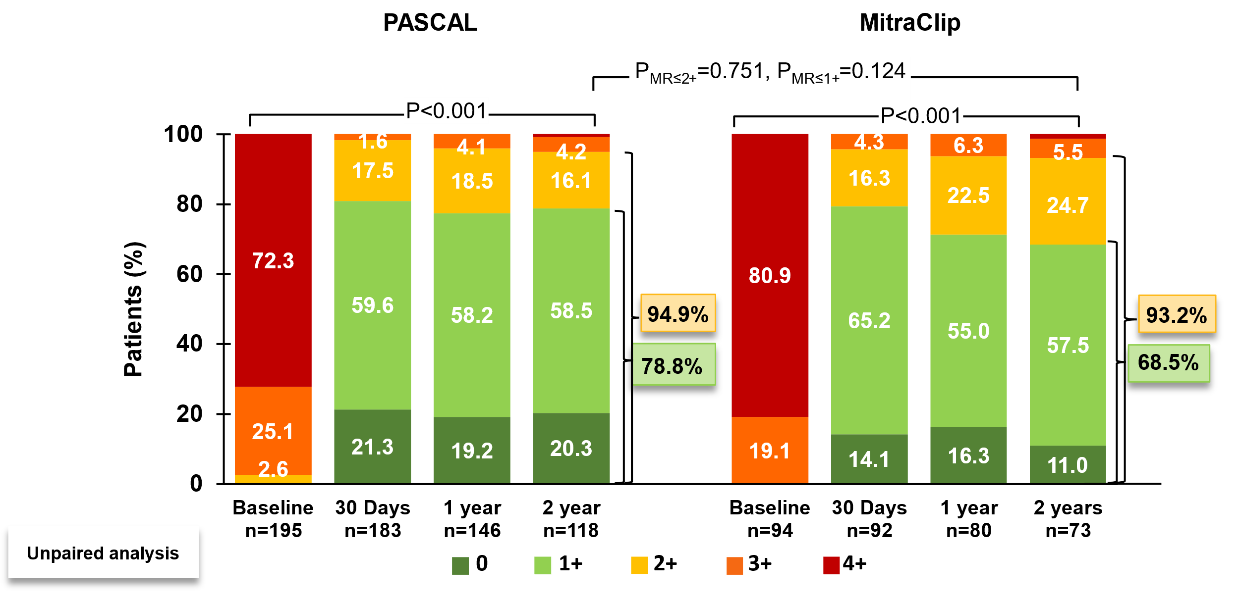
MR Reduction by Core Lab
Significant and sustained MR reduction at 2 years
Graph shows unpaired analysis. MR severity assessed by TTE. P values relative to baseline were calculated using the Wilcoxon signed rank test and P values between treatment groups were calculated from Fisher’s exact test. Echocardiographic Core Lab: Atlantic Health System Morristown Medical Center, Morristown, NJ, USA. TTE, Transthoracic echocardiography.

Slide 5
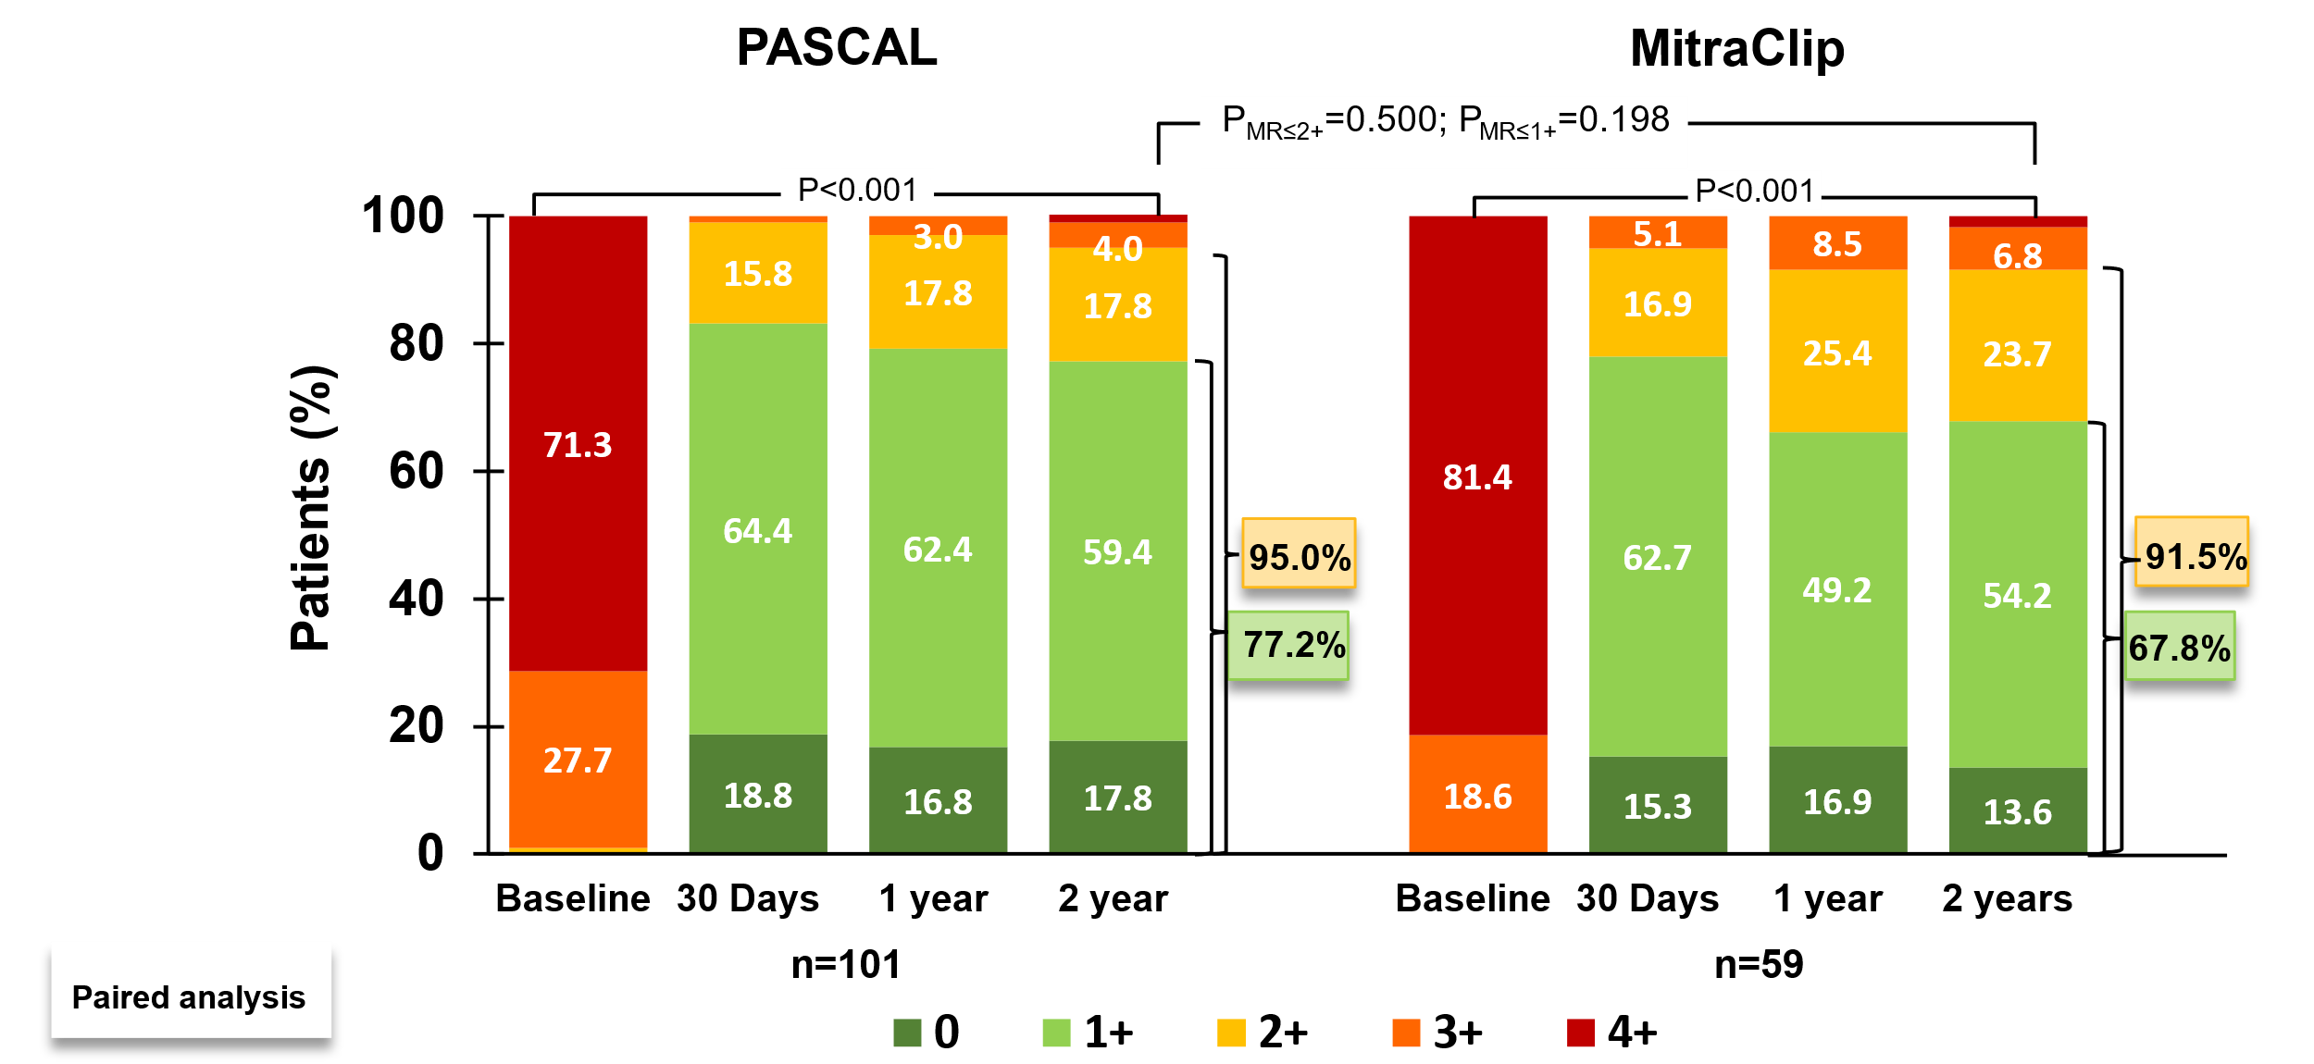
MR Reduction by Core Lab
Significant and sustained MR reduction at 2 years
Graph shows paired analysis (comprising data for the same patients across time points). MR severity assessed by TTE. P values relative to baseline were calculated using the Wilcoxon signed rank test and P values between treatment groups were calculated from Fisher’s exact test. Echocardiographic Core Lab: Atlantic Health System Morristown Medical Center, Morristown, NJ, USA. TTE, Transthoracic echocardiography.

Slide 6
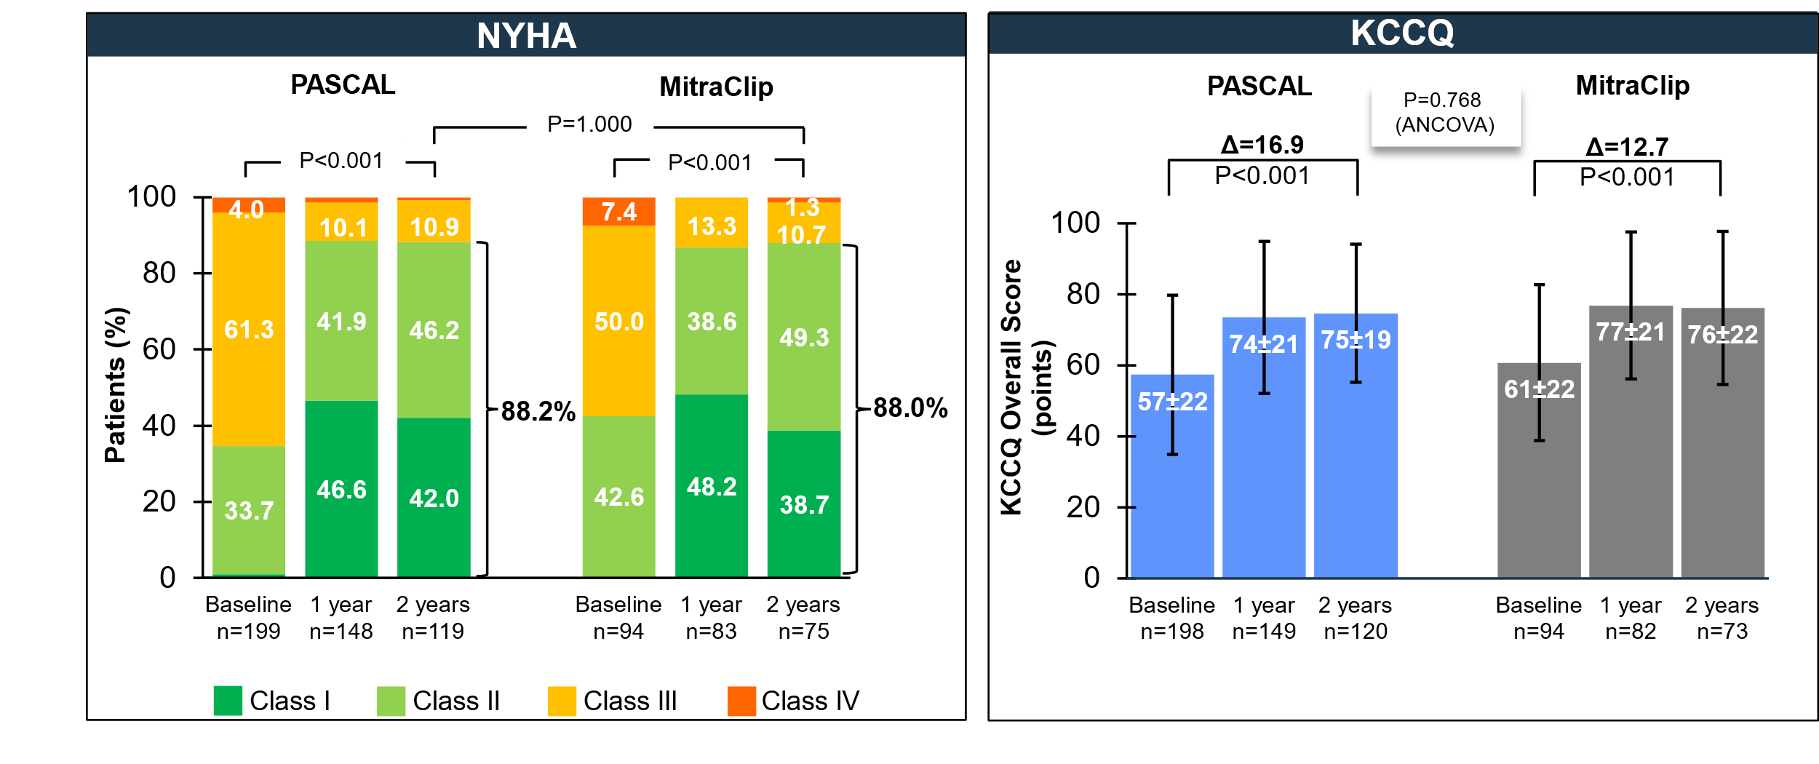
Functional and QoL Outcomes
Significant and sustained improvements at 2 years
Graph shows unpaired analysis for NYHA functional class and KCCQ (mean ±SD). P values for intragroup comparison for NYHA were calculated from paired analysis using the Wilcoxon signed rank test and P value for intergroup comparison of NYHA functional class I/II was calculated using Fisher exact test. P values for intragroup comparisons of KCCQ scores were calculated from paired analysis using Student’s t-test and P value for intergroup comparison was calculated using the analysis of covariance (ANCOVA) model adjusted for baseline values and planned treatment as covariates. NYHA, New York Heart Association functional class; KCCQ, Kansas City Cardiomyopathy Questionnaire.

Slide 7
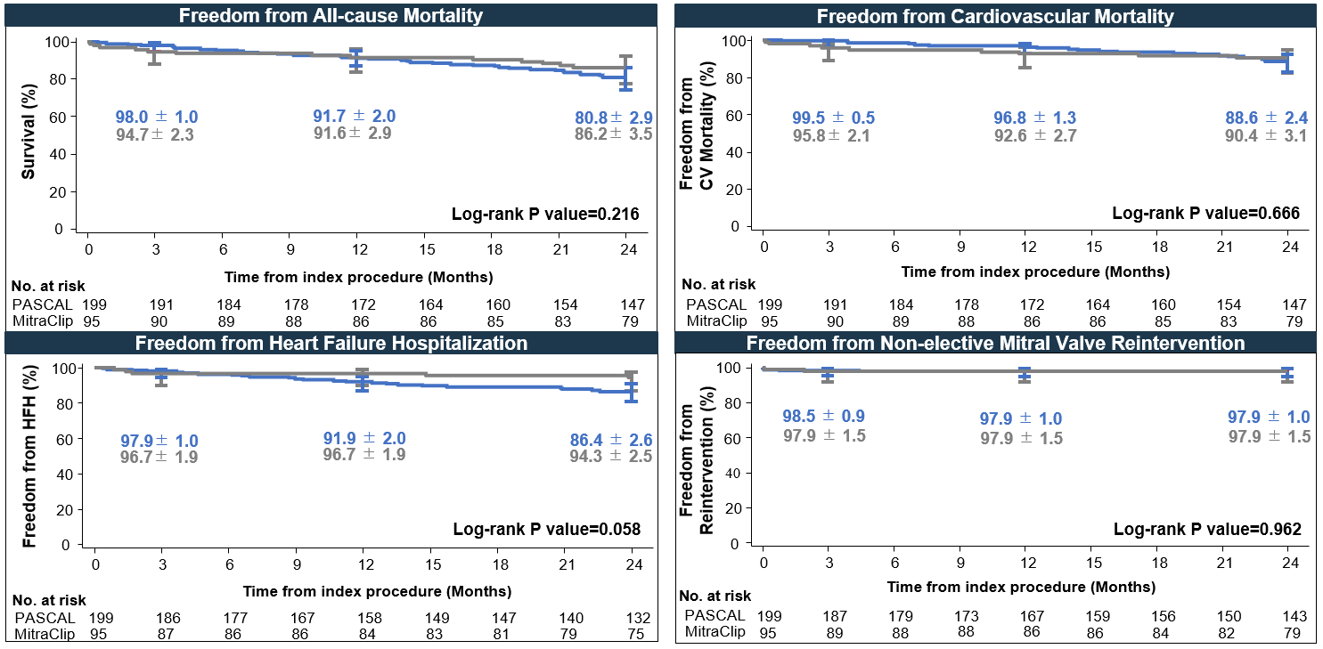
CEC-adjudicated Events
Outcomes at 2 years
Log-rank P value=NS
PASCAL
MitraClip
Graphs show Kaplan-Meier analysis time to first event (KM estimate ± SE) and error bars represent 95% CI. CEC, Clinical events committee; CV, cardiovascular; HFH, Heart Failure Hospitalization.

Slide 8
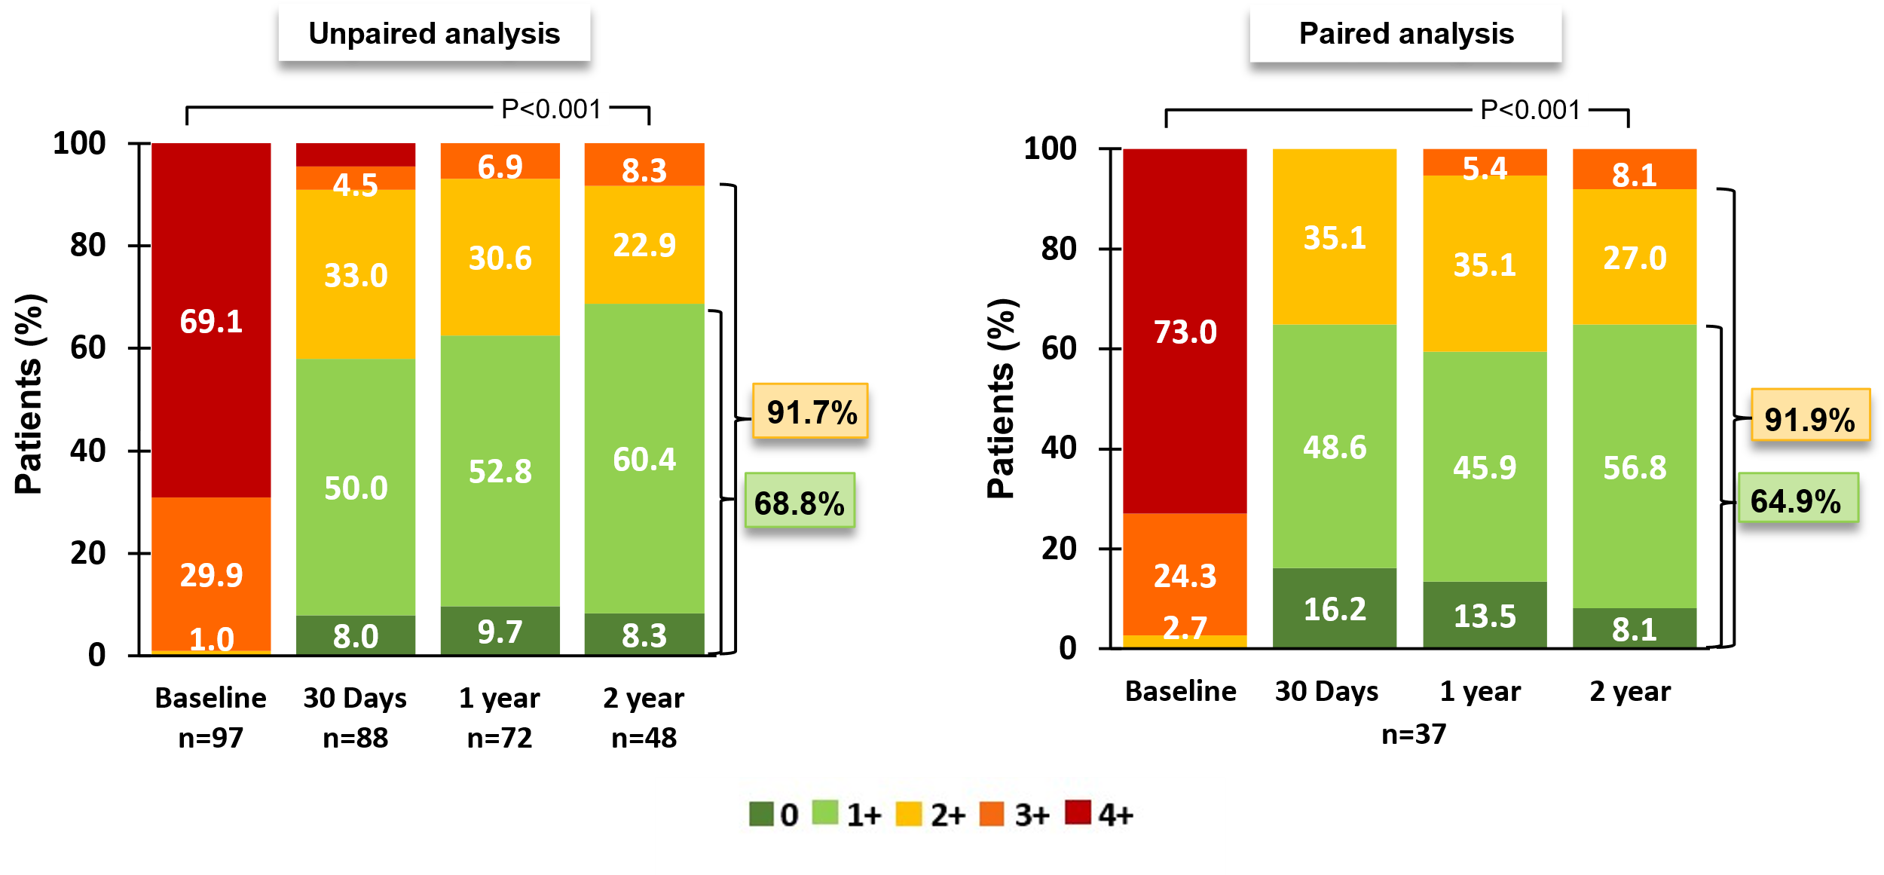
MR Reduction by Core Lab
Significant and sustained MR reduction at 2 years
Graphs show unpaired and paired analysis (comprising data for the same patients across time points). MR severity assessed by TTE. P values relative to baseline were calculated using the Wilcoxon signed rank test. Echocardiographic Core Lab: Atlantic Health System Morristown Medical Center, Morristown, NJ, USA. TTE, Transthoracic echocardiography.

Slide 9
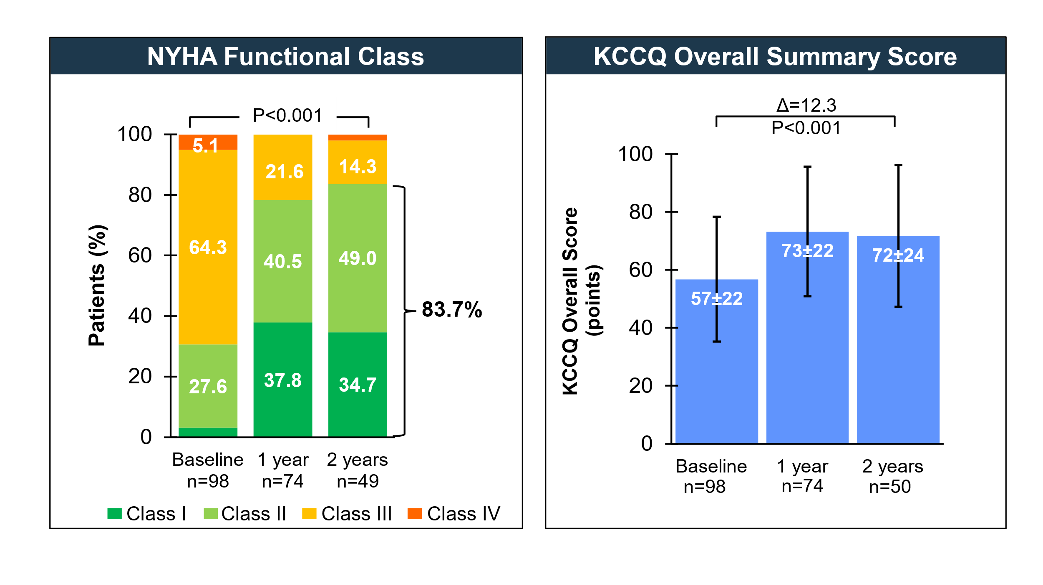
Functional and QoL Outcomes
Significant and sustained improvements at 2 years
Graphs show unpaired analysis. P value for NYHA was calculated from paired analysis using the Wilcoxon signed rank test. KCCQ graph shows mean ± SD. Δ represents paired change from baseline to 2 years and the P value was calculated using Student’s t-test. NYHA, New York Heart Association; KCCQ, Kansas City Cardiomyopathy Questionnaire.

Slide 10
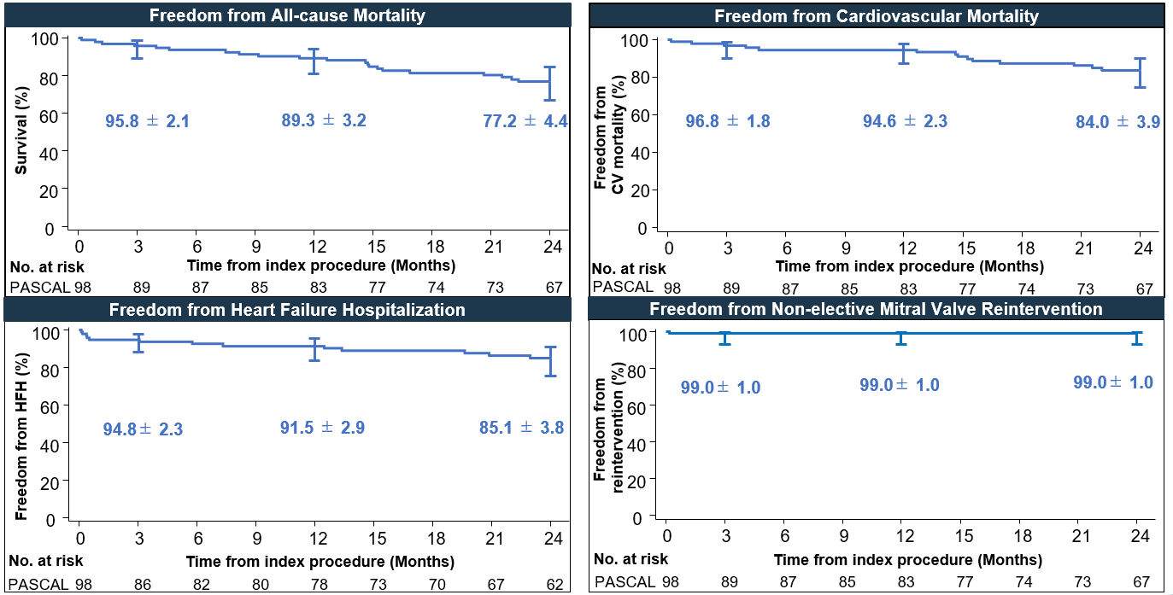
CEC-adjudicated Events
Outcomes at 2 years
PASCAL
Graphs show Kaplan-Meier analysis time to first event (KM estimate±SE) and error bars represent 95% CI. CEC, Clinical events committee; HFH, Heart failure hospitalization; CV, Cardiovascular.

Slide 11
Conclusions
Longest follow-up from the only prospective, CEC and core-lab adjudicated study evaluating contemporary M-TEER therapies in prohibitive risk DMR patients
Two-year results from the CLASP IID Randomized Trial reinforce M-TEER as a valuable treatment option
Across a wide range of mitral valve anatomies, including those ineligible for randomization, patients treated with the PASCAL system demonstrated:
Favorable survival
Robust and sustained MR reduction
Significant and durable ventricular remodeling
Significant and consistent improvements in functional status and quality of life
Two-year results from the CLASP IID Randomized Trial and Registry confirm the sustained safety and effectiveness of the PASCAL system in treating a broad population of DMR patients.
M-TEER, Mitral valve transcatheter edge-to-edge repair; CEC, Clinical events committee; DMR, Degenerative mitral regurgitation; MR: Mitral regurgitation.

