Slide 1
AI-guided Quantitative
Coronary CT Angiography (AI-QCT) Technology in Patients With Suspected Coronary Artery Disease
FINDINGS FROM A GLOBAL MULTI-CENTER REGISTRY
Alexander van Rosendael MD PhD, on behalf of the CONFIRM2 investigators*
*Mirvat Alasnag, Mouaz Al-Mallah, Daniele Andreini, Jeroen J. Bax, Ronny R. Buechel, Matthew Budoff, Filippo Cademartiri, Victor Y. Cheng, Andrew D. Choi, Rebecca Fisher, Gudrun Feuchtner, David M. German, Christoph Grani, Himanshu Gupta, Martin Hadamitzky, Ashraf Hamdan, Dinesh Kalra, Vasileios Kamperidis, Ronald P. Karlsberg, Omar Khalique, Hugo Marques, Enrico Martin, Jim Mills, Prashant Nagpal, Rine Nakanishi, Nick S. Nurmohamed, Andrew Oehler, Amit R. Patel, Gianluca Pontone, Carlos E. Rochitte, Kashif Shaikh, Ibrahim Danad;

Slide 2
Disclosure of Relevant Financial Relationships
Within the prior 24 months, I have had a relevant financial relationship with a company producing, marketing, selling, re-selling, or distributing healthcare products used by or on patients:
Nature of Financial Relationship | Ineligible Company
Grant/Research Support | Cleerly
Consultant Fees/Honoraria | -
Individual Stock(s)/Stock Options | -
Royalties/Patent Beneficiary | -
Executive Role/Ownership Interest | -
Other Financial Benefit | -
All relevant financial relationships have been mitigated.
Faculty disclosure information can be found on the app

Slide 3
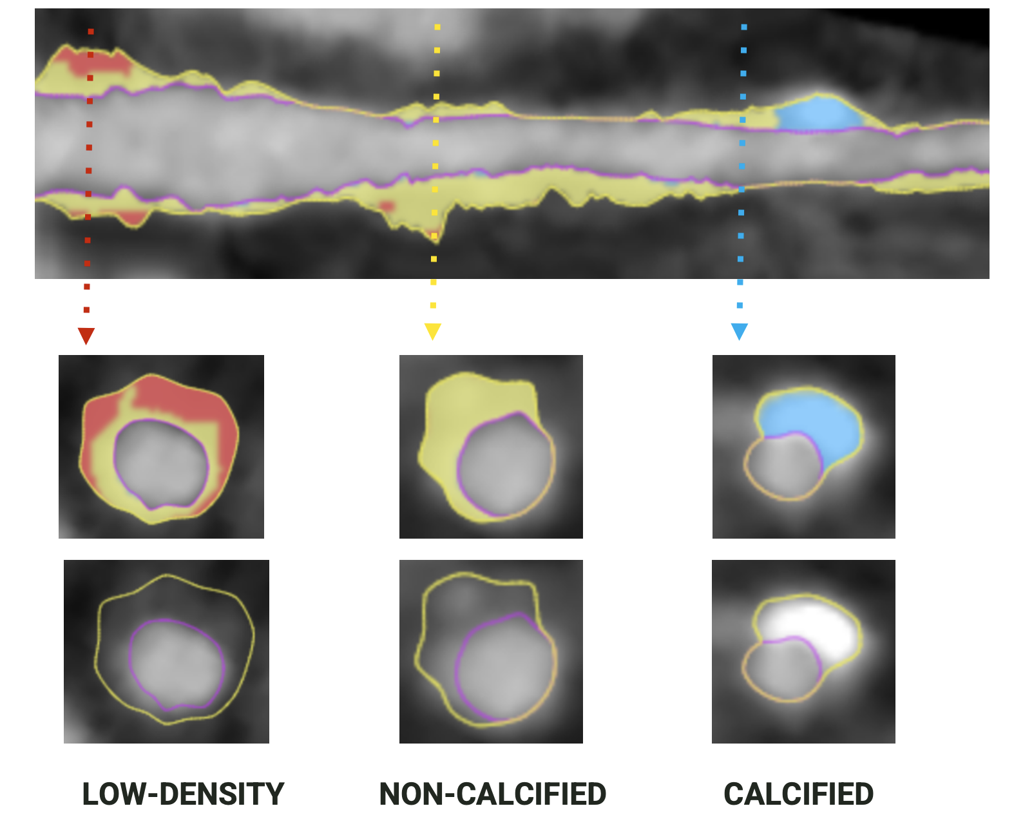
Introduction
Todays workup of chest pain is still mostly symptom and ischemia driven alghough several RCT’s have shown that they do not improve prognosis.
Intravascular ultrasound (IVUS) studies have shown that plaque features such as plaque burden, low attention plaque, minimal luminal area are highly prognostic.
Coronary CTA is a technique especially suited for assessing whole heart atherosclerotic burden and composition.
Many studies have demonstrated strong prognostic value.
Artificial intelligence quantitative CT (AI-QCT) allows standardized, reproducible, quantitative automatic whole heart plaque quantification with high degree of correlation to invasive gold standards.
EXAMPLE OF AI-QCT
(Artificial intelligence quantitative CT)
Notes:
‹#›
This is the Bulleted List slide.
To create this particular slide, click the NEW SLIDE button on your toolbar and choose the BULLETED LIST format. (Top row, second from left)
The Sub-Heading and footnote will not appear when you insert a new slide. If you need either one, copy and paste it from the sample slide.
If you choose not to use a Sub-Heading, let us know when you hand in your presentation for clean-up and we’ll adjust where the bullets begin on your master page.
Also, be sure to insert the presentation title onto the BULLETED LIST MASTER as follows:
Choose View / Master / Slide Master from your menu.
Select the text at the bottom of the slide and type in a short version of your presentation title.
Click the SLIDE VIEW button in the lower left hand part of your screen to return to the slide show. (Small white rectangle)

Slide 4
Research Question
To identify the quantitative atherosclerotic CT features most strongly associated with MACE, and to compare the prognostic value with traditional clinical risk scores.

Slide 5
Study Methodology
Inclusion
Patients greater than 18 years of age with clinical suspicion of CAD referred for further evaluation with coronary CTA
No known CAD
Exclusion
Life expectancy < 2 years

Slide 6
Study Methodology
Evaluations
Demographics, risk factors, and ASCVD risk score
Diamond Forrester
AI based quantitative CT evaluation (AI-QCT)
Composite primary endpoint
All-cause mortality, Myocardial infarction, Stroke, Congestive heart failure, Late revascularizations (>90 days), Hospitalizations for unstable angina
Composite secondary endpoint
All-cause mortality, Myocardial infarction

Slide 7
AI-QCT Atherosclerosis Evaluation
Stenosis-based assessment (non-obstructive, 1, 2, and 3 vessel disease)
Plaque-based assessment
Total Calcified Plaque Volume
Total Non-Calcified Plaque Volume
Low attenuation plaque volume
High risk plaque features greater than >2mm³ LAP and remodeling index >1.1
Other features (% stenosis, PAV)

Slide 8
Statistical Analysis
Multivariable cox hazard analysis to determine most predictive AI-QCT features.
Cumulative incidence curves:
Optimal AI-QCT model by tertiles
Diamond Forrester pre-test probability
AUC analysis using stepwise models:
Diamond Forrester pre-test probability for obstructive CAD
Added with clinical risk factors
Added with optimal multivariable AI-QCT model

Slide 9
Study Cohort
Inclusion from 18 sites in 13 countries worldwide
Follow-up period: 4.8 ± 2.2 years
167 (5%) events
death (N=34)
myocardial infarction (N=24)
cerebrovascular accident (N=12)
hospitalization for chronic heart failure (N=23)
hospitalization for unstable angina (N=17)
late revascularization (N=84)
4163 patients
Asymptomatic (N=288)
Prior CAD (N=322)
Missing clinical info (N=2)
3551 patients

Slide 10
Baseline Characteristics
All Patients (N=3551)
Age (years) | 58.81 ± 12.45
Male sex | 50.5%
Diamond Forrester
Low | 26.8%
Intermediate | 59.5%
High | 13.7%
Cardiac symptoms
Typical Angina | 19.1%
Atypical Angina | 37.6%
Non-differentiated Chest Pain | 16.6%
Dyspnea | 21.2%
Palpitations | 5.7%
Syncope | 1.9%
Other Symptoms | 16.2%
Race
African | 0.8%
African American | 4.1%
Caucasian | 79.1%
East Asian | 2.7%
Latin American | 2.1%
Middle Eastern | 6.0%
Other or Unknown | 5.2%

Slide 11
Coronary CTA Findings
CONVENTIONAL CAD CLASSIFICATION
AI-QCT ATHEROSCLEROTIC FEATURES
Stenosis
None/Minimal* | 25.0%
Non-Obstructive | 60.4%
1 vessel obstructive CAD | 9.9%
2 vessel obstructive CAD | 3.2%
3V or LM obstructive CAD | 1.4%
*Minimal CAD (<15 mm3) plaque volume was combined with a normal, since AI-QCT detects very small amounts of plaque. Obstructive CAD defines as ≥50% stenosis
Total Plaque Volume, mm³
Median (25th-75th IQR) | 56.80 (16.00-187.60)
Mean (SD) | 152.12 ± 245.13
Number any plaque | 93.0%
Non-calcified Plaque Volume, mm³
Median (25th-75th IQR) | 41.90 (12.90, 114.80)
Mean (SD) | 91.47 ± 136.36
Number any non-calcified plaque | 93.0%
Calcified Plaque Volume, mm³
Median (25th-75th IQR) | 6.60 (0.00,54.20)
Mean (SD) | 59.67 ± 134.49
Number any calcified plaque | 72.6%
Number of High Risk Plaques (<2 mm³ LAP and >1.1 RI) | 5.9%
Abbreviations: LAP; low attenuation plaque, RI; remodeling index

Slide 12
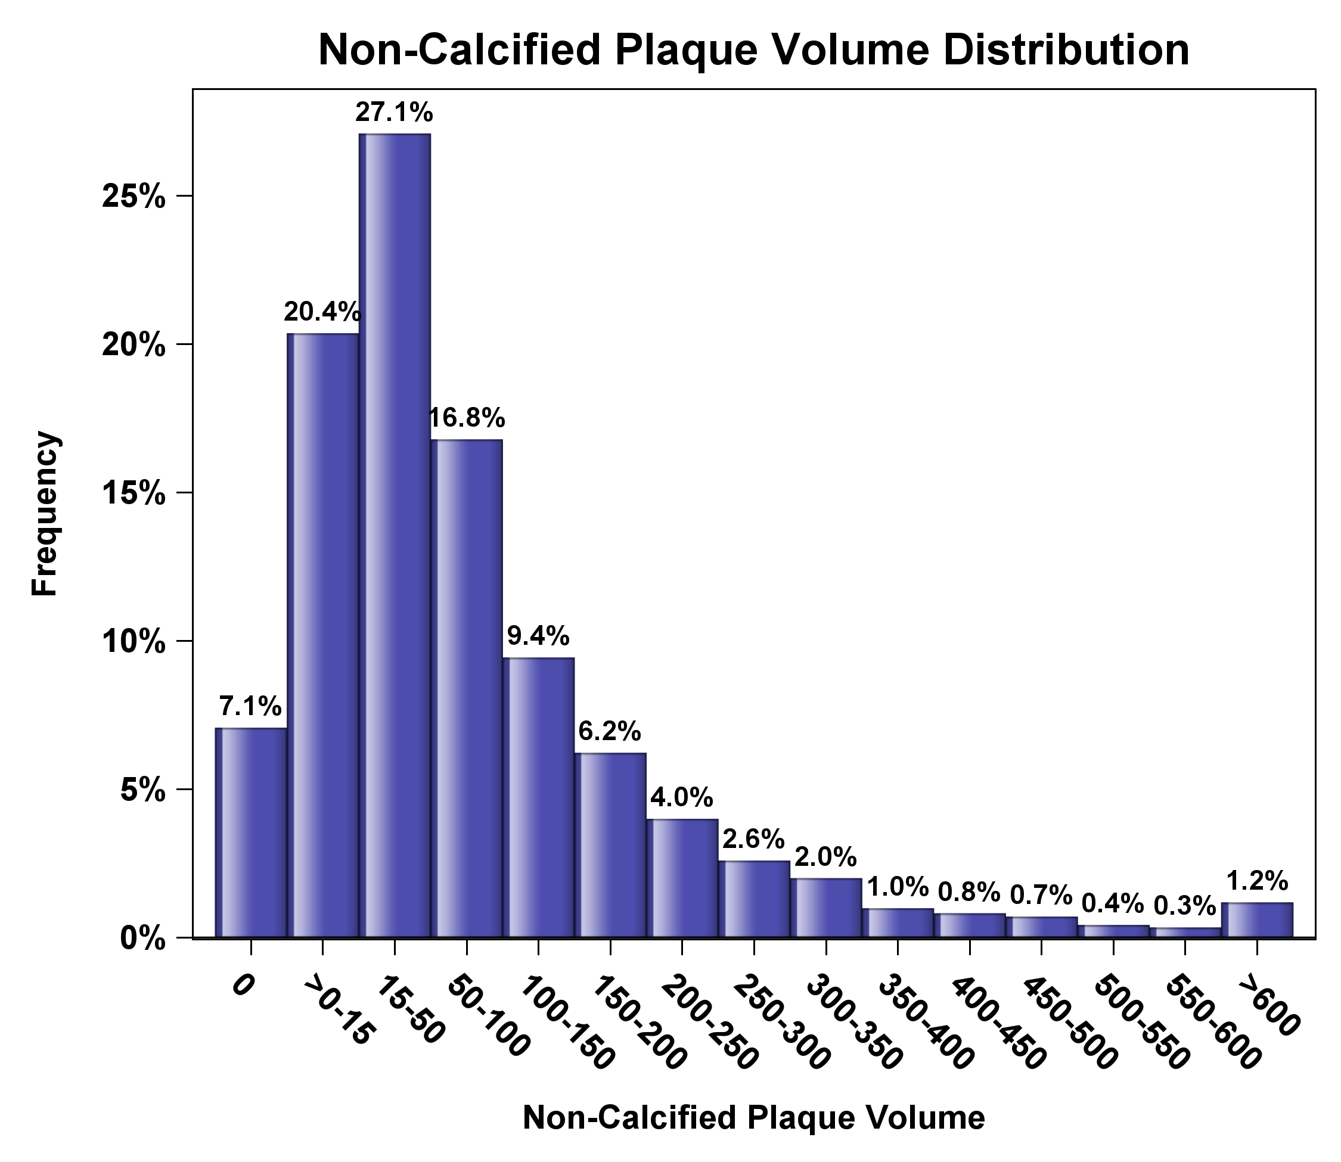
Distribution of Non-calcified Plaque Volume

Slide 13
AI-QCT According to Event Status
 | No Event N=3384 | Event N=171 | P-value
Plaque volume
Total Plaque Volume, mm³ | 53.30 (15.05,170.55) | 260.70 (84.50,482.00) | <0.001
Non-Calcified Plaque Volume, mm³ | 39.60 (12.25,107.40 | 148.80 (60.30,296.2 | <0.001
Calcified Plaque Volume, mm³ | 5.90 (0.00,48.45) | 53.70 (5.50,206.90) | <0.001
CAD extent |  |  | <0.001
No / minimal | 26.0% | 4.8%
Non-Obstructive | 60.8% | 51.5%
1 vessel obstructive CAD | 9.1% | 26.3%
2 vessel obstructive CAD | 2.9% | 10.2%
3V or LM obstructive CAD | 1.2% | 7.2%
Other
High Risk Plaques | 5.4% | 15.6% | <0.001
Percent Atheroma Volume (PAV), % | 2.04 (0.59,6.11) | 9.29 (3.45,17.59) | <0.001
Diameter stenosis, % |  |  | <0.001
0% | 10.3% | 0.6%
1-24% | 54.6% | 29.9%
25-49% | 22.1% | 25.7%
50-69% | 7.4% | 20.4%
70-99% | 3.6% | 15.0%
100% | 2.2% | 8.4%

Slide 14
Multivariable Cox Regression for Primary Endpoint
BEST PREDICTIVE MULTIVARIABLE AI-QCT MODEL
 | Multivariable HR (95% CI) | AUC
AI-QCT model |  | 0.755 (0.719, 0.792)
Lumen diameter stenosis, per 10% | 1.251 (1.183, 1.323) | --
Noncalcified plaque volume, per 50 mm³ | 1.069 (1.033, 1.107) | --
Once collinear variables were excluded, a Multivariate Cox Regression model was fit and backwards selection at P<0.05 was used to identify the best predictors. Non-Calcified plaque and % Diameter stenosis were the variables that remained in the Optimal quantitative CT Model. Univariable (N=24) CT candidates for an optimized quantitative CCTA model were percent diameter stenosis, percent area stenosis, number of moderate stenoses (50-69%), number of severe stenoses (≥70%), total plaque volume, calcified plaque volume, Non calcified plaque volume, low density non-calcified plaque volume, percent atheroma volume (PAV), PAV calcified plaque, PAV non-calcified plaque, PAV low density non-calcified plaque, number of high risk plaques, plaque diffuseness, total vessel length, left main with moderate stenosis, left main with severe stenosis, proximal LAD with moderate stenosis, proximal LAD with severe stenosis, number of chronic total occlusions (100% stenosis), lumen volume, vessel volume, lumen volume/vessel length, minimal luminal diameter, which were based on clinical utility and prior literature.

Slide 15
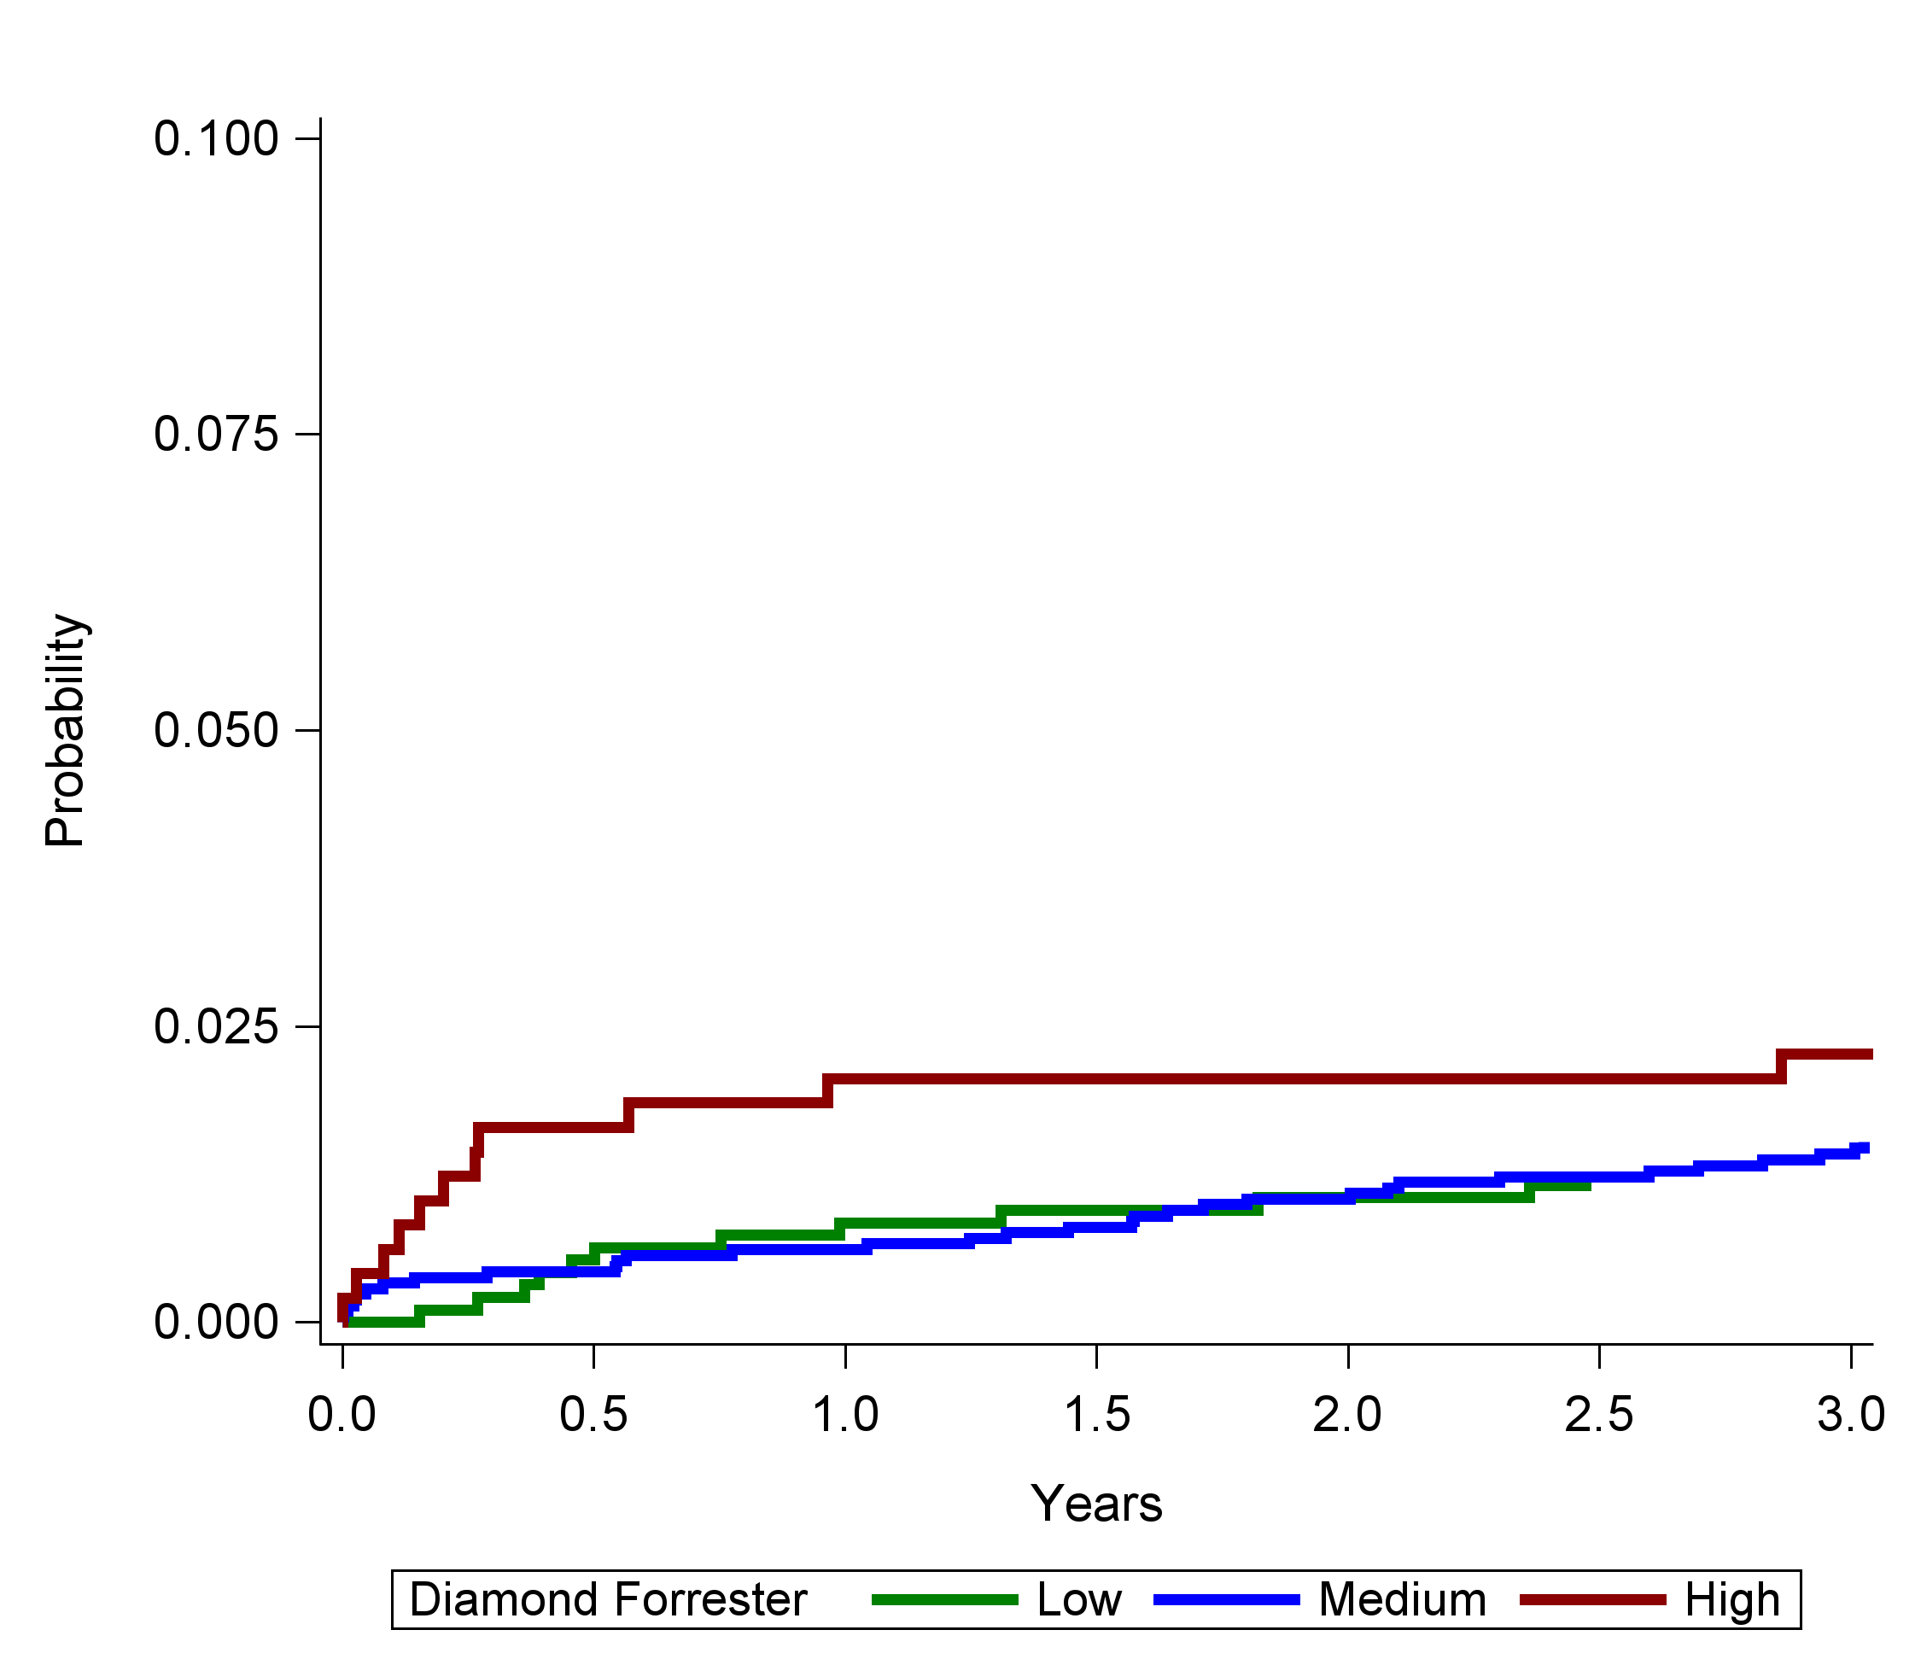
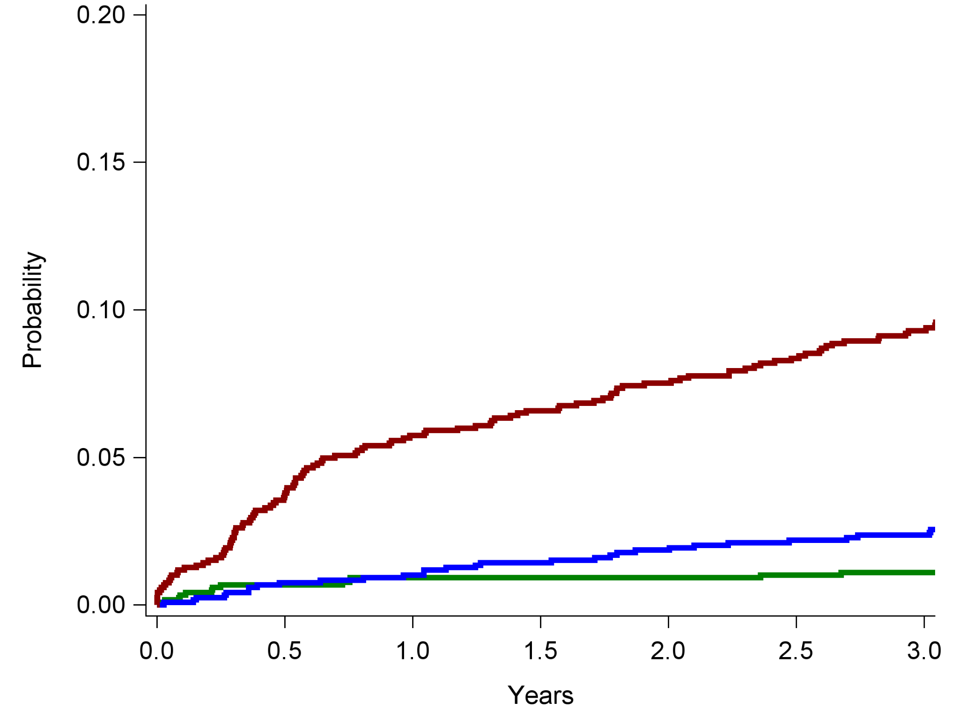
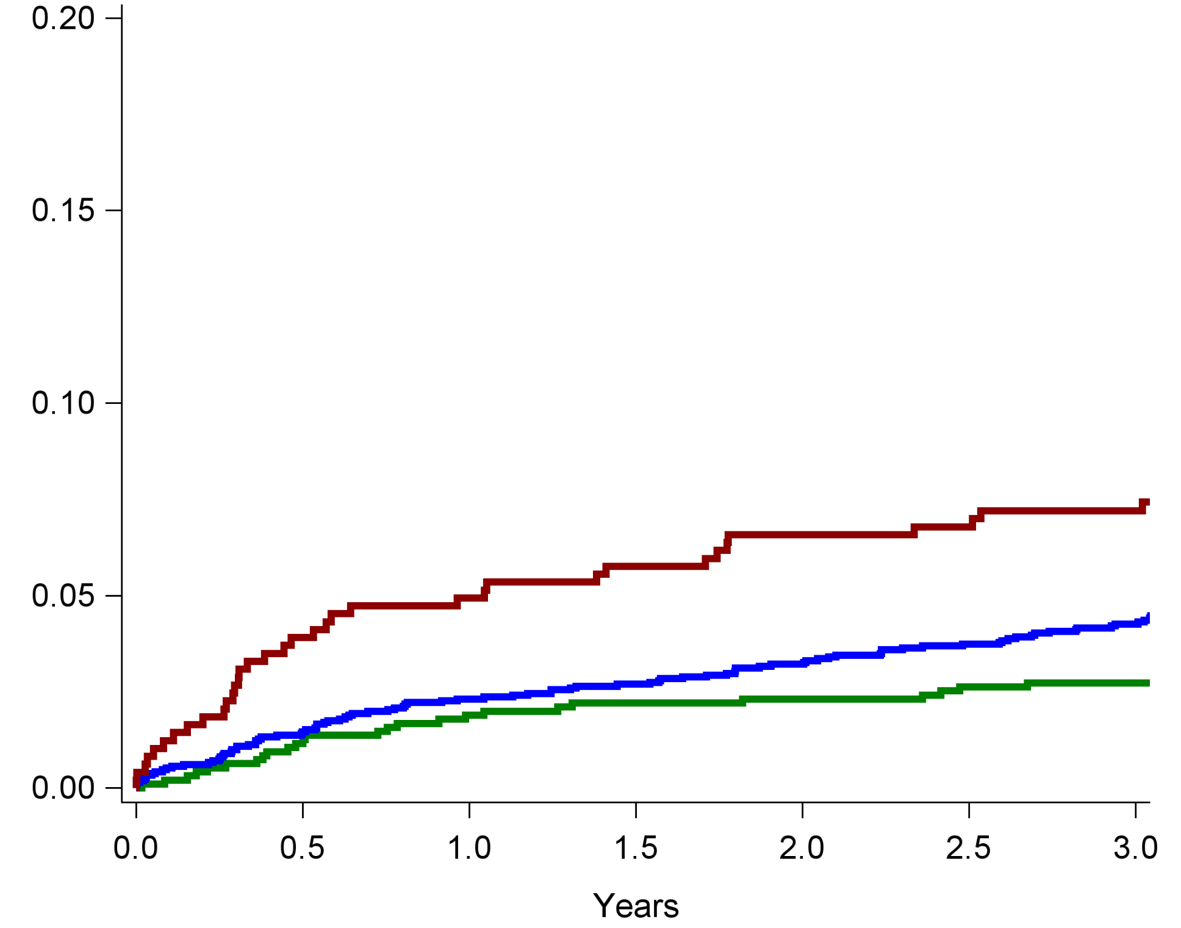
Cumulative Incidence Curves for Primary Composite Endpoint*
OPTIMAL AI-QCT MODEL
DIAMOND FORRESTER PTP for obstructive CAD
Low
Low
Intermediate
Intermediate
High
9.9%
High
8.1%
4.8%
3.2%
3.0%
1.3%
KEY POINTS:
Patients with low AI-QCT have fewer events than those with low Diamond Forrester
Patients with high AI-QCT have more events than those with high Diamond Forrester
*All-cause death, myocardial infarction, stroke, hospitalization for chronic heart failure, unstable angina, late revascularization

Slide 16
Incremental Value of AI-QCT Over Clinical Predictors*
P=0.001
P<0.001
0.77
(0.74–0.81)
0.65
(0.62–0.69)
0.58
(0.54–0.62)
*All-cause death, myocardial infarction, stroke, hospitalization for chronic heart failure, unstable angina, late revascularization

Slide 17
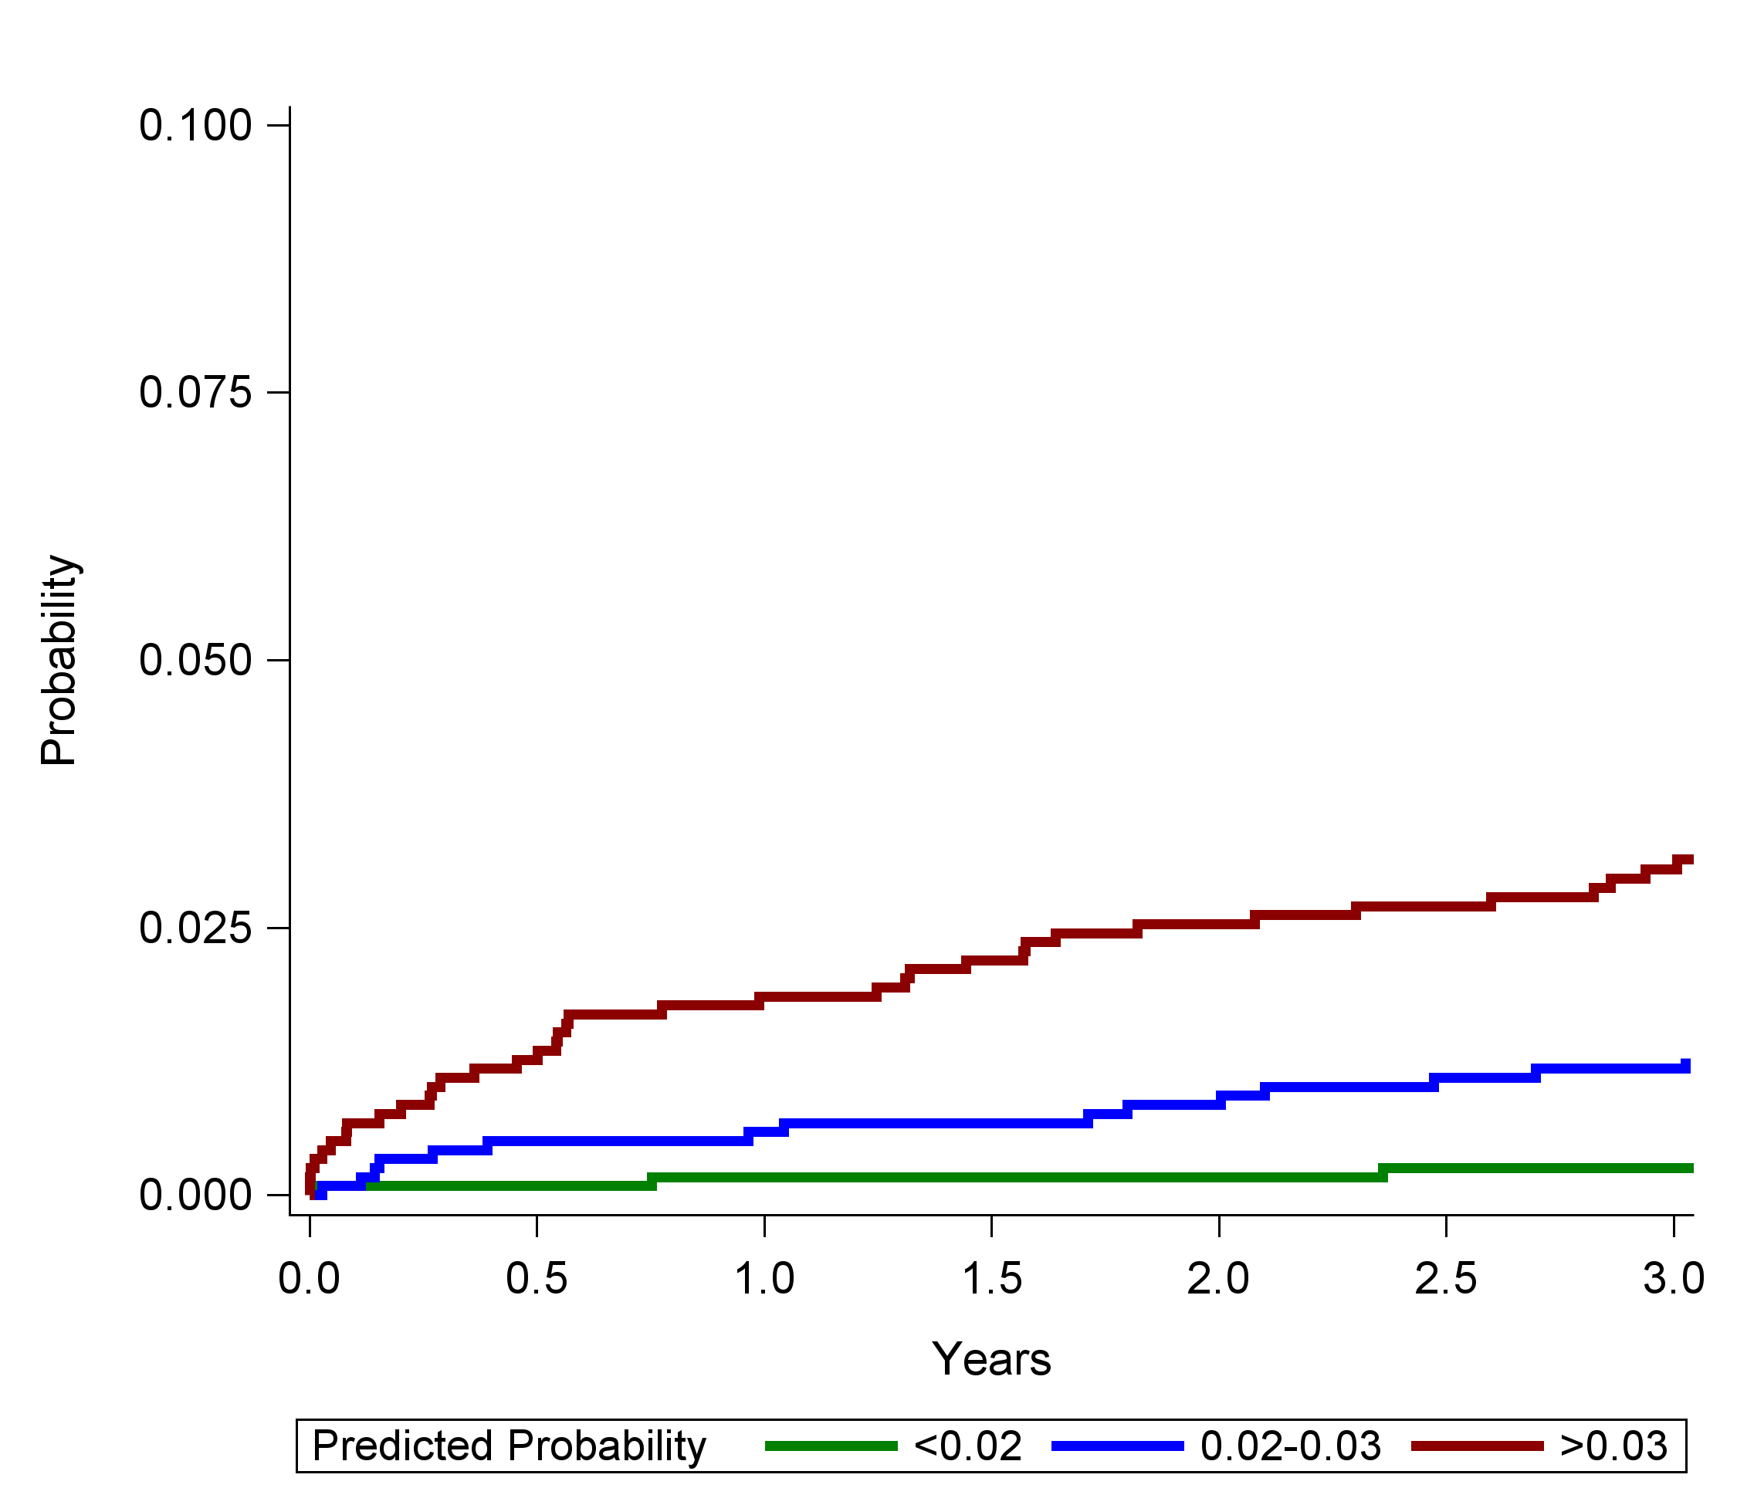
Cumulative Incidence Curves for Secondary Endpoint*
OPTIMAL AI-QCT MODEL
DIAMOND FORRESTER PTP for obstructive CAD
Low
Low
Intermediate
Intermediate
High
High
3.3%
2.9%
1.3%
1.5%
1.3%
0.4%
KEY POINTS:
Patients with low AI-QCT have fewer events than those with low Diamond Forrester
Patients with high AI-QCT have more events than those with high Diamond Forrester
*All-cause death, myocardial infarction,

Slide 18
Discrimination of the Secondary Endpoint*
P=0.109
P<0.001
0.75
(0.68–0.81)
0.62
(0.53–0.70)
0.57
(0.50–0.64)
*All-cause death, myocardial infarction

Slide 19
Conclusion
First multicenter multinational registry with AI based quantification of CAD.
AI-QCT quantification of coronary CTA lumen diameter stenosis and the noncalcified plaque volume were most predictive of MACE and added discriminative accuracy to Diamond and Forrester PTP and risk factors.
The atherosclerotic profile as assessed by AI-QCT may guide tailoring of anti-atherosclerotic therapies or coronary interventional procedures to reduce cardiovascular events.

