Slide 1
Temporary mechanical circulatory support in infarct-related cardiogenic shock:
An individual patient data meta-analysis
of randomized trials with 6-month follow-up
Holger Thiele*
Jacob E Møller*, Jose P S Henriques, Margriet Bogerd, Melchior Seyfarth, Daniel Burkhoff, Petr Ostadal, Richard Rokyta, Jan Belohlavek, Steffen Massberg, Marcus Flather, Matthias Hochadel, Steffen Schneider, Steffen Desch, Anne Freund, Hans Eiskjær, Norman Mangner, Janine Pöss, Amin Polzin, P Christian Schulze, Carsten Skurk,
Uwe Zeymer†, Christian Hassager†
on behalf of the MCS Collaborator Scientific Group
September 2, 2024

Slide 2
Conflict of Interest Statement
Funding:
German Research Foundation
German Heart Research Foundation
German Cardiac Society
European Union
Else-Kröner-Fresenius-Foundation
Schwiete-Foundation
Boston Scientific
Heart Center Leipzig
Institut für Herzinfarktforschung
Consulting: None
Speaker Honoraria:
None
Notes:
‹#›

Slide 3
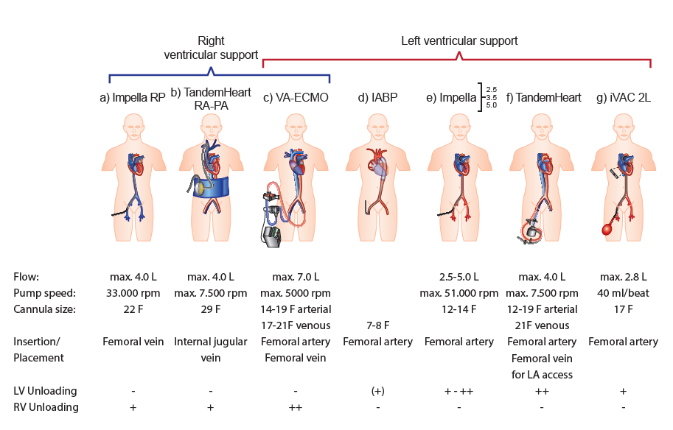
Background
Currently Available MCS
2.5
CP
5.0
5.5
ESC Class III B recommen-
dation
(IABP-SHOCK II Trial)
5
Loading
Unloading
Thiele et al. Eur Heart J 2019:40:2671-2683
Byrne et al. Eur Heart J 2023;44: 3720–3826
Notes:
‹#›

Slide 4
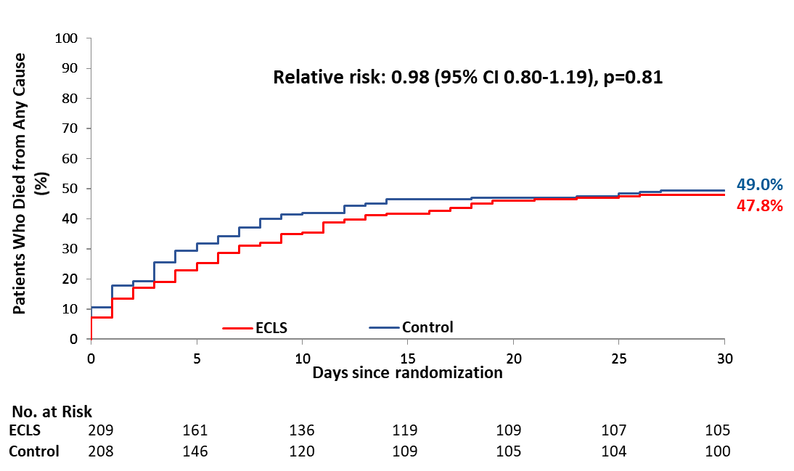
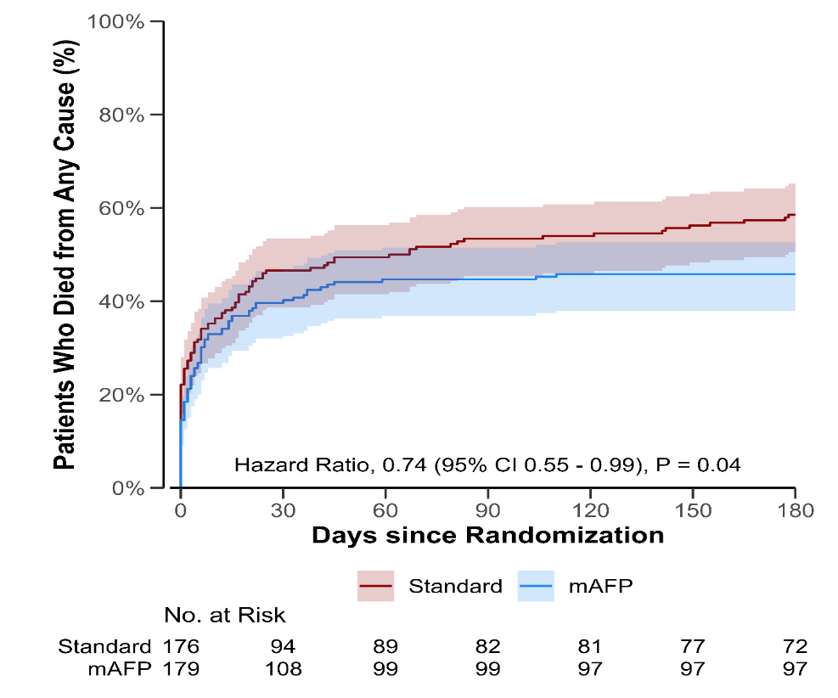
Background
Different Trial Results
58.5%
45.8%
Thiele et al. NEJM 2023; 389:1286-1297
Møller et al. NEJM 2024;390:1382-1393
Notes:
‹#›

Slide 5
How Can these Differences Be Explained?
Background
Device?
LV Unloading
LV Loading
STEMI + NSTEMI
STEMI only
77% Resuscitation -> 20% hypoxic brain injury
Lactate 6.9 mmol/l
Ventilation: 90%
Catecholamines: 90%
Patient selection?
20% Resuscitation - only witnessed CA
-> 2% hypoxic brain injury
Lactate 4.5 mmol/l
Ventilation: 70%
Catecholamines: 85%
30 days
Follow-up?
6 months
RRT 8.1% vs 13.1%
ICU time: 10 vs 8 days
MCS duration: 2.7 days
RRT 41.9% vs 26.7%
ICU time: 6 vs 3 days
MCS duration: 2.5 days
Treatment Bias?
Thiele et al. NEJM 2023; 389:1286-1297
Møller et al. NEJM 2024;390:1382-1393
Notes:
‹#›

Slide 6
To overcome current insufficient evidence related to MCS device and patient selection in the treatment of cardiogenic shock complicating AMI, we performed a collaborative meta-analysis of ALL RCTs using 1) individual patient data 2) including unpublished data with longer 6-month follow-up. This study is registered with PROSPERO (CRD42024504295).
Aims and Methods

Slide 7
Aims and Methods
Three major analyses were performed to ascertain the effects on 6-month mortality of
Early routine active MCS versus control (incl. IABP)
Focus on device type, i.e.
loading MCS (VA-ECMO) versus control and
unloading MCS (Impella/TandemHeart) vs control
Focus on patient selection, i.e., MCS versus control in DanGer-like patients (STEMI without risk of hypoxic brain injury).

Slide 8
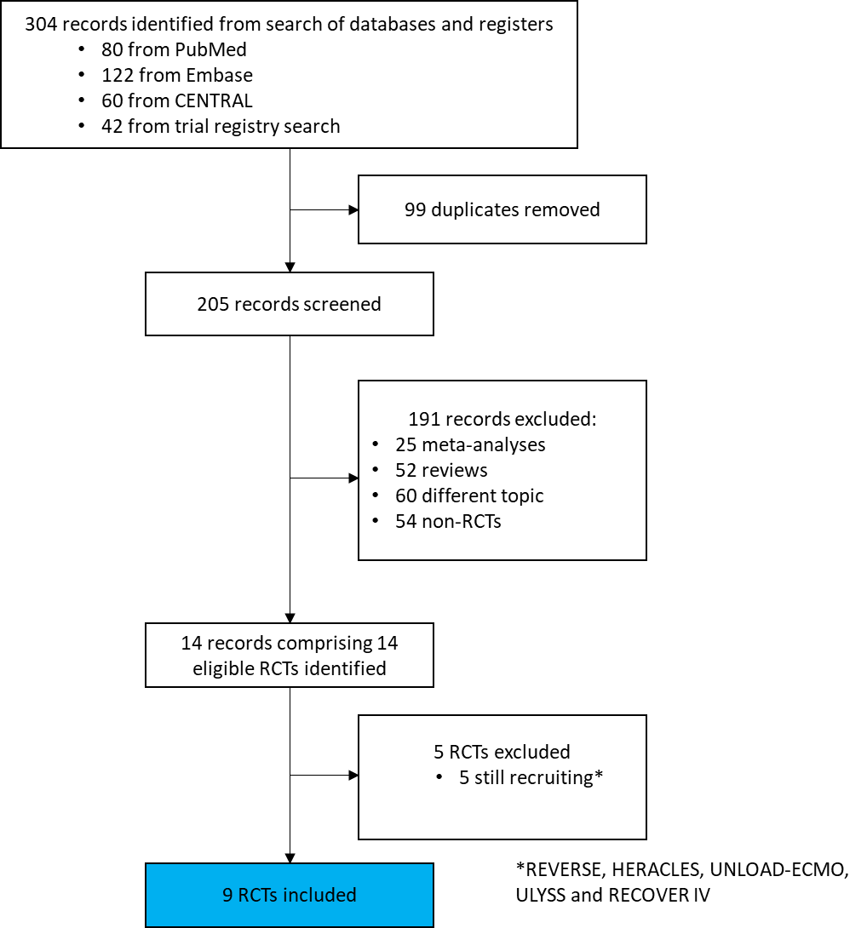
Search Strategy
Methods

Slide 9
Baseline Characteristics
Results
 | TOTAL | MCS | Control
Patients included | 1059 (100.0%) | 533 (50.3%) | 526 (49.7%)
Demographics
Age (years); Median (IQR) | 65 (57;73), N=1058 | 64 (57;72), N=532 | 66 (58;73), N=526
Male sex | 845/1058 (79.9%) | 421/532 (79.1%) | 424/526 (80.6%)
Cardiovascular risk factors
Current smoking | 364/976 (37.3%) | 185/486 (38.1%) | 179/490 (36.5%)
Hypertension | 573/1020 (56.2%) | 283/513 (55.2%) | 290/507 (57.2%)
Dyslipidemia | 331/930 (35.6%) | 150/465 (32.3%) | 181/465 (38.9%)
Diabetes mellitus | 292/1024 (29.0%) | 144/514 (28.0%) | 148/510 (29.0%)
Baseline hemodynamics
Systolic BP [mmHg] | 92±26, N=896 | 92±25, N=457 | 93±27, N=439
Mean BP [mmHg] | 70±19, N=959 | 69±18, N=488 | 70±20, N=471
ECG pre PCI
ST-segment elevation | 819/1008 (81.3%) | 412/504 (81.7%) | 407/504 (80.8%)
NSTEMI | 189/1008 (18.8%) | 92/504 (18.3%) | 97/504 (19.2%)
Anterior infarction | 644/997 (64.6%) | 323/502 (64.3%) | 321/495 (64.9%)
Resuscitation prior rando | 534/1037 (51.5%) | 272/521 (52.2%) | 262/516 (50.8%)
No. of diseased vessels
Single vessel disease | 306/1013 (30.2%) | 165/508 (32.5%) | 141/505 (27.9%)
Double vessel disease | 317/1013 (31.3%) | 174/508 (34.3%) | 143/505 (28.3%)
Triple vessel disease | 366/1013 (36.1%) | 158/508 (31.1%) | 208/505 (41.2%)
Baseline LVEF [%] | 25 (20;35), N=857 | 25 (20;35), N=422 | 27 (20;35), N=435
Baseline laboratory values
Pre-PCI Lactate | 5.6 (3.7;9.0), N=1020 | 5.6 (3.7;8.5), N=512 | 5.6 (3.7;9.5), N=508
Lactate ≥5 mmol/l | 576/1020 (56.5%) | 291/512 (56.8%) | 285/508 (56.1%)
GFR [ml/min] | 64.3 (47.5, 84.3), N=640 | 65.8 (47.5, 84.2), N=318 | 63.0 (47.5, 84.3), N=322

Slide 10
Treatment
Results
 | TOTAL | MCS | Control
Type of revascularisation
Initial revascularisation by PCI only | 994/1044 (95.2%) | 499/526 (94.9%) | 495/518 (95.6%)
Initial revascularisation by CABG | 3/1044 (0.3%) | 1/526 (0.2%) | 2/518 (0.4%)
PCI with immediate transfer to CABG | 11/1044 (1.1%) | 5/526 (1.0%) | 6/518 (1.2%)
No revascularisation | 36/1044 (3.4%) | 21/526 (4.0%) | 15/518 (2.9%)
TIMI flow before revascularisation
TIMI-flow 0 | 586/998 (58.7%) | 286/502 (57.0%) | 300/496 (60.5%)
TIMI-flow I | 136/998 (13.6%) | 74/502 (14.7%) | 62/496 (12.5%)
TIMI-flow II | 151/998 (15.1%) | 76/502 (15.1%) | 75/496 (15.1%)
TIMI-flow III | 125/998 (12.5%) | 66/502 (13.1%) | 59/496 (11.9%)
TIMI flow after revascularisation
TIMI-flow 0 | 24/978 (2.4%) | 14/489 (2.9%) | 10/489 (2.0%)
TIMI-flow I | 30/978 (3.1%) | 17/489 (3.5%) | 13/489 (2.7%)
TIMI-flow II | 115/978 (11.8%) | 51/489 (10.4%) | 64/489 (13.1%)
TIMI-flow III | 809/978 (82.6%) | 407/489 (83.2%) | 402/489 (82.2%)
Immediate multivessel-PCI | 74/546 (13.6%) | 42/273 (15.4%) | 32/273 (11.7%)
Circulatory support
Device randomized to
Standard care including IABP | 526/1059 (49.7%) | 0/533 (0%) | 526/526 (100·0%)
VA-ECMO | 284/1059 (26.8%) | 284/533 (53.3%) | 0/526 (0%)
TandemHeart | 33/1059 (3.1%) | 33/533 (6.2%) | 0/526 (0%)
Impella 2.5 | 13/1059 (1.2%) | 13/533 (2.4%) | 0/526 (0%)
Impella CP | 203/1059 (19.2%) | 203/533 (38.1%) | 0/526 (0%)
Other treatment
Mechanical ventilation | 859/1018 (84.4%) | 441/510 (86.5%) | 418/508 (82.3%)
Duration, Median (IQR) | 5.0 (2.3;10.0) | 6.0 (3.0;11.0) | 5.0 (2.0;8.3)

Slide 11
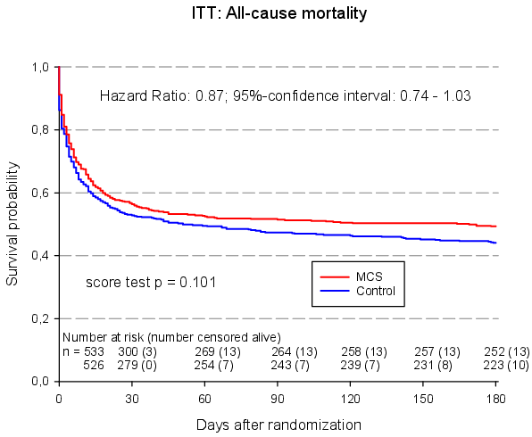
6-Month Mortality - MCS versus no MCS
Results

Slide 12
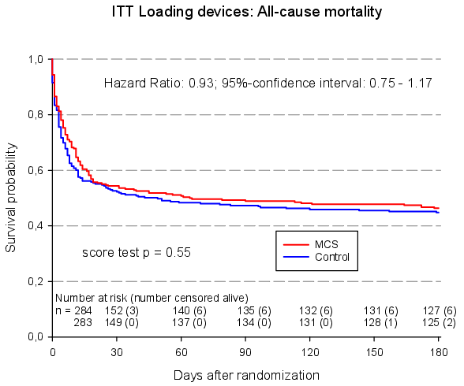
6-Month Mortality – Loading Devices (VA-ECMO) versus no MCS
Results

Slide 13
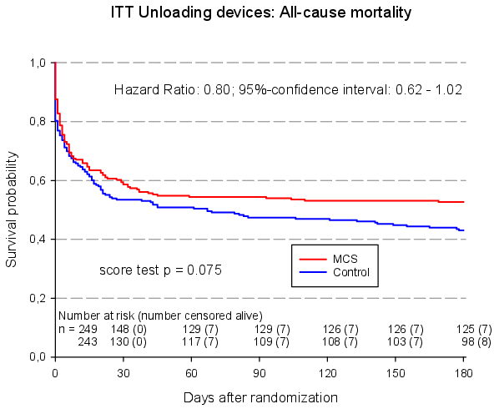
6-Month Mortality – Unloading (Impella/TandemHeart) versus no MCS
Results

Slide 14
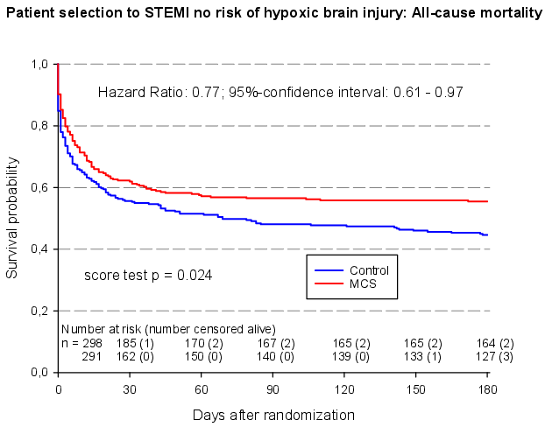
Results
6-Month Mortality – Patient Selection MCS versus no MCS

Slide 15
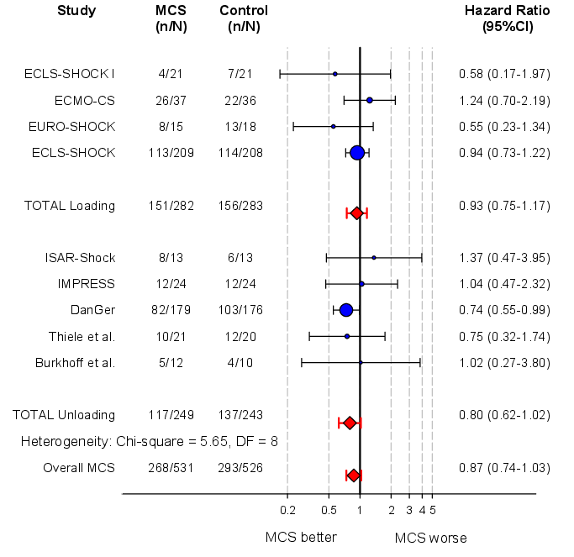
Forest Plot – 6-Month Mortality
Results

Slide 16
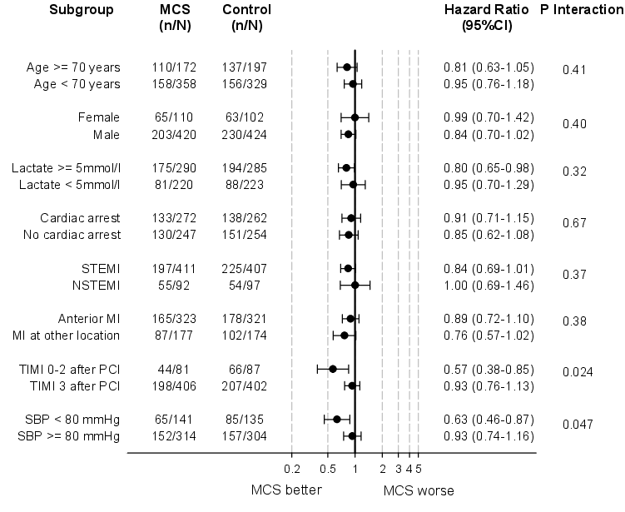
Results
Subgroup Analysis

Slide 17
Results
Secondary Endpoints + Safety @30 Days
HR 0.89
(0.74–1.06)
43.6
OR 2.64
(1.91–3.65)
OR 1.29
(0.94–1.77)
%
OR 1.28
(0.87–1.88)
OR 4.43
(2.37–8.26)
OR 1.48
(0.72–3.04)

Slide 18
Summary and Conclusions
In patients with acute myocardial infarction and cardiogenic shock with planned revascularization routine early MCS versus control does not reduce 6-month all-cause mortality.
This lack of 6-month mortality benefit is irrespective of the device type; i.e. loading versus unloading devices.
MCS use is associated with an increased risk of bleeding and peripheral vascular complications.
A benefit of early MCS on 6-month mortality was observed only for patients with STEMI and low risk of hypoxic brain injury.
Therefore, MCS should only be reserved for selected patients.

Slide 19
Acknowledgments and Thank You
Funding
Thank you to all investigators of the inidividial RCTs
Our greatest thanks go to the patients and relatives.
@thiele_holger
holger.thiele@medizin.uni-leipzig.de

Slide 20
Now Online
www.thelancet.com

