Slide 1
The British Heart Foundation SENIOR-RITA Trial
Invasive Treatment Strategy for Older Patients with Myocardial Infarction
Professor Vijay Kunadian
MBBS, MD, MRCP, FRCP, FACC, FESC, PG Dip (Clinical Trials)
Study Chair and Chief Investigator THE BHF SENIOR-RITA Trial
Personal Chair and Clinical Professor of Interventional Cardiology
Honorary Academic Consultant Interventional Cardiologist
Newcastle upon Tyne, United Kingdom

Slide 2
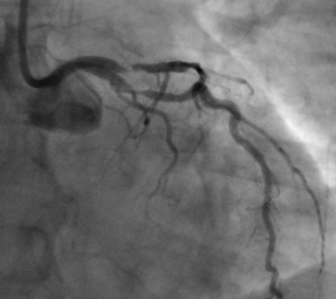
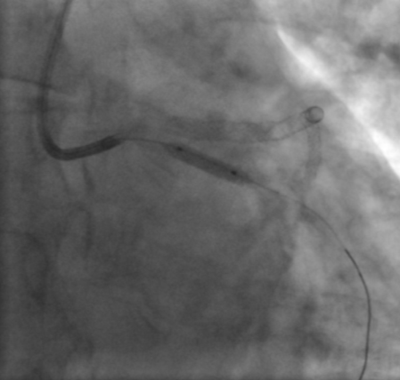
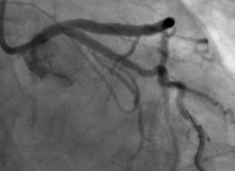
Background: Our population is rapidly ageing.....
88-year-old female with NSTEMI, multi-vessel stenting
Older adults are heterogeneous!
Multiple long-term conditions
Age
Frailty
Diabetes
COPD
Liver disease
Kidney disease
Anaemia
Stroke
Cancer
PAD
Cognition
Complex, ageing, calcified coronary arteries…
Recurrent events, repeat hospitalisations, cost to service providers
Frailty- high mortality
Co-morbidity- high mortality
Cognitive impairment- high mortality
Frail patients-high risk plaque features
PAD-peripheral arterial disease, COPD-chronic obstructive pulmonary disease
Ratcovich et al. Eur Heart J Open. 2022 16;2(3):oeac035; Dirjayanto et al. Heart. 2024;110(6):416-424; Beska et al. BMJ Open. 2022;12(7):e061830

Slide 3
Background: Optimal care underutilised in older patients
50% of NSTEMI occurs in patients aged ≥70years!
Questions:
Older adults undertreated?
What about the rest-86%?
Fear of complications?
Futility?
Care is diverse
Frequency distribution of STEMI and NSTEMI in 2013/14
Aspirin 18 – <65 65 – <75 75 – <85 85+
ACEi 18 – <65 65 – <75 75 – <85 85+
Statin 18 – <65 65 – <75 75 – <85 85+
Angiogram 18 – <65 65 – <75 75 – <85 85+
30
STEMI
25
NSTEMI
20
Percentage (%)
15
10
5
0
20–29
30–39
40–49
50–59
60–69
70–79
80–89
90+
Age
0
0.2
0.4
0.6
0.8
1.0
Odds ratios for receipt of treatment by age group
Only 14% of those ≥85 years receive angiography
Zaman J et al. Eur Heart J 2014;35(23):1551–1558.

Slide 4
Background: RCT evidence in older NSTEMI patients
Italian Elderly ACS: Sample size = 313
No difference between conservative vs invasive treatment
Savonitto S, et al. JACC. Cardiovasc Interv 2012;5:906–916.
✗
Limitations of existing studies:
Small sample sizes
Challenges with recruitment
No formal frailty assessment
No assessment of comorbidities burden
No assessment of cognitive function
No formal adjudication of events
Inconsistent findings
Limits generalizability
2012
After Eighty: Sample size = 457
Reduction in recurrent MIs and coronary revascularisations.
No major differences in the rates of death, stroke, or bleeding
Tegn N, et al. Lancet 2016;387:1057–1065.
Total sample size
2016
✓
1480!
MOSCA: Sample size = 106; MOSCA Frail = 167
No difference between conservative vs invasive treatment
Sanchis J, et al. Eur J Intern Med 2016;35:89–94; JAMA Netw Open. 2024;7(3):e240809.
✗
2016
2023
80+ Study: Sample size = 186
No difference between conservative vs invasive treatment
Hirlekar et al. Scandinavian Cardiovascular Journal 2020: 54(5):315-321
✗
2020
RINCAL: Sample size = 251
No difference between conservative vs invasive treatment
De Belder A et al. Eurointervention 2021 May 17;17(1):67-74
✗
2021
Mills et al. Eur Heart J Open. 2021;2(1):oeab044

Slide 5
RESEARCH QUESTION
To investigate whether conservative strategy with medical therapy alone or invasive strategy plus medical therapy is beneficial in an all-comer older adults with non-ST-elevation myocardial infarction.

Slide 6
STUDY DESIGN
75+ NSTEMI
Patients were recruited from EDs, MAU, cardiology wards, medical wards, geriatric wards at PCI and non-PCI centres
Randomise
For patients assigned to the conservative arm, coronary angiography was allowed if there was clinical deterioration, and it was clinically indicated at the discretion of the treating physicians.
Invasive treatment
Conservative treatment
Follow-up: 6 months, 1 year and then yearly until 5 years either via telephone or in person visit
Formal assessment of frailty, cognition, co-morbidity at baseline and follow-up
ED-emergency department; MAU-medical admissions unit; PCI-percutaneous coronary intervention

Slide 7
ELIGIBILITY CRITERIA
INCLUSION CRITERIA
Aged ≥75 years old
Type 1 NSTEMI during index hospitalisation
EXCLUSION CRITERIA
Patients presenting with STEMI or unstable angina
Patients with cardiogenic shock
Patients with a known life expectancy of <1 year
Previous randomisation in the SENIOR RITA trial
Inability to undergo invasive coronary angiography, such as no vascular access site, or absolute contraindication to coronary revascularisation
NSTEMI-non ST elevation myocardial infarction; STEMI-ST elevation myocardial infarction

Slide 8
STUDY ENDPOINTS
Primary outcome:
Time to cardiovascular death or non-fatal myocardial infarction.
Secondary outcomes:
Cardiovascular death
Non-fatal myocardial infarction
Composite of all cause death or myocardial infarction
All cause death
Non-cardiovascular death
Recurrent myocardial infarction
Subsequent coronary angiography
Subsequent coronary revascularization
Hospitalization for heart failure
Stroke, transient ischemic attack
Bleeding defined by the BARC criteria
BARC-bleeding academic research consortium

Slide 9
SAMPLE SIZE
We assumed a primary event rate of 20% in the conservative therapy arm at 12 months and aimed to detect a reduction to 16% in the invasive therapy arm, corresponding to hazard ratio of 0.78.
The target sample size was 1668 patients
Analyses used all available data, up to a maximum of 5 years follow-up, and were performed on an intention-to-treat basis.

Slide 10
STUDY ORGANISATION
48/52 Sites
Site | No. of participants
Northumbria | 171
Newcastle | 167
North Tees | 150
Chesterfield | 94
South Tees | 88
Darlington & Durham | 68
Sheffield | 57
Royal Derby | 56
Ayrshire & Arran | 53
Leeds | 52
Torbay & South Devon | 51
Edinburgh | 45
South Manchester | 32
Epsom & St Helier | 31
Dundee | 28
Bradford | 28
Blackpool | 28
Lincoln | 27
Wrightington Wigan & Leigh | 23
North Bristol | 20
Leicester | 20
Site | No. of participants
Plymouth | 19
Basildon | 17
Gateshead | 16
Royal Free London | 14
Pinderfields | 13
Luton | 13
York | 13
West Middlesex | 11
Sandwell Birmingham | 11
Mid Essex | 11
East Sussex | 10
Glasgow-QEUH | 10
Glasgow-Royal Alexandra | 9
Surrey & Sussex | 9
North Cumbria | 8
Salford | 6
South Tyneside | 6
Sunderland | 6
Maidstone | 5
Aberdeen | 5
Royal Oldham | 5
Nottingham | 3
Stoke | 2
Lanarkshire | 2
Royal Berkshire | 2
Salisbury | 1
Borders | 1
8 Sites
45% of patients recruited from Northeast of England
40 Sites
Research to the patient!
PCI and non-PCI centres

Slide 11
STUDY FLOW
75+ NSTEMI
1:5 screened patient was recruited*
Randomise: N=1518
90% had angiography in the invasive group
5.6% in conservative group had angiography
Invasive treatment: N=753
Conservative treatment: N=765
Follow-up: 4.04 years (4.01-4.88)
Follow-up: 4.06 years (4.02-4.31)**
98% events adjudicated by CEC
Follow-up available for 98.9% of patients across all time points
ITT Primary Analysis: N=753
ITT Primary Analysis: N=765
*Given we are recruiting all comer patients who are heterogeneous-this was expected. As per screening log, the demographics of non-recruited patients were similar to recruited patients.
** Median, 95% Confidence Interval. CEC-clinical events committee; ITT-intention to treat

Slide 12
BASELINE CHARACTERISTICS
Characteristics | Invasive strategy N = 753 (%) | Conservative strategy N = 765 (%)
Female sex | 337 (44.8%) | 342 (44.7%)
Mean age - years | 82.5 ± 4.7 | 82.2 ± 4.7
≥75 to <80 | 211 (28.0%) | 246 (32.2%)
≥80 to < 85 | 304 (40.4%) | 291 (38.0%)
≥85 to < 90 | 182 (24.2%) | 171 (22.4%)
≥90 to < 95 | 47 (6.2%) | 51 (6.7%)
≥95 | 9 (1.2%) | 6 (0.8%)
Median days from admission to randomization (IQR) | 2 (1, 3) | 2 (1, 3)
Median MoCA (IQR) | 25 (21, 27) | 24 (21, 26)
Impaired (MoCA < 26) | 433/724 (59.8%) | 476/731 (65.1%)
Median Rockwood Frailty score (IQR) | 3 (2, 4) | 3 (2, 4)
Frail (Rockwood score ≥ 5) | 153 (20.3%) | 164 (21.4%)
Median Fried Frailty score (IQR) | 2 (1, 3) | 2 (1, 3)
Robust (0) | 150 (20.9%) | 153 (21.0%)
Pre-frail (1 or 2) | 335 (46.8%) | 339 (46.4%)
Fried Frailty score Frail (≥3) | 231 (32.3%) | 238 (32.6%)
Median Charlson co-morbidity index (IQR) | 5 (4, 6) | 5 (4, 6)
Salient features:
45% Female
72% ≥80 years
Oldest 103 years
80% Prefrail/Frail
60% MoCA <26
Median CCI = 5
IQR-Inter quartile range; MoCA-Montreal cognitive assessment; CCI-Charlson co-morbidity index

Slide 13
BASELINE CHARACTERISTICS
Characteristics | Invasive strategy N = 753 (%) | Conservative strategy N = 765 (%)
Hypertension | 490 (65.1%) | 500 (65.4%)
Diabetes | 232 (30.8%) | 234 (30.6%)
Smoking status
Current smoker | 35 (4.7%) | 45 (6.0%)
Ex-smoker | 358 (47.9%) | 336 (44.4%)
Never smoked | 355 (47.5%) | 375 (49.6%)
Hypercholesterolemia | 242 (32.2%) | 231 (30.3%)
History of renal disease | 156 (20.7%) | 158 (20.7%)
Previous myocardial infarction | 247 (32.8%) | 227 (29.7%)
Previous PCI | 163 (21.7%) | 139 (18.2%)
Previous CABG | 101 (13.4%) | 80 (10.5%)
History of peripheral vascular disease | 57 (7.6%) | 61 (8.0%)
History of TIA/Stroke | 128 (17.0%) | 101 (13.2%)
History of COPD | 115 (15.3%) | 118 (15.4%)
History of malignancy | 138 (18.3%) | 129 (16.9%)
History of congestive heart failure | 73 (9.7%) | 70 (9.2%)
History of liver disease | 8 (1.1%) | 9 (1.2%)
History of peptic ulcer disease | 27 (3.6%) | 31 (4.1%)
History of bleeding | 25 (3.3%) | 25 (3.3%)
History of anemia | 58 (7.7%) | 53 (6.9%)
PCI-percutaneous coronary intervention; CABG-coronary artery byspass surgery; TIA-transient ischaemic attack; COPD-chronic obstructive pulmonary disease

Slide 14
MEDICAL THERAPY
DISCHARGE MEDICAL THERAPY | Invasive Strategy N=752 (%) | Conservative Strategy N=762 (%)
Aspirin | 682 (90.7%) | 663 (87.0%)
P2Y₁₂ Receptor Antagonist | 674 (89.6%) | 719 (94.4%)
Clopidogrel | 348 (46.3%) | 405 (53.1%)
Ticagrelor | 322 (42.8%) | 313 (41.1%)
Prasugrel | 4 (0.5%) | 1 (0.1%)
None | 20 (2.7%) | 8 (1.0%)
Anticoagulant | 170 (22.6%) | 183 (24.0%)
Triple therapy | 100 (13.3%) | 91 (11.9%)
ACE inhibitor or ARB | 536 (71.3%) | 513 (67.3%)
Beta-blocker | 596 (79.3%) | 601 (78.9%)
Lipid lowering therapy | 682 (90.7%) | 688 (90.3%)
ACE-angiotensin converting enzyme; ARB-aldosterone receptor blocker

Slide 15
PROCEDURAL CHARACTERISTICS
Angiography performed – no. (%)# | 680 (90.3%)
Radial access – no. (%) | 607 (89.3%)
Multivessel disease – no. (%) | 380 (55.9)
Median days from admission to angiography (IQR) | 5 (3, 7)
Median days from randomization to angiography (IQR) | 3 (1, 5)
Reason not performed
Clinical decision – no. (%) | 35 (4.6%)
Participant decision – no. (%) | 21 (2.8%)
Participant too unwell – no. (%) | 13 (1.7%)
Participant died – no. (%) | 3 (0.4%)
Not known – no. (%) | 1 (0.1%)
Revascularization performed – no. (%) | 376 (49.9%)
PCI – no. (%) | 351 (46.6%)*
CABG – no. (%) | 25 (3.3%)
Median days from admission to PCI (IQR) | 5 (3, 7)**
Median days from randomization to PCI (IQR) | 2 (1, 4)
Median days from admission to CABG (IQR) | 18 (13, 27)
Procedural complications | No. (%)
Bleeding (BARC criteria) | 13 (1.9)
Type 1 | 3 (0.4)
Type 2 | 8 (1.2)
Type 3a | 1 (0.1)
Type 5b | 1 (0.1)
Coronary dissection | 5 (0.7)
Myocardial infarction | 4 (0.6)
>25% increase in serum creatinine concentration | 3 (0.4)
Vascular complications needing intervention | 3 (0.4)
Other – Cardiac arrest | 3 (0.4)
Emergency repeat angiography or PCI | 2 (0.3)
Other – Cardiogenic shock | 2 (0.3)
Other – Vasovagal event | 2 (0.3)
Other – Stable chest pain | 2 (0.3)
TIA | 1 (0.1)
Stroke | 1 (0.1)
Death | 1 (0.1)
Other – Contrast reaction | 1 (0.1)
Other – Stent dislodgement | 1 (0.1)
Other – Confusion and agitation | 1 (0.1)
#Detailed core lab angiographic analysis ongoing; *30% had multivessel PCI; **Consistent with current UK practice
IQR-inter quartile range; PCI-percutaneous coronary intervention; CABG-coronary artery bypass surgery; TIA- transient ischaemic attack; BARC-bleeding academic research consortium

Slide 16
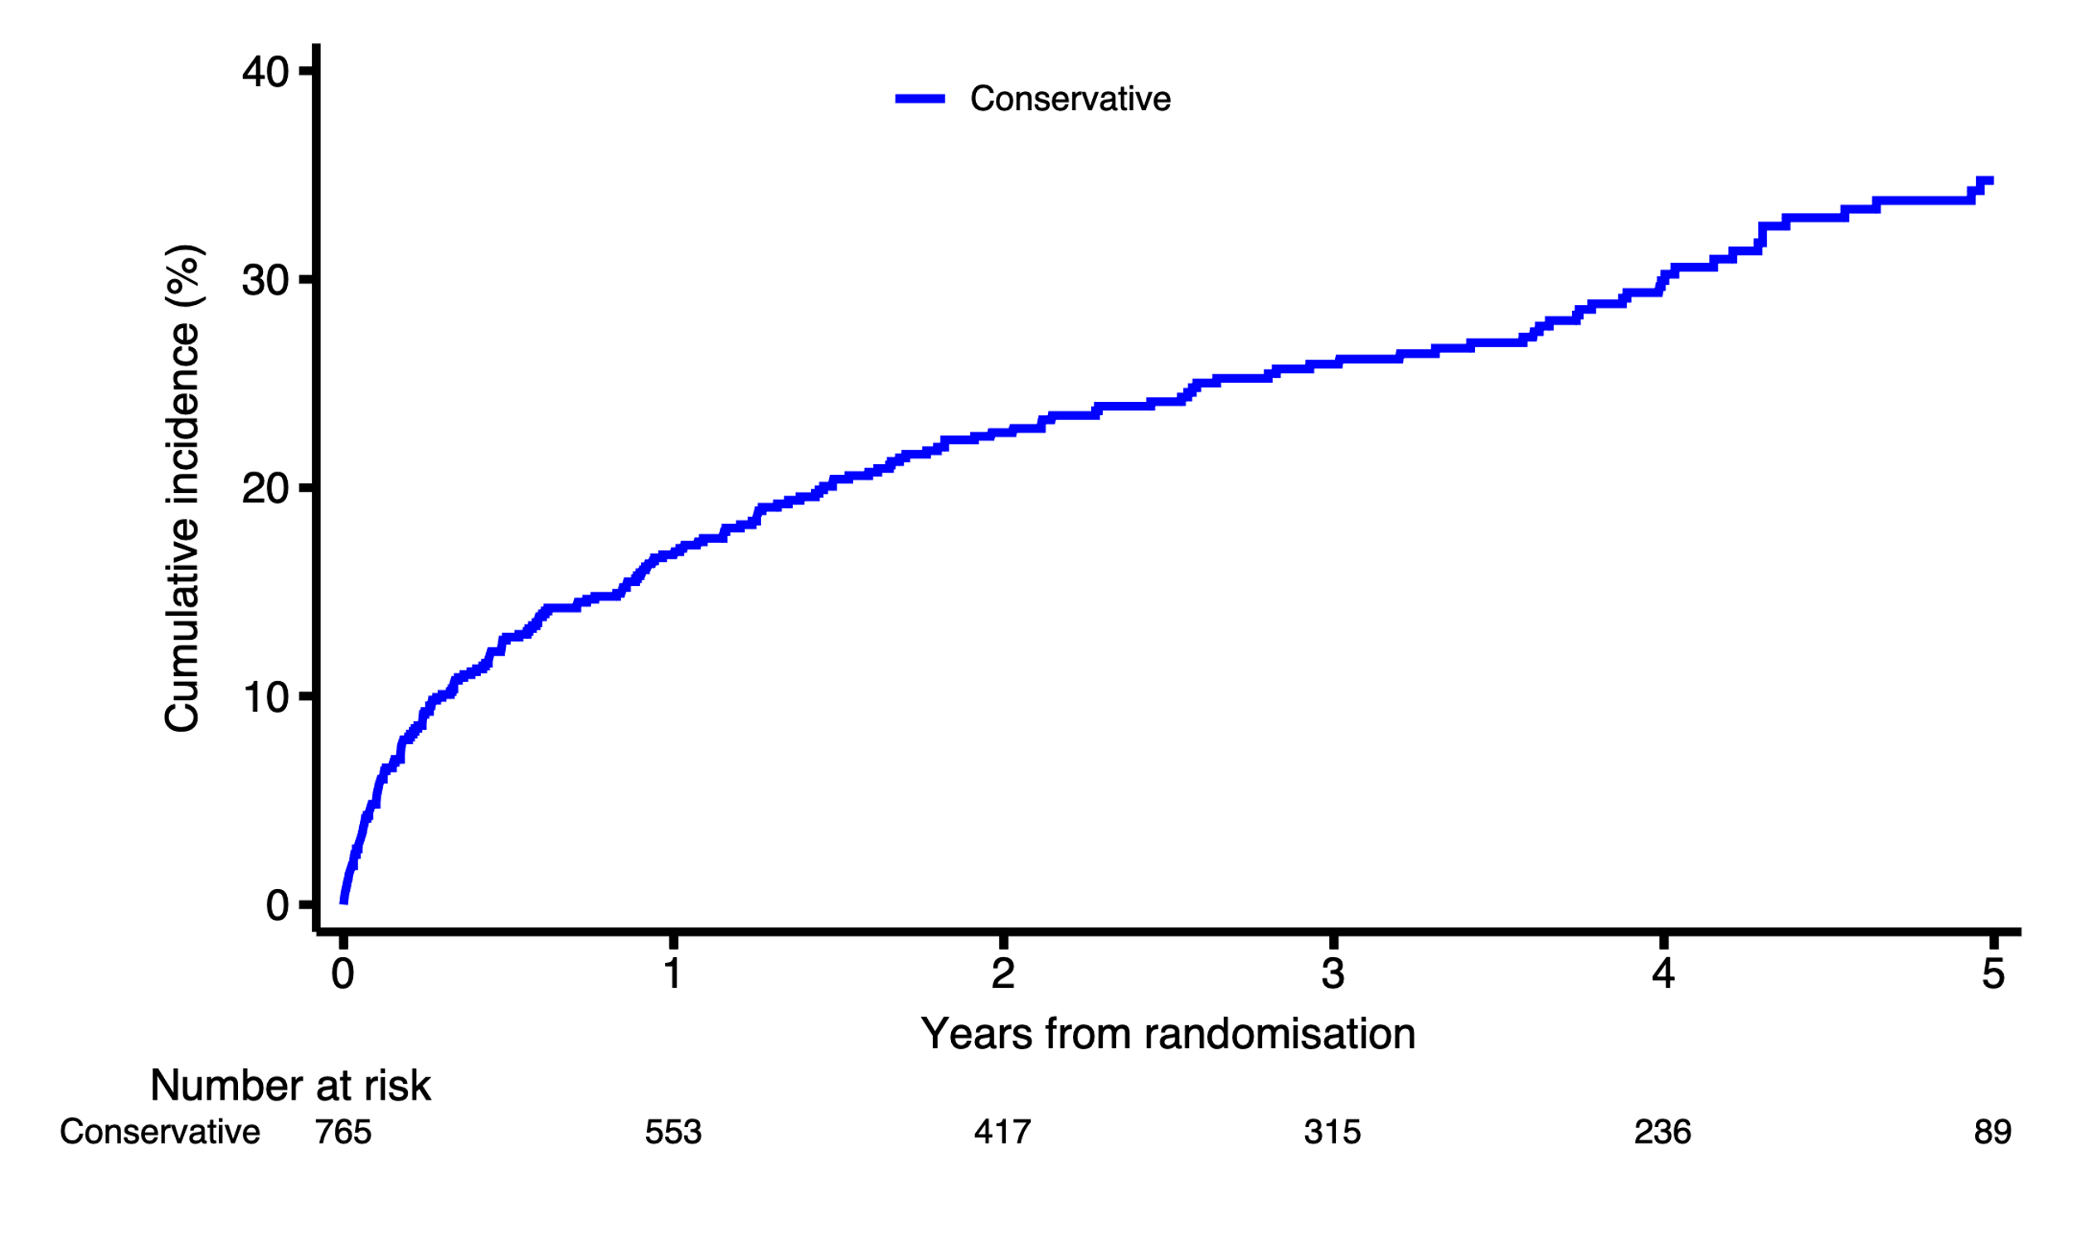
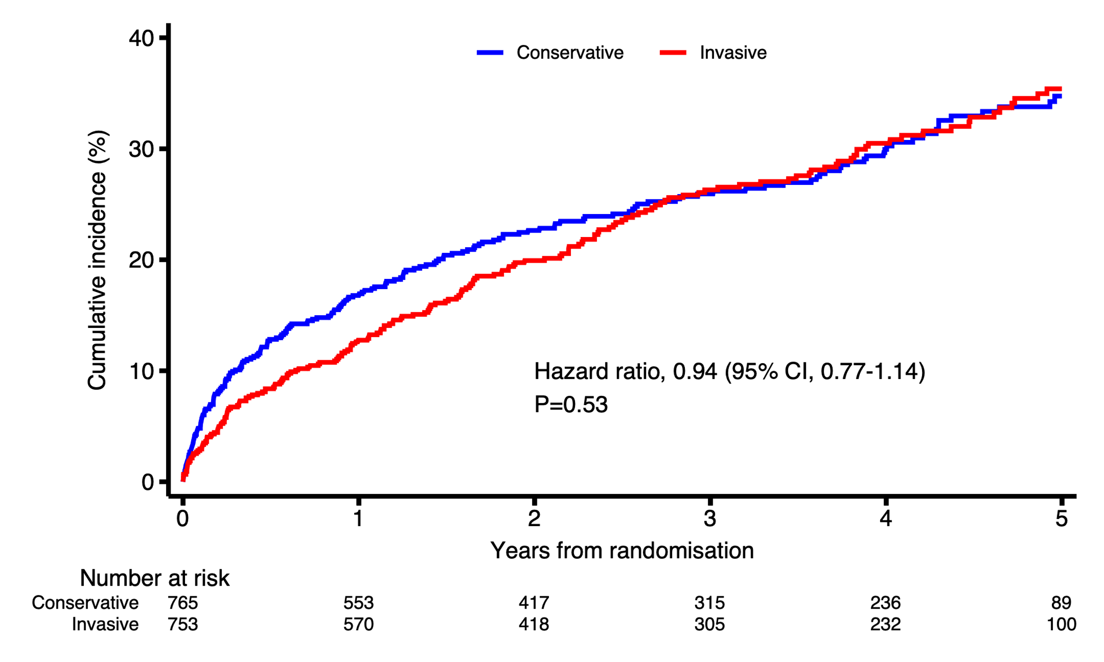
PRIMARY OUTCOME:
COMPOSITE OF CV DEATH OR NON-FATAL MI
Hazard ratio 0.94; 95% CI 0.77 - 1.14 P=0.53
CV-Cardiovascular; MI Myocardial infarction; CI-Confidence interval

Slide 17
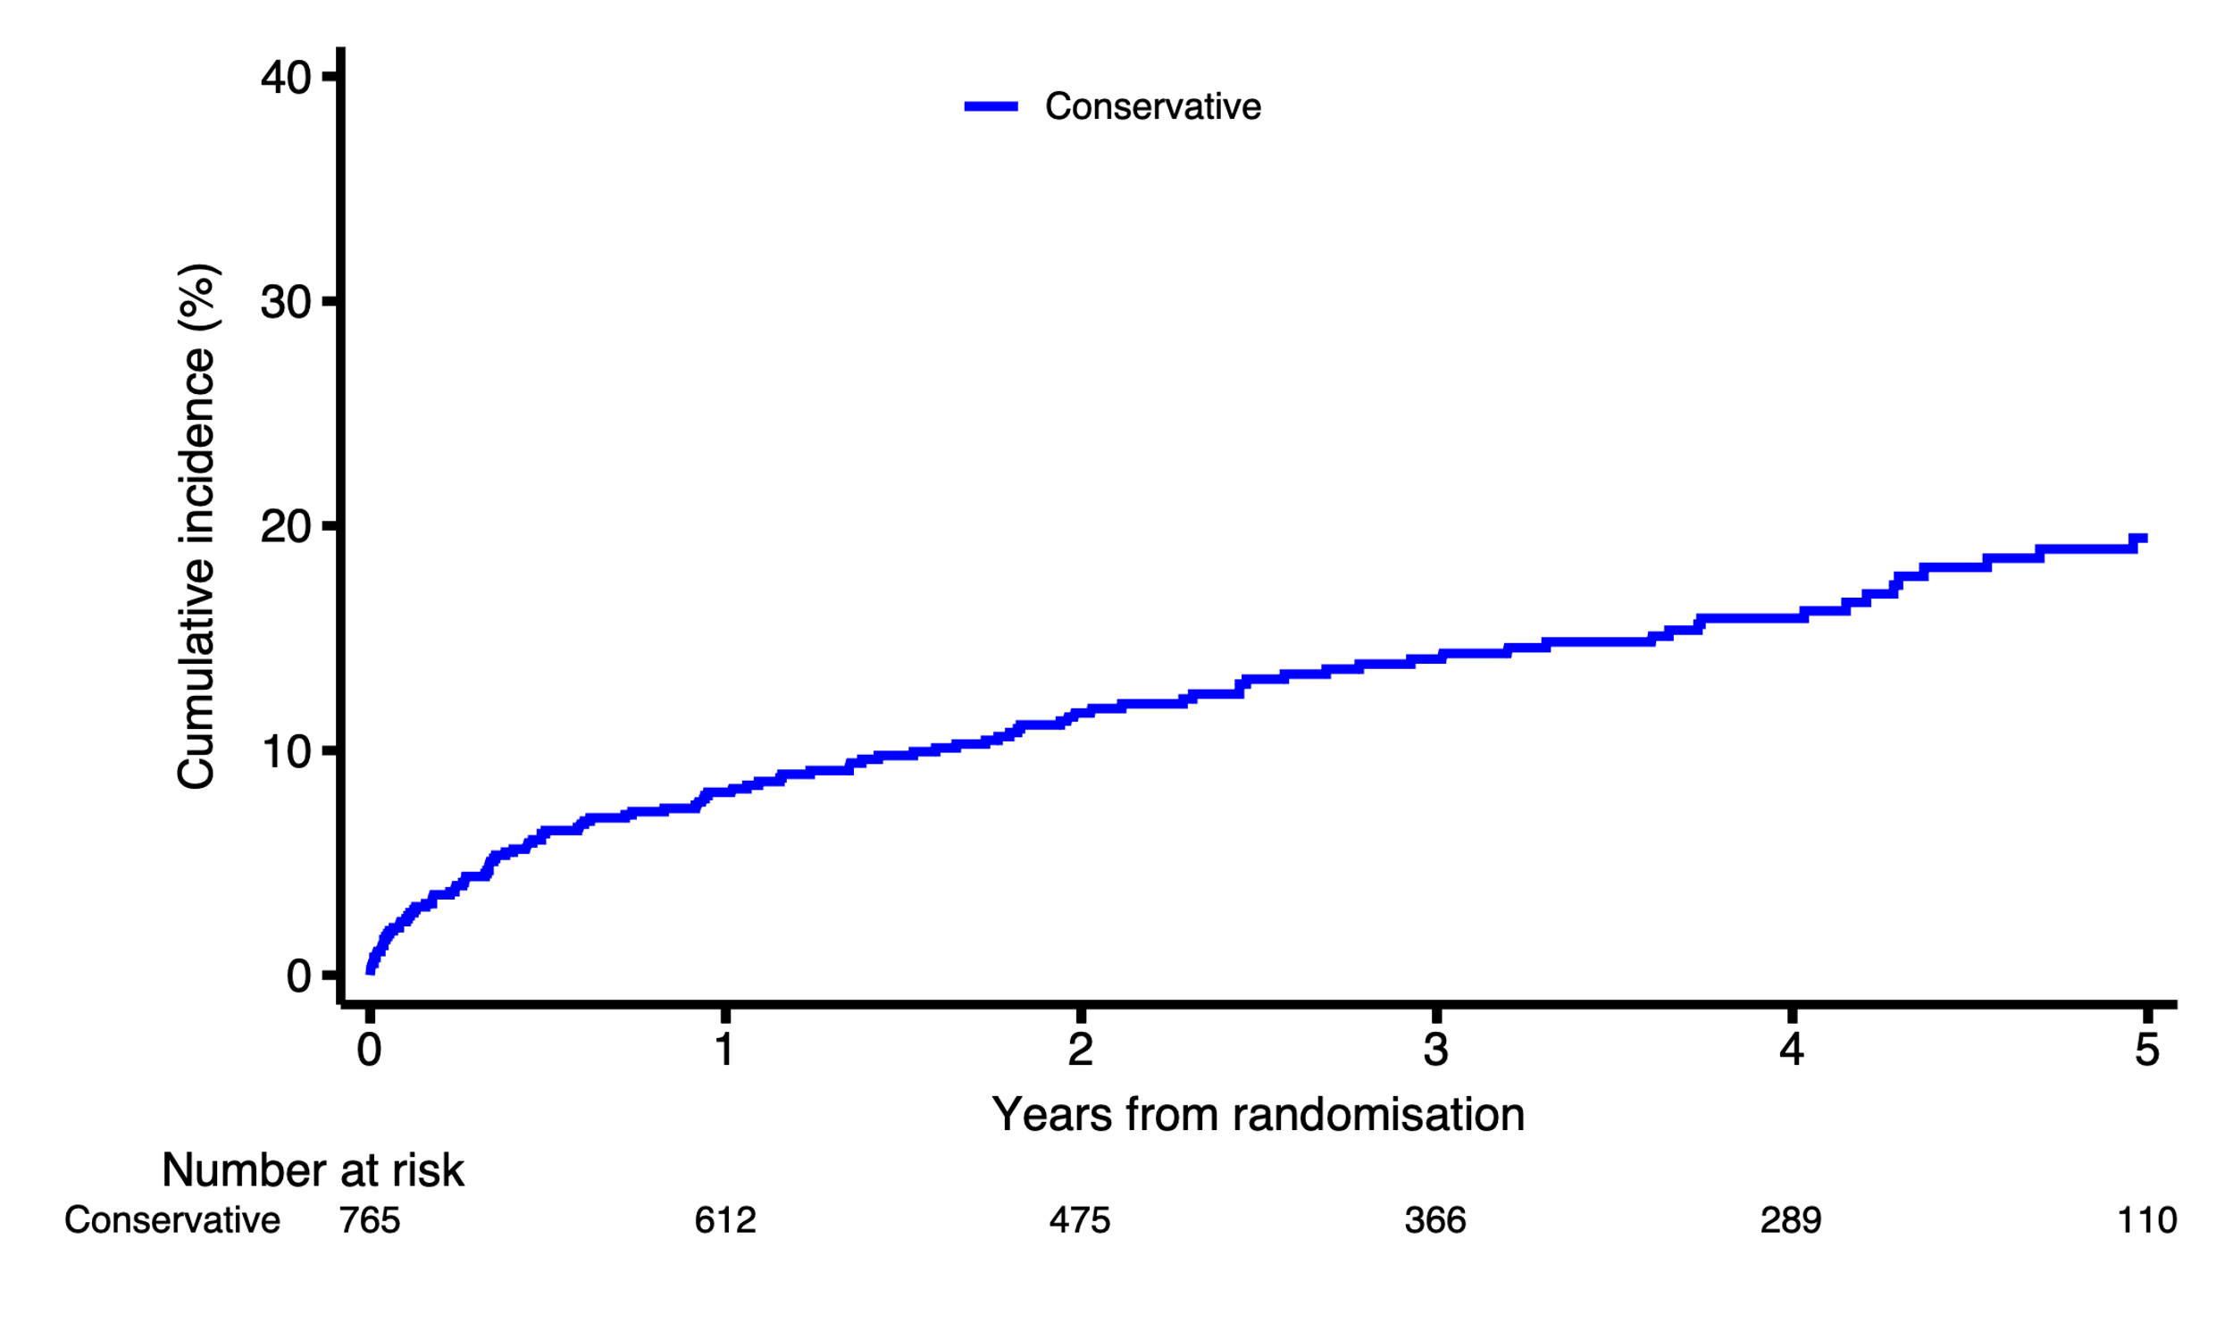
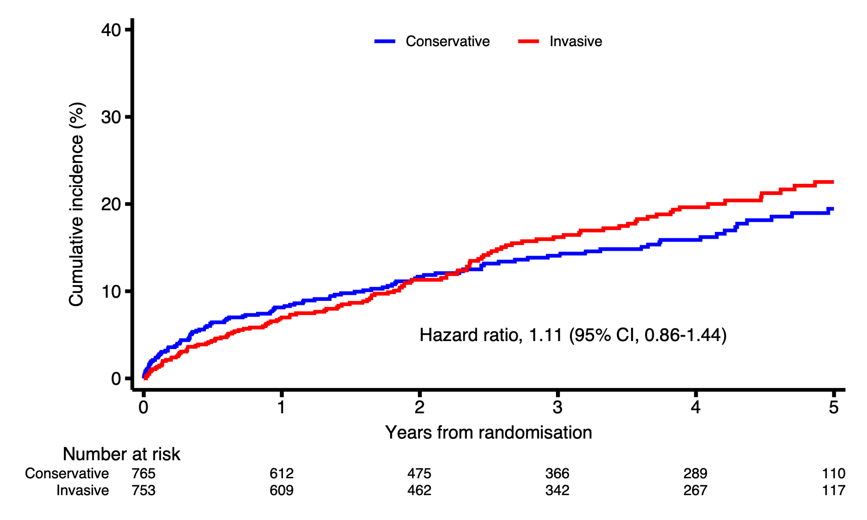
CARDIOVASCULAR MORTALITY
Hazard ratio 1.11; 95% CI 0.86-1.44

Slide 18
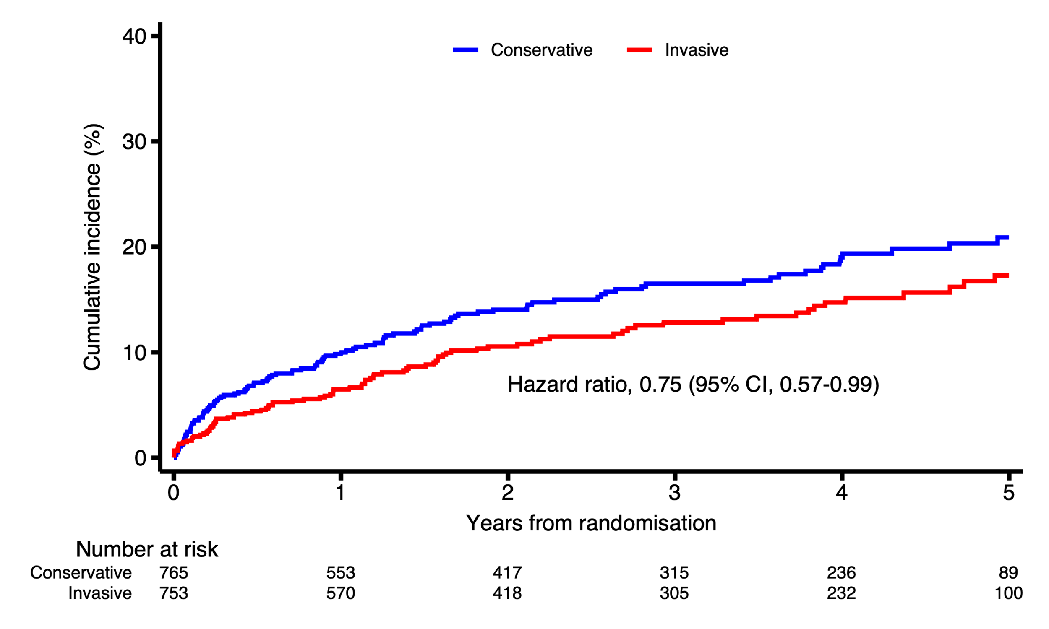
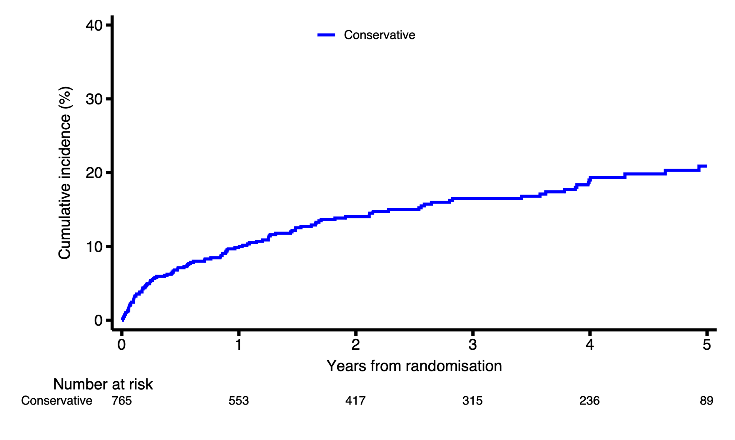
NON-FATAL MYOCARDIAL INFARCTION
Hazard ratio 0.75; 95% CI 0.57-0.99

Slide 19
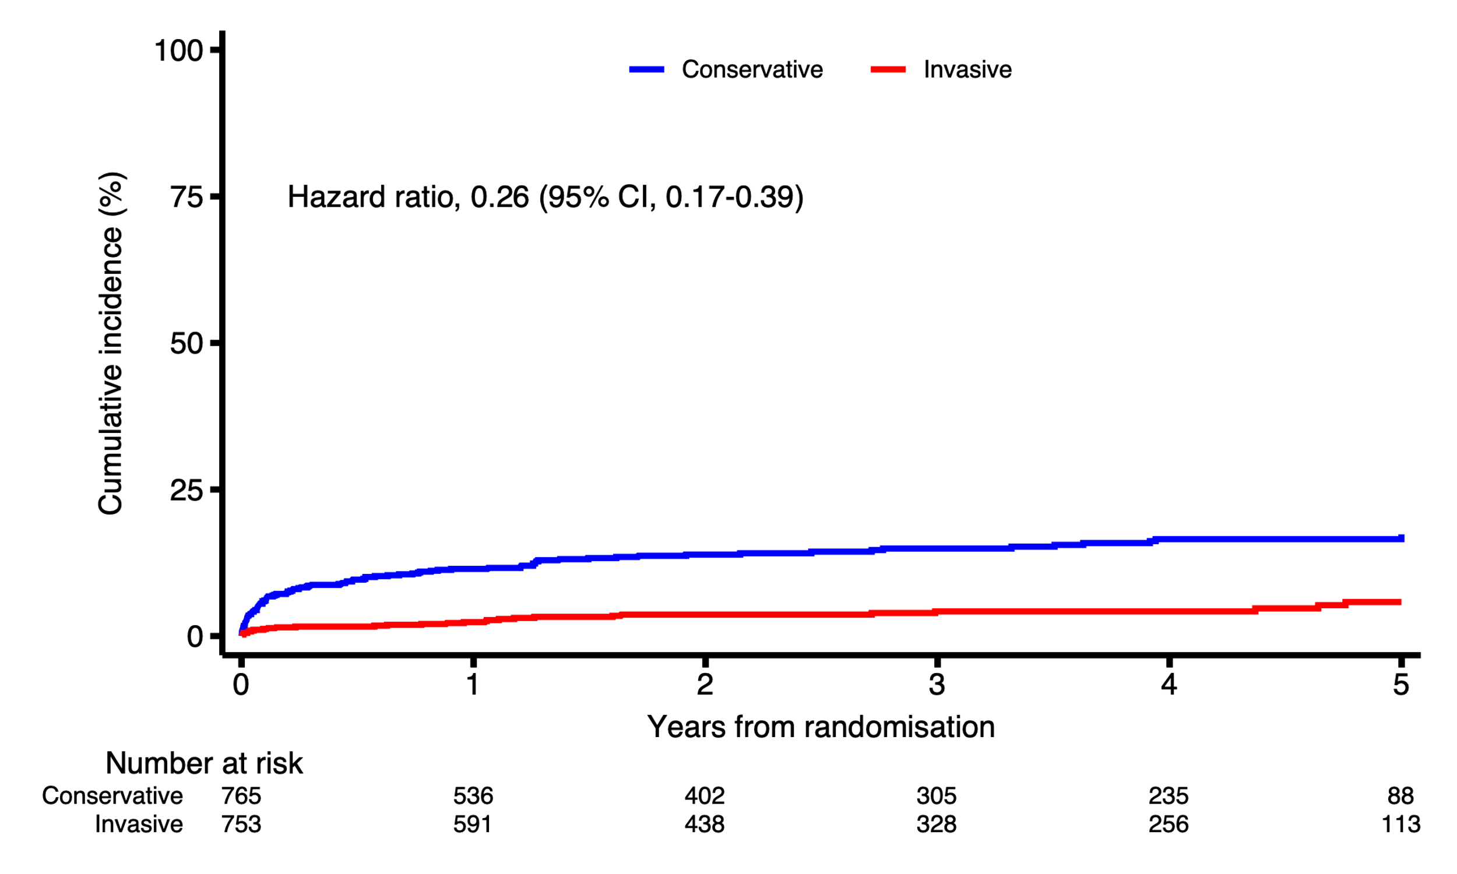
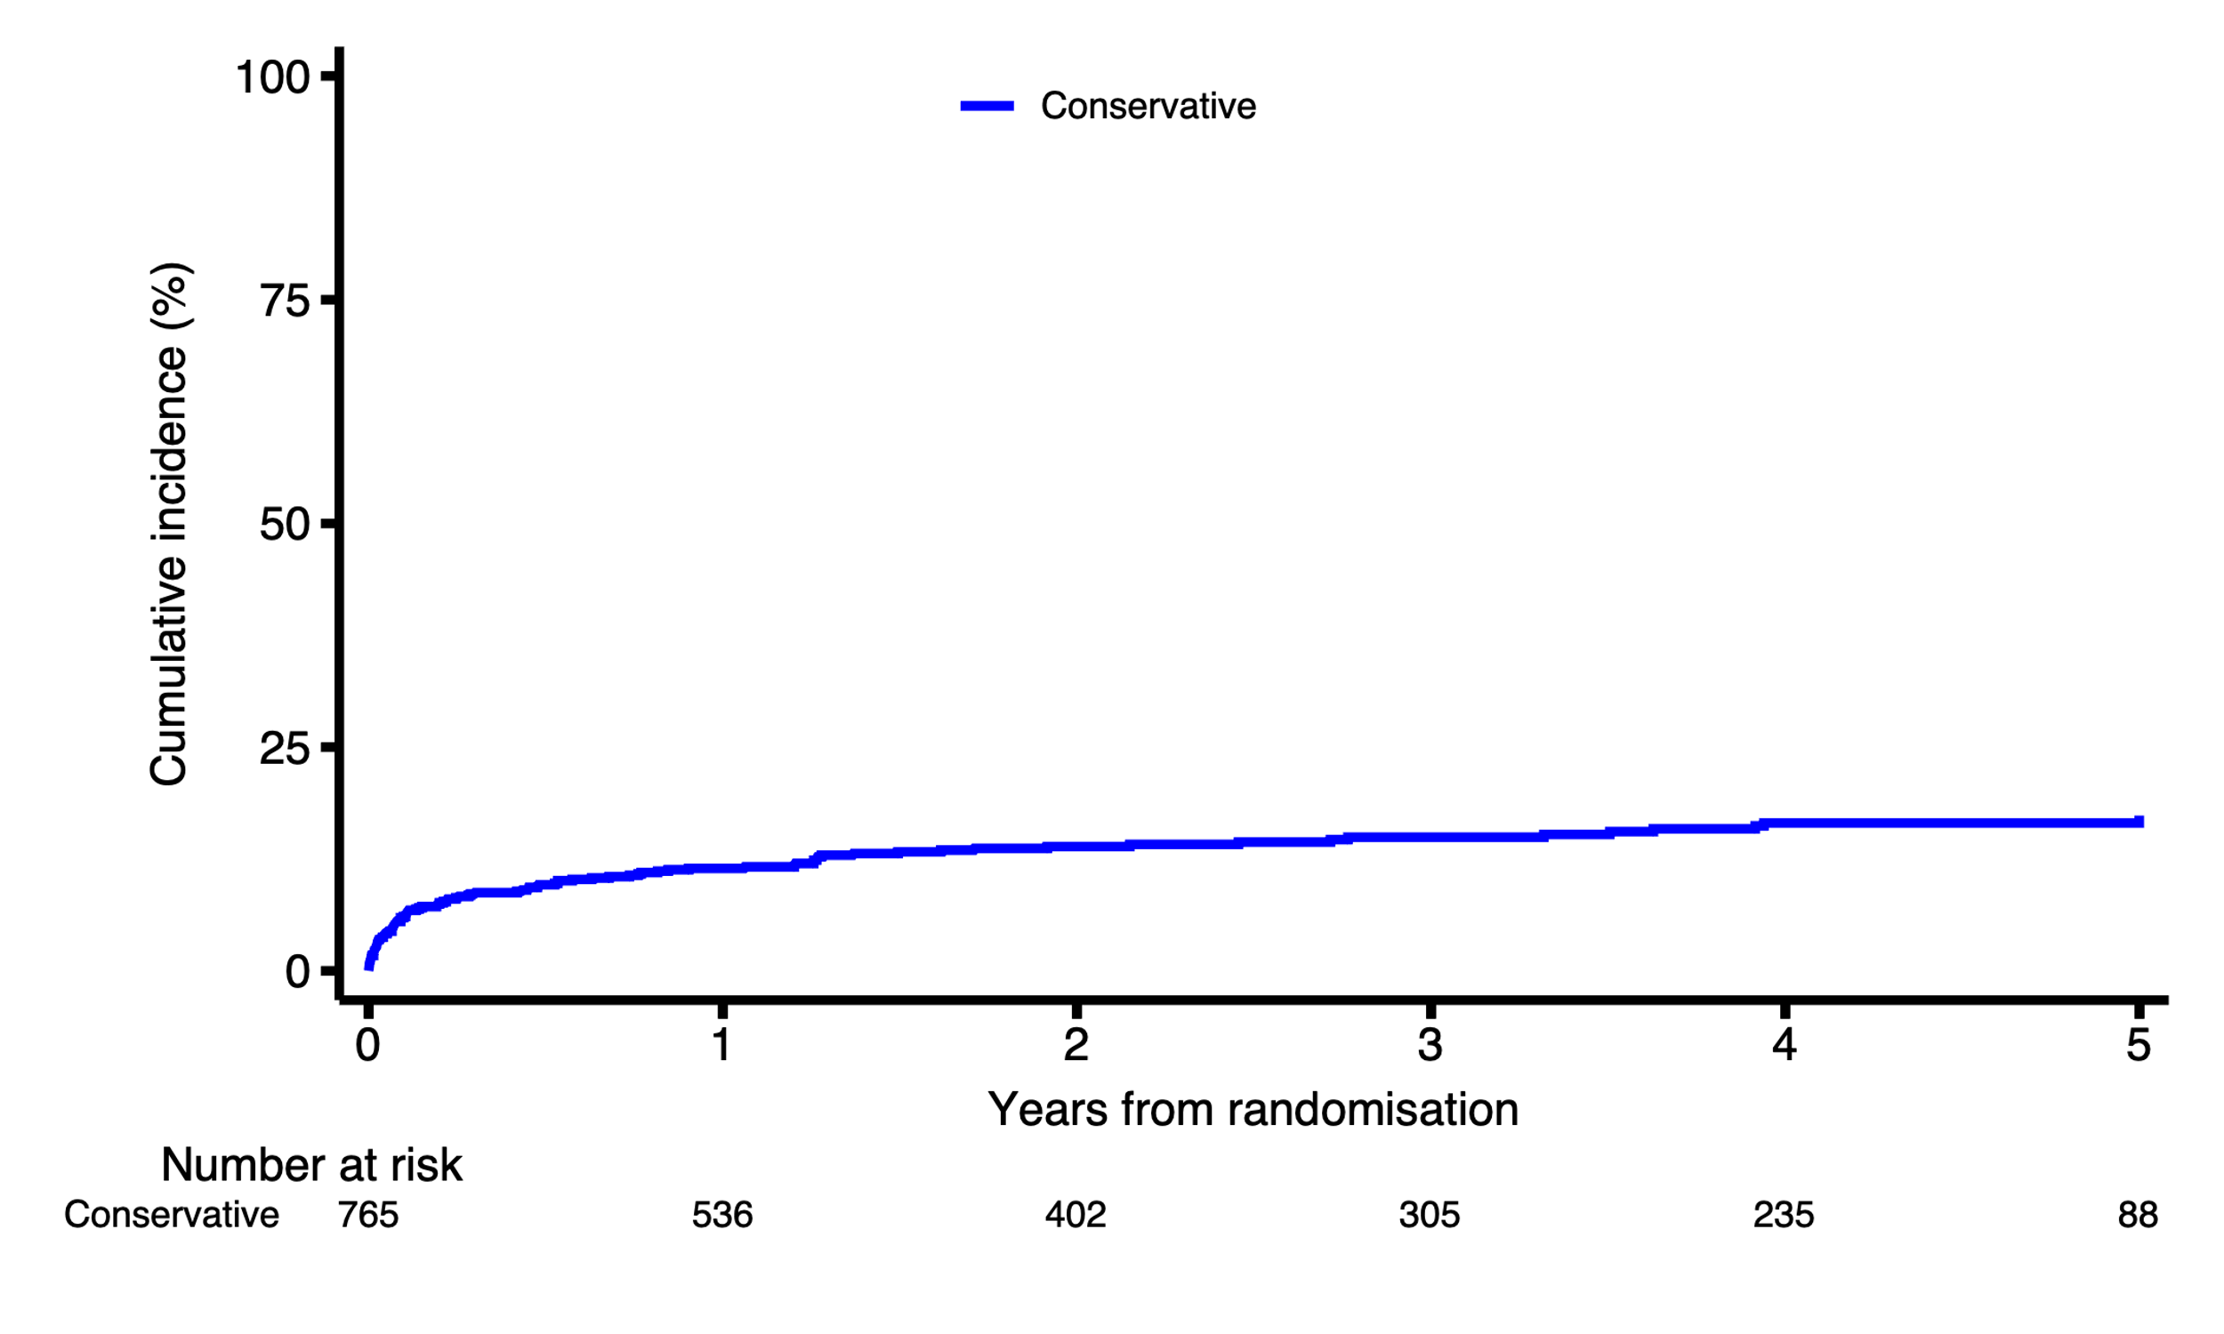
SUBSEQUENT REVASCULARISATION
Hazard ratio 0.26; 95% CI 0.17-0.39

Slide 20
SECONDARY OUTCOMES
Outcome variables | Invasive Strategy (N=753) | Conservative Strategy (N=765) | Treatment effect Hazard Ratio 95% CI
Secondary outcomes
All cause death and non-fatal MI - no. (%) | 319 (42.4%) | 321 (42.0%) | 0.97 (0.83-1.13)
All cause death - no. (%) | 272 (36.1%) | 247 (32.3%) | 1.13 (0.95-1.34)
Non-cardiovascular death - no. (%) | 153 (20.3%) | 138 (18.0%) | 1.14 (0.90-1.43)
Fatal and non-fatal MI - no. (%) | 100 (13.3%) | 124 (16.2%) | 0.79 (0.61-1.02)
Coronary angiography - no. (%) | 42 (5.6%) | 185 (24.2%) | 0.20 (0.14-0.28)
Coronary revascularization - no. (%) | 29 (3.9%) | 105 (13.7%) | 0.26 (0.17-0.39)
Stroke - no. (%) | 32 (4.2%) | 40 (5.2%) | 0.81 (0.51-1.28)
Transient ischemic attack - no. (%) | 18 (2.4%) | 9 (1.2%) | 2.05 (0.92-4.56)
Hospitalisation for heart failure - no. (%) | 82 (10.9%) | 82 (10.7%) | 1.02 (0.75-1.39)
Bleeding (BARC Type 2+) – no. (%) | 62 (8.2%) | 49 (6.4%) | 1.28 (0.88-1.86)
MI-myocardial infarction; CI-confidence interval; BARC-bleeding academic research consortium

Slide 21
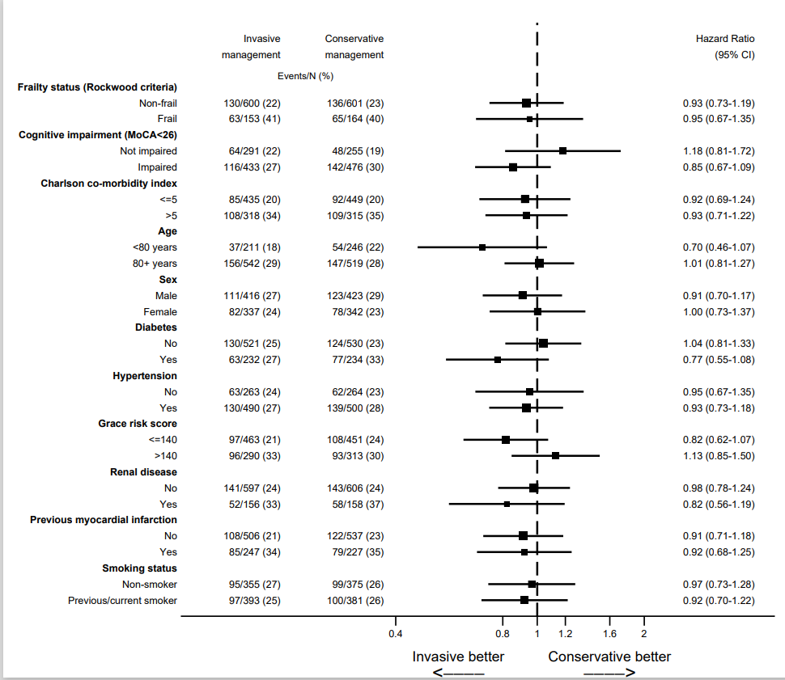
SUBGROUPS
The primary outcome findings appeared consistent across all pre-specified sub-groups

Slide 22
STUDY LIMITATIONS
Our final sample size was 1518, as opposed to the planned 1668. Nevertheless,
Our study is the largest
Median follow-up of 4 years
Addressing this important clinical question
Provides valuable insights into the optimal care of such patients
Strengthens the evidence base
1:5 patients screened were recruited into the trial (as anticipated at the outset)
Challenges recruiting these all-comer older adults in research due to conditions that prevent participation.
Patients who were not randomized had similar demographics (mean age 82 years, 47% female) to those undergoing randomization, with 55% undergoing invasive strategy and 44% conservative strategy
Strengthening the generalizability of our study findings.

Slide 23
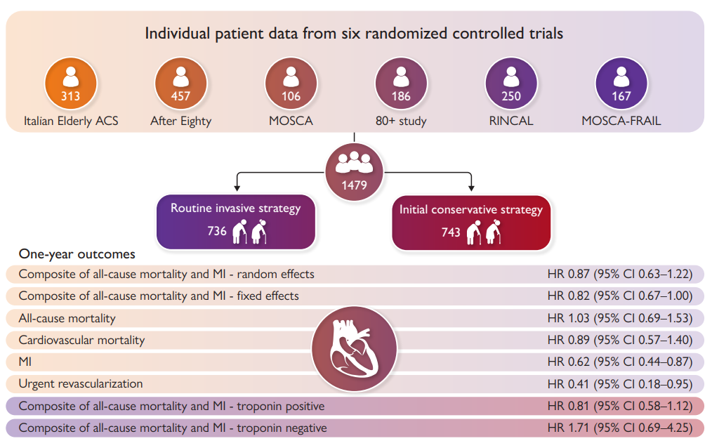
Individual patient meta-analysis
Updated IPD including SENIOR-RITA will follow soon!
Kotanidis et al. Eur Heart J. 2024 Jun 14;45(23):2052-2062

Slide 25
Take Home Messages
The SENIOR-RITA trial is the largest trial to date in older adults with heart attacks than all previous trials combined.
Among older adults with type I NSTEMI, an invasive strategy is safe.
An invasive strategy did not significantly reduce the combined risk of cardiovascular death or non-fatal myocardial infarction as compared with a conservative strategy.
Treatment with an invasive strategy did reduce the risk of non-fatal myocardial infarction and subsequent revascularization.
The results provide a foundation for older heart attack patients and their clinicians to make an informed decision about whether to undergo invasive coronary angiography or not.

