Slide 1
Assessment of the microvascular resistance reserve for predicting the effect of revascularization in patients with moderate coronary stenoses
On behalf of the Dan-NICAD (NCT03481712, NCT04707859) investigators
Laust Dupont Rasmussen, MD, PhD
September 1st, 2024

Slide 2
Disclosures
Nothing to declare

Slide 3
Background
Revascularization in non-high-risk chronic coronary syndrome (CCS) should improve myocardial perfusion and reduce anginal symptoms^{1,2}
²Spertus et al., N Engl J Med 2020;382:1408-1419
¹Maron et al., N Engl J Med 2020;382:1395-1407

Slide 4
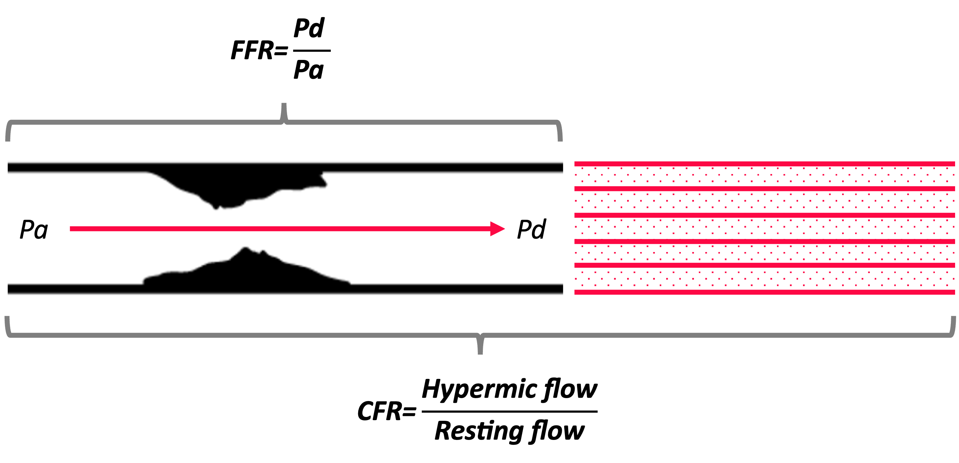
Background
The microvascular resistance reserve (MRR) assesses the vasodilator reserve capacity of the coronary microcirculation while eliminating the resistance of epicardial stenoses³
The MRR has both diagnostic and prognostic implications in CCS⁴
Whether MRR guides symptomatic benefit from revascularization is unknown
$$\text{MRR}\text{=}\frac{\text{CFR}}{\text{FFR}}\text{×}\frac{\text{Pa}\text{rest}}{\text{Pa}\text{hyper}\text{emia}}$$
⁴Boerhuyt et al., EHJ 2023 44, 2862–2869
³De Bruyne et al., JACC 2021 Oct, 78 (15) 1541–1549

Slide 5
Aims
To investigate whether MRR is associated with health-status outcomes after revascularization in patients with moderate coronary stenoses
Secondly, to investigate whether an improvement in health-status outcomes is associated with improvement of myocardial perfusion

Slide 6
Methods
Patients with new-onset chest pain and moderate stenoses (diameter 30-90%) on invasive angiography
Baseline SAQ and PET
Invasive angiography with FFR and CFR
3-months follow-up SAQ
12-months follow-up PET*
Freedom of angina⁵
$$\text{SAQ} \text{frequency} \text{score}\text{=100}$$
Stress perfusion PET
$\text{Δ}$Hyperemic MBF
Clinically relevant health-status changes⁵
$$\text{Δ} \text{SAQ} \text{frequency} \text{scor}\text{e}\text{>}\text{10}$$
$$\text{Δ} \text{SAQ} \text{physical} \text{limitation} \text{score} \text{>}\text{5}$$
$$\text{Δ} \text{SAQ} \text{summary} \text{score} \text{>}\text{5}$$
1.0
2.0
3.0
4.0
5.0
ml/g/min
⁵Thomas et al., JAMA Cardiol. 2021;6(5):593-599
*In patients with an initially abnormal PET

Slide 7
Results
N=222

Slide 8
Results - baseline
Male 68%
Hypertension 53%
Dyslipedemia 35%
Diabetes 12%
63y
Family history 43%
Smoking 65%
1VD 77%
Mean MRR 3.81
Mean FFR 0.82
Mean CFR 2.70
LAD lesion 73%
Mean DS 45%
Revasc. 24%
Patient characteristics
Invasive
angiography

Slide 9
Results – freedom of angina
Regression analyses for the association to freedom of angina at follow-up (n=38/178 (21%))
 | Multivariate*
Variable | Odds ratio | p-value
CFR per point increase | 0.92 (0.74-1.13) | 0.40
FFR per 5 point increase | 0.99 (0.82-1.19) | 0.89
MRR per point increase | 0.86 (0.74-0.99) | 0.04
Change in SAQ angina frequency score by MRR levels and revascularization
Effect on symptoms
No effect on symptoms
*Adjusted for sex, age, diabetes, hyperemic blood flow, diameter stenosis and revascularization

Slide 10
Results – patient distribution
 |  | MRR
 |  | Normal |  | Low*
Revascularization | - | n=105/222 47% |  | n=64/222 29%
 | + | n=29/222 13% |  | n=24/222 11%
*MRR ≤3.0: Boerhuyt et al., EHJ 2023 44, 2862–2869

Slide 11
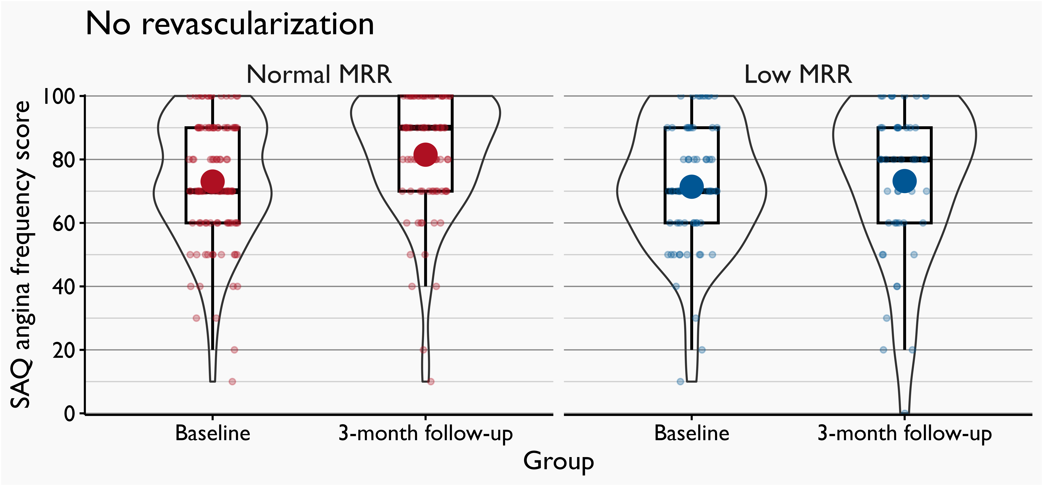
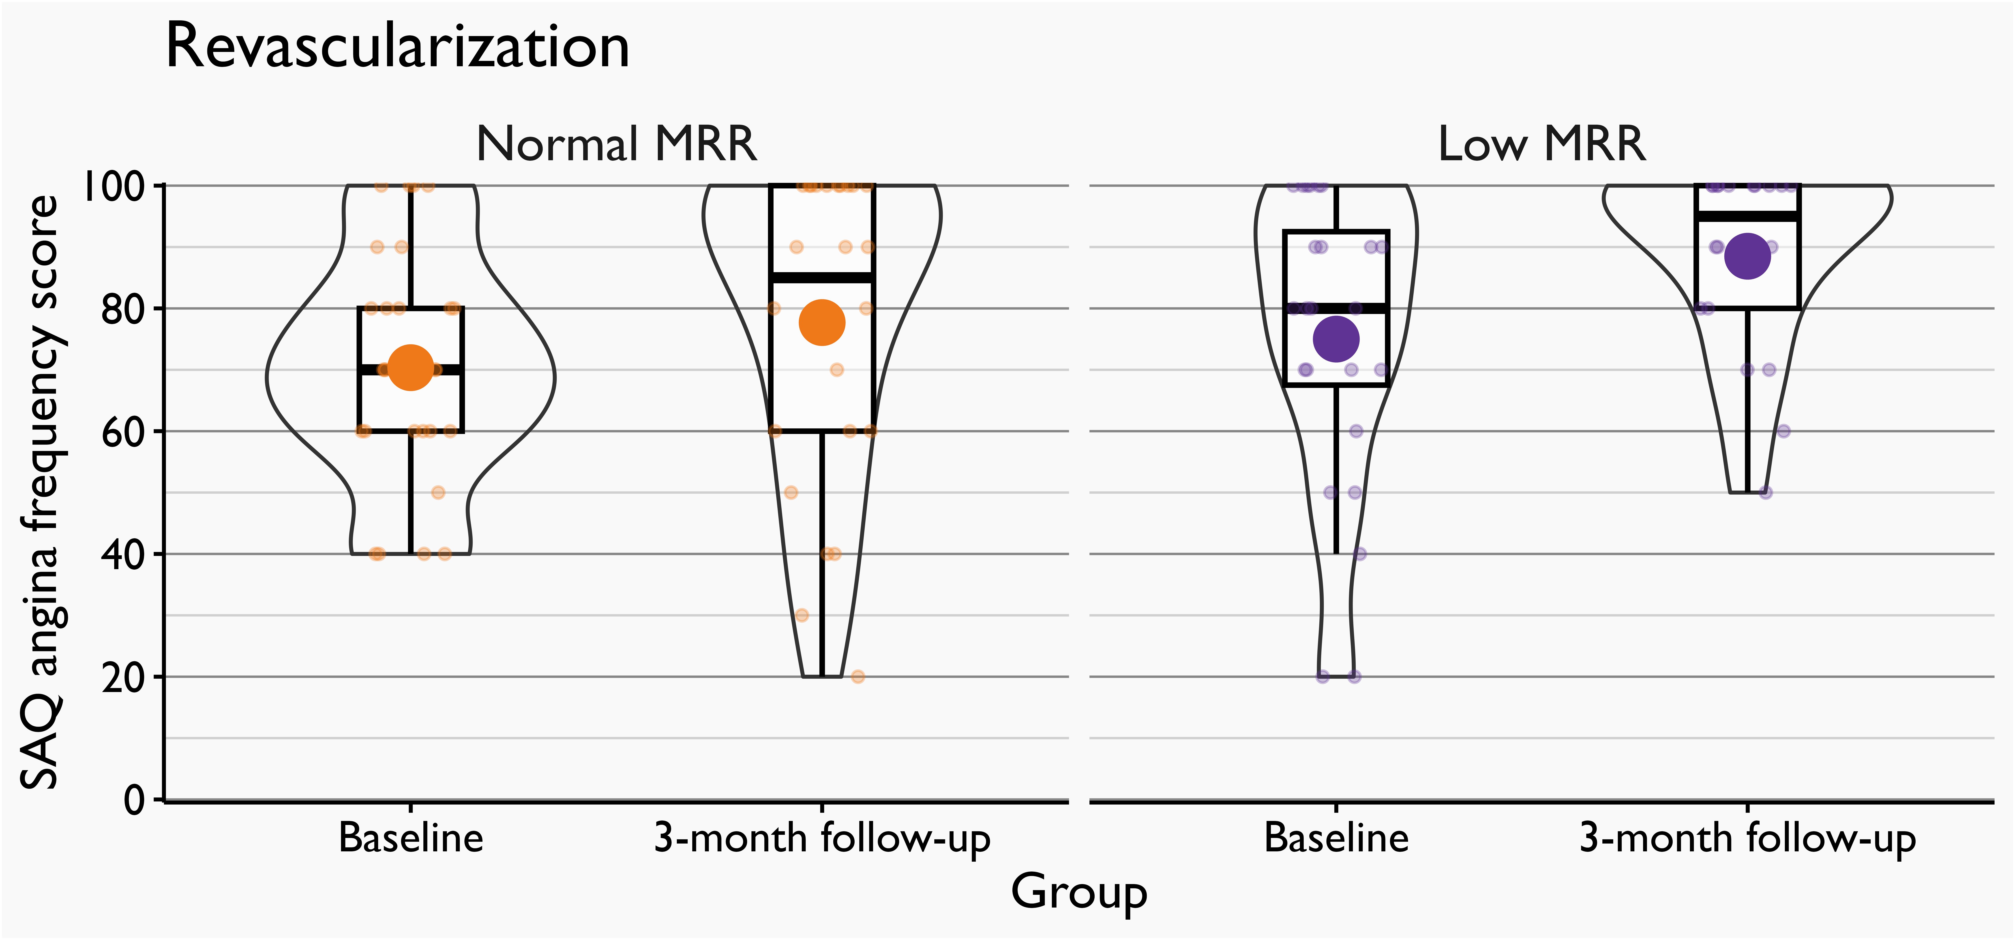
Results – change in angina frequency
 |  | MRR
 |  | Normal |  | Low*
Revascularization | - | 8.5 (3.1-13.1) p=0.002 |  | 1.1 (-5.1-7.9) p=0.78
 | + | 7.4 (-1.8-16.2) p=0.12 |  | 13.5 (2.8-23.2) p=0.01
 |  | FFR↑ CFR↑ | FFR↑ CFR↓ | FFR↓ CFR↑ | FFR↓ CFR↓
*MRR ≤3.0: Boerhuyt et al., EHJ 2023 44, 2862–2869

Slide 12
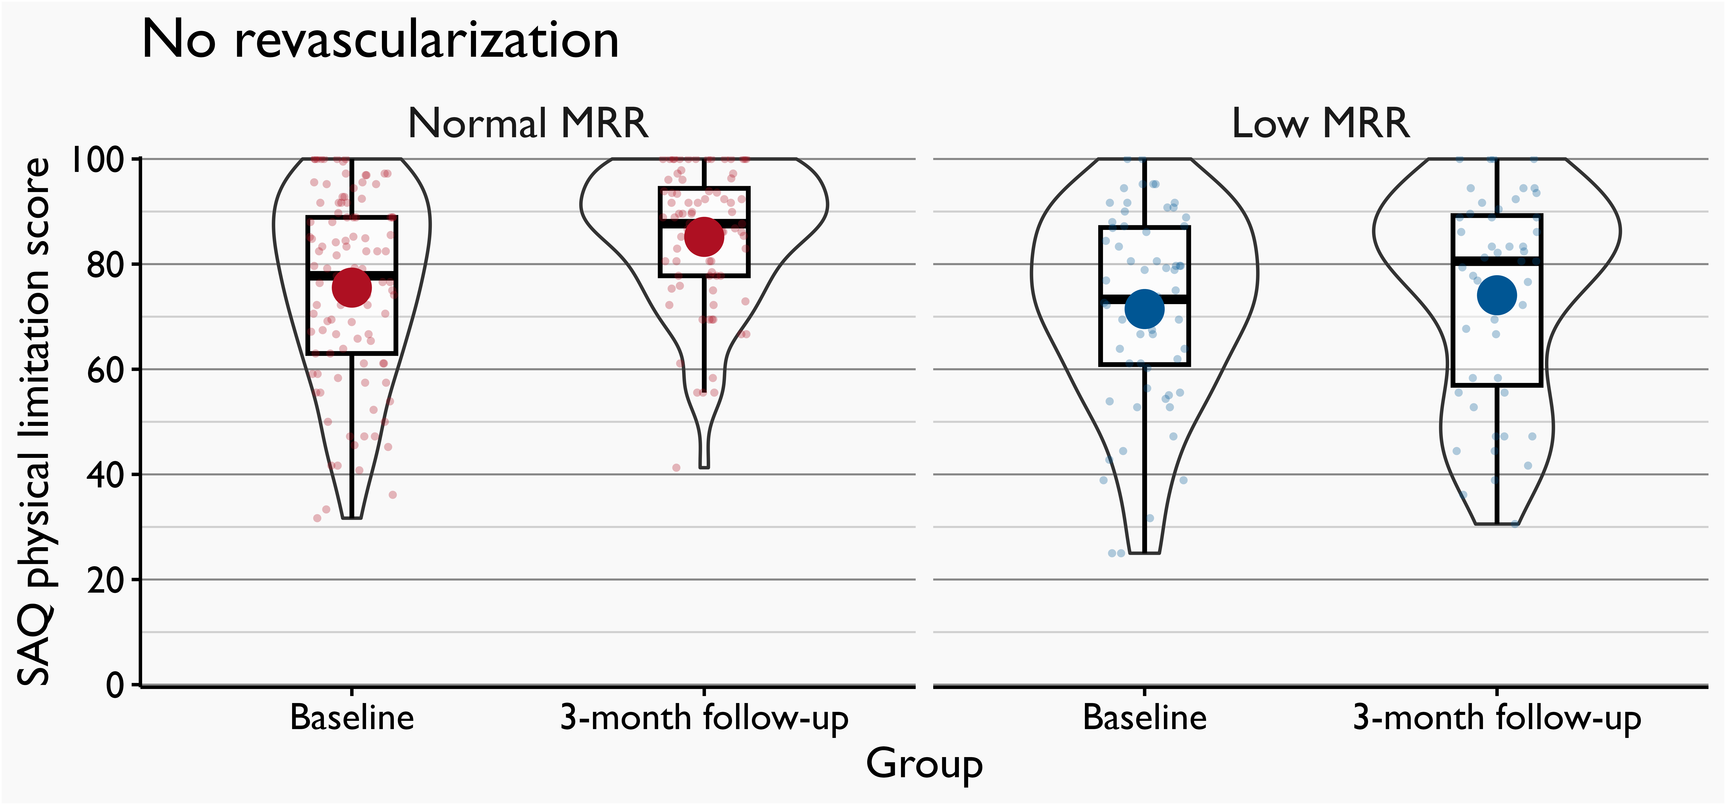
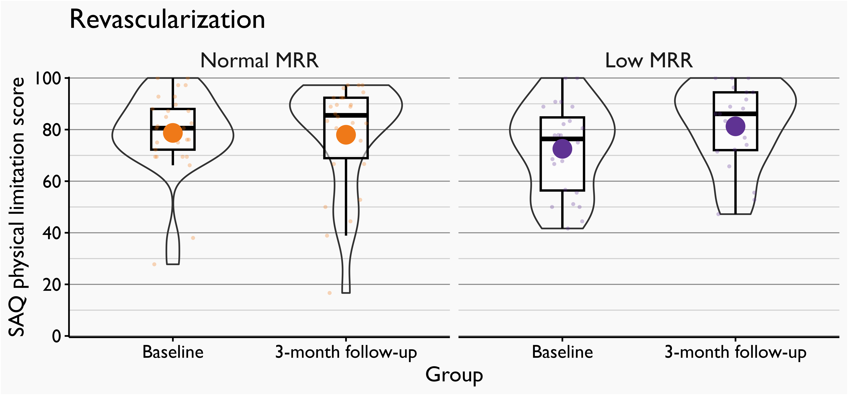
Results – change in physical limitation
 |  | MRR
 |  | Normal |  | Low*
Revascularization | - | 9.7 (4.8-11.9) p<0.001 |  | 2.6 (-2.1-7.1) p=0.29
 | + | -0.7 (-7.3-5.4) p=0.77 |  | 8.7 (0.5-13.9) p=0.04
 |  | FFR↑ CFR↑ | FFR↑ CFR↓ | FFR↓ CFR↑ | FFR↓ CFR↓
*MRR ≤3.0: Boerhuyt et al., EHJ 2023 44, 2862–2869

Slide 13
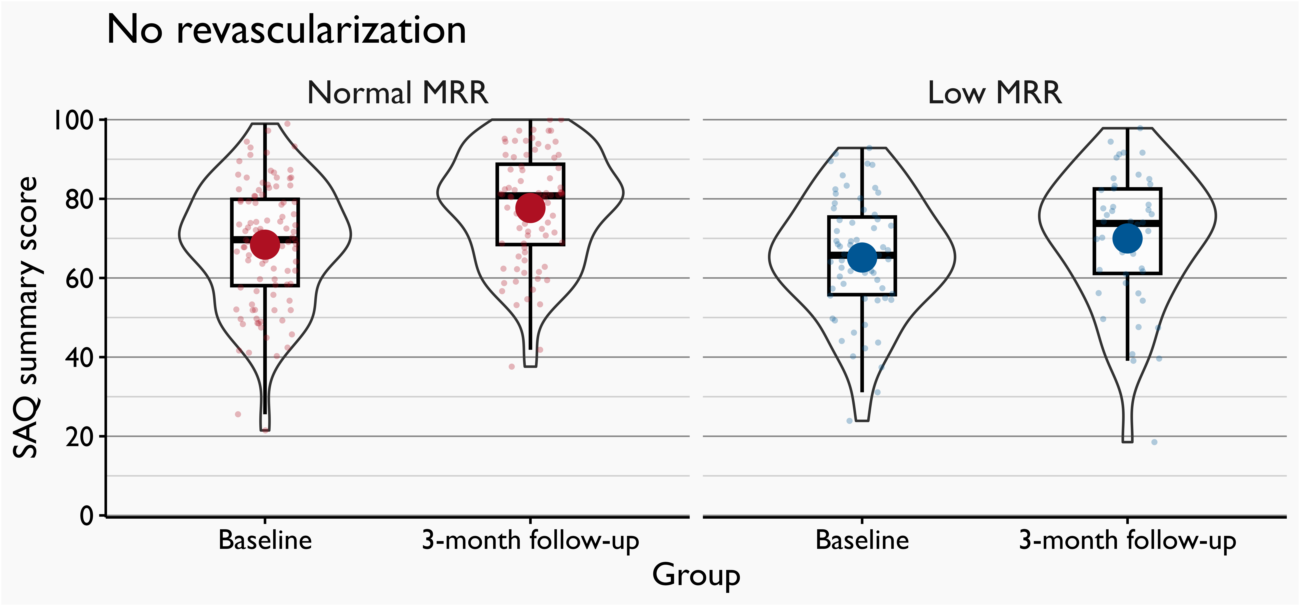
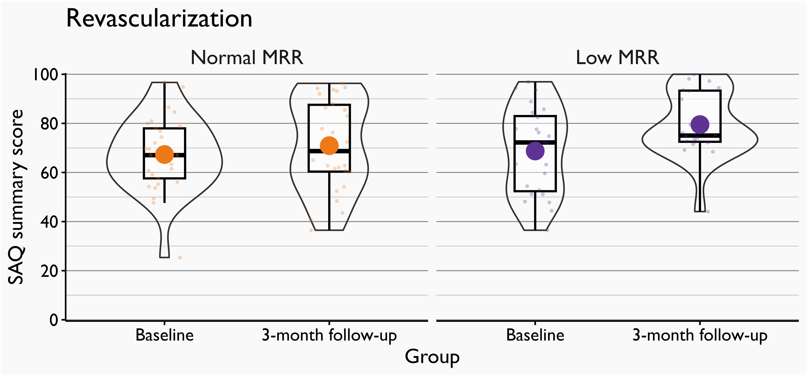
Results – change in general health status
 |  | MRR
 |  | Normal |  | Low*
Revascularization | - | 9.3 (5.2-12.5) p<0.001 |  | 4.3 (-0.5-9.2) p=0.10
 | + | 3.6 (-3.2-9.9) p=0.32 |  | 10.8 (2.5-17.3) p=0.01
 |  | FFR↑ CFR↑ | FFR↑ CFR↓ | FFR↓ CFR↑ | FFR↓ CFR↓
*MRR ≤3.0: Boerhuyt et al., EHJ 2023 44, 2862–2869

Slide 14
Results – change in myocardial perfusion**
3.0
 |  | MRR
 |  | Normal |  | Low*
Revascularization | - | 0.05 (-0.20-0.31) p=0.60 |  | 0.14 (-0.14-0.64) p=0.34
 | + | 0.13 (-0.11-0.59) p=0.32 |  | 0.61 (0.29-0.98) p=0.01
 |  | FFR↑ CFR↑ | FFR↑ CFR↓ | FFR↓ CFR↑ | FFR↓ CFR↓
2.5
2.0
1.5
1.0
0.5
0.0
*MRR ≤3.0: Boerhuyt et al., EHJ 2023 44, 2862–2869 **In patients with an initially abnormal PET

Slide 15
Take home-messages
In patients with stable new-onset chest pain and moderate coronary stenoses of unclear functional significance, low MRR is associated with freedom of angina beyond CFR and FFR
Patients with low MRR undergoing revascularization improve health-status outcomes, including measures of angina frequency and physical limitation, to levels similar to patients with normal MRR and no revascularization
Patients with normal MRR undergoing revascularization did not experience health-status improvements in the current study
Health-status outcomes seem to correlate to changes in myocardial perfusion

Slide 16
A special thanks to…
Simon Winther Morten Bøttcher Louise Nissen Jacob H. Søby Gitte S. Brix Jonathan N. Dahl Lars L. Knudsen Hanne M. Søndergaard Nicolaj C. L. Hansson Jane Kirk | Salma Karim Jelmer Westra Rebekka V. Jensen Ashkan Eftekhari Evald H. Christiansen June A. Ejlersen Lars P. Tolbod Jesper Mortensen Michael A. Madsen Lars C. Gormsen | Mette Nyegaard Vibeke Lynggaard Marianne Andersen Louise Stampe Kirsten Gottlieb Gitte Lerke Stine Søndergaard Aarhus University Danish Cardiovascular Academy All patients involved

Slide 17
More interest?
Microcirculatory resistance reserve: impact on health status and myocardial perfusion after revascularization in chronic coronary syndrome
LD Rasmussen, J Westra, SR Karim, JN Dahl, JH Søby, JA Ejlersen, LC Gormsen,
A Eftekhari, EH Christiansen, M Bøttcher and S Winther
European Heart Journal 2024
https://academic.oup.com/eurheartj/article-lookup/doi/10.1093/eurheartj/ehae546

