Slide 1

reducinG stroke by screening for UndiAgnosed atRial fibrillation in elderly inDividuals:
The GUARD-AF Trial Primary Results
September 1, 2024
Renato D. Lopes MD, PhD
on behalf of the GUARD-AF investigators

Slide 2
Declaration of Interest
Bristol Myers Squibb/Pfizer Alliance sponsored the trial.

Slide 3
Background
Atrial fibrillation (AF) independently increases ischemic stroke risk 4- to 5-fold.¹
AF-related strokes are more disabling or fatal compared with those associated with other causes.²
Risk of ischemic stroke can be reduced with oral anticoagulation.^{3,4}
Recent randomized trials of one-time, brief screening for AF have not consistently shown a significant increase in diagnosis of AF.⁵
Conversely, trials that used longer-term screening strategies have
shown an increase in diagnosed AF.⁶
To date, no trials have established that AF screening reduces
stroke rates.
1. Wolf PA, et al. Stroke 1991.
2. Lin HJ, et al. Stroke 1996.
3. Go AS, et al. Prog Cardiovasc Dis 2005.
4. Hart RG, et al. Ann Intern Med 2007.
5. Lubitz SA, et al. Circulation 2022.
6. Steinhubl SR, et al. JAMA 2018.

Slide 4
GUARD-AF Trial Objectives
OVERALL GOAL: To determine whether AF screening reduces stroke risk and provides a net clinical benefit compared with usual care
Primary efficacy
  To determine if an AF detection intervention in adults aged 70 years or older with no previously diagnosed AF or atrial flutter (AFL) reduces the rate of stroke compared with usual care.
Primary safety
  To compare the proportion of participants with bleeding leading to hospitalization between the screening and usual care groups.
Exploratory
  Compared with usual care, to determine if an intervention to detect undiagnosed AF/AFL increases:
    The diagnosis of AF/AFL.
    The likelihood of receiving an oral anticoagulant (OAC).

Slide 5
Key Eligibility Criteria
70 years or older in U.S. primary care practices.
Health insurance by Medicare Fee-for-Service or enrolled in Kaiser Permanente Northern California.
Provided consent to use personal health information to ascertain endpoints from the Medicare Claims and Kaiser Permanente databases.
Not receiving OAC at enrollment.
No prior documented AF or AFL.
No condition the investigator considered a contraindication to OAC.
No implanted cardiac devices (pacemakers, implantable cardiac defibrillators, cardiac resynchronization therapy, or implantable loop recorders).

Slide 6
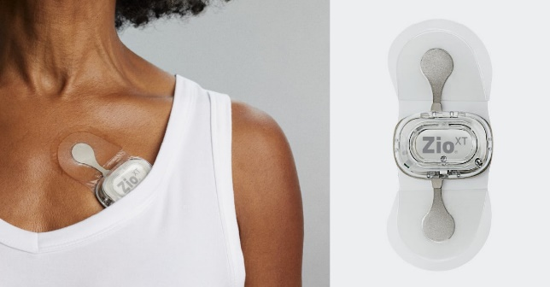
GUARD-AF Design
Screening Arm
Zio® XT Long-Term Continuous
Monitoring Device:*
AF detection intervention
for up to 14 days
N=26,000
Randomization
Usual Care Arm:
Usual care (no Zio® XT)
N=26,000
*Zio® XT and the ECG software are FDA cleared in the US and the devices were used on-label in the trial.
iRhythm Technologies (San Francisco, CA).
Singer DE, et al. Am Heart J 2022.

Slide 7
Outcomes Assessment
Primary Efficacy
  Occurrence of stroke leading to hospitalization
  (data from Medicare Part A/Kaiser Permanente).
Primary Safety
  Occurrence of bleeding leading to hospitalization
  (data from Medicare Part A/Kaiser Permanente).
Exploratory
  Occurrence of AF/AFL (data from Medicare Parts A and B/Kaiser Permanente).
  Prescriptions filled for OAC (data from Medicare Part D/Kaiser Permanente), which was done at the discretion of the treating physician.
  Only a subset of participants had Part D.

Slide 8
Trial Recruitment
Enrollment occurred between December 17, 2019 - May 31, 2021.
149 primary care sites across the U.S.
20% of participants were enrolled and consented virtually and self-applied patches in their homes with only remote support.
The COVID-19 pandemic led the sponsor to terminate funding, which led to premature termination of enrollment with 11,905 participants in the intention-to-treat population.
The follow-up end date for efficacy and safety outcomes was June 19, 2022.
Median (25th, 75th percentile) follow-up was 15.3 (13.8, 17.6) months.

Slide 9
Consort Diagram
11,957
enrolled
52 excluded
- 32 no longer met study criteria
- 5 withdrew consent
- 14 screen failed for other reasons
- 1 randomization error
EHRs, electronic health records; FFS, Fee-for-Service; ITT, intention-to-treat; Kaiser Permanente, Kaiser Permanente Northern California enrollees.
11,905
Randomized (ITT population)
5952 assigned to
Screening Group
5953 assigned to
Usual Care Group
5353/5447 successfully linked to any Medicare FFS plan (A, B, or D)
- 4738 in Parts A & B
- 3987 in Part D
505 linked to Kaiser Permanente EHRs
5332/5446 successfully linked to any Medicare FFS plan (A, B, or D)
- 4770 in Parts A & B
- 4033 in Part D
507 linked to Kaiser Permanente EHRs
5243/5952 enrolled in Medicare FFS (A & B) or Kaiser Permanente at randomization
5277/5953 enrolled in Medicare FFS (A & B) or Kaiser Permanente at randomization
Parts A & B or Kaiser data for stroke, bleed, and AF outcomes
3924/5952 enrolled in Medicare FFS (A, B, & D) or Kaiser Permanente at randomization
4010/5953 enrolled in Medicare FFS (A, B, & D) or Kaiser Permanente at randomization
Parts A, B, & D or Kaiser data for OAC measures

Slide 10
Baseline Characteristics
 | Screening N=5952 | Usual Care N=5953
Age (years)
Median (25th, 75th) | 75.0 (72.0, 78.0) | 75.0 (72.0, 79.0)
Sex
Male | 2569/5952 (43.2%) | 2599/5953 (43.7%)
Female | 3383/5952 (56.8%) | 3354/5953 (56.3%)
Follow-up time (months)
Median (25th, 75th) | 15.3 (13.8, 17.6) | 15.3 (13.8, 17.4)
CHA₂DS₂-VASc score
Median (25th, 75th) | 3.0 (2.0, 4.0) | 3.0 (2.0, 4.0)

Slide 11
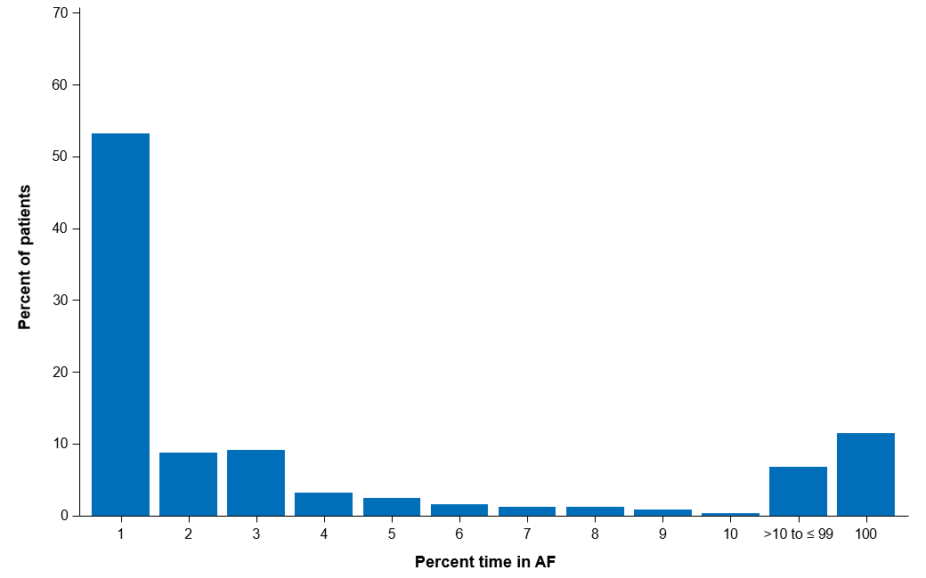
AF Burden: Percent Time in AF in 252 (4.2%) Intervention-Arm Participants with AF Detected on their ECG Monitor
100% of participants in the screening arm received the patch; 95% analyzable patches
Median (25th, 75th) longest episode of AF: 72.3 (2.4, 446) minutes
Median (25th, 75th) % time in AF: 0.78% (0.03%, 4.2%)
Of all participants with analyzable data (95%), 88% of AF episodes were paroxysmal AF
Around 25% were long episodes with multiple (>2) hours of duration
Note the change in scale of the x-axis above 10% time in AF.

Slide 12
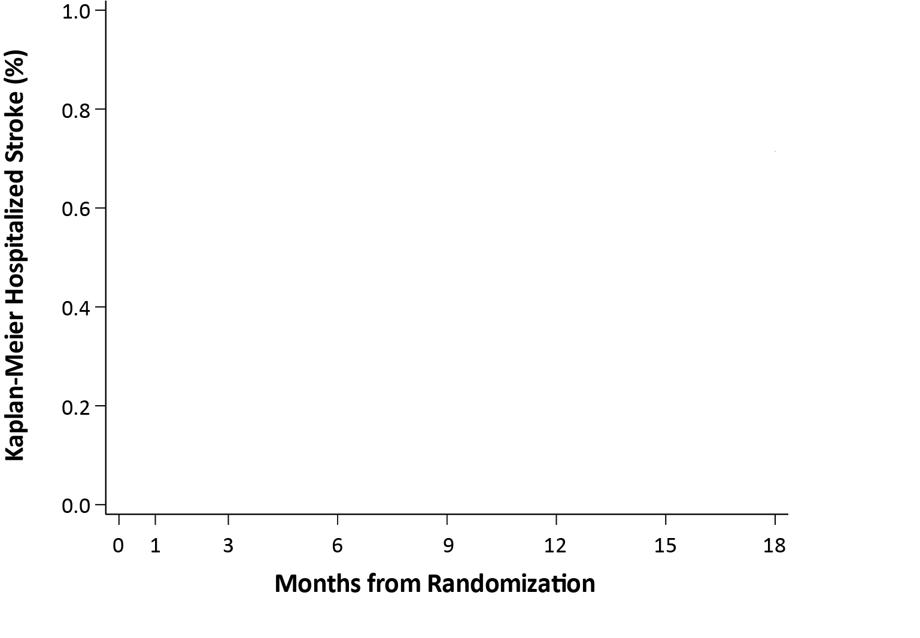
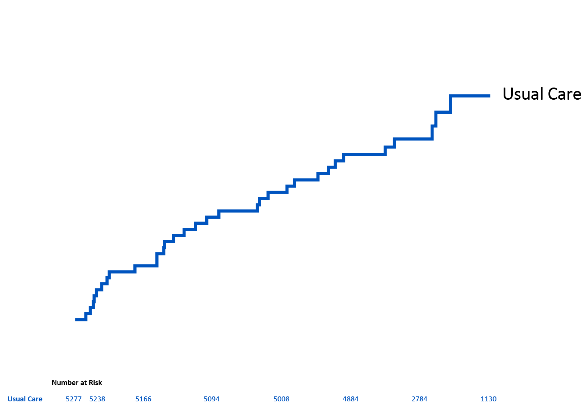
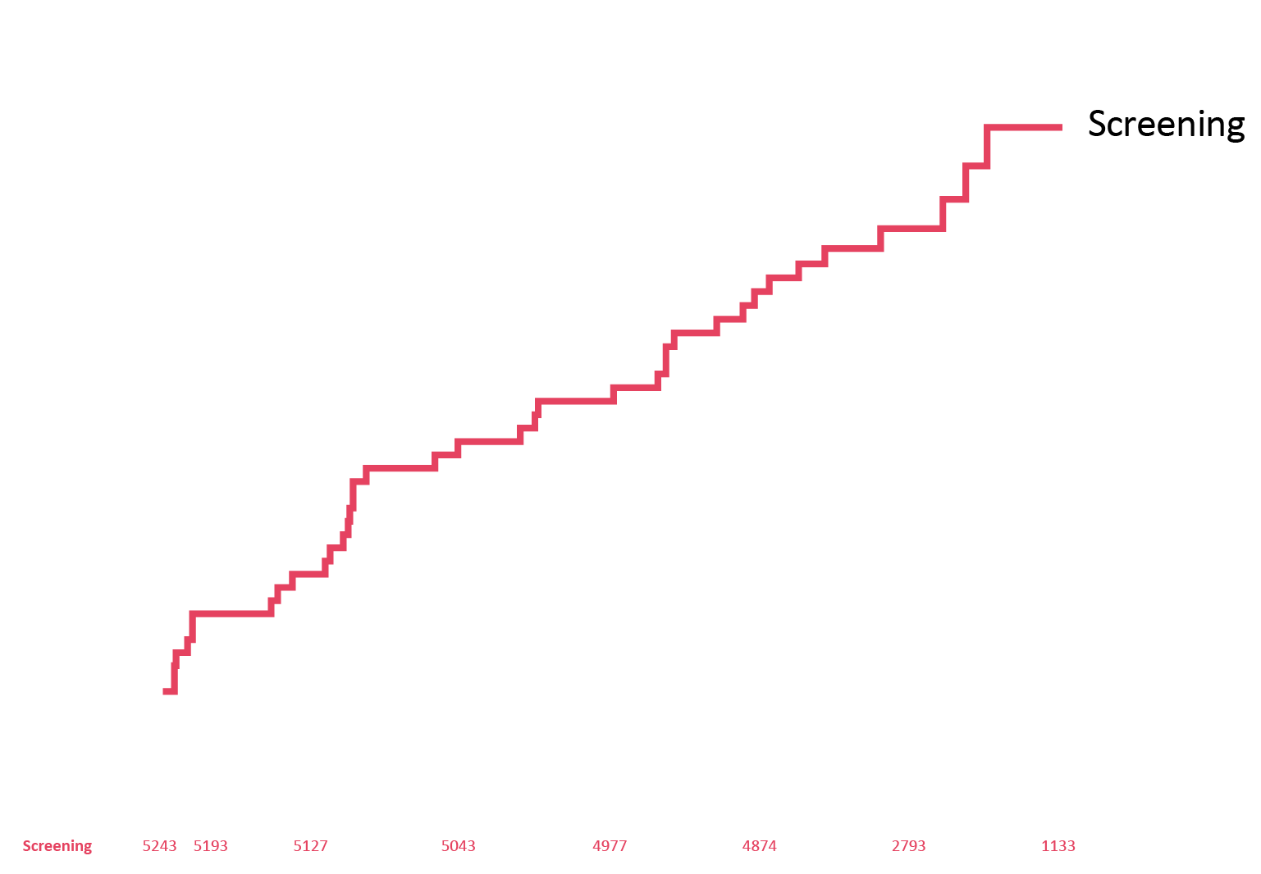
Primary Efficacy Outcome: Hospitalization for Stroke
HR 1.10; 95% CI: 0.69–1.75

Slide 13
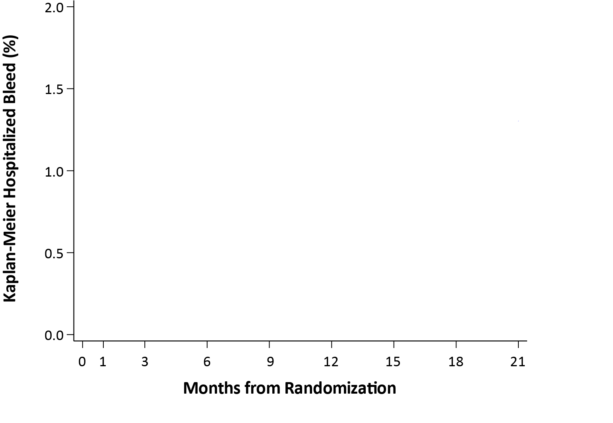
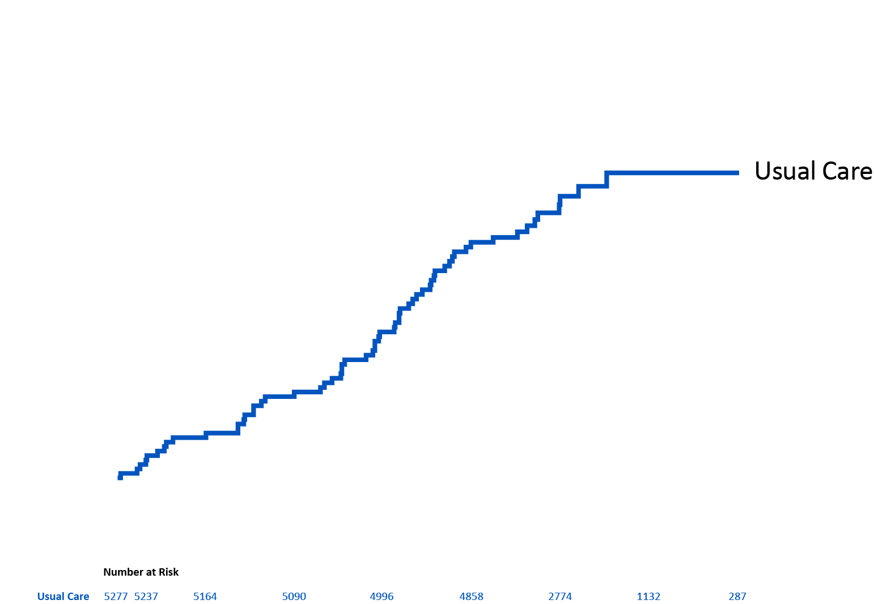
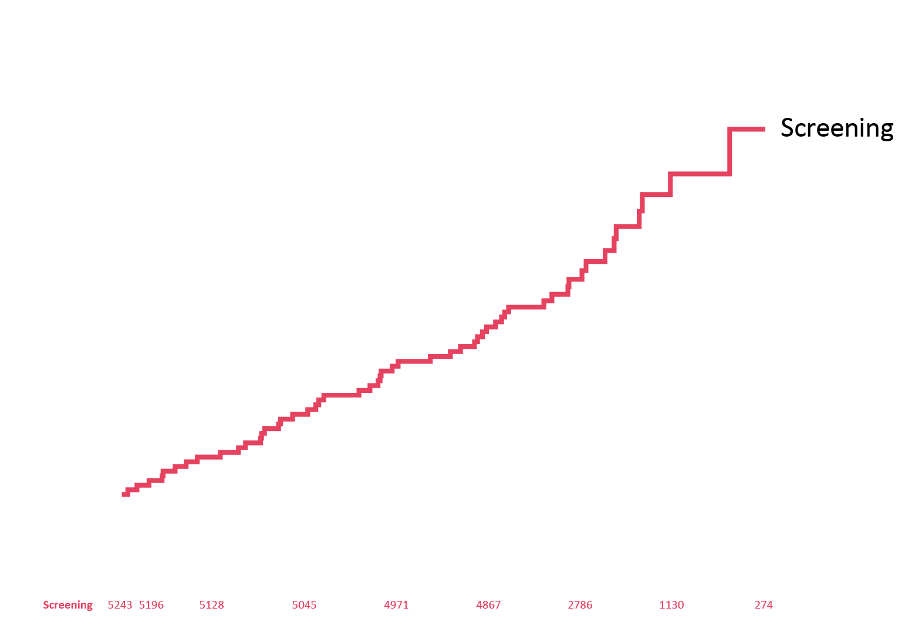
Primary Safety Outcome: Hospitalization for Bleeding
HR: 0.87; 95% CI: 0.60–1.26

Slide 14
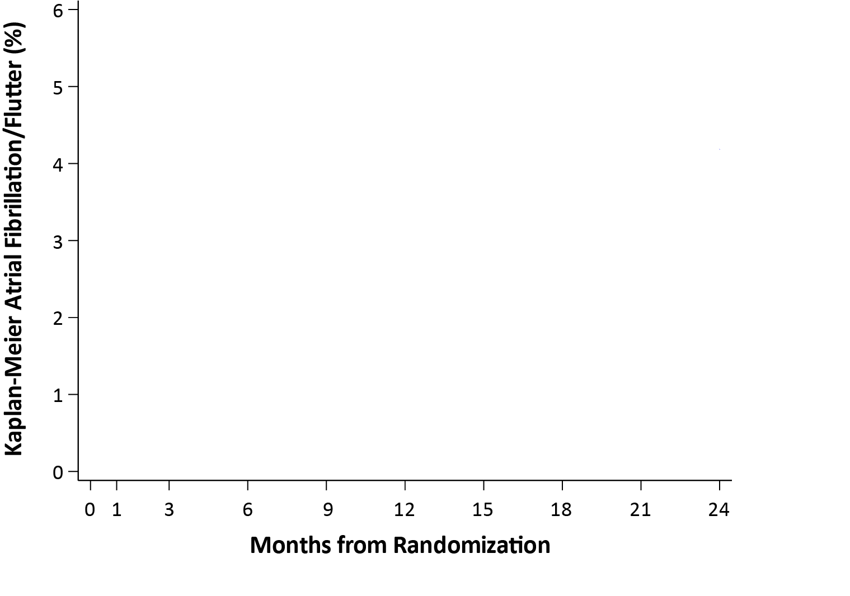
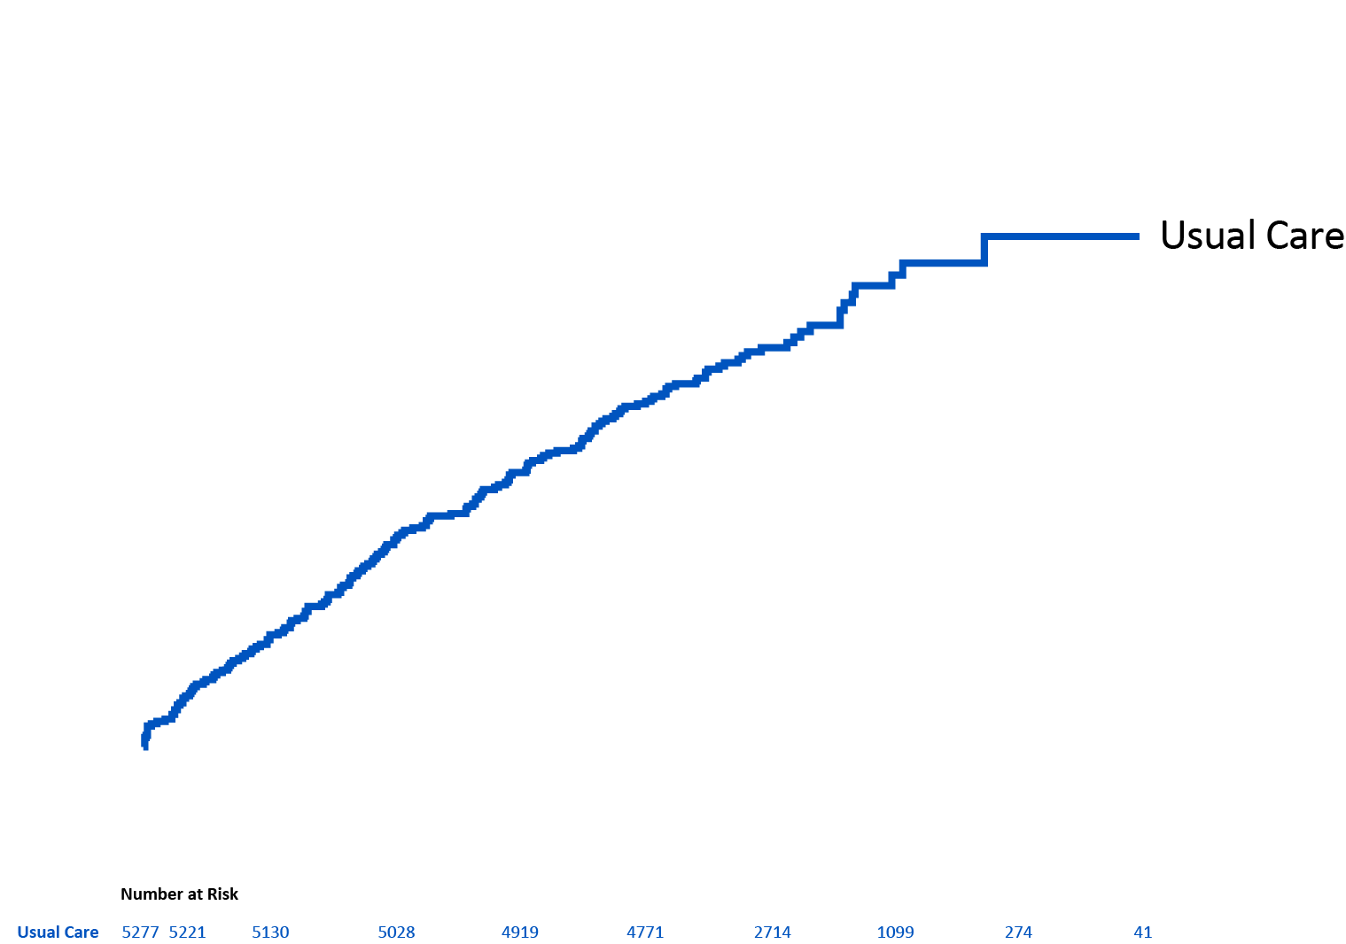
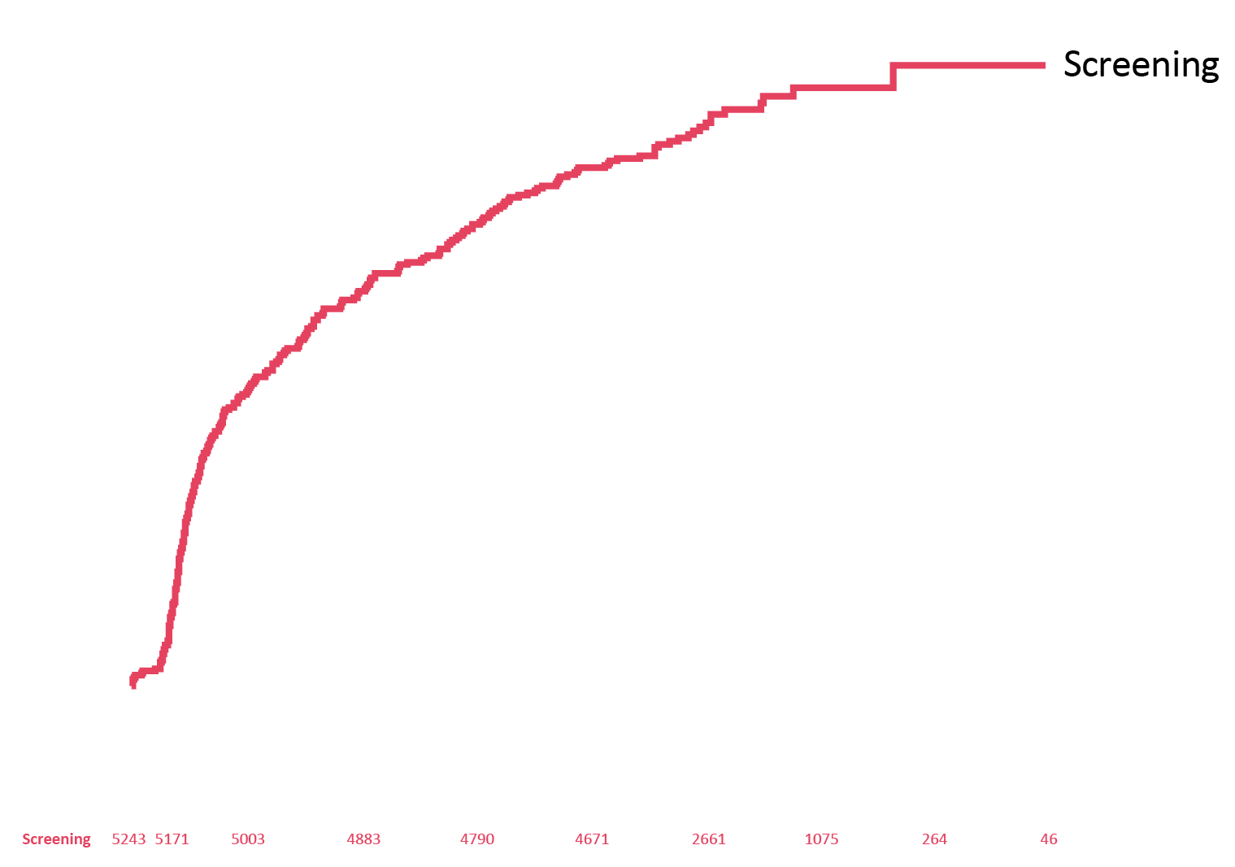
Diagnosed Atrial Fibrillation/Flutter*
4.00 per 100 person-years in the screening group
2.63 per 100 person-years in the usual care group
52% increase in the AF/AFL detection in the screening arm
*Diagnosed AF/AFL is based on ICD codes. AF/AFL detected by screening with the Zio® XT monitor was not counted as a study outcome since it could only occur in the screening arm.

Slide 15
Outcomes
Outcome, no./No. (%) | Screening | Usual Care | HR (95% CI)
First hospitalized stroke | 37/5243 (0.7%) | 34/5277 (0.6%) | 1.10 (0.69–1.75)
First hospitalized bleed | 52/5243 (1.0%) | 60/5277 (1.1%) | 0.87 (0.60–1.26)
First intracranial bleed | 16/5243 (0.3%) | 13/5277 (0.2%)
First non-intracranial bleed* | 36/5243 (0.7%) | 47/5277 (0.9%)
First GI bleed* | 19/36 (52.8%) | 29/47 (61.7%)
First bleed other than ICH/GI* | 22/36 (61.1%) | 21/47 (44.7%)
All-cause mortality | 125/5952 (2.1%) | 138/5953 (2.3%)
Prescription of any oral anticoagulant filled | 166/3924 (4.2%) | 114/4010 (2.8%)
*More than one type of non-ICH bleed can occur for a patient so types of non-ICH bleed are not mutually exclusive.
GI, gastrointestinal; ICH, intracranial hemorrhage.

Slide 16
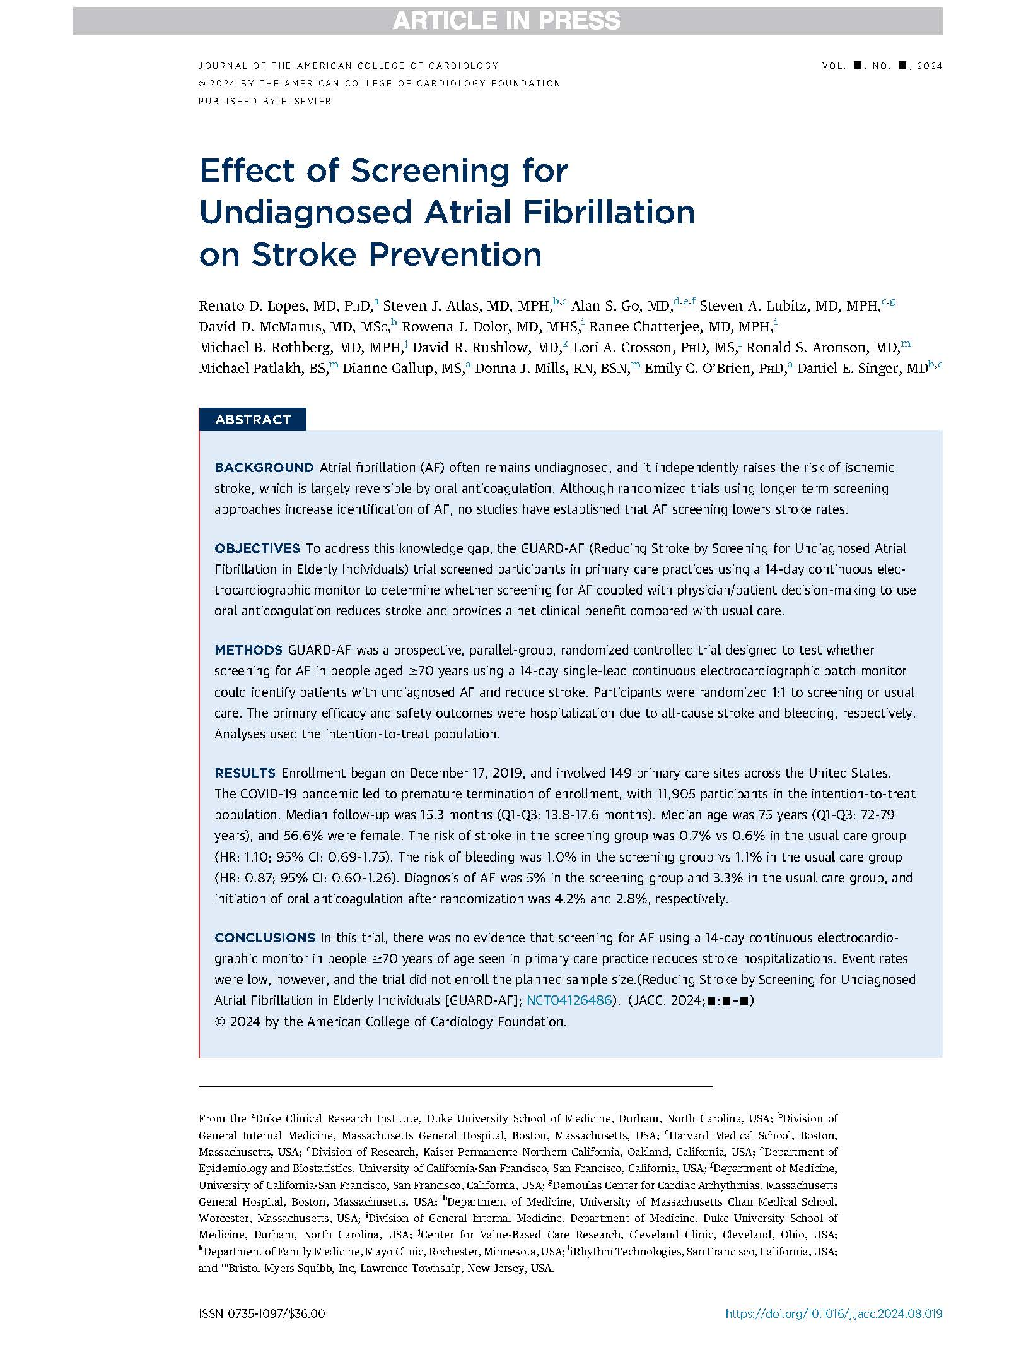


Simultaneously published in JACC

Slide 17
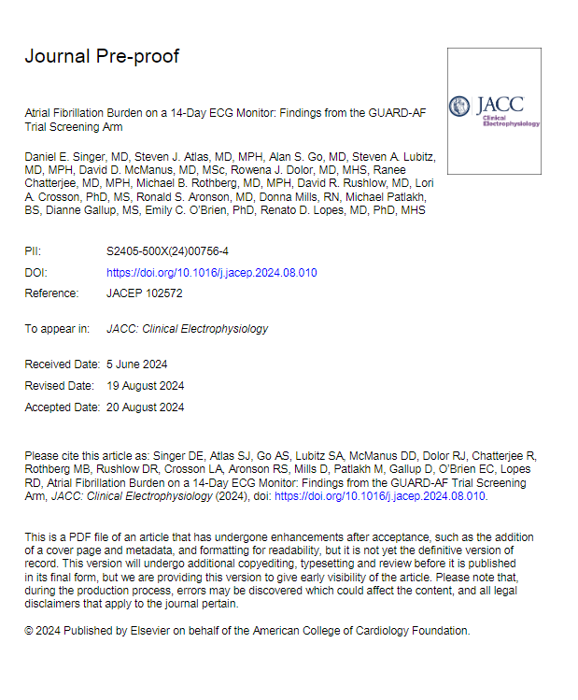



Slide 18
Take-Home Messages
Screening for AF using a 14-day, patch-based continuous ECG monitor among individuals aged ≥70 years increased detection of AF by 52%, and initiation of OAC, but did not reduce hospitalization for stroke.
No differences were observed in the rates of hospitalization for bleeding or all-cause mortality between AF screening and usual care.
The premature termination of enrollment and low statistical power do not allow a definitive conclusion about the impact of AF screening on stroke prevention.
Nonetheless, GUARD-AF showed that a simple pragmatic trial design that can be done virtually is a practical strategy for screening for AF.
A more effective method to enhance the risk of the population to be screened beyond an age threshold of 70 years is needed to potentially demonstrate an impact on stroke prevention.

