Slide 1
Edoxaban-Based Long-Term Antithrombotic Therapy for Atrial Fibrillation and Stable Coronary Disease
: The EPIC-CAD Randomized Clinical Trial
Gi-Byoung Nam, MD PhD and Duk-Woo Park, MD PhD
on behalf of the EPIC-CAD Investigators
Department of Cardiology, Asan Medical Center, University of Ulsan College of Medicine, Seoul, Korea
European Society of Cardiology Congress 2024 – Annual Scientific Session
Hot Line 6, September 1, 2024

Slide 2
Disclosure
Supported by research grant from
CardioVascular Research Foundation (CVRF)
Daiichi-Sankyo (Tokyo, Japan) &
Daewoong Pharmaceutical Co., Ltd (Seoul, Korea).

Slide 3
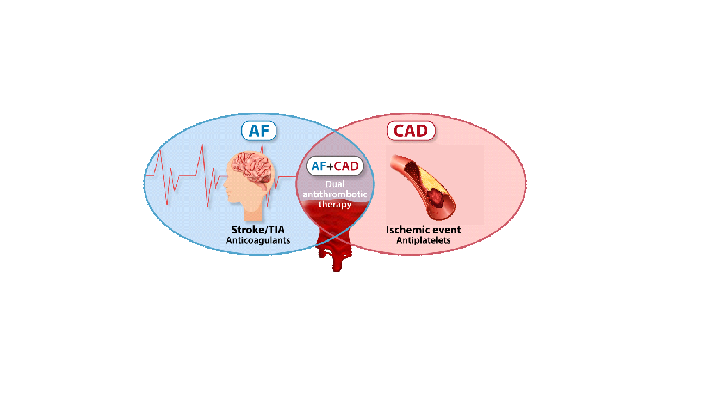
Background
The prevalence of AF is high among patients with CAD; however, choosing optimal antithrombotic therapy for both comorbidities is challenging
Patients with AF require anticoagulants to prevent thromboembolic events, whereas CAD require antiplatelets to prevent ischemic events
Combined use of anticoagulant and antiplatelet regimens markedly increase the risk of bleeding¹⁻⁵
AF, atrial fibrillation; CAD, coronary artery disease
¹Lancet 2013; 381:1107; ²N Engl J Med 2016;375:2423; ³N Engl J Med 2019; 380:1509; ⁴N Engl J Med 2017;377:1513; ⁵Lancet 2019;394:1335

Slide 4
Background: Current AF and CAD Guideline
After ACS or PCI up to 6mo – 1yr
AF and Stable CAD
CCS
PCI
OAC + P2Y12 up to 6mo
Post-PCI
6 – 12mo
Medically treated CAD
OAC
+Aspirin ≤1 mo
(+single antiplatelet)
ACS
PCI
OAC + P2Y12 up to 12mo
+Aspirin ≤1 mo
Medically treated ACS
OAC + P2Y12 up to 12mo
I | IIa | IIb | III
WOEST PIONEER AF-PCI AUGUSTUS
RE-DUAL PCI ENTRUST-AF PCI
OAC-ALONE
AFIRE
Lancet 2013; 381:1107; N Engl J Med 2016;375:2423; N Engl J Med 2019; 380:1509; N Engl J Med 2017;377:1513; Lancet 2019;394:1335
Circulation 2019;139:604; N Engl J Med 2019;381:1103
ACS, acute coronary syndrome; CCS, chronic coronary syndrome; OAC, oral anticoagulant; PCI, percutaneous coronary intervention
Eur Heart J 2020;42:373

Slide 5
Background: Prior RCT (OAC-ALONE and AFIRE)
OAC-ALONE trial
AFIRE trial
Efficacy endpoint*
ISTH major bleeding
Efficacy endpoint †
ISTH major bleeding
HR 1.16 (0.79-1.72)
HR 0.73 (0.44-1.20)
10.4%
7.8%
Circulation. 2019;139:604
N Engl J Med 2019;381:1103
Early termination d/t futility
Failed to show noninferiority
Predominant warfarin use
Early termination d/t an increased mortality signal
Use of locally approved dose rivaroxaban
(15 or 10mg once daily in Japan)
* Composite of death, myocardial infarction, stroke, or systemic embolism
† Composite of death, myocardial infarction, stroke, systemic embolism, or unstable angina requiring revascularization

Slide 6
Objective
To compare the efficacy and safety of standard-dose edoxaban monotherapy with the dual antithrombotic therapy (edoxaban + a single antiplatelet agent) in patients with high-risk AF and stable CAD.
The primary hypothesis was that edoxaban monotherapy would be superior to dual antithrombotic therapy with respect to the primary net clinical outcome.
Cho MS, Kang DY et al. Am Heart J 2022;247:123-131

Slide 7
Edoxaban versus Edoxaban with antiPlatelet agent In patients with atrial fibrillation and Chronic stable Coronary Artery Disease
Trial Design
investigator-initiated, multicenter,
open-label, superiority trial
EPIC-CAD Trial
1,038 patients with high-risk AF (CHA₂DS₂-VASc score ≥2) and stable CAD
A permuted block size of 4 or 6, stratified randomization by trial center
Edoxaban monotherapy
(N=519)
Dual antithrombotic therapy
(N=519)
Primary endpoint – net adverse clinical event (a composites of all-casuse death, stroke, systemic embolic event, myocardial infarction, unplanned urgent revascularization, major bleeding, and clinically relevant non-major bleeding) at 1 year after randomization
Cho MS, Kang DY et al. Am Heart J 2022;247:123-131

Slide 8
Enrollment Criteria
INCLUSION CRITERIA
EXCLUSION CRITERIA
Men or women at least age ≥ 18 years.
Patients with nonvalvular AF (prevalent or paroxysmal) with high embolic risk (CHA₂DS₂-VASc score ≥ 2)
Patients with stable CAD
Prior revascularization (PCI or CABG) ≥6M for chronic CAD and ≥12M for ACS
Anatomically confirmed CAD (≥50% stenosis in CAG or CCTA) on medical therapy alone
Patients with severe thrombocytopenia
High risk of bleeding or severe coexisting conditions prohibiting antithrombotic use
Prior history of intracranial hemorrhage
Mechanical prosthetic valve or moderate-to-severe mitral stenosis
Patients contraindicated for use of edoxaban or antiplatelets.
Planned PCI or CABG within 1 year after randomization.
Liver cirrhosis or severe hepatic dysfunction
Severe renal insufficiency (creatinine clearance <15 mL/min)
Life expectancy <12 months.
ACS, acute coronary syndrome; CAD, coronary artery disease; CAG, coronary angiography; CCTA, coronary computed tomographic angiography; PCI, percutaneous coronary intervention
Cho MS, Kang DY et al. Am Heart J 2022;247:123-131

Slide 9
Randomization and administration of study drug
Eligible patients were randomly assigned in a 1:1 ratio to either standard-dose edoxaban monotherapy or dual-antithrombotic therapy (edoxaban + a single antiplatelet agent) by means of a central, IWRS with block sizes of 4 or 6, stratified according to the participating site.
Standard-dose edoxaban was used in both group;
60-mg once daily as a standard dose
30-mg once daily with dose-reduction criteria
Body-weight ≤ 60 kg
Creatinine clearance of 15 – 50 mL/min
Concomitant use of P-glycoprotein inhibitors
Type of a single antiplatelet agent (either aspirin or a clopidogrel) was selected according to the discretion of the treating physician
IWRS, interactive web-based randomization system

Slide 10
Primary trial endpoint
Net adverse clinical event : defined as a composite of
Death from any causes
Myocardial infarction
Stroke
Systemic embolism
Unplanned urgent revascularization
Major or clinically relevant nonmajor bleeding event by ISTH definition
at 1 year after randomization
CI, confidence interval; ISTH, International Society on Thrombosis and Haemostasis

Slide 11
Secondary trial endpoints
Individual components of the primary outcome
Stent thrombosis
Major ischemic events
Composites of death, myocardial infarction ischemic stroke, and systemic embolism
Any ischemic events (post-hoc)
Composites of death, myocardial infarction ischemic stroke, and systemic embolism, and urgent repeat revascularization
Composite of major and clinically relevant nonmajor bleeding (by ISTH definition)
Fatal bleeding
Major bleeding
Any bleeding event

Slide 12
Statistical Considerations
Power Calculation (N = 1,038)
Assuming a 1-year event rate of 18% in the dual antithrombotic therapy group.
Statistical power of 80% to detect a relative reduction of 30% in the primary outcome in the edoxaban monotherapy group compared with the dual antithrombotic therapy group at a significance level of 0.05 on the basis of a two-sided log-rank test of survival.
Statistical Analysis
Primary intention-to-treat analysis
Cumulative event rates calculated by Kaplan-Meier estimates and compared with log-rank test
Cox proportional hazard models
Estimate the risk differences if proportional hazards assumption is not violated
Sensitivity and subgroup analysis
Per-protocol analysis (randomized groups without major protocol violations)
Subgroup analysis for primary endpoint according to the prespecified clinical factors

Slide 13
Participating Investigators and Trial Organization
Participating Investigators (18 Sites in South Korea)
Gi-Byoung Nam, Duk-Woo Park, Min Soo Cho, Do-Yoon Kang, Jung-Min Ahn, Seung-Jung Park (Asan Medical Centers); Yong-Seog Oh (Seoul St Mary's Hospital); Chang Hoon Lee (Veterans’ Health Service Medical Center); Eue-Keun Choi (Seoul National University); Ji Hyun Lee (Seoul National University Bundang Hospital); Chang Hee Kwon (Konkuk University Medical Center); Gyung-Min Park (Ulsan University Hospital); Hyung Oh, Choi (Soon Chun Hyang University Hospital Bucheon); Kyoung-Ha Park (Hallym University Medical Center); Kyoung-Min Park (Samsung Medical Center); Jongmin Hwang (Keimyung University Dongsan Hospital); Ki-Dong Yoo (St. Vincent's Hospital); Young-Rak Cho (Dong-A University Hospital); Ji Hyun Kim (Dongguk University Hospital); Ki Won Hwang (Pusan National University Yangsan Hospital); Eun Sun Jin (Kyung Hee University Hospital at Gangdong); Osung Kwon (Eunpyeong St. Mary's Hospital); Ki Hun Kim (Haeundae Paik Hospital)
Executive Committee
Gi-Byoung Nam (Trial PI) Duk-Woo Park (Trial PI) Min Soo Cho Do-Yoon Kang
Additional Steering Committee
Yong-Seog Oh Chang Hoon Lee Ji Hyun Lee Chang Hee Kwon
Event Adjudication Committee
Kee-Joon Choi (Chair) Junghoon Lee Joongmin Lee Jinsun Park
Su-young Park Kyung-Ae Kim
Data & Safety Monitoring Board
Hyun-Seok Nam (Chair) Jae-Seok Bae Suk-won Choi Elly Jeong-youn Bae
Trial Funding CardioVascular Research Foundation (CVRF)
Daiichi-Sankyo (Tokyo, Japan) & Daewoong Pharmaceutical Co., Ltd (Seoul, Korea).

Slide 14
Patient Flow and Follow-Up
Screened (1393)
(from May 14, 2019, through September 19, 2022)
Randomized (1040)
Edoxaban monotherapy (524)
Dual antithrombotic therapy(516)
1 Did not met eligibility criteria
12 Cross-over
1 Did not met eligibility criteria
11 Cross-over
2 Withdrew consent
8 Were lost to follow-up
3 Withdrew consent
6 Were lost to follow-up
At 12-month follow-up:
514 (98.1%) Completed follow-up
At 12-month follow-up:
507 (98.3%) Completed follow-up
524 (100%) Were included
in the intention-to-treat analysis
516 (100%) Were included
in the intention-to-treat analysis

Slide 15
Baseline Characteristics
 | Edoxaban Monotherapy (N=524) | Dual Antithrombotic Therapy (N=516)
Age [yrs], mean (SD) | 71.7±8.0 | 72.5±8.4
Male sex | 396 (75.6) | 406 (78.7)
Body-mass index | 25.3±3.3 | 25.4±3.3
Diabetes mellitus — no. (%) | 224 (42.7) | 197 (38.2)
Hypertension — no. (%) | 423 (80.7) | 422 (81.8)
Previous cerebrovascular disease — no. (%) | 77 (14.7) | 77 (14.9)
Previous myocardial infarction — no. (%) | 79 (15.1) | 92 (17.8)
Creatinine clearance by Cockcroft–Gault formula — ml/min | 67.0±23.6 | 66.0±21.4
CHA₂DS₂-VASc score | 4.3±1.6 | 4.4±1.5
CHADS₂ score | 2.1±1.2 | 2.2±1.2
HAS-BLED score | 2.1±0.8 | 2.2±0.8
Type of atrial fibrillation — no. (%)
Paroxysmal | 292 (55.7) | 283 (54.8)
Persistent or permanent | 232 (44.3) | 233 (45.2)
Indication for dose adjustment of edoxaban — no. (%) | 178 (34.0) | 168 (32.6)
Plus–minus values are means ± SD.

Slide 16
Baseline Characteristics
 | Edoxaban Monotherapy (N=524) | Dual Antithrombotic Therapy (N=516)
Obstructive CAD managed by medical therapy alone — no. (%) | 188 (35.9) | 169 (32.8)
Previous coronary revascularization — no. (%) | 336 (64.1) | 347 (67.2)
Previous PCI — no. (%) | 308 (58.8) | 318 (61.6)
Drug-eluting stent | 251 (81.5) | 267 (84.0)
Bare-metal stent | 13 (4.2) | 7 (2.2)
Both stent types | 8 (2.6) | 4 (1.3)
Unknown stent type | 36 (11.7) | 40 (12.6)
Previous CABG — no. (%) | 41 (7.8) | 36 (7.0)
Disease extent — no. (%)
1-vessel disease | 268 (51.1) | 260 (50.4)
2-vessel disease | 127 (24.2) | 135 (26.2)
3-vessel disease | 81 (15.5) | 77 (14.9)
Left main disease | 48 (9.2) | 42 (8.1)
CABG, coronary artery bypass grafting; CAD, coronary artery disease

Slide 17
Antithrombotic regiments before and after randomization
 | Edoxaban Monotherapy (N=524) | Dual Antithrombotic Therapy (N=516)
Prior use of antithrombotic strategy before randomization – no. (%)
None | 7 (1.3) | 6 (1.2)
Antiplatelet agent only | 51 (9.7) | 42 (8.1)
Oral anticoagulants only | 253 (48.3) | 217 (42.1)
Combination of antiplatelets and anticoagulants | 213 (40.6) | 251 (48.6)
Study drug regimens after randomization – no. (%)
Actual dose of edoxaban used
60mg | 317 (60.5) | 281 (54.5)
30mg | 207 (39.5) | 235 (45.5)
Type of a single antiplatelet agent
Aspirin | 1 (0.2) | 319 (61.8)
Clopidogrel | 2 (0.4) | 195 (37.8)

Slide 18
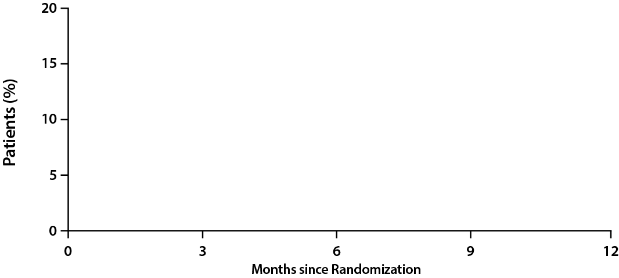
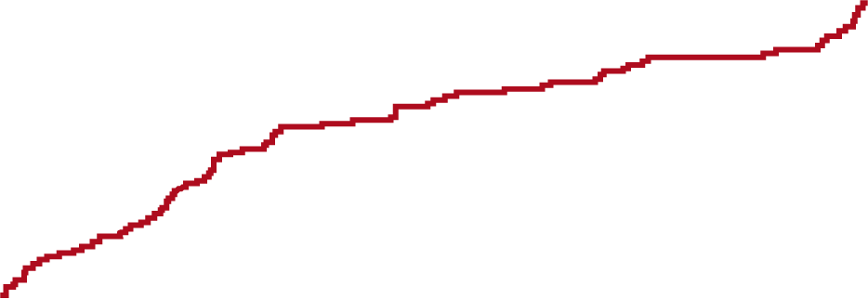
Primary Endpoint: Net adverse clinical event
Hazard ratio, 0.44 (95% CI, 0.30–0.65)
P < 0.001
16.2%
Dual antithrombotic therapy
Edoxaban monotherapy
6.8%
No. at Risk
Dual antithrombotic therapy | 516 |  | 475 |  | 452 |  | 437 |  | 391
Edoxaban monotherapy | 524 |  | 508 |  | 495 |  | 487 |  | 409
Primary net adverse clinical event was defined as a composite of death from any causes, myocardial infarction, stroke, systemic embolism, unplanned urgent revascularization, and major or clinically relevant nonmajor bleeding event

Slide 19
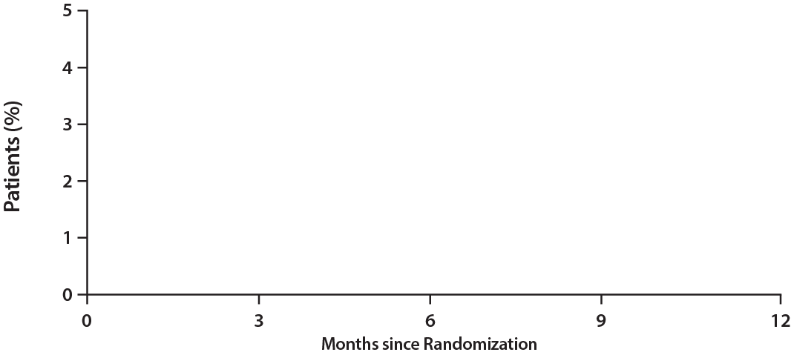
Key Secondary Endpoint: Major ischemic events
Hazard ratio, 1.23 (95% CI, 0.48–3.10)
Edoxaban monotherapy
Dual antithrombotic therapy
1.8%
1.6%
No. at Risk
Dual antithrombotic therapy | 516 |  | 510 |  | 505 |  | 499 |  | 446
Edoxaban monotherapy | 524 |  | 516 |  | 510 |  | 506 |  | 428
Major ischemic events: composite of death from any causes, myocardial infarction, ischemic stroke, and systemic embolism

Slide 20
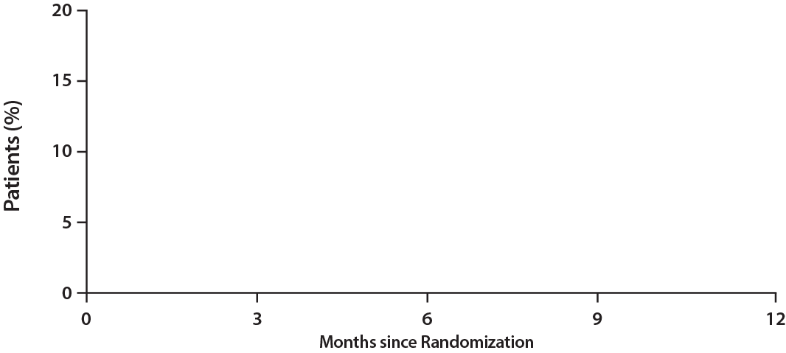
Key Secondary Endpoint: Major or clinically relevant non-major bleeding
Hazard ratio, 0.34 (95% CI, 0.22–0.53)
Dual antithrombotic therapy
14.2%
Edoxaban monotherapy
4.7%
No. at Risk
Dual antithrombotic therapy | 516 |  | 475 |  | 453 |  | 441 |  | 393
Edoxaban monotherapy | 524 |  | 512 |  | 500 |  | 492 |  | 414

Slide 21
Type of CV outcomes
Outcome* | Edoxaban Monotherapy (N=524) | Dual Antithrombotic Therapy (N=516) | Risk Difference (95% CI) | HR (95% CI)†
Primary composite outcome‡ | 34 (6.8) | 79 (16.2) | 9.41 (5.40 to 13.42) | 0.44 (0.30 to 0.65)
Secondary outcomes
Efficacy outcomes
Death | 3 (0.6) | 3 (0.7) | 0.08 (-0.97 to 1.13) | 1.29 (0.29 to 5.76)
Stroke | 7 (1.4) | 4 (0.8) | -0.60 (-1.89 to 0.69) | NR**
Myocardial infarction | 0 (0) | 2 (0.5) | 0.46 (-0.18 to 1.11) | NR**
Unplanned urgent revascularization | 7 (1.4) | 6 (1.4) | 0.0 (-1.50 to 1.50) | 1.00 (0.35 to 2.85)
Stent thrombosis | 0 / 308 (0) | 0 / 318 (0) | NA | NA
Major ischemic events | 8 (1.6) | 8 (1.8) | 0.13 (-1.52 to 1.78) | 1.23 (0.48 to 3.10)
Any ischemic events | 15 (3.0) | 11 (2.4) | -0.55 (-2.63 to 1.53) | 1.40 (0.67 to 2.93)
*The percentages were estimated by the Kaplan–Meier estimates. †Hazard ratios are for the edoxaban monotherapy compared to the dual antithrombotic therapy
‡The primary composite outcome was composite of death from any causes, myocardial infarction, stroke, systemic embolism, unplanned urgent revascularization, and major or clinically relevant nonmajor bleeding event.
**Hazard ratios were not reported (NR) for outcomes that did not appear to satisfy the proportional-hazards assumption.
CI, confidence interval; HR, hazard ratio; NA, not available

Slide 22
Type of CV outcomes
Outcome* | Edoxaban Monotherapy (N=524) | Dual Antithrombotic Therapy (N=516) | Risk Difference (95% CI) | HR (95% CI)†
Safety Outcomes
Major or clinically relevant nonmajor bleeding | 23 (4.7) | 70 (14.2) | 9.58 (5.92 to 13.24) | 0.34 (0.22 to 0.53)
Major bleeding | 6 (1.3) | 22 (4.5) | 3.12 (0.99 to 5.25) | 0.32 (0.14 to 0.73)
Clinically relevant nonmajor bleeding | 18 (3.5) | 52 (10.6) | 7.08 (3.89 to 10.27) | 0.36 (0.21 to 0.59)
Fatal bleeding | 0 (0) | 0 (0) | NA | NA
Any bleeding | 49 (9.9) | 99 (20.1) | 10.20 (5.73 to 14.67) | 0.48 (0.35 to 0.67)
Intracranial hemorrhage | 2 (0.4) | 3 (0.6) | 0.21 (-0.65 to 1.06) | 0.70 (0.12 to 4.16)
Gastrointestinal hemorrhage | 8 (1.6) | 13 (2.6) | 1.03 (-0.75 to 2.81) | NR**
*The percentages were estimated by the Kaplan–Meier estimates. †Hazard ratios are for the edoxaban monotherapy compared to the dual antithrombotic therapy. **Hazard ratios were not reported (NR) for outcomes that did not appear to satisfy the proportional-hazards assumption.
CI, confidence interval; HR, hazard ratio; NA, not available.

Slide 23
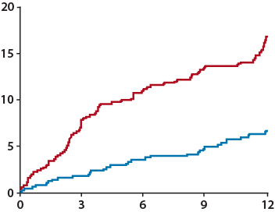
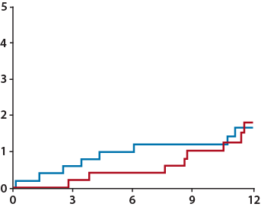
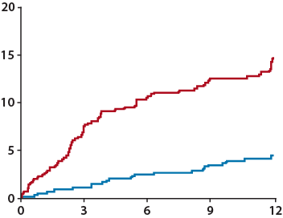
Sensitivity analysis: Per-protocol analysis
Primary net adverse clinical event
Major ischemic event
Major bleeding and clinically relevant non-major bleeding
Hazard ratio 0.42 (95% CI, 0.28-0.61)
Hazard ratio 1.23 (95% CI, 0.49-3.12)
Hazard ratio 0.32 (95% CI, 0.20-0.50)
16.4%
Dual antithrombotic therapy
14.4%
Dual antithrombotic therapy
Edoxaban monotherapy
Cumulative Incidence of Events (%)
Cumulative Incidence of Events (%)
6.6%
Dual antithrombotic therapy
1.8%
Edoxaban monotherapy
4.6%
1.7%
Edoxaban monotherapy
No. at Risk
Dual antithrombotic therapy | 504 | 464 | 441 | 427 | 382
Edoxaban monotherapy | 511 | 497 | 484 | 476 | 399
No. at Risk
Dual antithrombotic therapy | 504 | 464 | 441 | 427 | 382
Edoxaban monotherapy | 511 | 497 | 484 | 476 | 399
Months since Randomization
Months since Randomization
Months since Randomization
No. at Risk
Dual antithrombotic therapy | 504 | 464 | 441 | 427 | 382
Edoxaban monotherapy | 511 | 497 | 484 | 476 | 399
Primary net adverse clinical event was composite of death from any causes, myocardial infarction, stroke, systemic embolism, unplanned urgent revascularization, and major or clinically relevant nonmajor bleeding event.
Major ischemic event was as a composite of death from any cause, myocardial infarction, ischemic stroke, or systemic embolism.

Slide 24
Prespecified Subgroup Analysis
Percent of
Patients
Estimated 1-Yr Event Rate (%)
Subgroup
Edoxaban
monotherapy
Dual antithrombotic therapy
Hazard Ratios (95% CI)
Age
≥75 years | 42.2 | 5.3 | 18.7 |  | 0.31 (0.17 to 0.59)
<75 years | 57.8 | 7.8 | 14.2 |  | 0.56 (0.35 to 0.92)
Sex
Male | 77.1 | 6.0 | 17.4 |  | 0.37 (0.23 to 0.58)
Female | 22.9 | 9.4 | 12.1 |  | 0.81 (0.39 to 1.72)
Creatinine clearance
≥50 mL/min | 75.8 | 5.2 | 14.5 |  | 0.41 (0.25 to 0.66)
<50 mL/min | 24.2 | 12.1 | 21.7 |  | 0.53 (0.28 to 0.99)
Last revascularization
PCI | 59.1 | 6.4 | 17.1 |  | 0.43 (0.26 to 0.70)
Bypass grafting | 6.5 | 7.4 | 20.6 |  | 0.46 (0.13 to 1.67)
Medical treatment | 34.3 | 7.1 | 13.7 |  | 0.50 (0.26 to 0.99)
Edoxaban dose
60 mg | 57.5 | 6.5 | 16.4 |  | 0.46 (0.28 to 0.75)
30 mg | 42.5 | 7.5 | 16.1 |  | 0.44 (0.24 to 0.79)
Risk of stroke
CHA₂DS₂-VASc ≥4 | 67.3 | 6.1 | 16.2 |  | 0.39 (0.24 to 0.63)
CHA₂DS₂-VASc <4 | 32.7 | 8.2 | 16.3 |  | 0.57 (0.31 to 1.05)
Risk of bleeding
HAS-BLED ≥3 | 31.8 | 7.7 | 15.1 |  | 0.48 (0.25 to 0.93)
HAS-BLED <3 | 68.2 | 6.5 | 16.9 |  | 0.43 (0.27 to 0.69)
Edoxaban Monotherapy
Better
Dual antithrombotic Therapy
Better
PCI, percutaneous coronary intervention

Slide 25
Post-Hoc Subgroup Analysis
Percent of
Patients
Estimated 1-Yr Event Rate (%)
Subgroup
Edoxaban
monotherapy
Dual antithrombotic therapy
Hazard Ratios (95% CI)
Prior dual antithrombotic therapy
Yes | 44.6 | 6.3 | 14.4 |  | 0.46 (0.25 to 0.83)
No | 55.4 | 7.2 | 18.1 |  | 0.43 (0.26 to 0.71)
Prior anticoagulation Therapy
Yes | 89.8 | 7.0 | 14.9 |  | 0.51 (0.34 to 0.76)
No | 10.2 | 5.2 | 30.1 |  | 0.18 (0.06 to 0.59)
Prior antiplatelet therapy
Yes | 53.6 | 6.2 | 17.3 |  | 0.37 (0.22 to 0.63)
No | 46.4 | 7.4 | 15.2 |  | 0.56 (0.32 to 0.98)
Appropriateness of edoxaban dose
Appropriate dose | 86.0 | 7.1 | 16.5 |  | 0.45 (0.30 to 0.67)
Inappropriate dose | 14.0 | 4.9 | 15.3 |  | 0.40 (0.12 to 1.34)
Type of antiplatelets
Aspirin | 62.1 | 6.8 | 12.8 |  | 0.53 (0.35 to 0.82)
Clopidogrel | 37.9 | 6.8 | 22.3 |  | 0.34 (0.22 to 0.52)
Edoxaban Monotherapy
Better
Dual antithrombotic Therapy
Better
PCI, percutaneous coronary intervention

Slide 26
Study Limitations
Open-label design that entailed a risk of reporting or ascertainment bias
Not designed to detect potential differences in less common but clinically relevant ischemic outcomes
Net adverse clinical event as primary trial end point
Relatively higher incidence of bleeding events than ischemic events
Bias results in favor of the less potent antithrombotic strategy
The generalizability and reproducibility of our trial findings may be potentially limited
East Asian population
Women were underrepresented

Slide 27
Summary for the EPIC-CAD Trial Findings
In this multicenter RCT, use of standard-dose edoxaban monotherapy was associated with a lower risk of primary net adverse clinical events as compared with dual antithrombotic therapy (edoxaban and a single antiplatelet agent) in patients with AF and stable CAD.
This result appeared to be driven mainly by a lower incidence of bleeding events.
The incidence of ischemic events and mortality appeared to be similar in the trial groups.

Slide 28
Conclusion
In this EPIC-CAD involving patients with AF and stable CAD,
edoxaban monotherapy was associated with a lower risk of a composite outcomes of death from any cause, myocardial infarction, stroke, systemic embolism, unplanned urgent revascularization, or major bleeding or clinically relevant nonmajor bleeding than dual antithrombotic therapy at 12 months.

Slide 29
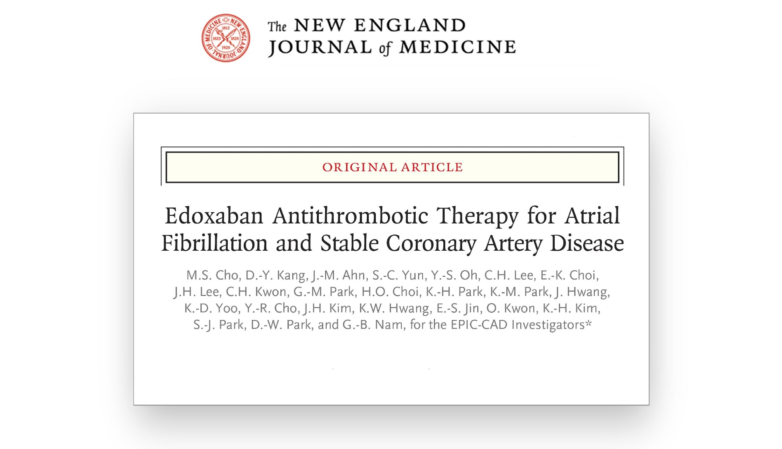
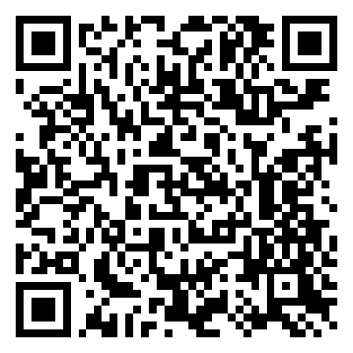
Further Details, Just Published in NEJM

Slide 30
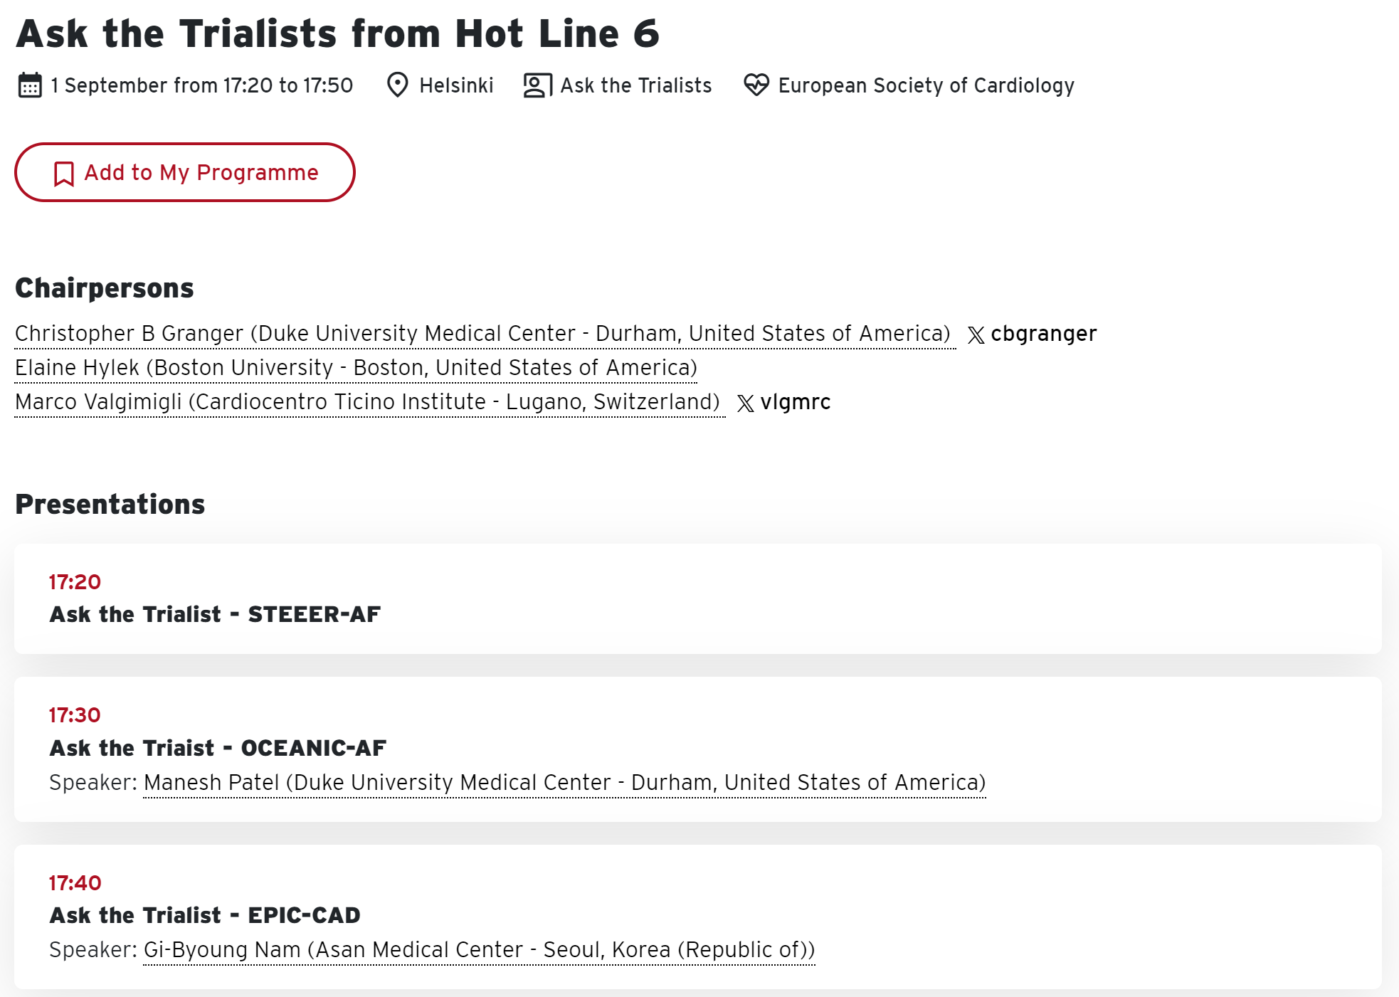
Ask the Trialist: Deep-Dive EPIC-CAD Trial

