Slide 1
Safety and Care OF no Fasting prior to catheterisation laboratory procedures: a non-inferiority randomised control trial (SCOFF Trial)
Fasting versus No Fasting Prior to Cardiac Catheterisation Procedures
David Ferreira
1st September 2024

Slide 2
Background
The American Society of Anesthesiology 2017 (1) and 2023 (2)
“Fasting from the intake of a light meal (e.g., toast and a clear liquid) of 6 or more hours before elective procedures requiring general anesthesia, regional anesthesia, or procedural sedation and analgesia should be maintained”

Slide 3
Background
CHOW NOW Trial (3)

Slide 4
Aim and Purpose
Aim
To perform a pragmatic and randomised trial to assess the non-inferiority of no-fasting compared to fasting for cardiac catheterisation procedures requiring concious sedation
Hypothesis
No fasting is non-inferior to fasting for a composite primary outcome of aspiration pneumonia, hypotension, hyperglycaemia and hypoglycaemia with improvement in patient satisfaction

Slide 5
Design
Multicentre Randomised Control Trial with a PROBE design (Prospective Open-Label Blinded Endpoint)
Blinded clinical events committee (electrophysiologist, interventional cardiologist and cardiac anaesthetist)
Non-inferiority trial assessed with a Bayesian approach

Slide 6
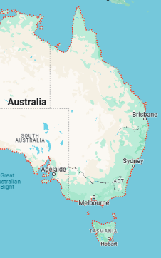
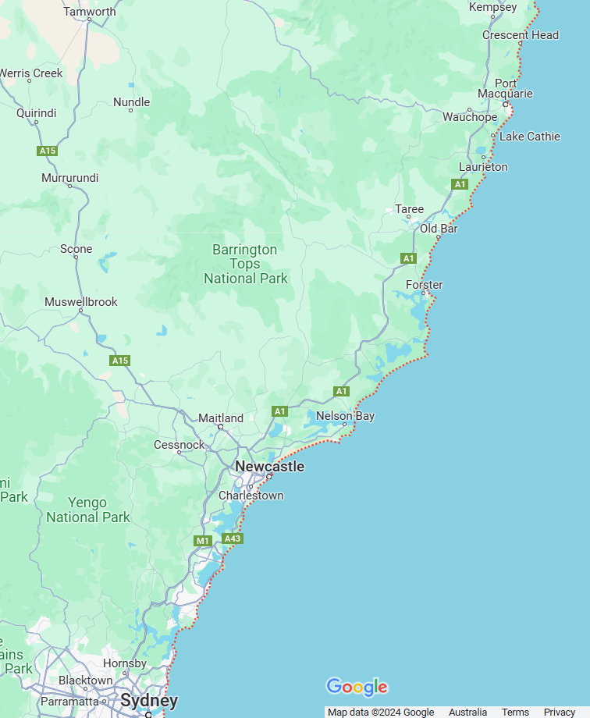
Design
Tamworth Rural Referral Hospital
Recruitment from 6 sites with procedures performed at 3 sites in New South Wales Australia
Maitland Hospital
Calvary Mater Hospital
John Hunter Hospital
Belmont District Hospital
Gosford Hospital

Slide 7
Methodology
Randomisation 1:1 with stratification for procedure site and procedure type (coronary vs device)
Control Arm:
6 hours solid food fasting, 2 hours clear liquid fasting
Intervention Arm:
No fasting requirements and encouraged to have regular meals

Slide 8
Inclusion Criteria
Exclusion Criteria
18 years or older
Referred for
Coronary angiogram
Coronary intervention
Implantable cardiac device related procedure
Need for general anaesthetic
Structural cardiac intervention
Planned calcium modification
Electrophysiology Study
Cardiac resynchronisation therapy
Emergent procedure

Slide 9
Primary Outcome
Primary Composite Endpoint
Aspiration Pneumonia - clinical syndrome of tachypnoea, hypoxia, fever, tachycardia with x-ray changes after an aspiration event
Hypotension – Systolic blood pressure <90mmhg or fluids/medications required to treat blood pressure
Hyperglycaemia – blood sugar level >11mmol/L
Hypoglycaemia – blood sugar level <3.9mmol/L

Slide 10
Secondary Outcomes
Secondary Outcomes
Individual components of the primary outcome
New intensive-care unit admission post procedure
New non-invasive or invasive ventilation requirement post procedure
30-day mortality
30-day readmission
30-day pneumonia events
Pre procedure Patient Satisfaction Survey (5)
Pre procedure EuroQol-5D

Slide 11
Patient Satisfaction Score (5)
PATIENT SATISFACTION QUESTIONNAIRE (5-point ordinal scale response)
PRE-PROCEDURE QUESTIONS: I am thirsty. I am hungry. My voice is hoarse. I am feeling anxious. I feel weak. I am nauseous. | RESPONSE OPTIONS: Strongly Disagree Disagree Neutral Agree Strongly Agree

Slide 12
Power Calculation
Absolute non-Inferiority margin of 3%
600 patients would be required to declare non-inferiority in 80% (power) of simulations
Aimed to recruit 700 patients (600 coronary procedures and 100 device procedures)

Slide 13
Statistical Analysis
Probability of non-inferiority >95% -> Non-Inferiority declared
If non-inferiority confirmed -> Analyse for superiority
If probability of superiority >95% -> Superiority declared

Slide 14
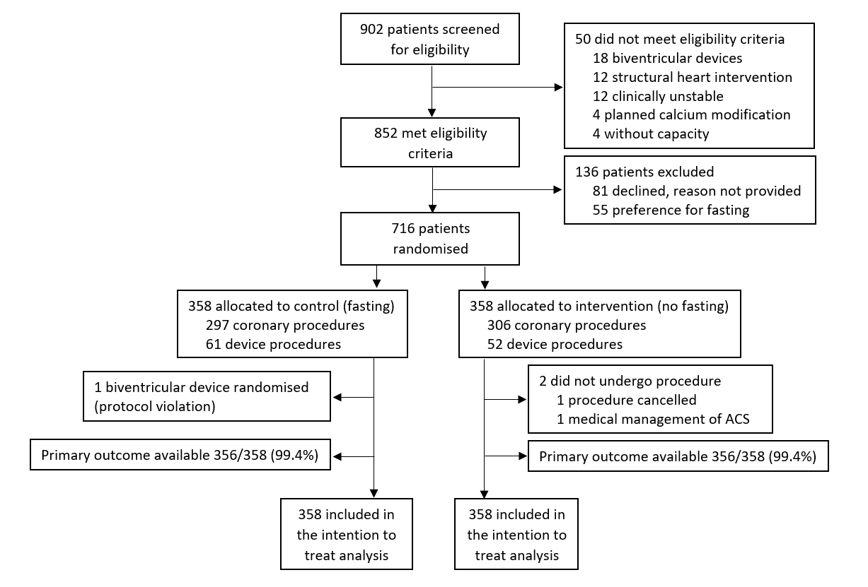
Consort

Slide 15
BASELINE CHARACTERISTICS
Baseline Characteristics | Fasting (N=358) | No Fasting (N=358)
Age (years) – mean±SD | 70±11.4 | 69±10.9
Male Sex – no. (%) | 231/358 (64.5) | 236/358 (65.9)
Body Mass Index† (kg/m²) – mean±SD | 29.6±5.9 | 29.6±5.9
Hypertension – no./total no. (%) | 250/358 (69.8) | 249/358 (69.6)
Myocardial Infarction – no./total no. (%) | 72/358 (20.1) | 89/356 (25)
Heart Failure – no./total no. (%) | 43/358 (12.0) | 51/358 (14.3)
Chronic Kidney Disease – no./total no. (%) | 77/350 (22.0) | 69/354 (19.5)
Type 2 Diabetes Mellitus – no./total no. (%) | 97/358 (27.1) | 95/358 (26.5)
Ischemic Stroke/TIA – no./total no. (%) | 20/356 (5.6) | 29/357 (8.1)
Hemorrhagic Stroke – no./total no. (%) | 5/358 (1.4) | 2/357 (0.6)
Baseline Serology
Creatinine (µmol/L) – mean±SD | 98±71 | 97±70
Haemoglobin (g/L) – mean±SD | 137±17 | 137±18

Slide 16
PROCEDURAL CHARACTERISTICS
Procedural Characteristics | Fasting (N=358) | No Fasting (N=358)
Coronary Procedure – no./total no. (%) | 297/358 (83.0) | 306/358 (85.5)
Radial Access Attempted – no./total no. (%) | 288/297 (97) | 293/304 (95.7)
Femoral Access Attempted – no./total no. (%) | 17/297 (5.7) | 18/304 (5.9)
Coronary Intervention£ – no./total no. (%) | 90/297 (30.3) | 113/306 (36.9)
Physiology Assessment – no./total no. (%) | 19/297 (6.4) | 29/306 (9.5)
Coronary Stent/Balloon – no./total no. (%) | 72/297 (24.2) | 83/306 (27.1)
Number of Stents | 1.4±0.7 | 1.4±0.7
Device Procedure – no./total no. (%) | 61/358 (17.0) | 52/358 (14.5)
Pacemaker – no./total no. (%) | 40/61 (65.6) | 28/52 (53.8)
Defibrillator – no./total no. (%) | 9/61 (14.8) | 4/52 (7.8)
Lead Revision – no./total no. (%) | 5/61 (8.2) | 2/52 (3.8)
Generator Change – no./total no. (%) | 7/61 (11.5) | 18/52 (34.6)

Slide 17
FASTING BETWEEN GROUPS
Procedural Characteristics | Fasting (N=358) | No Fasting (N=358) | Bayes Factor
In-Patient Procedure – no./total no. (%) | 122/358 (34.1) | 125/358 (34.9)
Sedation Provision | 311/358 (87) | 318/358 (89)
Midazolam (mg) – mean±SD | 1.3±0.75 | 1.2±0.5
Fentanyl (microg) – mean±SD | 40.3±20.4 | 41.3±24.4
Fasting Times
Solid Food Fasting Time, hours (IQR) | 13.2 (8.5-15.1) | 3.0 (1.8-4.2) | >100
Clear Liquid Fasting Time, hours (IQR) | 7.0 (4.2-12.1) | 2.4 (1.2-3.5) | >100

Slide 18
PRIMARY COMPOSITE OUTCOME MET NON-INFERIORITY AND SUPERIORITY
Outcomes | Fasting (N=358) | No Fasting (N=358)
Primary Composite Outcome
Composite of procedure related aspiration pneumonia, hypotension, hyperglycaemia, hypoglycaemia no./total no. (%) | 19.1% | 12.0%
 | 95% Credible Interval
Relative Difference in the Primary Composite | 0.68 (0.46 - 0.91)
PROBABILITY OF NON-INFERIORITY – >99.5
PROBABILITY OF SUPERIORITY – 99.1%

Slide 19
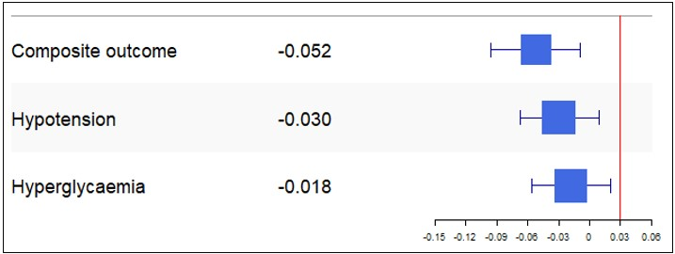
FOREST PLOT OF THE PRIMARY COMPOSITE OUTCOME

Slide 20
SECONDARY OUTCOMES BETWEEN GROUPS
Secondary Outcomes | Fasting (N=358) | No Fasting (N=358)
Contrast Induced Nephropathy no./total no. (%) | 3/78 (3.8) | 5/80 (6.3)
New Ventilation Requirement no./total no. (%) | 0/358 (0) | 0/358 (0)
New Intensive Care Unit Admission no./total no. (%) | 0/358 (0) | 0/358 (0)
Readmission within 30 days no./total no. (%) | 28/358 (7.8) | 28/358 (7.8)
Death within 30 days no./total no. (%) | 1/358 (0.3) | 1/358 (0.3)
Pneumonia within 30 days no./total no. (%) | 2/358 (0.6) | 0/358 (0)
Patient Satisfaction Score£ – mean±SD | 15±4.3 | 11±4.0

Slide 21
Decisive Evidence of Improvement in Patient Satisfaction Scores with No Fasting
Fasting Arm – 15 ± 4.3
No Fasting Arm – 11 ± 4.0
Analysis | Patient Satisfaction Score | Difference | Bayes Factor
Bayes Factor Analysis Complete Case Population | Estimate of Difference (95% CI) | -4.02 (-4.67 to -3.34) | >100
* CI refers to credible intervals.

Slide 22
Discussion
No fasting was non-inferior and superior to fasting for the primary composite outcome
Result was robust to Per-Protocol analysis with uninformative priors
No fasting was superior for patient satisfaction scores
It seems reasonable to let patients modulate their own intake

Slide 23
Limitations
Performance Bias - Unable to blind patients and caregivers to group allocation
Routine intravenous hydration was not protocolised
Food content and volume was not recorded
57% of patients no-fasting arm reported no clear liquid intake within 2 hours of procedure (91.1% of the intervention group were “not fasted” according to guidelines)

Slide 24
The case for non-inferiority of no fasting is strong
Mishra, A. Strict versus no fasting prior to cardiac catheterization: a prospective evaluation of safety and clinical outcomes. Can we safely have our patients eat with cardiac catheterization - nix or allow: the CHOW NOW study [abstract 11758]. SCAI 2020 Virtual Scientific Sessions: Virtual Conference, May 14 to 16, 2020. Accessed January 19, 2021.
Boukantar, M, Chiaroni, P, Gallet, R. et al. A Randomized Controlled Trial of Nonfasting vs Fasting Before Interventional Coronary Procedures: The TONIC Trial. J Am Coll Cardiol Intv. 2024 May, 17 (10) 1200–1210.
Bode K, Gerhards M, Doering M, Lucas J, Tijssen J, Dagres N, et al. A randomized trial of non-fasting vs. fasting for cardiac implantable electronic device procedures (Fast-CIED Study). Europace. 2022;24(10):1617-26.
Woods C, Wood M, Boylan A, Flanagan ME, Powers J. Fasting Versus a Heart-Healthy Diet Before Cardiac Catheterization: A Randomized Controlled Trial. American Journal of Critical Care. 2024;33(1):29-33.
Tamborrino, Pietro Paolo et al. Do We Need Fasting Prior to Coronary Angiography? The CORO-NF Randomized Pragmatic Study. The American Journal of Medicine, Volume 137, Issue 7, 666 - 672
Proctor R, Wong A, Robinson R, Said C, Kempton H, Muller D. Fasting Prior to Coronary Procedures, a Thing of the Past: A Retrospective Audit. Heart, Lung and Circulation. 2023;32:S434-S5.
Bacus SB, Parsons J, Benatar J, Somaratne J, Webster M, Parke R. Fasting prior to cardiac catheterisation: a single-centre observational study. N Z Med J. 2020;133(1510):16-22.

Slide 25
Take Home Points
No fasting was non-inferior and superior to fasting prior to cardiac catheterisation coronary and implantable cardiac device procedures for the primary composite outcome
Those who were not fasted had significant improvements in patient reported satisfaction scores

Slide 26
References
Practice Guidelines for Preoperative Fasting and the Use of Pharmacologic Agents to Reduce the Risk of Pulmonary Aspiration: Application to Healthy Patients Undergoing Elective Procedures: An Updated Report by the American Society of Anesthesiologists Task Force on Preoperative Fasting and the Use of Pharmacologic Agents to Reduce the Risk of Pulmonary Aspiration. Anesthesiology 2017; 126:376–393
Girish P. Joshi, et al. 2023 American Society of Anesthesiologists Practice Guidelines for Preoperative Fasting: Carbohydrate-containing Clear Liquids with or without Protein, Chewing Gum, and Pediatric Fasting Duration—A Modular Update of the 2017 American Society of Anesthesiologists Practice Guidelines for Preoperative Fasting. Anesthesiology 2023
Mishra, A. Strict versus no fasting prior to cardiac catheterization: a prospective evaluation of safety and clinical outcomes. Can we safely have our patients eat with cardiac catheterization - nix or allow: the CHOW NOW study [abstract 11758]. SCAI 2020 Virtual Scientific Sessions: Virtual Conference, May 14 to 16, 2020. Accessed January 19, 2021. https://virtual2020.scai.org
Brar SS, Aharonian V, Mansukhani P, Moore N, Shen AYJ, Jorgensen M, et al. Haemodynamic-guided fluid administration for the prevention of contrast-induced acute kidney injury: the POSEIDON randomised controlled trial. The Lancet. 2014;383(9931):1814-23.
Popovic MM, Kalaichandran S, Kabanovski A, El-Defrawy S, Arzola C, Rai A, et al. Development and Validation of a Questionnaire Assessing Patient Distress from Preoperative Fasting in Cataract Surgery. Ophthalmic Epidemiology. 2021;28(4):337-48.

Slide 27
Supplementary Slides

Slide 28
Procedural Data
Procedural Characteristics | Fasting (N=358) | No Fasting (N=358)
Coronary Procedure – no./total no. (%) | 297/358 (83.0) | 306/358 (85.5)
Radial Access Attempted – no./total no. (%) | 288/297 (97) | 293/304 (95.7)
Femoral Access Attempted – no./total no. (%) | 17/297 (5.7) | 18/304 (5.9)
Coronary Intervention£ – no./total no. (%) | 90/297 (30.3) | 113/306 (36.9)
Coronary Stent/Balloon – no./total no. (%) | 72/297 (24.2) | 83/306 (27.1)
Number of Stents | 1.4±0.7 | 1.4±0.7
Left Main Intervention | 2/72 (2.8) | 5/83 (6.0)
Left Anterior Descending Artery | 31/72 (43.1) | 39/83 (47.0)
Right/Circumflex Artery | 44/72 (61.1) | 51/83 (61.4)
Graft Intervention | 1/72 (1.4) | 3/83 (3.6)
Unplanned Calcium Modification | 0/72 (0) | 2/83 (2.4)

Slide 29
Primary Composite Outcome Breakdown
Outcomes | Fasting (N=358) | No Fasting (N=358)
Primary Outcome
Composite of procedure related aspiration pneumonia, hypotension, hyperglycaemia, hypoglycaemia no./total no. (%) | 68/356 (19.1) | 43/356 (12.0)
Components of the Primary Outcome
Hypotension no./total no. (%) | 32/358 (8.9) | 22/358 (6.1)
Fluid Provision - no./total no. (%) | 7/32 (21.9) | 1/22 (4.5)
Medication Support - no./total no. (%) | 7/32 (21.9) | 4/22 (18.2)
Hyperglycaemia no./total no. (%) | 30/356 (8.4) | 23/356 (6.5)
Hypoglycaemia no./total no. (%) | 7/356 (2.0) | 2/356 (0.6)
Aspiration Pneumonia no./total no. (%) | 0/358 (0) | 0/358 (0)

Slide 30
Results – Intention to Treat Analysis
Primary Composite Outcome | 95% Credible Interval | Posterior Probability for Non-Inferiority (%) | Posterior Probability for Superiority (%)
Informative Priors
Absolute Difference | -0.052 (-0.096, -0.009) | >0.995 | 0.991
Relative Difference | 0.68 (0.46, 0.91)
Un-Informative Priors
Absolute Difference | -0.069 (-0.122, -0.016) | >0.995 | 0.995
Relative Difference | 0.65 (0.43, 0.88)
Jeffries Beta Priors
Absolute Difference | -0.069 (-0.122, -0.016) | >0.995 | 0.994
Relative Difference | 0.65 (0.43, 0.88)

Slide 31
Results – Per Protocol Analysis
Primary Composite Outcome | 95% Credible Interval | Posterior Probability for Non-Inferiority (%) | Posterior Probability for Superiority (%)
Informative Priors
Absolute Difference | -0.045 (-0.090, -0.001) | >0.995 | 0.974
Relative Difference | 0.71 (0.46, 0.98)
Un-Informative Priors
Absolute Difference | -0.061 (-0.120, -0.002) | >0.995 | 0.978
Relative Difference | 0.68 (0.42, 0.96)
Jeffries Beta Priors
Absolute Difference | -0.060 (-0.119, -0.002) | >0.995 | 0.981
Relative Difference | 0.68 (0.42, 0.88)

Slide 32
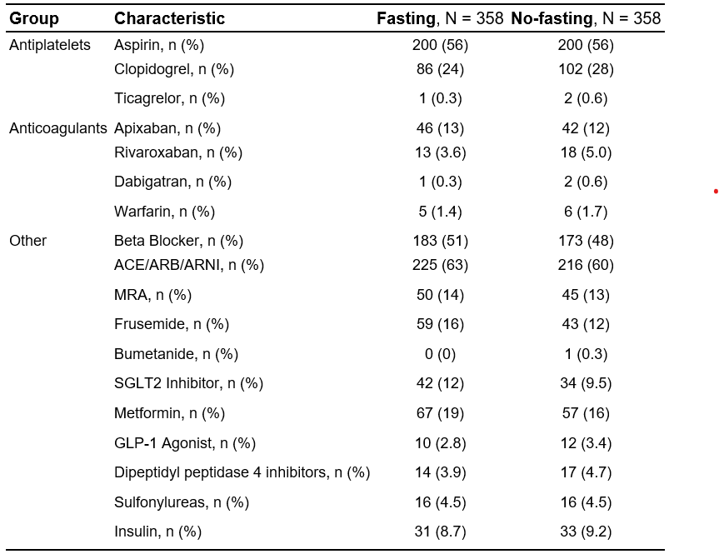
Base Medications

Slide 33
Fasting between groups

Slide 34
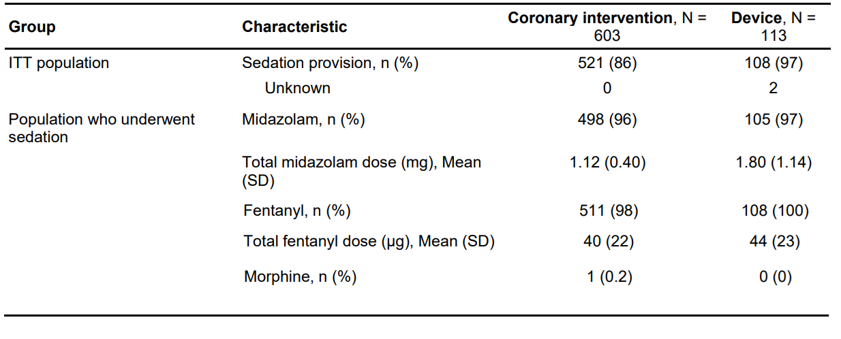
Sedation Provision Based on Procedure

Slide 35
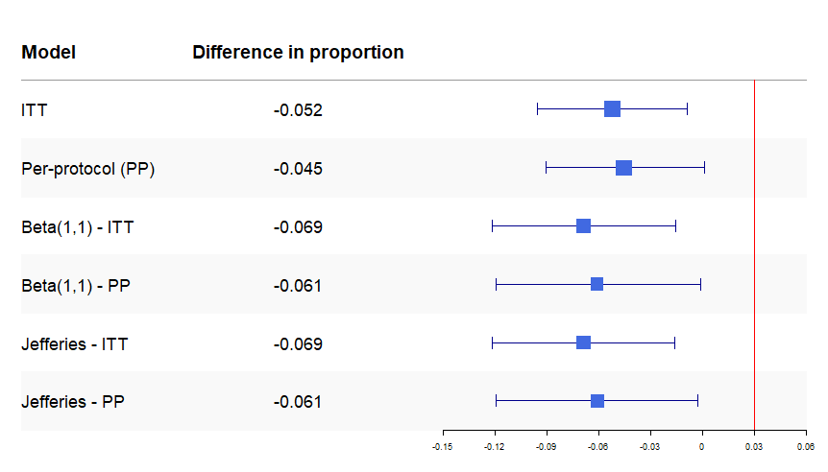
Forest plots of posterior estimate of difference in proportions for primary analysis and sensitivity analyses
Favours No Fasting

Slide 36
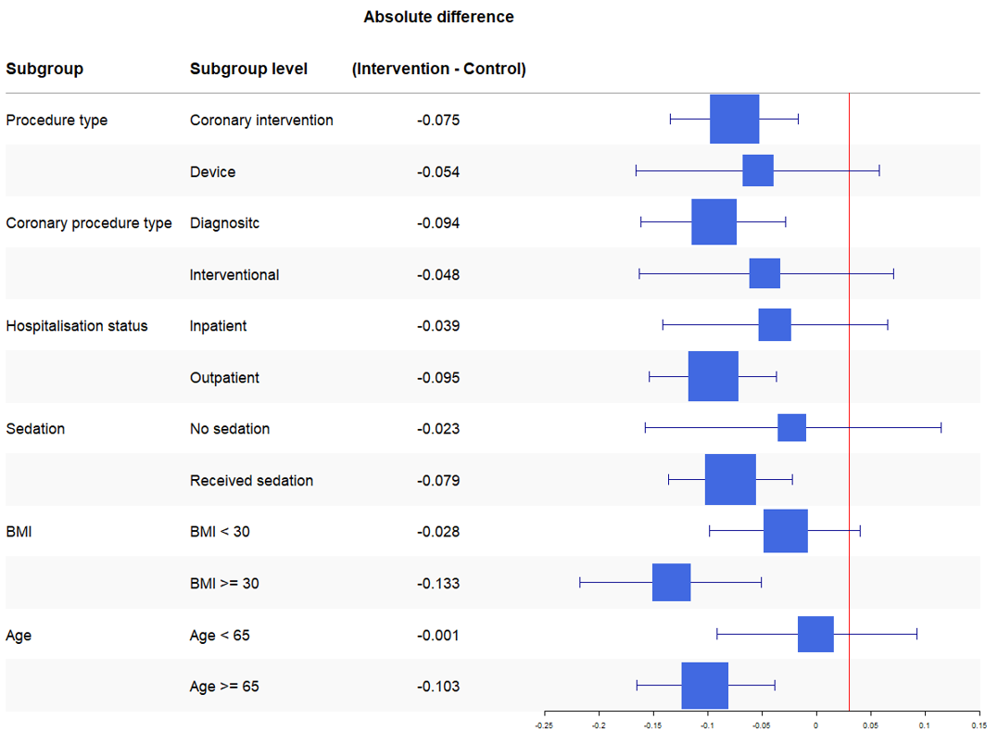
Favours No Fasting
Forest plots of posterior estimate of difference in proportions for subgroup analyses of the intention to treat cohort.

Slide 37
