Slide 1
Transcatheter versus surgical mitral valve repair in patients with heart failure and secondary mitral regurgitation
Results of the MATTERHORN trial
Volker Rudolph¹, Torsten Doenst², Roman Pfister³, Mirjam Kessler⁴, Peter Boekstegers⁵, Stefan Blankenberg⁶, Jörg Hausleiter⁷, Stephan von Bardeleben⁸, Wolfgang Rottbauer⁴, P. Christian Schulze⁹, Martin Hellmich¹⁰, Christian Hagl¹¹, Hermann Reichenspurner¹², Thorsten Wahlers³, Stephan Baldus³ on behalf of the MATTERHORN investigators
1 General and Interventional Cardiology/Angiology, Heart & Diabetes Centre NRW, University Hospital of the Ruhr-Universität Bochum, Medical Faculty OWL, Germany; 2 Department of Cardiothoracic Surgery, Jena University Hospital, Friedrich-Schiller-University of Jena, Jena, Germany; 3 University of Cologne, Faculty of Medicine and University Hospital Cologne, Clinic III for Internal Medicine, Cologne, Germany; 4 Ulm University Heart Center, Department of Cardiology, Albert-Einstein-Allee 23, 89081, Ulm, Germany; 5 Department of Cardiology, Helios Klinikum Siegburg, Siegburg, Germany; Department of Cardiology, Faculty of Health, School of Medicine, Witten, Witten/Herdecke University; 6 Department of Cardiology, University Heart and Vascular Center Hamburg, University Medical Center Hamburg-Eppendorf, Hamburg, Germany; 7 Medical Clinic and Polyclinic I, University Hospital of Munich, Munich, Germany; 8 Department of Cardiology, University Medical Center Mainz, Mainz, Germany; 9 Department of Cardiology, Jena University Hospital, Friedrich-Schiller-University of Jena, Jena, Germany; 10 Institute of Medical Statistics and Computational Biology, Faculty of Medicine and University Hospital Cologne, University of Cologne, Cologne, Germany; 11 Department of Cardiothoracic Surgery, University Hospital of Munich, Munich, Germany; 12 Department of Cardiothoracic Surgery, University Heart and Vascular Center Hamburg, University Medical Center Hamburg-Eppendorf, Hamburg, Germany.
31/08/2024

Slide 2
Disclosures
Research grants Abbott Vascular, Boston Scientific, Edwards Lifesciences
Consulting fees Abbott Vascular, Edwards Lifesciences (to institution)
Speakers honoraria Abbott Vascular, Astra Zeneca, Bristol Myers Squibb, Edwards Lifesciences (to institution)

Slide 3
MATTERHORN: Study Design
Key eligibilty criteria
Multicentric controlled non-inferiority trial
Secondary mitral regurgitation:
EROA ≥ 0.2cm²
biplane vena contracta > 8mm
regurgitant volume ≥ 30ml or regurgitant fraction ≥ 50%
at least two HF hospitalisations in the last 12 months
LV ejection fraction ≥ 20%
High surgical risk determined by Heart Team consensus
NYHA ≥ II despite GDMT
No other severe valve disorder
No revascularisation or CRT ≤ 30d
Mitral Transcatheter Edge-to-Edge Repair
N = 104
1 year primary efficacy endpoint
Death
HF rehospitalisation
Mitral reintervention
Assist device implantation
Stroke
1:1-randomization
Key secondary end-point:
Recurrence of MR grade 3 or 4
Surgical Mitral Valve Repair or Replacement
(ablation, tricuspid repair at discretion of operator)
N = 104
30d primary safety endpoint
MAE at 30 days

Slide 4
Sample Size And Power Analysis
Assumptions
incidence of primary end-point: 35%
non-inferiority margin: 17.5%
→ sample size:
180 patients (90 per group) provide a power (1-β) of 80% at a one-sided α of 0.05
→ accounting for stratification by study site and 5% drop-out:
210 patients (105 per group)

Slide 5
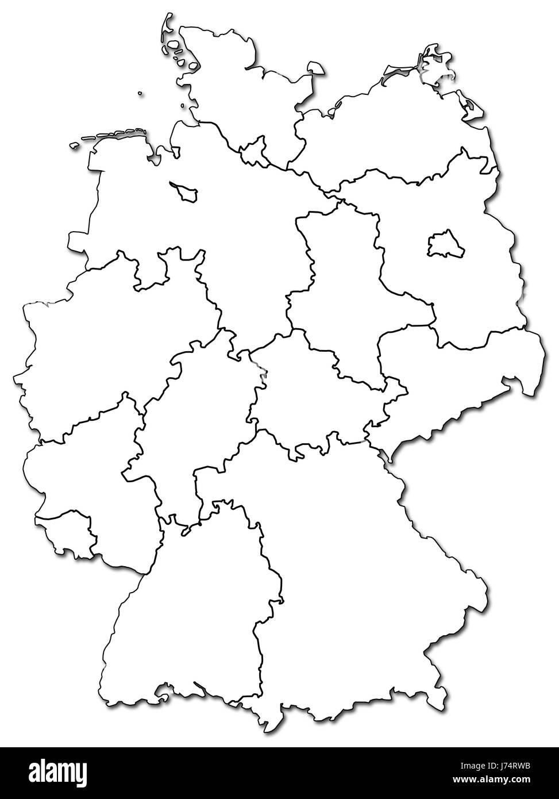
Study Conduct
Lübeck
Rostock
investigator-initiated study supported by an unrestricted research grant by Abbott Vascular
UKE Hamburg
patients enrolled in 16 participating study sites
Krefeld
Bad Oeynhausen
Magdeburg
Düsseldorf
Echo Core Lab: University Medical Center Mainz
Cologne
Leipzig
Siegburg
Aachen
Jena
5 pts. lost to follow-up, 15 pts. withdraw consent
Bad Nauheim
Frankfurt
data available at 1 year in 190 pts.
Ulm
LMU Munich

Slide 6
Baseline characteristics
Characteristic | TEER Group | Surgical Group | Total
Age − yr (mean±SD) | 70.2±8.1 | 70.9±7.8 | 70.5±7.9
Female sex – no. (%) | 38 (36.5) | 45 (43.3) | 83 (39.9)
Coronary artery disease – no. (%) | 48 (46.6) | 42 (40.8) | 90 (43.7)
History of atrial fibrillation –no. (%) | 57 (55.3) | 48 (46.6) | 105 (51.0)
STS score – %‡ (median [IQR]) | 1.9 (0.9-3.3) | 2.2 (1.4-4.1) | 2.0 (1.1-3.7)
EuroScore II – %§ (median [IQR]) | 3.0 (1.6-4.5) | 3.0 (1.8-4.2) | 3.0 (1.7-4.3)
NYHA class – no. (%)
III | 79 (77.5) | 83 (82.2) | 162 (79.8)
IV | 5 (4.9) | 7 (6.9) | 12 (5.9)
HF hospitalization ≤ 1 yr –no. (%) | 86 (83.5) | 84 (82.4) | 170 (82.9)
Previous CRT –no. (%) | 16 (15.5) | 11 (10.7) | 27 (13.1)
Previous ICD– no. (%) | 14 (13.6) | 9 (8.7) | 23 (11.2)

Slide 7
Baseline characteristics
Characteristic | TEER Group | Surgical Group | Total
Age − yr (mean±SD) | 70.2±8.1 | 70.9±7.8 | 70.5±7.9
Female sex – no. (%) | 38 (36.5) | 45 (43.3) | 83 (39.9)
Coronary artery disease – no. (%) | 48 (46.6) | 42 (40.8) | 90 (43.7)
History of atrial fibrillation –no. (%) | 57 (55.3) | 48 (46.6) | 105 (51.0)
STS score – %‡ (median [IQR]) | 1.9 (0.9-3.3) | 2.2 (1.4-4.1) | 2.0 (1.1-3.7)
EuroScore II – %§ (median [IQR]) | 3.0 (1.6-4.5) | 3.0 (1.8-4.2) | 3.0 (1.7-4.3)
NYHA class – no. (%)
III | 79 (77.5) | 83 (82.2) | 162 (79.8)
IV | 5 (4.9) | 7 (6.9) | 12 (5.9)
HF hospitalization ≤ 1 yr –no. (%) | 86 (83.5) | 84 (82.4) | 170 (82.9)
Previous CRT –no. (%) | 16 (15.5) | 11 (10.7) | 27 (13.1)
Previous ICD– no. (%) | 14 (13.6) | 9 (8.7) | 23 (11.2)

Slide 8
Baseline characteristics
Characteristic | TEER Group | Surgical Group | Total
Age − yr (mean±SD) | 70.2±8.1 | 70.9±7.8 | 70.5±7.9
Female sex – no. (%) | 38 (36.5) | 45 (43.3) | 83 (39.9)
Coronary artery disease – no. (%) | 48 (46.6) | 42 (40.8) | 90 (43.7)
History of atrial fibrillation –no. (%) | 57 (55.3) | 48 (46.6) | 105 (51.0)
STS score – %‡ (median [IQR]) | 1.9 (0.9-3.3) | 2.2 (1.4-4.1) | 2.0 (1.1-3.7)
EuroScore II – %§ (median [IQR]) | 3.0 (1.6-4.5) | 3.0 (1.8-4.2) | 3.0 (1.7-4.3)
NYHA class – no. (%)
III | 79 (77.5) | 83 (82.2) | 162 (79.8)
IV | 5 (4.9) | 7 (6.9) | 12 (5.9)
HF hospitalization ≤ 1 yr –no. (%) | 86 (83.5) | 84 (82.4) | 170 (82.9)
Previous CRT –no. (%) | 16 (15.5) | 11 (10.7) | 27 (13.1)
Previous ICD– no. (%) | 14 (13.6) | 9 (8.7) | 23 (11.2)

Slide 9
Baseline characteristics
Characteristic | TEER Group | Surgical Group | Total
Age − yr (mean±SD) | 70.2±8.1 | 70.9±7.8 | 70.5±7.9
Female sex – no. (%) | 38 (36.5) | 45 (43.3) | 83 (39.9)
Coronary artery disease – no. (%) | 48 (46.6) | 42 (40.8) | 90 (43.7)
History of atrial fibrillation –no. (%) | 57 (55.3) | 48 (46.6) | 105 (51.0)
STS score – %‡ (median [IQR]) | 1.9 (0.9-3.3) | 2.2 (1.4-4.1) | 2.0 (1.1-3.7)
EuroScore II – %§ (median [IQR]) | 3.0 (1.6-4.5) | 3.0 (1.8-4.2) | 3.0 (1.7-4.3)
NYHA class – no. (%)
III | 79 (77.5) | 83 (82.2) | 162 (79.8)
IV | 5 (4.9) | 7 (6.9) | 12 (5.9)
HF hospitalization ≤ 1 yr –no. (%) | 86 (83.5) | 84 (82.4) | 170 (82.9)
Previous CRT –no. (%) | 16 (15.5) | 11 (10.7) | 27 (13.1)
Previous ICD– no. (%) | 14 (13.6) | 9 (8.7) | 23 (11.2)

Slide 10
Baseline characteristics
Characteristic | TEER Group | Surgical Group | Total
Age − yr (mean±SD) | 70.2±8.1 | 70.9±7.8 | 70.5±7.9
Female sex – no. (%) | 38 (36.5) | 45 (43.3) | 83 (39.9)
Coronary artery disease – no. (%) | 48 (46.6) | 42 (40.8) | 90 (43.7)
History of atrial fibrillation –no. (%) | 57 (55.3) | 48 (46.6) | 105 (51.0)
STS score – %‡ (median [IQR]) | 1.9 (0.9-3.3) | 2.2 (1.4-4.1) | 2.0 (1.1-3.7)
EuroScore II – %§ (median [IQR]) | 3.0 (1.6-4.5) | 3.0 (1.8-4.2) | 3.0 (1.7-4.3)
NYHA class – no. (%)
III | 79 (77.5) | 83 (82.2) | 162 (79.8)
IV | 5 (4.9) | 7 (6.9) | 12 (5.9)
HF hospitalization ≤ 1 yr –no. (%) | 86 (83.5) | 84 (82.4) | 170 (82.9)
Previous CRT –no. (%) | 16 (15.5) | 11 (10.7) | 27 (13.1)
Previous ICD– no. (%) | 14 (13.6) | 9 (8.7) | 23 (11.2)

Slide 11
Baseline characteristics
Characteristic | TEER Group | Surgical Group | Total
Age − yr (mean±SD) | 70.2±8.1 | 70.9±7.8 | 70.5±7.9
Female sex – no. (%) | 38 (36.5) | 45 (43.3) | 83 (39.9)
Coronary artery disease – no. (%) | 48 (46.6) | 42 (40.8) | 90 (43.7)
History of atrial fibrillation –no. (%) | 57 (55.3) | 48 (46.6) | 105 (51.0)
STS score – %‡ (median [IQR]) | 1.9 (0.9-3.3) | 2.2 (1.4-4.1) | 2.0 (1.1-3.7)
EuroScore II – %§ (median [IQR]) | 3.0 (1.6-4.5) | 3.0 (1.8-4.2) | 3.0 (1.7-4.3)
NYHA class – no. (%)
III | 79 (77.5) | 83 (82.2) | 162 (79.8)
IV | 5 (4.9) | 7 (6.9) | 12 (5.9)
HF hospitalization ≤ 1 yr –no. (%) | 86 (83.5) | 84 (82.4) | 170 (82.9)
Previous CRT –no. (%) | 16 (15.5) | 11 (10.7) | 27 (13.1)
Previous ICD– no. (%) | 14 (13.6) | 9 (8.7) | 23 (11.2)
85.7%

Slide 12
Baseline characteristics
Characteristic | TEER Group | Surgical Group | Total
Age − yr (mean±SD) | 70.2±8.1 | 70.9±7.8 | 70.5±7.9
Female sex – no. (%) | 38 (36.5) | 45 (43.3) | 83 (39.9)
Coronary artery disease – no. (%) | 48 (46.6) | 42 (40.8) | 90 (43.7)
History of atrial fibrillation –no. (%) | 57 (55.3) | 48 (46.6) | 105 (51.0)
STS score – %‡ (median [IQR]) | 1.9 (0.9-3.3) | 2.2 (1.4-4.1) | 2.0 (1.1-3.7)
EuroScore II – %§ (median [IQR]) | 3.0 (1.6-4.5) | 3.0 (1.8-4.2) | 3.0 (1.7-4.3)
NYHA class – no. (%)
III | 79 (77.5) | 83 (82.2) | 162 (79.8)
IV | 5 (4.9) | 7 (6.9) | 12 (5.9)
HF hospitalization ≤ 1 yr –no. (%) | 86 (83.5) | 84 (82.4) | 170 (82.9)
Previous CRT –no. (%) | 16 (15.5) | 11 (10.7) | 27 (13.1)
Previous ICD– no. (%) | 14 (13.6) | 9 (8.7) | 23 (11.2)
85.7%

Slide 13
Baseline Characteristics - Echocardiography
Characteristic | TEER Group | Surgical Group | Total
EROA– cm² (median [IQR]) | 0.22 (0.17-0.28) | 0.23 (0.16-0.28) | 0.22 (0.17-0.28)
Regurgitant fraction – % (median [IQR]) | 53.8 (43.4-65.1) | 55.7 (43.3-70.0) | 55.0 (43.3-67.9)
LVEDV– ml (mean±SD) | 164.1±60.7 | 144.6±51.7 | 155.4±57.5
LVEF– % (mean±SD) | 42.6±10.9 | 43.4±12.5 | 43.0±11.7

Slide 14
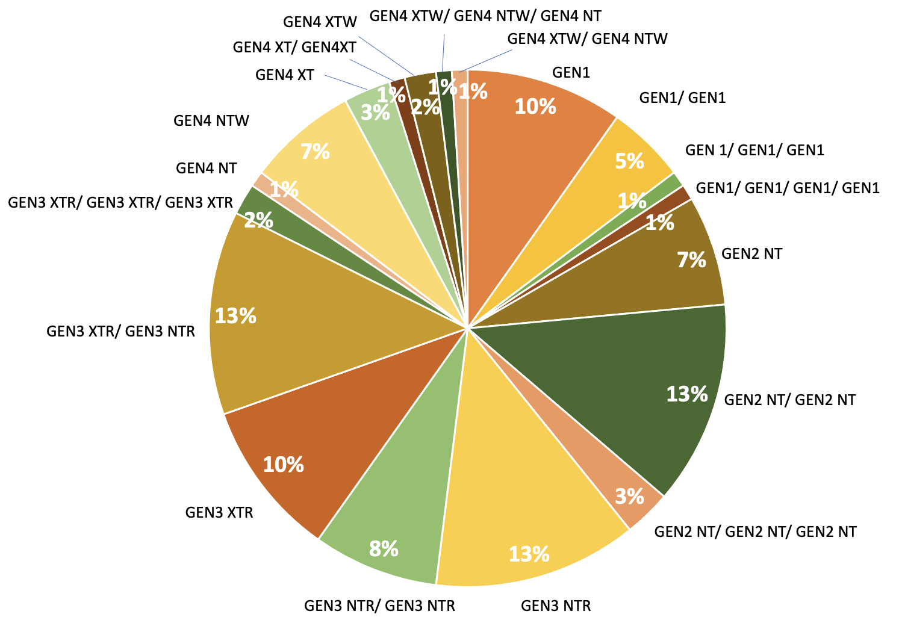
Procedural Characteristics - Interventional Group
procedural success (MR grade ≤ 2+): 96.1%
one device: 49%
two devices: 41%
GEN4: 17%
GEN1: 17%
intra-hospital MV surgery 2.9%
partial clip detachment 1.0%
pericardial effusion 0%
access site complication 0%
GEN2: 46%
GEN3: 46%

Slide 15
Procedural Characteristics - Surgical Group
procedural success (MR grade ≤ 2+): 98.9%
mitral valve repair: 72%
mitral valve replacement: 28%
pre-discharge re-do surgery 8.5%
pre-discharge MV surgery 1.0%
concomitant AF ablation 14%
concomitant tricuspid repair 10%

Slide 16
Primary end-point
16.7% of patients
22.5% of patients
OR 0.69 (95% CI 0.33-1.44), p=0.320; p_{non-inferiority} <0.001

Slide 17
Primary Endpoints - Components
 | TEER Group N=104 | Surgical Group N=104 | Mean Difference (95% CI)
Primary efficacy end-point – no. (%) | 16 (16.7) | 20 (22.5) | -0.06 (-0.17; 0.06)
Death – no. (%) | 8 (8.3) | 9 (10.3) | -0.02 (-0.11; 0.07)
Heart Failure Rehospitalisation– no. (%) | 3 (3.0) | 7 (6.9) | -0.04 (-0.11; 0.03)
Mitral Valve Reintervention – no. (%) | 5 (5.0) | 2 (2.0) | 0.03 (-0.03; 0.09)
VAD Implantation – no. (%) | 2 (2.0) | 4 (4.0) | -0.02 (-0.08; 0.04)
Stroke – no. (%) | 1 (1.0) | 4 (4.0) | -0.03 (-0.09; 0.02)

Slide 18
Key Secondary End-Point: MR Recurrence At 1 Year
TEER: 8.9% (n=7) vs. Surgery: 1.5% (n=1)
(mean difference of proportions: 0.07 (0.00; 0.14); p=0.091, p for non-inferiority=0.024)
Mitral regurgitation at baseline and 1 year
96.4%
98.6%
87.3%
73.2%

Slide 19
Primary Safety End-Point
death, MI, major bleeding, stroke or TIA, rehospitalization, reintervention, non-elective cardiovascular surgery, renal failure, deep wound infection, mechanical ventilation >48 hours, gastrointestinal complication requiring surgery, new-onset atrial fibrillation, septicemia or endocarditis
14.9% of patients
36.5% of patients
54.8% of patients
75.3% of patients
difference, -40%; 95% CI, -51 to -27%; p<0.001

Slide 20
Symptomatic Improvement
6 minute walk distance
NYHA functional class
MLHFQ
ns
ns

Slide 21
Conclusion
Among heart failure patients with secondary mitral regurgitation, TEER was non-inferior to mitral valve surgery with regard to death, heart failure rehospitalization, stroke, reintervention or left ventricular assist device implantation at 1 year with a favorable safety profile of TEER vs. surgery.

Slide 22
Thank you!
Steering Committee Prof. Dr. med. Stephan Baldus, University of Cologne Prof. Dr. med. Stefan Blankenberg, University Heart Center Hamburg Prof. Dr. med. Peter Boekstegers, Helios Hospital Siegburg Prof. Dr. med. C Hagl, Ludwig-Maximilian University Munich Prof. Dr. med. Jörg Hausleiter, Ludwig-Maximilians University Munich Prof. Dr. med. Hermann Reichenspurner, University Heart Center Hamburg Prof. Dr. med. Thorsten Wahlers, University of Cologne
Data Safety Monitoring Board
Prof. Dr. med. J. Wippermann, University Hospital Magdeburg Dr. med. O. Franzen, Hirslanden, Zürich Prof. Dr. rer. nat. W. Köpcke, University of Münster
Project -, Data-, SAE-Management, Monitoring
CTCC (Clinical Trials Center Cologne) University of Cologne Gleueler Str. 269 50935 Cologne Germany
Study Statisticians
Prof. Dr. Martin Hellmich, University of Cologne Wiebke Müller M.Sc., University of Cologne Julia Frank, M.Sc. University of Cologne
Study coordinator
Prof. Dr. med. Volker Rudolph, HDZ-NRW
Participating Study Sites
University Hospital Cologne
Ludwig-Maximilian University Munich
University Heart Center Hamburg-Eppendorf
Kerckhoff Clinic Bad Nauheim
Heart & Diabetes Center NRW, Bad Oeynhausen
Helios Hospital Siegburg
University Hospital Aachen
University Hospital Duesseldorf
University Hospital Jena
University Hospital Ulm
Goethe-University Frankfurt
University Hospital Rostock
Helios Heart Center Leipzig
Helios Hospital Krefeld
University Hospital Magdeburg
University Hospital Lübeck

Slide 23
