Slide 1
ESC Late-Breaking Clinical Studies, London, UK, August 31, 2024, Bishkek Room Thirty-Year Cardiovascular Outcomes Among 27,939 Initially Healthy Women Based on a Single Baseline Measure of C-Reactive Protein, LDL Cholesterol, and Lipoprotein(a) Has the time come for universal screening of 3 simple modifiable risk markers? Paul M Ridker, M. Vinayaga Moorthy, Nancy R. Cook, Nader Rifai, I-Min Lee, and Julie E. Buring Brigham and Women’s Hospital, Children’s Hospital, Harvard Medical School, Boston MA USA

Slide 2
Introduction : Why Focus on long-term risk for hsCRP, LDL-C, and Lp(a) in women?
Modifiable blood biomarkers such as hsCRP, LDL-C, and Lp(a) can be instrumental for understanding biology, predicting risk, and targeting cardiovascular interventions.
Reflecting completed and ongoing trials, guidelines for primary and secondary prevention are shifting to include greater focus on modifiable risk markers including hsCRP, LDL-C, and Lp(a) which predict short-term risk among individuals taking and not taking statin therapy.
However, data are scarce on the long term (25 to 30 year) risks associated with these biomarkers when used alone and in combination, particularly among women for whom cardiovascular disease remains under-diagnosed and under-treated.
As atherosclerosis develops over decades, these issues are a major concern for preventive cardiology and for the selection of pharmacologic and wellness interventions.

Slide 3
Hypothesis and Methods
We hypothesized that a single baseline measure of hsCRP, LDL-C, and Lp(a) obtained in mid-life could predict future cardiovascular risk in women over a 30-year period, and that combined use of these three modifiable biomarkers could provide greater information on risk compared to any one biomarker used alone.
We addressed these issues in the NIH-funded* Women’s Health Study (WHS^{)1,2,} a prospective cohort of 27,939 initially healthy American women who had all three biomarkers measured in a blood sample obtained at baseline and who have been followed by our research group for a period of 30 years for the primary endpoint of first major cardiovascular events (inclusive of centrally adjudicated incident myocardial infarction, coronary revascularization procedures, ischemic stroke, and cardiovascular death).
HL043851, HL080467, and HL099355, CA047988 and CA182913
NEJM 2005;352:1293-1304
JAMA 2005;294:56-65

Slide 4
Biomarker Assays and Statistical Analysis Plan
All biomarkers assayed in a certified academic core laboratory at the Harvard Medical School.
hsCRP : validated high sensitivity assay (Denka Seikan)
LDL-C : validated direct method (Roche Diagnostics)
Lp(a) : validated assay independent of apo(a) isoform size (Denka Seikan)
30-year Hazard Ratios (HR) for incident CV events were assessed across increasing quintiles of each
biomarker in cause-specific Cox proportional models, adjusted for age, smoking, diabetes,
blood pressure, eGFR, use of HRT, and body mass index.
30-year cumulative incidence curves adjusted for age and the competing risks of death were constructed
for each biomarker using cause-specific Cox modeling.
To assess for potential joint effects between any two biomarkers, covariable adjusted analyses were
conducted assessing event rates according to whether paired baseline biomarker levels were above or
below clinically relevant thresholds for each biomarker.
To assess for potential combined effects of all three biomarkers, analysis were repeated after classifying
participants based upon having 0, 1, 2, or 3 levels of baseline hsCRP, LDL-C, or Lp(a) in the top quintile.

Slide 5
Women’s Health Study: Baseline Characteristics and Biomarker Distributions
27,939 women with no prior history of cardiovascular disease
Mean age 54.7 years
Mean Body Mass Index 25.9 kg/m²
Hypertension 25 %, Current Smoker 12 %, Diabetes 2.5 %
 | Quintile 1 | Quintile 2 | Quintile 3 | Quintile 4 | Quintile 5
hsCRP (mg/L) | < 0.7 | 0.7 – 1.4 | 1.5 – 2.8 | 2.8 – 5.1 | > 5.1
LDL-C (mg/dL) | < 96 | 96 – 113 | 114 – 129 | 130 - 150 | > 150
Lp(a) (mg/dL) | < 4 | 4 – 8 | 8 – 15 | 15 – 44 | > 44
Minimal correlation between biomarkers: Spearman correlation coefficients all < 0.2
Ridker PM et al, NEJM (August 31, 2024)

Slide 6
30-Year Covariable Adjusted* Hazard ratios (HR) for
First Major Adverse Cardiovascular Events in 27,939 Initially Healthy American Women
According to Baseline Quintile of Lp(a), LDL-C, and hsCRP
HR* 5th vs 1st Quintile (95%CI)
Lp(a) 1.33 (1.21-1.47)
LDL-C 1.36 (1.23-1.52)
hsCRP 1.70 (1.52-1.90)
HR* per Quintile (95%CI)
Lp(a) 1.06 (1.03-1.08)
LDL-C 1.08 (1.05-1.10)
hsCRP 1.14 (1.11-1.17)
HR* per St. Dev. (95%CI)
Lp(a) 1.09 (1.05-1.13)
LDL-C 1.10 (1.06-1.14)
hsCRP 1.23 (1.18-1.27)
*HR adjusted for age, smoking status, diabetes,
blood pressure, eGFR, HRT use, and BMI
Adjusted HR*
Ridker PM et al, NEJM (August 31, 2024)

Slide 7
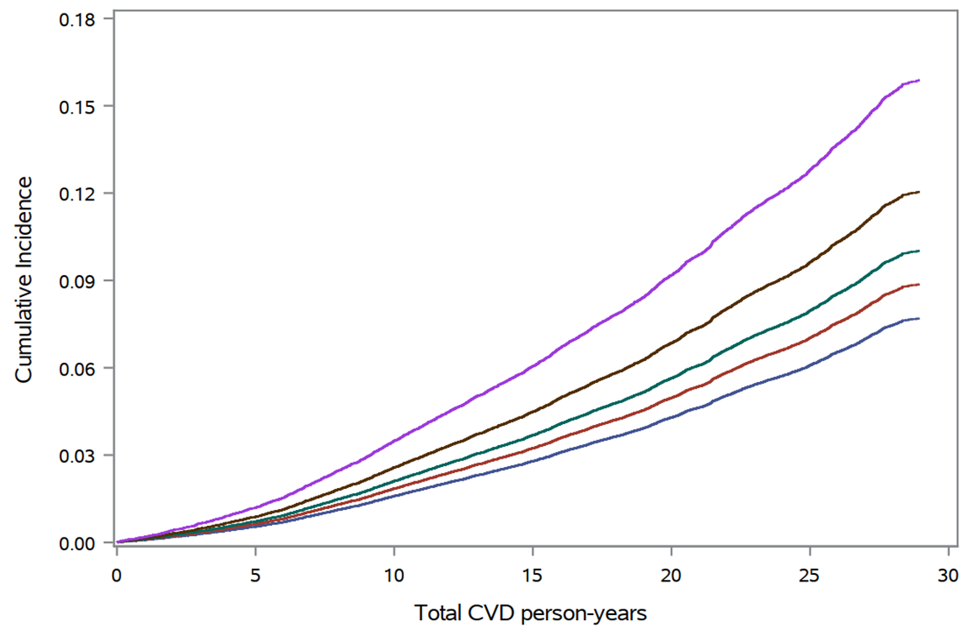
30-Year Age and Competing Risk Adjusted Cumulative Incidence of
First Major Adverse Cardiovascular Events in 27,939 Initially Healthy American Women
According to Baseline Quintile of hsCRP
hsCRP
Q5 (> 5.1 mg/L)
Q4 (2.8 – 5.1 mg/L)
Q3 (1.5 – 2.7 mg/L)
Q2 (0.7 – 1.4 mg/L)
Q1 (< 0.7 mg/L)
Quintile (range)
Years
Ridker PM et al, NEJM (August 31, 2024)

Slide 8
30-Year Age and Competing Risk Adjusted Cumulative Incidence of
First Major Adverse Cardiovascular Events in 27,939 Initially Healthy American Women
According to Baseline Quintile of hsCRP
hsCRP
Q5 (> 5.1 mg/L)
Q4 (2.8 – 5.1 mg/L)
Q3 (1.5 – 2.7 mg/L)
Q2 (0.7 – 1.4 mg/L)
Q1 (< 0.7 mg/L)
Quintile (range)
Years
Ridker PM et al, NEJM (August 31, 2024)

Slide 9
30-Year Age and Competing Risk Adjusted Cumulative Incidence of
First Major Adverse Cardiovascular Events in 27,939 Initially Healthy American Women
According to Baseline Quintile of hsCRP
hsCRP
Q5 (> 5.1 mg/L)
Q4 (2.8 – 5.1 mg/L)
Q3 (1.5 – 2.7 mg/L)
Q2 (0.7 – 1.4 mg/L)
Q1 (< 0.7 mg/L)
Quintile (range)
Years
Ridker PM et al, NEJM (August 31, 2024)

Slide 10
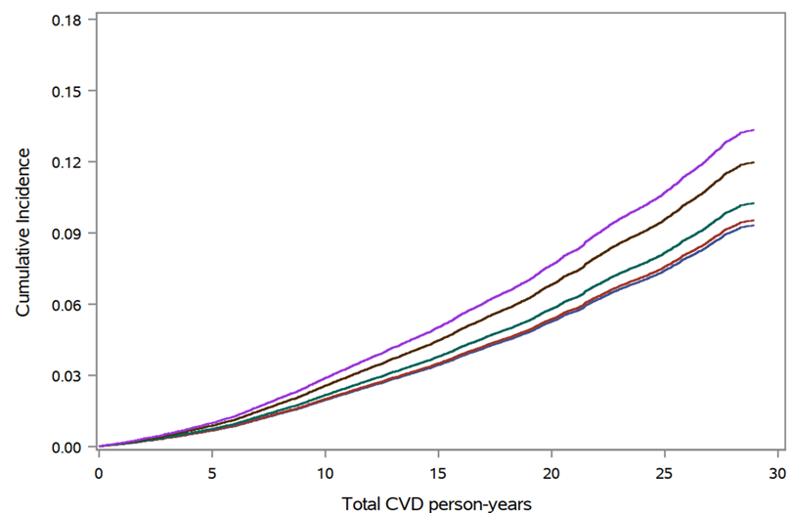
30-Year Age and Competing Risk Adjusted Cumulative Incidence of
First Major Adverse Cardiovascular Events in 27,939 Initially Healthy American Women
According to Baseline Quintile of LDL-C
LDL-C
Q5 (> 150 mg/dL)
Q4 (130 – 150 mg/dL)
Q3 (114 - 129 mg/dL)
Q2 (96 - 113 mg/dL)
Q1 (< 96 mg/dL)
Quintile (range)
Years
Ridker PM et al, NEJM (August 31, 2024)

Slide 11
30-Year Covariable Adjusted* Hazard Ratios (HR) and Cumulative Incidence for
First Major Adverse Cardiovascular Events in 27,939 Initially Healthy American Women
According to Baseline Quintile of LDL-C and hsCRP
LDL-C
HR* per SD 1.10 (95%CI 1.06-1.14)
hsCRP
HR* per SD 1.23 (95%CI 1.18-1.27)
Q5 (> 150 mg/dL)
Q5 (> 5.1 mg/L)
Q4 (130 – 150 mg/dL)
Q4 (2.8 – 5.1 mg/L)
Q3 (114 - 129 mg/dL)
Q3 (1.5 – 2.7 mg/L)
Q2 (96 - 113 mg/dL)
Q2 (0.7 – 1.4 mg/L)
Q1 (< 96 mg/dL)
Q1 (< 0.7 mg/L)
Years
Years
*HR adjusted for age, treatment assignment, smoking status, diabetes, blood pressure, eGFR, HRT use, and BMI
Ridker PM et al, NEJM (August 31, 2024)

Slide 12
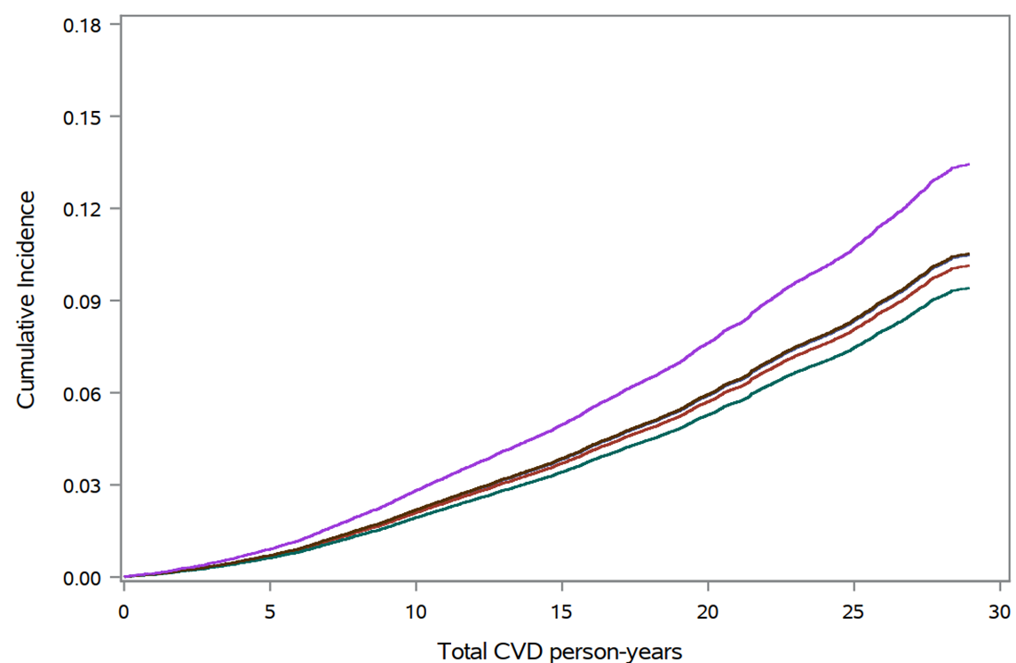
30-Year Age and Competing Risk Adjusted Cumulative Incidence of
First Major Adverse Cardiovascular Events in 27,939 Initially Healthy American Women
According to Baseline Quintile of Lp(a)
Lp(a)
HR* per SD 1.09 (95%CI 1.05-1.13)
Q5 (> 44 mg/dL)
Q4 (15 - 44 mg/dL)
Q3 (8 - 15 mg/dL)
Q2 (4 - 8 mg/dL)
Q1 (< 4 mg/dL)
Quintile (range)
Years
Years
Ridker PM et al, NEJM (August 31, 2024)

Slide 13
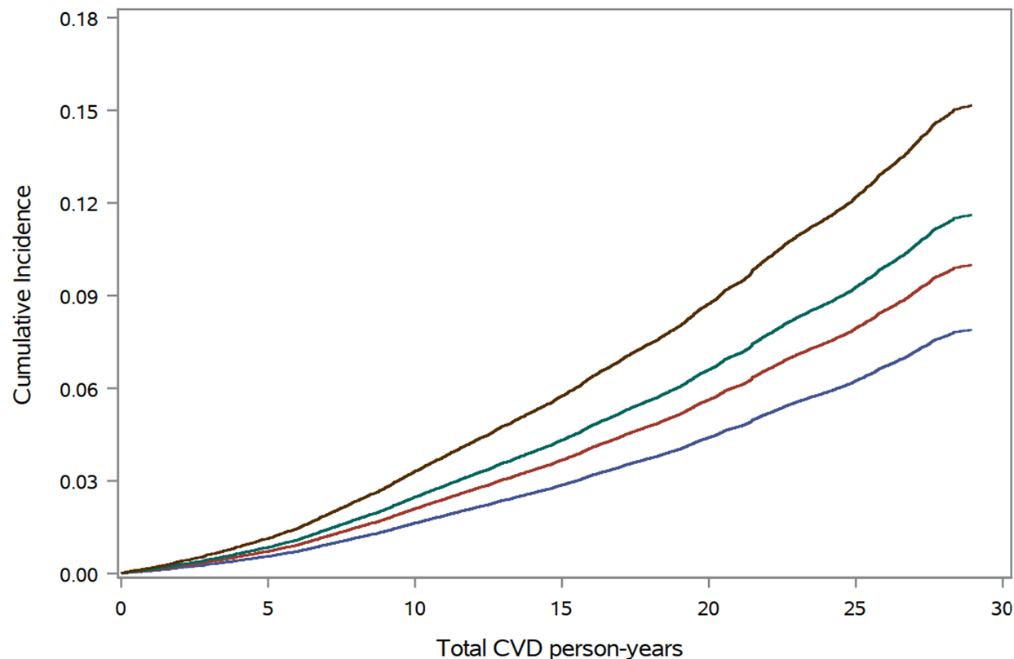
30-Year Age and Competing Risk Adjusted Cumulative Incidence of
First Major Adverse Cardiovascular Events in 27,939 Initially Healthy American Women
Joint Effects of hsCRP and LDL-C
hsCRP above or below 2 mg/L
LDL-C above or below 130 mg/dL
High hsCRP, High LDL-C
High hsCRP, Low LDL-C
Low hsCRP, High LDL-C
Low hsCRP, Low LDL-C
Ridker PM et al, NEJM (August 31, 2024)
Years
Years

Slide 14
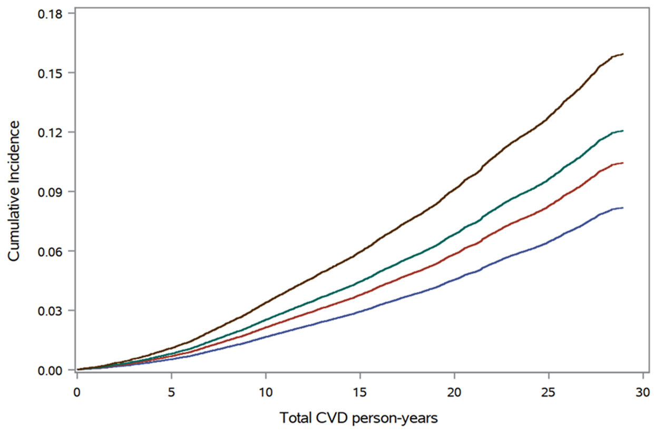
30-Year Age and Competing Risk Adjusted Cumulative Incidence of
First Major Adverse Cardiovascular Events in 27,939 Initially Healthy American Women
Joint Effects of hsCRP and Lp(a)
hsCRP above or below 2 mg/L
Lp(a) above or below 40 mg/dL
High hsCRP, High Lp(a)
High hsCRP, Low Lp(a)
Low hsCRP, High Lp(a)
Low hsCRP, Low Lp(a)
Ridker PM et al, NEJM (August 31, 2024)
Years
Years

Slide 15
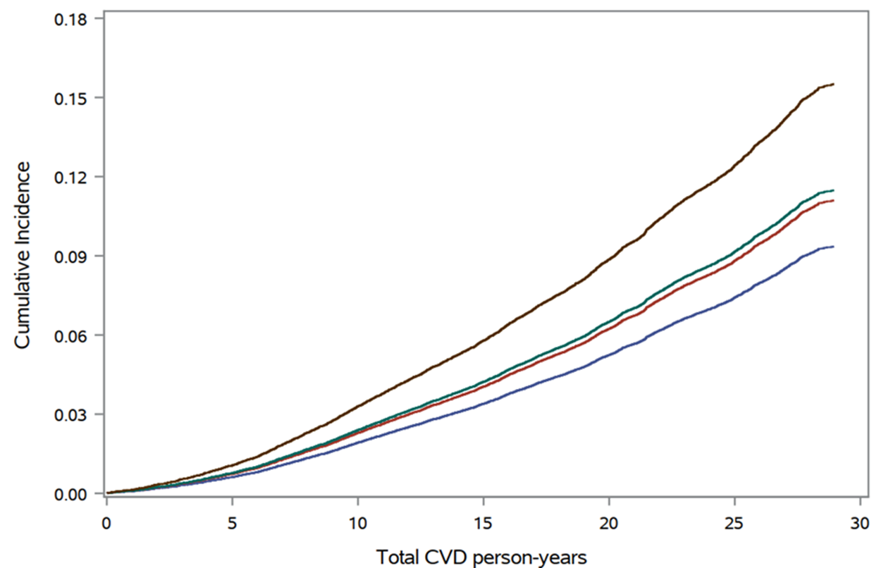
30-Year Age and Competing Risk Adjusted Cumulative Incidence of
First Major Adverse Cardiovascular Events in 27,939 Initially Healthy American Women
Joint Effects of LDL-C and Lp(a)
LDL-C above or below 130 mg/dL
Lp(a) above or below 40 mg/dL
High LDL-C, High Lp(a)
High LDL-C, Low Lp(a)
Low LDL-C, High Lp(a)
Low LDL-C, Low Lp(a)
Years
Ridker PM et al, NEJM (August 31, 2024)
Years

Slide 16
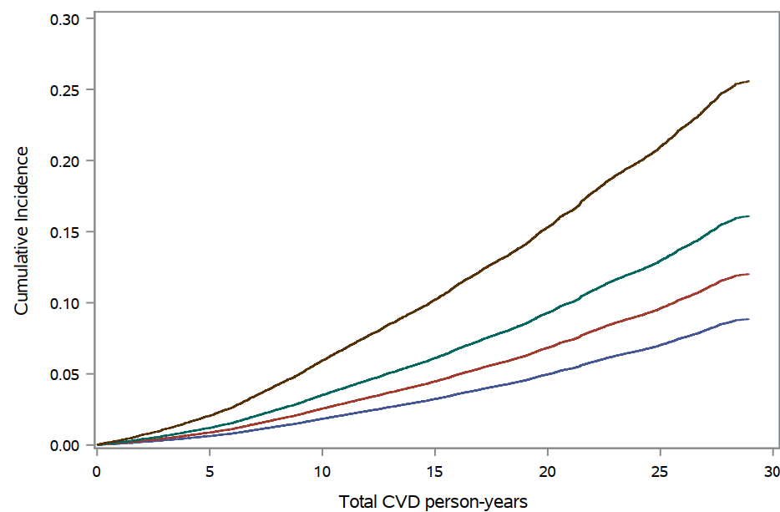
30-Year Age and Competing Risk Adjusted Cumulative Incidence of
Major Adverse Cardiovascular Events in 27,939 Initially Healthy American Women
Combined Effects of hsCRP, LDL-C, and Lp(a)
Major Adverse Cardiovascular Events
3 Elevated Biomarkers
(HR 2.6, 95%CI 2.2-3.2)
2 Elevated Biomarkers
1 Elevated Biomarker
0 Elevated Biomarkers
Number of Biomarkers
in the Top Quintile
Years
Years
Ridker PM et al, NEJM (August 31, 2024)

Slide 17
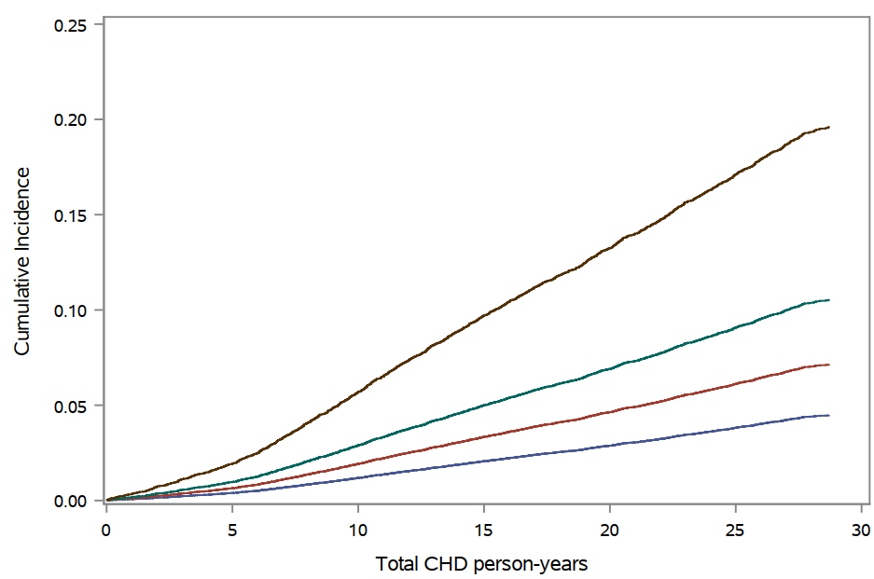
30-Year Age and Competing Risk Adjusted Cumulative Incidence of
Coronary Heart Disease Events in 27,939 Initially Healthy American Women
Combined Effects of hsCRP, LDL-C, and Lp(a)
Coronary Heart Disease Events
3 Elevated Biomarkers
(HR 3.7, 95%CI 2.9-4.7)
2 Elevated Biomarkers
1 Elevated Biomarker
0 Elevated Biomarkers
Number of Biomarkers
in the Top Quintile
Years
Years
Ridker PM et al, NEJM (August 31, 2024)

Slide 18
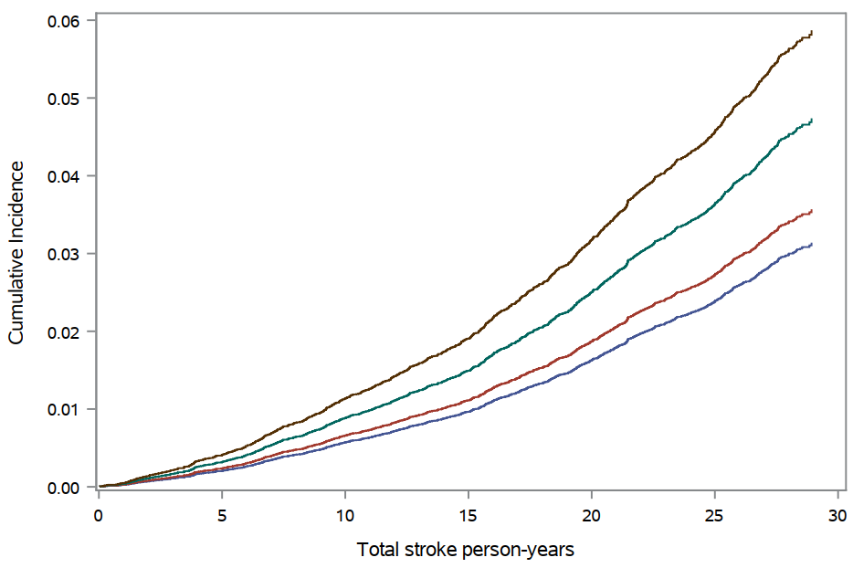
30-Year Age and Competing Risk Adjusted Cumulative Incidence of
Ischemic Stroke Events in 27,939 Initially Healthy American Women
Combined Effects of hsCRP, LDL-C, and Lp(a)
3 Elevated Biomarkers
(HR 1.7, 95%CI 1.1-2.5)
Ischemic Stroke Events
2 Elevated Biomarkers
1 Elevated Biomarker
0 Elevated Biomarkers
Number of Biomarkers
in the Top Quintile
Years
Ridker PM et al, NEJM (August 31, 2024)
Years

Slide 19
Additional Findings
While hsCRP was the stronger predictor than LDL-C or Lp(a), the greatest
spread in risk was obtained in models that incorporated all three biomarkers
which were fully independent of each other.
All findings were consistent for the individual endpoints of coronary heart
disease and stroke.
All findings were similar in sensitivity analyses that censored participant
follow-up time if statin therapy was initiated.
Effects marginally attenuated over time for hsCRP and LDL-C, with no
attenuation for Lp(a).

Slide 20
Summary
A single combined measure of hsCRP, LDL-C, and Lp(a) among initially
healthy American women was predictive of incident cardiovascular events
over a 30-year period.
As each of these three biomarkers is modifiable through either lifestyle
and/or pharmacologic interventions, these data support efforts to extend
strategies for the primary prevention of atherosclerotic disease
well beyond traditional 10-year estimates of risk.

Slide 21
Implications for Patient Care, Guidelines, and Public Health
We can’t treat what we don’t measure
While imaging tests can tell us who to treat, measurement of hsCRP, LDL-C, and Lp(a) can tell us what to treat with.
We need to focus on lifelong risk and lifelong interventions, not simply
5-to-10-year risks and 5-to-10-year interventions.
We need to focus on prevention among younger women for whom CVD remains underdiagnosed and undertreated.
Given the remarkable consistency of these primary prevention data with prior cohorts inclusive of more than 45,000 contemporary secondary prevention patients^{1,2}, we believe the time has come for universal screening of 3 simple modifiable cardiovascular risk factors: hsCRP, LDL-C, and Lp(a)
¹ Lancet 2023;401:1293-1301
² Circulation 2024;1149:28-35

Slide 22
