Slide 1
No-touch Vein Grafts in
Coronary Artery Bypass Surgery
A Nordic, multicentre, randomized, registry-based clinical trial on no-touch vein grafts in coronary surgery (SWEDEGRAFT)
Stefan James, Professor Cardiology Uppsala University Hospital Sweden
31/08/2024

Slide 2
Rationale for the SWEDEGRAFT trial
Coronary Artery Bypass Graft (CABG) is the most common cardiac surgical procedure with >600,000 operations performed every year worldwide
Randomized clinical trials have indicated that saphenous vein graft harvesting using the no-touch technique improves graft patency compared with the conventional open skeletonized technique.
No touch
Vein harvesting with a pedicle of surrounding tissue and without vein graft distension
Conventional
No-touch vein harvesting should be considered when an open technique is used
IIa
B
Hypothesis: no-touch vein grafts are superior to conventionally harvested veins with respect to mid-term patency and long-term clinical outcomes.
Vein skeletonized and stripped of all adventitial tissue and distended prior to implantation.

Slide 3
Trial design
Inclusion criteria (n=900)
Accepted for first time nonemergent isolated CABG
Age < 80 years
Need for at least one vein graft
No-touch SVG
2 years
Telephone
SAQ-7
Computed tomography angiography (CTA)
Randomization
3 months
Telephone
Conventional SVG
Data collected as part of routine clinical care
mean follow-up 52 (SD 16) months
8 centers
Western Denmark Heart Registry
1 center

Slide 4
End points
Primary
The proportion of patients with graft failure within two years after CABG defined as:
At least one SVGs occluded/ stenosed >50% on CTA, OR;
Patient has undergone PCI in a vein graft or in a native vessel segment proximal to the distal anastomosis of a vein graft, OR;
Patient has died
Key Secondary
MACE - all-cause death, myocardial infarction, any repeat revascularization during follow-up
Postoperative leg wound complications

Slide 5
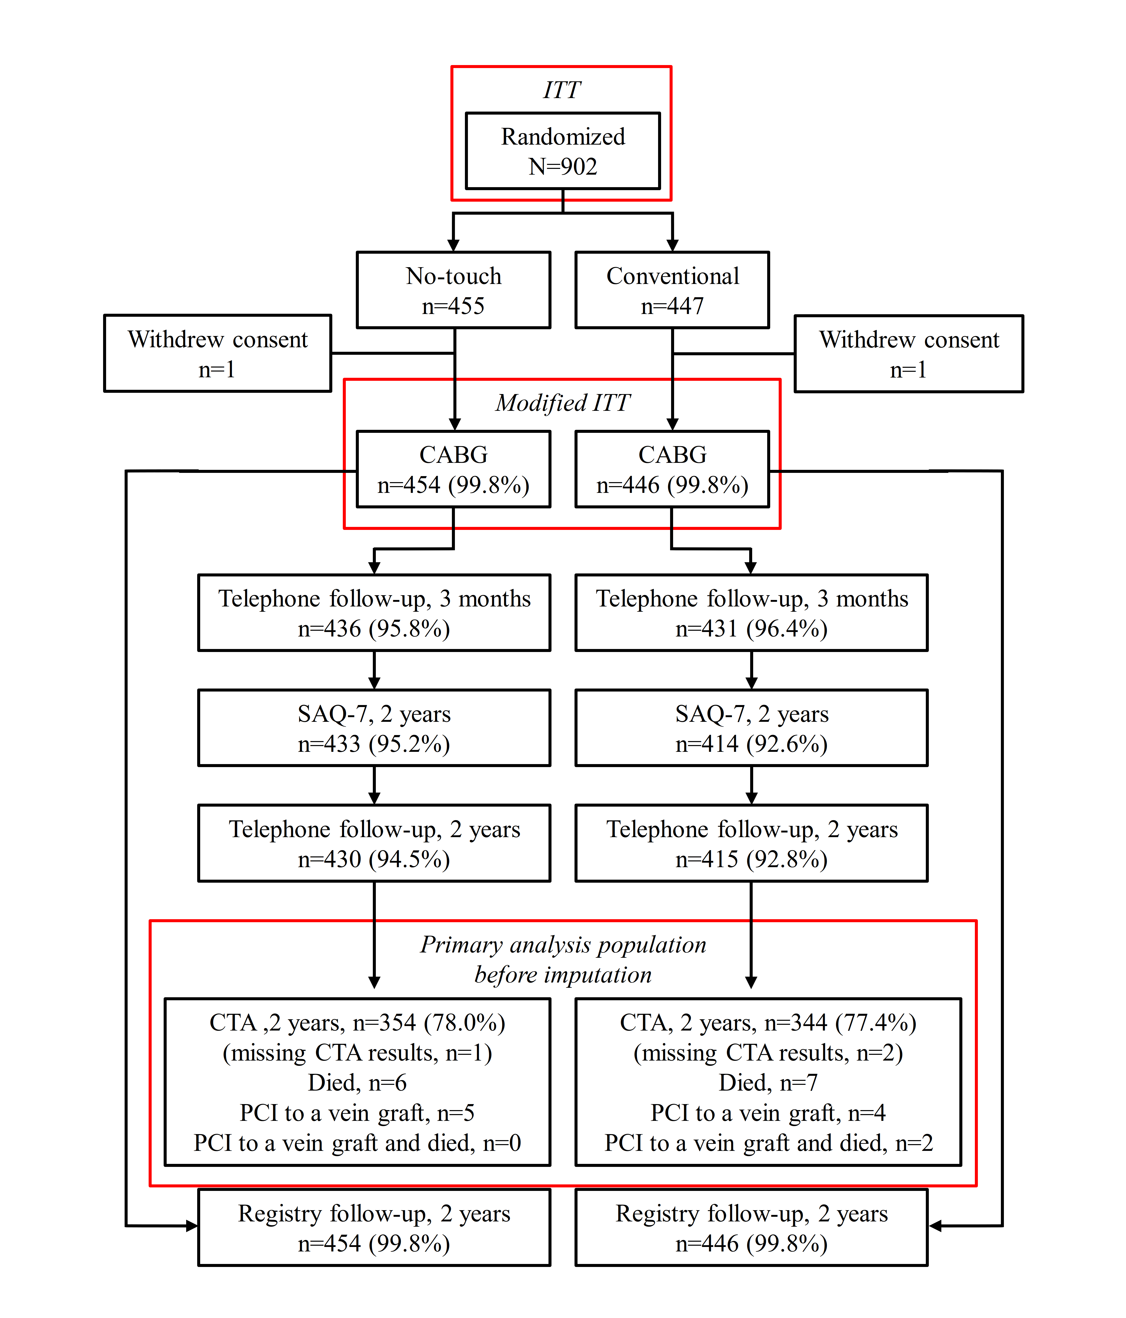
Trial flow chart

Slide 6
Demographics
Variables | No-touch (n=454) | Conventional (n=446) | All (n=900)
Age, years (S.D) | 66.9 (7.8) | 67.1 (7.4) | 67.0 (7.6)
Male, n (%) | 400 (88.1) | 392 (87.9) | 792 (88.0)
BMI, kg/m² | 28.0 (3.9) | 28.0 (4.0) | 28.0 (4.0)
eGFR (ml/min/1.73 m²) | 86.8 (15.1) | 86.2 (15.0) | 86.5 (15.0)
Diabetes mellitus, n (%) | 129 (28.5) | 115 (25.8) | 244 (27.1)
Prior PCI, n (%) | 92 (20.3) | 86 (19.3) | 178 (19.8)
Previous stroke, n (%) | 28 (6.2) | 19 (4.3) | 47 (5.2)
Extracardiac arteriopathy, n (%) | 21 (4.6) | 16 (3.6) | 37 (4.1)
Systolic left ventricular function, n (%)
Good (>50%) | 353 (77.8) | 356 (79.8) | 709 (78.8)
Moderate (31-50%) | 88 (19.4) | 79 (17.7) | 167 (18.6)
Poor (<30%) | 13 (2.9) | 11 (2.5) | 24 (2.7)
Mean of total distal vein anastomoses (%) | 1.9 (0.9) | 2.1 (0.8) | 2.0 (0.9)
Left main stenosis, n (%) | 158 (34.8) | 165 (37.0) | 323 (35.9)
EuroSCORE II | 1.6 (1.3) | 1.6 (1.5) | 1.6 (1.4)
Urgency, n (%)
Elective | 233 (51.3) | 248 (55.6) | 481 (53.4)
Urgent | 221 (48.7) | 198 (44.4) | 419 (46.6)

Slide 7
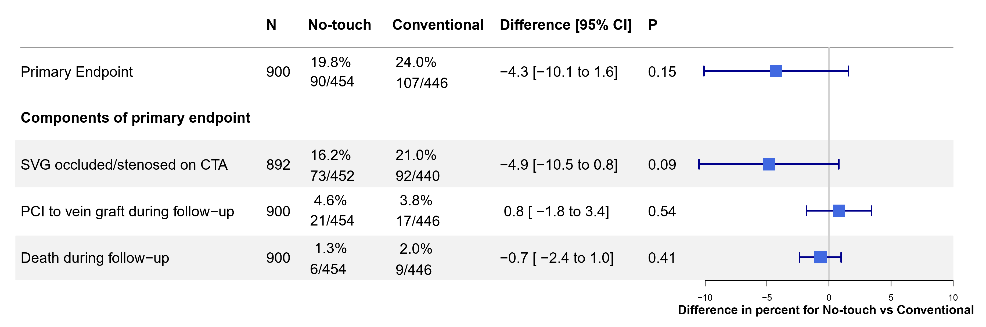
Primary endpoint
CTA was performed at mean duration from randomization of 2.8 (SD 0.4) years
No significant difference was observed between the no-touch and conventional vein harvest groups in regard to the primary endpoint or the individual components of the endpoint.

Slide 8
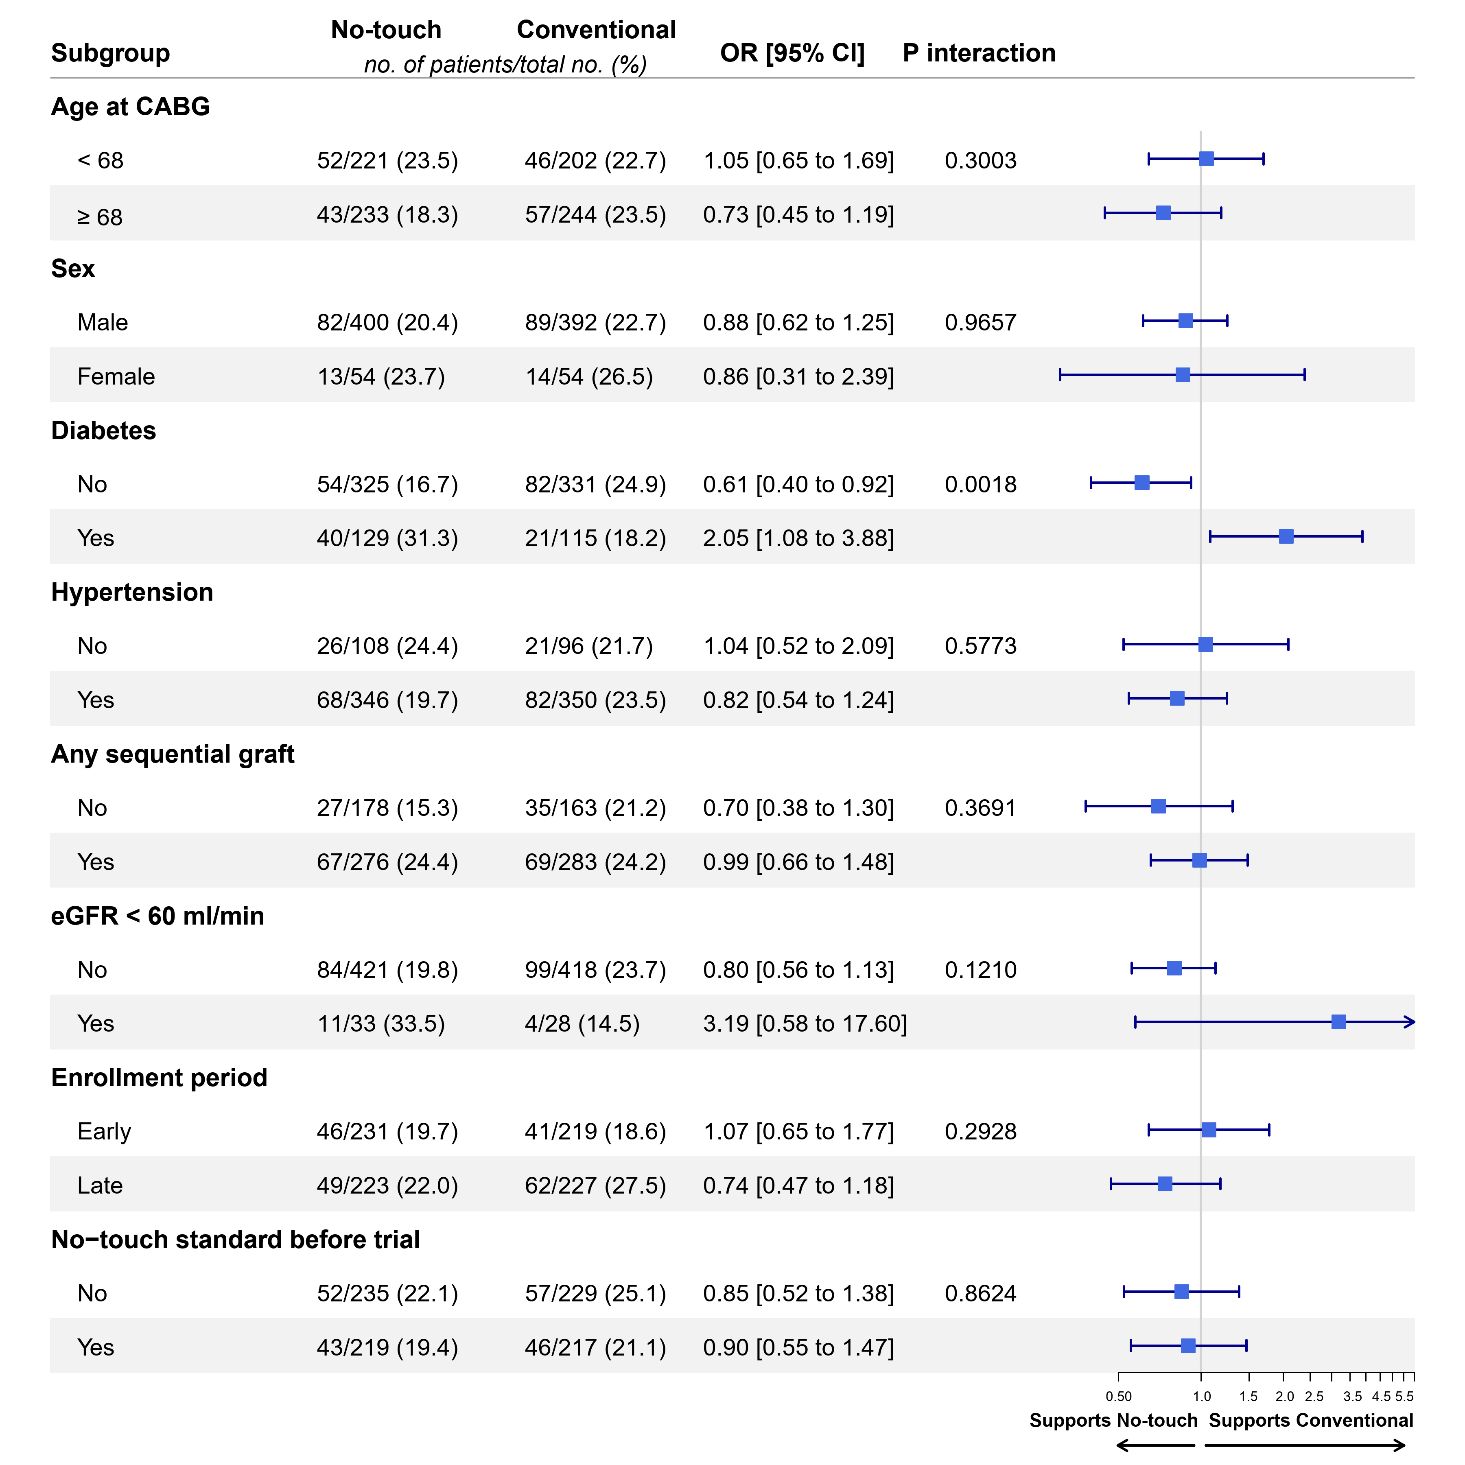
Subgroup analyses
The primary outcome was consistent across important subgroups.
In patients without diabetes, randomized to no-touch, there was a significantly lower primary event rate and in patients with diabetes there was a significantly higher event rate (interaction p-value <0.001).

Slide 9
Secondary endpoint
No significant difference in the composite of MACE (death, myocardial infarction or repeat revascularization) between the no-touch and conventional vein harvest groups at mean follow-up 4.3 (SD 1.3) years
Variabel | No-touch (n=454) |  | Conventional (n=446) |  | HR (95% CI) | P-value
 | Patients with events (%) | KM (%) | Patients with events (%) | KM (%)
MACE | 57 (12.6) | 7.27 | 44 (9.9) | 4.93 | 1.30 (0.87–1.93) | 0.195
Death | 9 (2.0) | 0.44 | 10 (2.2) | 0.67 | 0.87 (0.35–2.16) | 0.770
MI | 20 (4.4) | 2.21 | 19 (4.3) | 2.02 | 1.03 (0.55–1.93) | 0.936
Revascularization | 43 (9.5) | 6.62 | 34 (7.6) | 4.27 | 1.25 (0.80–1.97) | 0.327
Kaplan-Meier (KM) percentages is calculated at 360 days. Hazard ratio (HR) for no-touch vs. conventional from Cox proportional hazards model. MI, myocardial infarction.

Slide 10
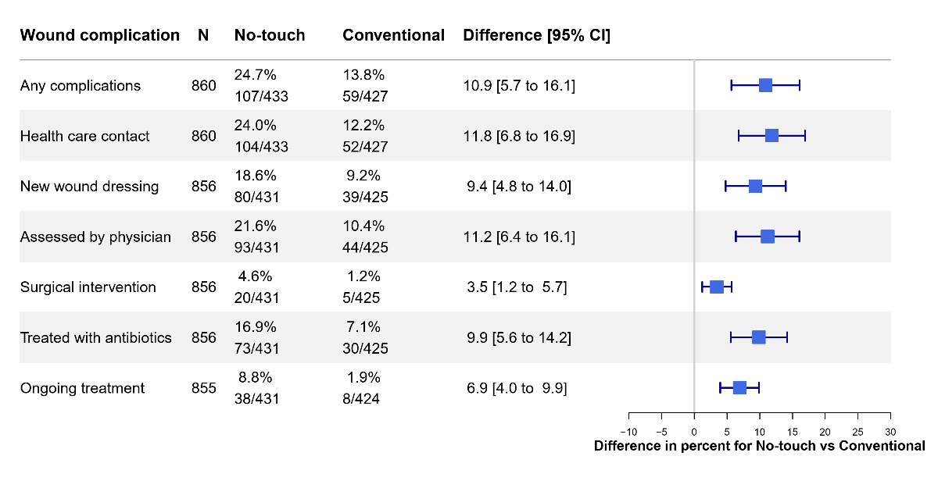
Leg wound complications at 3 months
More leg wound complications at 3 months in patients randomized to the no-touch technique.

Slide 11
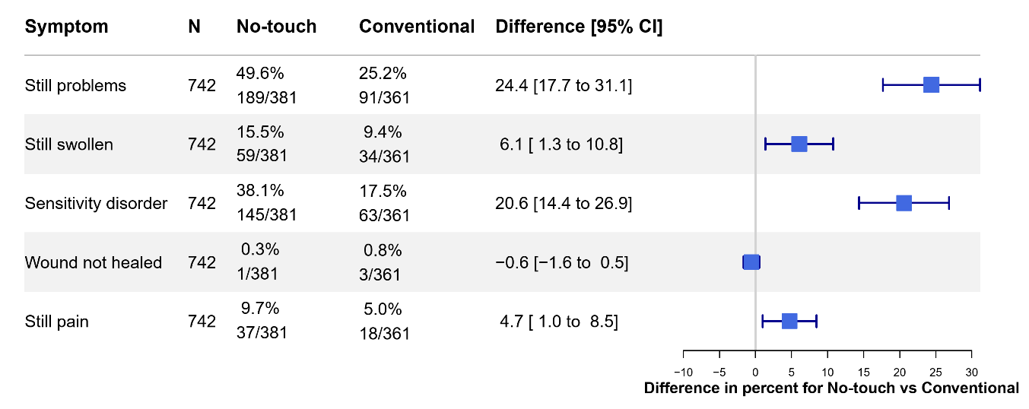
Leg wound symptoms at 2 years
More remaining leg wound symptoms two years after surgery in patients randomized to the no-touch technique.
The predominant symptoms, sensitivity disturbance and residual pain, were consistently reported across all subgroups.

Slide 12
Conclusions
In this bi-national, multicenter, registry-based, randomized trial (R-RCT) of patients undergoing non-emergent CABG, the no-touch vein technique was not superior to the conventional technique regarding vein graft failure or mid-term clinical outcomes.
No-touch vein harvest was associated with an increased rate of early leg wound complications and residual wound symptoms.
Our trial does not support the routine use of the no-touch harvesting technique compared to the standard technique of vein handling.

Slide 13
Thank you!
Executive Committee
Trial Statistician
Stefan Thelin, Uppsala University, Sweden - Coordinating investigator
Ivy Susanne Modrau, Århus, Denmark
Olov Duvernoy, Uppsala University, Sweden
Anders Jeppsson, University of Gothenburg, Sweden
Ulrik Sartipy, Karolinska Institutet, Sweden
Mats Dreifaldt, Örebro University, Sweden
Stefan James, Uppsala University, Sweden - Study chair
Karin Jensevik Eriksson, Uppsala University hospital
Uppsala Clinical Research Center, UCR
Susanne Heller (Senior Project Leader)
Stefano Caramuta, (Lead Data Manager),
Ida Björkgren (Publications Manager),
Maria Eriksson-Svensson (Executive director).
Site Investigators
Magnus Dalén, Karolinska University Hospital
Anders Ericsson, Blekinge Hospital
Örjan Friberg, Örebro University hospital
Anders Holmgren, University Hospital of Umeå
Per Hostrup Nielsen, Aarhus University hospital
Henrik Hultkvist, Linköping University Hospital
Shahab Nozohoor, Skåne University Hospital, Lund
Sigurdur Ragnarsson, Skåne University Hospital, Lund
Lisa Ternström, Sahlgrenska University Hospital
Per Vikholm, Uppsala University hospital
Funding bodies
Swedish Research Council
The Swedish Heart Lung Foundation
Regulatory sponsor
Dept. of Surgical Sciences, Uppsala University
National quality registries
Coronary CTA assessors
Western Denmark Heart Registry
Olov Duvernoy, Uppsala University hospital
Mats Lidén, Örebro University hospital
Raquel Themudo, Karolinska University Hospital
All participating patients

