Slide 1
Continuation versus Interruption of Oral Anticoagulation during TAVI
International, randomized, open-label, noninferiority trial
Presented by Dirk-Jan van Ginkel, MD
on behalf of the POPular PAUSE TAVI investigators
Principal investigator: Prof. Jurriën M ten Berg, M.D., M.Sc., Ph.D. Coordinating investigators: Dirk-Jan van Ginkel, M.D. Wilbert Bor, M.D.

Slide 2
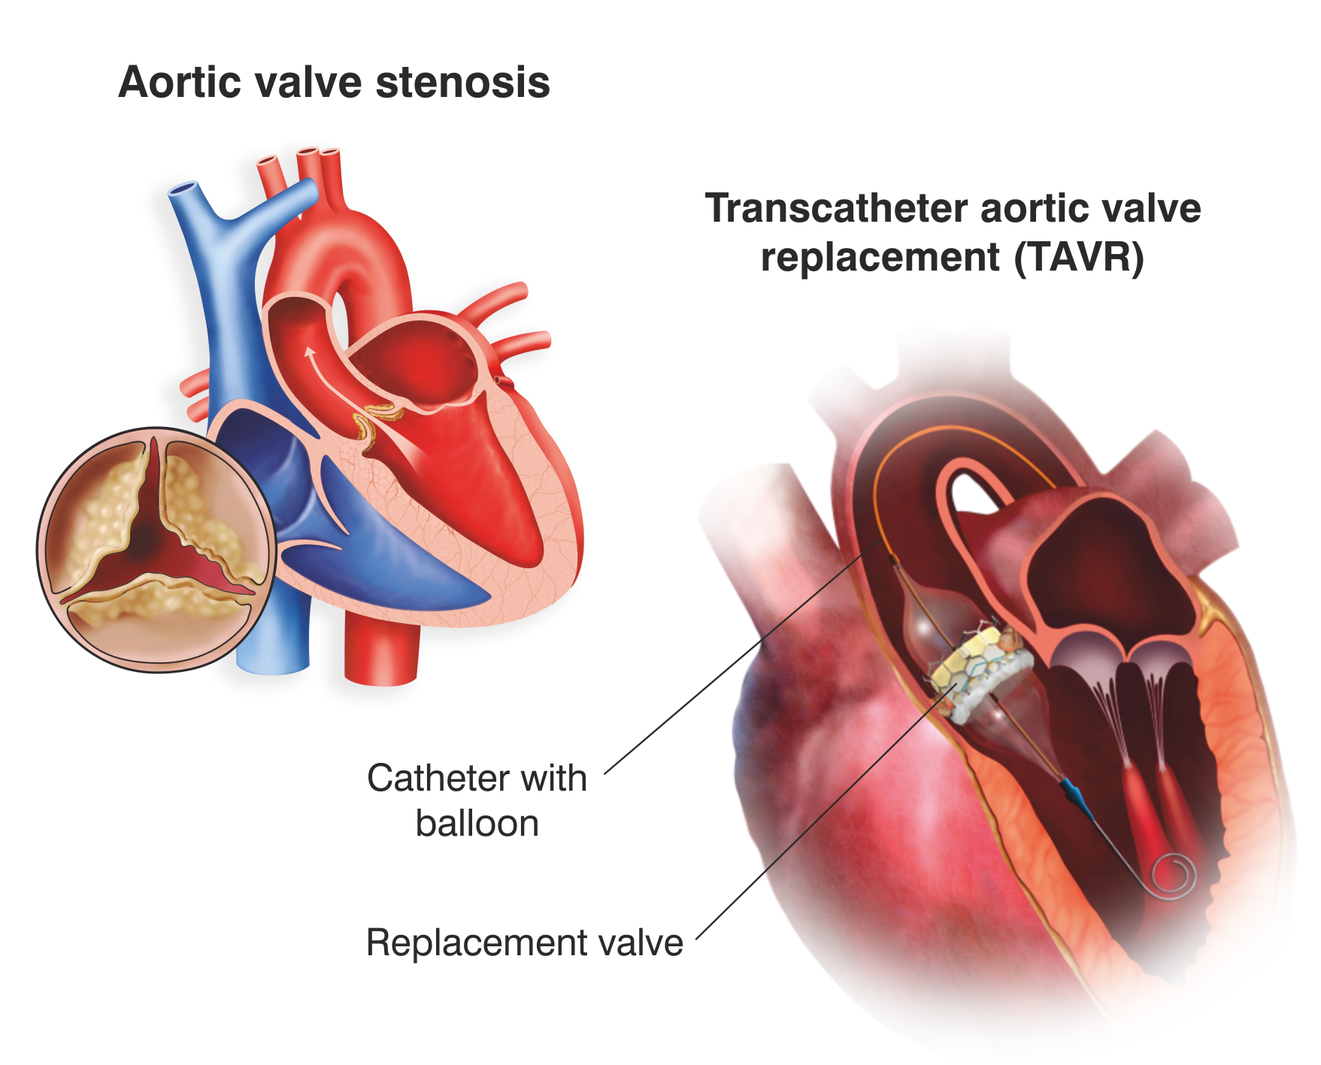
Transcatheter aortic valve implantation (TAVI)

Slide 3
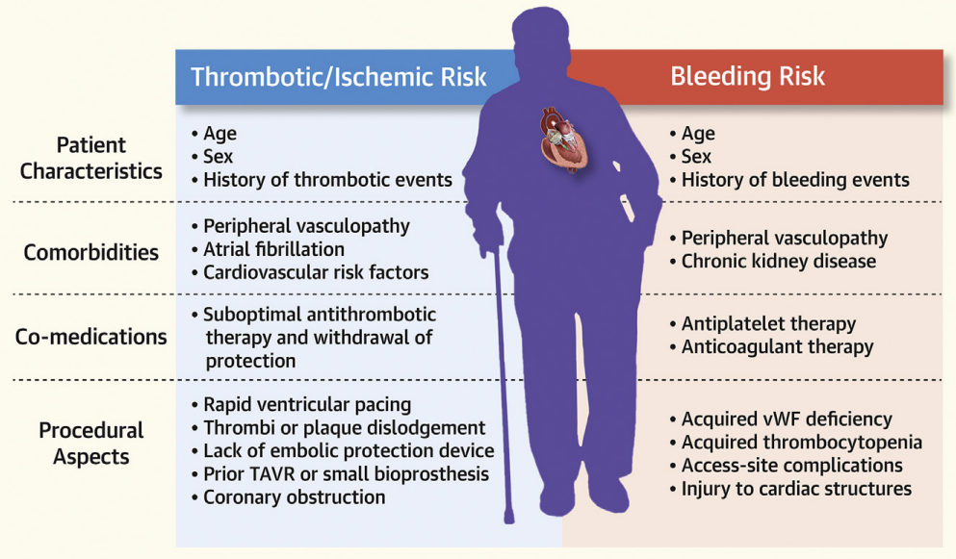
Patients on oral anticoagulation: high-risk subgroup
35%
Capodanno D, et al. JACC Cardiovasc Interv. 2021

Slide 4
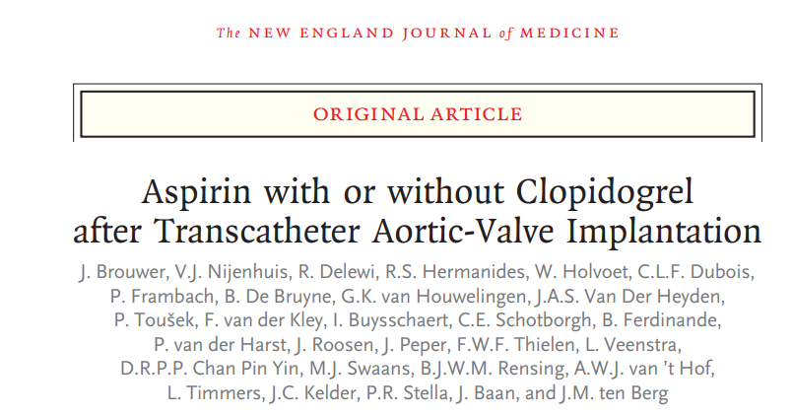
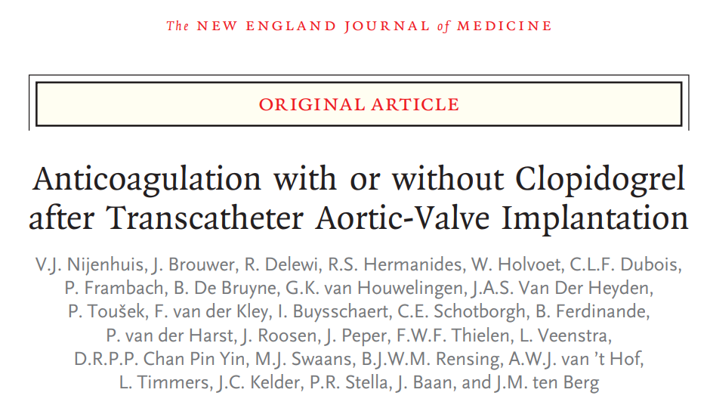
Previous POPular TAVI studies focused on postprocedural antithrombotic therapy

Slide 5
Periprocedural period: continuation vs. interruption
General guidelines recommend interruption of oral anticoagulation^{1,2}
Observational studies on continued oral anticoagulation during TAVI:^{3,4}
Lower risk of stroke
No increase in major bleeding
Douketis JD, et al. Chest 2022
Steffel J, et al. Eur Heart J 2018
Brinkert M, et al. J Am Coll Cardiol. 2019
Brinkert M, et al. JACC Cardiovasc Interv. 2021
Adapted from Brinkert M, et al. JACC Cardiovasc Interv. 2021

Slide 6
Objective
To investigate the safety and efficacy of periprocedural continuation versus interruption of oral anticoagulation during TAVI
Primary outcome: cardiovascular mortality, all stroke, myocardial infarction, major vascular complications and major bleeding within 30 days after TAVI
VARC-3 WRITING COMMITTEE. Eur Heart J. 2021

Slide 7
Trial organization
Trial Design
Multicenter, international, investigator-initiated, randomized, open-label, noninferiority trial with blinded outcome assessment
Sponsor and coordinating center
St. Antonius Hospital, Nieuwegein, The Netherlands
Funding and support
St. Antonius Research Fund
The Netherlands Organization for Health Research and Development (ZonMw)

Slide 8
Study population
Inclusion criteria:
Planned transfemoral or transsubclavian TAVI
Long-term oral anticoagulant use
Written informed consent
Exclusion criteria:
Mechanical heart valve prosthesis
Intracardiac thrombus
Venous thromboembolism < 3 months
TIA / stroke < 6 months in patients with atrial fibrillation

Slide 9
Study procedures
Patients were randomized (1:1) before TAVI to a continued or interrupted¹ oral anticoagulation strategy
Stratification: study site and type of oral anticoagulation (VKA or DOAC)
Bridging with (low-molecular-weight) heparin not recommended
 |  | Day -6 | Day -5 | Day -4 | Day -3 | Day -2 | Day -1 | TAVI | Day +1
Continuation group | Any oral anticoagulant
Interruption group | Apixaban / Edoxaban / Rivaroxaban / Dabigatran (eGFR ≥ 80) |  |  |  |  | X | X | X
 | Dabigatran (eGFR 50-80) / Acenocoumarol |  |  |  | X | X | X | X
 | Dabigatran (eGFR 30-50) |  |  | X | X | X | X | X
 | Phenprocoumon / Warfarin |  | X | X | X | X | X | X
Douketis JD, et al. Chest 2022

Slide 10
Study power & statistics
Sample size = 858
Noninferiority, power 90%, α = 0.025
Expected event rate continued vs. interrupted: 13.5% vs. 17.5%^{1,2}
Margin 4.0% for absolute between-group difference³
If noninferiority criterion satisfied, then superiority testing
Brinkert M, et al. J. Am. Coll. Cardiol. 2019
Nijenhuis VJ, et al. N Engl J Med. 2020
Blackwelder WC. Control Clin Trials 1982

Slide 11
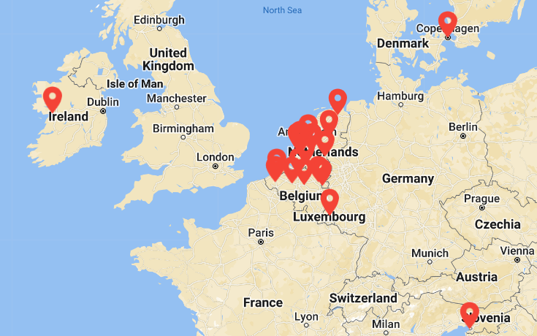
Recruitment
22 European sites
Netherlands
Belgium
Denmark
Luxembourg
Ireland
Italy

Slide 12
Planned transfemoral/subclavian TAVI and on long-term OAC
Randomization 1:1 N=869
Continuation of OAC
N=435
Interruption of OAC
N=434
4 EXCLUDED
3 had no TAVI procedure
1 withdrew written
informed consent
7 EXCLUDED
4 had no TAVI procedure
3 withdrew written informed consent
Modified ITT Analysis
N=431
Modified ITT Analysis
N=427
Follow-up 30 days
Primary outcome: cardiovascular mortality, all stroke, myocardial infarction, major vascular complications and major bleeding

Slide 13
Baseline
 | Continued (n=431) | Interrupted (n=427)
Age | 81.4 ± 5.6 | 80.9 ± 6.2
Female | 158 (36.7) | 138 (32.3)
Atrial fibrillation | 414 (96.1) | 406 (95.1)
CHA₂DS₂-VASc score | 4.5 (1.4) | 4.4 (1.4)
Prior ischemic stroke | 39 (9.0) | 51 (11.9)
Peripheral artery disease | 79 (18.3) | 85 (19.9)
Chronic renal insufficiency | 213 (49.4) | 221 (51.8)

Slide 14
Antithrombotic therapy
81.9% DOAC, 18.1% VKA
25.1% reduced dose
Concomitant antiplatelet therapy:
13.7% in continuation group
11.2% in interruption group
Adherence to study protocol:
94.9% in continuation group
91.8% in interruption group

Slide 15
Procedural characteristics
 | Continued (n=431) | Interrupted (n=427)
Transfemoral access | 423 (98.6) | 424 (99.3)
Cerebral embolic protection | 47 (10.9) | 38 (8.9)
Heparin dose (IU) | 7.500 (5.000-8.000) | 7.500 (6.000-10.000)
Protamine administration (IU) | 5.000 (4.375-7.500) | 7.000 (4.900-8.400)
Vascular closure primary access site:
ProGlide / ProStyle | 334 (77.5) | 318 (74.5)
MANTA Vascular Closure Device | 71 (16.5) | 80 (18.7)
Angio-Seal | 110 (25.5) | 103 (24.1)

Slide 16
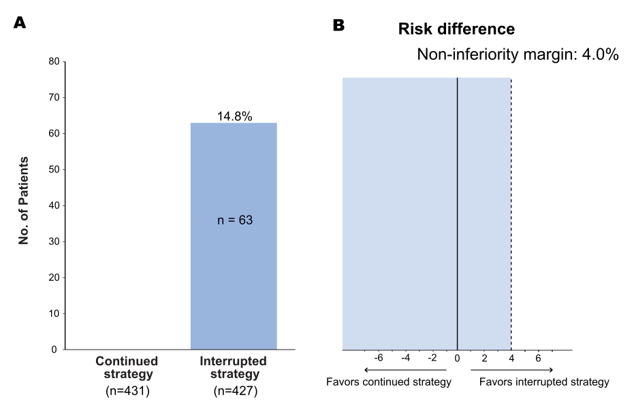
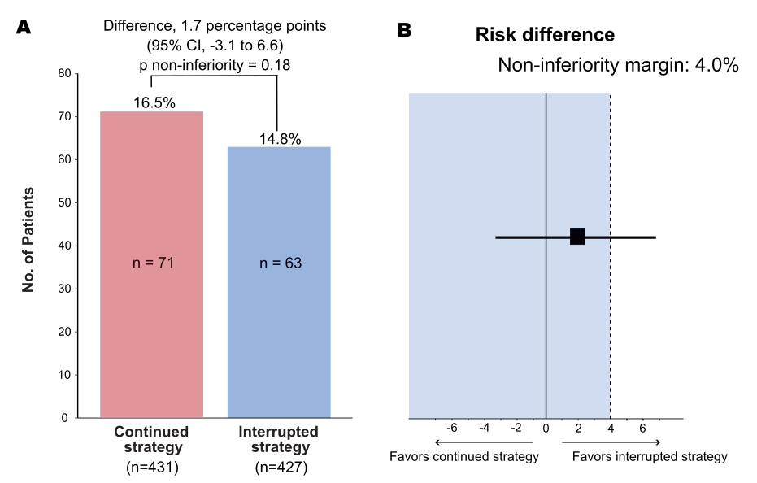
Primary outcome: cardiovascular mortality, stroke, myocardial infarction, major vascular complications and major bleeding at 30 days

Slide 17
Secondary outcomes at 30 days
Secondary outcomes – no. (%) | Continued (n=431) | Interrupted (n=427) | Risk difference - % (95% CI)
Cardiovascular death | 9 (2.1) | 9 (2.1) | 0.0 (-1.9 - 1.9)
Thromboembolic event | 38 (8.8) | 35 (8.2) | 0.6 (-3.1 - 4.4)
Ischemic stroke | 14 (3.2) | 16 (3.7) | -0.5 (-3.0 - 2.0)
Transient ischemic attack | 14 (3.2) | 10 (2.3) | 0.9 (-1.3 - 3.1)
Myocardial infarction | 5 (1.2) | 7 (1.6) | -0.5 (-2.1 - 1.1)
Systemic embolism | 6 (1.4) | 3 (0.7) | 0.7 (-0.7 - 2.1)

Slide 18
Secondary outcomes at 30 days
Secondary outcomes – no. (%) | Continued (n=431) | Interrupted (n=427) | Risk Difference % (95% CI)
Any bleeding* | 134 (31.1) | 91 (21.3) | 9.8 (3.9 - 15.6)
Major bleeding (VARC type 2-4) | 48 (11.1) | 38 (8.9) | 2.2 (-1.8 - 6.3)
Minor bleeding (VARC type 1) | 93 (21.6) | 55 (12.9) | 8.7 (3.7 - 13.7)
Major vascular complication | 44 (10.2) | 33 (7.7) | 2.5 (-1.3 - 6.3)
Hemorrhagic stroke | 0 (0.0) | 2 (0.5) | -0.5 (-1.1 - 0.2)
*91% of bleedings were procedure-related

Slide 19
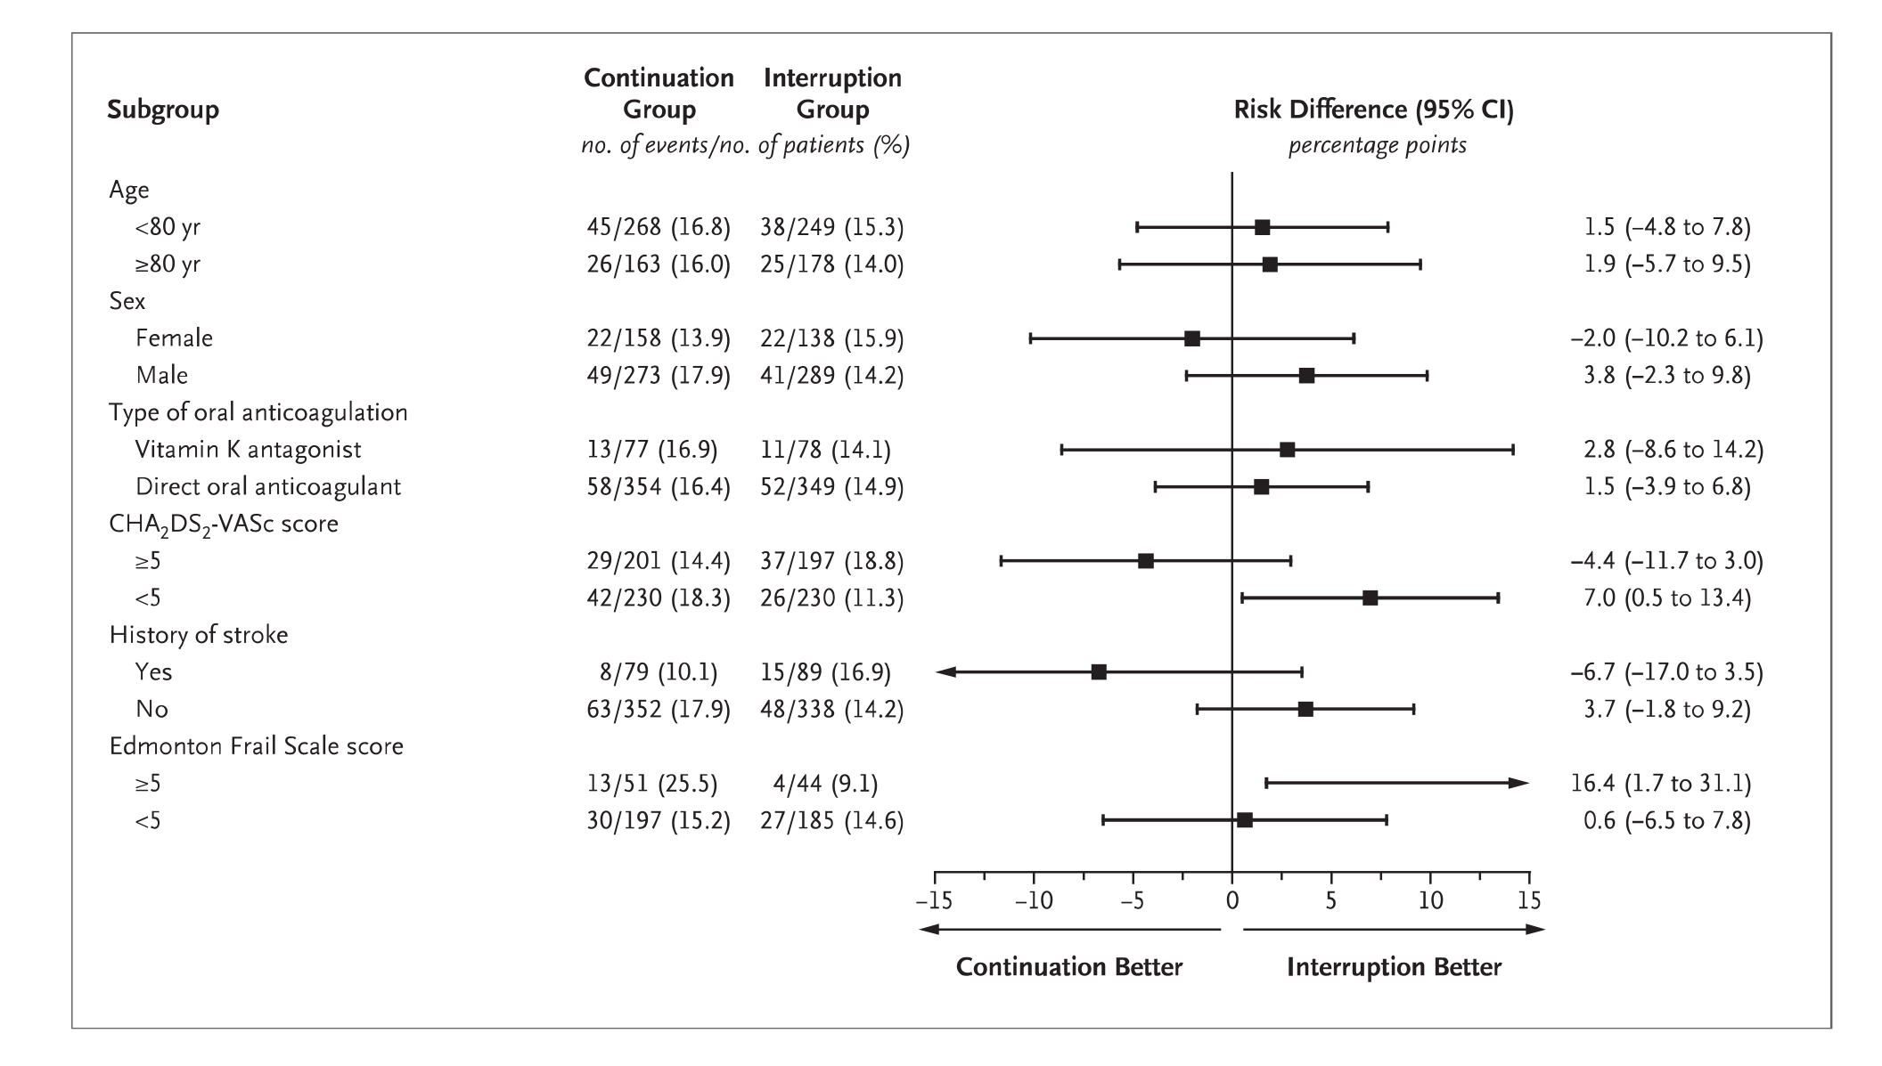
Subgroup analyses primary outcome

Slide 20
Limitations
Open-label design
Risk of reporting and ascertainment biases
No routine neuroimaging
Effect on silent cerebral ischemia not studied
Powered for composite outcome of bleeding and thromboembolic events
Careful interpretation of individual components of primary outcome and secondary outcomes
Almost all patients treated through transfemoral approach
Results not generalizable to other vascular approaches

Slide 21
Conclusions
In patients undergoing TAVI with an indication for oral anticoagulation, periprocedural continuation was not found to be noninferior to interruption of oral anticoagulation during TAVI
The incidence of thromboembolic events appeared similar between both groups, whilst more bleeding complications were observed in the continuation group

Slide 22
Acknowledgements
Investigators Willem L. Bor (CI) Hugo M. Aarts Christophe Dubois Ole De Backer Maxim J.P. Rooijakkers Liesbeth Rosseel Leo Veenstra Frank van der Kley Kees H. van Bergeijk Nicolas M. Van Mieghem Pierfrancesco Agostoni Michiel Voskuil Carl E. Schotborgh Alexander J.J. IJsselmuiden Jan A.S. Van Der Heyden Renicus S. Hermanides Emanuele Barbato Darren Mylotte Enrico Fabris Peter Frambach Karl Dujardin Bert Ferdinande Benno J.W.M. Rensing Leo Timmers Martin J. Swaans Jorn Brouwer Vincent J. Nijenhuis Daniel C. Overduin Tom Adriaenssens Yusuke Kobari Pieter A. Vriesendorp Jose M. Montero-Cabezas Hicham El Jattari Jonathan Halim Ben J.L. Van den Branden Remigio Leonora Marc Vanderheyden Michael Lauterbach Joanna J. Wykrzykowska Arnoud W.J. van 't Hof Niels van Royen Ronak Delewi Jurriën M. ten Berg (PI) All study coordinators & study nurses Trial statisticians Joyce Peper
Jan G.P. Tijssen Clinical-events committee Jaap Kappelle Egbert Bal Stef Hubbers Data Safety Monitoring Board Freek Verheugt Eric Boersma Jan-Henk Dambrink Funding St. Antonius Research Fund ZonMW The patients involved!

Slide 24
Take home message
This first randomized trial on periprocedural oral anticoagulation in patients undergoing TAVI provides evidence for interruption of oral anticoagulation

