Slide 1
CSL 112 (Apolipoprotein A-I) Infusions and Cardiovascular Outcomes in Patients With Acute Myocardial Infarction (ApoA-I Event ReducinG in Ischemic Syndromes II (AEGIS-II) Trial)
C. Michael Gibson, M.S., M.D.; Danielle Duffy, M.D.; Gerald Chi, M.D.; Serge Korjian, M.D.; M. Cecilia Bahit, M.D.; John H. Alexander, M.D., M.H.S.; A. Michael Lincoff, M.D.; Mark Heise, Ph.D.; Pierluigi Tricoci, M.D., Ph.D., M.H.S.; Jose C. Nicolau, M.D., PhD; Renato Lopes, M.D.; Bela Merkely, M.D.; Basil S. Lewis, M.D.; Jan H. Cornel, M.D.; Jaroslaw Trebacz, M.D.; Alexander Parkhomenko, M.D.; Peter Libby, M.D.; Frank Sacks, M.D.; Thomas J. Povsic, M.D. Ph.D.; Lawrence I. Deckelbaum, M.D.; Jenny Mears; Marc Bonaca, M.D.; Shaun G. Goodman, M.D., M.S.c.; Deepak L. Bhatt, M.D., M.P.H.; Michal Tendera, M.D.; P. Gabriel Steg, M.D.; Paul Ridker, M.D.; Philip Aylward, M.D.; John Kastelein, M.D.; Christophe Bode, M.D.; Kenneth W. Mahaffey, M.D; Stephen J. Nicholls, M.B.B.S., Ph.D..; Stuart Pocock, Ph.D.; Roxana Mehran, M.D.; Robert Harrington, M.D.
On Behalf of the AEGIS-II Committees and Investigators

Slide 2
Disclosures
Consultant
Spouse: Employee of Boston Clinical Research Institute, has equity
Present Research/Grant Funding
Janssen/Johnson & Johnson
CSL Behring
SCAD Alliance
Baim Institute
Patents and Stocks: None
Equity:
nference, Inc.
Dyad Medical
Absolutys
Fortress Biotech
FlowTherapy
Angel/Avertix Medical | MD Magazine
AstraZeneca | Microport
Bayer | Novartis
Beren Therapeutics | NovoNordisk
Boehringer Ingelheim | Pfizer
Boston Clinical Research Institute | PLxPharma
Bristol-Myers Squibb | Smart Medics
Cardiovascular Research Foundation | Solstic Health/New Amsterdam Pharma
CeleCor Therapeutics | Somahlution/Marizyme
Esperion | Vectura
EXCITE International ($0 Received) | WedMD
Fortress Biotech | Woman As One
Janssen/ J&J
MashUp MD
Angel/Avertix Medical | MD Magazine
AstraZeneca | Merck
Bayer/Janssen/ J&J | Microport
Beren Therapeutics | MjHealth
Bioclinica | Novartis
Boehringer Ingelheim | NovoNordisk
Boston Clinical Research Institute | PERT Consortium
Boston Scientific | Pfizer
Bristol-Myers Squibb | PhaseBio
Cardiovascular Research Foundation | PHRI
CeleCor Therapeutics | PLxPharma
CSL Behring | Revance Therapeutics
DCRI | Samsung
Esperion | SFJ
EXCITE International ($0 Received) | SCAI
Fortress Biotech | Solstic Health/New Amsterdam Pharma
Gilead Sciences, Inc. | Somahlution/Marizyme
Inari | Vectura
MashUp MD | Woman As One

Slide 3
Evolution in the “HDL Hypothesis”
The main role of HDL-C is to carry cholesterol from cells to the liver, where hepatocytes degrade cholesterol for excretion via bile
Higher HDL-C associated with lower events, but therapies that raise HDL-C numbers have not reduced events
We hypothesized that improving HDL function by infusing human ApoA-1, the primary functional component of HDL, would improve outcomes
Past
Present
Improving
HDL-C
Number
Improving
HDL
Function
?
Dysfunctional HDL
Off Target Toxicity
Improves Clinical Outcomes
HDL, high-density lipoprotein

Slide 4


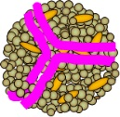

Measuring HDL Function Instead of HDL-C Number: Measuring Cholesterol Efflux Capacity From Macrophages
Macrophages with radioactive cholesterol are added to the patient's blood and the amount of radioactive cholesterol taken up by the HDL is measured
HDL
Macrophage With Radioactive Cholesterol
HDL From Patients Blood

Slide 5
Improved Cholesterol Efflux Capacity (CEC) Is Associated With Improved 6 Year Survival Following MI
CEC and Mortality in AMI (1-Month Follow-Up)
100
100
HR (95% CI), adjusted*
CEC and Mortality in AMI
Q4
0.32 (0.13–0.78)
HR (95% CI), adjusted*
Q3
0.76 (0.39–1.47)
90
90
Q2
0.70 (0.38–1.28)
Cumulative survival (%)
Q4
0.54 (0.32–0.89)
Q1
Reference
Q3
0.76 (0.48–1.21)
Cumulative survival (%)
80
Q2
0.84 (0.55–1.27)
80
Most of the difference emerges in the first 30 days
70
Q1
Reference
0
1
2
3
4
5
6
Follow-up (years)
70
0
5
10
15
20
25
30
Follow-up (days)
Q1, Q2, Q3 and Q4 relate to the quartiles of CEC measured, in both figures.
.
Age and sex, CV risk factors and prognostic factors of MI. AMI, acute myocardial infarction; CEC, cholesterol efflux capacity; CI, confidence interval; CV, cardiovascular; HR, hazard ratio; MI, myocardial infarction; Q, quartile Figures adapted from Guerin, M. et al. J Am Coll Cardiol. 2018;72:3259–69.

Slide 6
CSL112 Is Human ApoA-1 Purified From Human Plasma, Reconstituted With Phosphatidylcholine, Stabilized With Sucrose; Suitable For IV Infusion & Produces a Significant, Dose-Dependent Improvement in Cholesterol Efflux in Post-MI Patients
Fold elevation at peak after 1st infusion compared to baseline
In Phase II trials, CSL112 produced a dramatic, dose-dependent increase in apoA-I levels and cholesterol efflux¹
Gibson CM, et al. Circulation 2016;134:1918–30.
Notes:
As approximately one third of ACS patients have comorbid chronic kidney disease (CKD),¹ the effect of the 6 g CSL112 dose on cholesterol efflux was investigated in post-MI patients with stage 3 moderate CKD and was observed to be similar to post-MI patients with normal or mildly-impaired renal function.^{2,3}
Fox KA, et al. Eur Heart J. 2010; 31:2755-2764.
Gibson CM, et al. Circulation 2016;134:1918–30
Gibson CM, et al. Am Heart J 2019;208:81–90

Slide 7
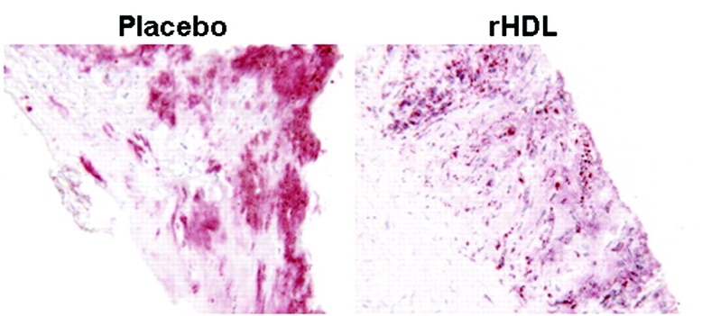
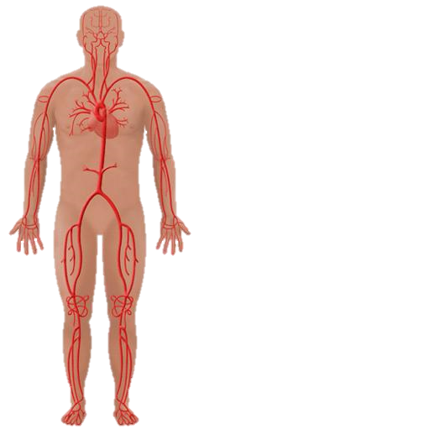
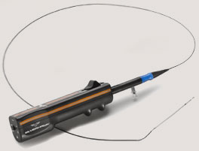
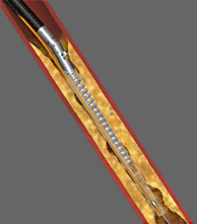
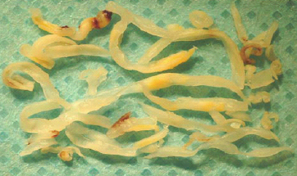
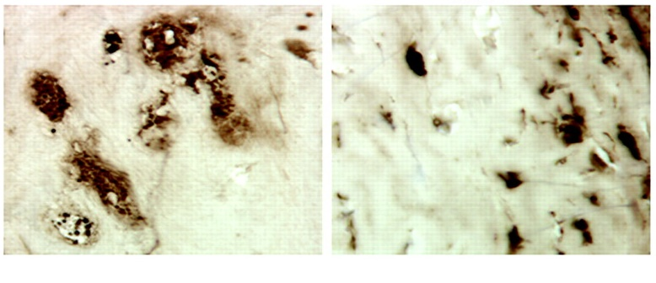
Histology Data from Human Femoral Arteries:
ApoA-I Infusion Reduces Macrophage & Fat Content in Plaque
A single infusion of ApoA-I (CSL111) reduced femoral plaque by >50% in 5–7 days¹
Placebo
rHDL
*
Placebo
rHDL
*
Shaw et al. Circ Res. 2008;103:1084-91

Slide 8
Hypothesis of the AEGIS 2 Trial
Prior Observations:
  CSL 112 ApoA-1 infusions improved cholesterol efflux in the setting of MI and reduced fat and macrophage content in atherosclerotic plaque
  Improved cholesterol efflux is associated with improved CV outcomes in the setting of MI
Hypothesis:
  CSL 112 infusion will improve CV outcomes in the setting of MI

Slide 9
ApoA-1 Event ReducinG in Ischemic Syndromes II
A phase 3, multicenter, double-blind, randomized, placebo-controlled, event-driven, parallel-group study
Within 5 days of MI after angio
Treatment period
(4 weekly infusions)
Follow-up period (1 year)
18,219 AMI patients
Stratification by:
STEMI/NSTEMI
PCI/medical management
Region
6 g CSL112 (n=9,112)
Placebo (n=9,107)
Infusion:
Visit:
Study day:
1
2
1
2
3
8
(-2/+1)
3
4
15
(-2/+1)
4
5
22
(-2/+1)
6
29
(±2)
7
60
(±10)
8
90
(±10)
Key secondary EPs 180 & 365 days
1
9
180 C
(±10)
10
270
(±10)
11
365
(+14)
Within 5 days of arriving for evaluation and treatment of MI
Multivessel Disease
AND
either Drug Treated Diabetes
OR
2 of the following:
≥65 years
Prior MI
PAD
Randomization
All infusions given within 30 days of the ﬁrst infusion
Primary endpoint at 90 days
ITT analysis. Two-sided type I error of 0.05 with 90% power on an assumed hazard ratio of 0.80 for the primary endpoint with an observed event rate of 5% at 75% of the way through the trial led to a required sample size of 18,200, targeting 905 primary events
Cumulative event rates using the Kaplan-Meier method were calculated for the primary efficacy endpoint and other time to event endpoints. A covariate-adjusted Cox regression model including fixed effects for treatment, region, index MI type, index MI management, age, diabetes, peripheral arterial disease, prior MI, and an interaction term for index MI type and index MI management was fitted to estimate the hazard ratio and two-sided 95% confidence interval
AMI, acute myocardial infarction; MI, myocardial infarction; NSTEMI, non-ST-elevation myocardial infarction; PCI, percutaneous coronary intervention; STEMI, ST-elevation myocardial infarction. Gibson CM, et al. Am Heart J. 2021;231:121–7.

Slide 10
Trial Leadership
Executive Committee:
C. Michael Gibson, MS, MD (Chairman); Robert A. Harrington, MD, (Co-Chairman)
John Alexander, MD, MHS; Philip A. Aylward, BM, BCh, PhD; Deepak Bhatt, MD, MPH; Christoph Bode, MD; Shaun Goodman, MD, MS​​c; John Kastelein, MD, PhD; Kenneth Mahaffey, MD; A. Michael Lincoff, MD; Roxana Mehran, MD; Stephen J. Nicholls, MBBS, PhD; Stuart Pocock, PhD; Paul Ridker, MD; P. Gabriel Steg, MD; Michal Tendera, MD. Sponsor Representatives: Danielle Duffy, MD; Pierluigi Tricoci, MD, PhD.
Independent Data Monitoring Committee:
Douglas Weaver, MD (Chair); Michel Bertrand, MD; David Faxon, MD; Bruce Molitoris, MD; David Waters, MD; Jan Tijssen, PhD.
Clinical Events (Adjudication) Committee:
Venu Menon, MD (CEC Director); Vidyasagar Kalahasti, MD (CEC Associator Director); Aldo Schenone, MD; Dane Meredith, MD; Jonathan Hansen, MD; Nyal Borges, MD; Cameron Lambert, MD; Bryan Wilner, MD; Amit Goyal, MD; Anirudh Kumar, MD; Kartik Telukuntla, MD; Divyang Patel, MD; Robert Montgomery, MD; Reza Reyaldeen, MD; Todd Brophy, MD; Travis Howard, MD; Balint Laczay, MD; Rohan Shah, MD; Ramya Vajapey, MD; Zachary Goff, MD; Nicholas Kamp, MD; Trent Wei, MD; David Katzianer, MD; Erich Kiehl, MD; Dane Meredith, MD; Jitendra Sharma, MD; Nirav Vora, MD; Siddharth Sehgal, MD; Ken Uchino, MD; Willis C. Maddrey, MD; James H. Lewis, MD; James Freston, MD, PhD.

Slide 11
National Lead Investigators
18,226 participants at 886 sites in 49 countries were randomized between March 2018 and November 2022
(Argentina) Cecilia Bahit, MD;
(Australia) Gemma Figtree, MB BS, DPHIL (OXON), FRACP, FCSANZ, FAHA;
(Austria) Kurt Huber, MD, FESC, FACC, FAHA;
(Belgium) Pascal Vranckx, MD;
(Brazil) Renato Lopes, MD, MHS, PhD; (Brazil) Jose Carlos Nicolau, MD, PhD;
(Bulgaria) Nina Gotcheva, MD, PhD;
(Canada) Kevin Bainey, MD, MSc;
(Chile) Juan Carlos Prieto, MD;
(Colombia) Miguel Urina Triana, MD, MSc, PhD, FACC;
(Czech Republic) Miroslav Solar, MD;
(Denmark) Svend Eggert Jensen, MD, PhD, FESC; Morten Bøttcher, MD PhD;
(Estonia) Margus Viigimaa, MD, PhD, FESC;
(Finland) Mika Laine, MD;
(France) Gilles Montalescot, MD, PhD;
(Georgia) Tamaz Shaburishvili;
(Germany) Daniel Duerschmied, MD;
(Greece) Dimistris Tousoulis, MD;
(Hong Kong) Michael Lee, MD;
(Hungary) Bela Merkely, MD, PhD;
(Israel) Basil Lewis, MD;
(Italy) Giuseppe Ambrosio, MD, PhD;
(Japan) Satoshi Yasuda, MD;
(Latvia) Andrejs Erglis, MD;
(Lithuania) Rimvydas Slapikas, MD, PhD;
(Malaysia) Alan Fong, MD;
(Mexico) Jose Luis Leiva Pons, MD;
(Netherlands) Jan H. Cornel, MD;
(New Zealand) Harvey White, MD;
(Norway) Vibeke Juliebø, MD;
(Peru) Manuel Horna, MD, FACC, FASE, FESC;
(Poland) Jaroslaw Trebacz, MD;
(Portugal) João Morais, MD;
(Romania) Dragos Vinereanu, MD;
(Russia) Sergey Zenin, MD;
(Serbia) Nebojsa Tasic, MD;
(Singapore) Jack Tan, MD;
(Slovakia) Jan Murin, MD, PhD;
(South Africa) Lesley Burgess, MD;
(South Korea) Hyun Jae Kang, MD;
(Spain) Angel Cequier Fillat, MD;
(Sweden) Emil Hagström, MD;
(Switzerland) Stephan Windecker, MD;
(Taiwan) Jiunn-Lee Lin, MD;
(Thailand) Piyamitr Sritara, MD, PhD;
(Turkey) Umit Guray, MD;
(United Kingdom) Vijay Kunadian, MD;
(Ukraine) Alexandr Parkhomenko, MD;
(United States) Marc Bonaca, MD, MPH, Thomas Povsic, MD.
We would like to thank Dr. Anthony Gershlick, the country leader of the United Kingdom, and Dr. Amadeu Betriu, the country leader of Spain for their enormous contribution to the study prior to their untimely deaths. We miss them as friends and colleagues.

Slide 12
Baseline Characteristics
Type of index MI - no. (%) | CSL 112 | Placebo
STEMI | 4606 (50.5) | 4600 (50.5)
NSTEMI | 4506 (49.5) | 4507 (49.5)
PCI performed for index MI – no. (%) | 8037 (88.2) | 7997 (87.8)
Medications at time of Randomization – no. (%)
Aspirin | 8489 (93.2) | 8473 (93.0)
P2Y12 inhibitor or other anti-platelet agent | 8508 (93.4) | 8490 (93.2)
HMG CoA reductase inhibitor (statin) | 8429 (92.5) | 8424 (92.5)
High intensity statin therapy^^ | 6871 (75.4) | 6890 (75.7)
Median lipid level (IQR) – mg/dL**
Total Cholesterol | 160 (133-192) | 159 (133-190)
LDL Cholesterol | 84 (61-112) | 84 (62-111)
HDL Cholesterol | 39 (33-46) | 39 (33-47)
Triglycerides | 156 (117-212) | 153 (117-208)

Slide 13
Trial Compliance and Follow Up
  90% of subjects completed all 4 infusions
  99.5% of subjects completed 90 days of follow-up
  99% completed 365 days of follow-up
  1 patient lost to follow up in each group

Slide 14
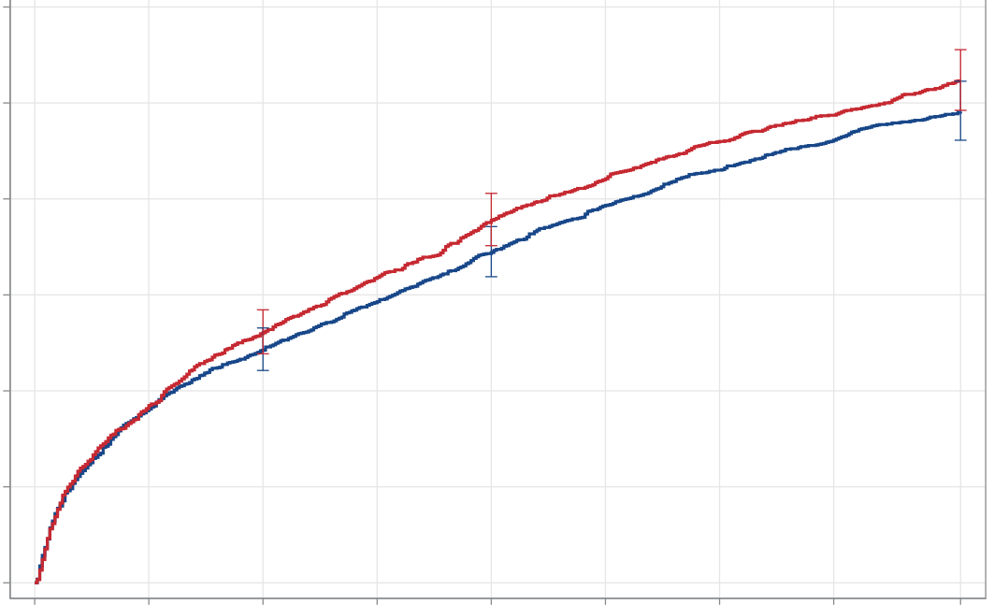
Primary Endpoint
Time to First Occurrence of CV Death, MI or Stroke
Key Secondary
Endpoint
180 days
6.9% vs. 7.6%
HR=0.91
(0.81-1.01)
p=0.077
Key Secondary
Endpoint
365 days
9.8% vs. 10.5%
HR=0.93
(0.85-1.02)
p=0.137
12
Placebo
10
Primary Endpoint
90 days
4.9% vs. 5.2%
HR=0.93
(0.81-1.05)
p=0.24
8
CSL 112
6
4
2
0
0
45
90
135
180
225
270
315
365
CSL 112
9112
9107
8714
8714
8581
8562
8470
8442
8364
8329
8264
8232
8188
8155
8121
8093
7790
7761
Placebo
Cumulative event rates using the Kaplan-Meier method were calculated for the primary efficacy endpoint and other time to event endpoints. A covariate-adjusted Cox regression model including fixed effects for treatment, region, index MI type, index MI management, age, diabetes, peripheral arterial disease, prior MI, and an interaction term for index MI type and index MI management was fitted to estimate the hazard ratio and two-sided 95% confidence interval

Slide 15
Other Key Pre-Specified Secondary Endpoints
End Point | CSL112 (N = 9112) | Placebo (N = 9107) | Hazard Ratio or Rate Ratio (95% CI)
Key Secondary Efficacy Endpoints
Hospitalizations for coronary, cerebral, or peripheral ischemia per 90 days of follow-up – no. hospitalizations, mean rate* | 433 (0.045) | 442 (0.047) | 0.97 (0.84–1.12)
Other Secondary Efficacy End Points and Components of the Composite Endpoint
All-cause death at 365 days — no. (%) | 341 (3.8) | 345 (3.8) | 0.98 (0.84–1.14)
CV death through 180 days — no. (%) | 150 (1.7) | 169 (1.9) | 0.88 (0.71–1.10)
CV death through 365 days — no. (%) | 230 (2.6) | 242 (2.7) | 0.94 (0.79–1.13)
MI through 180 days — no. (%) | 450 (5.0) | 513 (5.7) | 0.87 (0.77–0.99)
MI through 365 days— no. (%) | 638 (7.2) | 705 (7.9) | 0.90 (0.81–1.00)
Stroke through 180 days — no. (%) | 81 (0.9) | 71 (0.8) | 1.13 (0.82–1.56)
Stroke through 365 days — no. (%) | 115 (1.3) | 109 (1.2) | 1.05 (0.89–1.36)

Slide 16
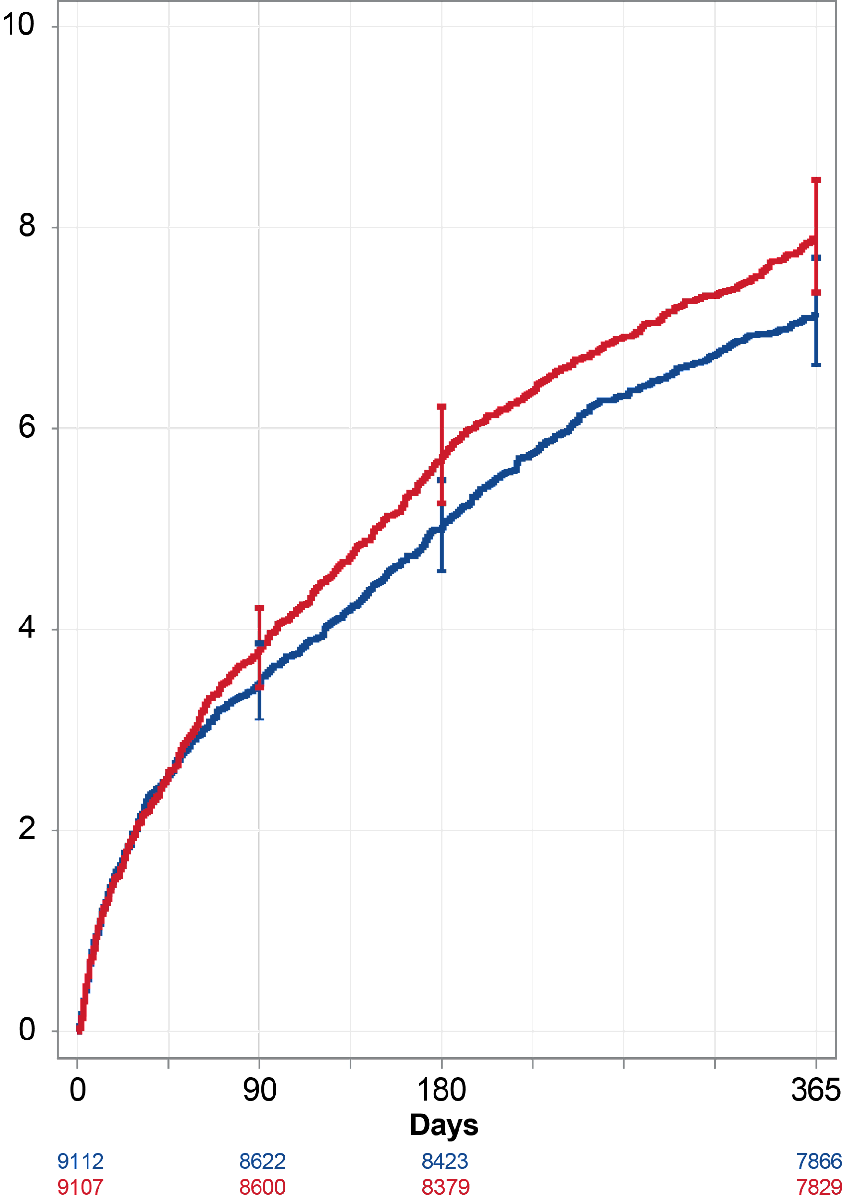
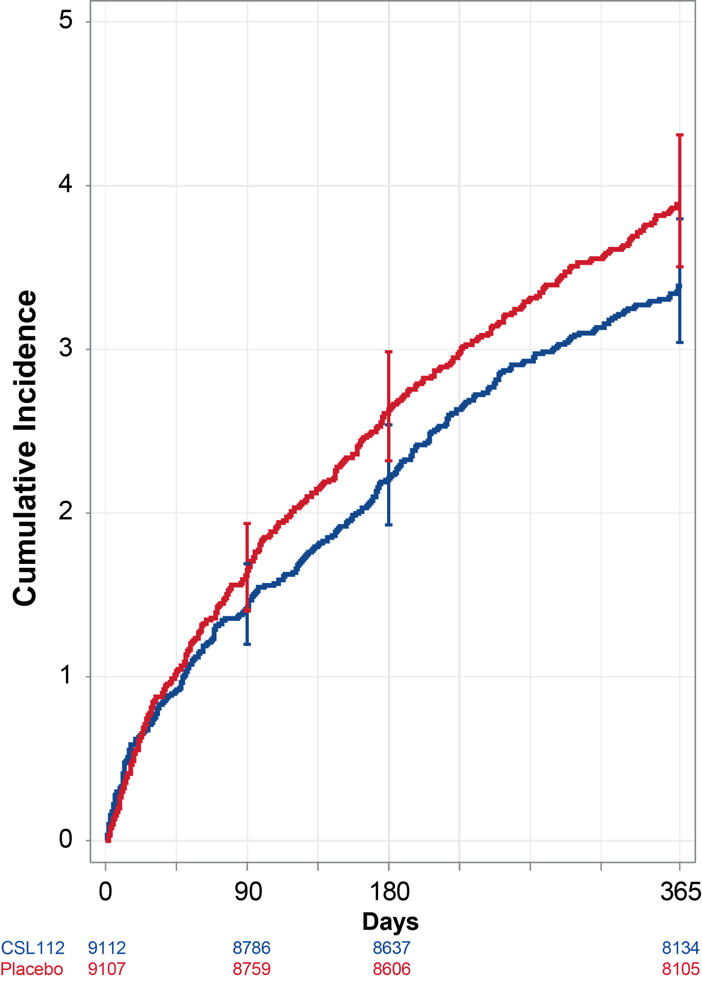
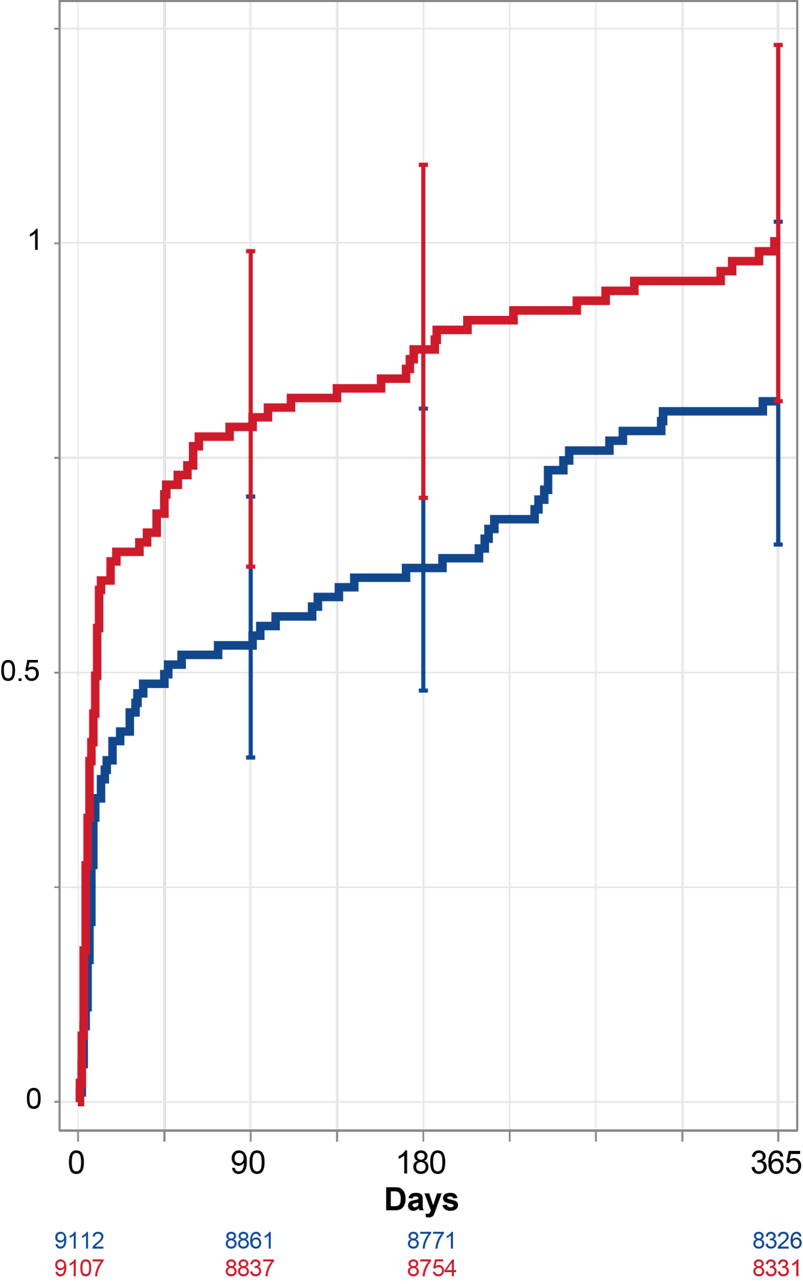
Myocardial Infarction Event Rates by MI Type
Secondary Endpoint; All Patients Included
All MI
Type 1 MI
Type 4b MI
365 days
7.2% vs. 7.9%
HR=0.90
(0.81-1.00)
p=0.056
365 days
3.4% vs. 3.9%
HR=0.87
(0.74-1.01)
p=0.074
180 days
5.0% vs. 5.7%
HR=0.87
(0.77-0.99)
p=0.038
180 days
2.2% vs. 2.6%
HR=0.84
(0.69-1.01)
p=0.064
90 days
3.5% vs. 3.8%
HR=0.91
(0.78-1.06)
p=0.23
90 days
1.4% vs. 1.7%
HR=0.86
(0.68-1.09)
p=0.21
Cumulative Incidence (%)
365 days
0.8% vs. 1.0%
HR=0.82
(0.60 - 1.11)
p=0.098
180 days
0.6% vs. 0.9%
HR=0.71
(0.51-1.00)
p=0.052
90 days
0.5% vs. 0.8%
HR=0.68
(0.47-0.98)
p=0.038

Slide 17
Safety Findings
Overall, there were similar rates of adverse events with CSL112 compared to placebo.
There were no imbalances in all hypersensitivity events (serious and non-serious). The number of immune system disorder events (e.g. hypersensitivity or anaphylactoid reactions) leading to discontinuation from investigational product were low but were higher in the CSL112 group compared with the placebo group (14 vs 4 events, p=0.02).
There were fewer acute kidney injury events in the CSL112 arm (defined by changes in creatinine through the active treatment period): 570 (6.3%) vs 650 (7.2%)(p=0.02).
There were no significant imbalances in potential hepatic injury events (defined as ALT >3x ULN with Tbili >2x ULN or ALT >5x ULN), or new or worsening heart failure events (based on adjudication)

Slide 18
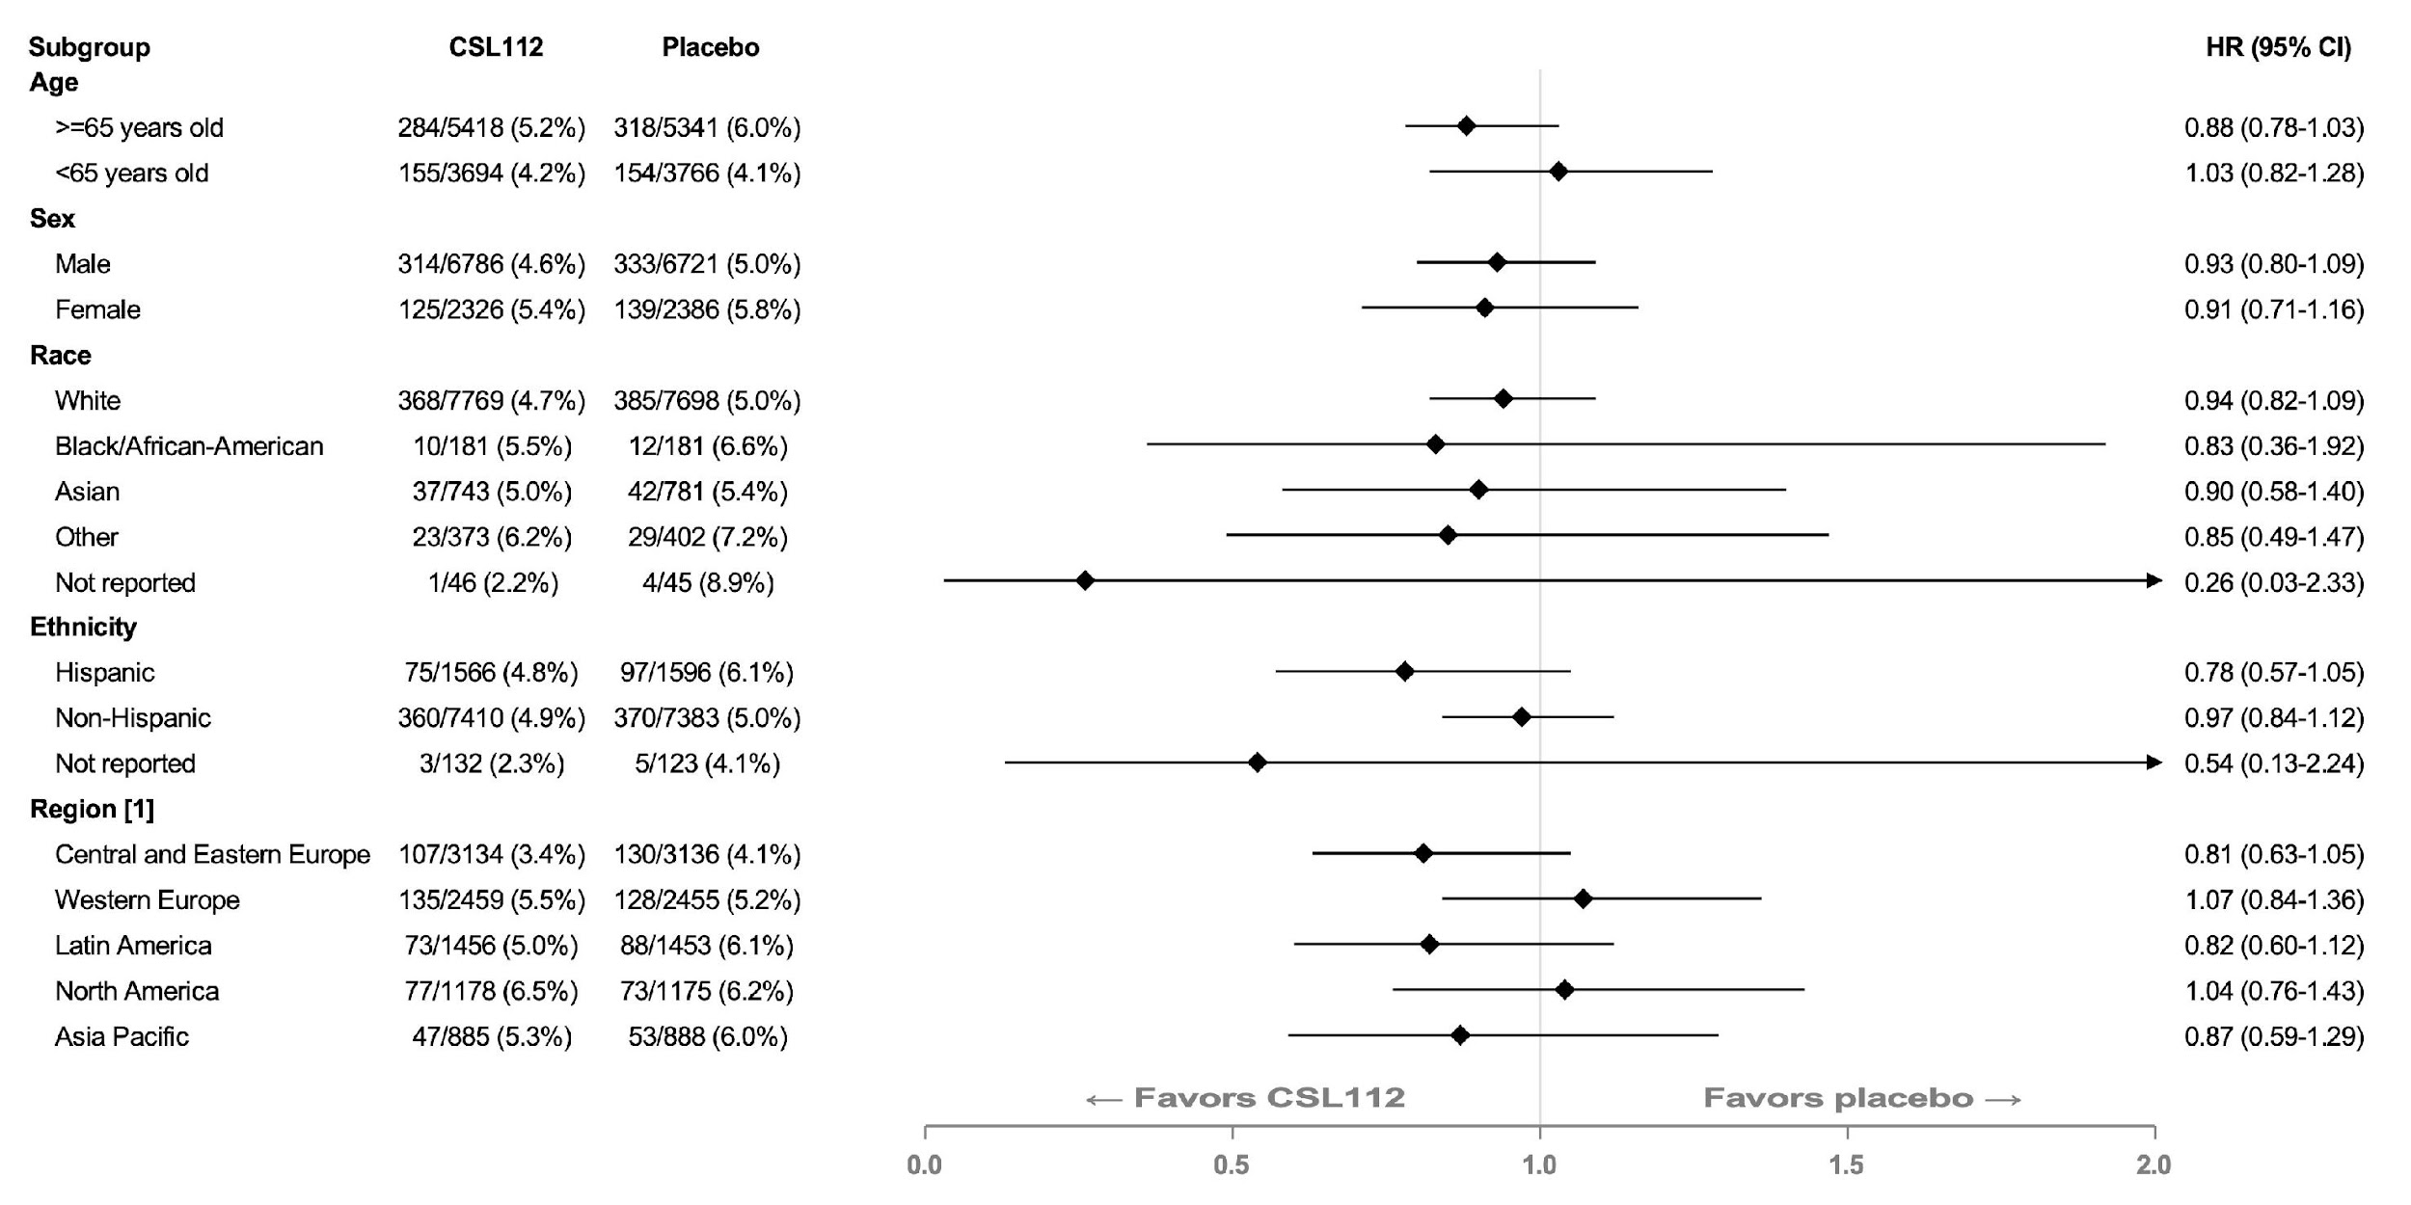
Primary Endpoint Subgroups

Slide 19
Secondary and Exploratory Hypothesis Generating Analyses

Slide 20
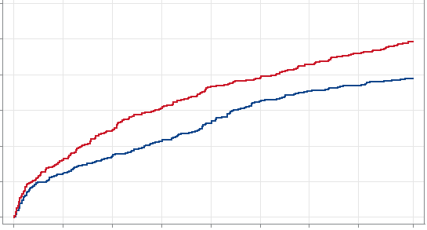
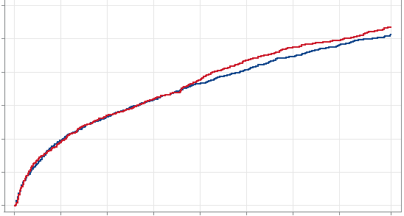
Primary MACE Endpoint Lower In Patients With Baseline Hyperlipidemia (LDL-C > 100, All On Statins)
Baseline LDL > 100 mg/dl
Baseline LDL < 100 mg/dl
365 days
7.8% vs. 9.9%
HR=0.78
(0.65-0.93)
p=0.006
12
180 Days
5.3% vs.7.3%;
HR=0.71
(0.57-0.88)
p=0.002
10
90 days
3.4% vs. 4.9%
HR=0.69
(0.53-0.90)
p=0.007
All p=NS
8
P _{interaction}
= 0.070
Cumulative Incidence (%)
6
NNT 48
4
P _{interaction}
= 0.023
NNT 50
As the baseline LDL increased, the potential treatment effect of ApoA-1 infusion increased significantly when analyzed as a continuous variable
2
P _{interaction}
= 0.041
NNT 66
0
0
90
180
365
0
90
180
365
Days
Days
CSL 112
2655
2551
2496
2348
5198
4882
4759
4412
Placebo
2649
2514
2444
2285
5229
4910
4784
4440

Slide 21
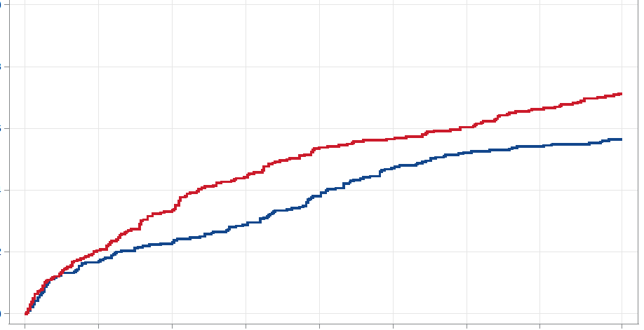
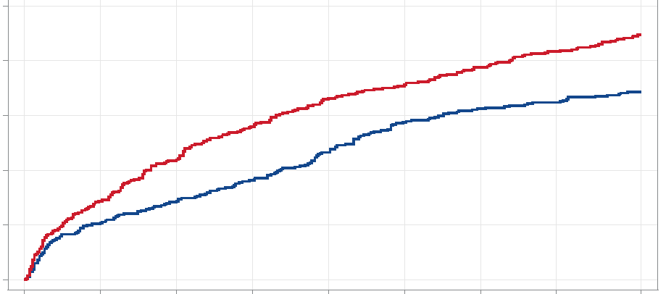
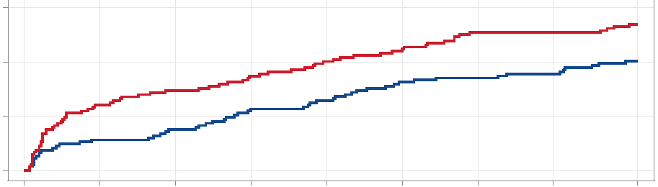
Patients with Baseline Hyperlipidemia
(LDL-C > 100, All on Statins)
CV Death
MI
CV Death / MI
365 days
6.9% vs. 8.9%
HR=0.75
(0.62-0.91)
p=0.004
10
365 days
5.6% vs. 7.1%
HR=0.78
(0.63-0.97)
p=0.027
180 days
4.7% vs. 6.6%
HR=0.69
(0.55-0.87)
p=0.002
8
180 days
3.8% vs. 5.4%
HR=0.70
(0.54-0.90)
p=0.006
90 days
2.9% vs. 4.4%
HR=0.64
(0.48-0.86)
p=0.003
6
90 days
2.3% vs. 3.4%
HR=0.68
(0.49-0.94)
p=0.021
365 days
2.0% vs. 2.7%
HR=0.73
(0.51-1.04)
p=0.080
P _{interaction}
= 0.069
Cumulative Incidence (%)
180 days
1.3% vs. 2.0%
HR=0.63
(0.41-0.97)
p=0.037
NNT 50
90 days
0.8% vs. 1.5%
HR=0.50
(0.29-0.86)
p=0.012
4
P _{interaction}
= 0.024
NNT 52
2
P _{interaction}
= 0.016
NNT 66
0
0
90
180
365
0
90
180
365
0
90
180
365
Days
Days
Days
CSL 112
2655
2619
2599
2490
2655
2566
2513
2372
2655
2566
2513
2372
Placebo
2649
2599
2576
2455
2649
2526
2461
2306
2649
2526
2461
2306

Slide 22
Conclusions
Among AMI patients with multivessel disease and additional cardiovascular risk factors on guideline directed background therapies, 4 weekly infusions of CSL112 compared with placebo did not significantly reduce the primary endpoint of CV death, MI or stroke through 90 days.
There was consistency in the primary endpoint in pre-specified subgroups.
The drug was well tolerated.

Slide 23
Conclusions: Secondary & Exploratory Hypothesis Generating Endpoints
As the baseline LDL-C increased, the potential treatment effect of ApoA-1 infusion increased significantly when analyzed as a continuous variable.
There was a positive interaction term such that the treatment effect in those patients with an LDL-C > 100 mg / dl was statistically significant while it was not in those with an LDL < 100 mg/dl.
The benefit on ApoA-1 infusions in hyperlipidemic patients is biologically plausible, but the observation is hypothesis generating and requires prospective validation.
The trends seen for the individual components of CV death and MI are consistent with the a priori proposed biologic effect of plaque stabilization.

Slide 24
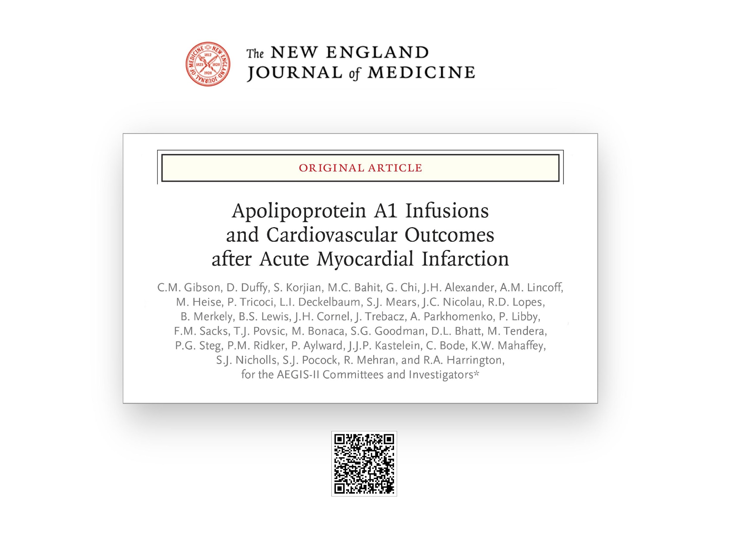

Slide 25
Back Up Slides

Slide 26
Differentiating CSL112 from other ApoA-I Infusion Therapies
CSL112 results in much larger increases in ApoA-I, cholesterol efflux and ABCA1-dependent cholesterol efflux than other ApoA-I therapies and activates LCAT
CSL112
(6 g)
Increase^{*1}
Increase^{*1}
Increase^{*1}
Activated⁵
CER-001
(3 mg/kg)
Increase^{†2}
Increase^{†2}
No change^{†2}
Inhibited⁶⁻⁸
MDCO-216
(20 mg/kg)
Hypercatabolism^{‡3}
Not available^{‖3}
Not available^{‖3,4}
Inhibited^{9,10}
ApoA-I levels
106%
6%
Total Cholesterol efflux
145%
6%
ABCA1-dependent
cholesterol efflux
330%
LCAT
Data not from head-to-head studies
ABCA1, ATP-binding cassette transporter A1; apoA-I, apolipoprotein A-I; LCAT, lecithin-cholesterol acyltransferase; RCT, reverse cholesterol transport
Measured before and immediately after 2-hour infusion; †Measured before and 1 hour after infusion; ‡Timing of measurement not reported; ‖Data not available for MILANO-PILOT; however, limited data at the 20 mg/kg dose from Phase 1 suggests an increase in ABCA1-dependent efflux.
1. Gibson CM, et al. Circulation 2016;134:1918–30; 2. Zheng KH, et al. Atherosclerosis 2016;251:381–8; 3. Nicholls SJ. Oral presentation at AHA, November 2016; 4. Kallend DG, et al. Euro Heart J Cardiovasc Pharmaco 2016;2:23–9; 5.; 5. Diditchenko S, et al. Arterioscler Thromb Vasc Biol. 2013;33:2202–11; 6. Tardy C, et al. Atherosclerosis 2014;232:110–118; 7. Boerema DJ, et al. Poster presentation at ATVB, May 2014; 8. Bolin DJ, et al. J Biol Chem. 1996; 271:19152–19158; 9. Calabresi L, et al. Biochem Biophys Res Commun. 1997; 232:345-349; 10. Kempen HJ, et al. Atherosclerosis 2016;255:17-24

Slide 27
Multiple Event Analysis: CV Death, MI and Stroke
Day 365
RR 0.89
(95% CI 0.80 – 0.99)
2-sided P = 0.04
Day 180
RR 0.87
(95% CI 0.77 – 0.99)
2-sided P = 0.04
9
9
48
41
Day 90
RR 0.88
(95% CI 0.76 – 1.03)
2-sided P = 0.11
1
3
19
Events
14
1
1
5
6

