Slide 1
One-month Ticagrelor Monotherapy After PCI in Acute Coronary Syndromes: Principal Results From the Double-blind, Placebo-controlled ULTIMATE-DAPT Trial
Gregg W Stone MD
Icahn School of Medicine at Mount Sinai
on behalf of Shao-Liang Chen and the ULTIMATE-DAPT Investigators
@GreggWStone
ClinicalTrials.gov number: NCT03971500

Slide 2
Background
International guidelines currently recommend DAPT with aspirin plus a potent P2Y₁₂ receptor inhibitor for 12 months in most patients presenting with an ACS treated with PCI to prevent MI and stent thrombosis
Limited data exist regarding the use of single antiplatelet therapy with a potent P2Y₁₂ inhibitor starting 1 month after PCI in ACS, and no such trials have been placebo-controlled

Slide 3
Objectives
We therefore performed a large-scale, international, multicenter, placebo-controlled, double-blind randomized trial to determine whether the use of ticagrelor alone beginning 30 days after PCI in pts with ACS could reduce clinically-relevant bleeding without an accompanying increase in major adverse cardiovascular or cerebrovascular events (MACCE) compared with ticagrelor plus aspirin

Slide 4
Inclusion Criteria
Patients presenting with ACS within 30 days before randomization
≥18 years of age
With either:
- Biomarker pos NSTEMI or STEMI, or
- Biomarker neg unstable angina
1) DS ≥90%, or
2) Ruptured plaque, or
3) Thrombotic lesion
Had been randomized in the IVUS-ACS trial of IVUS-guided vs. angio-guided PCI
Remained event-free after PCI with contemporary drug-eluting stents (DES) for one month on ticagrelor (90 mg bid) plus aspirin (100 mg qd)

Slide 5
Key Exclusion Criteria
Stroke within 3 months or any permanent neurologic deficit
Previous CABG
Any planned surgery within 12 months
eGFR <20 ml/min/1.73 m²
Need for chronic oral anticoagulation
Life expectancy <1 year
Any condition likely to interfere with study processes

Slide 6
Primary Endpoints - Assessed between 1- and 12-months post-PCI -
Effectiveness: Clinically-relevant bleeding (BARC types 2, 3, or 5), powered for superiority testing
Safety: Composite MACCE, including cardiac death, MI, ischemic stroke, definite stent thrombosis, or clinically-driven TVR, powered for non-inferiority testing

Slide 7
Assumptions and Sample Size Calculations
Effectiveness: Assuming a 3.0% rate of clinically-relevant bleeding between 1 and 12 months on ticagrelor plus aspirin, randomizing 3400 patients provided 80% power to detect a 50% reduction with ticagrelor monotherapy with 2-sided alpha 0.05
Safety: Assuming a 6.2% rate of MACCE between 1 and 12 months on ticagrelor plus aspirin, randomizing 3068 patients provided 80% power to demonstrate noninferiority of ticagrelor monotherapy with an absolute margin of 2.5% with 1-sided alpha 0.025
Tested hierarchically to preserve alpha: Effectiveness had to pass for safety to be tested

Slide 8
Sponsorship, Funding and Study Leadership
Investigator-sponsored study
Shao-Liang Chen, MD, Nanjing First Hospital, China
Steering Committee
Shao-Liang Chen, MD
Gregg W Stone, MD
Imad Sheiban, MD
Afsar Raza, MD
Muhammad Anjum, MD
Country Leaders
Imad Sheiban, MD (Italy)
Afsar Raza, MD (United Kingdom)
Muhammad Anjum, MD (Pakistan)
Zhiming Wu, MD (China)
Funding
Chinese Society of Cardiology [CSCF 2019-A0003], the National Natural Scientific Foundation of China [NSFC, grant number: 91639303, 81770441, and 82121001] and Jiangsu Provincial & Nanjing Municipal Clinical Trial Project [BE 2019615]. Study medications were supplied by Yung Shin Pharmaceutical Industrial Co. (Kunshan, China) and Shenzhen Salubris Pharmaceuticals Co., Ltd (Shenzhen, China).
Executive Committee
Shao-Liang Chen, MD (Study chair and PI)
Gregg W Stone, MD (Study co-chair and co-PI)
Jing Kan, MD (Chair of Clinical Data Coordinating Center)
Jun-Jie Zhang, MD, PhD
Afsar Razar, MD
Imad Sheiban, MD
Fei Ye, MD
Ping Xie, MD

Slide 9
2x2 Randomization and Study Flowchart
IVUS-ACS RCT
ULTIMATE-DAPT RCT
3505 pts with ACS who underwent PCI were enrolled at 58 centers in China (N=52), Pakistan (N=4), the UK (N=1), and Italy (N=1) between August 20, 2019 and October 27, 2022
IVUS-guided PCI (N=1753)
Ticagrelor + aspirin (N=1700)
1-year follow-up
(N=1700)
3400 pts
underwent the 2nd randomization at 30 days
(23-37 days)
Randomized 1:1 stratified by ACS type, diabetes, IVUS vs angio guidance, and site using dynamic minimization
R
Randomized 1:1*
Ticagrelor + aspirin x1 mo
R
Angiography-guided PCI (N=1752)
Ticagrelor + placebo (N=1700)
1-year follow-up
(N=1699)
105 pts were not randomized
8 DAPT discontinuation for ≥48h
19 Severe MACCE within 30 days* 14 BARC 3 or 5 bleeding
17 Patient refusal
40 Dyspnea from ticagrelor
2 Allergy to ticagrelor
4 Need for chronic OAC
1 Lost-to follow-up
1 pt lost to follow-up
*Patients and all personnel interacting with the patient after leaving the cath lab were blinded to randomized assignment
*Death, stroke, STEMI, definite ST, or clinically-driven TVR)

Slide 10
Baseline Characteristics
 | Ticagrelor plus placebo (N = 1700) | Ticagrelor plus aspirin (N = 1700)
Age, years, median (IQR) | 62 (54, 70) | 63 (54, 69)
Male sex | 1264 (74.4%) | 1257 (73.9%)
Race, Chinese | 1476 (86.8%) | 1519 (89.4%)
Hypertension | 1058 (62.2%) | 1063 (62.5%)
Diabetes mellitus | 540 (31.8%) | 535 (31.5%)
Dyslipidemia | 1178 (69.3%) | 1157 (68.1%)
Current smoking | 486 (28.6%) | 482 (28.4%)
CKD (eGFR <60 mL/min/1.73m²) | 119 (7.0%) | 129 (7.6%)
Previous PCI | 171 (10.1%) | 174 (10.2%)
Previous CABG | 2 (0.1%) | 4 (0.2%)
Previous MI | 143 (8.4%) | 156 (9.2%)
Previous stroke | 154 (9.1%) | 147 (8.7%)
Initial clinical presentation
Unstable angina With ischemic ECG changes | 668 (39.3%) 650/668 (97.3%) | 708 (41.7%) 685/708 (96.8%)
Non-STEMI | 545 (32.1%) | 531 (31.2%)
STEMI | 487 (28.7%) | 461 (27.1%)
LVEF (TTE), % | 62 (55, 65) | 63 (56, 65)

Slide 11
Culprit Lesion Characteristics (site-assessed)
 | Ticagrelor plus placebo (N = 1700) | Ticagrelor plus aspirin (N = 1700)
Number of diseased vessels
One | 1199 (70.5%) | 1171 (68.9%)
Two | 397 (23.4%) | 393 (23.1%)
Three | 104 (6.1%) | 136 (8.0%)
Total number of lesions treated | 1.3 ± 0.6 | 1.3 ± 0.6
Culprit lesion location
Unprotected left main | 86 (5.1%) | 60 (3.5%)
Left anterior descending | 956 (56.2%) | 956 (56.2%)
Left circumflex | 237 (13.9%) | 258 (15.2%)
Right | 421 (24.8%) | 426 (25.1%)
Culprit lesion types
True bifurcation (Medina 1,1,1 or 0,1,1) | 265 (15.6%) | 255 (15.0%)
Long or diffuse (≥30 mm) | 1256 (73.9%) | 1205 (70.9%)
Moderate or severe calcification (encircling) | 120 (7.1%) | 133 (7.8%)
Thrombus (filling defect in multiple views) | 158 (9·3%) | 147 (8·7%)
TIMI flow at baseline
0/1 | 333 (19.6%) | 326 (19.2%)
2 | 88 (5.2%) | 88 (5.2%)
3 | 1279 (75.2%) | 1286 (75.6%)

Slide 12
Procedural Characteristics
 | Ticagrelor plus placebo (N = 1700) | Ticagrelor plus aspirin (N = 1700)
Transradial access | 1645 (96.8%) | 1630 (95.9%)
Intravascular imaging guidance | 854 (50.2%) | 857 (50.4%)
Aspiration thrombectomy used | 23 (1.4%) | 24 (1.4%)
Rotational atherectomy used | 3 (0.2%) | 10 (0.6%)
Number of stents implanted | 1.5 ± 0.7 | 1.4 ± 0.7
Type of DES implanted
Firehawk family | 874 (51.4%) | 888 (52.2%)
Resolute family | 717 (42.2%) | 706 (41.5%)
Mixed | 103 (6.1%) | 98 (5.8%)
Maximum stent diameter, mm | 3.17 ± 0.43 | 3.16 ± 0.46
Total stent length, mm | 33 (23 - 51) | 32 (23 - 48)
Post-dilation performed | 1625 (95.6%) | 1608 (94.6%)
Maximum balloon pressure, atm | 17.3 ± 3.1 | 17.2 ± 2.9
Contrast media used, mL | 150 (120 - 180) | 150 (120 - 180)
Procedural time, min | 40 (25 - 60) | 40 (27 - 60)
Complete revascularization | 1493 (87.8%) | 1496 (88.0%)
Procedural success* | 1688 (99.3%) | 1686 (99.2%)
*TIMI 3 flow, residual DS <20%, absence of ≥type B dissection, no intra-procedural complications

Slide 13
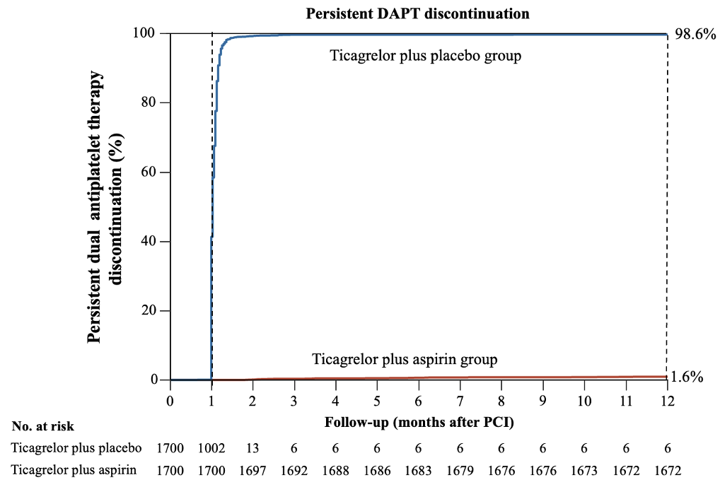
DAPT Adherence During Follow-up
Persistent DAPT discontinuation was defined as permanent discontinuation of either aspirin as dictated by the study protocol or non-directed discontinuation of either aspirin or ticagrelor for >60 days.
During FU a reduction in ticagrelor from 90 mg to 60 mg bid was required in 12 pts (0.7%) treated with ticagrelor plus placebo and 16 pts (0.9%) treated with ticagrelor plus aspirin. Conversion from ticagrelor to clopidogrel was required in 22 (1.3%) and 19 (1.1%) pts respectively. Unblinding was required during follow-up in 39 pts (1.1%) who had a BARC 3 or 5 bleed (11 in the ticagrelor alone group and 28 in the ticagrelor plus aspirin group) and in 8 pts (0.2%) who had a stent thrombosis (3 in the ticagrelor alone group and 5 in the ticagrelor plus aspirin group).

Slide 14
Primary Effectiveness Endpoint: BARC types 2, 3 or 5 bleeding
10
Ticagrelor plus Aspirin
Ticagrelor plus Placebo
8
HR 0.45; 95% CI 0.30 to 0.66
P<0.0001
6
Clinically-relevant bleeding (%)
(BARC types 2, 3, or 5)
4.6%
4
2.1%
2
0
0
60
120
180
240
300
330
Number at risk (number censored):
Follow-up (days after 2nd randomization)
Ticagrelor plus Aspirin
1700 (0)
1681 (1)
1664 (2)
1652 (1)
1634 (3)
1622 (2)
1615 (2)
Ticagrelor plus Placebo
1700 (0)
1688 (2)
1684 (2)
1676 (2)
1665 (2)
1657 (3)
1654 (3)

Slide 15
Bleeding Endpoints
Between 1- and 12-months post-PCI | Ticagrelor plus placebo (N = 1700) | Ticagrelor plus aspirin (N = 1700) | Hazard ratio (95% CI) | P-value
Primary endpoint: Clinically-relevant bleeding (BARC types 2, 3, or 5) | 35 (2.1%) | 78 (4.6%) | 0.45 (0.30 – 0.66) | <0.0001
Major bleeding
BARC types 3 or 5 | 11 (0.7%) | 28 (1.7%) | 0.39 (0.19 – 0.79) | 0.009
TIMI major or minor | 11 (0.7%) | 27 (1.6%) | 0.41 (0.20 – 0.82) | 0.01
Major | 8 (0.5%) | 19 (1.1%) | 0.42 (0.18 – 0.96) | 0.04
Minor | 3 (0.2%) | 8 (0.5%) | 0.39 (0.10 – 1.46) | 0.16
GUSTO moderate, severe or life-threatening | 8 (0.5%) | 19 (1.1%) | 0.42 (0.18 – 0.96) | 0.04
Moderate | 3 (0.2%) | 10 (0.6%) | 0.30 (0.08 – 1.10) | 0.07
Severe or life-threatening | 5 (0.3%) | 9 (0.5%) | 0.56 (0.19 – 1.66) | 0.29
ISTH major bleeding | 8 (0.5%) | 21 (1.2%) | 0.38 (0.17 – 0.86) | 0.02
BARC types 1-5
1 | 8 (0.5%) | 12 (0.7%) | 0.67 (0.27 – 1.63) | 0.37
2 | 24 (1.4%) | 50 (2.9%) | 0.48 (0.29 – 0.78) | 0.003
3 | 10 (0.6%) | 24 (1.4%) | 0.42 (0.20 – 0.88) | 0.02
5 | 1 (0.1%) | 4 (0.2%) | 0.25 (0.03 – 1.98) | 0.20

Slide 16
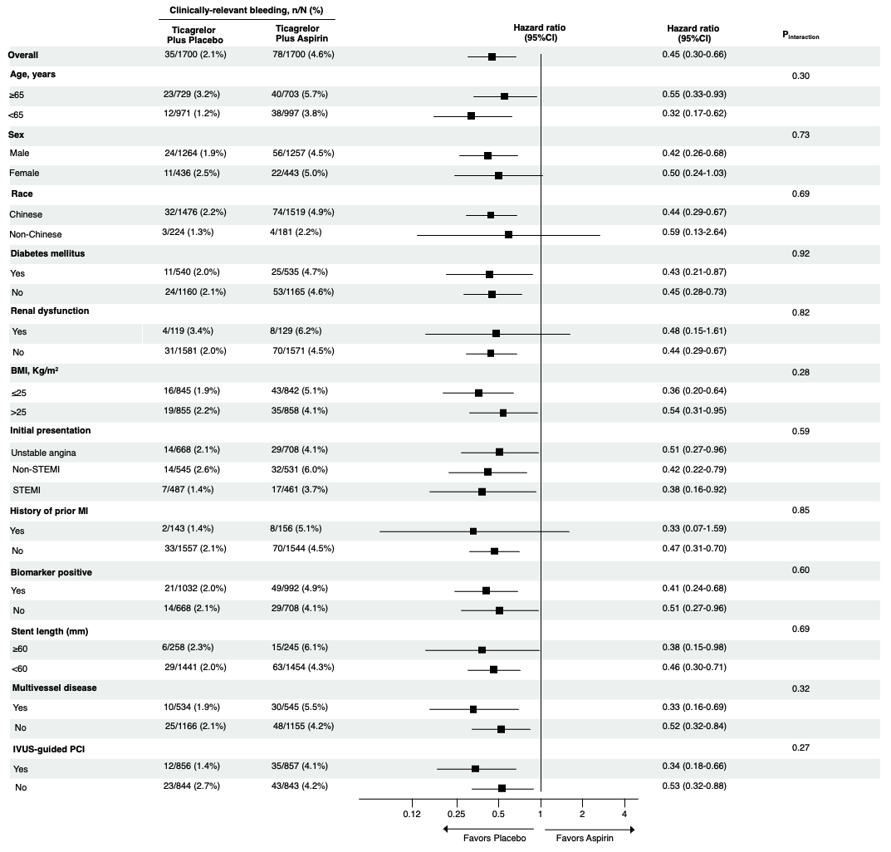
Clinically-Relevant Bleeding (BARC types 2, 3, 5)
- Subgroup analysis -
No significant interactions were present in 12 pre-specified subgroups

Slide 17
Primary Safety Endpoint: MACCE
10
Ticagrelor plus Aspirin
Ticagrelor plus Placebo
8
MACCE (%)
Cardiac death, MI, ischemic
stroke, definite stent thrombosis,
or clinically-driven TVR
Absolute difference -0.1%; 95% CI -1.4% to 1.2%
HR 0.98; 95% CI 0.69 to 1.39
P_{noninferiority} <0.0001, P_{superiority}=0.89
6
4
3.7%
3.6%
2
0
0
60
120
180
240
300
330
Number at risk (number censored):
Follow-up (days after 2nd randomization)
Ticagrelor plus Aspirin
1693 (0)
1669 (2)
1659 (2)
1700 (0)
1684 (1)
1648 (2)
1636 (2)
Ticagrelor plus Placebo
1700 (0)
1690 (0)
1684 (0)
1673 (1)
1664 (1)
1652 (2)
1640 (2)

Slide 18
MACCE and NACE Endpoints
Between 1- and 12-months post-PCI | Ticagrelor plus placebo (N = 1700) | Ticagrelor plus aspirin (N = 1700) | Hazard ratio (95% CI) | P-value
Primary endpoint: MACCE | 61 (3.6%) | 63 (3.7%) | 0.98 (0.69 – 1.39) | 0.89
Secondary endpoints
All-cause death | 12 (0.7%) | 13 (0.8%) | 0.93 (0.42 – 2.03) | 0.84
Cardiac death | 8 (0.5%) | 7 (0.4%) | 1.15 (0.42 – 3.18) | 0.46
Stroke | 20 (1.2%) | 24 (1.4%) | 0.83 (0.46 – 1.50) | 0.54
Myocardial infarction | 17 (1.0%) | 11 (0.7%) | 1.45 (0.67 – 3.23) | 0.27
Procedural MI | 1 (0.05%) | 1 (0.05%) | - | 0.88
Non-procedural MI | 16 (0.9%) | 11 (0.7%) | 1.42 (0.66 – 3.03) | 0.29
Repeat revascularization | 40 (2.4%) | 41 (2.4%) | 0.99 (0.64 – 1.53) | 0.95
TVR | 33 (2.0%) | 36 (2.1%) | 0.93 (0.58 – 1.49) | 0.75
TLR | 27 (1.6%) | 28 (1.7%) | 0.97 (0.57 – 1.65) | 0.92
Stent thrombosis, definite or probable | 5 (0.3%) | 5 (0.3%) | 0.97 (0.28 – 3.40) | 0.96
Definite | 3 (0.2%) | 5 (0.3%) | 0.59 (0.14 – 2.51) | 0.47
Probable | 2 (0.1%) | 0 (0.0%) | - | -
Net adverse clinical events (NACE): MACCE or BARC types 1-5 bleeding | 97 (5.7%) | 140 (8.2%) | 0.68 (0.53 – 0.88) | 0.007

Slide 19
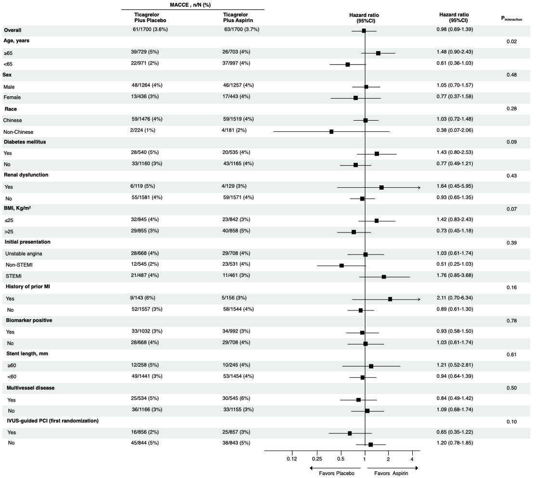
MACCE
- Subgroup analysis -
No significant interactions were present in 12 pre-specified subgroups, except possibly for age

Slide 20
Limitations
The primary efficacy endpoint included minor bleeding (BARC type 2)
However, major bleeding was also significantly reduced with ticagrelor monotherapy (BARC types 3 or 5, TIMI major or minor, GUSTO and ISTH)
Non-inferiority for MACCE was tested with an absolute margin of 2.5%. Given the lower observed ischemic event rate in the control group than anticipated (3.7% vs. 6.2%), this relative margin is wide
Given the 95% CI of the observed difference, it is likely that the absolute MACCE rate with ticagrelor monotherapy is <1.2% greater than with ticagrelor + aspirin
~40% of pts had biomarker-negative unstable angina
hs-troponin assays were not widely available in China and Pakistan during the enrollment period, and it is likely that many of these pts had NSTEMI
88.1% of pts were from China, possibly affecting the generalizability of the results

Slide 21
Conclusions and Clinical Implications
The present results demonstrate that in pts with ACS treated with PCI with contemporary DES who are free from major adverse ischemic and bleeding events after 1 month on DAPT, treatment with ticagrelor alone between 1 and 12 months will decrease clinically-relevant and major bleeding while providing similar protection from MACCE compared with ticagrelor plus aspirin
These results, in concert with prior trials, warrant updating the guidelines and change in practice to treat most pts with ACS after PCI with 1-month DAPT only followed by conversion to SAPT with a potent P2Y₁₂ inhibitor (with the strongest evidence to date supporting ticagrelor)

Slide 22
The ULTIMATE-DAPT trial is now published in The Lancet
April 7, 2024
[link placeholder]
[QR code placeholder]

