Slide 1
A Double-blind, Randomized Placebo-Procedure-Controlled Trial of an Interatrial Shunt In Patients with HFrEF and HFpEF: Principal Results from the RELIEVE-HF Trial
Gregg W Stone MD
for the RELIEVE-HF study group
@GreggWStone

Slide 2
Background
Heart failure (HF) is characterized by increased left atrial pressure and pulmonary venous congestion
Left atrial pressure rises with exercise and fluid overload and may be difficult to regulate pharmacologically
An inter-atrial shunt (IAS) may provide an autoregulatory mechanism to decrease left atrial pressure and improve HF symptoms and prognosis
In pilot studies, the Ventura IAS (V-Wave Ltd.) reduced filling pressures, improved cardiac structure and function, and provided symptomatic relief and functional improvement in patients with HFrEF and HFpEF

Slide 3
Objectives and Trial Design
We therefore sought to determine the safety and effectiveness of the V-Wave Ventura IAS device in symptomatic HF patients with any LVEF in a randomised, double-blind, placebo-procedure-controlled, multicenter trial
Given uncertainty as to whether the response to an IAS would vary according to systolic function, stratified randomizations were performed in patients with reduced (≤40%) and preserved (>40%) LVEF

Slide 4
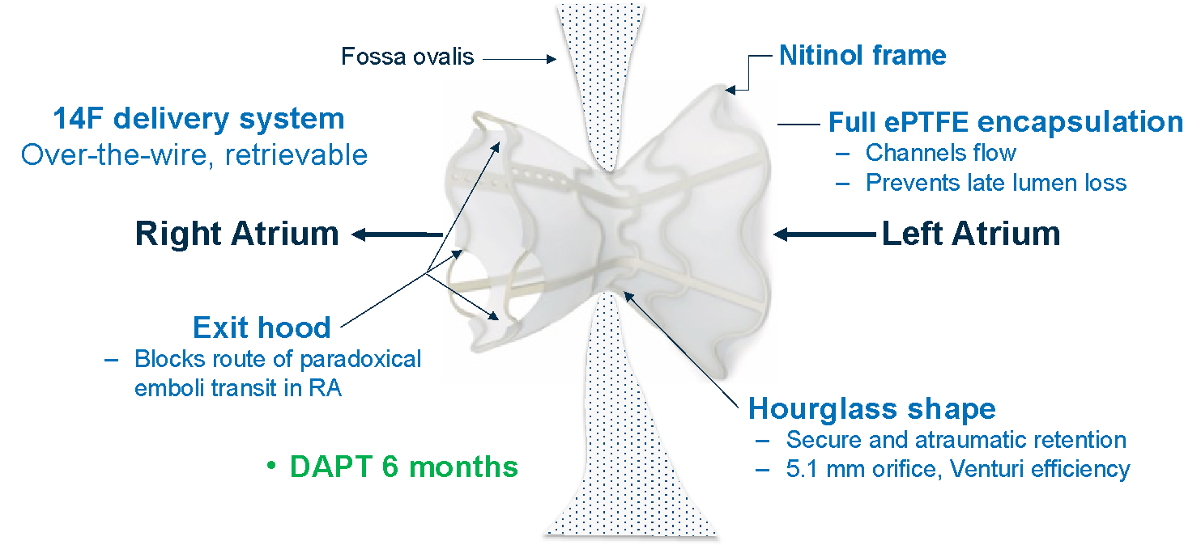
V-Wave Ventura Inter-atrial Shunt
Length: 12mm; LA diameter: 14mm; RA diameter: 11mm;
Neck diameter: 5.1mm; Qp/Qs: approximately 1.2:1

Slide 5
Key Inclusion Criteria
Ischemic or non-ischemic cardiomyopathy with any LVEF and documented HF for at least 6 months
NYHA class II, III, or ambulatory IV functional class despite maximally-tolerated class I GDMT and cardiac rhythm management device therapy for HF as assessed by a central eligibility committee
HF hospitalization within the prior 12 months and/or an elevated (BMI-adjusted) BNP/NT-proBNP (both required for NYHA II)
6MWT ≥100 meters - ≤450 meters
Written, informed consent

Slide 6
Key Clinical Exclusion Criteria
Resting SBP <90 or >160 mmHg or intractable HF
Severe pulmonary hypertension defined as PASP >70 mmHg by echo/Doppler or PVR >4.0 WU on RHC that cannot be reduced by vasodilator therapy
RV dysfunction defined as TAPSE <12 mm or RVFAC ≤25% on TTE
LVEDD >8 cm on TTE
ASD, PFO, APVR, corrected CHD, severe valve lesions
Transseptal procedure for another indication planned within 6 months

Slide 7
Final Key Exclusion Criteria After RHC and TEE/ICE
- performed just prior to randomization -
Anatomical anomaly that precludes implanting the IAS across the fossa ovalis (FO) including: Minimal FO thickness >6 mm or length <10 mm; ASD or PFO with >trace shunting; atrial septal aneurysm; intracardiac thrombus
Hemodynamic, heart rhythm, or respiratory instability including: Mean PCWP <7 mmHg or >35 mmHg; RAP ≥ LAP (or PCWP) when LAP (PCWP) is ≥7 mmHg; CI <1.5 L/min/m²; severe pulmonary HTN as previously defined, SBP <90 or >160 mmHg; need for IV vasopressor or inotrope medication; malignant arrhythmias; acute respiratory distress or hypoxemia

Slide 8
RELIEVE-HF Primary Effectiveness Endpoint
Comparison between groups of the hierarchical composite ranking of:
All-cause death
Cardiac transplantation or left ventricular assist device (LVAD) implantation
All HF hospitalizations
All outpatient worsening HF events
Change in KCCQ-OS from baseline to 12 months (5-point minimum difference)
Analyzed by the Finkelstein-Schoenfeld method when the last enrolled patient reaches 12 months with longest FU to 24 months, expressed as the win ratio
A single interim analysis of the primary effectiveness outcome with adaptive sample size re-estimation by an independent third party was planned when 200 enrolled patients completed 6-month follow-up. To prevent inflation of type-1 error the final FS statistic is derived from data weighted differently before and after the interim analysis.*
*Cui L, Hung HMJ, Wang S-J. Biometrics 1999;55:853-857

Slide 9
RELIEVE-HF Primary Safety Endpoint
Device-related or procedure-related MACNE (all-cause death, stroke, systemic embolism or need for open cardiac surgery or major endovascular surgical repair) at 30 days in the IAS group, compared against an OPC of 11%
Numerous additional secondary safety and effectiveness endpoints were pre-specified
All primary and secondary endpoints will be tested in the randomized strata of patients with reduced and preserved LVEF

Slide 10
Study Leadership and Organization
Principal investigators: Stefan D. Anker, JoAnn Lindenfeld, Josep Rodés-Cabau, Gregg W. Stone
Executive Committee: PIs + Michael Zile, Saibal Kar, John Gorcsan, Rich Holcomb, William T. Abraham
Steering Committee: EC + Maria Rosa Costanzo, Antoni Bayes-Genis, Jeroen Bax, Alan Bank, Stefan Verheye, Ariel Roguin, Gerasimos Filippatos, Stephan von Bardeleben, Raj Makkar, Tom McRae, Wayne Batchelor, Frank Ruschitzka, Berkert Pieske
Central Eligibility Committee: Michael Zile (moderator), JoAnn Lindenfeld, Jeroen Bax, Alan Bank, Maria Rosa Costanzo, Gregg W. Stone, Josep Rodes-Cabau, Ariel Roguin, Stefan Verheye
Echocardiographic Core Laboratory: Penn State Health-Milton S. Hershey Medical Center: Michael P. Pfeiffer (director), 1/26/21-current; Washington University: John Gorcsan (director), 2/24/18-1/26/21
Clinical Endpoints Committee: Cardiovascular Research Foundation (CRF); Marrick Kukin (chair)
Data Safety Monitoring Board: CRF; Bernard Gersh (chair)
Data management and biostatistics: CRF; Ovidiu Dressler and Yiran Zhang
Site management and data monitoring: V-Wave Ltd.
Sponsor and funding: V-Wave Ltd.

Slide 11
Patient Flow
1136 patients were screened for enrollment at 113 sites in 11 countries (USA, Canada, Israel, Germany, Spain, Switzerland, Belgium, Poland, The Netherlands, Australia, and New Zealand
Roll-in cases
N=97
Shunt implanted
0 Lost-to-FU
0 Withdrew
0 Lost-to-FU
1 Withdrew
0 Lost-to-FU
1 Withdrew
Inter-atrial shunt
N=250
N=250/250 (100%)
N=249/250 (99.6%)
N=150/151 (99.3%)
Randomized
N=508 at 94 sites
between Oct 24, 2018 and Oct 19, 2022
Enrolled
N=605 at 101 sites
Randomized 1:1
Stratified by core lab LVEF ≤40% vs. >40% and site
12-mo FU
(primary endpoint minimum)
24-mo FU
(eligible pts)
30-d FU
Placebo-procedure
N=258
N=258/258 (100%)
N=256/258 (99.2%)
N=133/137 (97.1%)
Ineligible
N= 531
All inclusion criteria not met (n=212)
Exclusion criteria present (n=182)
Not approved by eligibility committee (n=17)
Failed final eligibility assessment in the cath lab (n= 60)
Withdrew consent during screening (n=33)
Incomplete screening or other (n= 24)
Death during screening (n=3)
Patients and all post-cath lab personnel were blinded
0 Lost-to-FU
0 Withdrew
0 Lost-to-FU
2 Withdrew
0 Lost-to-FU
4 Withdrew
Post-procedure patients not on OAC were treated with open-label aspirin (75-100 mg per day) for 2 years + study drug clopidogrel (75 mg per day in the IAS group vs. matching placebo in the control group) for 6 months
Median follow-up 22.0 (13.3, 23.9) months

Slide 12
Top 12 Randomizing Sites
PI | Hospital, City, State, Country | N randomized
Julio Núñez | Hospital Clínico Universitario, INCLIVA, University of Valencia, Valencia, Spain | 32
Josep Rodés-Cabau | Institut universitaire de cardiologie et de pneumologie de Québec - Université Laval, Quebec City, Quebec, Canada | 25
Elizabeth Lee | Rochester General Health System, Rochester, NY, US | 23
Antoni Bayes‐Genis | Hospital Universitari Germans Trias and Pujol de Badalona, Barcelona, Spain | 19
Michal Laufer-Perl | Tel Aviv Sourasky Medical Center, affiliated with the Tel Aviv School of Medicine, Tel Aviv University, Tel Aviv, Israel | 18
Gil Moravsky | Assaf HaRofeh Medical Center, Beer Yaakov, Israel | 17
Sheldon Litwin | Medical University of South Carolina, Charleston, South Carolina, US | 15
Hemal Gada | UPMC Pinnacle / Pinnacle Health Cardiovascular Institute, Harrisburg, PA, US | 14
Edgard Prihadi | Antwerp Cardiovascular Center, ZNA Middelheim Hospital, Antwerpen, Belgium | 13
Dimitry Schewel | Marienkrankrankenhas, Hamburg, Germany | 12
Eugene Chung | Lindner Center for Research and Education at The Christ Hospital, Cincinnati, OH, US | 12
Matthew Price | Scripps Clinic, La Jolla, CA, US | 12

Slide 13
Baseline Characteristics (1)
 | Shunt group (N=250) | Placebo group (N=258)
Age, years | 74.0 (67.0, 79.0) | 72.0 (65.0, 78.0)
Sex, male | 162 (64.8%) | 157 (60.9%)
Body mass index, kg/m² | 30.0 (25.6, 34.9) | 30.3 (26.2, 36.0)
Diabetes mellitus | 124 (49.6%) | 125 (48.4%)
Hypertension | 209 (83.6%) | 216 (83.7%)
Hyperlipidemia | 201 (80.4%) | 195 (75.6%)
Current or previous smoker | 133 (53.2%) | 137 (53.1%)
Prior stroke or TIA | 43 (17.2%) | 48 (18.6%)
COPD | 43 (17.2%) | 52 (20.2%)
Ischemic cardiomyopathy | 114 (45.6%) | 120 (46.5%)
Non-ischemic cardiomyopathy | 136 (54.4%) | 138 (53.5%)
At least one HFH in the prior year | 128 (51.2%) | 127 (49.2%)
Known CAD | 169 (67.6%) | 160 (62.0%)
Prior MI | 104 (41.6%) | 103 (39.9%)
Prior PCI | 103 (41.2%) | 96 (37.2%)
Prior CABG | 65 (26.0%) | 58 (22.5%)

Slide 14
Baseline Characteristics (2)
 | Shunt group (N=250) | Placebo group (N=258)
History of atrial fibrillation or flutter | 170 (60.8%) | 159 (61.2%)
- Baseline rhythm is atrial fib or flutter | 76 (30.4%) | 64 (24.8%)
ICD or CRT-D | 115 (46.0%) | 123 (47.7%)
CRT-D or CRT-P | 70 (28.0%) | 59 (22.9%)
NYHA class II | 9 (3.6%) | 7 (2.7%)
NYHA class III | 239 (95.6%) | 251 (97.3%)
NYHA class IV | 2 (0.8%) | 0 (0.0%)
KCCQ overall summary score | 52.1 (35.4, 66.9) | 50.8 (34.6, 66.4)
Six-minute walk distance, m | 264.8 (195.5, 325.0) | 270.9 (198.0, 330.0)
LVEF (biplane, core lab assessment), % | 45.4 (33.4, 58.9) | 45.3 (33.3, 57.4)
- ≤40% (reduced LVEF) | 101/250 (40.4%) | 105/258 (40.7%)
- >40% (preserved LVEF) | 149/250 (59.6%) | 153/258 (59.3%)
BNP (pg/mL) | 237.9 (117.2, 412.5) | 221.0 (101.0, 518.3)
NT-proBNP(pg/mL) | 1939.4 (1066.0, 3259.0) | 1596.6 (852.0, 2868.1)
eGFR, mL/min/1.73 m² | 45.5 (37.5, 59.8) | 48.5 (37.2, 60.8)
- <60 mL/min/1.73 m² | 188 (75.2%) | 188 (72.9%)

Slide 15
Baseline TTE (core-lab)
 | Shunt group (N=250) | Placebo group (N=258)
LVEDV (biplane), mL | 123.3 (87.0, 175.5) | 126.0 (96.0, 181.5)
LVESV (biplane), mL | 66.3 (37.5, 115.5) | 70.0 (40.5, 117.0)
LAV (biplane), mL | 78.5 (63.5, 103.0) | 76.0 (59.5, 101.0)
SV, mL | 54.0 (41.0, 67.0) | 54.0 (44.0, 67.0)
SVI, mL/m² | 26.7 (21.7, 31.9) | 27.5 (21.8, 33.0)
CO, L/min | 3.7 (2.9, 4.6) | 3.8 (3.1, 4.7)
CI, L/min/m² | 1.8 (1.5, 2.2) | 1.9 (1.5, 2.3)
RV FAC, % | 37.7 (33.3, 42.9) | 37.5 (33.3, 42.9)
TAPSE, mm | 16.5 (14.0, 20.0) | 17.0 (14.0, 19.0)
PASP, mmHg | 32.0 (24.0, 41.0) | 32.0 (25.0, 40.0)
RVEDAI, cm²/m² | 9.8 (8.2, 11.9) | 10.4 (8.4, 12.4)
IVC diameter max, cm | 1.6 (1.2, 2.0) | 1.6 (1.2, 1.9)
MR moderate or greater | 49 (19.6%) | 38 (14.7%)
TR moderate or greater | 50/247 (20.2%) | 45/257 (17.5%)

Slide 16
Baseline Right Heart Catheterization
 | Shunt group (N=250) | Placebo group (N=258)
HR, bpm | 67.0 (60.0, 75.0) | 68.0 (60.0, 77.0)
SBP, mmHg | 116.0 (104.0, 133.0) | 115.0 (103.0, 134.0)
DBP, mmHg | 64.0 (57.0, 73.0) | 65.0 (59.0, 73.0)
Mean RAP, mmHg | 9.0 (6.0, 12.0) | 9.0 (6.0, 11.0)
Systolic PAP, mmHg | 37.0 (30.0, 45.0) | 37.0 (31.0, 44.0)
Mean PAP, mmHg | 25.0 (21.0, 31.0) | 25.0 (20.0, 30.0)
PVR, WU | 2.1 (1.5, 3.1) | 2.0 (1.4, 2.8)
PCWP, mmHg | 15.5 (12.0, 20.0) | 16.0 (12.0, 21.0)
CO, L/min | 4.2 (3.4, 5.3) | 4.3 (3.6, 5.3)
CI, L/min/m² | 2.1 (1.8, 2.6) | 2.2 (1.8, 2.6)

Slide 17
Procedural Details
 | Shunt group (N=250) | Placebo group (N=258) | Difference [95% CI]
Procedure duration, minutes | 80 (59, 100) | 43 (30, 55) | 35.5 [31.0, 40.0]
Fluoroscopy time, minutes | 14 (10, 21) | 4 (2, 7) | 9.9 [8.9, 10.9]
Contrast administered, mL | 0.0 (0.0, 0.0) | 0.0 (0.0, 0.0) | 0.0 (0.0, 0.0)
Heparin administered, units | 9000 (7000, 12,000) | - | -
Activated clotting time, secs | 291 (246, 342) | - | -
Shunt implant attempt | 250 (100%) | 1 (0.4%)* | -
- Shunt implanted successfully | 250 (100%) | 1 (0.4%) | -
Hospital duration post procedure, days | 1 (1, 1) | 1 (1, 1) | 0.0 [0.0, 0.0]
*Site randomization error

Slide 18
RELIEVE-HF Primary Safety Endpoint
Device-related or procedure-related MACNE (all-cause death, stroke, systemic embolism or need for open cardiac surgery or major endovascular surgical repair) at 30 days in the IAS group, compared against an OPC of 11%
Within 30 days, MACNE occurred in 0 (0.0%) of 250 patients in the IAS group (upper 1-sided 97.5% CL = 1.5%),
which is below the 11% performance goal, P<0.0001 using an exact binomial test
MACNE occurred in 0 (0.0%) IAS-treated patients through 2-year FU

Slide 19
RELIEVE-HF Primary Effectiveness Endpoint
Shunt group
N = 250
Patient pairs
N = 64,500
Placebo group
N = 258
Shunt group outcomes
Wins
Ties
Losses
% of decisions
Level 1: All-cause death
5424
51,461
7615
21.4%
Level 2: Cardiac transplantation or LVAD implantation
1177
50,122
162
2.2%
Level 3: Heart failure hospitalizations
9264
30,271
10,587
32.5%
Level 4: Out-patient worsening heart failure events
3921
22,488
3862
12.8%
Level 5: Change in KCCQ from
baseline by at least 5 points
8876
3533
10,079
31.1%
Total wins = 28,662, total losses = 32,305
Win ratio (unweighted) = 28,662/32,305 = 0.89 (0.72, 1.09)
Win ratio (phase weighted for interim analysis) = 0.86 (0.61, 1.22); p=0.20

Slide 20
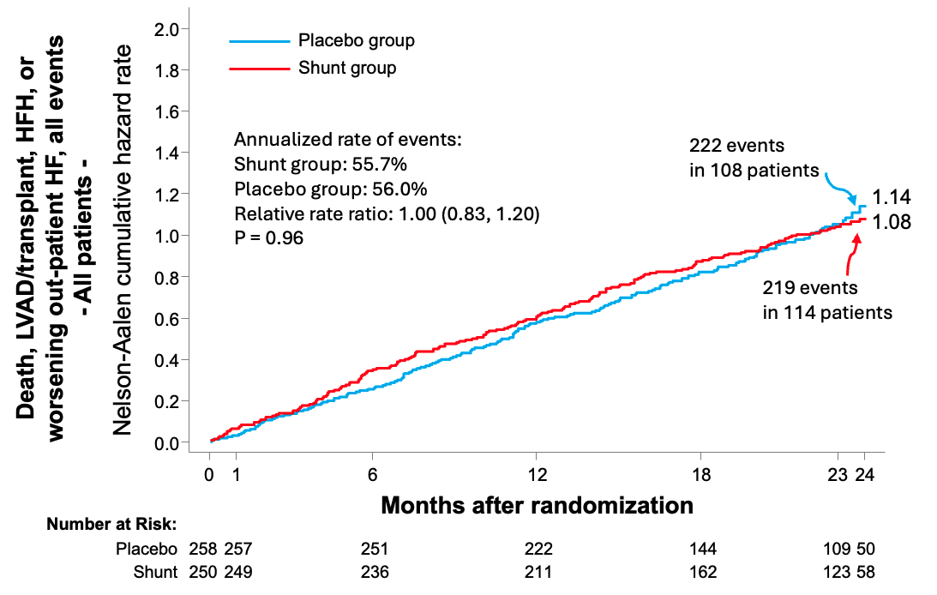
Risk of all Cardiovascular Events
- All-cause death, LVAD/HT, all HFHs, and all out-patient worsening HF events -

Slide 21
Risk of all Cardiovascular Events
- All-cause death, LVAD/HT, all HFHs, and all out-patient worsening HF events -
2-year rates | Shunt group (N=101) | Placebo group (N=108) | RR or HR (95% CI) | P-value
All events¹ | 219/392.7 (55.7%/year) | 222/396.1 (56.0%/year) | 1.00 (0.83, 1.20) | 0.96
All-cause death² | 35 (15.6%) | 27 (13.7%) | 1.31 [0.79, 2.16] | 0.30
LVAD/HT² | 2 (0.8%) | 2 (1.1%) | 1.01 [0.14, 7.14] | 1.00
All HFHs^{1,3} | 128/392.7 (32.6%/year) | 125/396.1 (31.6%/year) | 1.09 [0.79, 1.50] | 0.60
All out-pt WHFs^{1,3} | 55/392.7 (14.0%/year) | 64/396.1 (16.2%/year) | 0.88 [0.61, 1.26] | 0.48
¹Total no. of events/total no. of patient-years of follow-up (annualized rate) with relative rate ratio (95% CI)
²Time-to-first event analysis – n events (Kaplan-Meier estimated rate) with HR (95% CI) from a Cox model
³HR (95% CI) from a joint frailty model accounting for the competing risk of death

Slide 22
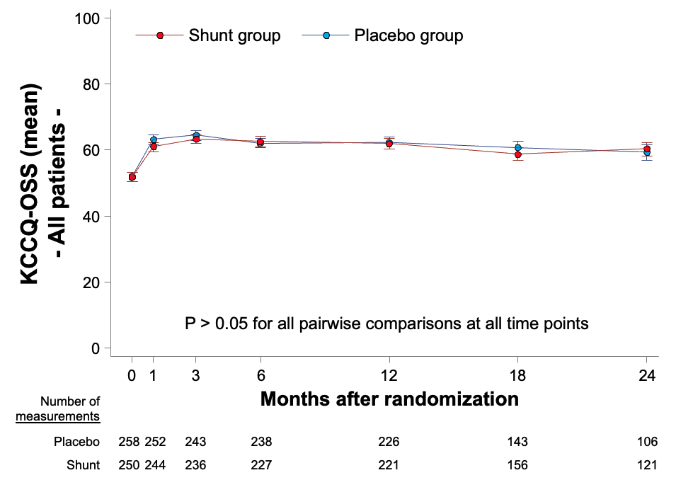
Change in KCCQ-OSS Over Time
Change from baseline through 1 year
9.4 ± 21.6 vs. 10.2 ± 21.3, P=0.74

Slide 23
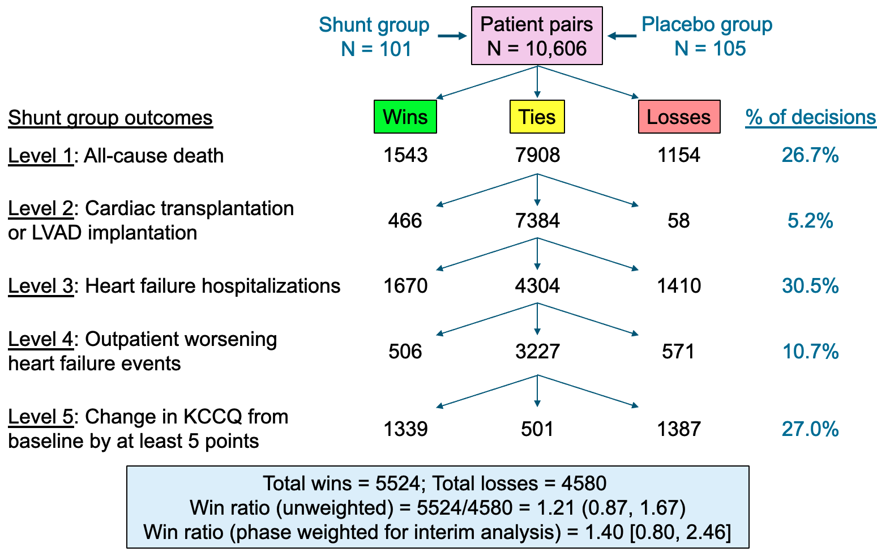
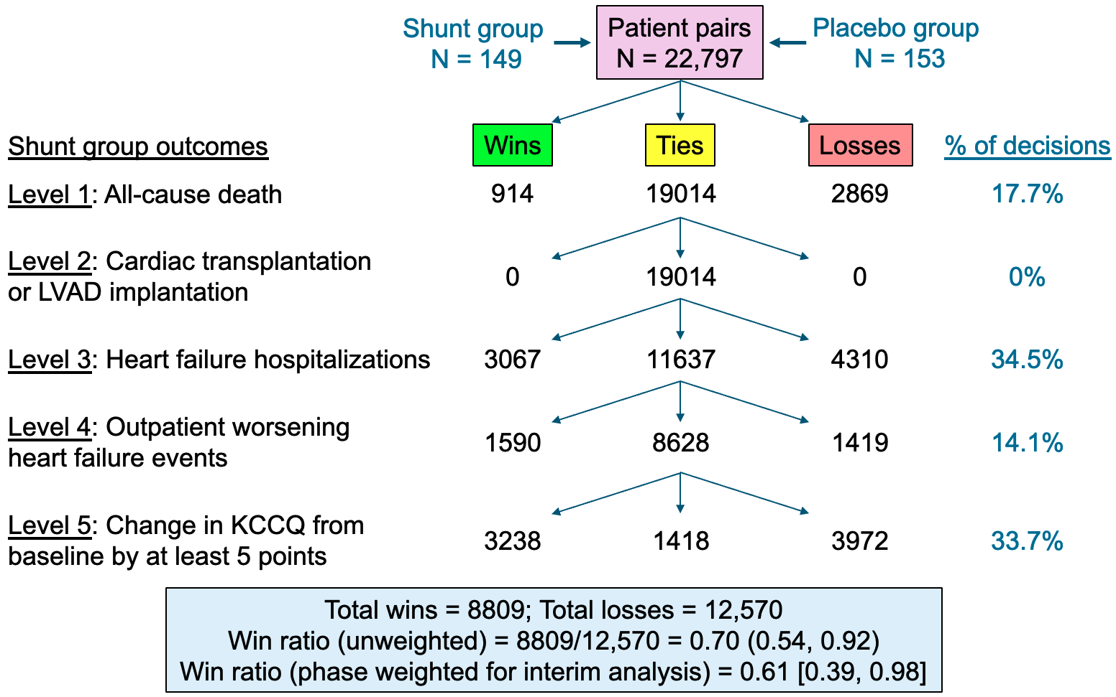
Primary Effectiveness Outcome by LVEF
LVEF ≤40% (n=206)
LVEF >40% (n=302)
P_{interaction}=0.0275

Slide 24
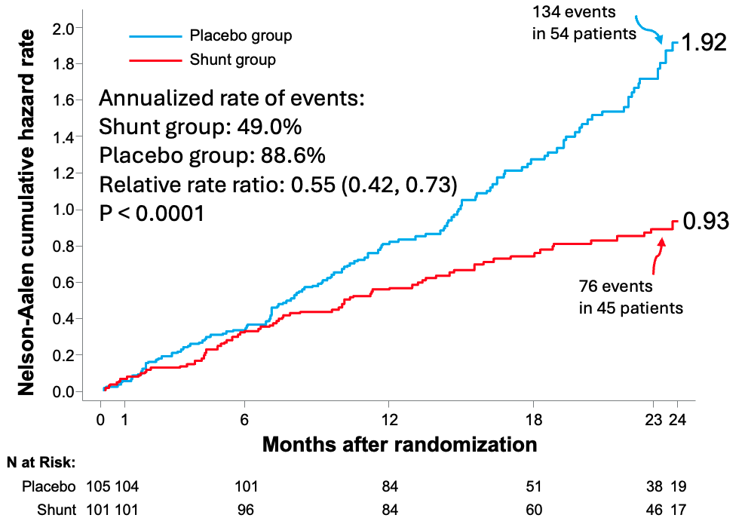
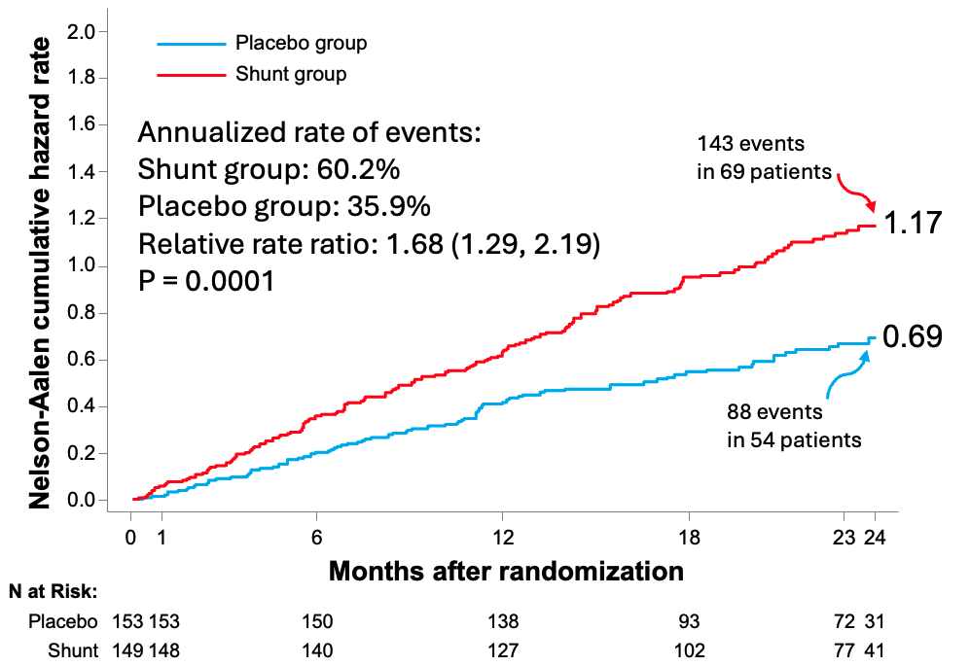
Risk of all Cardiovascular Events by LVEF
- All-cause death, LVAD/HT, all HFHs, and all out-patient worsening HF events -
LVEF ≤40% (n=206)
LVEF >40% (n=302)
P_{interaction}<0.0001

Slide 25
Risk of all Cardiovascular Events by LVEF
- All-cause death, LVAD/HT, all HFHs, and all out-patient worsening HF events -
 | LVEF ≤40% |  |  | LVEF >40%
2-year rates | Shunt group (N=101) | Placebo group (N=108) | RR or HR (95% CI) | Shunt group (N=149) | Placebo group (N=153) | RR or HR (95% CI)
All events¹ | 76/155.2 (49.0%/year) | 134/151.2 (88.6%/year) | 0.55 (0.42, 0.73) P<0.0001 | 143/237.5 (60.2%/year) | 88/2450 (35.9%/year) | 1.68 (1.29, 2.19) P=0.0001
All-cause death² | 13 (14.3%) | 20 (26.8%) | 0.63 [0.31, 1.26] P=0.19 | 22 (16.4%) | 7 (5.2%) | 3.24 [1.38, 7.59] P=0.004
LVAD/HT² | 1 (1.5%) | 6 (9.0%) | 0.16 [0.02, 1.32] P=0.051 | 0 (0.0%) | 0 (0.0%) | -
All HFHs^{1,3} | 41/155.2 (26.0%/year) | 78/151.2 (52.0%/year) | 0.52 [0.31, 0.86] P=0.01 | 87/237.5 (37.0%/year) | 47/245.0 (19.0%/year) | 2.05 [1.35, 3.10] P=0.0008
All out-pt WHFs^{1,3} | 21/155.2 (14.0%/year) | 30/151.2 (20.0%/year) | 0.70 [0.39, 1.23] P=0.21 | 34/237.5 (14.0%/year) | 34/245.0 (14.0%/year) | 1.04 [0.64, 1.68] P=0.88
¹Total no. of events/total no. of patient-years of follow-up (annualized rate) with relative rate ratio (95% CI)
²Time-to-first event analysis – n events (Kaplan-Meier estimated rate) with HR (95% CI) from a Cox model
³HR (95% CI) from a joint frailty model accounting for the competing risk of death

Slide 26
Risk of Cardiovascular Events by LVEF
 | LVEF ≤40% HR or RRR [95% CI] | LVEF >40% HR or RRR [95% CI] | Hazard ratio or relative rate ratio [95% CI] | P-value for interaction
All-cause death through 2 years, time to first | 0.63 [0.31, 1.26] | 3.24 [1.38, 7.59] |  | 0.0036
HT or LVAD implantation through 2 years, time to first | 0.16 [0.02. 1.32] | - |  | -
Heart failure hospitalizations (HFHs), all through 2 years – no. of events/total no. of pt-yr (annualized rate), JF model | 0.52 [0.31, 0.86] | 2.05 [1.35, 3.10] |  | <0.0001
Outpatient worsening HF events, all through 2 years – no. of events/total no. of pt-yr (annualized rate), JF model | 0.70 [0.39, 1.23] | 1.04 [0.64, 1.68] |  | 0.27
All-cause death or HT or LVAD implantation through 2 years, time to first | 0.52 [0.27, 1.00] | 3.24 [1.38, 7.59] |  | 0.0008
All-cause death, HT or LVAD, and HFHs, all events through 2 years – no. of events/total no. of patient-yr-yr (annualized rate) | 0.52 [0.37, 0.71]* | 2.08 [1.50, 2.88]* |  | <0.0001
All-cause death, HT or LVAD, HFH and outpatient worsening HF events, all through 2 years – no. of events/total no. of patient-yr (annualized rate) | 0.55 [0.42, 0.73]* | 1.68 [1.29, 2.19]* |  | <0.0001
*RRR (otherwise HR)

Slide 27
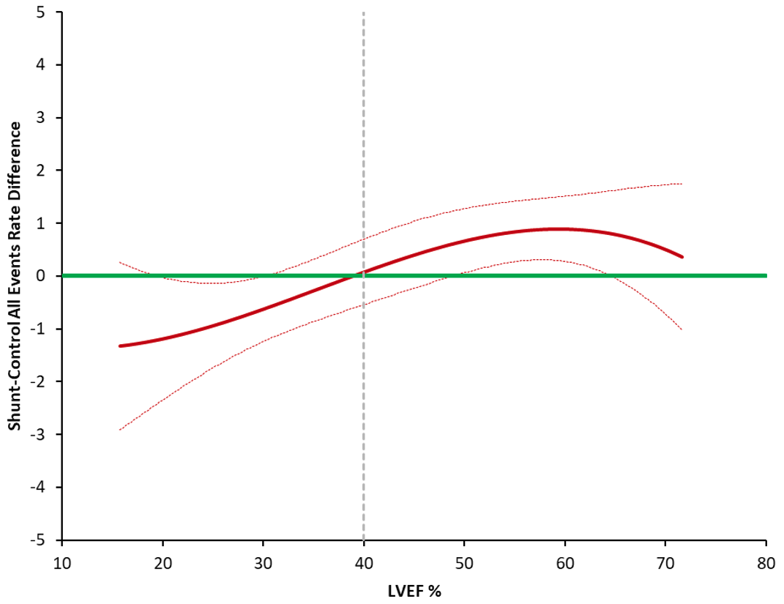
Risk of all Cardiovascular Events by LVEF
- All-cause death, LVAD/HT, all HFHs, and all out-patient worsening HF events -
Shunt minus control arm
event rate difference
LVEF (%)

Slide 28
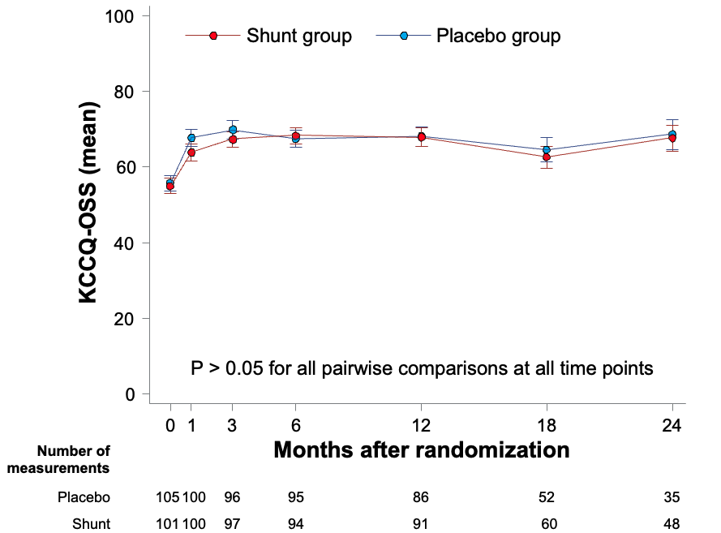
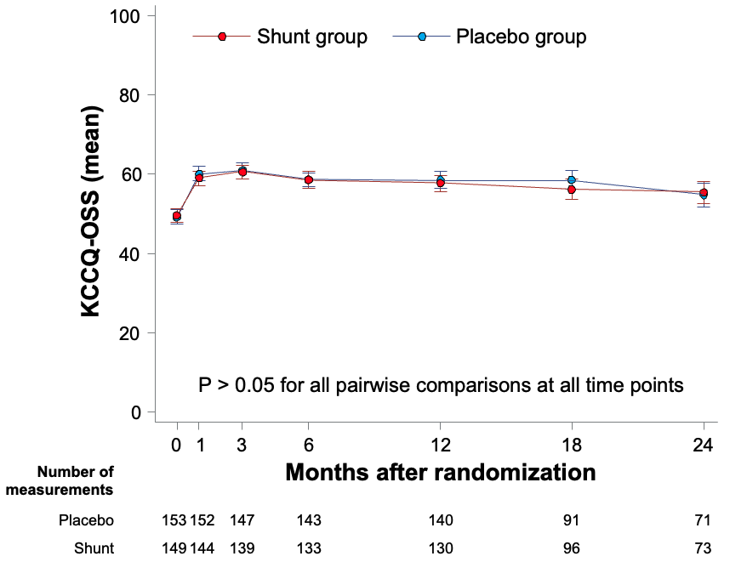
Change in KCCQ-OSS Over Time by LVEF
LVEF ≤40% (n=206)
LVEF >40% (n=302)
Change from baseline through 1 year
12.2 ± 20.5 vs. 11.4 ± 20.5, P=0.89
Change from baseline through 1 year
7.4 ± 22.1 vs. 9.4 ± 21.8, P=0.51

Slide 29
Limitations
The present results apply only to the profile of the pts enrolled and treated with the Ventura inter-atrial shunt
The reduced and preserved LVEF groups, although pre-specified randomized strata, were not individually powered for effectiveness; the results within each strata must therefore be considered exploratory
However, the strong interaction (P<0.0001) and spline curve analysis for cardiovascular events suggests these findings are not due to play of chance
The large and similar increase in KCCQ-OSS in both the device and control groups emphasizes the relevance of the placebo effect and the necessity for blinded trials
Moreover, the similar magnitude of KCCQ-OSS improvement and the lack of between-group differences in this metric despite a large decrease in HFHs in shunt-treated pts with reduced LVEF and a large increase in HFHs and mortality in shunt-treated pts with preserved LVEF confounds its interpretation in blinded (and open-label) trials

Slide 30
Conclusions
Transcatheter implantation of the Ventura inter-atrial shunt was safe but did not reduce symptoms or improve prognosis through 2 years in patients with HF across the full range of all LVEF
The results from a pre-specified stratified analysis suggest that inter-atrial shunt implantation is beneficial in patients with reduced LVEF and harmful in patients with preserved LVEF

