Slide 1
Self-Expanding Versus Balloon-Expandable TAVR in Patients with Aortic Stenosis and Small Aortic Annuli
SMART
Small Annuli Randomized
to Evolut or SAPIEN
Primary Outcomes from the Randomized SMART Trial
Howard C. Herrmann, MD Roxana Mehran, MD Didier Tchétché, MD on behalf of the SMART Trial Investigators

Slide 2
Disclosure of relevant financial relationships
Within the past 12 months, I or my spouse/partner have had a financial interest/arrangement
or affiliation with the organization(s) listed below:
Financial Relationship | Company
Institutional grants/research support | Abbott Vascular, Boston Scientific, Edwards LifeSciences, Medtronic, Highlife Med, Innovalve, Shockwave
Consulting fees/honoraria | Edwards Lifesciences, Johnson & Johnson, Medtronic, Prolifagen, Truffle Capital, Wells Fargo
Shareholder/equity | Microinterventional Devices, Holistick
Editorial | Mass Medical Society

Slide 3
Background
In multiple studies, the supra-annular
self-expanding Evolut valve has been shown to have superior hemodynamic properties compared with the intra-annular balloon-expandable SAPIEN platform.¹
The SMART Trial was designed to compare the performance and safety of the supra-annular, self-expanding Evolut valve (SEV) to the intra-annular, balloon-expandable SAPIEN valve (BEV) in TAVR patients with severe symptomatic aortic stenosis and a small aortic valve annulus.
Hemodynamic valve performance is linked to long-term outcomes.²
These hemodynamic differences may be particularly important in patients with a small aortic annulus who comprise up to 40% of patients, typically women who are under-represented in clinical trials.³
Compared with men, women with aortic stenosis present differently⁴ and are at greater risk of complications following surgery and TAVR.
1. Abdel-Wahab M, et al. JACC Cardiovasc Interv 2020;13(9):1071-1082. 2. Playford D, et al. J Am Soc Echocardiogr 2020;33(9):1077-1086. 3. Freitas-Ferraz AB, et al. Circulation 2019;139(23):2685-2702. 4. DesJardin JT, et al. Circulation Research. 2022;130:455–473.
Notes:
Background
TAVR dominant, few trials have compared prostheses
In observational trials, SEV superior hemos to BEV
SAA, up to 1/3 in randomized trials, female preponderance
For these reasons,…
Include references

Slide 4
Trial organization
Executive committee
Independent steering committee
Independent physician case planning committee
Howard Herrmann
Mohammed Abdel-Wahab
Paul Mahoney
Guilherme Attizzani
Roxana Mehran
Roxana Mehran
Guilherme Attizzani
Roxana Mehran
Michael Deeb
Toby Rogers
Didier Tchétché
Wayne Batchelor
Anna Sonia Petronio
Kendra Grubb
Joshua Rovin
Sabine Bleiziffer
Toby Rogers
Philipe Genereux
Didier Tchétché
Hemal Gada
Joshua Rovin
Howard Herrmann
Brian Whisenant
Linda Gillam
Molly Szerlip
Paul Mahoney
Mayra Guerrero
Didier Tchétché
Howard Herrmann
Brian Whisenant
Independent CEC and DSMB
Core laboratories
(blinded to clinical outcomes)
Echocardiography: Mayo Clinic
Statistical analysis
Performed by the sponsor
Angiography: Baim Institute for Clinical Research
Medtronic (Minneapolis, MN)

Slide 5
Global site participation – 83 sites in 13 countries
FINLAND
DENMARK
1
NETHERLANDS
1
CANADA
2
2
5
UNITED KINGDOM
8
GERMANY
3
1
SWITZERLAND
FRANCE
3
UNITED STATES
1
1
53
PORTUGAL
ITALY
SPAIN
2
ISRAEL

Slide 6
Trial design
Prospective, randomized controlled, post-market trial conducted at 83 international sites
All-comer trial with all surgical risk categories including bicuspid patients
Key eligibility
Symptomatic severe AS*
Small aortic annulus (< 430 mm² by MDCT)
Randomization
1:1 stratified by site & sex
SEV (N=355)
Medtronic Evolut PRO/PRO+/FX
BEV (N=361)
Edwards SAPIEN 3/SAPIEN 3 Ultra
716 patients treated
Co-Primary Endpoints at 1 year with planned 5-year follow-up
Co-Primary Endpoint 1: Composite of mortality, disabling stroke, or heart failure rehospitalization through 12 months
Co-Primary Endpoint 2: Bioprosthetic valve dysfunction through 12 months
*AVA ≤1.0 cm² (AVAi ≤0.6 cm²/m²) or mean gradient ≥40 mmHg or max velocity ≥4.0 m/s; 30-day predicted risk of surgical mortality <15% by heart team assessment.

Slide 7
Patient flow
737 Randomized
ITT SEV
N=366
ITT BEV
N=371
10 Exited prior to procedure
1 Net loss to crossovers
[2 SEV to BEV]
[1 BEV to SEV]
11 Exited prior to procedure
[+1 Net gain to crossovers]
[2 SEV to BEV]
[1 BEV to SEV]
AT SEV
N=355
AT BEV
N=361
716 As-Treated
1 Not implanted
4 Crossovers
0 Not implanted
0 Crossovers
Implanted SEV
N=350
Implanted BEV
N=365
715 Implanted
98% completed the 12-month trial visit
Notes:
Exits prior to procedure reasons:
Evolut (n=10) – 1 died, 4 subject withdrew consent, 2 physician decision, 1 screen fail, 2 other reasons
Sapien (n=11) – 0 died, 7 subject withdrew consent, 1 physician decision, 2 screen fail, 1 other reason

Slide 8
Statistical methods
Powered for noninferiority, margin of 8%
Co-primary endpoint #1
Clinical outcome composite through 12 months
As-treated population (1st attempted device)
Mortality
Disabling stroke
K-M estimate with risk difference (90% CI) through 12 months
Heart failure rehospitalization
85% power with 700 patients
Co-primary endpoint #2
Bioprosthetic valve dysfunction through 12 months
Powered for superiority
Hemodynamic structural valve dysfunction:
Mean gradient ≥20 mmHg
Implanted population (final valve received)
Nonstructural valve dysfunction:
Severe PPM (VARC-3), ≥moderate total AR
K-M estimate with risk difference (95% CI) through 12 months
Clinical valve thrombosis (VARC-2)
Endocarditis (Duke criteria)
>99% power with 700 patients
Aortic valve reintervention
Notes:
Methods (3) - endpoints
Powered primary endpoints
Powered secondary endpoints
Non-powered secondary endpoints: device success, DVI, total AR, QOL/KCCQ, D/stroke
Methods (4) - stats
Primary clinical: non-inferiority, 1-sided alpha 0.05, margin 8%, through 12 mos (90% CI)
Primary BVD: superiority, 1-sided alpha 0.25, thru 12 mos (95% CI)
If both primary endpoints met, hierarchical testing powered secondary endpoints in pre-specified order
Sample size 700 pts provide at least 85% power for all hypothesis-tested endpoints

Slide 9
Statistical methods
Hypothesis-tested secondary endpoints
If both primary endpoints were met,
hierarchical testing of secondary endpoints occurred in a prespecified order.
1
Hemodynamic mean gradient at 12 months
2
Effective orifice area at 12 months
Hemodynamic SVD (mean gradient ≥20 mmHg) through 12 months
3
Powered for superiority
4
BVD in women through 12 months
Moderate/severe prosthesis-patient mismatch at 30 days
5
Notes:
Methods (3) - endpoints
Powered primary endpoints
Powered secondary endpoints
Non-powered secondary endpoints: device success, DVI, total AR, QOL/KCCQ, D/stroke
Methods (4) - stats
Primary clinical: non-inferiority, 1-sided alpha 0.05, margin 8%, through 12 mos (90% CI)
Primary BVD: superiority, 1-sided alpha 0.25, thru 12 mos (95% CI)
If both primary endpoints met, hierarchical testing powered secondary endpoints in pre-specified order
Sample size 700 pts provide at least 85% power for all hypothesis-tested endpoints

Slide 10
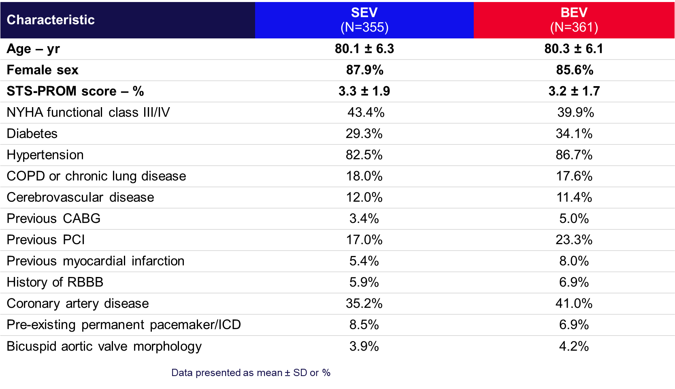
Baseline characteristics

Slide 11
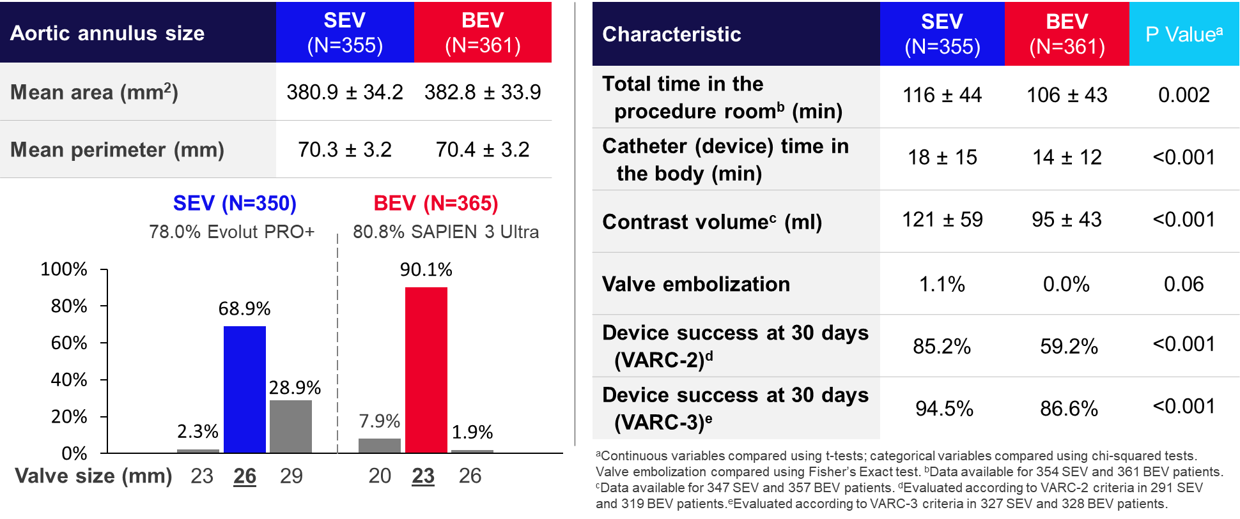
Valve and procedural data
Valve size
Procedural characteristics and outcomes

Slide 12
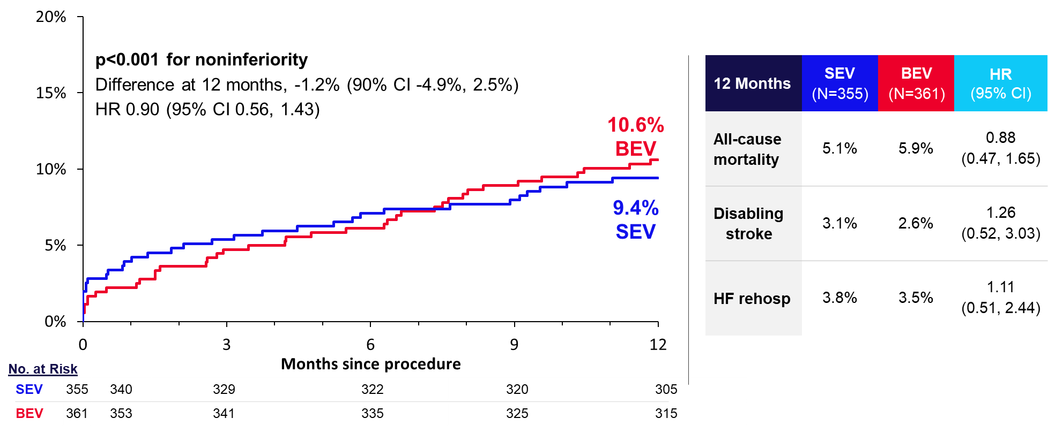
Co-primary endpoint 1: Clinical outcome composite through 12 months powered for noninferiority
Mortality, Disabling Stroke, or HF Rehospitalization

Slide 13
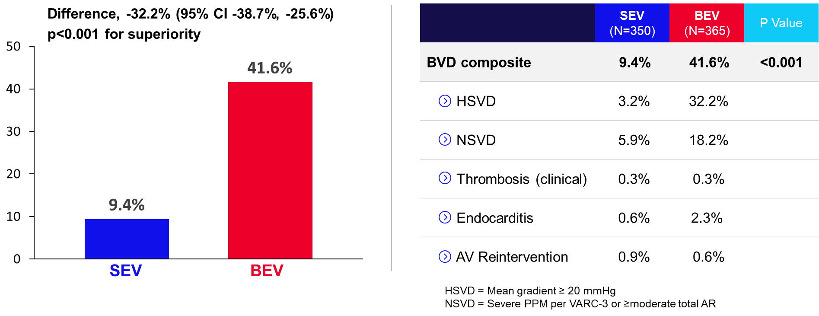
Co-primary endpoint 2: BVD through 12 months powered for superiority
Bioprosthetic Valve Dysfunction through 12 months

Slide 14
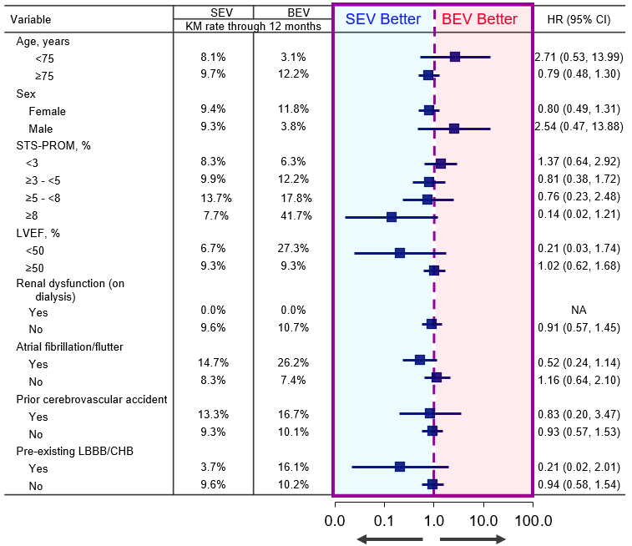
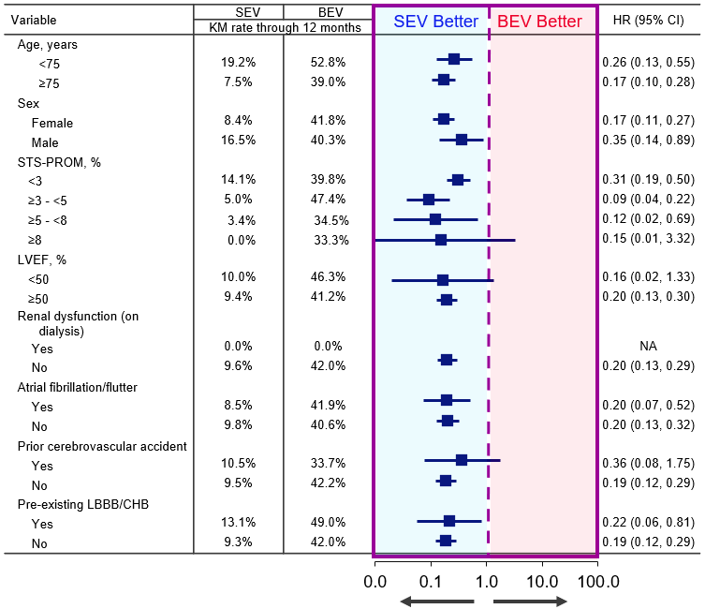
Prespecified subgroup analyses for the co-primary endpoints
Clinical Outcome Composite Through 12 Months
BVD Through 12 Months
No significant interactions were observed between treatment and any of the prespecified baseline subgroups with respect to either of the co-primary endpoints.

Slide 15
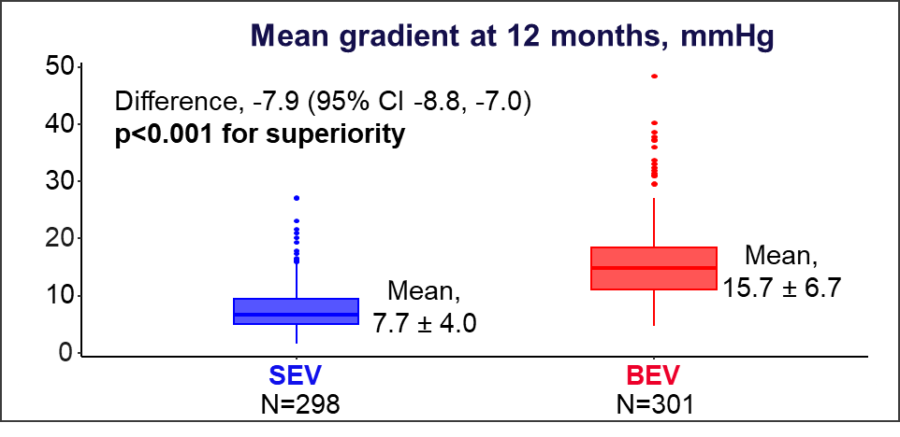
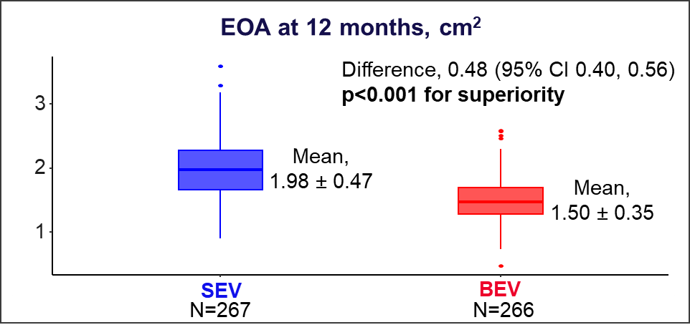
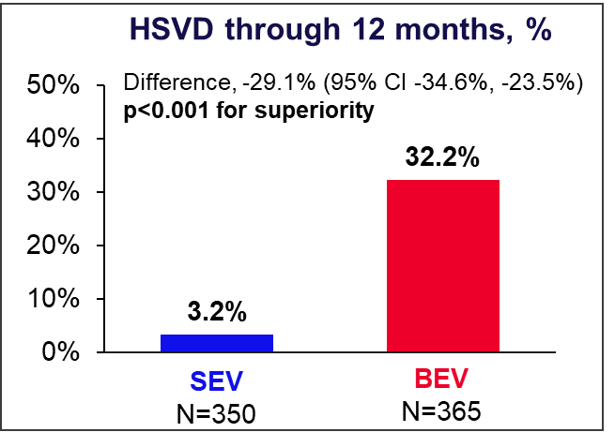
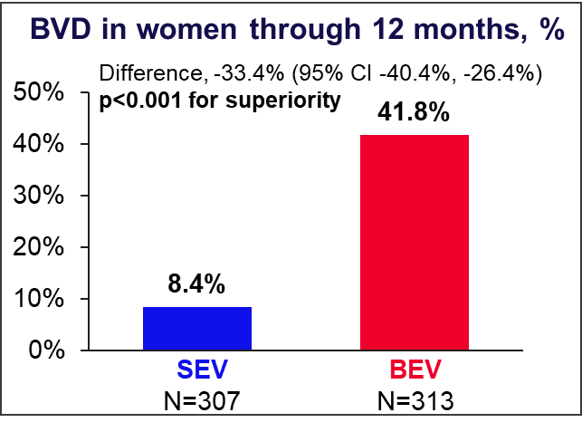
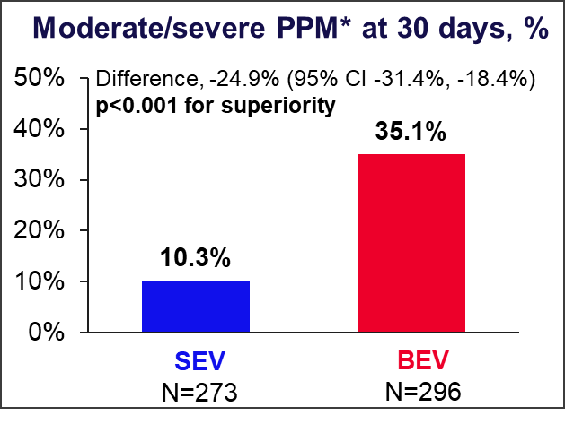
Hypothesis-tested secondary endpoints
p<0.001 for superiority
p<0.001 for superiority
p<0.001 for superiority
p<0.001 for superiority
p<0.001 for superiority
*VARC-3

Slide 16
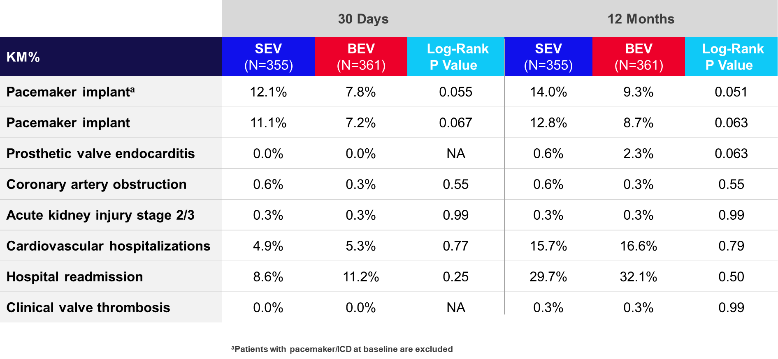
Additional safety outcomes

Slide 17
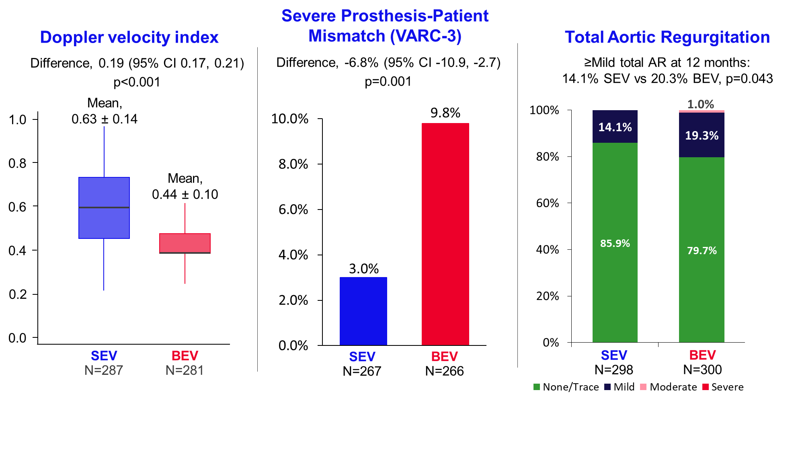
Other hemodynamic outcomes at 12 months

Slide 18
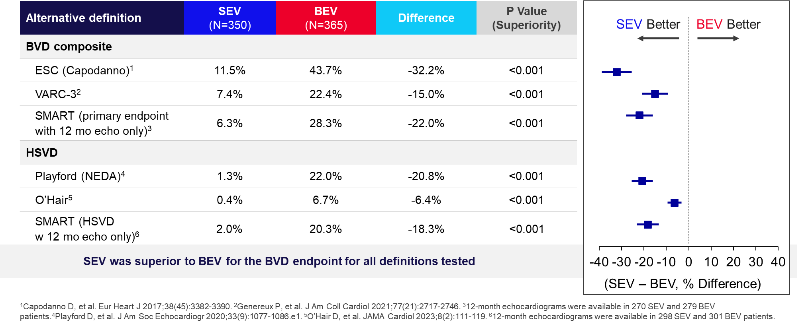
Alternative bioprosthetic valve dysfunction definitions
Notes:
1. Capodanno: Based on a composite of (1) SVD, defined as mean gradient ≥20 mmHg at any follow-up echo from discharge through the 12-month study visit; (2) NSVD, defined as severe PPM using the VARC-2 definition without the obesity correction or moderate/severe total AR at any follow-up echo from discharge through the 12-month study visit; (3) thrombosis (time to first event, ≤365 days); and (4) endocarditis (time to first event, ≤365 days).
2. VARC-3: Based on a composite of (1) SVD, defined as mean gradient ≥20 mmHg with a change from the reference echo of ≥10 mmHg, AND an EOA decrease of ≥0.3 OR percent EOA decrease of ≥25% OR DVI decrease of ≥0.1 OR percent DVI decrease of ≥20%, OR moderate/severe transvalvular AR with an increase from the reference echo; (2) NSVD, defined as severe PPM or moderate/severe paravalvular regurgitation at any follow-up echo from discharge through the 12-month study visit, 395 days; (3) thrombosis (time to first event, ≤365 days); and (4) endocarditis (time to first event, ≤365 days).
3. SMART primary endpoint with 12-mont echo only: Based on a composite of (1) SVD, defined as mean gradient ≥20 mmHg on the 12-month visit echo; (2) NSVD, defined as severe PPM or moderate/severe total AR on the 12-month visit echo; (3) thrombosis (time to first event, ≤365 days); (4) endocarditis (time to first event, ≤365 days); and (5) reintervention (time to first event, ≤365 days).
4. Playford: Based on SVD, defined as mean gradient ≥22.5 mmHg at any follow-up echo from discharge through the 12-month study visit
5. O’Hair: Based on SVD, defined as mean gradient ≥20 mmHg with a change from the reference echo of ≥10 mmHg OR moderate/severe transvalvular AR with increase from the reference echo.
6. Based on SVD, defined as mean gradient ≥20 mmHg on the 12-month visit echo

Slide 19
Quality of life
SEV demonstrated significantly better VARC-3 Ordinal Outcome for quality of life at 12 months

Slide 20
Summary
The SMART trial is the largest, most rigorous trial to date, to randomize patients to the 2 most widely used TAVR devices, and the largest TAVR trial to enroll mostly women.
The SMART trial met both primary and all 5 prespecified secondary endpoints.
Compared with BEV, the supra-annular SEV demonstrated:
Noninferior clinical outcomes at 1 year
Superior valve performance at 1 year:
32.2% lower incidence of BVD
8 mmHg lower mean gradient
0.5 cm² greater effective orifice area
0.19 larger Doppler velocity index
6.8% lower incidence of severe PPM
Improvements in other secondary outcomes at 1 year:
Less total AR and better QOL per the KCCQ ordinal outcome
Based on the large differences observed in valve performance, we expect that the SEV will demonstrate improved valve durability and outcomes during longer follow-up

Slide 21
The Leeds Teaching Hospitals NHS Trust, Leeds, UK
Allegheny General Hospital, Pittsburgh, PA
Kath Saint Johannes-Gesellschaft, Dortmund, Germany
Helios Health Institute Standort Leipzig, Germany
Montreal Heart Institute, Montreal, Canada
Sentara Norfolk General Hospital, Norfolk, VA
Deutsches Herzzentrum München, Germany
Hospital of the University of Pennsylvania, Philadelphia, PA
Saint Paul‘s Hospital, Vancouver, Canada
Herz- und Diabeteszentrum NRW, Ruhr-Universität Bochum, Bad Oeynhausen, Germany
Lankenau Medical Center, Wynnewood, PA
UPMC Pinnacle Harrisburg Campus, Mechanicsburg, PA
Azienda Ospedaliero-Universitaria Pisana, Pisa, Italy
Tufts Medical Center, Boston, MA
Clinique Pasteur, Toulouse, France
Hospital Vall D’Hebron, Barcelona, Spain
Spectrum Health Hospitals, Grand Rapids, MI
Thank You to All of Our Patients, Trial Investigators, Research Coordinators, and Top Enrolling Sites!

Slide 24
Backup

Slide 25
Definitions
Severe prosthesis-patient mismatch per VARC-3¹: indexed effective orifice area of ≤0.65 cm²/m² for body-mass index (BMI) <30 kg/m² or ≤0.55 cm²/m² for BMI ≥30 kg/m^{2.}
Bioprosthetic valve dysfunction per VARC-3¹: Based on a composite of (1) structural valve dysfunction, defined as mean gradient ≥20 mmHg with a change from the reference echo of ≥10 mmHg, AND an effective orifice area decrease of ≥0.3 OR percent effective orifice area decrease of ≥25% OR Doppler Velocity Index decrease of ≥0.1 OR percent Doppler Velocity Index decrease of ≥20%, OR moderate/severe transvalvular AR with an increase from the reference echo; (2) nonstructural valve dysfunction, defined as severe prosthesis-patient mismatch or moderate/severe paravalvular regurgitation at any follow-up echo from discharge through the 12-month study visit; (3) thrombosis (time to first event, ≤365 days); and (4) endocarditis (time to first event, ≤365 days). The reference echo was at 30 days or at discharge if the 30-day echo was unavailable.
Bioprosthetic valve dysfunction per the European Society of Cardiology (Capodanno)²: Based on a composite of (1) structural valve dysfunction, defined as mean gradient ≥20 mmHg at any follow-up echo from discharge through the 12-month study visit; (2) nonstructural valve dysfunction, defined as severe prosthesis-patient mismatch using the VARC-2 definition without the obesity correction or moderate/severe total AR at any follow-up echo from discharge through the 12-month study visit; (3) thrombosis (time to first event, ≤365 days); and (4) endocarditis (time to first event, ≤365 days).
Bioprosthetic valve dysfunction per the SMART primary endpoint with 12-month echo only: Based on a composite of (1) structural valve dysfunction, defined as mean gradient ≥20 mmHg on the 12-month visit echo; (2) nonstructural valve dysfunction, defined as severe prosthesis-patient mismatch or moderate/severe total AR on the 12-month visit echo; (3) thrombosis (time to first event, ≤365 days); (4) endocarditis (time to first event, ≤365 days); and (5) reintervention (time to first event, ≤365 days).
Hemodynamic structural valve dysfunction per Playford³: Based on structural valve dysfunction, defined as mean gradient ≥22.5 mmHg at any follow-up echo from discharge through the 12-month study visit.
Hemodynamic structural valve dysfunction per O’Hair⁴: Based on structural valve dysfunction, defined as mean gradient ≥20 mmHg with a change from the reference echo of ≥10 mmHg OR moderate/severe transvalvular AR with increase from the reference echo. The reference echo was at 30 days or at discharge if the 30-day echo was unavailable.
Hemodynamic structural valve dysfunction per the SMART primary endpoint with 12-month echo only: Based on structural valve dysfunction, defined as mean gradient ≥20 mmHg on the 12-month visit echo
¹Genereux P, et al. J Am Coll Cardiol 2021;77(21):2717-2746. ²Capodanno D, et al. Eur Heart J 2017;38(45):3382-3390. ³Playford D, et al. J Am Soc Echocardiogr 2020;33(9):1077-1086.e1. ⁴O’Hair D, et al. JAMA Cardiol 2023;8(2):111-119.

Slide 26
SMART Trial Clinical Sites
The Leeds Teaching Hospitals NHS, Leeds, UK | University of Florida, Gainesville, FL | Morristown Medical Center, Morristown, NJ
Allegheny General Hospital, Pittsburgh, PA | Toronto General Hospital, Toronto, Canada | Los Robles Hospital & Medical Center, Thousand Oaks, CA
Kath Saint Johannes-Gesellschaft, Dortmund, Germany | University of Pittsburgh Medical Center UPMC Presbyterian, Pittsburgh, PA | Catharina Ziekenhuis, Eindhoven, Netherlands
Helios Health Institute Standort Leipzig, Germany | NorthShore University Health System, Evanston, IL | University of Iowa Hospitals and Clinic, Iowa City, IA
Montreal Heart Institute, Montreal, Canada | WellStar Kennestone Hospital, Marietta, GA | Inova Fairfax Hospital, Falls Church, VA
Sentara Norfolk General Hospital, Norfolk, VA, USA | Centro Hospitalar de Lisboa Ocidental, E.P.E. Hospital de Santa Cruz, Carnaxide, Portugal | Cleveland Clinic, Cleveland, OH
Deutsches Herzzentrum München, Germany | Ascension Saint John Hospital, Detroit, MI | Baylor Jack and Jane Hamilton Heart and Vascular Hospital, Dallas, TX
Hospital of the University of Pennsylvania, Philadelphia, PA | Rigshospitalet, København, Denmark | Inselspital - Universitätsspital Bern, Bern, Switzerland
Saint Paul’s Hospital, Vancouver, Canada | MedStar Washington Hospital Center, Washington, DC | Piedmont Atlanta Hospital, Atlanta, GA
Herz- und Diabeteszentrum NRW - Ruhr-Universität Bochum, Bad Oeynhausen, Germany | Seton Medical Center Austin, TX | Ascension Via Christi Saint Francis, Wichita, KS
Lankenau Medical Center, Wynnewood, PA | WellSpan York Hospital, York, PA | Cedars Sinai Medical Center, Los Angeles, CA
UPMC Pinnacle Harrisburg Campus, Mechanicsburg, PA | Emory University Hospital Midtown, Atlanta, GA | Universitätsklinikum Schleswig-Holstein - Campus Lübeck, Lübeck, Germany
Azienda Ospedaliero-Universitaria Pisana – Stabilimento di Cisanello, Pisa, Italy | Mission Hospital, Asheville, NC | Scripps Green Hospital, La Jolla, CA
Tufts Medical Center, Boston, MA | Universitätsklinikum Düsseldorf, Düsseldorf, Germany | NYU Langone Medical Center, NY, NY
Clinique Pasteur, Toulouse, France | Yale New Haven Hospital, New Haven, CT | University of Virginia, Charlottesville, VA
Hospital Vall D'Hebron, Barcelona, Spain | University of Michigan Health System - University Hospital, Ann Arbor, MI | University of Kansas Medical Center, Kansas City, KS
Spectrum Health Hospitals, Grand Rapids, MI | Mayo Clinic, Rochester, MN | University of Colorado Hospital, Aurora, CO
Hillcrest Medical Center, Tulsa, OK | Intermountain Saint George Regional Hospital, Saint George, UT | Saint Vincent Heart Center of Indiana, Indianapolis, IN
Azienda Ospedaliera Universitaria Integrata Verona, Italy | University of Texas Health Sciences Center at Houston - Center for Advanced Heart Failure, Houston, TX | Bethesda North Hospital, Cincinnati, OH
Centre Hospitalier Universitaire de Clermont-Ferrand - Gabriel-Montpied, Clermont Ferrand, France | Policlinico Di Sant’Orsola Malpighi, Bologna, Italy | Mount Sinai Medical Center, Miami Beach, FL
University Hospitals Cleveland Medical Center, OH | Advocate Christ Medical Center, Oak Lawn, IL | TriStar Centennial Medical Center, Nashville, TN
Morton Plant Hospital, Clearwater, FL | Maastricht Universitair Medisch Centrum, Maastricht, Netherlands | Royal Infirmary of Edinburgh, Edinburgh, UK
The Mount Sinai Hospital, NY, NY | Vancouver Island Health Authority / Royal Jubilee Hospital, Victoria, Canada | The University of Texas Health Science Center at Houston, Houston, TX
Saint Michaels Hospital, Toronto, Canada | Helsinki University Hospital, Helsinki, Finland | Charité – Universitätsmedizin Berlin, Berlin, Germany
Sheba Medical Center, Ramat Gan, Israel | HealthPark Medical Center, Fort Myers, FL | Universitätsklinikum Schleswig-Holstein - Campus Kiel, Kiel, Germany
The Heart Hospital Baylor Plano, TX | Hôpital Haut-Lévêque - CHU de Bordeaux, Pessac, France | New York-Presbyterian Hospital/Weill Cornell Medical Center, NY, NY
J.W. Ruby Memorial Hospital, Morgantown, WV | Missouri Baptist Medical Center, Saint Louis, MO | University of North Carolina Memorial Hospital, Chapel Hill, NC
Saint Cloud Hospital, Saint Cloud, MN | Ichilov Medical Center Tel Aviv, Tel Aviv, Israel

Slide 27
Summary of valve sizes and valves implanted
Last implanted valve model
Last implanted valve size
4.3%
0.6%
SEV
17.1%
78.0%
19.2%
BEV
23mm
26mm
29mm
20mm
23mm
26mm
80.8%
SEV
BEV

Slide 28
Global site participation
United States
UPMC Presbyterian
University Hospitals Cleveland Medical Center
Cleveland Clinic
CentraCare Heart & Vascular Center MN – Saint Cloud Hospital
Ascension Saint John Hospital
Mayo Clinic
University of Michigan Health System - University Hospital
University of Pittsburgh Medical Center
Spectrum Health Hospitals
Morristown Medical Center
NorthShore University Health System
UPMC Pinnacle Harrisburg Campus
The Mount Sinai Hospital
University of Iowa Hospitals and Clinic
Advocate Christ Medical Center
Tufts Medical Center
Yale New Haven Hospital
Allegheny General Hospital
New York-Presbyterian Hospital/Weill Cornell Medical Center
University of Colorado Hospital
University of Kansas Medical Center
Saint Vincent Heart Center of Indiana
NYU Langone Medical Center
Bethesda North Hospital
Hospital of the University of Pennsylvania
Ascension Via Christi Saint Francis
Missouri Baptist Medical Center
J.W. Ruby Memorial Hospital
WellSpan York Hospital
Lankenau Medical Center
MedStar Washington Hospital Center
Intermountain Saint George Regional Hospital
University of Virginia
Inova Fairfax Hospital
Hillcrest Medical Center
TriStar Centennial Medical Center
Sentara Norfolk General Hospital
Los Robles Hospital & Medical Center
Mission Hospital
University of North Carolina (UNC) Memorial Hospital
Cedars Sinai Medical Center
WellStar Kennestone Hospital
Scripps Green Hospital
The Heart Hospital Baylor Plano
Piedmont Atlanta Hospital
Emory University Hospital Midtown
Baylor Jack and Jane Hamilton Heart and Vascular Hospital
Seton Medical Center Austin
University of Texas Health Sciences Center at Houston - Center for Advanced Heart Failure
The University of Texas Health Science Center at Houston
University of Florida
Morton Plant Hospital
HealthPark Medical Center
Mount Sinai Medical Center

Slide 29
Global site participation
Canada
Denmark
Finland
France
Centre Hospitalier Universitaire de Clermont-Ferrand - Gabriel-Montpied
Vancouver Island Health Authority/Royal Jubilee Hospital
Hôpital Haut-Lévêque – CHU de Bordeaux
Montreal Heart Institute
Rigshospitalet
Saint Paul’s Hospital
Toronto General Hospital
Helsinki University Hospital
Clinique Pasteur
Saint Michaels Hospital
Germany
Israel
Italy
Netherlands
Universitätsklinikum Schleswig-Holstein - Campus Kiel
Azienda Ospedaliera Universitaria Integrata Verona
Universitätsklinikum Schleswig-Holstein - Campus Lübeck
Ichilov Medical Center Tel Aviv
Policlinico Di Sant’Orsola Malpighi
Herz- und Diabeteszentrum NRW - Ruhr-Universität Bochum
Charité – Universitätsmedizin Berlin
Azienda Ospedaliero-Universitaria Pisana – Stabilimento di Cisanello
Universitätsklinikum Düsseldorf
Helios Health Institute Standort Leipzig
Sheba Medical Center
Catharina Ziekenhuis
Kath Saint Johannes-Gesellschaft Dortmund gGmbHSaint Johannes-Hospital Dortmund
Maastricht Universitair Medisch Centrum
Deutsches Herzzentrum München
Portugal
Spain
Switzerland
United Kingdom
Centro Hospitalar de Lisboa Ocidental, E.P.E. Hospital de Santa Cruz
Hospital Vall D'Hebron
Inselspital - Universitätsspital Bern
Royal Infirmary of Edinburgh
The Leeds Teaching Hospitals NHS Trust - Leeds General Infirmary

