Slide 1
The Effect of Edetate Disodium-based Chelation on Cardiovascular Events in Patients with a Prior Myocardial Infarction
and Diabetes – Results of the TACT2 Randomized Trial
Gervasio A. Lamas MD FACC, for the
TACT2 Investigators
@GLamasMD

Slide 2
I have no conflicts of interest

Slide 3
TACT2: Background
Lead and cadmium are ubiquitous environmental pollutants and recognized risk factors for atherosclerosis
Edetate disodium (EDTA) is an avid lead and cadmium chelator, promotes their urinary elimination
The Trial to Assess Chelation Therapy (TACT, 2003-2012) randomized 1702 patients with a prior MI (633 with diabetes) to placebo or edetate disodium (EDTA) infusions
Overall cardiovascular events were reduced in the edetate disodium group (HR=0.82, p=0.035)¹ with a marked effect size (HR=0.59, p=0.0002)² in patients with concomitant diabetes
Lamas G et al. JAMA 2013
Escolar E et al. Circ Cardiovasc Qual Outcomes 2014

Slide 4
TACT2: Purpose
The purpose of the Trial to Assess Chelation Therapy 2 (TACT2) was to:
Efficiently replicate TACT in post MI patients with diabetes
Measure the effect of repeated edetate disodium infusions on blood lead and urine cadmium

Slide 5
TACT2: Funding and Organization
Funded by the National Institutes of Health
National Center for Complementary and Integrative Health
National Heart Lung and Blood Institute
National Institute for Diabetes Digestive and Kidney Diseases
National Institute of Environmental Health Sciences
Coordinating Centers
Clinical Coordinating Center
Mount Sinai Medical Center
Miami Beach, FL
Data Coordinating Center- Duke Clinical Research Institute (DCRI), Durham, NC
Trace Metals Core and Biorepository Center- Mailman School of Public Health, Columbia University NY, NY
Patient management
Clinical Sites US and Canada (n=88)
DCRI Patient Reported Outcomes (PRO) Call Center
Central Pharmacy to prepare and distribute study drug

Slide 6
TACT2: Design
Double blind factorial trial of
(i) edetate disodium-based infusions and
(ii) high dose oral multivitamins and minerals
Randomization was 1:1:1:1
The present report focuses on edetate disodium vs placebo infusions only
vs. corresponding placebos

Slide 7
TACT2: Methods
1000 post MI patients with diabetes randomly assigned to 40 weekly edetate disodium or placebo infusions and oral low-dose vitamin and mineral supplements
Follow-up:
Planned minimum = 2.5 years
Median = 4 years

Slide 8
TACT2: Key Inclusion Criteria
Age 50 or older, non-childbearing if female
Prior MI >6 weeks
Diabetes
Creatinine < 2.0 mg/dL
Non-smoker

Slide 9
TACT2: Study Infusions
Active infusions
Placebo infusions
edetate disodium up to 3 grams
based on renal function
7 g of ascorbic acid
2 g of magnesium chloride
Other components as detailed
in the design paper *
Total volume 500mL
500 mL of normal saline and 1.2% dextrose (2.5 g total).
Infusions administered through peripheral intravenous access over at least 3 hours
*Lamas G et al. Am Heart J 2022

Slide 10
TACT2 Endpoints
Primary endpoint: composite of time to first occurrence of all-cause mortality, MI, stroke, coronary revascularization, or hospitalization for unstable angina
The secondary endpoints were:
Recurrent events of the primary composite endpoint
All-cause mortality
Composite of cardiovascular mortality, MI, or stroke
The metals endpoint was a decrease in body burden of blood lead and urine cadmium

Slide 11
TACT2: Statistical Considerations
Time from randomization to the first occurrence of any of the primary composite event components using the Cox proportional hazards regression model
Sample size calculations based on >85% power to detect a 30% reduction in the primary endpoint with an alpha of 0.05.
The primary analyses are reported for the modified intention-to-treat (mITT) population, which excludes 41 of the 1000 randomized patients who never received any infusions

Slide 12
Selected Baseline Characteristics (mITT Population)
 | Total (N=959)
Age-years (median IQR) | 67 (60-72)
Female - % | 26.9
Non-Hispanic White - % | 61.5
Time from qualifying MI to randomization Median years (IQR) | 5 (2 - 10)
Diabetes Medications - %
Insulin | 46.7
GLP-1a or SGLT-2i | 22.2
Other Medications - %
Aspirin, warfarin, or P2Y12 inhibitor | 90.0
Beta-blocker | 79.5
Statin | 85.9
Hemoglobin A1c, %,Mean ± SD | 7.5 ± 1.3
LDL, mg/dL, Mean ± SD | 79.6 ± 35.3

Slide 13
Additional Characteristics (mITT Population)
 | % Detectable | Median (IQR)
Lead (blood) µg/L | 100 | 9.22 (6.30, 14.00)
Cadmium (urine) µg metal/g Creatinine | 97 | 0.30 (0.18, 0.52)

Slide 14
Compliance with Infusion Regimen
 | Total # of infusions 31,615 | 40 Infusions | 20 Infusions
Active | 15,787 | 68% | 78%
Placebo | 15,828 | 67% | 78%

Slide 15
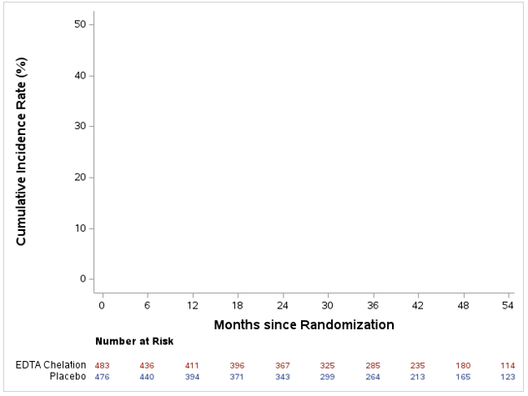
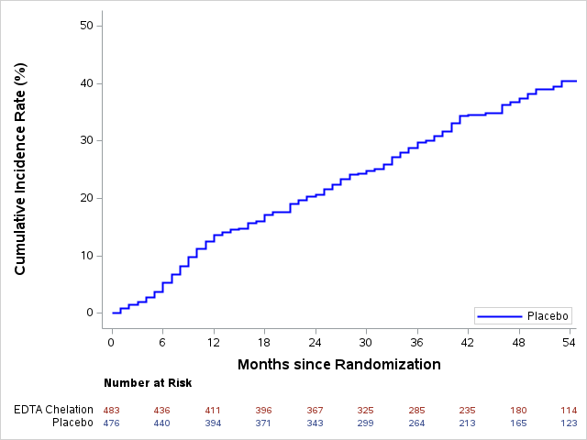
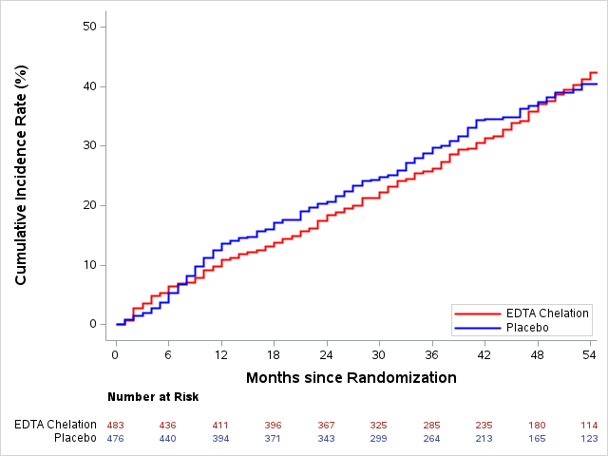
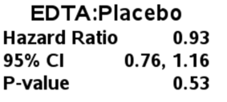
Cumulative Incidence of Time to First Event: Myocardial Infarction, Stroke, Hospitalization for Unstable Angina, Coronary Revascularization, or Death from Any Cause
Primary Outcome Results

Slide 16
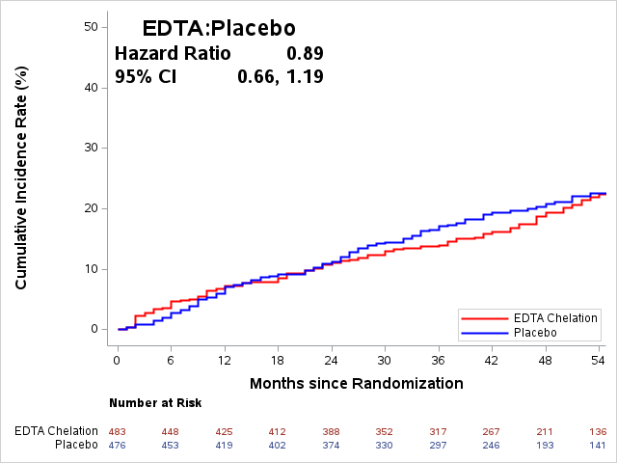
Time to First Event: Myocardial Infarction, Stroke, or Cardiovascular Death

Slide 17
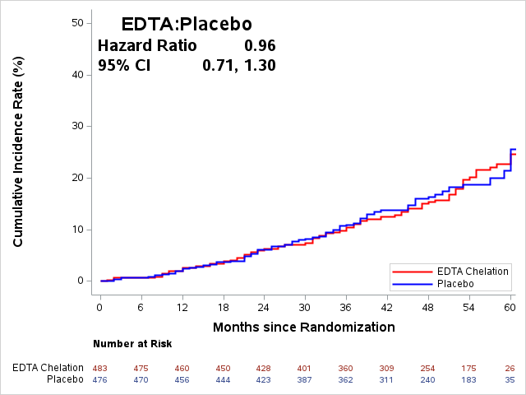
Time to All-Cause Mortality

Slide 18
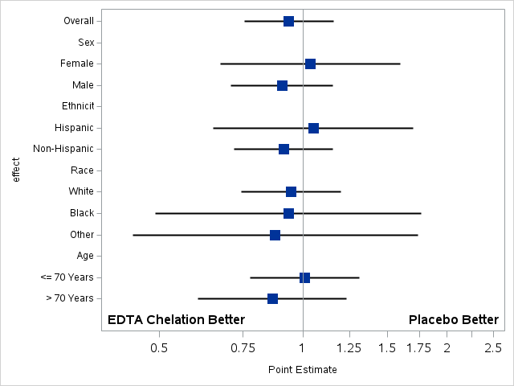
Subgroup Analysis for Primary Endpoint (mITT)
Subject Group | Adjusted Hazard Ratio | 95% CI
All Participants | 0.93 | (0.76, 1.16)
Sex
Female | 1.03 | (0.67, 1.59)
Male | 0.90 | (0.71, 1.16)
Ethnicity
Hispanic/Latino | 1.05 | (0.65, 1.70)
Non-Hispanic/Latino | 0.91 | (0.72, 1.16)
Race
White | 0.94 | (0.74, 1.20)
Black | 0.93 | (0.49, 1.76)
Other | 0.88 | (0.44, 1.74)
Age
< 70 Years | 1.01 | (0.77, 1.31)
> 70 Years | 0.86 | (0.60, 1.23)
Adjusted HR
95% CI
EDTA Chelation Better
Placebo Better
0.1
1.0
2.0
3.0

Slide 19
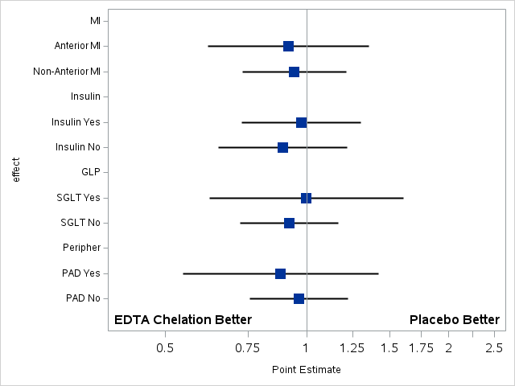
Subgroup Analysis for Primary Endpoint (mITT)
Subject Group | Adjusted Hazard Ratio | 95% CI
MI Location
Anterior MI | 0.91 | (0.62, 1.36)
Non-anterior MI | 0.94 | (0.73, 1.21)
Insulin-use at Baseline
Yes | 0.97 | (0.73, 1.30)
No | 0.89 | (0.65, 1.22)
GLP-receptor agonist or SGLT-2 inhibitor at baseline
Yes | 1.00 | (0.62, 1.60)
No | 0.92 | (0.72, 1.16)
Peripheral Artery Disease at baseline
Yes | 0.88 | (0.55, 1.42)
No | 0.96 | (0.76, 1.22)
Adjusted HR
95% CI
EDTA Chelation Better
Placebo Better
0.1
1.0
2.0
3.0

Slide 20
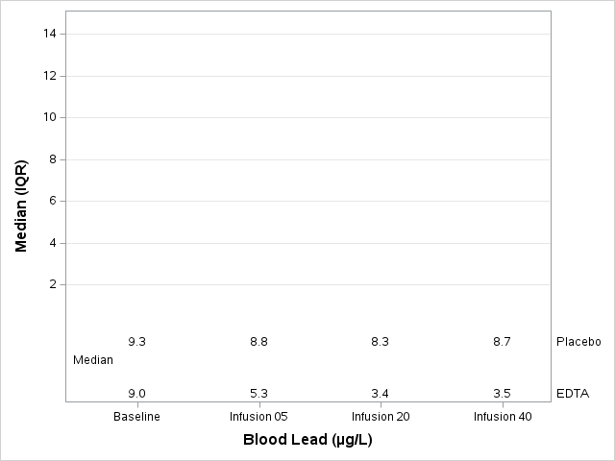
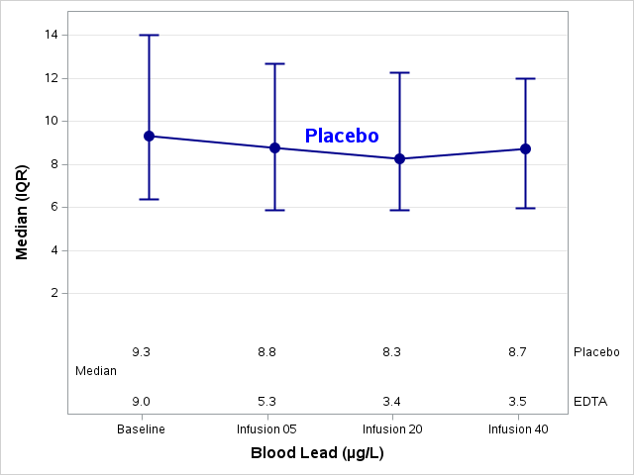
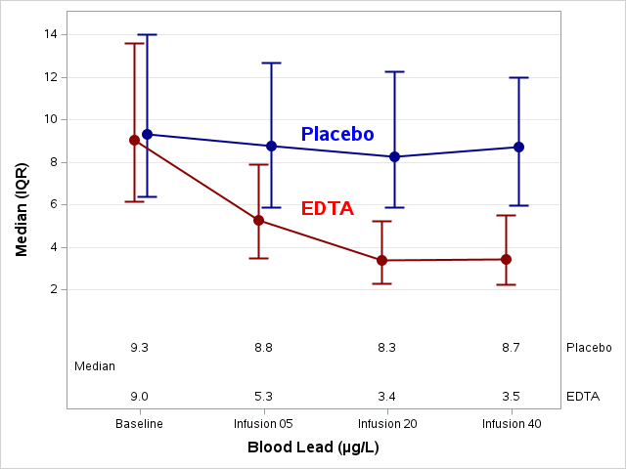
Pre-Infusion Blood Lead (µg/L) Levels at Baseline and during Study
Note: P-value tests the change from baseline to pre-infusion 40 between active and placebo using the Wilcoxon rank sums test.

Slide 21
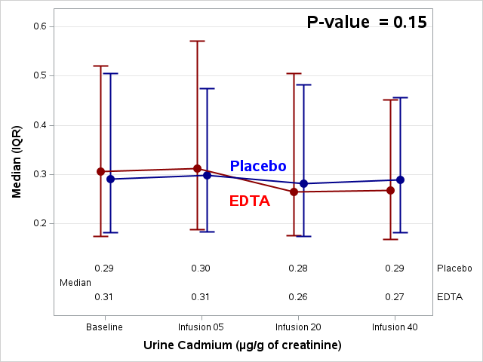
Pre-Infusion Urine Cadmium (µg/g of creatinine) Levels at Baseline and during Study
Note: P-value tests the change from baseline to pre-infusion 40 between active and placebo using the Wilcoxon rank sums test.

Slide 22
TACT2 Summary
EDTA chelation produced >60% reduction in blood lead levels
No safety issues
EDTA did not result in a significant clinical benefit on
primary or secondary endpoints or on all-cause mortality

Slide 23
Why were the results of TACT (2003-2012) and TACT2 (2016-2023) so different?
NHANES may shed light
2003 to 2010 (TACT) blood lead levels 17 mcg/L
2015 to 2020 (TACT2) blood lead levels 10 mcg/L (41% drop)
TACT2 blood lead levels even lower at baseline: 9 mcg/L
Hypothesis: US blood lead levels have markedly dropped since 2003, possibly reducing the potential therapeutic impact of further lowering blood lead level

Slide 24
Conclusion
TACT2 does not support the use of edetate disodium (EDTA) chelation for risk reduction in stable post MI patients with diabetes

