Slide 1

American Heart Association, November 13, 2023, Philadelphia, PA
Inflammation and Cholesterol as Predictors of Cardiovascular Events Among 13,970 Statin-Intolerant Patients
Paul M Ridker, Lei Lei, Louie MJ, Haddad T, Nicholls SJ, Lincoff AM, Libby P and Nissen SE on behalf of the CLEAR Outcomes Investigators

Slide 2
Background and Rationale - I
Inflammation and hyperlipidemia jointly contribute to initiation, progression, and eventual plaque rupture leading to myocardial infarction, stroke, and cardiovascular death.
A recent analysis¹ of 31,245 contemporary statin-treated patients in the PROMINENT, REDUCE-IT, and STRENGTH trials demonstrated that residual inflammatory risk (assessed by hsCRP) was a more powerful predictor of future cardiovascular events than was residual cholesterol risk (assessed by LDLC).
This issue has substantial implications for care as low-dose colchicine, bempedoic acid,
GLP-1r agonists, and SGLT2 inhibitors all lower hsCRP and all are associated with lower risks of future cardiovascular events.
¹Lancet 2023;401:1293-1301

Slide 3
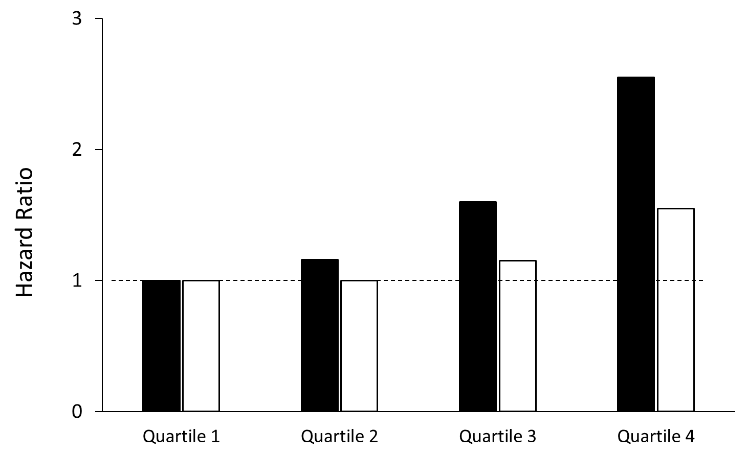
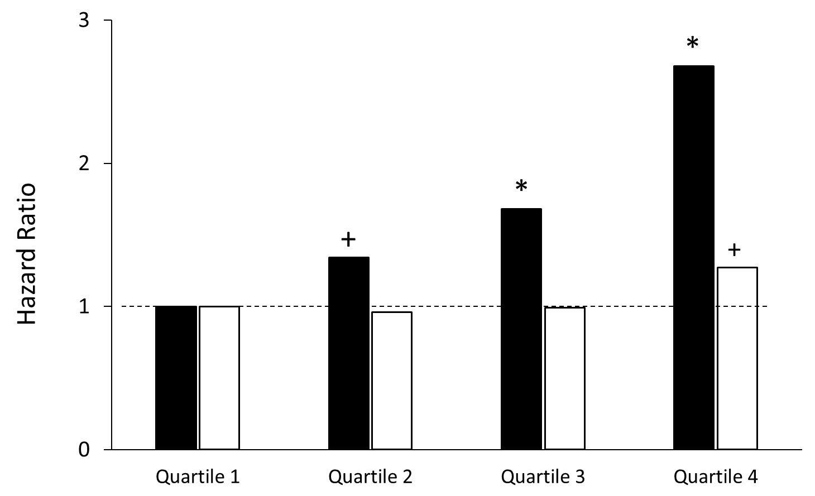
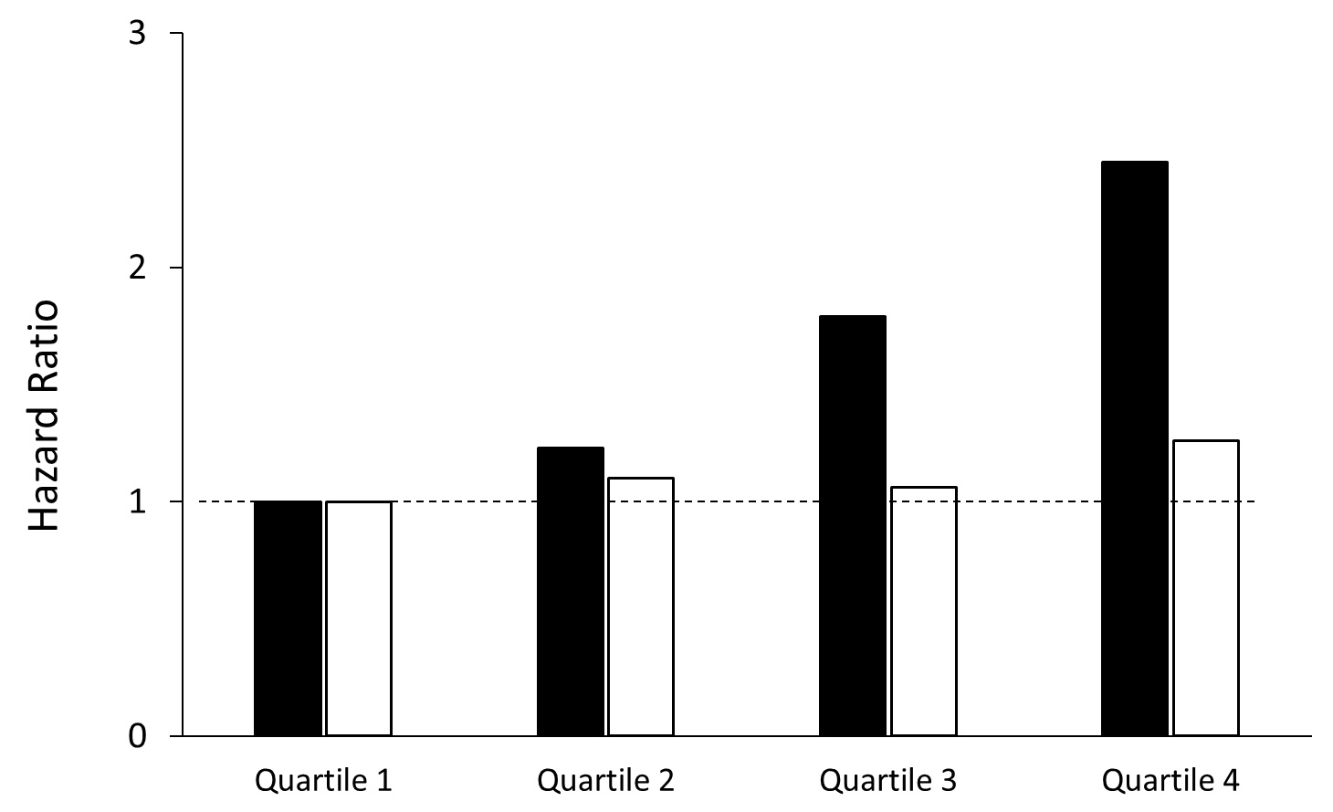
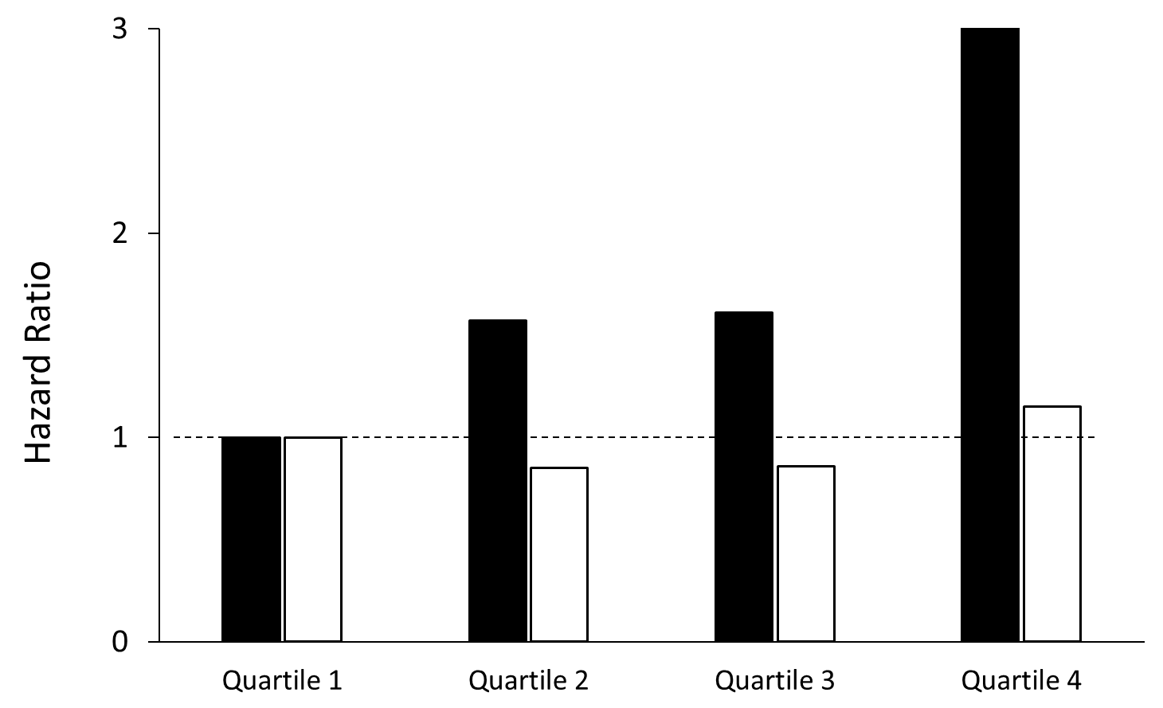
hsCRP is a More Powerful Determinant of Cardiovascular Death than LDLC Among
31,245 Contemporary Statin Treated Patients
Pooled Data (N = 31,245)
Cardiovascular Death
PROMINENT
(N = 9,988)
HR
2.68
* P < 0.0001 + P < 0.05
REDUCE-IT
(N = 8,179)
HR
1.27
STRENGTH
(N = 13,078)
LDLC
hsCRP
Lancet 2023;401:1293-1301

Slide 4
Background and Rationale - II
Not all patients can tolerate statin therapy.
The contemporary relationships of hsCRP and LDLC to cardiovascular risk are uncertain for those not taking statins.
Completion of the CLEAR Outcomes trial (N = 13,970) comparing bempedoic acid to placebo among statin-intolerant patents with, or at high risk, for ASCVD afforded us the opportunity to evaluate the contemporary relationships of hsCRP (a clinical biomarker for residual inflammatory risk) and LDL-C (a clinical biomarker for residual cholesterol risk) with the incidence of future major adverse cardiovascular events (MACE), cardiovascular mortality, and all-cause mortality.

Slide 5
Methods
Population:
Endpoints:
Statistical
Analysis:
13,970 statin-intolerant participants in the contemporary CLEAR Outcomes trial in which individuals with LDLC > 100 mg/dL were randomly allocated to 180 mg bempedoic acid QD or to placebo at 1250 sites in 32 countries and followed for a median period of 40.6 months (maximum 5 years).
As reported elsewhere (Nissen et al, NEJM 2023), the trial included a secondary prevention cohort (N = 9764) and a high-risk primary prevention cohort (N = 4206), both inclusive of patients unable or unwilling to take statin therapy owing to an adverse effect that started or increased during statin therapy and/or resolved or improved after statin discontinuation.
Incident 4-Point MACE, CV mortality, and all-cause mortality during trial follow-up
For our primary analysis, we computed adjusted HRs (95%CIs) in proportional hazard models addressing risks for each endpoint across increasing quartiles of hsCRP and LDL-C. All analyses adjusted on an a priori basis for age, gender, BMI, smoking, alcohol, blood pressure, diabetes, eGFR, history of atherosclerotic disease, and randomized treatment assignment.
The relative benefits of bempedoic acid as compared to placebo were also assessed across hsCRP and LDLC strata.

Slide 6
Results – I
Clinical characteristics of statin-intolerant participants in the CLEAR Outcomes trial
Characteristic | Bempedoic Acid (N = 6992) | Placebo (N = 6978)
Age, years | 65.5 | 65.5
Female, % | 48.1 | 48.4
Diabetes, % | 45.0 | 46.3
Body Mass Index, kg/m² | 29.9 | 30.0
Secondary Prevention, % | 70.0 | 69.8
Triglycerides, mg/dL | 159.5 | 158.5
LDL-C, mg/dL | 139.0 | 139.0
HDL-C, mg/dL | 49.6 | 49.4
hsCRP, mg/L | 2.3 | 2.3

Slide 7
Results – II
Comparison of cut-points for baseline hsCRP and LDL-C among 31,245 statin-treated participants in the PROMINENT, REDUCE-IT, and STRENGTH trials and among 13,970 statin-intolerant participants in the CLEAR Outcomes trial
Quartile Cut-points for hsCRP (mg/L)
 | Quartile 1 | Quartile 2 | Quartile 3 | Quartile 4
Statin-Treated | <1.1 | 1.2-2.2 | 2.3-4.5 | > 4.5
Statin-Intolerant | < 1.2 | 1.2-2.3 | 2.3-4.5 | > 4.5
Quartile Cut-points for LDL-C (mg/dL)
 | Quartile 1 | Quartile 2 | Quartile 3 | Quartile 4
Statin-Treated | <60 | 60-76 | 76-96 | > 96
Statin-Intolerant | < 115 | 115-135 | 135-159 | > 159

Slide 8
Results – III Hazard Ratios for Incident MACE Among 13,970 Statin-Intolerant Patients
Residual Inflammatory Risk (Quartiles of hsCRP)
 | Quartile 1 <1.2 mg/L | Quartile 2 1.2-2.3 mg/L | Quartile 3 2.3-4.5 mg/L | Quartile 4 > 4.5 mg/L
HR, adjusted* | 1.0 | 1.19 | 1.24 | 1.43
95% CI | Referent | 1.03 – 1.37 | 1.07 – 1.43 | 1.24 – 1.65
P-value | Referent | 0.02 | 0.004 | < 0.0001
Residual Cholesterol Risk (Quartiles of LDL-C)
 | Quartile 1 < 115 mg/dL | Quartile 2 115-135 mg/dL | Quartile 3 135-159 mg/dL | Quartile 4 > 159 mg/dL
HR, adjusted* | 1.0 | 1.01 | 1.18 | 1.19
95% CI | referent | 0.88 – 1.15 | 1.03 – 1.35 | 1.04 – 1.37
P-value | referent | 0.93 | 0.02 | 0.01
* adjusted for age, gender, body mass index, smoking, blood pressure, prior history of CVD, and randomized treatment assignment

Slide 9
Results – III Hazard Ratios for CV Death Among 13,970 Statin-Intolerant Patients
Residual Inflammatory Risk (Quartiles of hsCRP)
 | Quartile 1 <1.2 mg/L | Quartile 2 1.2-2.3 mg/L | Quartile 3 2.3-4.5 mg/L | Quartile 4 > 4.5 mg/L
HR, adjusted* | 1.0 | 1.31 | 1.58 | 2.00
95% CI | Referent | 0.99 - 1.73 | 1.20 – 2.07 | 1.53 – 2.61
P-value | Referent | 0.06 | 0.001 | < 0.0001
Residual Cholesterol Risk (Quartiles of LDL-C)
 | Quartile 1 < 115 mg/dL | Quartile 2 115-135 mg/dL | Quartile 3 135-159 mg/dL | Quartile 4 > 159 mg/dL
HR, adjusted* | 1.0 | 0.93 | 1.02 | 0.90
95% CI | referent | 0.74 – 1.18 | 0.80 – 1.29 | 0.70 – 1.17
P-value | referent | 0.57 | 0.89 | 0.44
* adjusted for age, gender, body mass index, smoking, blood pressure, prior history of CVD, and randomized treatment assignment

Slide 10
Results – III Hazard Ratios for Total Mortality Among 13,970 Statin-Intolerant Patients
Residual Inflammatory Risk (Quartiles of hsCRP)
 | Quartile 1 <1.2 mg/L | Quartile 2 1.2-2.3 mg/L | Quartile 3 2.3-4.5 mg/L | Quartile 4 > 4.5 mg/L
HR, adjusted* | 1.0 | 1.33 | 1.70 | 2.21
95% CI | Referent | 1.06 – 1.66 | 1.37 – 2.11 | 1.79 – 2.73
P-value | Referent | 0.01 | <0.0001 | < 0.0001
Residual Cholesterol Risk (Quartiles of LDL-C)
 | Quartile 1 < 115 mg/dL | Quartile 2 115-135 mg/dL | Quartile 3 135-159 mg/dL | Quartile 4 > 159 mg/dL
HR, adjusted* | 1.0 | 0.93 | 0.98 | 0.95
95% CI | referent | 0.77 – 1.12 | 0.81 – 1.18 | 0.78 – 1.16
P-value | referent | 0.42 | 0.79 | 0.60
* adjusted for age, gender, body mass index, smoking, blood pressure, prior history of CVD, and randomized treatment assignment

Slide 11
Results – VI Similar Efficacy of Bempedoic Acid Across hsCRP and LDLC Subgroups
Participant Group | Bempedoic Acid n/N (%) | Placebo n/N (%) | HR 4-point MACE* | 95% CI
Total Cohort | 819/6992 (11.7%) | 927/6978 (13.3%) | 0.87 | 0.79-0.96
hsCRP < 2 mg/L | 320/3070 (10.4%) | 352/3071 (11.5%) | 0.89 | 0.77-1.04
hsCRP > 2 mg/L | 493/3847 (12.8%) | 567/3840 (14.8%) | 0.86 | 0.76-0.97
LDLC < 130 mg/dL | 351/3074 (11.4%) | 396/3089 (12.8%) | 0.88 | 0.76-1.02
LDLC > 130 mg/dL | 468/3918 (11.9%) | 51/3889 (13.7%) | 0.86 | 0.76-0.98
* 4-point MACE: nonfatal myocardial infarction, nonfatal stroke, coronary revascularization, or cardiovascular death

Slide 12
Direct Comparison of hsCRP and LDLC as Predictors of Cardiovascular Death in Contemporary Data - Part I
hsCRP
LDLC
Quartile 1
Quartile 2
Quartile 3
Quartile 4
Statin-Treated
(N = 31,245)
76 mg/dl
2.1 mg/L
Quartile 1
Quartile 2
Quartile 3
Quartile 4
Statin-Intolerant
(N = 13,970)
2.3 mg/L
135 mg/dl
Hazard Ratio (95% CI)

Slide 13
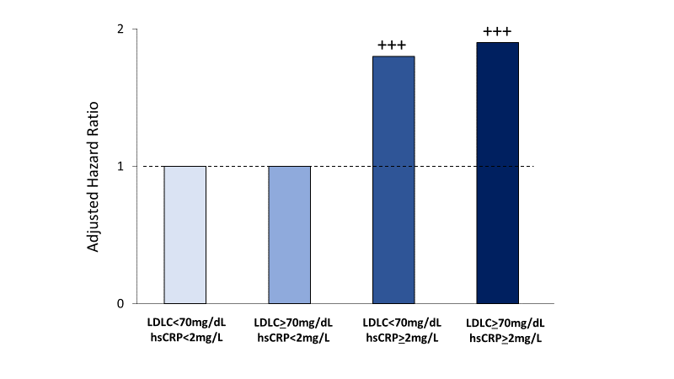
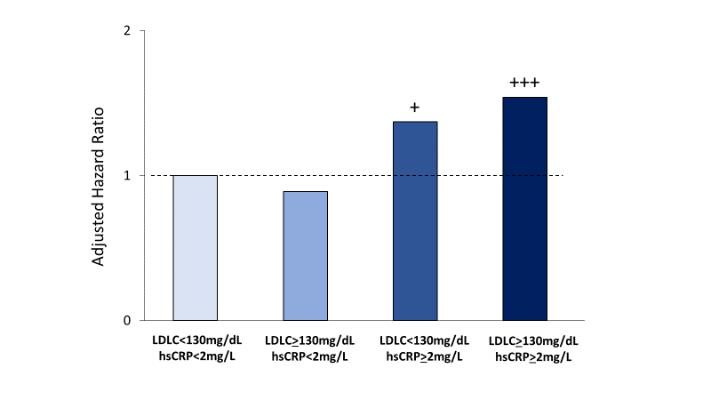
Direct Comparison of hsCRP and LDLC as Predictors of Cardiovascular Death in Contemporary Data - Part II
Highest Risk
hsCRP > 2 mg/L
LDLC > or < 70 mg/dL
Statin-Treated
(N = 31,245)
Statin-Intolerant
(N = 13,970)
Highest Risk
hsCRP > 2 mg/L
LDLC > or < 130 mg/dL

Slide 14
Summary:
In a pattern almost identical to prior data among 31,245 contemporary statin-treated patients in the PROMINENT, REDUCE-IT, and STRENGTH trials, residual inflammatory risk as assessed by hsCRP was a stronger determinant of risk for future cardiovascular events and death than residual cholesterol risk as assessed by LDL-C among 13,970 contemporary statin-intolerant patients in the CLEAR Outcomes trial.
In both contemporary settings, individuals with elevated hsCRP were at high cardiovascular risk irrespective of LDLC level.
Bempedoic acid, an agent that lowers both LDLC and hsCRP, was equally effective across LDLC and hsCRP strata.

Slide 15
Implications for practice
While these data must not be construed to diminish the proven and crucial role of lipid-lowering for our patients with hypercholesterolemia, they do suggest that targeting of LDLC alone is unlikely to completely reduce atherosclerotic risk and that inflammatory pathways have yet to be fully exploited to reduce fatal and nonfatal CV events.
In contemporary care, moving beyond LDLC alone, should clinicians consider inflammation inhibition for patients with atherosclerotic disease?
  Consideration of colchicine 0.5 mg po qd for those with stable atherosclerosis and normal eGFR.
  Consideration of bempedoic acid which, like statin therapy, reduces both LDL-C and hsCRP
  Consideration of GLP1r agonists and SGLT2 inhibitors, all of which have concomitant anti-inflammatory effects.

Slide 16
Implications for practice
It is not an either/or situation: In the future, we believe the combined use of aggressive LDL-lowering and inflammation inhibiting therapies will become standard of care for almost all atherosclerotic patients.
Finally, in addition to increasing the use of targeted anti-inflammatory therapies for atherosclerosis, these data strongly support ongoing ACC/AHA prevention efforts directed at diet, weight loss, exercise, and smoking cessation, all of which lower vascular inflammation and lower cardiovascular event rates.

Slide 17
