Slide 1
Disclosures
No other relevant disclosures

Slide 2
Jeffrey L Carson, MD
Study Chair and Principal Investigator
Rutgers Robert Wood Johnson Medical School

Slide 3
Background
Anemia is common in patients with acute MI
Indications for red blood cell transfusion in MI patients are controversial given the paucity of evidence
Three trials have compared transfusion thresholds in 820 patients with MI and found inconsistent results
Trials in other clinical settings suggest use of restrictive transfusion strategy is safe

Slide 4
Objective
To determine whether the risk of death or MI through 30 days differed with a restrictive transfusion strategy with a hemoglobin threshold of 7 to 8 g/dL as compared to a liberal transfusion strategy with a hemoglobin threshold of 10 g/dL among patients with an acute MI and a hemoglobin concentration < 10 g/dL.

Slide 5
Randomized controlled trial
Enrolled April 2017 to April 2023
144 sites in the United States, Canada, France, Brazil, New Zealand and Australia
Methods

Slide 6
Canada 885
France 323
United States 2157
Brazil 105
Australia 9
New Zealand 25

Slide 7
Inclusions
18 years or older
STEMI or NSTEMI
Types 1, 2, 4b, and 4c MI
Hemoglobin concentration
< 10 g/dL within 24 hours
Exclusions
Uncontrolled bleeding
Receiving only palliative treatment
Scheduled for cardiac surgery during the current admission
Declined blood transfusion

Slide 8
Transfusion Strategies
Restrictive strategy: transfusion permitted, but not required, when hemoglobin concentration < 8 g/dL (and strongly recommended when < 7 g/dL) or when anginal symptoms not controlled with medications.
Liberal strategy: 1 unit of packed red blood cells administered following randomization and red blood cells transfused to maintain hemoglobin concentration ≥ 10 g/dL through hospital discharge or 30 days.

Slide 9
Outcomes
Primary outcome: composite of all-cause death or MI up to 30 days following randomization
MI adjudicated by blinded committee
Prespecified secondary outcomes
30-day death
30-day MI
Composite of death, MI, ischemia driven unscheduled coronary revascularization, or hospital readmission for ischemic cardiac diagnosis within 30 days.
Cause of death was classified as cardiac, non-cardiac, or undetermined

Slide 10
Analysis Plan and Power
80% power to detect 20% relative difference in primary outcome assuming overall event rate of 16.4%
Target sample size 3500 participants
Intention-to-treat analysis
Two-sided test with alpha=0.05
Log-binomial regression model using multiple imputation

Slide 11
Consent
3530
Follow-up for Primary Outcome
98.3%
Ineligible
24
CONSORT Diagram
Randomized
3506
Restrictive
1749
Liberal
1757
Complete Data 1729 (98.9%)
Died by Day 30 238
Contact / Proxy / Medical Record 1491
Incomplete Data 20 (1.1%)
Withdrew/Lost with Vital Status 12
Withdrew/Lost No Outcomes 8
Non-Analyzable Data 0 (0%)
Withdrew with No Data 0
Complete Data 1718 (97.8%)
Died by Day 30 201
Contact / Proxy / Medical Record 1517
Incomplete Data 37 (2.1%)
Withdrew/Lost with Vital Status 9
Withdrew/Lost no Outcomes 28
Non-Analyzable Data 2 (0.1%)
Withdrew with No Data 2

Slide 12
Baseline Characteristics
Characteristic | Restrictive (N=1749) | Liberal (N=1755)
Age in years, mean (SD) | 72 | 72
Female (identity), n (%) | 44% | 47%
White or Caucasian | 78% | 78%
Black or African-American | 14% | 14%
Multivessel CAD >50% | 66% | 65%
NSTEMI | 82% | 81%

Slide 13
Baseline Characteristics
Characteristic | Restrictive (N=1749) | Liberal (N=1755)
Type 1 MI | 42% | 42%
Type 2 MI | 55% | 56%
Revascularization prior to randomization | 29% | 28%
Heart failure in-hospital | 22% | 23%
LV ejection fraction (%) | 47% | 48%
Intubated on ventilator | 14% | 13%
Renal dialysis | 12% | 12%

Slide 16
Primary Outcome
$$\frac{295}{1749}$$
$$\frac{255}{1755}$$
P = 0.07

Slide 17
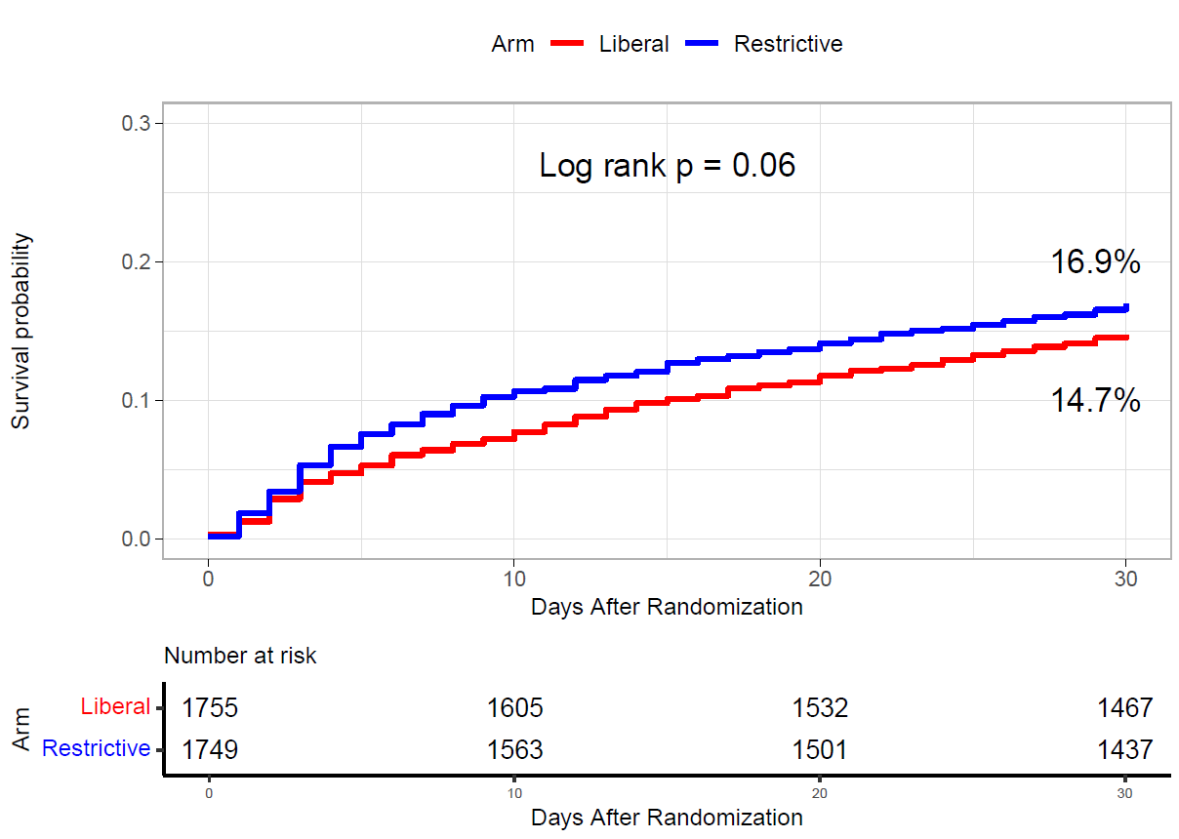
Primary Outcome Over 30-days

Slide 18
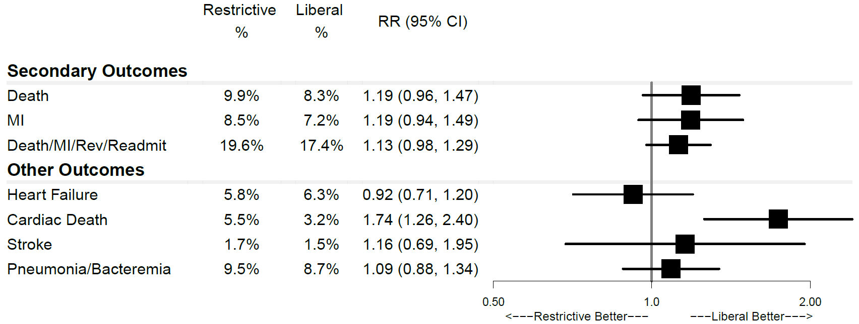
Secondary and Other Outcomes

Slide 19
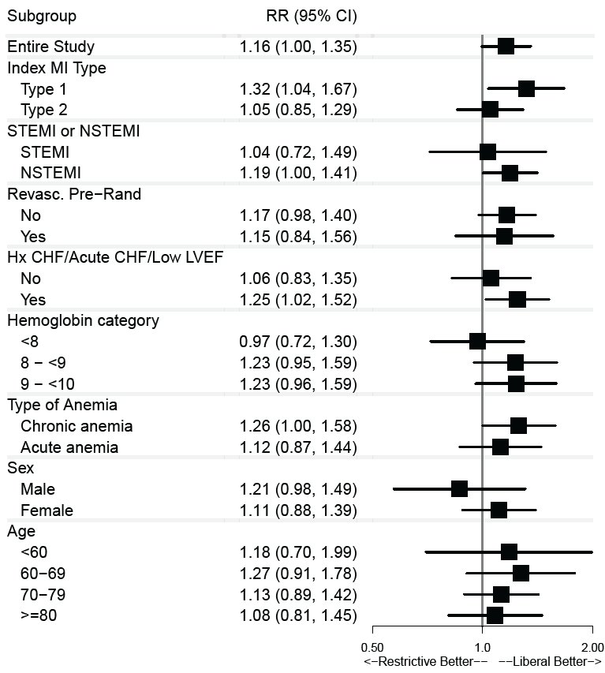
30-day
Death or MI by Baseline
Pre-specified Subgroups

Slide 20
Like all transfusion trials, assigned strategy was not masked
Although pre-specified, cardiac death was not designated as primary, secondary, or tertiary outcome or adjudicated
Trial results not adjusted for multiple comparisons
Limitations

Slide 21
The MINT trial did not demonstrate a statistically significant difference in the rate of 30-day death or recurrent MI in patients with acute MI and anemia assigned to a restrictive compared to a liberal transfusion strategy.
While not statistically significant, the point estimates for the primary outcome and secondary outcomes favored a liberal transfusion strategy.
Heart failure and other safety outcomes were comparable in the two transfusion groups.
Summary

Slide 22
Clinical Implications
Whether to transfuse is an every day decision faced by clinicians caring for patients with acute MI.
We cannot claim that a liberal transfusion strategy is definitively superior based on our primary outcome.
The 95% confidence interval is consistent with treatment effects corresponding to no difference between the two transfusion strategies and to a clinically relevant benefit with the liberal strategy.

Slide 23
Clinical Implications
The trial results therefore suggest that a liberal transfusion strategy has the potential for clinical benefit with an acceptable risk of harm and
May be the most prudent approach to transfusion in anemic patients with MI.

Slide 24
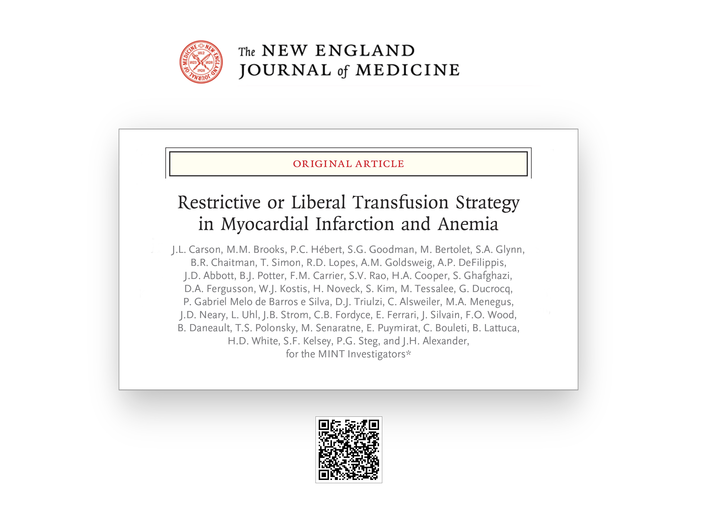

Slide 25
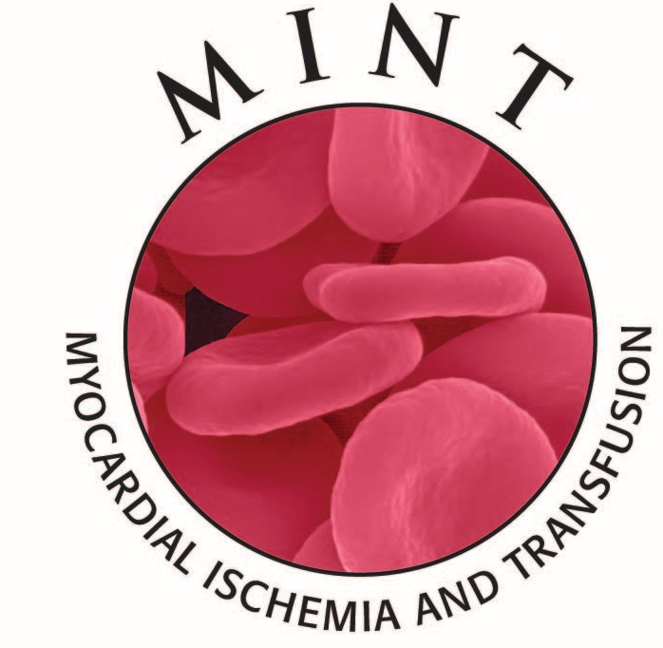
Thanks to the entire MINT Investigator team
and to all of the MINT trial participants!

