Slide 1
Efficacy and safety of anticoagulation with edoxaban in patients with Atrial high rate-episodes (AHRE) durations ≥ 24 hours - The NOAH-AFNET 6 trial -
Nina Becher, Tobias Toennis, Emanuele Bertaglia, Carina Blomstrom-Lundqvist, Nuno Cabanelas, Melanie Calvert, A John Camm, Gregory Chlouverakis, Gheorghe-Andrei Dan, Wolfgang Dichtl, Hans Christoph Diener, Alexander Fierenz, Andreas Goette, Joris R. de Groot, Astrid N. L. Hermans,, Gregory Y. H. Lip, Andrzej Lubinski, Eloi Marijon, Béla Merkely, Lluís Mont, Ann-Kathrin Ozga, Kim Rajappan, Andrea Sarkozy, Daniel Scherr, Renate B. Schnabel, Ulrich Schotten, Susanne Sehner, Emmanuel Simantirakis, Panos Vardas, Vasil Velchev, Dan Wichterle, Antonia Zapf, Paulus Kirchhof

Slide 2
Disclosures
Dr. Nina Becher received speaker fees from Medtronic, Abbott and an educational grant from Biotronik not related to this work.
The NOAH-AFNET 6 trial received financial support from the German Center for Cardiovascular Research, funded by the German Ministry of Education and Research (BMBF), and Daiichi Sankyo Europe.
Sponsor of NOAH-AFNET 6 is AFNET.

Slide 3
Background
Atrial high-rate episodes (AHRE) resemble short episodes of atrial fibrillation and are detected in every fifth patient with an implanted device.¹
Stroke risk associated with AHRE is lower than the stroke risk associated with ECG-documented atrial fibrillation.^{2,3}
The double-blind, double dummy “Non vitamin K antagonist Oral anticoagulants in patients with Atrial High-rate episodes” (NOAH-AFNET 6) trial found that oral anticoagulation with edoxaban does not markedly reduce a composite outcome of stroke, systemic embolism, or CV death compared to no anticoagulation in patients with AHRE and stroke risk factors but increased major bleedings.⁴
Observational studies suggest a higher stroke risk associated with AHRE lasting 24 hours or longer.^{5,6}
Randomized data evaluating anticoagulation in patients with long AHRE are lacking.
1 Toennis et al. Europace 2023. DOI: 10.1093/europace/euad166; 2 Healey et al. NEJM 2012. DOI: 0.1056/NEJMoa1105575
3 Bertaglia et al. Europace 2019. DOI: 10.1093/europace/euz172; 4 Kirchhof et al. NEJM 2023. DOI: 0.1056/NEJMoa2303062;
5 Uittenbogaart et al. Europace 2018. DOI: 10.1093/europace/eux356; 6 Van Gelder et al. Eur Heart J 2017. DOI:10.1093/eurheartj/ehx042

Slide 4
Study Design and Objectives
Prespecified subanalysis of NOAH-AFNET 6
To assess the efficacy and safety of oral anticoagulation with edoxaban compared to no anticoagulation in patients with AHRE lasting ≥24 hours compared to shorter episodes in the NOAH-AFNET 6 trial

Slide 5
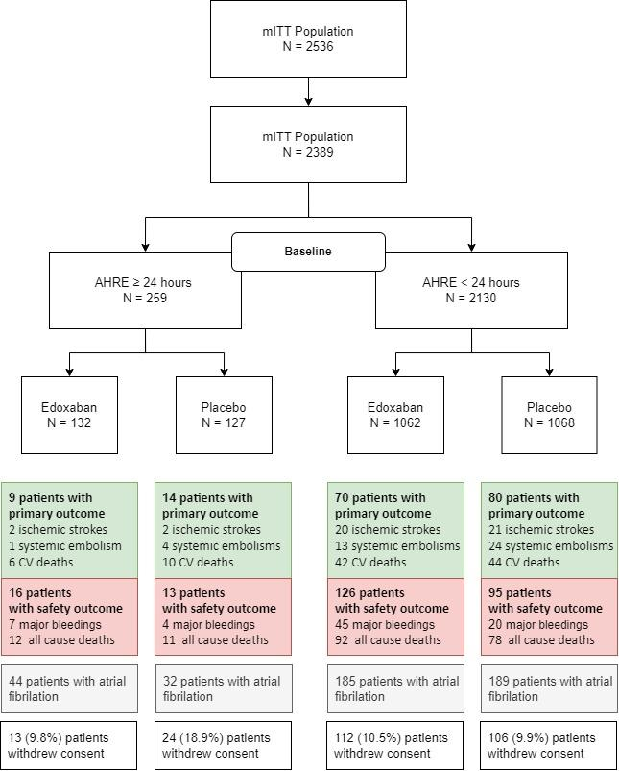
CONSORT Flow Diagram of the Substudy
All AHRE were reviewed by core lab.
Patients were classified by duration of the longest AHRE episode at baseline
Patients with core lab verified duration of longest AHRE at baseline
All patients changed to open-label anticoagulation upon ECG-documentation of atrial fibrillation
(ECG every 6 month)

Slide 6
Outcomes
Primary efficacy outcome
Composite of stroke, systemic embolism, or cardiovascular death
Safety outcome
Composite of ISTH major bleeding and all-cause death
Key secondary outcomes
Components of these outcomes
ECG-diagnosed atrial fibrillation
Post-hoc outcome
Composite of ischemic stroke and systemic embolism excluding pulmonary embolism and myocardial infarction

Slide 7
Baseline Characteristics
 | AHRE duration at baseline ≥24 hours |  | AHRE duration at baseline <24 hours |  | All Patients
 | Edoxaban (N=132) | Placebo (N=127) | Edoxaban (N=1062) | Placebo (N=1068) | Total (N=2389)
Age [years], mean ± SD | 77 ± 6.5 | 78 ± 7.6 | 78 ± 6.5 | 78 ± 5.6 | 78 ± 6.6
Female Sex, N (%) | 32/132 (24.2%) | 40/127 (31.5%) | 398/1062 (37.5%) | 405/1068 (37.9%) | 875/2389 (36.6%)
CHA₂DS₂-VASc score, Median (Q1, Q3) | 4 (3, 5) | 4 (3, 5) | 4 (3, 5) | 4 (3, 5) | 4 (3, 5)
Prior stroke or transient ischemic attack, N (%) | 11/132 (8.3%) | 14/127 (11.0%) | 101/1062 (9.5%) | 112/1068 (10.5%) | 238/2389 (10.0%)
Modified HAS-BLED Score, median (Q1,Q3) | 3 (3, 4) | 3 (3, 4) | 3 (3, 4) | 3 (3, 4) | 3 (3, 4)
Maximum duration of AHRE [hours], median (Q1, Q3) | 58.0 (30.7, 100.0) | 52.5 (33.4, 96.0) | 2.2 (0.7, 5.9) | 2.2 (0.6, 5.9) | 2.8 (0.8, 9.4)
Number of total AHRE, Median (Q1, Q3) | 10.5 (2.0, 36.2) | 9.0 (2.0, 24.0) | 4.0 (1.0, 15.0) | 4.0 (1.0, 13.8) | 4.0 (1.0, 15.0)

Slide 8
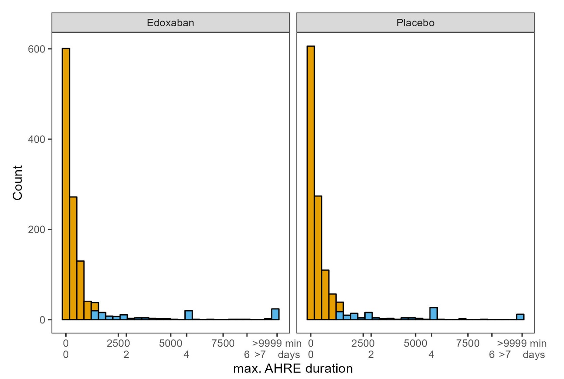
Duration of maximum AHRE at baseline
AHRE ≥ 24 hours
AHRE < 24 hours

Slide 9
Primary Efficacy Outcome (stroke, systemic embolism, or cardiovascular death)
 | AHRE duration ≥24 hours |  | AHRE duration <24 hours |  | p-value interaction
 | Edoxaban (n=132) | Placebo (n=127) | Edoxaban (n=1062) | Placebo (n=1068)
 | Patients with event |  | Patients with event
Primary efficacy outcome | 9 | 14 | 70 | 80 | 0.65
Ischemic stroke | 2 | 2 | 20 | 21 | 0.89
Systemic embolism | 1 | 4 | 13 | 24 | 0.51
CV death | 6 | 10 | 42 | 44 | 0.58
The results were consistent using AHRE as a continuous variable or using median AHRE duration.

Slide 10
Safety Outcome (major bleeding or death)
 | AHRE duration ≥24 hours |  | AHRE duration <24 hours |  | p-value interaction
 | Edoxaban (n=132) | Placebo (n=127) | Edoxaban (n=1062) | Placebo (n=1068)
 | Patients with event |  | Patients with event
Safety outcome | 16 | 13 | 126 | 95 | 0.96
Major bleeding | 12 | 11 | 92 | 78 | 0.69
Death | 7 | 4 | 45 | 20 | 0.97
The results were consistent using AHRE as a continuous variable or using median AHRE duration.

Slide 11
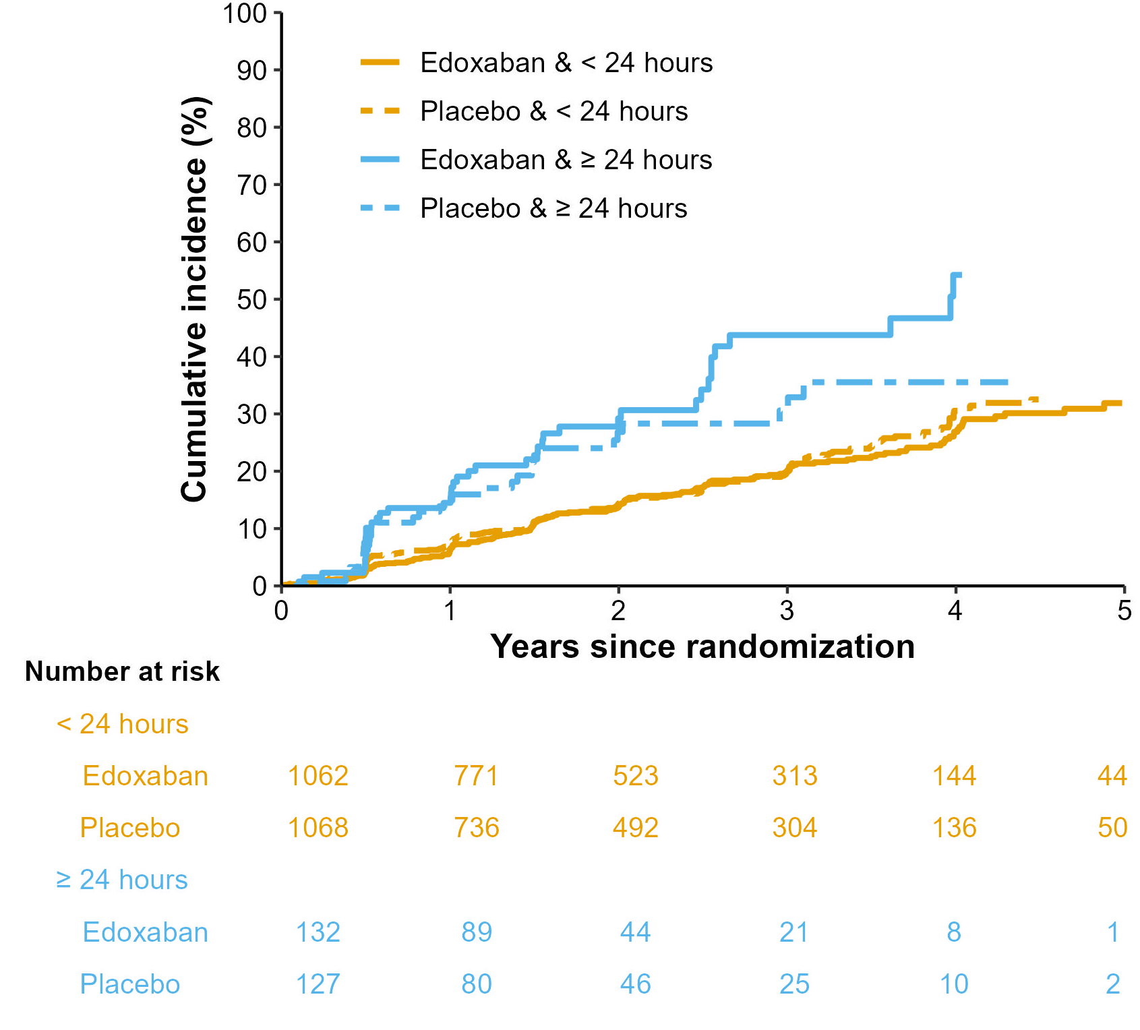
ECG-diagnosed Atrial Fibrillation
Incidence of ECG diagnosed atrial fibrillation
(ECG every 6 months)
AHRE duration ≥24 hours | AHRE duration <24 hours
17.0%/patient-year | 8.2%/patient-year
HR 2.20 (95% CI 1.71, 2.84), p<0.001

Slide 12
Strengths and Limitations
Prespecified secondary subanalysis of NOAH-AFNET 6
First randomized comparison of oral anticoagulation and placebo in patients with AHRE ≥24 hours.
All episodes were reviewed by a core lab.
97% of AHRE resembles device-detected atrial fibrillation
Number of ischemic events was too small to rule out effects of anticoagulation on stroke prevention.
Enrolment confined to Europe, population predominantly Caucasian.

Slide 13
Conclusions
In this prespecified subanalysis of the NOAH-AFNET 6 trial, the rate of stroke appeared low in patients with AHRE durations ≥24 hours.
There was no interaction between the duration of the longest AHRE episode and the efficacy and safety of oral anticoagulation.
Patients experiencing AHRE durations ≥24 hours are more likely to develop atrial fibrillation over time than those with shorter AHRE, calling for regular ECGs.
Further research is needed to identify patients with AHRE at higher risk of stroke and other cardiovascular events.

