Slide 1
Aspirin and Hemocompatibility Events with a Left Ventricular Assist Device in Advanced Heart Failure The ARIES-HM3 Clinical Trial
Mandeep R. Mehra, Ivan Netuka, Nir Uriel, Jason N. Katz, Francis D. Pagani, Ulrich P. Jorde, Finn Gustafsson,
Jean M. Connors, Peter Ivak, Jennifer Cowger, John Ransom, Aditya Bansal, Koji Takeda, Richa Agarwal, Mirnela Byku,
Michael M. Givertz, Abbas Bitar, Shelley Hall, Daniel Zimpfer, J David Vega, Manreet K. Kanwar, Omar Saeed,
Daniel J. Goldstein, Rebecca Cogswell, Farooq H. Sheikh, Matthew Danter, Yuriy Pya, Anita Phancao, John Henderson,
Daniel L. Crandall, Kartik Sundareswaran, Edward Soltesz and Jerry D. Estep
On Behalf of the ARIES Investigators

Slide 2
Disclosures
This presentation will discuss off-label use of the HeartMate 3
The ARIES HM3 Trial (NCT04069156) is funded and sponsored by Abbott, the manufacturer of the HeartMate 3 Left Ventricular Assist System
Dr Mehra reports payments made to his institution from Abbott for consulting, received personal consulting fees from Moderna, Paragonix and Natera.
He is an advisory board member for NuPulseCV, Leviticus, Transmedics and FineHeart.

Slide 3
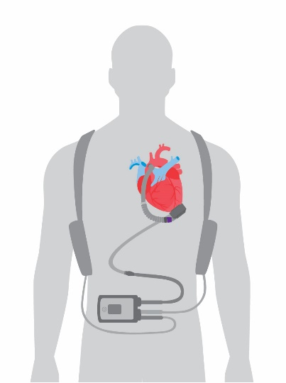
HeartMate 3 Left Ventricular Assist Device
The HeartMate 3 LVAD is a centrifugal-flow, fully magnetically levitated blood pump engineered to minimize destruction of red blood cells and thrombosis
Wide blood-flow passages to reduce shear stress
Frictionless with absence of mechanical bearings
Intrinsic Pulse designed to reduce stasis and avert thrombosis
Bourque, Cotter, Dague, et al, ASAIO J 2016;62:375-83
Mehra, Naka, Uriel, et al, N Engl J Med. 2017; 376:440-450
Mehra, Goldstein, Uriel, et al. N Engl J Med. 2018;378:1386-1395

Slide 4
A New Survival Benchmark with LVAD Therapy
5-year survival of 58.4% with the centrifugal flow HeartMate 3 LVAD in advanced HF patients
50%
Mehra, Goldstein, Cleveland et al, JAMA 2022; 328(12):1233-1242
Notes:
Due to the technological advances conferred by the HM3 pump, a new…. Has been established

Slide 5
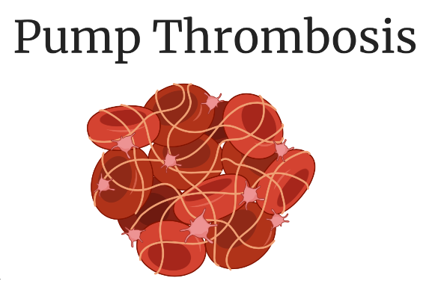
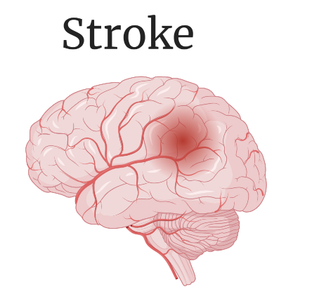
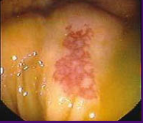
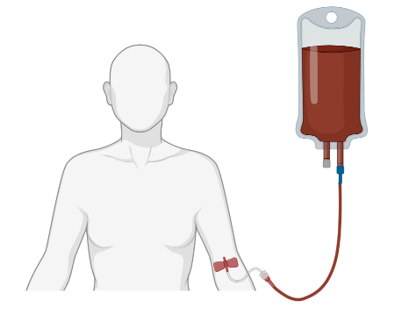
HEMOCOMPATIBILITY RELATED OUTCOMES
Opportunity to Reduce Residual Risk
Mehra MR, Crandall DL, Gustafsson F, et al., Eur J Heart Fail. 2021;23(7):1226-1237

Slide 6
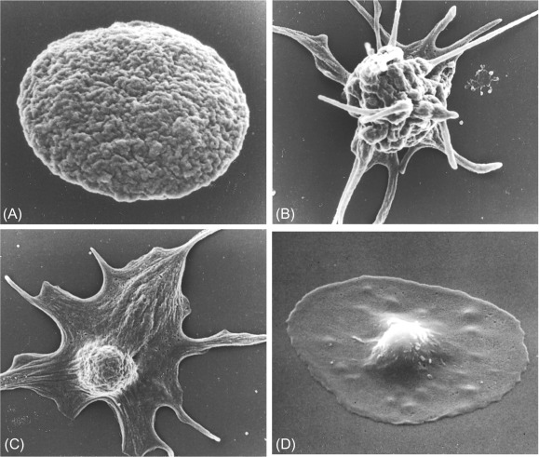
Can aspirin be safely excluded from the antithrombotic regimen
(which includes Vitamin-K Antagonists)
in HM3 LVAD Patients?
ACETYLATION
COX-1 INHIBITION
PLATELET INHIBITION
ACETYLSALICYLIC ACID
THROMBOSIS
SALICYLATION
COX-2 INHIBITION
ANTI-INFLAMMATION
Mehra MR, Crandall DL, Gustafsson F, et al., Eur J Heart Fail. 2021;23(7):1226-1237
Thomas, The Structure of Resting and Activated Platelets. Platelets 4th Ed. 2019, Pages 47-77

Slide 7
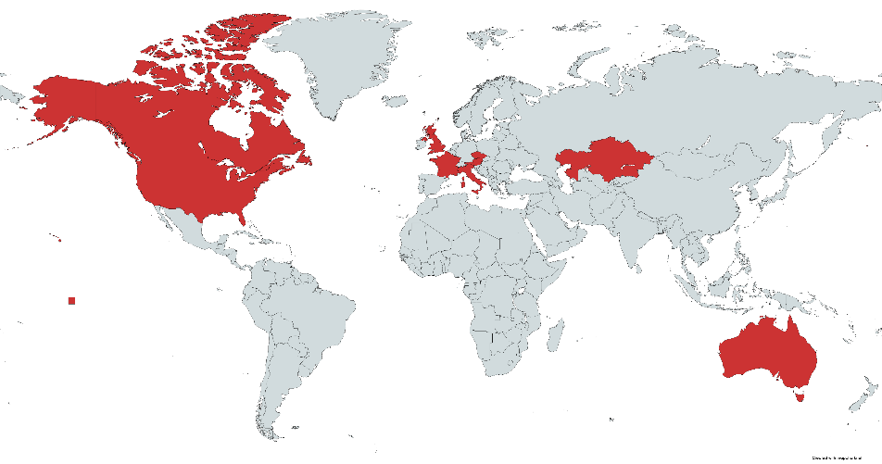
International, Multicenter, Prospective, Randomized,
Double-blind, Placebo-controlled Study
HYPOTHESIS
Exclusion of aspirin from the antithrombotic regimen of HM3 LVAD patients will not adversely affect safety or efficacy of the HM3 and may reduce non-surgical bleeding
Global Study of 51 centers in 9 countries
Antithrombotic Regimens
Aspirin (100mg) + Standard VKA (INR 2.0-3.0)
versus
Placebo + Standard VKA (INR 2.0-3.0)
US
Canada
United Kingdom
France
Italy
Austria
Czechia
Kazakhstan
Australia

Slide 8
End Points
Primary: Survival free of any non-surgicalª major hemocompatibility related adverse event^{b} at 1-year post implant
The final sample size provided >90% power to assess the primary end point
Non-inferiority met if the lower boundary of the one-sided 97.5% confidence limit was greater than the non-inferiority margin (-10%)
Principal Secondary: All Non-surgical Bleeding
ª >14 days post implant. ^{b}Any Stroke, Pump Thrombosis, Major Bleeding, and Arterial Peripheral Thromboembolism

Slide 9
Patient Population
Patient Meets ARIES HM3 Eligibility?
Placebo with VKA (INR 2.0-3.0)
Randomization 1:1
Day 2-7 post implant
Aspirin with VKA (INR 2.0-3.0)
Randomized Population
N=628
Placebo
N=314
Aspirin
N=314
Surgical Events and Outcomes (n=18)
Transitioned to open label (n=8)
Died (n=1)
Withdrawn (n=9)
Surgical Events and Outcomes (n=21)
Transitioned to open label (n=12)
Died (n=2)
Withdrawn (n=7)
Primary Analysis Population
N=589
Follow up on Placebo
N=296
Follow up on Aspirin
N=293
Withdrawn without primary end point event (n=25)
Withdrawn without primary end point event (n=20)
Primary Endpoint Set
N=544
Evaluated for Primary Endpoint
N=271
Evaluated for Primary Endpoint
N=273

Slide 10
Baseline Characteristics
Characteristic | Placebo (N =296) | Aspirin (N =293)
Age – years, median (range) | 60 (20-79) | 59 (18-80)
Female sex – no. (%) | 72 (24) | 61 (21)
Race (white) – no. (%)* | 179 (60.5) | 181 (61.8)
Ischemic etiology of heart failure – no. (%) | 106 (35.8) | 101 (34.5)
History of atrial fibrillation – no. (%) | 137 (46.3) | 122 (41.6)
History of stroke – no. (%) | 44 (14.9) | 35 (11.9)
History of prior bleeding – no. (%) | 17 (5.7) | 12 (4.1)
History of diabetes mellitus – no. (%)† | 134 (45.3) | 106 (36.2)
Destination therapy goal of pump support – no. (%) | 180 (60.8) | 174(59.4)
INTERMACS profile – no. (%)
1 | 12 (4.1) | 18 (6.1)
2 | 76 (25.7) | 75 (25.6)
3 | 133 (44.9) | 133 (45.4)
4-7 | 75 (25.3) | 67 (22.7)
Enrolled in North America – no. (%) | 251 (85) | 248 (85)
Notes:
Simplify into non colored table. Make black and white table with row delineations

Slide 11
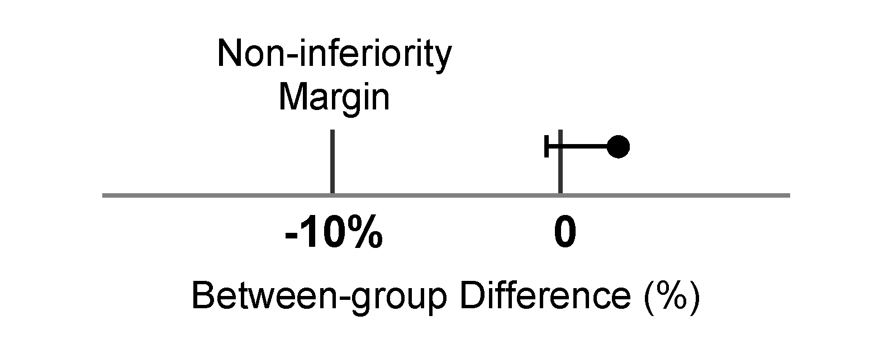
Primary End Point Analysis
Time-to-First Event
r
%
 | Placebo | Aspirin | Difference (Lower 97.5% CI)* | P-value*
Non-Inferiority Primary End Point Analysis | 74.2 (201/271) | 68.1 (186/273) | 6.0% (-1.6%) | <.001
o
,
j
t
a
n
50
M
e
l
v
a
E
c
e
i
s
g
r
40
r
e
u
v
Aspirin
s
d
-
A
n
Placebo
o
d
30
N
e
r
t
o
a
l
h
e
t
R
a
y
20
e
t
D
i
l
i
f
b
o
i
t
y
a
t
p
10
i
l
m
i
b
o
a
c
Hazard Ratio at 2 y, 0.73 (95% CI, 0.55 - 0.97) P=0.03
b
o
o
m
r
e
0
P
H
0
6
12
18
24
Months After Implant
No. at Risk:
Placebo
296
221
161
84
44
Aspirin
293
205
146
72
33
All sensitivity analyses concur with the primary analysis, including randomized population, worst case allocation of withdrawals, and impact of transition to open label
Notes:
Increase font in table. Increase table size. Fix numbers in the graph. Fix pixelation. Remove arrow. Label NIM. Change font of the axis titles in KM Curve (and follow through to other KMs)

Slide 12
Principal Secondary Endpoint
Rate of Non-surgical Bleeding Events
%
,
50
s
t
Aspirin
n
42.4
e
Placebo
v
E
40
g
n
i
d
29.7
e
e
30
l
B
30.0
l
a
c
i
g
20
r
u
23.1
s
-
n
o
N
10
f
o
e
Hazard Ratio at 2 y, 0.67 [95% CI, 0.50 - 0.92] P=0.01
t
a
0
R
0
6
12
18
24
Months After Implant
No. at Risk:
Placebo
296
222
163
85
44
Aspirin
293
207
148
73
34
Notes:
Add blood transfusion man

Slide 13
Secondary Endpoints – Total Events
For every 100 patients implanted with the study LVAD,
aspirin exclusion prevents
14.5 major bleeding events in the first year

Slide 14
Safety Endpoints
Mortality
 | Placebo | Aspirin
12-month Mortality | 4.3% | 7.2%
24-month Mortality | 12.3% | 9.1%
There was no difference in mortality between Placebo and Aspirin.
HR [95% CI]: 0.90 [0.50 - 1.62] P=0.71

Slide 15
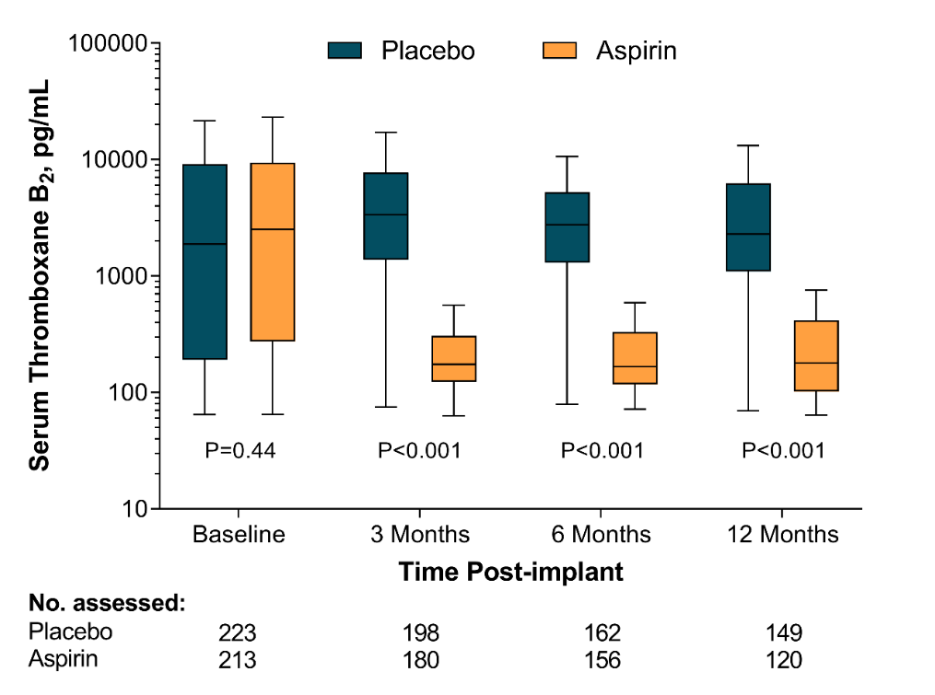
Efficacy of Antithrombotic Therapy
Time in therapeutic range was not different between the two groups
 | Placebo | Aspirin | P-Value
INR Median (IQR) | 55.1% (39.5-73.9) | 58.9% (39.5-69.0) | 0.93
Notes:
Move to earlier change TTR to text and don’t use butterfly plot. Everywhere should say exclusion.

Slide 16
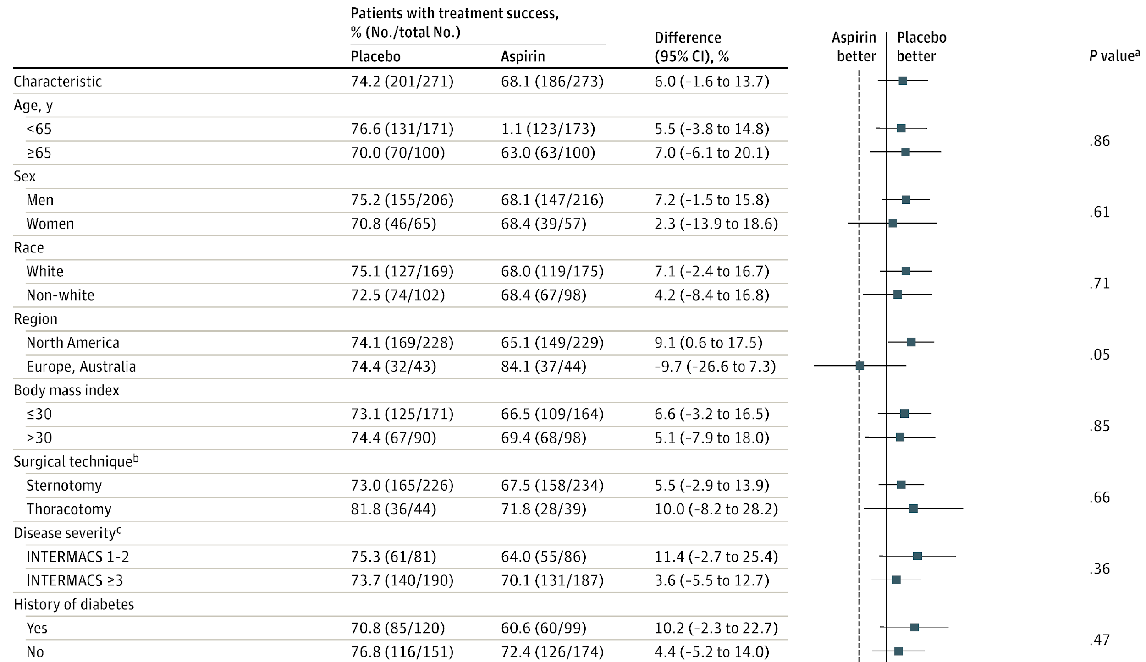
Important Patient Subgroups

Slide 17
Important Patient Subgroups

Slide 18
Hospitalizations and Cost Savings* *US population only, US payer perspective only
47%
41%

Slide 19
Conclusions
In patients with advanced heart failure receiving support from a fully magnetically levitated LVAD, aspirin is not required as part of an antithrombotic regimen that includes a Vitamin K Antagonist to preserve outcomes
Exclusion of aspirin is associated with a significant decrease in bleeding events with no increase in risk of thrombo-embolic events
Benefits of aspirin avoidance are associated with a decrease in hospitalization rates and cost of care due to bleeding complications.

Slide 20
We THANK all the patients, our investigators, clinical nurse coordinators, and allied health personnel for their dedication to the conduct of the ARIES HM3 Study
Data Safety Monitoring Board
William Holman, MD (Chair)
Kenneth Bauer, MD
Stuart Russell, MD
Daniel Heitjan, PhD
Clinical Events Committee
Joseph Cleveland, MD (Chair)
Joshua Willey, MD, MS
Gregory Egnaczyk, MD, PhD
Erin Coglianese, MD
Study Steering Committee
Mandeep R. Mehra, MBBS, MSc (Chair)
Ivan Netuka, MD, PhD
Nir Uriel, MD, MSc
Jason N. Katz, MD, MS
Francis D. Pagani, MD, PhD
Ulrich P. Jorde, MD
Finn Gustafsson, MD, PhD, DMSci
Jean M. Connors, MD

Slide 21
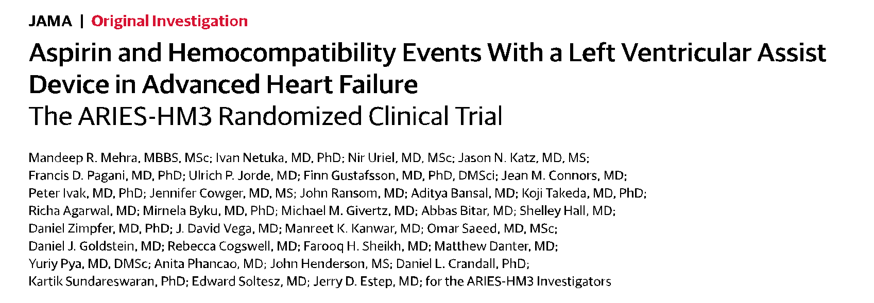
Published online November 11, 2023
American Heart Association Scientific Sessions 2023

