Slide 1

Long-term Clinical Outcomes After iFR vs. FFR-guided Coronary Revascularization
Insights from the SWEDEHEART National Registry
Matthias Götberg, MD, Assoc Prof. Director Cardiac Cath lab
Department of Cardiology, Skane University Hospital
Lund University, Sweden

Slide 2

Disclosure of Relevant Financial Relationships
Within the prior 24 months, I have had a relevant financial relationship with a company producing, marketing, selling, re-selling, or distributing healthcare products used by or on patients:
Nature of Financial Relationship | Ineligible Company
Consultant Fees/Honoraria | Abbott Vascular, Boston Scientific, Medtronic, Philips IGT
All relevant financial relationships have been mitigated.
Faculty disclosure information can be found on the app

Slide 3
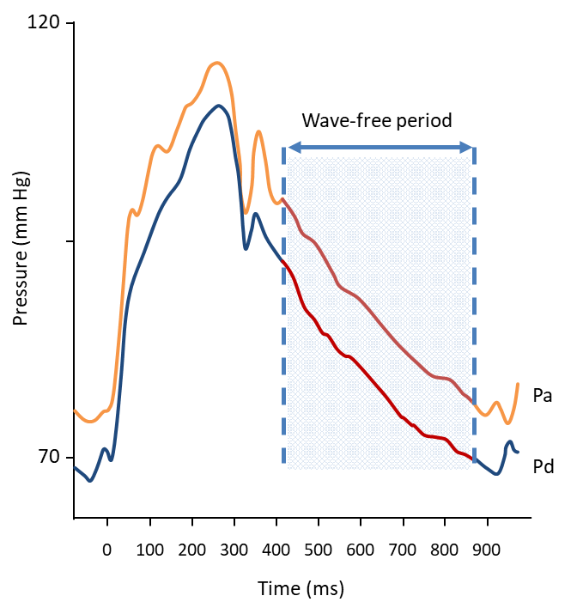
Background
Instantaneous Wave-free ratio (iFR) is a non-hyperemic index for assessment of coronary lesion severity
iFR-validation studies have demonstrated ≈85% agreement with Fractional Flow Reserve (FFR). iFR and FFR have similar agreement with other ischemic indices
CFR, Coronary Flow Reserve; HSR, Hyperaemic Stenosis Resistance; PET, positron emission tomography; SPECT, single-photon emission computed tomography
1. Van de Hoef TP et al. Circ Cardiovasc Interv. 2012;5:508-14; 2. Sen S et al. J Am Coll Cardiol. 2013;61:1409-20; 3. Van de Hoef TP et al. EuroIntervention. 2015;11:914-25;
4. Sen S et al. J Am Coll Cardiol. 2013;62:566; 5. Petraco R et al. Circ. Int. 2014;7:492-502; 6. de Waard G et al. J Am Coll Cardiol. 2014;63:A1692.

Slide 4
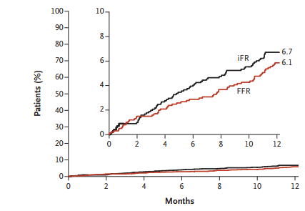
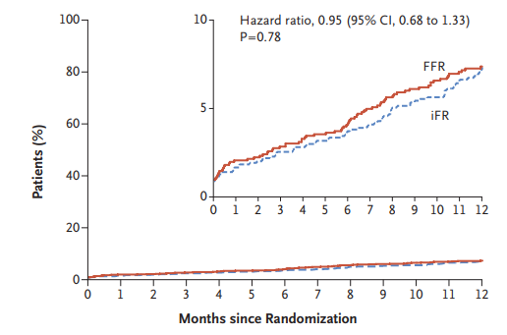
iFR vs FFR 1-year outcomes
All-cause death, MI, unplanned revascularization
iFR-SWEDEHEART DEFINE-FLAIR
HR 1.12 (0.79-1.58)
p=0.53
HR 0.95 (0.68-1.33)
p=0.78
iFR was non-inferior to FFR at 1-year
Davies et al, N Engl J Med 2017; 376:1824-1834
Götberg et al, N Engl J Med 2017; 376:1813-1823

Slide 5
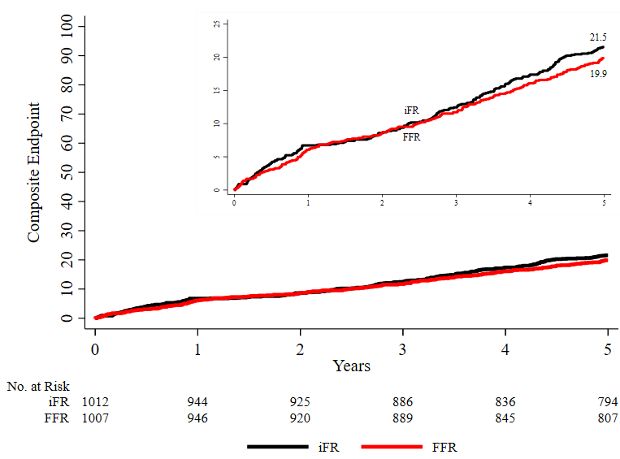
iFR vs FFR 5-year outcomes
All-cause death, MI, unplanned revascularization
iFR-SWEDEHEART
iFR 21.5%
FFR 19.9%
HR 1.09 (0.90-1.33)
No difference in MACE, death, MI, or unplanned revasc. at 5 years
Götberg et al, J Am Coll Cardiol 2022 Mar 15:79(10):965-974

Slide 6
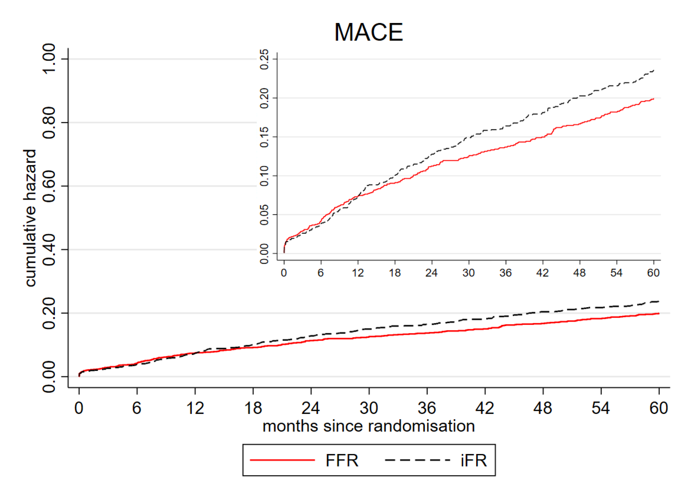
iFR vs FFR 5-year outcomes
All-cause death, MI, unplanned revascularization
DEFINE-FLAIR
iFR 21.1%
FFR 18.4%
HR 1.18 (95%CI 0.99-1.42), p=0.06
No difference in MACE at 5 years
Escaned et al EUROPCR 2023

Slide 7
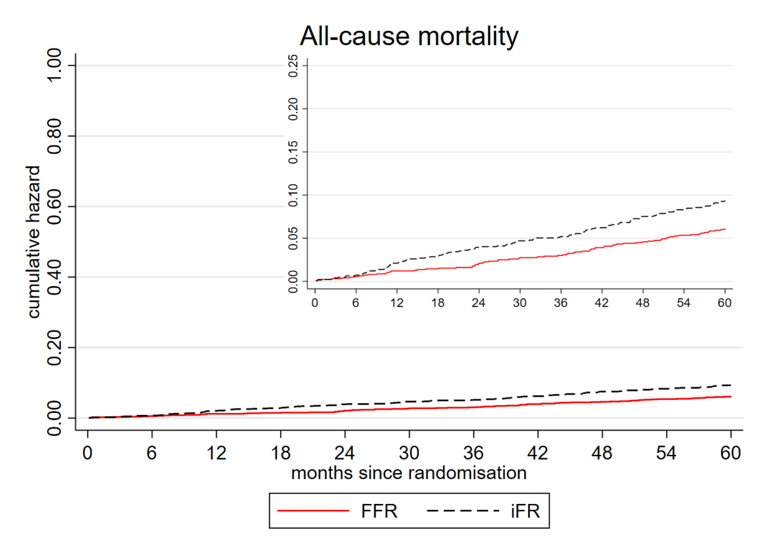
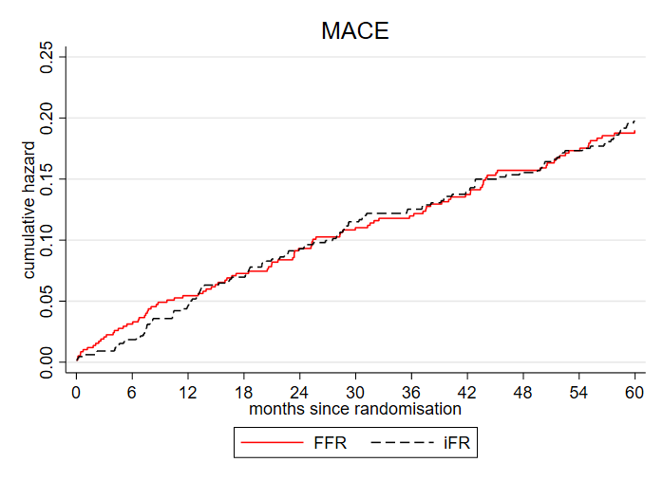
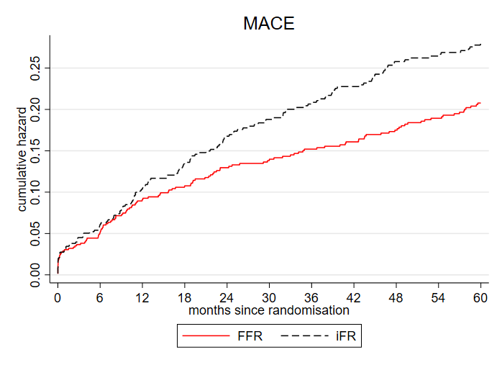
iFR vs FFR 5-year outcomes
DEFINE-FLAIR
All-cause death
MACE deferred
MACE treated
HR 1.56 (95% CI 1.16-2.09)
P<0.01
HR 1.03 (95% CI 0.79-1.35)
p=0.80
HR 1.36 (95% CI 1.07-1.72)
p=0.01
DEFINE-FLAIR:Significant increase in mortality with iFR
Signal restricted to treated patients driving MACE
No difference in MI or unplanned revascularization
Escaned et al EUROPCR 2023

Slide 8
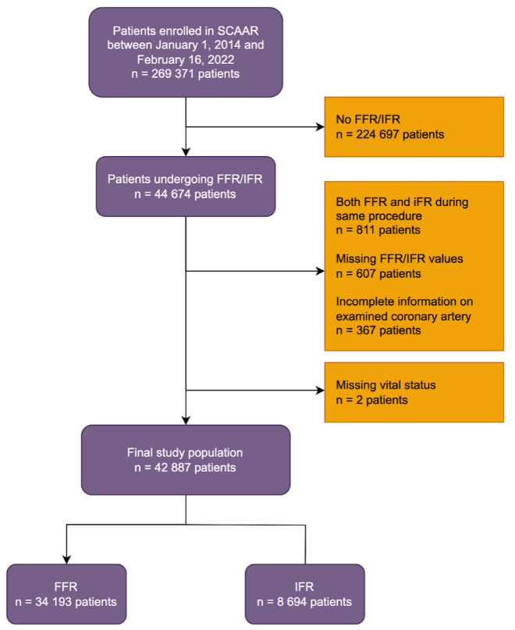
Swedeheart National Registry Analysis
42887 patients included in the analysis
Follow-up up to 5 years:
National Population Registry (mortality)
SWEDEHEART (revasc with PCI)
National Patient Registry (MI, revasc with CABG)
100% tracking of all patients

Slide 9
Baseline characteristics
 | Total | FFR | IFR | P–value
 | 42887 (100.0%) | 34193 (79.7%) | 8694 (20.3%)
Age (years) – median (IQR) | 69.0 (61.0–75.0) | 69.0 (61.0–75.0) | 69.0 (61.0–75.0) | 0.08
Men | 31797 (74.1%) | 25509 (74.6%) | 6288 (72.3%) | <0.001
Diabetes | 10312 (24.0%) | 8129 (23.8%) | 2183 (25.1%) | 0.01
Hypertension | 31725 (74.0%) | 25246 (73.8%) | 6479 (74.5%) | 0.19
Previous myocardial infarction | 12897 (30.1%) | 10138 (29.6%) | 2759 (31.7%) | <0.001
Previous PCI | 15863 (37.0%) | 12640 (37.0%) | 3223 (37.1%) | 0.87
Stroke | 2598 (6.1%) | 2026 (5.9%) | 572 (6.6%) | 0.02
Chronic heart failure | 4410 (10.3%) | 3510 (10.3%) | 900 (10.4%) | 0.81
Peripheral artery disease | 1947 (4.5%) | 1549 (4.5%) | 398 (4.6%) | 0.85
Chronic obstructive pulmonary disease | 2771 (6.5%) | 2139 (6.3%) | 632 (7.3%) | 0.001
Renal failure | 1637 (3.8%) | 1283 (3.8%) | 354 (4.1%) | 0.17
Cancer | 1547 (3.6%) | 1203 (3.5%) | 344 (4.0%) | 0.05
Baseline differences between iFR vs. FFR
iFR more often utilized in women, DM, MI, stroke, COPD

Slide 10
Deferred vs. treated
 | Deferred
 | Total | FFR | iFR | P-value
Age (years) – median (IQR) | 69.0 (62.0-75.0) | 69.0 (62.0-75.0) | 69.0 (61.0-75.0) | 0.053
Men | 19983 (71.3%) | 15609 (71.3%) | 4374 (71.1%) | 0.772
Diabetes | 6464 (23.1%) | 5039 (23.0%) | 1425 (23.2%) | 0.808
Hypertension | 20837 (74.3%) | 16283 (74.4%) | 4554 (74.0%) | 0.588
Previous myocardial infarction | 8282 (29.5%) | 6371 (29.1%) | 1911 (31.1%) | 0.003
Previous PCI | 10252 (36.6%) | 7998 (36.5%) | 2254 (36.6%) | 0.881
Stroke | 1753 (6.3%) | 1366 (6.2%) | 387 (6.3%) | 0.882
Chronic heart failure | 3026 (10.8%) | 2381 (10.9%) | 645 (10.5%) | 0.384
Peripheral artery disease | 1289 (4.6%) | 1012 (4.6%) | 277 (4.5%) | 0.693
Chronic obstructive pulmonary disease | 1961 (7.0%) | 1479 (6.8%) | 482 (7.8%) | 0.003
Renal failure | 1098 (3.9%) | 853 (3.9%) | 245 (4.0%) | 0.757
Cancer | 1063 (3.8%) | 814 (3.7%) | 249 (4.0%) | 0.231
Treated
Total | FFR | iFR | P-value
68.0 (61.0-74.0) | 68.0 (61.0-74.0) | 70.0 (61.0-75.0) | <0.001
11814 (79.6%) | 9900 (80.5%) | 1914 (75.3%) | <0.001
3848 (25.9%) | 3090 (25.1%) | 758 (29.8%) | <0.001
10888 (73.3%) | 8963 (72.9%) | 1925 (75.7%) | 0.003
4615 (31.1%) | 3767 (30.6%) | 848 (33.3%) | 0.007
5611 (37.8%) | 4642 (37.7%) | 969 (38.1%) | 0.732
845 (5.7%) | 660 (5.4%) | 185 (7.3%) | <0.001
1384 (9.3%) | 1129 (9.2%) | 255 (10.0%) | 0.180
658 (4.4%) | 537 (4.4%) | 121 (4.8%) | 0.381
810 (5.5%) | 660 (5.4%) | 150 (5.9%) | 0.281
539 (3.6%) | 430 (3.5%) | 109 (4.3%) | 0.052
484 (3.3%) | 389 (3.2%) | 95 (3.7%) | 0.138
Treated iFR-group: older, more often women, DM, HT, MI, stroke
Baseline characteristics influence revascularization decision differently in iFR- vs FFR-group

Slide 11
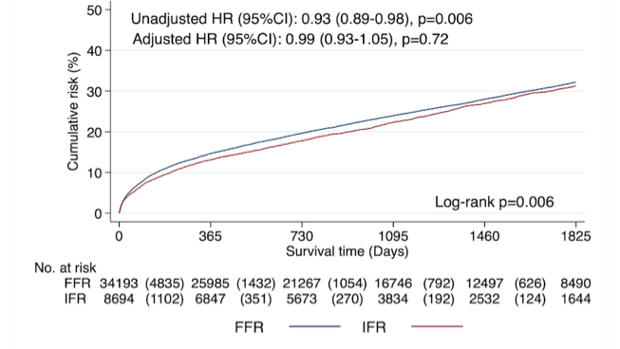
iFR vs FFR 5-year MACE
All-cause death, MI, unplanned revascularization
*Adjusted HR 0.99 (0.93-1.05)
p=0.72
No difference in MACE between iFR and FFR
*Adjusted for age, sex, calendar year, smoking, diabetes, hypertension, history of MI, history of stroke, chronic heart failure, renal failure, COPD, cancer, indication for procedure, angiographic findings, periprocedural pharmacotherapy including the use of upstream ticagrelor, aspirin, heparin, upstream fondaparinux, FFR/iFR examined coronary artery segments, treatment strategy (deferral/treatment), PCI treated coronary artery segments, number of stents inserted, use of intravascular imaging during PCI, PCI center and CABG as revascularization method.

Slide 12
iFR vs FFR 5-year outcomes
All-cause death
Myocardial infarction
Unplanned revascularization
Adjusted HR 1.04 (0.94-1.14)
p=0.43
Adjusted HR 0.94 (0.85-1.05)
p=0.30
Adjusted HR 1.00 (0.92-1.08)
p=0.98
Similar outcome in all components of MACE
(all-cause death, MI, or unplanned revascularization)

Slide 13
Deferred vs. treated patients
MACE (Deferred)
MACE (Treated)
Adjusted HR 0.97 (0.90-1.04)
p=0.44
Adjusted HR 1.03 (0.92-1.15)
p=0.60
No difference in MACE between iFR and FFR
No interaction between treatment decision and outcome

Slide 14
Deferred vs. treated patients
All-cause death (Deferred)
All-cause death (Treated)
Adjusted HR 1.06 (0.95-1.20)
p=0.30
Adjusted HR 1.00 (0.85-1.18)
p=0.98
No difference in All-cause death between iFR and FFR

Slide 15
Deferred vs. treated patients
Myocardial infarction (Deferred)
Myocardial infarction (Treated)
Adjusted HR 0.91 (0.79-1.04)
p=0.16
Adjusted HR 1.03 (0.86-1.22)
p=0.76
No difference in Myocardial infarction between iFR and FFR

Slide 16
Deferred vs. treated patients
Unplanned revasc. (Deferred)
Unplanned revasc. (Treated)
Adjusted HR 1.00 (0.91-1.09)
p=0.96
Adjusted HR 0.99 (0.85-1.15)
p=0.85
No difference in Unplanned revascularization between iFR and FFR

Slide 17
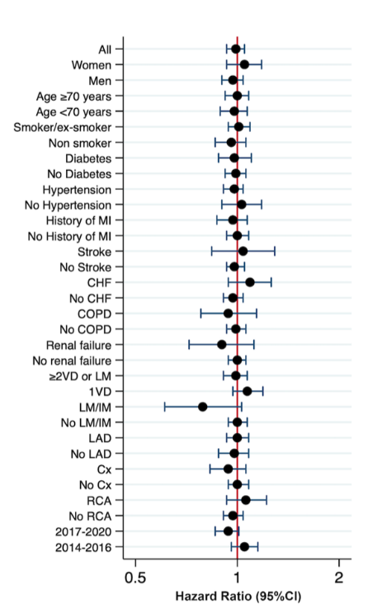
Subgroup analyses
5-year MACE
No difference in MACE
between iFR and FFR
in any of the subgroups

Slide 18
Summary I
In a national registry analysis of 42 887 patients investigated with iFR or FFR with a follow-up up to 5-years:
Similar outcome between iFR and FFR
MACE (all-cause death, MI, unplanned revasc)
All-cause death
Myocardial infarction
Unplanned revascularization
Deferred and treated populations

Slide 19
Summary II
The observed difference in mortality between iFR and FFR among treated patients in DEFINE-FLAIR could not be verified in this large nation-wide real-world all-comers registry analysis

