Slide 1
One-Year Outcomes after Amulet or Watchman/FLX Device for Percutaneous Left Atrial Appendage Closure: Pre-Specified Analyses of the SWISS-APERO Randomized Clinical Trial
Roberto Galea, MD
Department of Cardiology, Bern University Hospital, Bern, Switzerland
on behalf of the SWISSAPERO Trial Investigators
@robertogalea7
roberto.galea@insel.ch

Slide 2
Disclosure of Relevant Financial Relationships
I, Roberto Galea, DO NOT have any relevant financial relationships to disclose.
Acknowledgements
Images of Amplatzer Amulet device are reproduced with permission of Abbott, © 2021. All rights reserved. Images of Watchman FLX have been provided courtesy of Boston Scientific, ©2021 Boston Scientific Corporation or its affiliates. All rights reserved.

Slide 3
Background and objectives
Residual LAA patency after LAAC has been associated with higher thromboembolic risk, especially when detected remotely after the procedure.
Watchman FLX and Amulet devices are the two most frequently used devices for LAAC worldwide and SwissApero Trial is the first randomized comparison between them. The main findings of the study showed a similar LAA sealing performance of the two devices at 45-day CCTA.
In these pre-specified subanalyses of SwissApero Trial, we compared Watchman FLX and Amulet in terms of LAA patency and DRT at 13-month CCTA, besides clinical outcomes through 13 months.

Slide 4
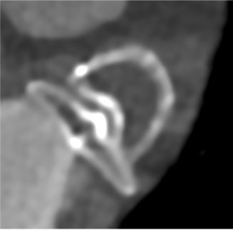
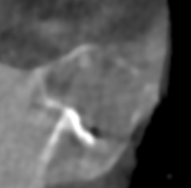
SWISS-APERO Trial Design
Screening phase
Amulet
LAAC clinically indicated
LAAC
45-DAY fu
13-Month fu
DEVICE RANDOMIZATION
Mid-term LAA PATENCY
Long-term LAA PATENCY
Watchman
FLX
Eligibility
High bleeding risk
LAA morhology suitable for both devices
No LAA thrombus
ASA +
Clopidogrel or (N)OAC
(Days after LAAC)
45 ± 7
90 ± 7
395 ± 30
Medical and drug history assessment
Laboratory tests
TEE (optional if intraprocedural TEE)
CCTA
Intraprocedural TEE/ICE
Randomization
Medical and drug
history assessment
TEE
CCTA
Medical and drug
history assessment
CCTA
O

Slide 5
SWISS-APERO Trial Design
Screening phase
Amulet
LAAC clinically indicated
LAAC
13-Month fu
DEVICE RANDOMIZATION
Long-term LAA PATENCY
Watchman
FLX
Eligibility
High bleeding risk
LAA morhology suitable for both devices
No LAA thrombus
ASA +
Clopidogrel or (N)OAC
(Days after LAAC)
45 ± 7
90 ± 7
395 ± 30
Medical and drug history assessment
Laboratory tests
TEE (optional if intraprocedural TEE)
CCTA
Intraprocedural TEE/ICE
Randomization
Medical and drug
history assessment
TEE
CCTA
Medical and drug
history assessment
CCTA
O

Slide 6
Pre-specified Analyses
Primary Analyses
Comparison of two study groups in terms of:
Residual LAA patency and related subtypes at 13-month CCTA
DRT at 13-month CCTA
13-month clinical outcomes
All cause or cardiovascular death
All stroke, ischemic or haemorrhagic stroke
Systemic or Pulmonary embolism
Bleeding according to the BARC classification
Both imaging and clinical endpoints were centrally adjudicated
Secondary Analysis
Comparison of 45-day and 13-month CCTAs with the aim of exploring the evolution of LAA patency and related subtypes during the first year after procedure

Slide 7
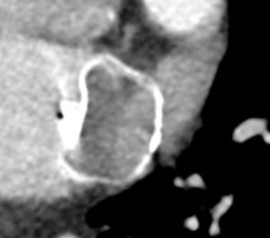
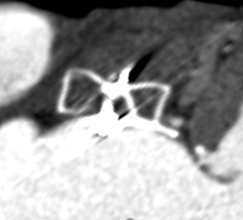
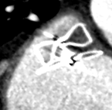
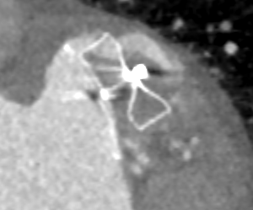
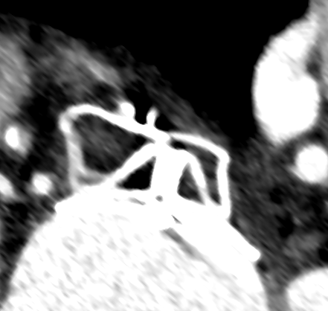
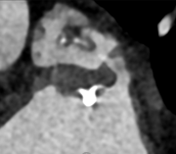
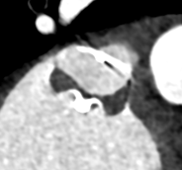
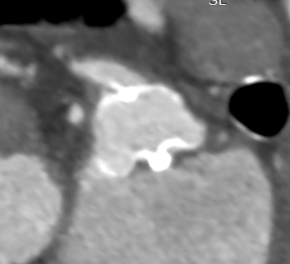
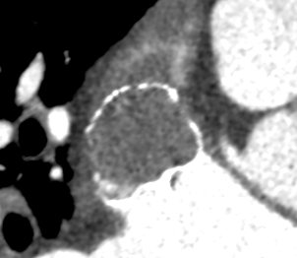
LAA Patency subtypes
LAA PATENCY DEFINITION:
LAA density ≥ 100 HU and/or
LAA density ≥ 25% of that of the LA
PATENT LAA (PA)
NON PATENT LAA (NPA)
C
64 HU
457 H
457 HU
526 HU
421 HU
PERIDEVICE
MIXED
INTRADEVICE
PANVL
115
HU
AMULET
132 HU
WATCHMAN
Underlying
Leak Mechanisms
INCOMPLETE SIDE
SEALING (GAP LEAKS)
DEVICE PERMEABILITY
UNCLEAR

Slide 8
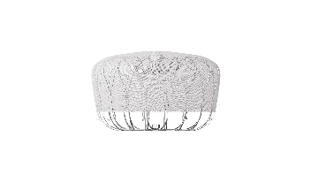
Excluded (n=202)
Enrolled in other cardiovascular device or an investigational drug trial (n=47)
Patient did not provide consent (n=44)
Severe chronic kidney insufficiency (n=40)
Incomplete screening (n=25)
First operator with limited experience with one of the two LAAC devices (n=18)
Intra-cardiac thrombus (n=10)
LAA morphology not suitable for one of the two devices (n=9)
Other eligibility criteria not met (n=9)
LAA Closure performed (n = 423)
Randomized (n = 221)
Allocated to
Amulet (n=111)
Allocated to
Watchman FLX (n=110)
From June 2018 until October 2019 only Watchman 2.5 available (n = 25)
Death (n = 12)
13-month CCTA refused (n=11)
13-month CCTA not performed for medical reasons (n=1)
Patient withdrew consent (n = 2)
Patient was lost to follow-up (n = 1)
Death (n = 11)
13-month CCTA refused (n=11)
13-month CCTA not performed for medical reasons (n=6)
Patient withdrew consent (n = 1)
Patient was lost to follow-up (n = 1)
Considered for 13-month CCTA analysis
(n = 84)
Considered for 13-month CCTA analysis
(n = 80)

Slide 9
Baseline characteristics and post-LAAC antithrombotic therapy regimen
Discharge
45-day
13-month
p=0.499
p=0.650
p=0.720
Mean age: 76.9 years
Male: 70.6%
Prior cerebrovascular event: 39.3%
Mean CHA2DS2-VASc score: 4.3
Mean HASBLED score 3.1
Prior relevant bleeding: 87.8%
Percentage of Subjects
Notes:
‹#›

Slide 10
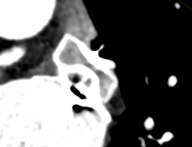
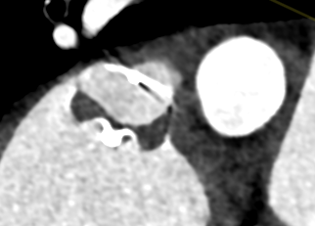
Patent Appendage rate at 13-month CCTA
AMULET
53.6%
(n=45/84)
WATCHMAN FLX
48.8%
(n=39/80)
VS.
1.10 (0.81-1.48);
P= 0.537
 | Amulet N = 84 | Watchman/FLX N = 80 | Amulet vs Watchman/FLX Risk Ratio (95% CI) | P value
PDL or MIL, no. (%) | 24 (28.6%) | 22 (27.5%) | 1.04 (0.64-1.70) | 0.879
IDL, no. (%) | 20 (23.8%) | 14 (17.5%) | 1.36 (0.74-2.51) | 0.319
PANVL, no. (%) | 6 (7.1%) | 10 (12.5%) | 0.57 (0.22-1.50) | 0.248

Slide 11
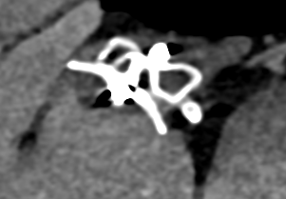
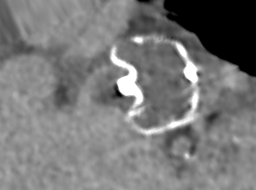
Device Related Thrombus rate at 13-month CCTA
AMULET
1.2%
(n=1/84)
WATCHMAN FLX
1.3%
(n=1/80)
VS.
0.95 (0.06-14.97);
P= 0.972
 | Amulet N = 84 | Watchman/FLX N = 80 | Amulet vs Watchman/FLX Risk Ratio (95% CI) | P value
Definite or possible DRT, no. (%) | 2 (2.4%) | 3 (3.8%) | 0.63 (0.11-3.70) | 0.610

Slide 12
13-Month Clinical Follow-up
 | Amulet N = 111 | Watchman/FLX N = 110 | Amulet vs Watchman/FLX Hazard Ratio (95% CI) | P value
Composite of CV death, stroke or systemic embolism, no. (%) | 10 (9.5%) | 11 (10.2%) | 0.91 (0.39-2.14) | 0.829
Death, no. (%) | 13 (11.7%) | 11 (10.1%) | 1.19 (0.53-2.66) | 0.671
Cardiovascular death, no. (%) | 8 (7.7%) | 9 (8.3%) | 0.90 (0.35-2.33) | 0.823
Stroke, no. (%) | 3 (2.7%) | 4 (3.7%) | 0.75 (0.17-3.35) | 0.706
Ischaemic stroke, no. (%) | 3 (2.7%) | 3 (2.9%) | 1.00 (0.20-4.95) | 0.999
Haemorrhagic stroke, no. (%) | 0 (0.0%) | 1 (0.9%) | 0.33 (0.01-8.01) | 0.498
Systemic or Pulmonary embolism, no. (%) | 3 (2.9%) | 1 (0.9%) | 3.00 (0.31-28.88) | 0.341
Systemic embolism, no. (%) | 0 (0.0%) | 1 (0.9%) | 0.33 (0.01-8.01) | 0.498
Pulmonary embolism, no. (%) | 3 (3.0%) | 0 (0.0%) | 6.94 (0.36-132.79) | 0.247
Any bleeding, no. (%) | 45 (40.8%) | 34 (31.4%) | 1.46 (0.93-2.28) | 0.098
Minor bleeding (BARC 1-2), no. (%) | 32 (29.4%) | 26 (24.3%) | 1.31 (0.78-2.20) | 0.302
Major bleeding (BARC 3-5), no. (%) | 18 (16.5%) | 10 (9.3%) | 1.84 (0.85-3.99) | 0.122

Slide 13
Evolution of Residual LAA Patency During the First 13 Months After LAAC
(analysis including 158 of 221 randomized patients where LAA patency was assessable by both 45-day and 13-month CCTA)
P<0.001
22.7%
Transient
New-Onset
Number of patients
Number of patients
Persistent
56.8%
Persistent
87.5%
45-day CCTA
13-month CCTA
Side gap-leaks
(PDL/MIL)
IDL
PANVL
Patent Appendage
Non Patent Appendage
45-day
13-month
30.5% of 45-day PA
resolved at 13-months after LAAC
Only 13.2% of appendages
became patent
later than 45 days
PDL/MIL was the PA subtype more frequently persistent
over the 1st year

Slide 14
Study Limitations
Open label study: the two devices can be easily distinguished during CCTA assessment
Trial not powered to show differences with regard to clinical endpoints
Minority yet sizable proportion of Watchman/FLX patients received Watchman 2.5
A relevant percentage of randomized patients died before undergoing 13-month CCTA follow-up, due to the high-risk population included in this study

Slide 15
Conclusions
Among patients undergoing clinically indicated LAAC and in whom LAA anatomy was deemed suitable for both Amulet and Watchman FLX devices:
Rates of PA, its subtypes and DRT at 13-month CCTA were similar between the randomised device groups
Rates of clinical outcomes at 13 months did not differ between the study groups.
Two thirds of 45-day PAs and especially those related to side-gap leaks, persisted at 13 months.

