Slide 1
Extracorporeal life support for acute myocardial infarction complicated by cardiogenic shock
ECLS-SHOCK
Holger Thiele on behalf of the ECLS-SHOCK Investigators
26th of August 2023

Slide 2
Conflict of Interest Statement
Funding:
German Research Foundation
German Heart Research Foundation
German Cardiac Society
European Union
Else-Kröner-Fresenius-Foundation
Schwiete-Foundation
Boston Scientific
Consulting: None
Speaker Honoraria:
None
Notes:
‹#›

Slide 3
Background
Cardiogenic Shock - Mortality over Time
SHOCK
Trial
CULRPIT-SHOCK Trial
TRIUMPH
Trial
IABP-SHOCK II
Trial
Multivessel PCI
Culprit only
2017
Adapted from Werdan et al. Eur Heart J 2014;35:156-167
Notes:
‹#›
‹#›

Slide 4
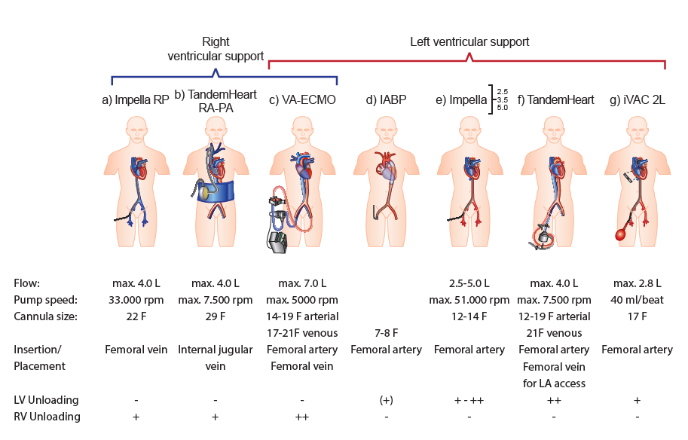
Background
Currently Available MCS
2.5
CP
5.0
5.5
ESC Class III B recommen-
dation
(IABP-SHOCK II Trial)
5
Thiele et al. Eur Heart J 2019:40:2671-2683
Byrne/Ibanez et al. Eur Heart J 2023;epub
Notes:
‹#›

Slide 5
Increase in VA-ECMO (ECLS) Over Time
Background
IABP-SHOCK II
Trial
Karagiannidis et al. Intensive Care Med.2016;42:889–896
Becher et al. Circulation 2018;138:2298-2300

Slide 6
Methods
Endpoints/Statistical Methodology
Primary endpoint
30-day all-cause mortality
Secondary endpoints
Time to hemodynamic stabilization
Duration of catecholamine therapy
Serial creatinine-level and creatinine-clearance until hemodynamic stabilization
Mean and area under the curve of arterial lactate during 48 hours after PCI
Peak release of myocardial enzymes
Serial SAPS II
Length of mechanical ventilation
Length of ICU stay
Length of hospital stay
Acute renal failure requiring renal replacement therapy within 30 days
Recurrent myocardial infarction within 30 days
Need for repeat revascularization (PCI and/or CABG) within 30-days
Rehospitalization for heart failure within 30 days
Cerebral performance category (CPC) at 30 days
Sample size
Estimated event rate for primary endpoint: 49% in control group versus 35% in ECLS group 1 interim analysis (50% of patients) 2-sided Chi²-test; power: 80%, alpha=0.048 for final analysis → 390 patients To compensate for losses in follow-up → 420 patients
Thiele et al. Am Heart J 2021;234: 1-1

Slide 7
Methods
In- and Exclusion Criteria
Inclusion Criteria | Exclusion Criteria
Cardiogenic shock complicating AMI (STEMI or NSTEMI) plus obligatory: 1. Planned revascularization 2. SBP <90 mmHg >30 min or catecholamines required to maintain SBP >90 mmHg 3. Signs of impaired organ perfusion with at least one of the following criteria: Altered mental status Cold, clammy skin and extremities Oliguria with urine output <30 ml/h 4. Arterial lactate >3 mmol/l Informed consent | Resuscitation >45 minutes Mechanical cause of cardiogenic shock Onset of shock >12 h Severe peripheral artery disease with impossibility to insert ECLS cannulae Age <18 years or >80 years Shock of other cause (bradycardia, sepsis, hypovolemia, etc.) Other severe concomitant disease with limited life expectancy <6 months Pregnancy Participation in another trial
Thiele et al. Am Heart J 2021;234: 1-1

Slide 8
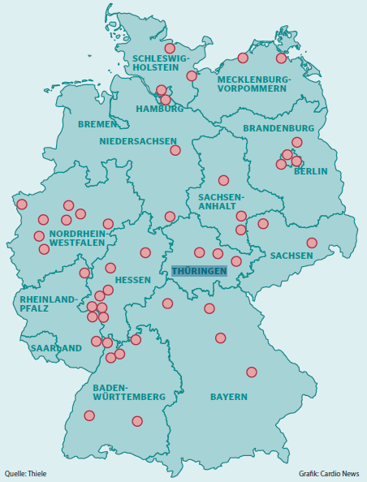
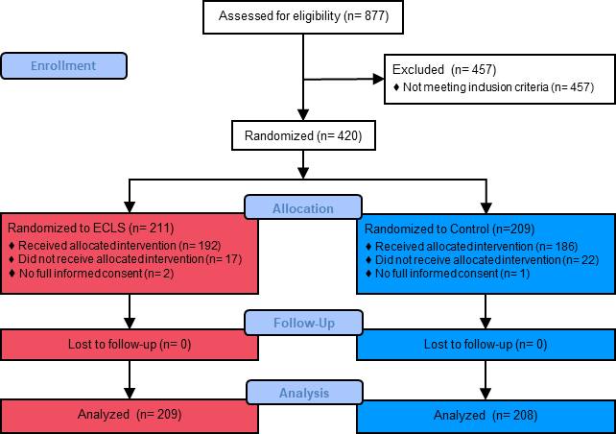
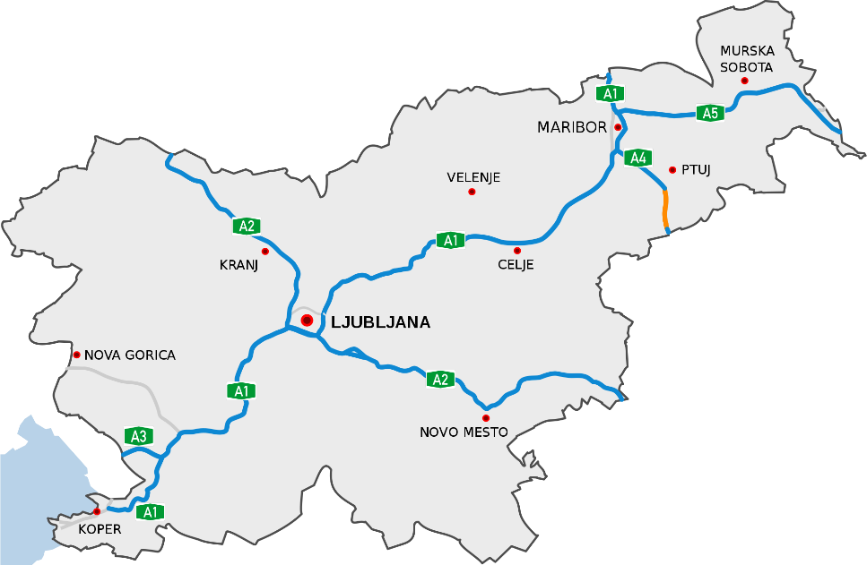
Results
Trial Flow
44 study sites
Thiele et al. Am Heart J 2021;234: 1-1

Slide 9
Results
Baseline Characteristics
 | ECLS (n=209) | Control (n=208)
Age (years); median (IQR) | 62 (56 - 69) | 63 (57 - 71)
Male sex; n/total (%) | 170/209 (81.3) | 169/208 (81.3)
Signs of impaired organ perfusion; n/total (%) Altered mental status Cold, clammy skin and extremities Oliguria | 200/209 (95.7) 202/209 (96.7) 150/209 (71.8) | 198/208 (95.2) 204/208 (98.1) 150/208 (72.1)
Mean blood pressure (mmHg); median (IQR) | 71 (61 - 87) | 72 (60 - 88)
STEMI; n/total (%) | 135/204 (66.2) | 141/207 (68.1)
Resuscitation before randomization; n/total (%) | 162/209 (77.5) | 162/208 (77.9)
No. of diseased vessels; n/total (%) 1 2 3 | 71/203 (35.0) 71/203 (35.0) 61/203 (30.0) | 63/200 (31.5) 53/200 (26.5) 84/200 (42.0)
LVEF (%); median (IQR) | 30 (20 - 35) | 30 (20 - 40)
Laboratory values on admission pH; median (IQR) Lactate (mmol/L); median (IQR) | 7.2 (7.1 - 7.3) 6.8 (4.5 – 9.6) | 7.2 (7.1 - 7.3) 6.9 (4.6 – 10.0)

Slide 10
Results
Treatment
 | ECLS (n=209) | Control (n=208)
Type of inital revascularization; n/total (%) PCI CABG PCI with emergent transfer to CABG | 199/208 (95.7) 1/208 (0.5) 2/208 (1.0) | 199/204 (97.5) 0/204 0/204
ECLS therapy; n/total (%) Initiation in catheterization laboratory Prior revascularization During revascularization After revascularization Initiation after catheterization laboratory <24 hours ≥24 hours | 192/209 (91.8) 42/192 (21.9) 50/192 (26.0) 100/192 (52.1) 0/192 0/192 | 26/208 (12.5) 4/26 (15.4) 8/26 (30.8) 7/26 (26.9) 3/26 (11.5) 4/26 (15.4)
Duration of ECLS therapy (days); median (IQR) | 2.7 (1.5 - 4.8) | 2.7 (2.2 – 3.8)
Peripheral antegrade perfusion sheath; n/total (%) | 183/192 (95.3) | 16/19 (84.2)
Active left ventricular unloading in ECLS; n/total (%) | 11/191 (5.8) | 6/19 (31.6)
Other MCS in patients without ECLS; n/total (%) | 0/17 | 28/182 (15.4)
Invasive mechanical ventilation; n/total (%) | 183/203 (90.1) | 177/202 (87.6)

Slide 11
Results
Primary Endpoint – 30-Day All-Cause Mortality
Relative risk: 0.98 (95% CI 0.80-1.19)
P=0.81
Patients Who Died from Any Cause (%)
No. at Risk
ECLS | 209 | 161 | 136 | 119 | 109 | 107 | 105
Control | 208 | 146 | 120 | 109 | 105 | 104 | 100

Slide 12
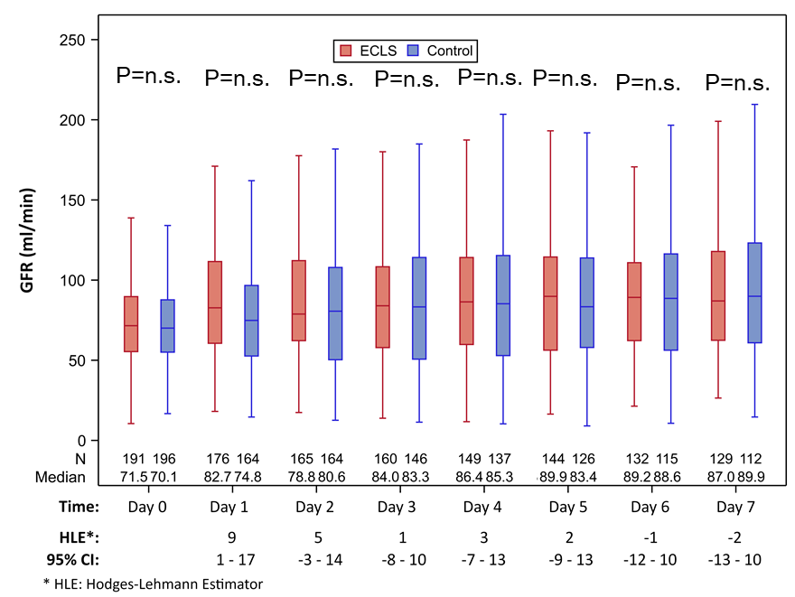
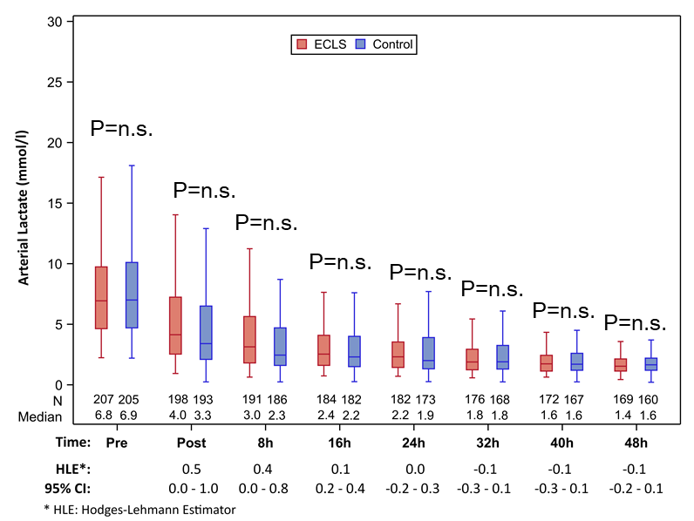
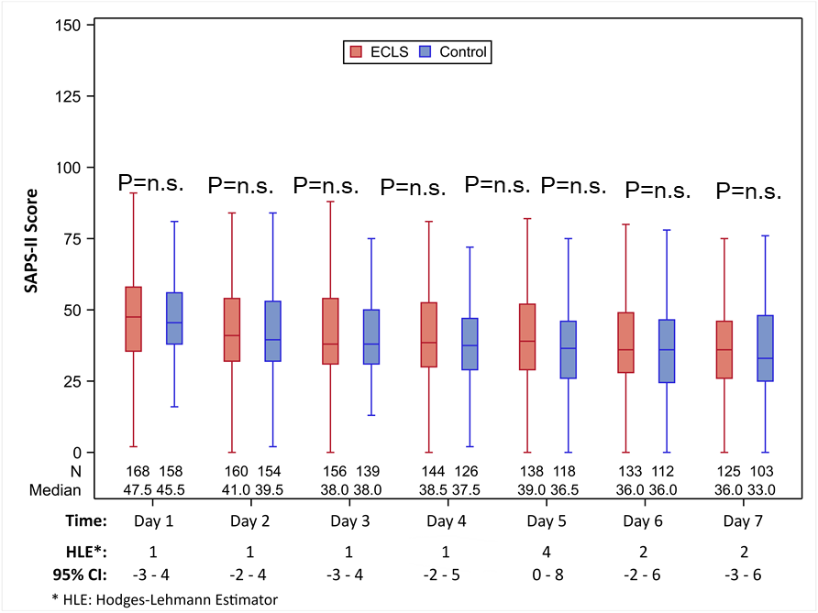
Results
Key Secondary Endpoints
Renal Function - eGFR
Arterial Lactate
SAPS-II

Slide 13
Results
Safety
RR 2.44
(95% CI 1.50-3.95)
23.4%
RR 2.86
(95% CI 1.31-6.25)
RR 1.33
(95% CI 0.47-3.76)
11.0%
9.6%
3.8%
2.9%
3.8%

Slide 14
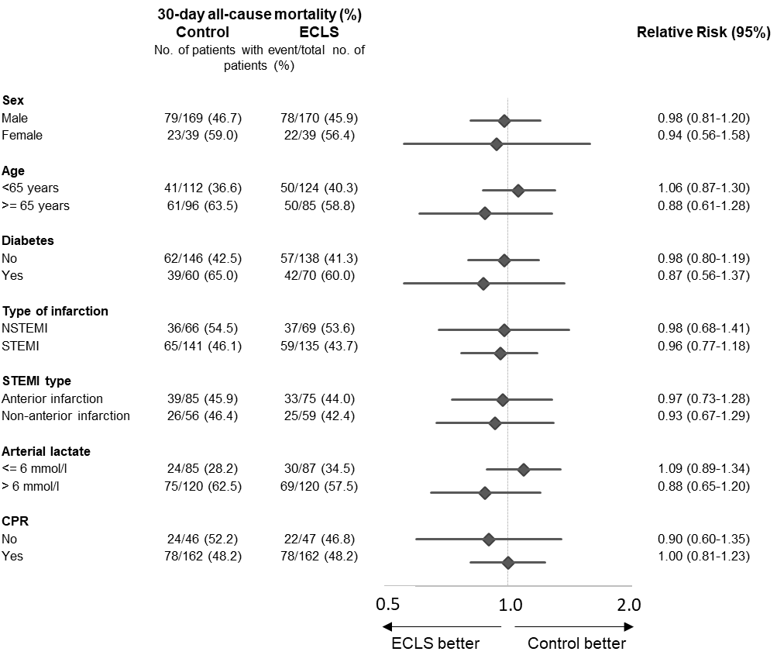
Results
30-Day All-Cause Mortality - Subgroups

Slide 15
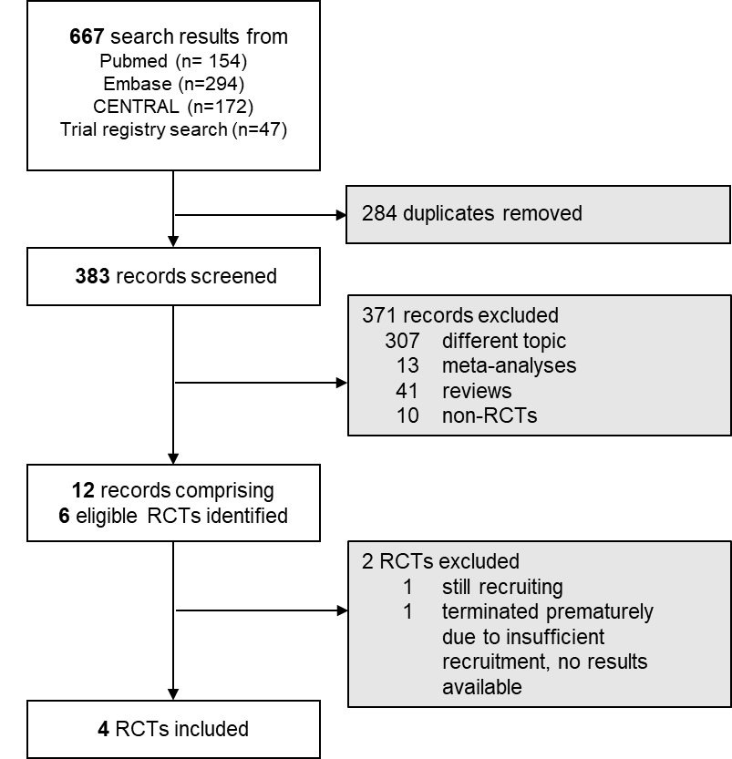
Results
IPD Meta-Analysis VA-ECMO vs No VA-ECMO

Slide 16
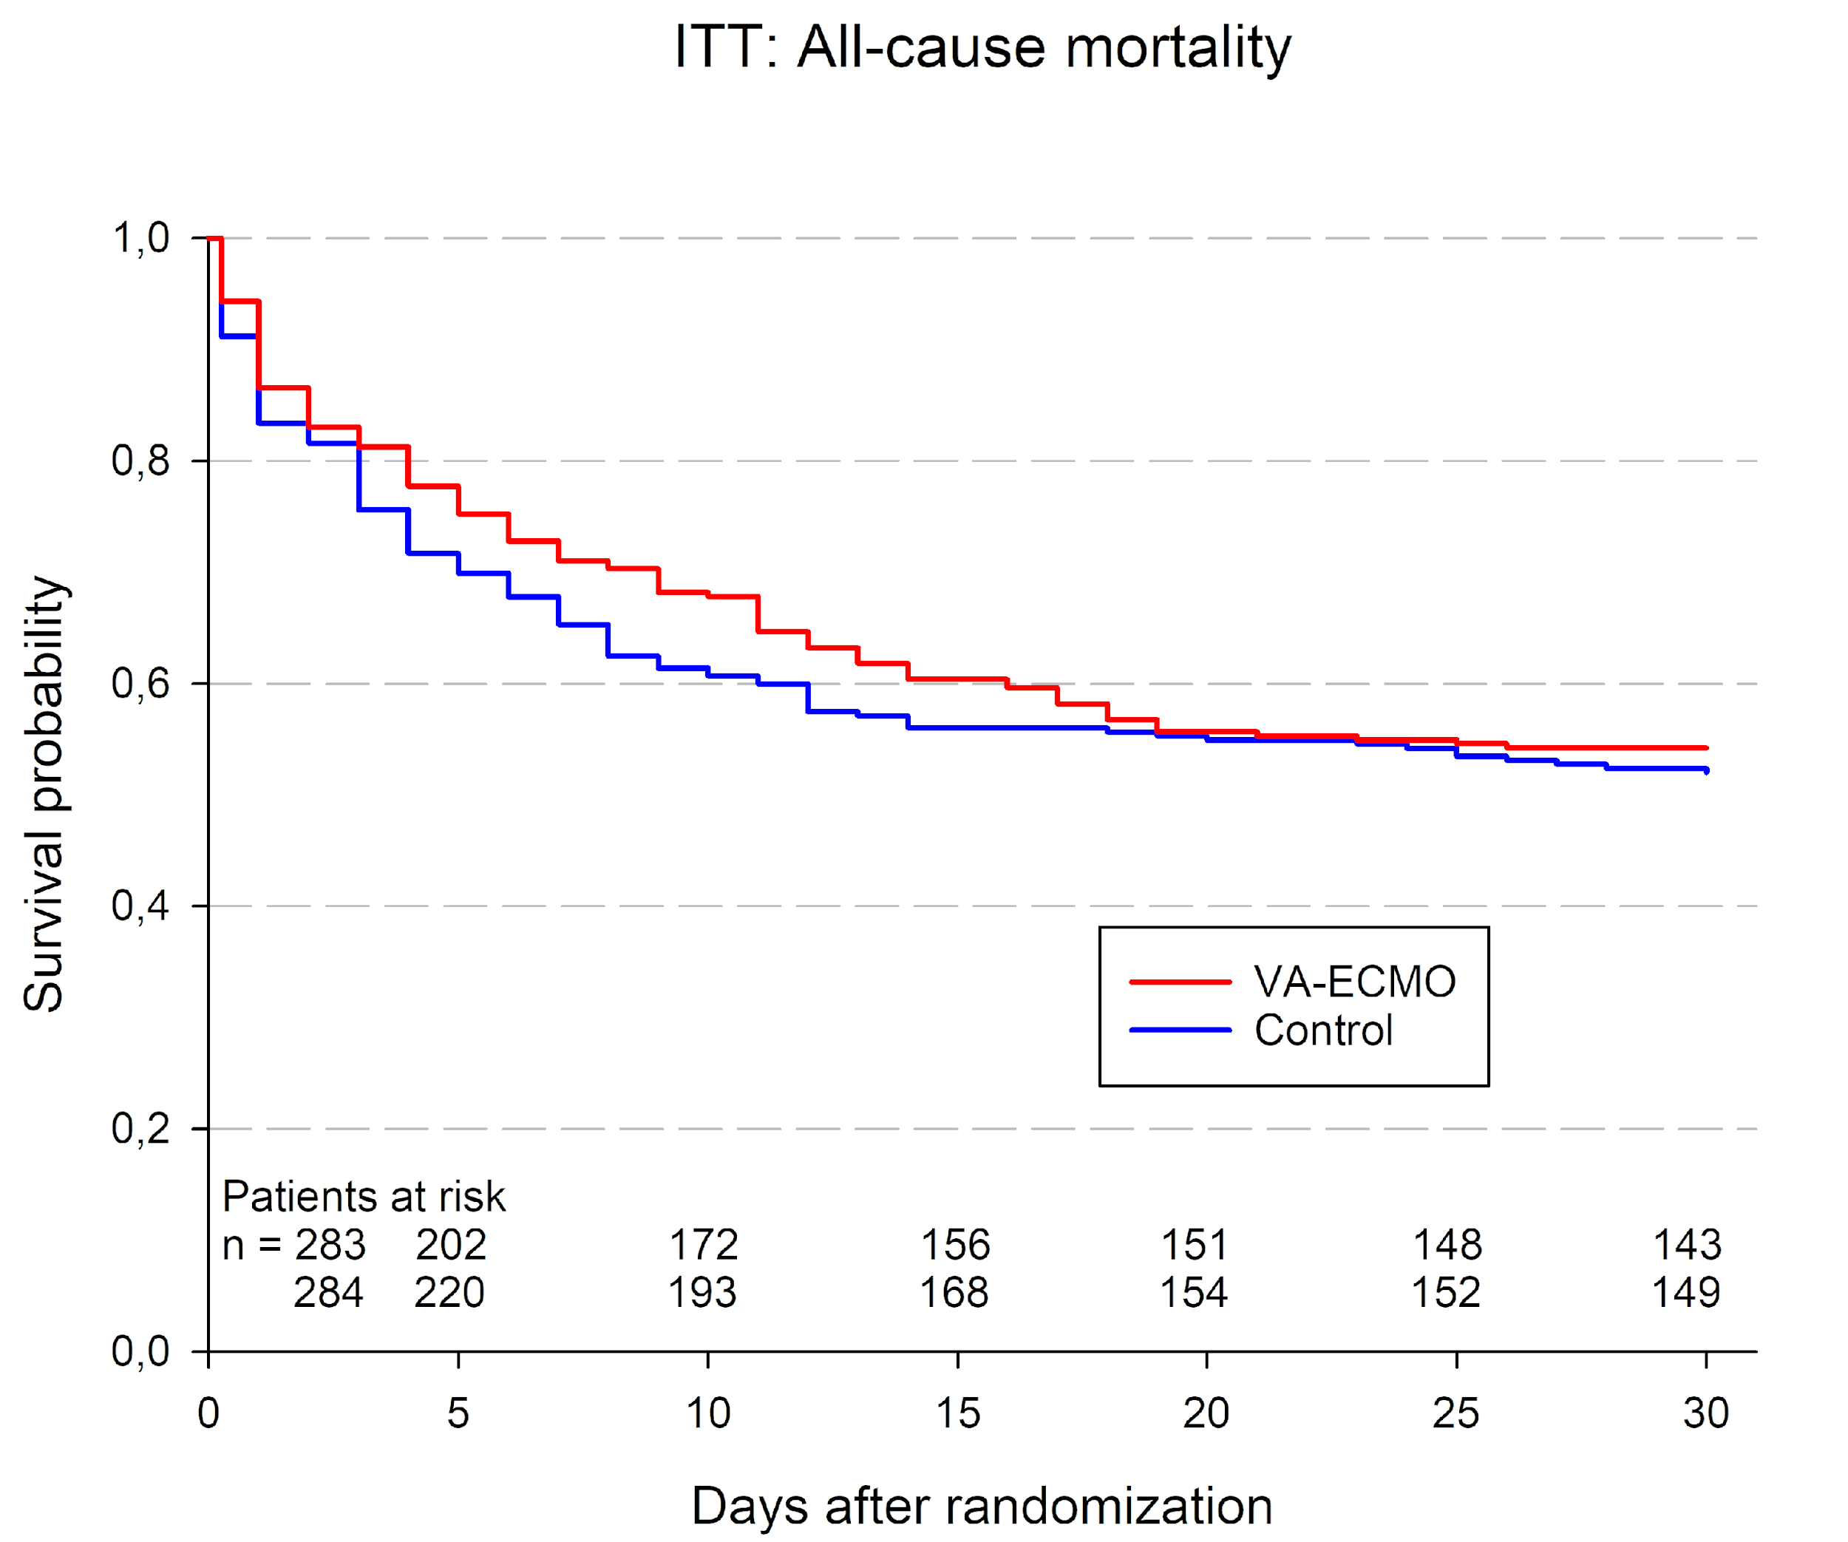
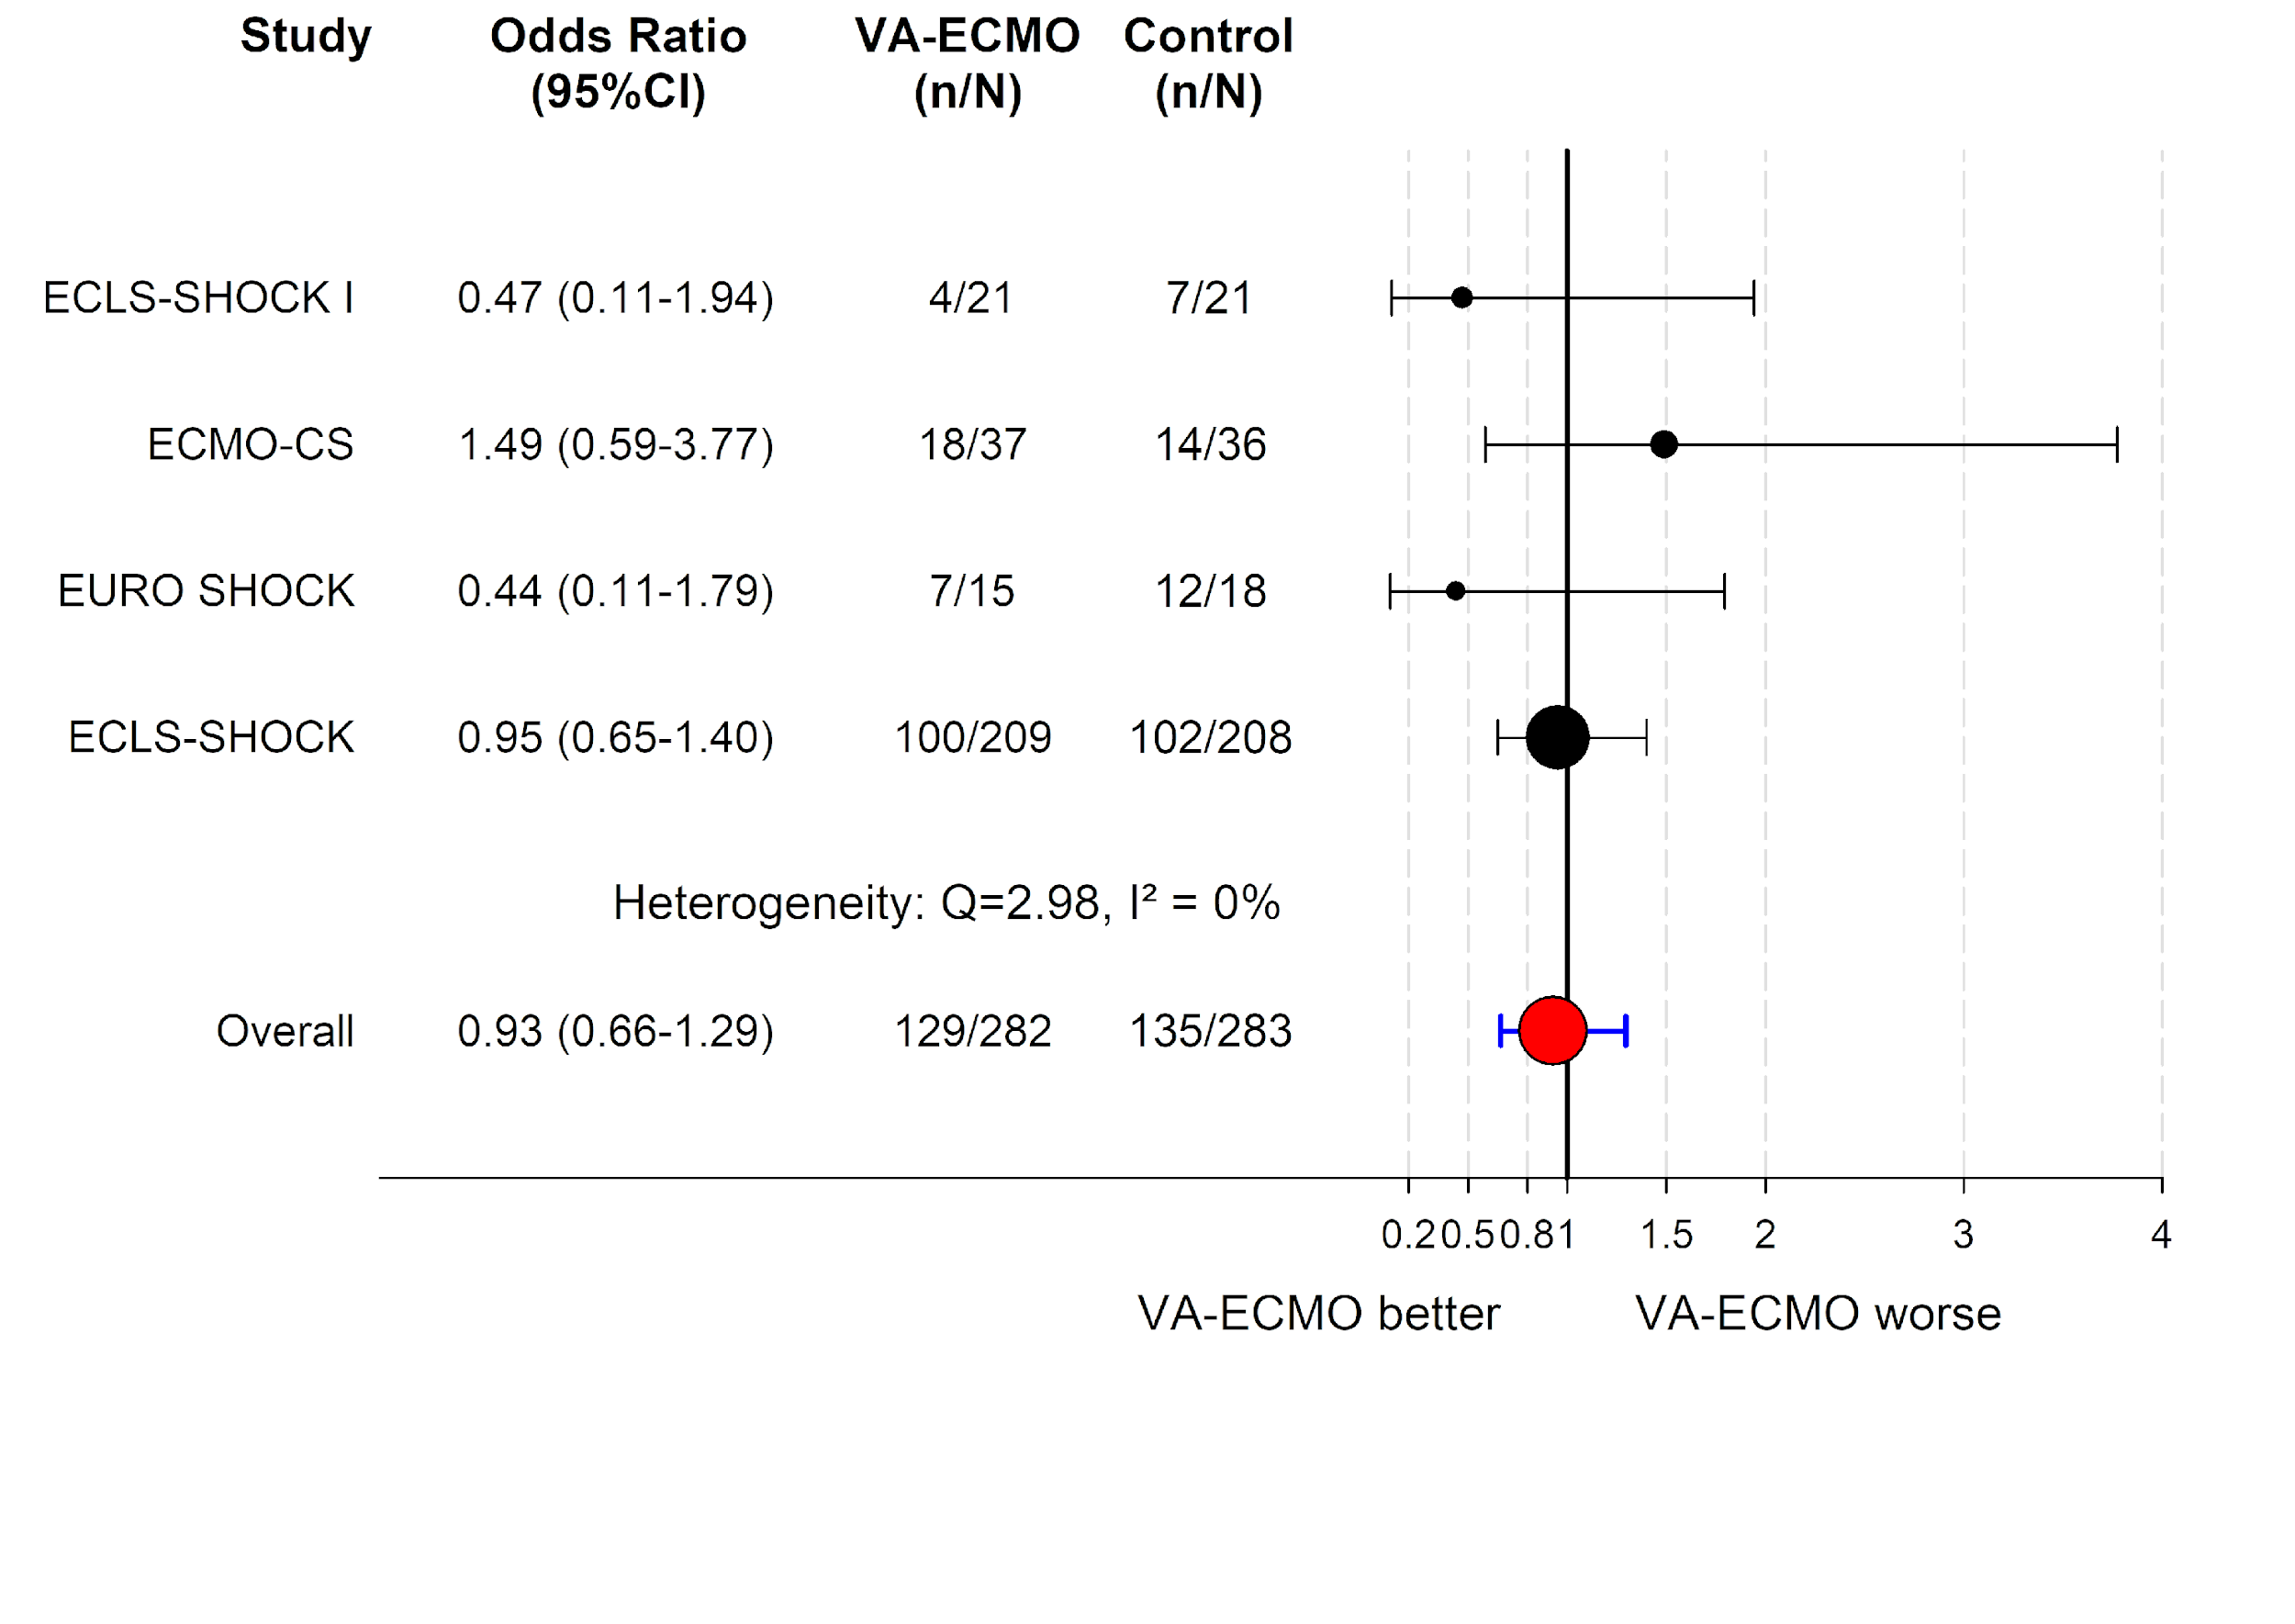
Results
IPD Metaanalysis – 30-Day All-Cause Mortality

Slide 17
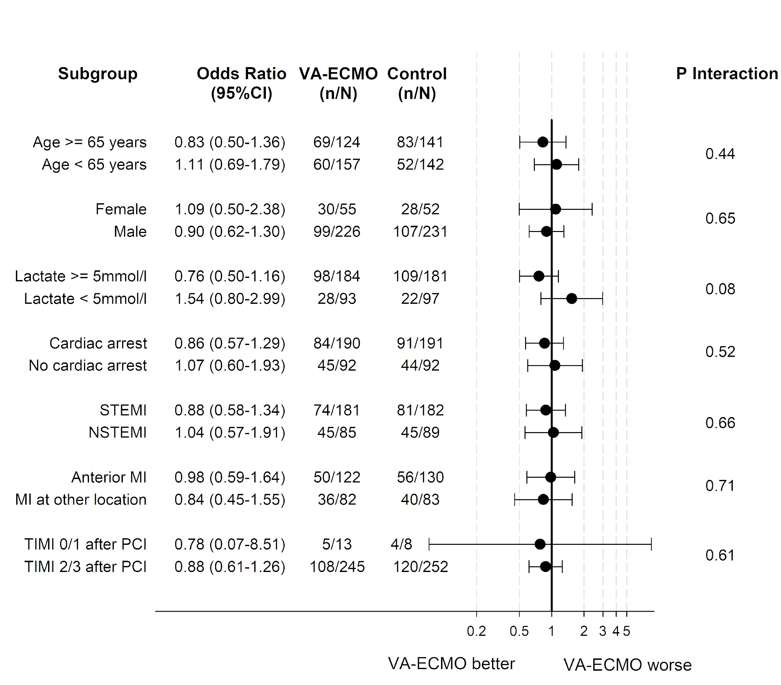
Results
IPD Metaanalysis – 30-Day Mortality - Subgroups

Slide 18
Summary and Conclusions
In patients with acute myocardial infarction and cardiogenic shock with planned revascularization ECLS (VA-ECMO) versus control does not reduce 30-day all-cause mortality.
This lack of mortality benefit is supported by an IPD metaanalysis of all 4 RCTs comparing ECLS vs control.
This lack of mortality benefit is further supported by the fact that there were no differences in the secondary endpoints (e.g. lactate, renal function, duration of catecholamines, etc.).
ECLS is associated with higher rates of moderate or severe BARC bleeding and peripheral ischemic complications requiring intervention.
The findings challenge current guideline recommendations and clinical practice with increasing rates of mechanical circulatory support in cardiogenic shock.

Slide 19
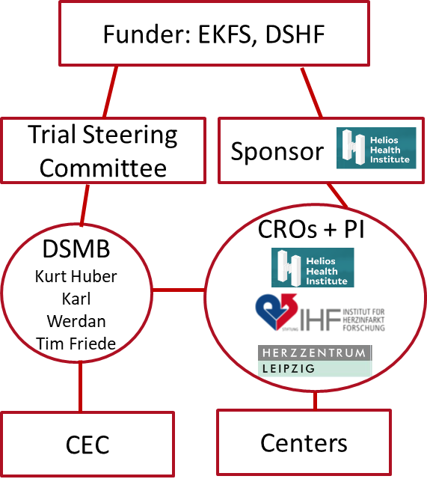
Acknowledgments and Thank You
Our greatest thanks go to the patients and relatives.
@thiele_holger
holger.thiele@medizin.uni-leipzig.de

Slide 20
www.nejm.org
www.thelancet.com

